Slide 1

Northside High School
Title I Information Session
September 15, 2026

Slide 2

What is a Title I School?
Title I is a program that provides federal funds through the Georgia Department of Education to local educational agencies and public schools with high numbers or percentages of children in poverty to help ensure that all children meet challenging state academic content and student academic achievement standards.

Slide 3

How is Title I Parent and Family Engagement Money Spent?
NHS uses its Title funds for:
Personnel
  Intervention Teacher - supports students who need to recover credits
  Intervention Specialist - work on graduation plans for students who are under-credited & over age limit.
  Family Engagement Liaison – plans family engagement workshops and other activities that support student academic achievement and creates a welcoming environment
Supplies
Books/materials for classroom
Technology
Training for teachers – course team planning days

Slide 4

What are our Title I School wide goals?
Our goals are high-quality instruction for all students and providing intervention and support for students who need them.

Slide 5

What programs/supports are in place to help my child?
Structured after-school tutoring program
IXL Software that utilizes MAP scores to build student’s foundational knowledge and close gaps in learning
PBIS to positively impact behavior goals

Slide 6

What curriculum does our school use?
NHS follows Georgia’s Standards of Excellence with the help of various
textbooks and resources

Slide 7

What tests will my child take?
Normal classroom assessments
MAP tests for 9th and 10th graders in ELA/Reading and Math
EOC in Biology, Algebra 1CC, US History, and 10th Grade Literature & Composition II
AP tests for those in the courses
PSAT for all 10th graders
SAT/ACT/ASVAB based on student needs

Slide 8
How do these tests measure my child’s progress?
Classroom Assessments: Teachers analyze the data of common summative and common formative to remediate and monitor student progress.
MAP Growth measures: Achievement: Your child’s current understanding and performance in a subject compared to other students nationwide at the same grade level. Growth: The progress a student has made overtime, from one testing period to the next.
End of Course Tests (EOC) test students on their knowledge of the standards. Students are provided with a numerical score for grading and the designation of “Beginning Learner”, “Developing Learner”, “Proficient Learner”, and “Distinguished Learner” for each EOC they take.

Slide 9

What proficiency level is my child expected to meet?
The NHS expectation is proficient or above for EOCs.

Slide 10
What is required, by law, for Parent and Family Engagement?
Northside High School is required to provide families opportunities to be engaged in the education of their child by providing:
Annual Title I Meeting to explain what it means to be a Title I school
Academic-based activities covering Literacy, Curriculum Standards, Technology, Testing and ESOL
Welcoming Climate
Shared Decision-Making opportunities to include surveys and input meetings
Professional Develop for Staff on the importance of family engagement

Slide 11


What is the District’s Parent and Family Engagement Plan?

Slide 12

What is the NHS Parent and Family Engagement Plan?
This plan describes how NHS will provide opportunities to improve family engagement to support student learning.

Slide 13
What is the School – Parent Compact?
This is an agreement between NHS, our students and their parents/families to work together to improve student learning and achievement.

Slide 14
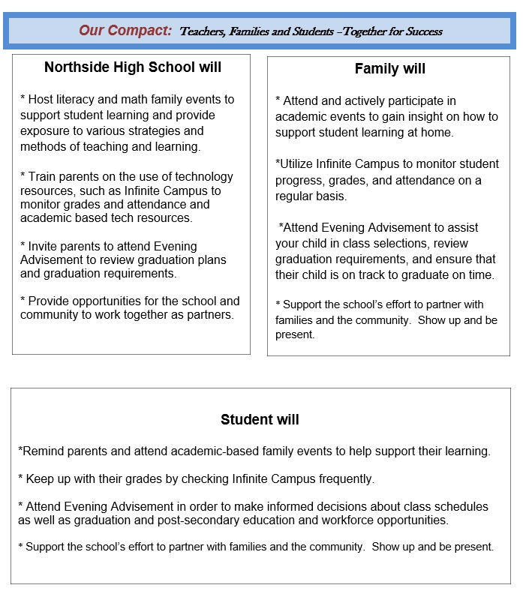

School – Parent Compact

Slide 15

Does my child’s teacher meet professional qualifications?
Yes, 100% of NHS teachers and paraprofessionals are highly qualified.

Slide 16

What is a Parents Right to Know?
The federal education law – TheEvery Student Succeeds Act (ESSA) requires that all parents in a Title I school be notified and given the opportunity to request information about the professional qualifications of classroom teachers and paraprofessionals instructing their child.

Slide 17

What opportunities does the school provide for parent engagement?
Northside hosts academic events and activities meant to provide parents/families opportunities to engage with their child to support student learning and success. Northside parents are encouraged to volunteer and participate in school activities both during the school day and after school.
Northside parents are encouraged to participate in our School Council and Parent Action Team along with contributing their feedback during our Shared Decision Making process in the Spring.

Slide 18

How does the school build staff capacity for parent and family engagement?
Northside’s faculty and staff participate in professional development sessions focused on the importance of family engagement. 4 PD opportunities are provided each year covering topics such as effective communication, disengaging reluctant parents and customer service.

Slide 19

How responsive will the school be to my questions when staff is contacted?
Northside High has an open-door policy. Please feel free to reach out via email, phone calls or stopping by the front office to schedule an appointment. You will receive a reply to any questions or concerns within 24 hours.

Slide 20

What other federal programs are available to benefit my student?
ESOL – Rosalin Rodriguez and Dalmarie Torres - Gonzales
McKinney –Vento Homeless – Patricia Lane
Migrant Education – Araceli Ulmer

Slide 21

Thank you for joining us!
If you have any further questions concerning the Title I program at Northside High School, please reach out to our Family Engagement Liaison.
Nyquell Terry
478.215.8920
Ext. 2646

