Slide 1
Getting Ready for
Notes:
Welcome
Introductions

Slide 2
Introduction
Next year brings many exciting experiences for your child as he/she moves to first grade. This powerpoint has been prepared to guide you in ways that you can help your child be ready for this year. We encourage you to read with your child several times a week. Practice opening food items (chip bags, Capri Suns, fruit cups, ketchup packets, etc.) Encourage your child to be independent with personal tasks such as getting dressed and putting away lunch dishes. Encourage your child to make good choices and practice self-control.
Notes:
First grade is more than academics.
Develop social skills, become more responsible, self-sufficient, and independent.

Slide 3
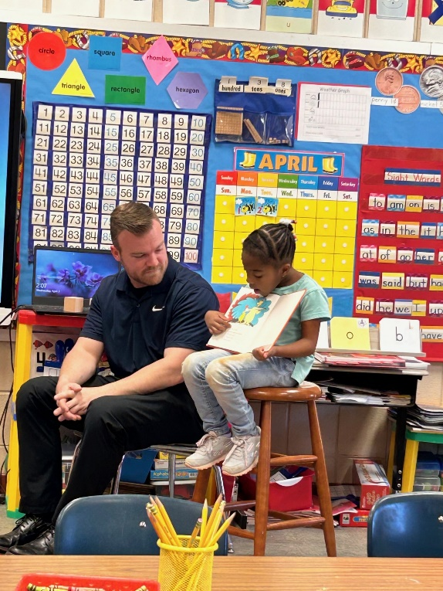
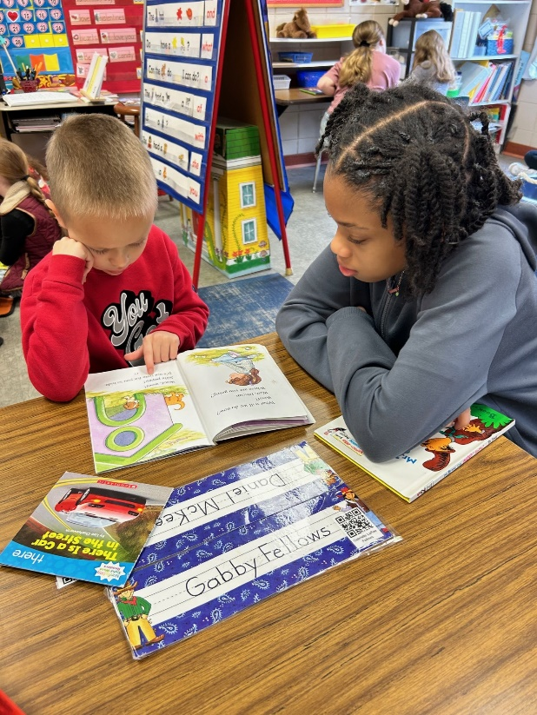
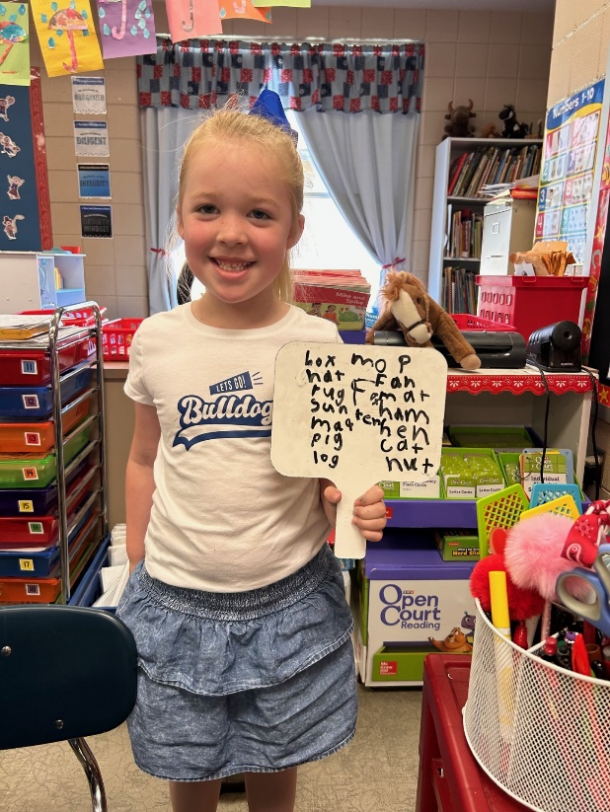
Literacy
Reads Kindergarten level sight words; knows at least 20 sight words
Identifies a simple sentence
Sounds out decodable words such mop, fin, bag, pet, rub
Spells age appropriate words in writing
Reads nonsense words without sounding out the letters such as nuf, lig, geb, vam, bot
Names all uppercase and lowercase letter
Knows all sounds for letters
Recognizes and writes first and last name
Writes from left to right on lined paper
Notes:
As you go
What do you think?
How do you think the character felt?

Slide 4
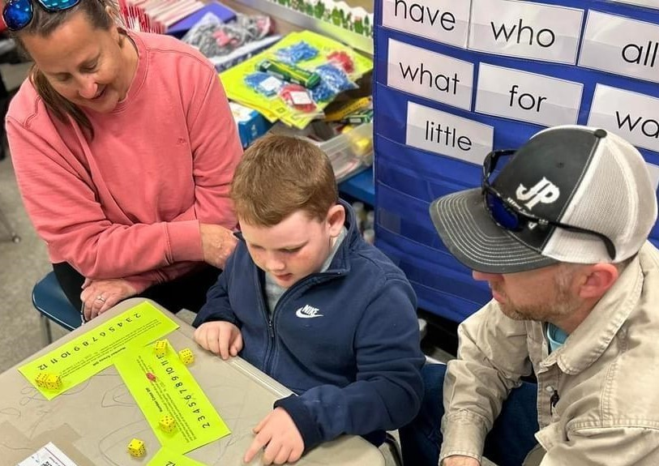
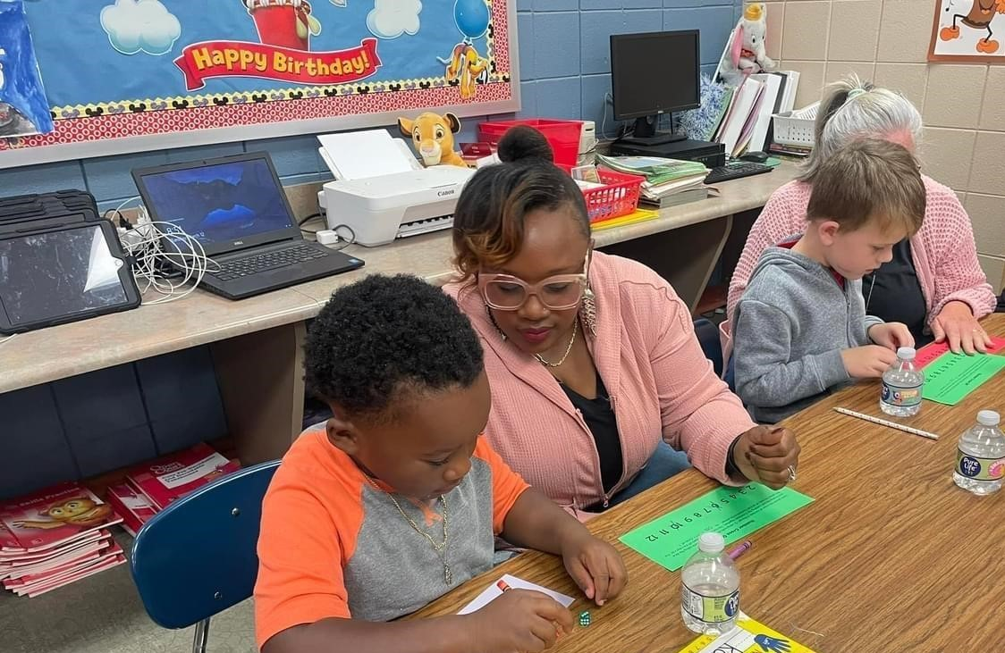
Math
Adds basic facts
Identifies numbers 0-20
Writes numbers 0-20 neatly and correctly
Understands the concept of numbers and quantity
Understands one-to-one correspondence
Subtracts basic facts
Has an understanding of basic numbers sense
Notes:
Basic number sense – sense of what numbers mean
Relationship to each other – more/less
Mental math
Symbols + -
#’s in real life situations – cooking, telling time, making purchases – we constantly use math

Slide 5
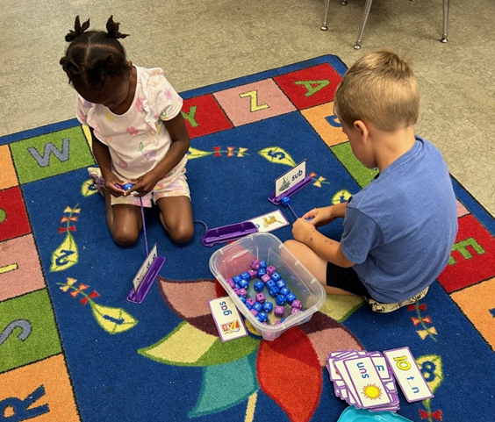
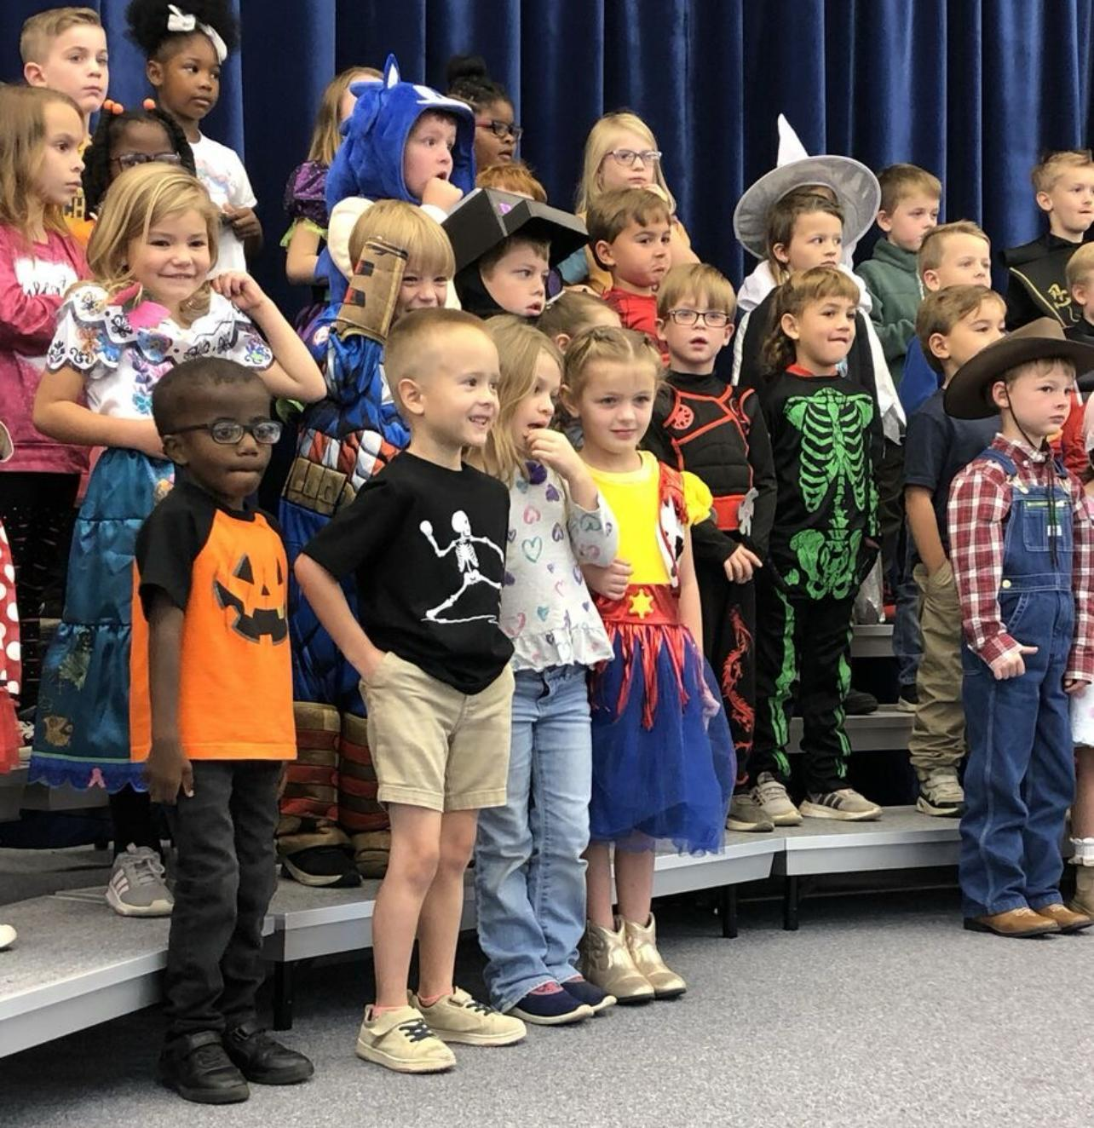
Social/Emotional
Follows 2-3 step directions
Stays on task for at least 10 minutes during independent work
Maintains attention during a 10-15 minute lesson/story
Carries out classroom responsibilities independently
Works cooperatively in small groups with partners
Communicates clearly and in complete sentences
Works, plays, and shares with others
Knows how to wait his/her turn
Uses words to solve conflicts
Notes:
Helping others
Independent, confident learners
Responsibility – small job to do – make sure that it’s completed – finish what they start
Make choices
Talk with your child
There are two great things that you can give your children: one is roots, the other is wings.” Hodding Carter

Slide 6
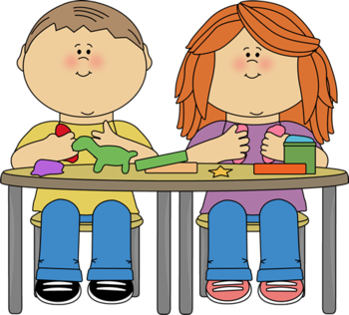
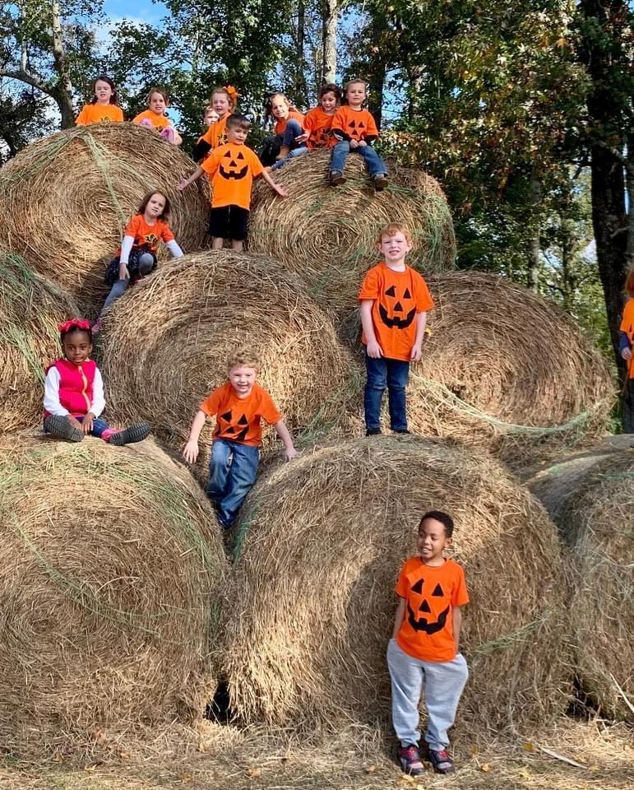
Physical
Forms letters correctly (left to right, top to bottom)
Has good hand-eye coordination
Knows how to properly hold a pencil, using the correct grip
Holds scissors correctly when cutting
Sits correctly in a chair
Beginning to learn to tie
Can button, snap, and zip
Drops a ball and kicks it forward before it hits the floor
Notes:
Put puzzles together
Art work
dance, jump rope, ride bikes

Slide 7
Parent Expectations
Speak positively about school and staff.
Communicate with teacher and sign weekly folder.
Take time each day to talk about the school day.
Help with homework.
Read to and have your child read independently every day. Ask them to tell you about the reading.
Practice packing and unpacking their backpack.
Make sure your child is prepared to come to school with needed items and supplies.
Make sure your child gets plenty of rest each night.
Make attendance at school a priority. However, please be aware of any symptoms your child might have that would indicate illness. Keep your child home if he/she has a fever.

Slide 8
Parent Suggestions
Practice packing and unpacking their backpack including taking notes from home out of their binder and giving it to their teacher..
Take time each day to talk to your child.
Urge your child to use logical arguments to defend his/her opinion.
Involve your child in activities and games that require listening and following directions.
Support and encourage your child’s independence.
Encourage work values such as effort, persistence, and initiative.
Encourage responsibility by having your child take care of personal belongings and assisting with simple chores.

Slide 9
Other Information
Daily Folder
Zipper Pouch
Label Money in Ziploc bag
Spelling words; a way to communicate with the teacher.
Tennis Shoes or closed toe shoes
Snack Procedure
Can bring snack but keep it separate from lunch. Please make sure your child knows which is which.
Phone Number
No rolling backpacks
Weekly Tests (reading and spelling)

Slide 10
Back to School Events
Tentative Back to School Event: August 5th - 2:00-6:00 pm
First Day of School: August 7th
Open House: TBD

