Slide 1
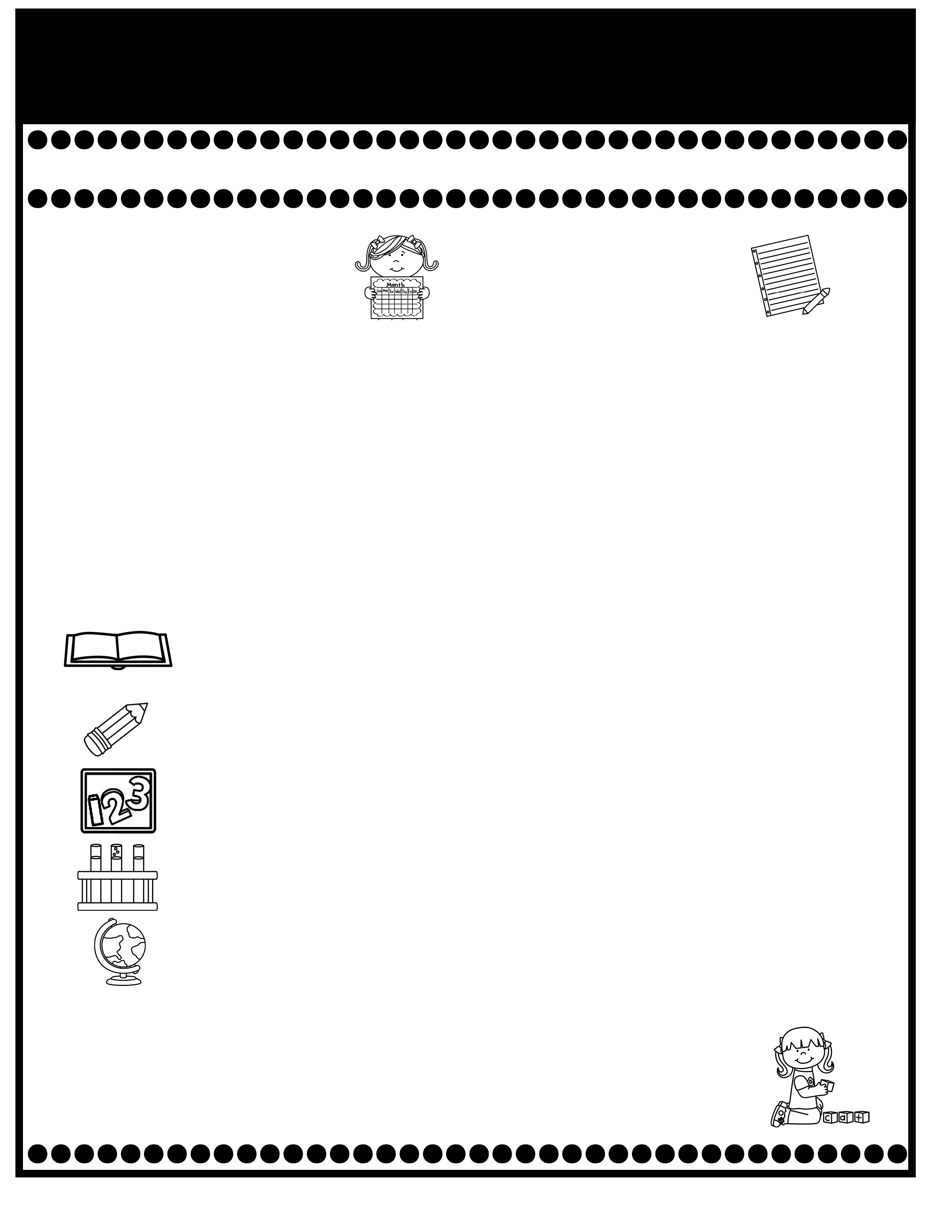
Branning’s Buzz
Week of: September 22-26, 2025
What’s Happening
This Week
Upcoming Events
  The Attendance Challenge continues this month. The students who are present each day without check ins or check outs earn a pizza party with Mr. Cochran & Mrs. Baxley.
  The cost for snack is $1.00 each.
  9-26: Special Snack: Slushy $1.00.
  9-26 PPS Spirit Day: “If you can dream it, you can dress it.” Dress up as your favorite Disney Character.
  A Weekly Reading Overview page wll be sent home each week to help you practice skills with your child. Also, nightly reading homework will be assigned in your child’s Take Home Binder. Please don’t remove pages.
  I will continue teaching your child to take A.R. tests this week. Library books aren’t allowed to go home at this time. A Reading Log was placed in your child’s Take Home Binder. .At this time, we are only recording the books read at school.
Tuesday Folders will be sent home Tuesday. Please review test papers & return them to school. Sign the sign in sheet. Please don’t keep the test papers at home. I keep them on file for the entire year. You don’t have to sign each test paper, unless I have stamped it.).
Oct. 7: PPS Family Night 5:30-7:00
Oct.8: Pumpkin Patch Field Trip
Oct. 10: End of 1st Nine Weeks & Early Dismissal
If you have questions or concerns, you may email me at wendy.branning@acboe.net or message me on Parent Square.
A Peek At What We Are Learning
Reading | Phonics: f, ff, ss ,g, j Comprehension: Making Inferences, Summarizing, Fact & Opinion 9/26 Minor Grade (High Frequency Words and Beginning Consonants
Writing | Possessive Nouns, Penmanship e, c 9/25 Wrting Sample
Math | Complete Topic 2: & begin Topic 6: Represent & Interpret Data 9/24 Topic 2 Test (Review pages will be sent home Tuesday for you to review.)
Science | Plants
Social Studies | N/A ( We will alternate weeks for SS/Science).
Spelling Words
Spelling will begin in Unit 7.

