Slide 1
Slide 1
Spring SIC Meeting
JMS
School Improvement Council
2022-2023
Mirandi Squires
April 20, 2023

Slide 2
Agenda
Welcome
Slide Presentation
i-Ready Scores for ELA /fall to winter
i-Ready Scores for Math/fall to winter
3. School Designations Based on State Test Scores from Last Year
4. Slide Presentation on Upcoming Events
5. Suggestions and Recommendations from SIC Members
5. Questions

Slide 3
JMS ELA i-Ready Progress

Slide 4
Fall 2022 ELA

Slide 5
Spring 2023 ELA

Slide 6
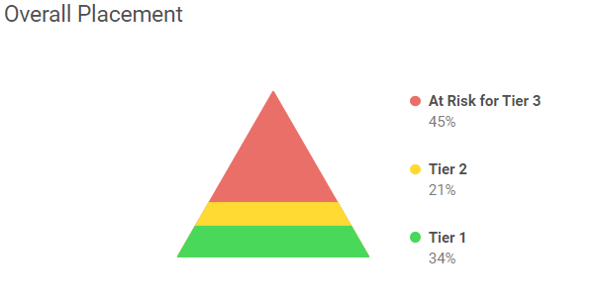
Progress JMS has made in ELA!
Spring Data
17 % decrease in Tier 3 AT RISK from fall testing
3% increase in Tier 2 from fall testing
14% increase in Tier 1 from fall testing

Slide 7
Comparing JMS ELA Growth in Each Grade Level
FALL DIAGNOSTIC
Spring Diagnostic

Slide 8
Fall/Winter/Spring ELA Grade Level Placement

Slide 9
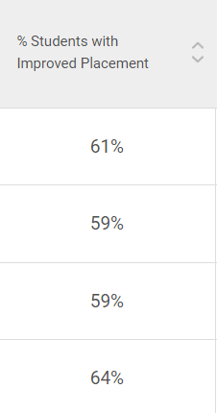
Overall Typical/Stretch Growth Accomplishments for JMS in ELA
Typical Growth
Stretch Growth
Notes:
5th Grade- 85 tested
6th Grade-93 tested
7th Grade- 91 tested
8th Grade -96 tested
Total Typical Growth
`213 students met Typical Growth Target out of 366 students assessed= 58% of Students have already met typical growth for the year
Stretch Goals
71 students met stretch goals ourt of 366 students = 19%

Slide 10
JMS Math i-Ready Progress

Slide 11
Fall 2022 MATH

Slide 12
Spring 2023 MATH

Slide 13
Progress JMS has made in Math!
17% decrease in Tier 3 AT RISK from fall
1% decrease in Tier 2 from fall
19 % increase in Tier 1from fall

Slide 14
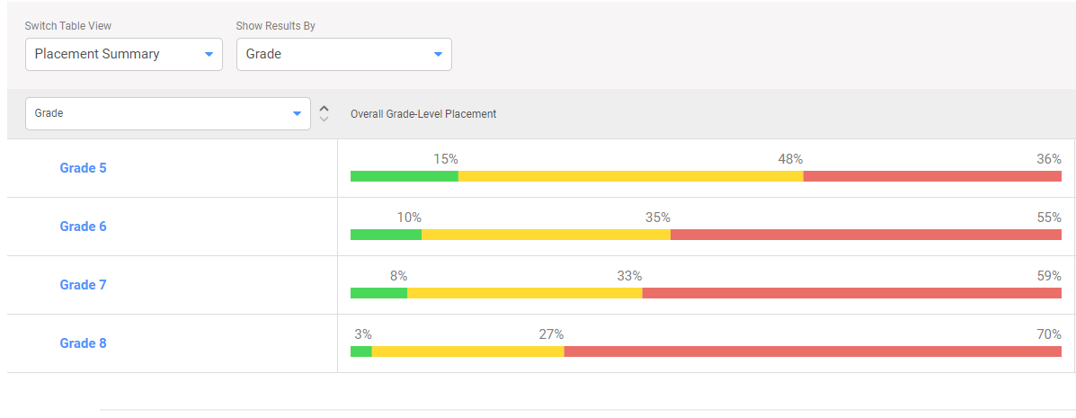
Comparing JMS Math Growth in Each Grade Level
FALL DIAGNOSTIC
SPRING DIAGNOSTIC

Slide 15
Fall/Winter/Spring Math Grade Level Placement

Slide 16
Math Overall Annual Typical/Stretch Growth Accomplishments for JMS
Typical Growth
Stretch Growth
Students With Improved Placement
Notes:
5th Grade- 85 tested
6th Grade-93 tested
7th Grade- 91 tested
8th Grade -96 tested
Total Typical Growth
`147 students met Typical Growth Target out of 365 students assessed= 40% of Students have already met typical growth for the year

Slide 17
Slide 1
Making Progress on Diagnostics
for i-Ready in all Grade Levels!!!
JMS
2022-2023

Slide 18
School Improvement Plan

Slide 19
JMS EVENTS and
CELEBRATIONS

Slide 20
Monday, April 24- Interim Reports/Kona Ice Thursday, April 27- Parent Meeting at 7:00 for PACE Trip Friday, April 28 - 6th Grade Review Olympics for Testing Review Tuesday, May 2 -ELA State Testing Thursday, May 4- Writing State Test Monday, May 8-12-Teacher Appreciation Week Tuesday, May 9- Math State Test Thursday, May 11- Science State Test for 6th Grade Friday, May 12- 8th Grade Celebration Day (All Day, Inflatables, and Food Trucks) Monday, May 15-17- PACE Trip to Washington, DC Thursday, May 18- Dream Box Incentive Party Karaoke/Pizza Friday, May 19- Reading Plus Ice Cream Incentive Party
Upcoming Dates for JMS

Slide 21
8TH Grade Graduation -Monday, May 22 at 6:30 in Gym 5th and 6th Grade Awards-Tuesday, May 23 at 8:30 to 9:45 7th Grade Awards – Tuesday, May 23 at 10:00 to 11:00
Award Day Recognition

Slide 22
Your Ideas and Suggestions for Next Year 2023-2024

Slide 23
Thank You SIC FOR GIVING YOUR TIME to MAKE JMS A GREAT PLACE TO LEARN!

