Slide 1
2024-2025
Annual Report
Summary
Public Hearing
February 16, 2026

Slide 2
2024-2025 Annual Report
The complete annual report will be available in electronic form on the FISD website.
https://www.frankstonisd.net/txacademicperformance2024-2025

Slide 3
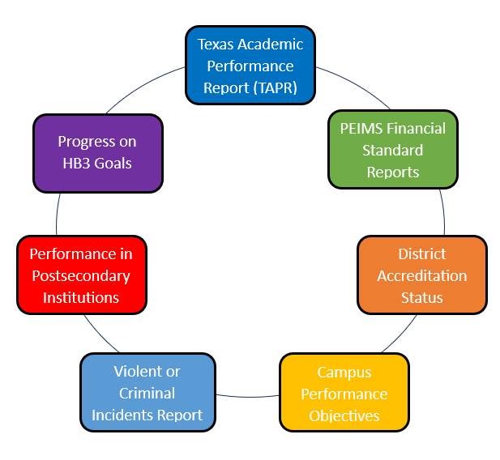
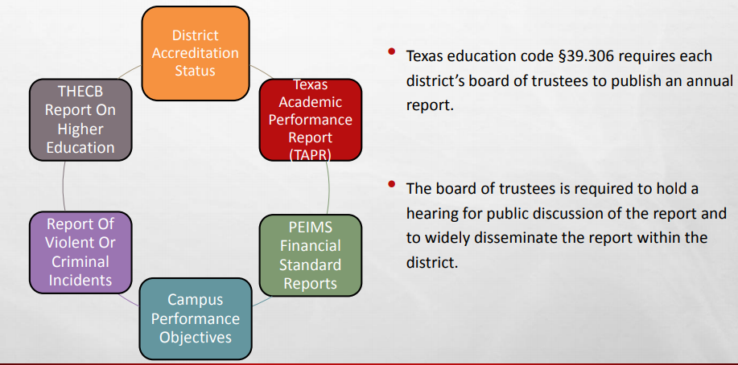
Components of the Annual Report

Slide 4

District Accreditation Status

Slide 5
District Accreditation Status
FIRST Rating: A Superior
Accreditation Rating: Accredited
District Accountability Rating: B (87)
Special Ed Determination Status: Meets Requirements
https://rptsvr1.tea.texas.gov/perfreport/tapr/tapr_srch.html?srch=D

Slide 6
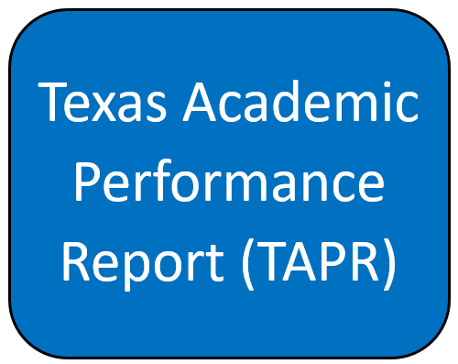
Texas Academic Performance Report

Slide 7
Texas Academic Performance Report
Board Goal #1
Increase on-grade-level performance in all subject areas

Slide 8
Texas Academic Performance Report
Board Goal #1
Increase on-grade-level performance in all subject areas

Slide 9
Texas Academic Performance Report
Board Goal #1
Increase on-grade-level performance in all subject areas

Slide 10
Texas Academic Performance Report
Board Goal #2
Every student will graduate with the knowledge and skills necessary to be successful
in college, career, or the military.

Slide 11
Texas Academic Performance Report
Board Goal #2
Every student will graduate with the knowledge and skills necessary to be successful
in college, career, or the military.
CCRM Data
 | Class of 2019 | Class of 2020 | Class of 2021 | Class of 2022 | Class of 2023 | Class of 2024
Approved Industry-Based Certifications | 12.3% | 41.2% | 26.8% | 91.1% | 96.3% | 84.1%
SAT/ACT Tested | 89.4% | 96.1% | 92.7% | 95.6% | 100% | 100%
TSI Criteria Met in ELA and Math | 45.6% | 31.4% | 48.8% | 77.8% | 77.8% | 97.7%
Dual Credit (9 ≥ hours any subject; 3 ≥ hours in ELA/Math) | 70.1% | 52.9% | 63.4% | 42.2% | 38.9% | 45.5%
Associate’s Degree | 1.7% | 5.9% | 0.0% | 2.2% | 13.0% | 13.6%

Slide 12
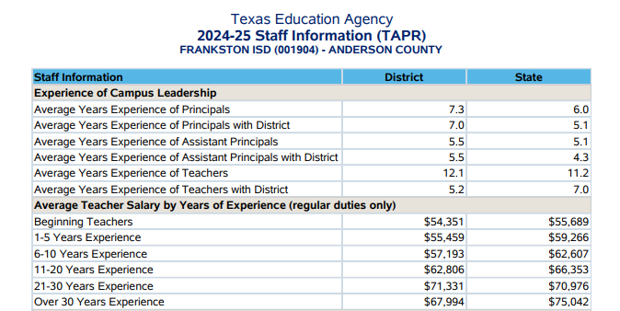
Texas Academic Performance Report
Board Goal #4
Attract, develop, and retain world class educators dedicated to serving each student
in Frankston ISD.
Beginning teachers at FISD made $43,000 (without stipends), and $1,338 less than the state average (with stipends).
Notes:
Beginning Teachers for 21-22 Over 30 years
Lloyd 40,500 Duesterhoft & Braly lowered average
Walden 39,000 + 5086
Daniels 39000 + 7600
Peek 39330
Severn 46060

Slide 13
Texas Academic Performance Report
Board Goal #4
Attract, develop, and retain world class educators dedicated to serving each student
in Frankston ISD.
Teacher Turnover Rate
 | District | State
2017-2018 | 37.3% | 16.6%
2018-2019 | 30.5% | 16.5%
2019-2020 | 24.0% | 16.8%
2020-2021 | 15.7% | 14.3%
2021-2022 | 21.6% | 17.7%
2022-2023 | 24.5% | 21.4%
2023-2024 | 13.2% | 19.1%
2024-2025 | 20.5% | 18.8%
15 out of 74 Teachers did not return for the 2024-2025 year
( 8 another TX district, 3 retired, 4 out of education)

Slide 14
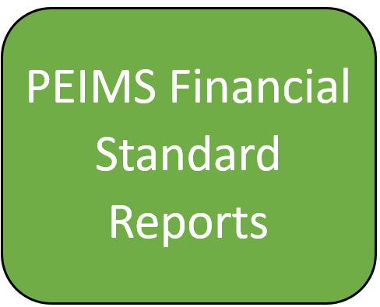
PEIMS Financial Report

Slide 15
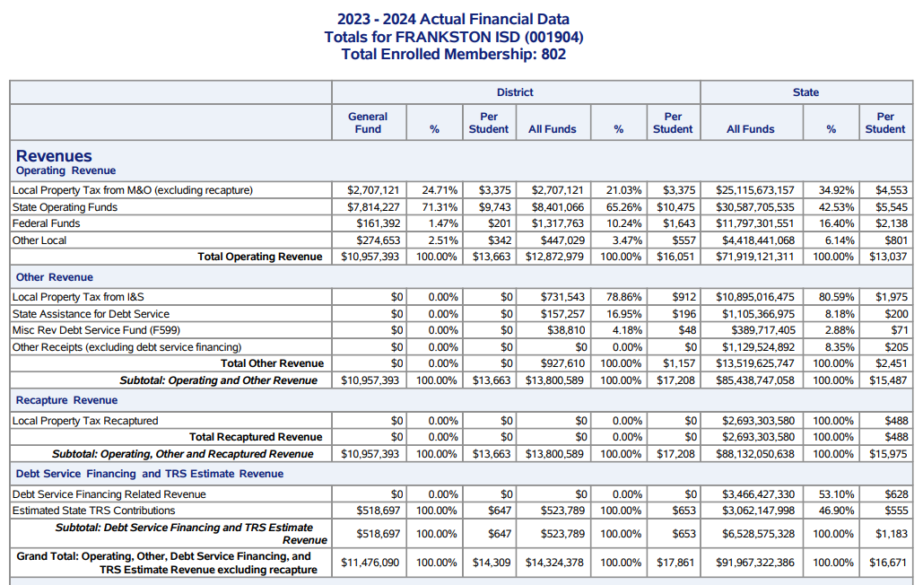
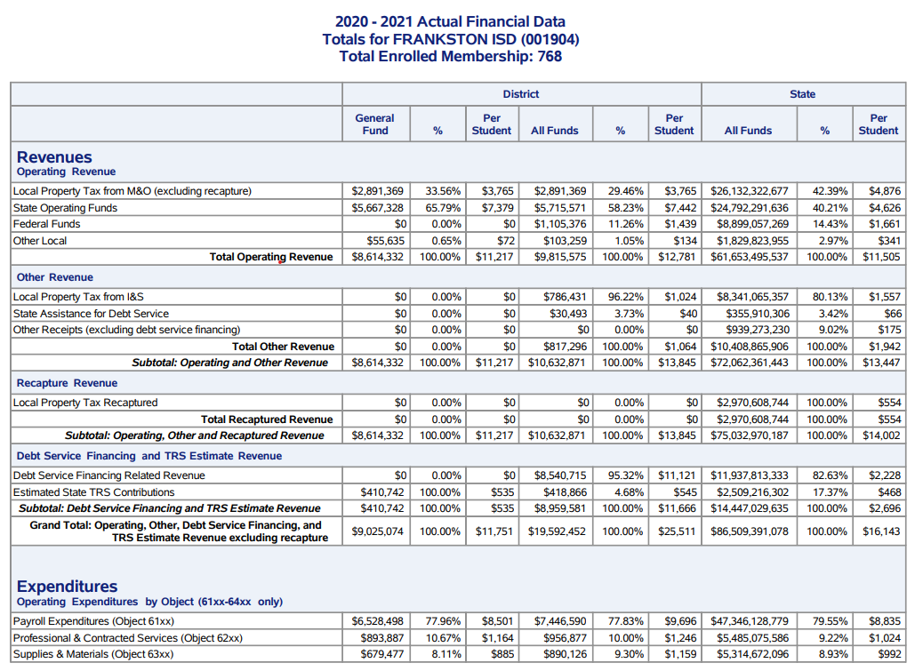

Slide 16
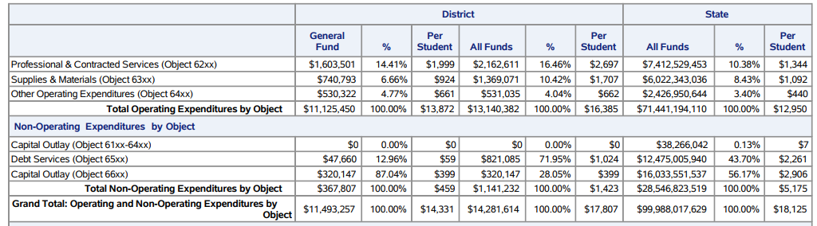
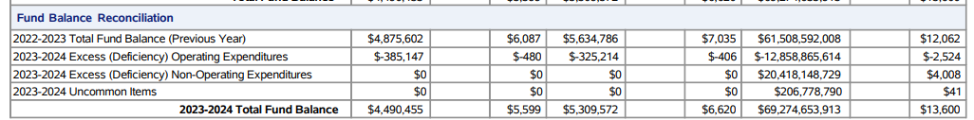

Slide 17

Performance Objectives

Slide 18
FISD Strategic Goals
Increase on-grade-level performance in all subject areas.
Every student will graduate with the knowledge and skills necessary to be successful in college, career, or the military.
Provide a school culture & climate that promotes participation in extracurricular activities and the development of positive character traits.
Attract, develop, and retain world class educators dedicated to serving each student in Frankston ISD.
Strengthen strategic communication with students, families, employees, and community members to foster engagement and increase transparency, support, and confidence in FISD.

Slide 19

Violent/Criminal Incidents

Slide 20
Violent/ Criminal Incidents
PEIMS Code | Type of Violation/ Criminal Incident | Elem | Middle School | High School | Total Students/Incidents
0 | Alcohol | 0 | 1 | 1 | 2/2
21 | Student Code of Conduct Violation | 23 | 35 | 40 | 64/98
26 | Terroristic Threat | 0 | 1 | 0 | 1/1
41 | Fighting | 0 | 5 | 0 | 9/5
61 | Bullying | 3 | 0 | 0 | 3/3
62 | Marihuana/THC | 0 | 1 | 1 | 2/2
63 | E-Cigarette | 0 | 0 | 10 | 9/10
 | Total by Campus | 26 | 43 | 52 | 90/121
--------- | ---------------------------------------
 | Number of DAEP Placements | 0 | 3 | 13 | 16

Slide 21

Higher Education Report

Slide 22
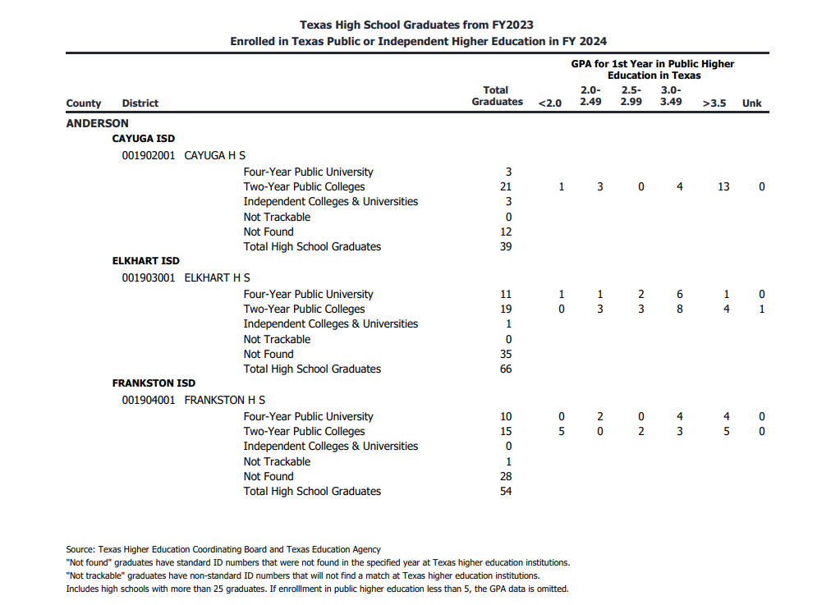
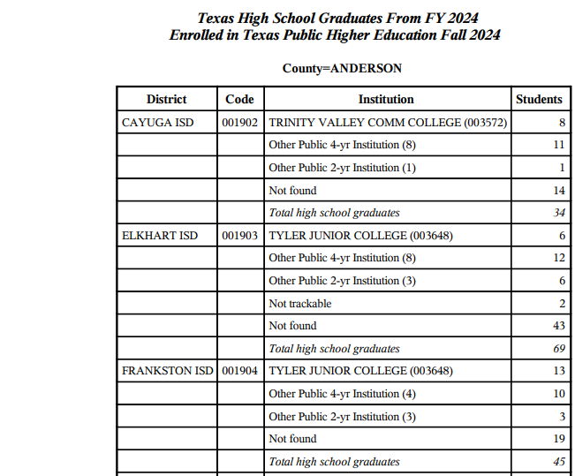
Higher Education Report

Slide 23
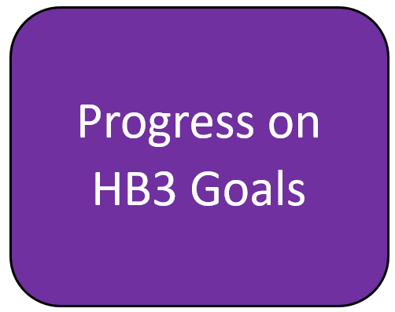
HB3 Goals Progress

Slide 24
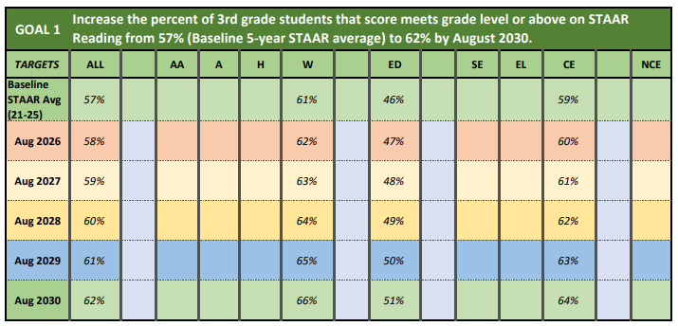
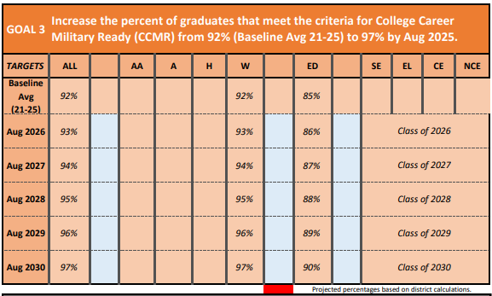
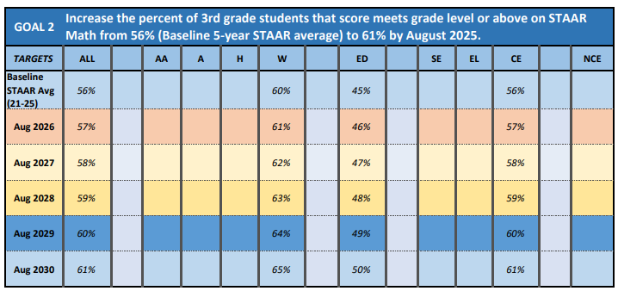
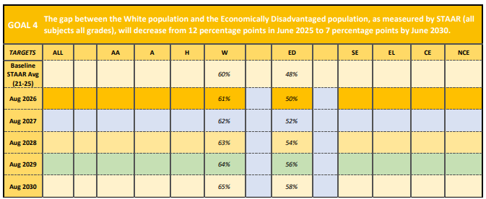
HB3 Goals Progress

Slide 25


