Slide 1
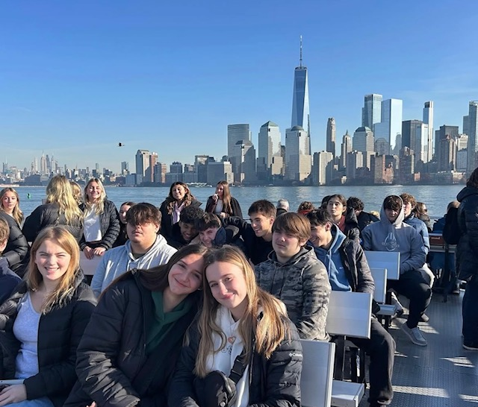
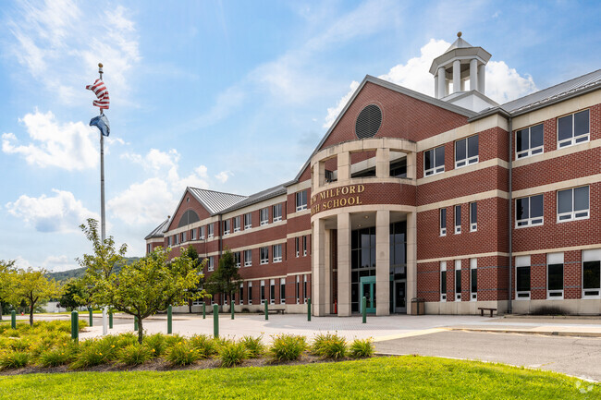
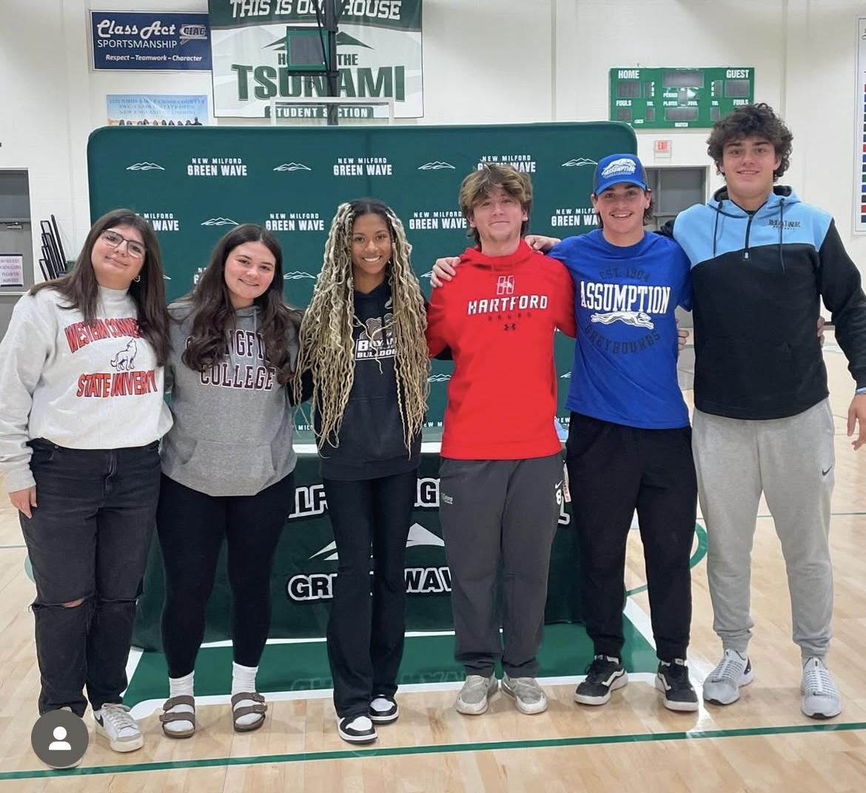
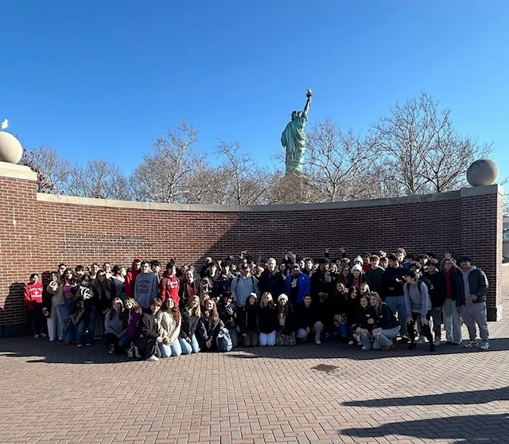
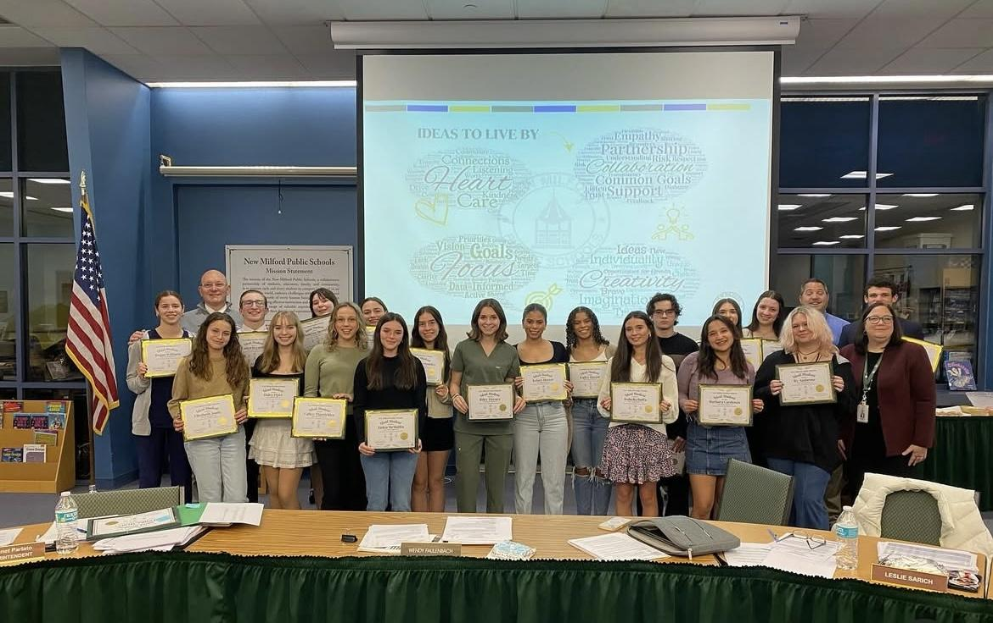
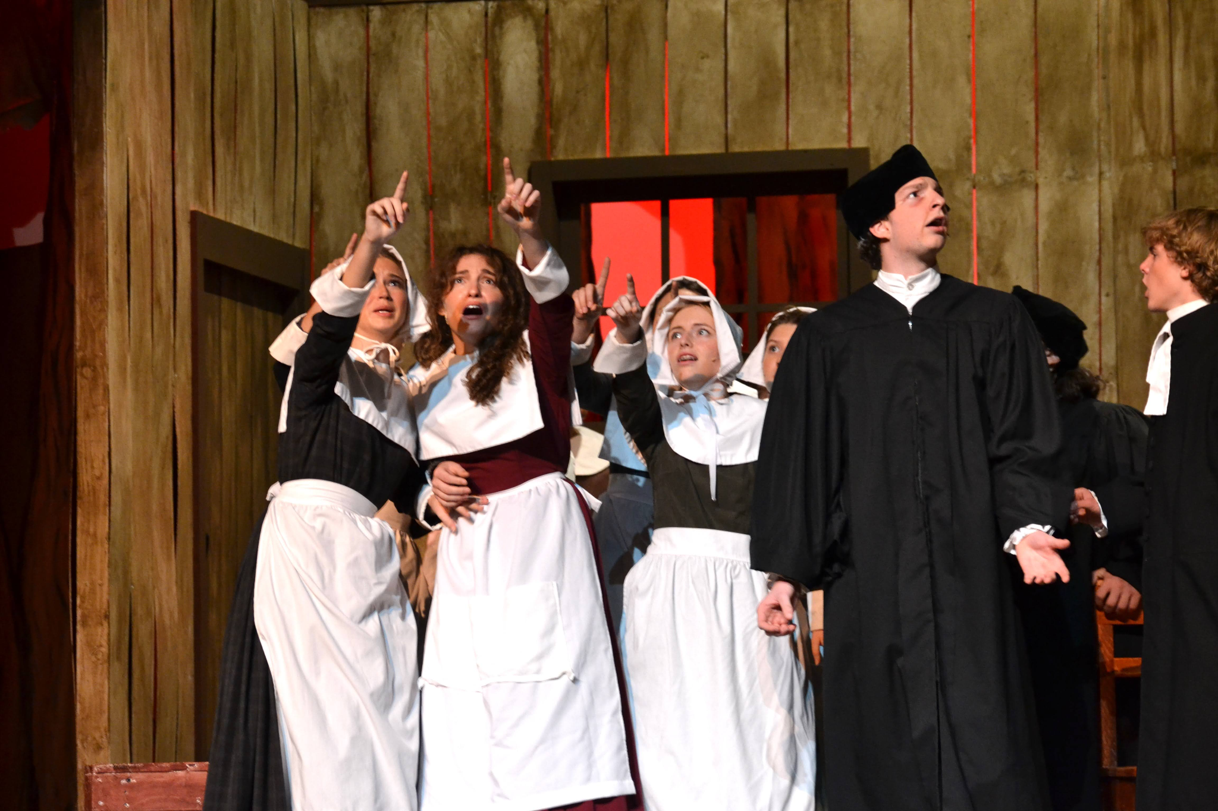
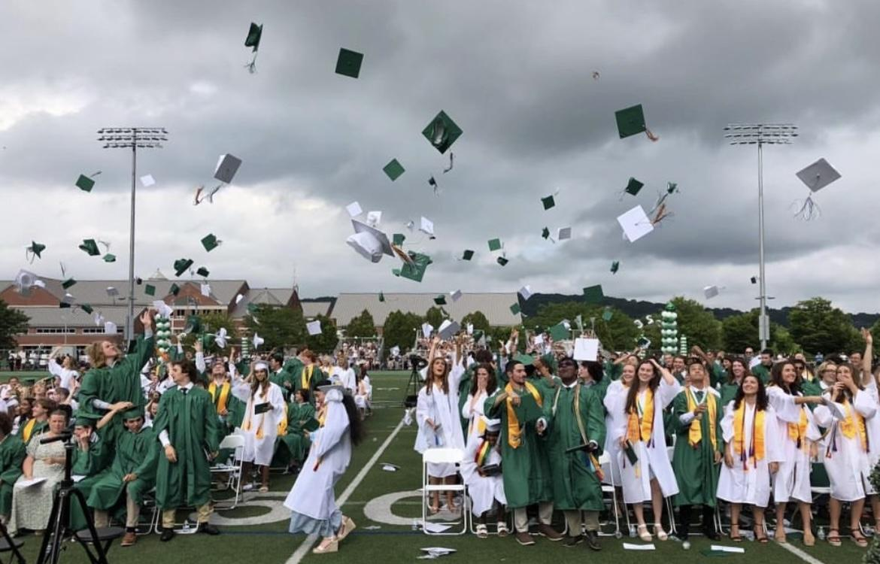
New Milford Public Schools
Budget Overview for 2025-2026
New Milford High School
Principal- Raymond Manka

Slide 2
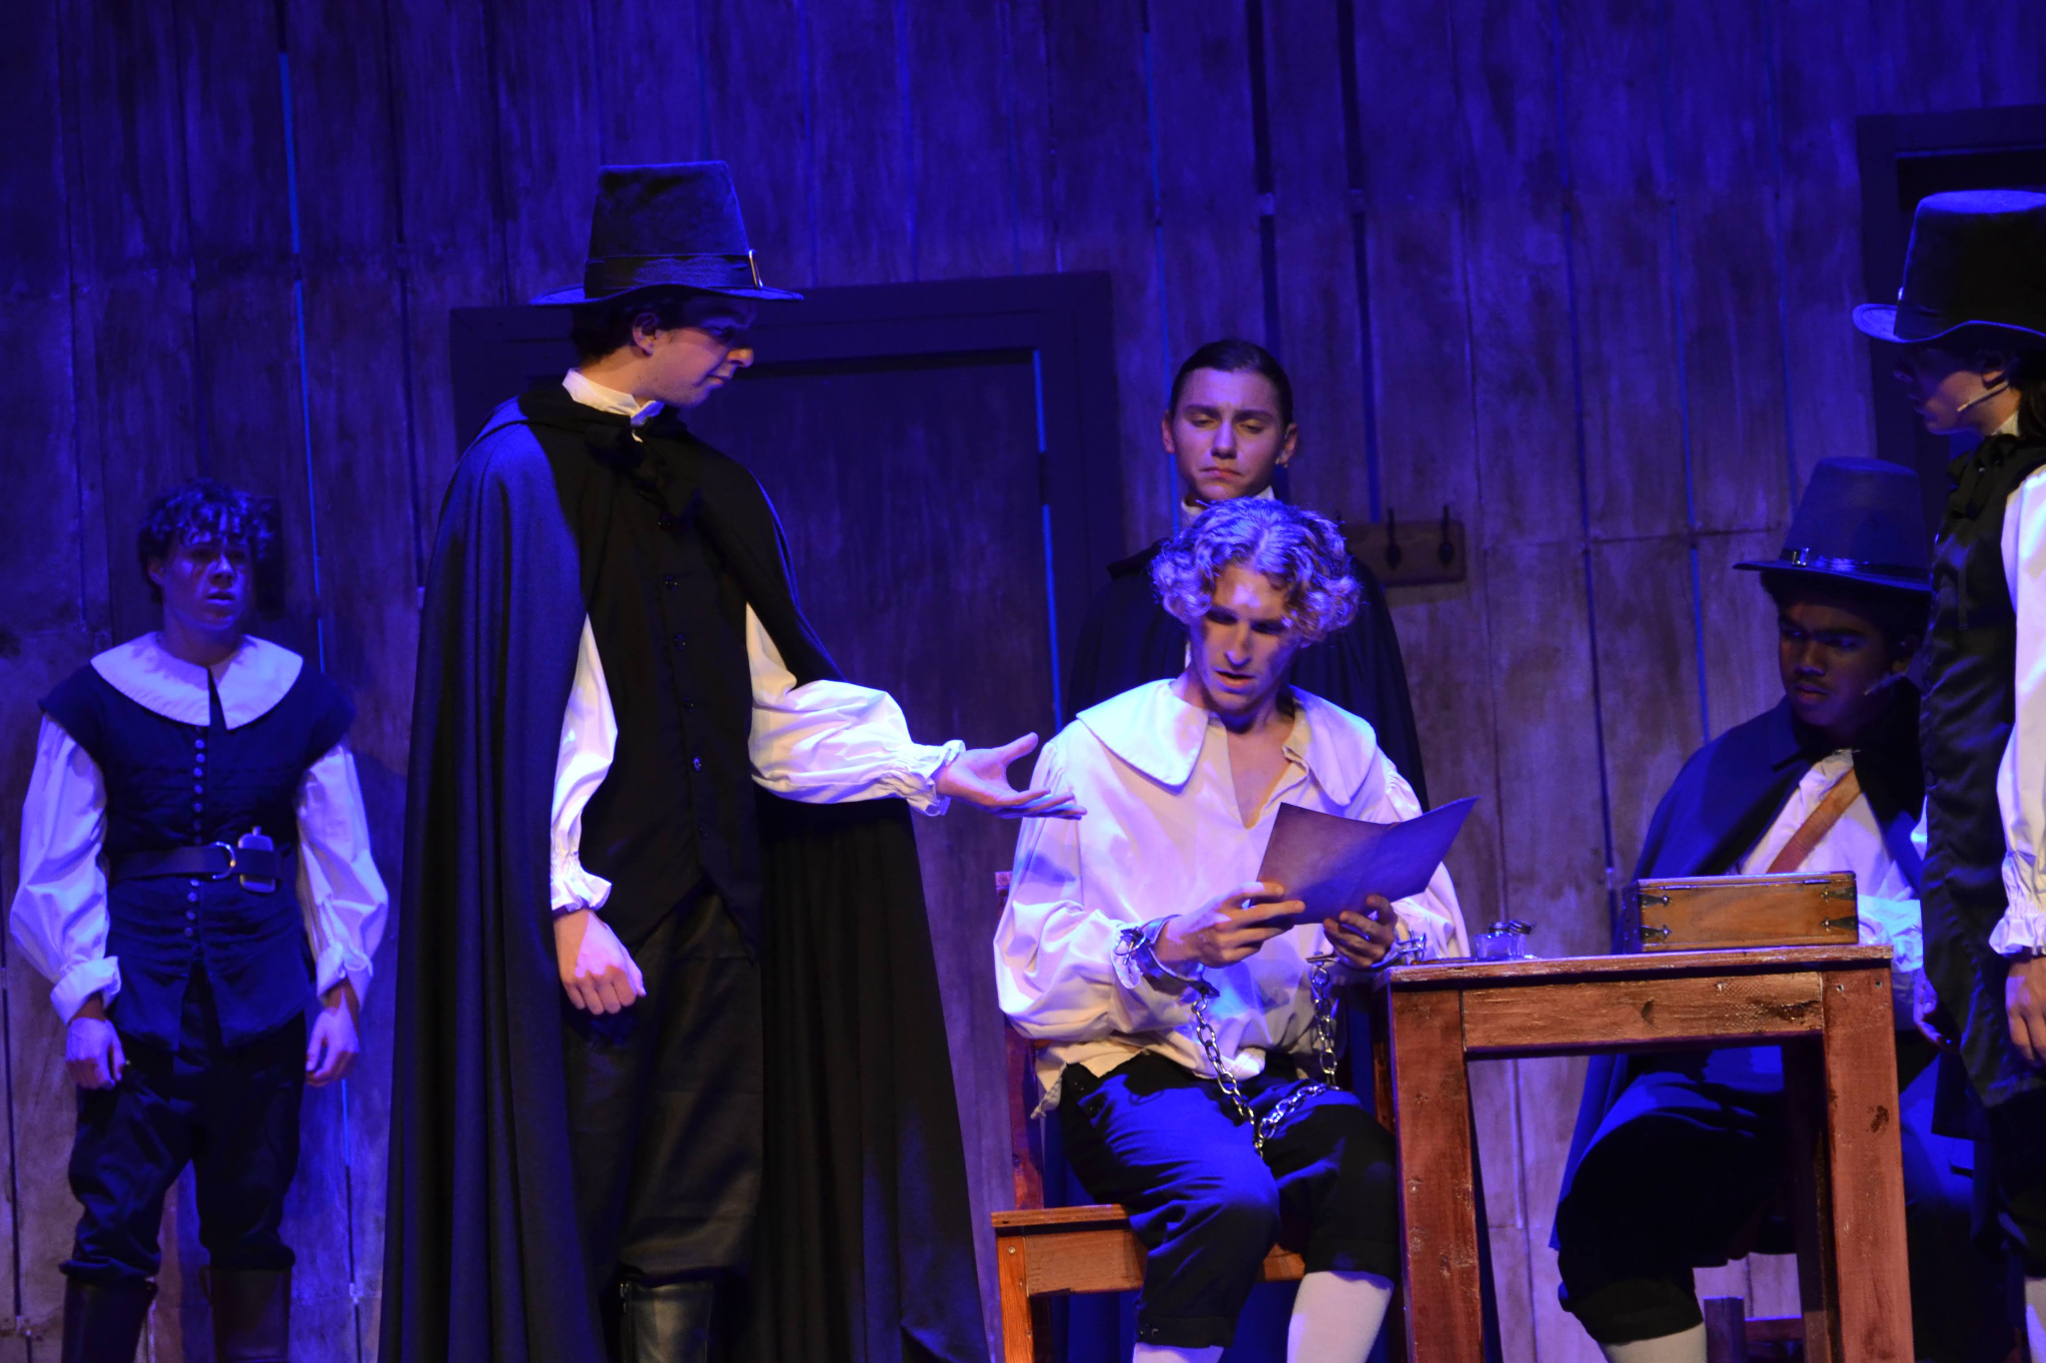
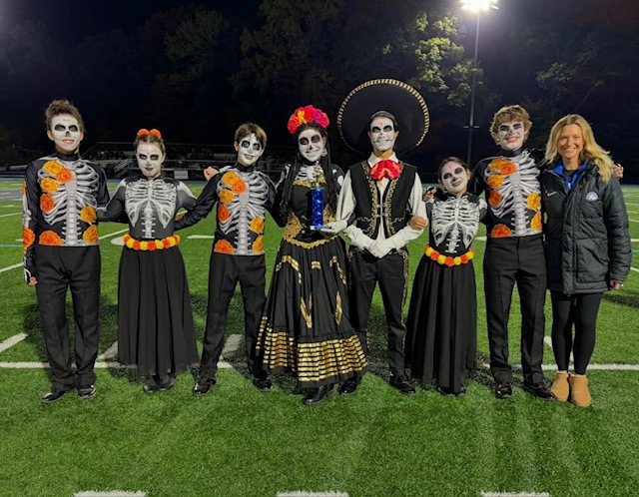
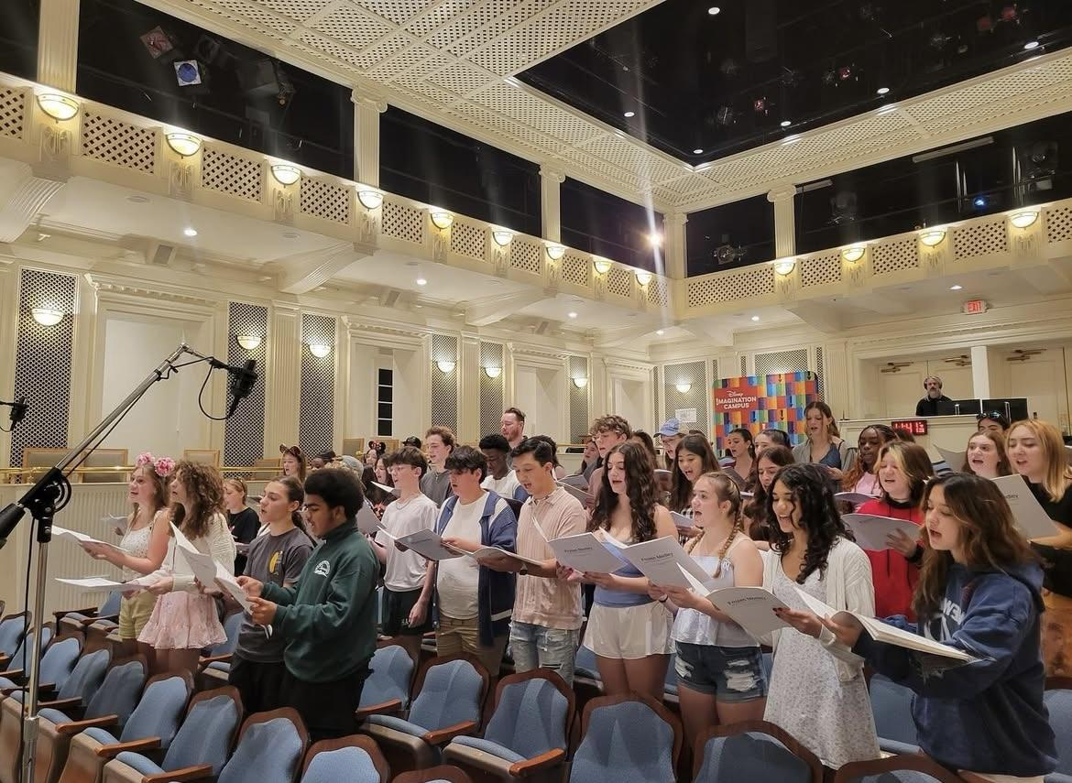
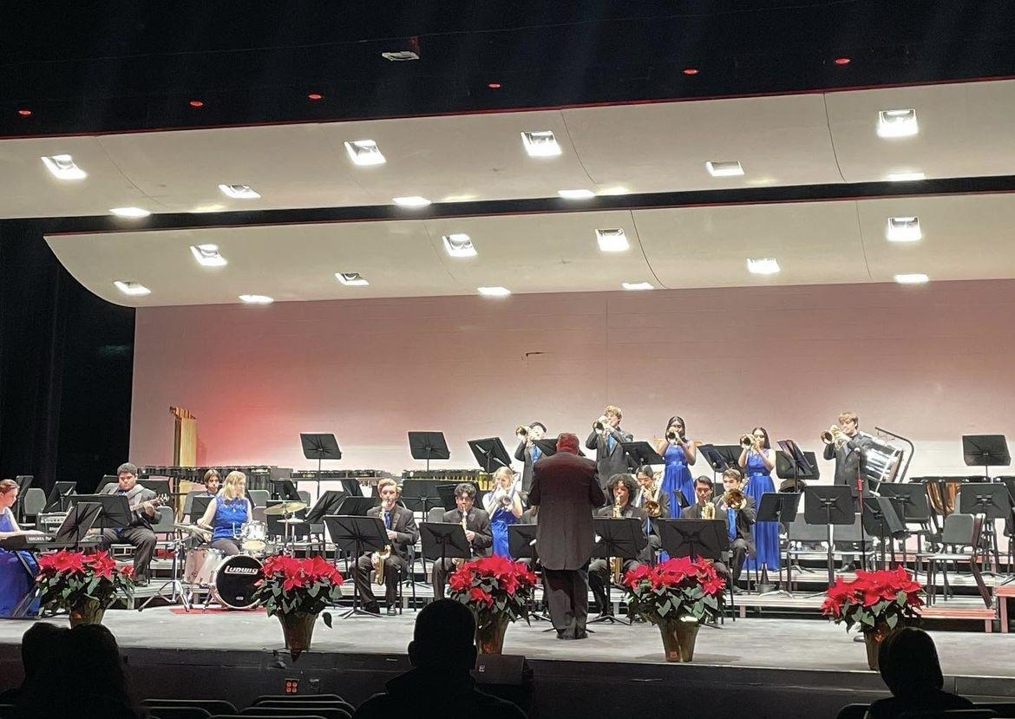
New Milford Public Schools
Budget Overview for 2025-2026
New Milford Public Schools Mission Statement and Ideas We Live By
The mission of the New Milford Public Schools, a collaborative partnership of students, educators, family and community, is to prepare each and every student:
To compete and excel in an ever-changing world;
To embrace challenges with vigor;
To respect and appreciate the worth of every human being,
To contribute to society by providing effective instruction and dynamic curriculum, offering a wide range of valuable experiences, and inspiring students to pursue their dreams and aspirations.

Slide 3
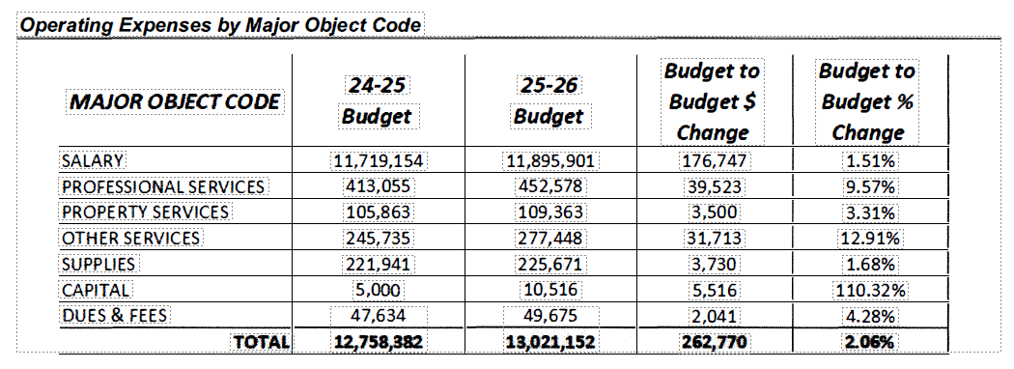
New Milford Public School In Action
Student led, and staff supported, Wingman & P-2-P build our SEL, empathy, and acceptance within our school community.
Pathways work provides programming and opportunities for NMHS students & families.
Attendance work stresses the value of attendance and provides support for students and families.
FLEX has become a major asset to NMHS students and staff.

Slide 4
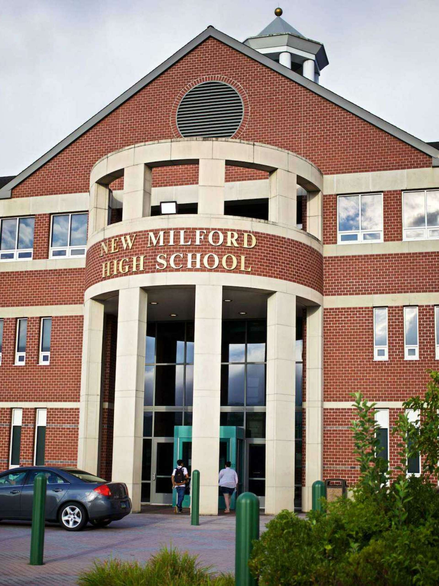
New Milford Public Schools
Budget Overview for 2025-2026
Certified | Teachers: 106 (includes department chairs) Special Ed DC: 1.0 Pathways Coordinator:1.0
Support Staff | Social Workers: 2 Psychologist: 1.5 Substance Abuse: 1 Counselors: 6 Para: 15 (2 vacant) SCW: 1 (1 vacant) S&L: 1.5 OT/PT: 2.0 shared
Projected Enrollment | Class of 2026: 285 Class of 2027: 302 Class of 2028: 249 Class of 2029: 281

Slide 5
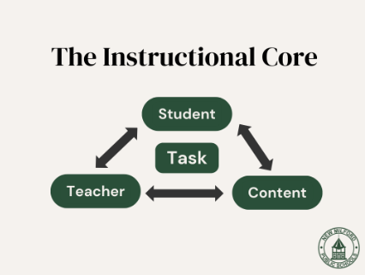
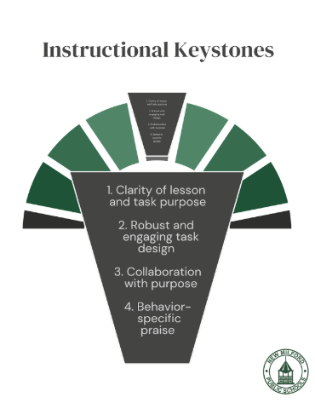
New Milford Public Schools
Budget Overview for 2025-2026
Vision of the Graduate- our guiding light
Communication is critical: ATM, ILT & faculty
Instructional rounds to explore teacher, student, and curriculum connection of the instructional core
NMHS committees work to analyze data, identify areas of strength, and inform our planning for NMHS goals
CSDE accountability measures and making a connection to our department & classroom
Grants (i.e. SBDI) to continue to support our growth & development as a school and district

Slide 6
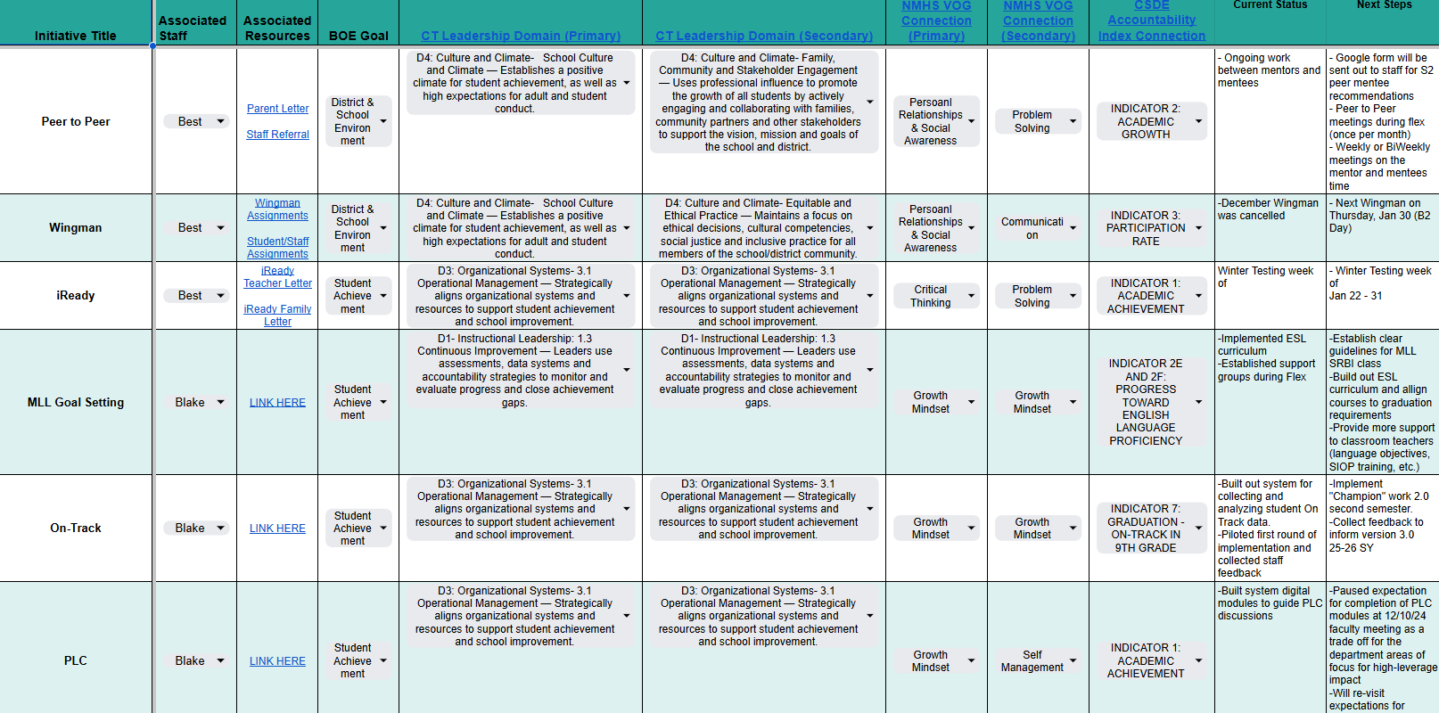
New Milford Public Schools
Budget Overview for 2025-2026
*NEW* 24-25 Initiative Mapping: WHAT are we doing & WHY

Slide 7
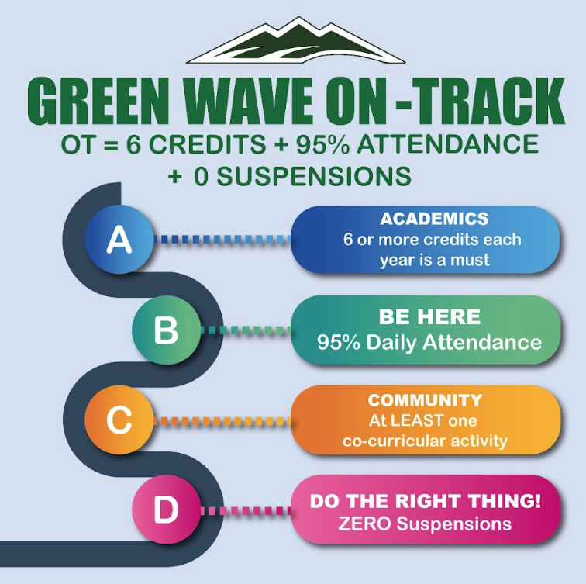
New Milford Public Schools
Budget Overview for 2025-2026
On Track
What we’ve done in 24-25 School Year:
Set clear, measurable goals for students aligned to our Next Gen Accountability System (see graphic on the left).
Assigned every student a “Champion” who will monitor their On Track status, and help students set nuanced goals.
Implemented student-led conferences between students and their “Champions” during Advisory time.

Slide 8
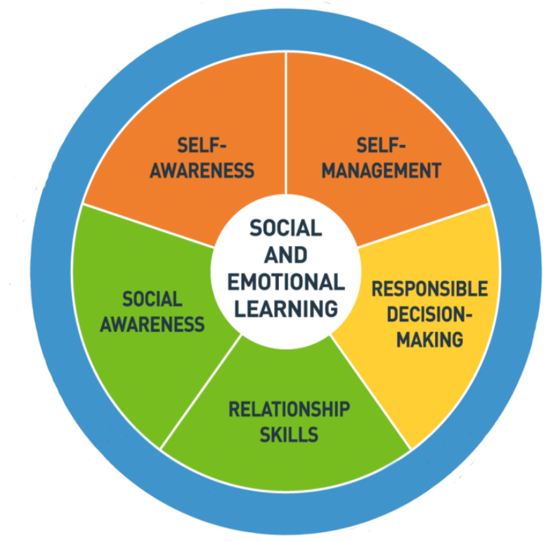
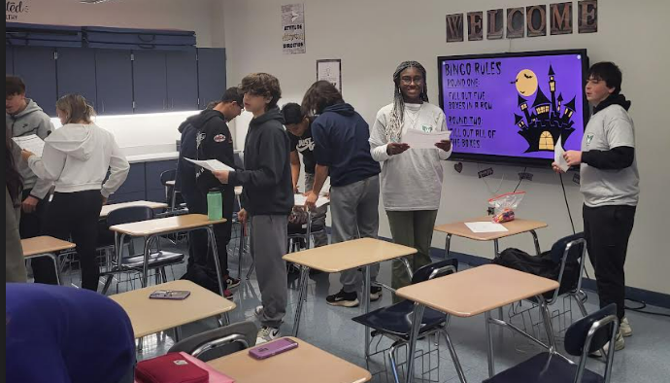
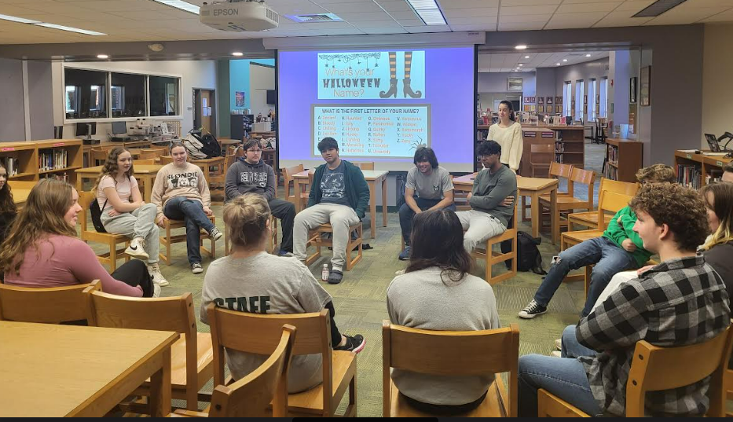
New Milford Public Schools
Budget Overview for 2025-2026
Social Emotional School-wide Programming: Wingman Movement
WINGMAN: 146 Student Leaders oversee a student-led activity based program on inclusivity, empathy and providing opportunities for all students to have a voice for positive change in their school/community.
Using the SEL CASEL Standards, lessons/activities are prepared for each Wingman Day to support Social-Emotional learning and Social Awareness, Relationship Skills, Responsible Decision Making, Self- Management & Self-Awareness.
Staff/Student Subcommittees: Lesson planning, Materials, Social media/promotion, Data analysis
Feedback surveys inform decisions on future activities and connect with other committee work at NMHS
Look Up, Look Out, Look After!

Slide 9
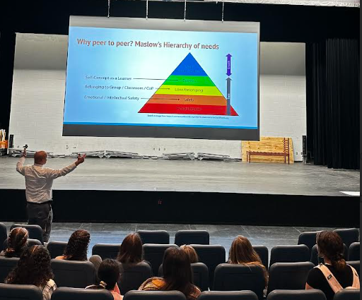
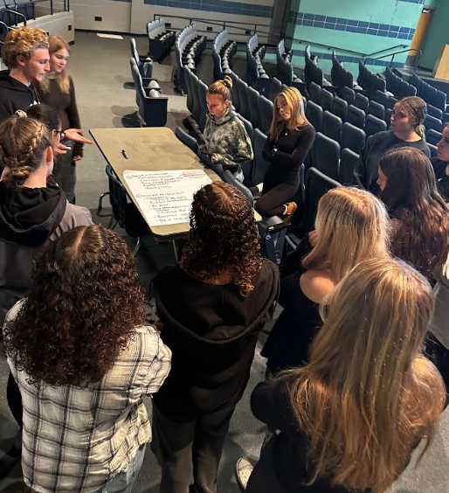
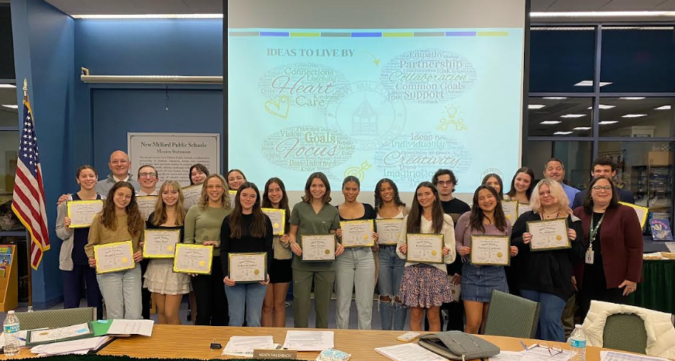
New Milford Public Schools
Budget Overview for 2025-2026
Social Emotional School-wide Programming: Peer to Peer
PEER to PEER: The program pairs NMHS Freshmen mentees with an upperclassmen mentor to discuss topics including academics, communication with peers and teachers, facing peer pressure, getting involved in the NMHS Community (clubs/activities, athletics), Inclusivity and empathy discussions, managing emotions, NMHS support systems available (School counseling, SBHC) and other topics as requested by the mentee.
8th grade team discussions with NMHS administration this past summer created our group for the 2024-2025 mentorship program
NMHS staff make recommendations for future mentees to the program

Slide 10
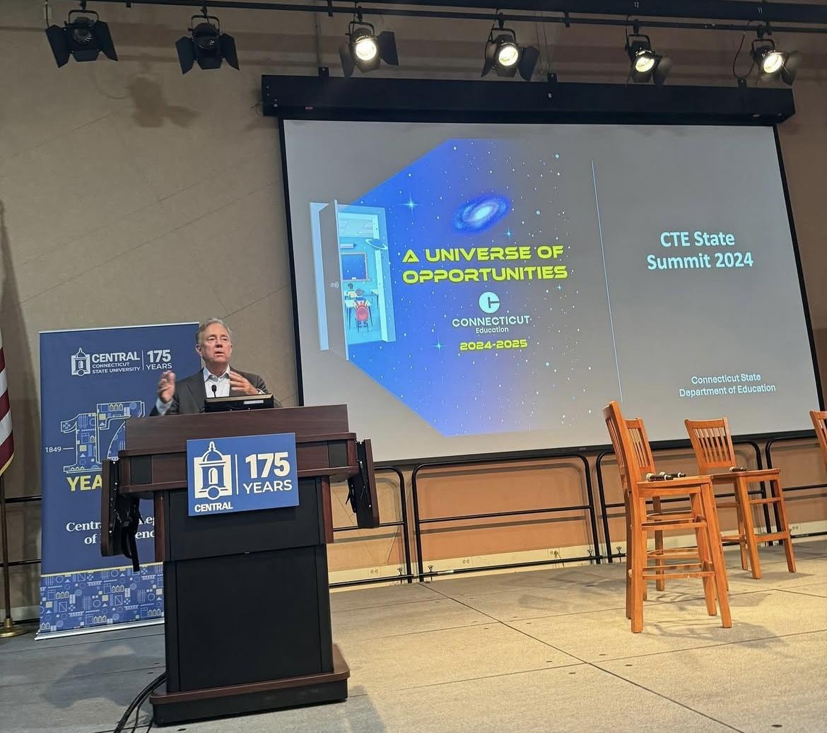
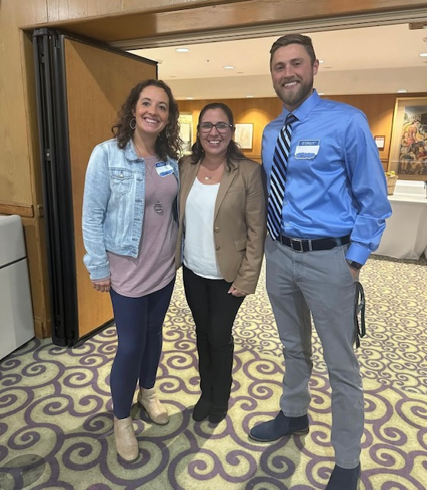
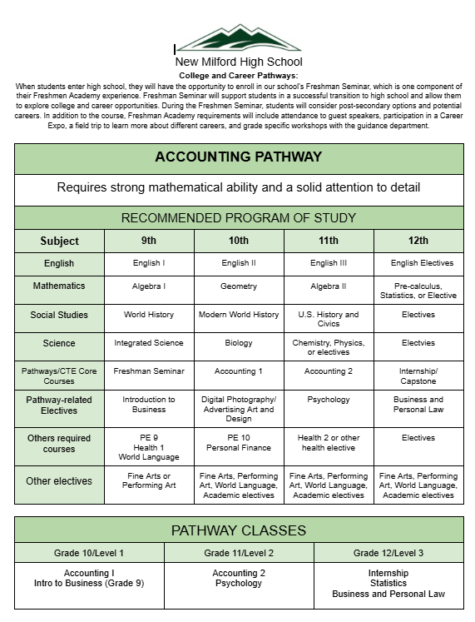
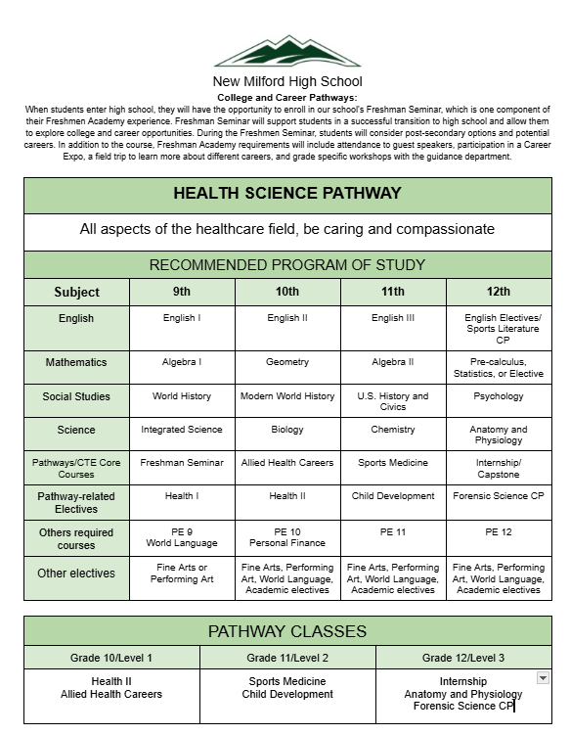
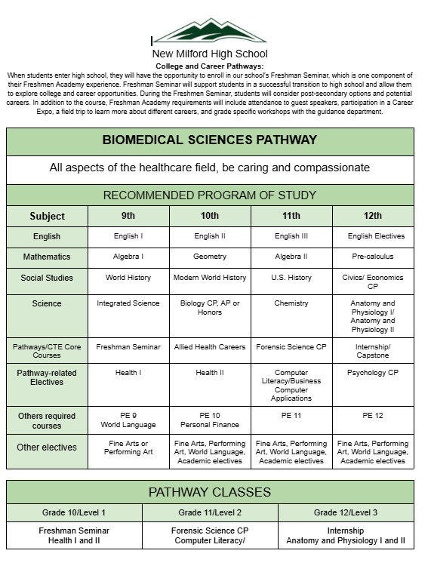
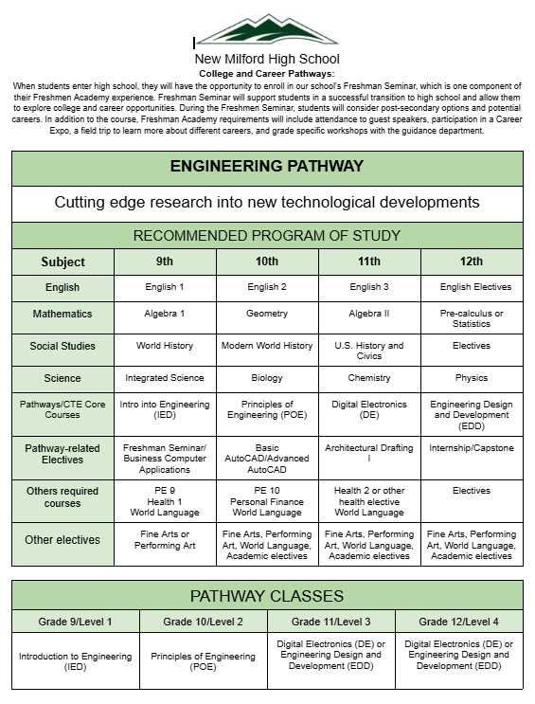
New Milford Public Schools
Budget Overview for 2025-2026
Pathways Programming Progress at NMHS!
Career Pathways Coordinator
Advisory Board- Community Engagement
Plan for increased Internships and Career Connected Learning
Cluster of academic courses for Pathways
Career Expo for all students
Career Readiness and Work Based Learning
Continued professional learning opportunities

Slide 11
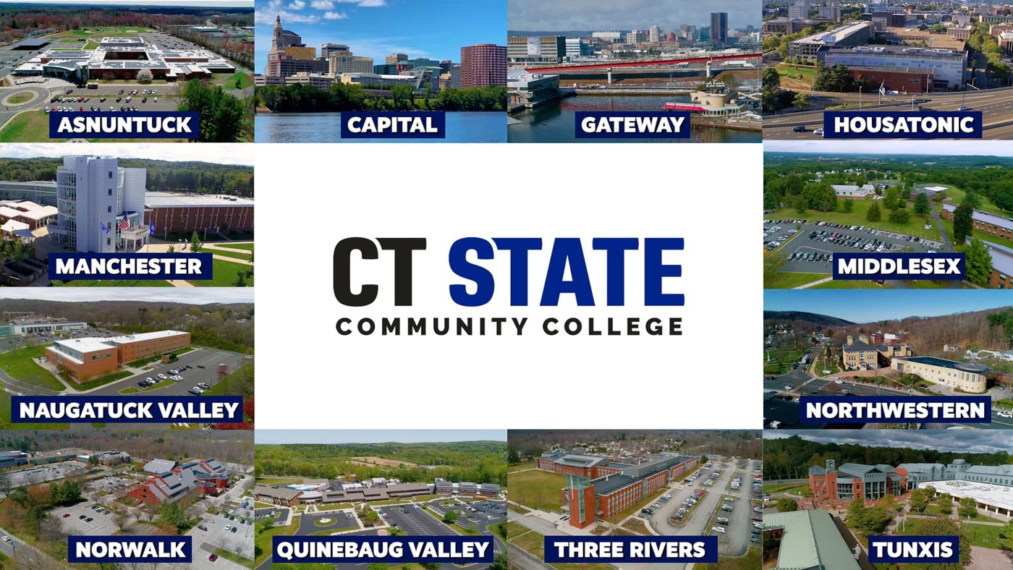
New Milford Public Schools
Budget Overview for 2025-2026
*TENTATIVE* Early College Experience Courses
CSDE ECE grant recipient: 2yr award in 2023 and started work in summer 2024
Less than 3% of NMHS grads with 3+ credits amongst lowest statewide
Coming Soon (dependant on 2/4 CT&L outcome): 9 new, 2 returning, and 2 under construction for 26-27 consideration!
Enrolled as a college student and access IHE supports
College content in a familiar environment
Transferable credits at a fraction of the cost!

Slide 12
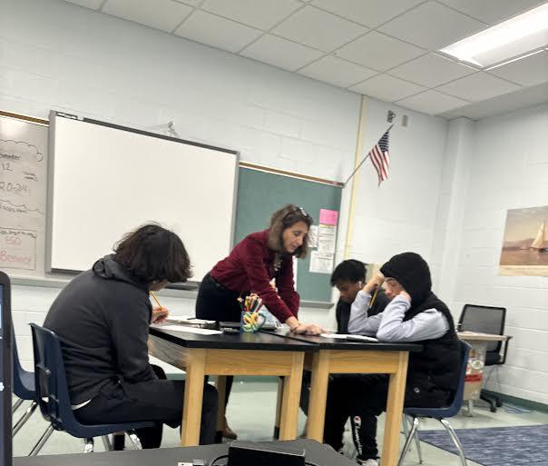
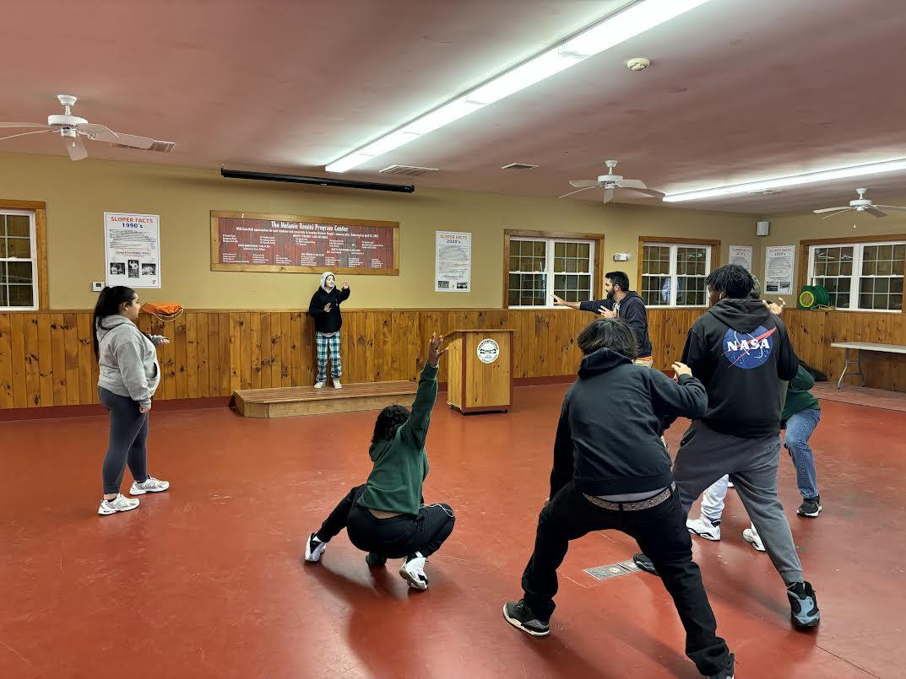
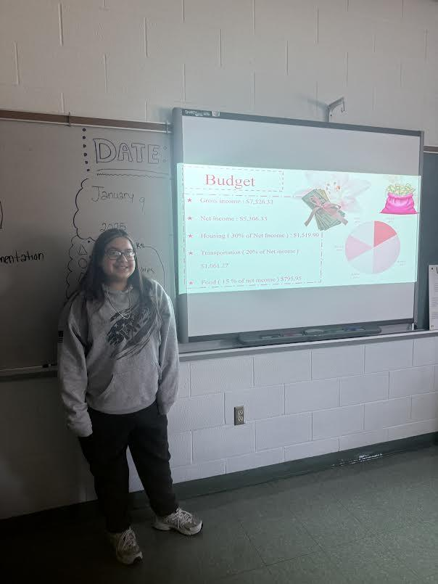
New Milford Public Schools
Budget Overview for 2025-2026
Alternative Education: The Summit
Year 1 of Alternative Education Program
Goal was 8-12 students
14 faculty/staff involved with the program
Opportunity for students who are not On-Track
Credit accumulation
Provides social, emotional, and academic support
Promotes positive behavioral changes
Offers daily constructive guidance and check-ins
Attendance and discipline improvements
Alternative environment to meet students where they are.

Slide 13
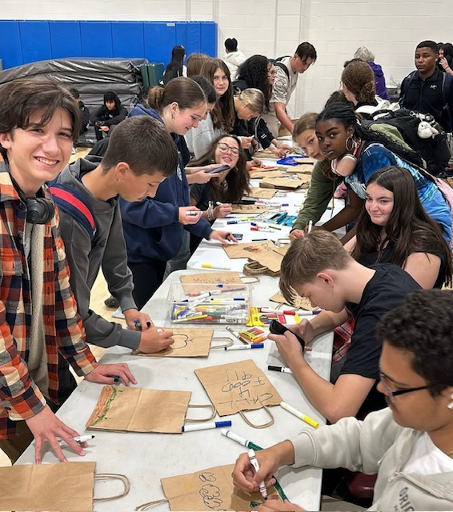
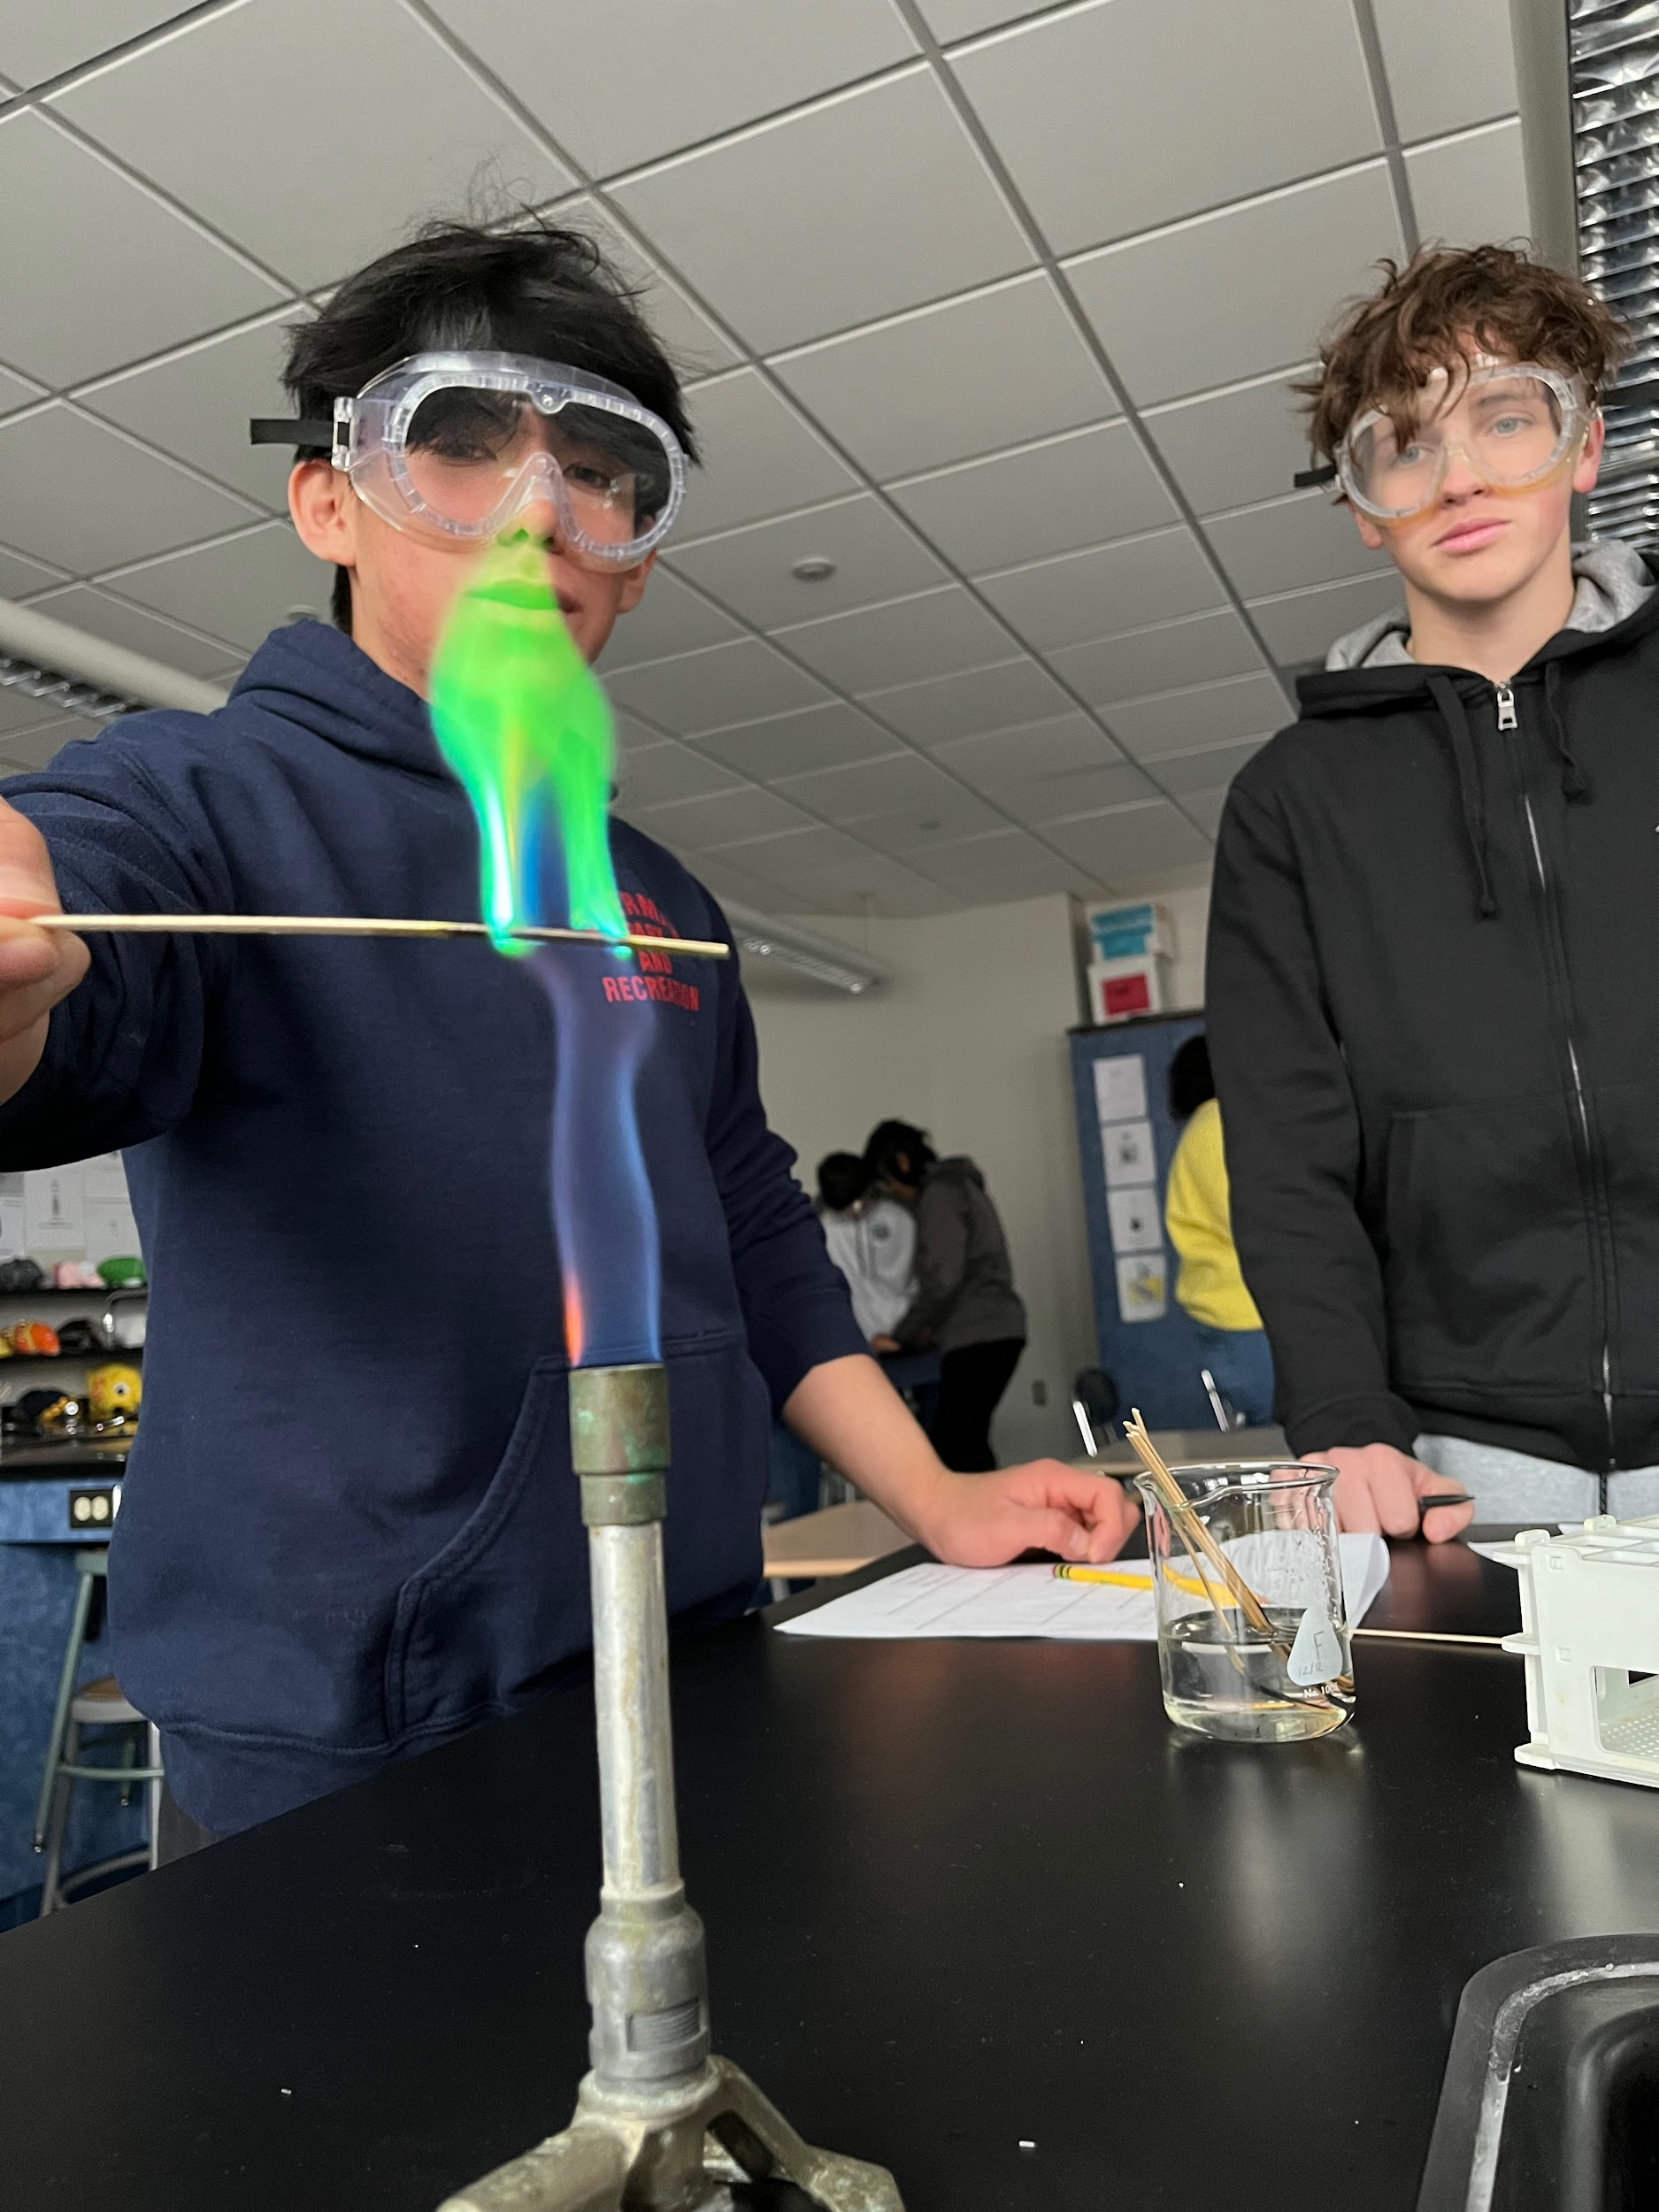
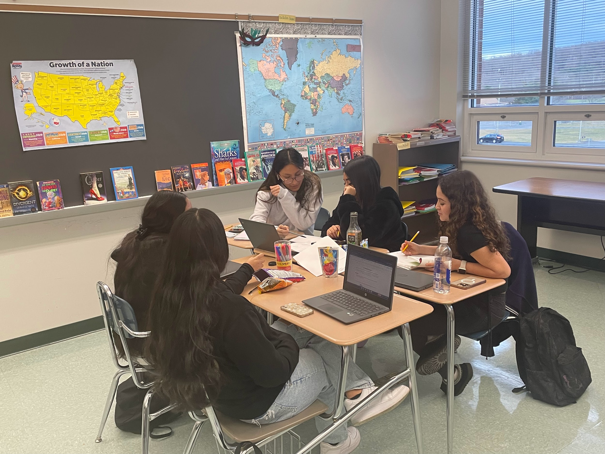
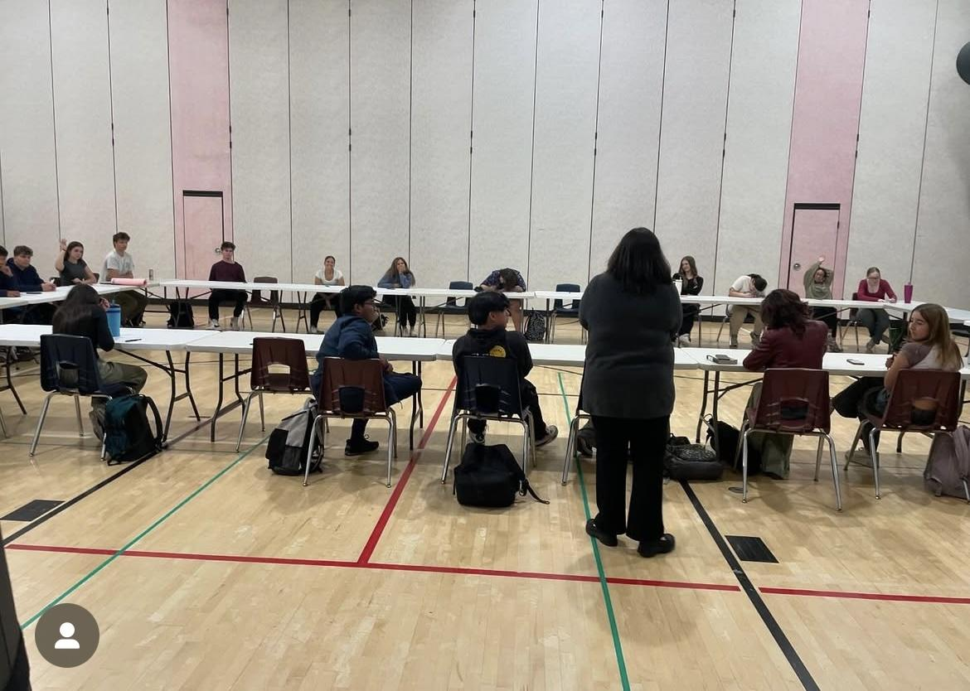
New Milford Public Schools
Budget Overview for 2025-2026
The 2025-2026 NMHS Budget Request ensures:
Addition of 1.0 FTE CTE teacher
Add 1.0 SSO and reduce 1.0 Securitas
Adequate FTE including teaching, administration, clerical, pupil support staff satisfactory for student schedules for the 25-26 academic school year.
Appropriate instructional materials (including disposable resources and digital subscriptions) to support teaching and learning.
Resources to support and access the arts including band, chorus, fine arts, and music.

Slide 14
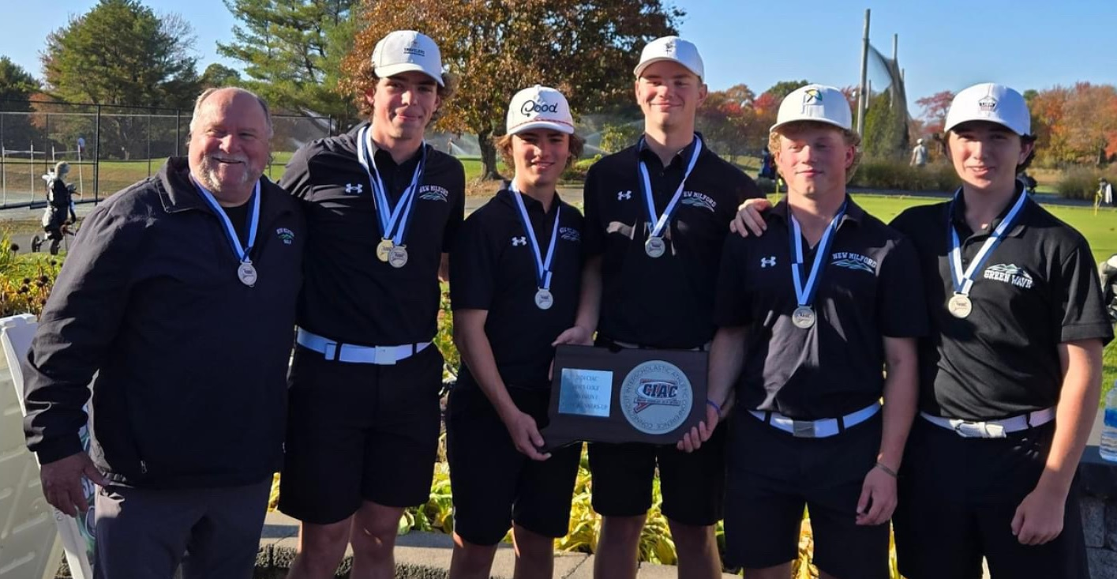
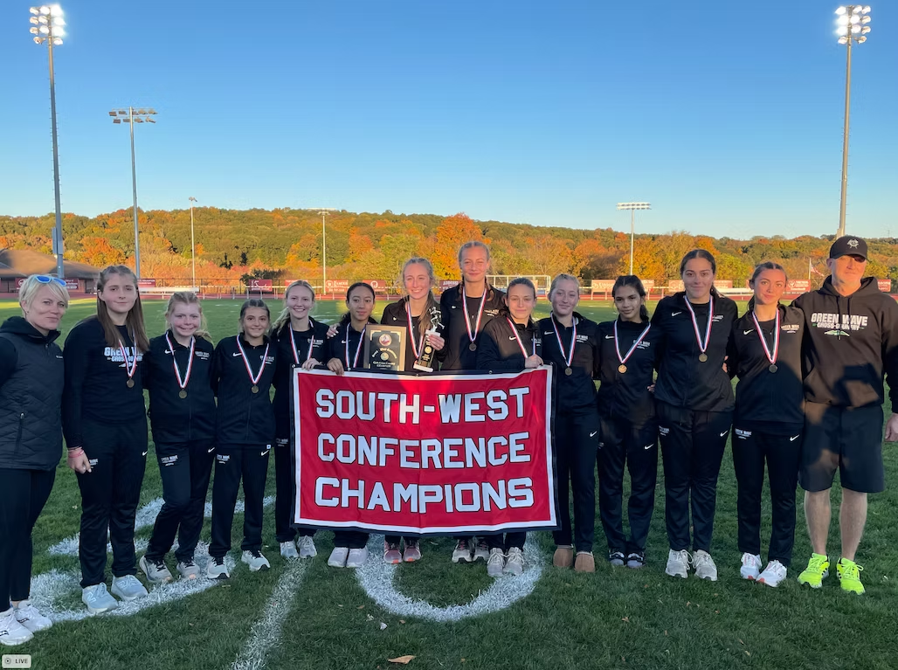
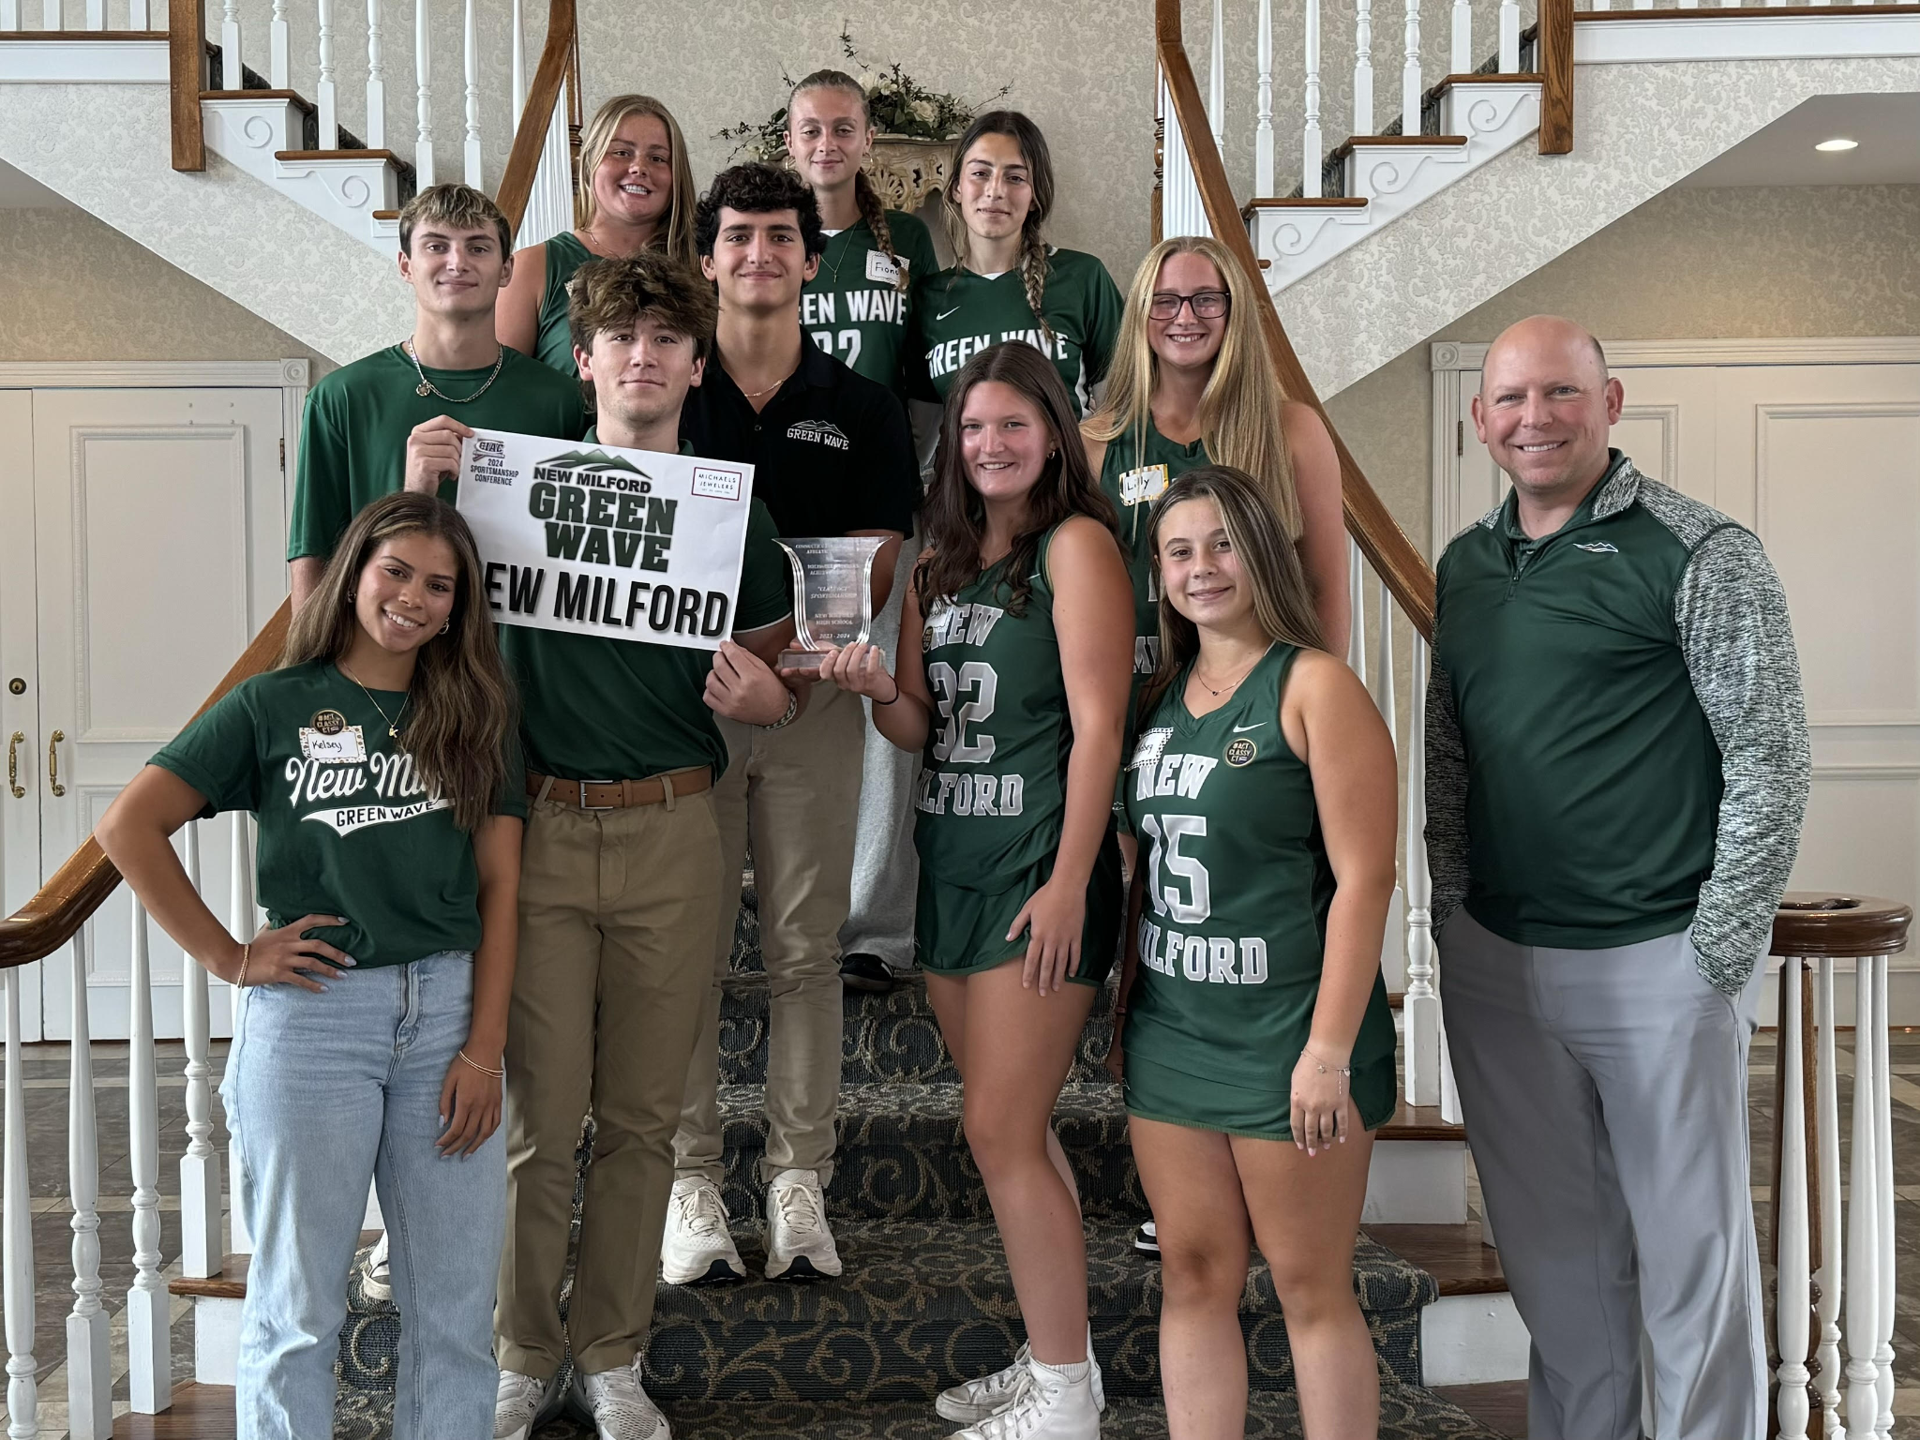
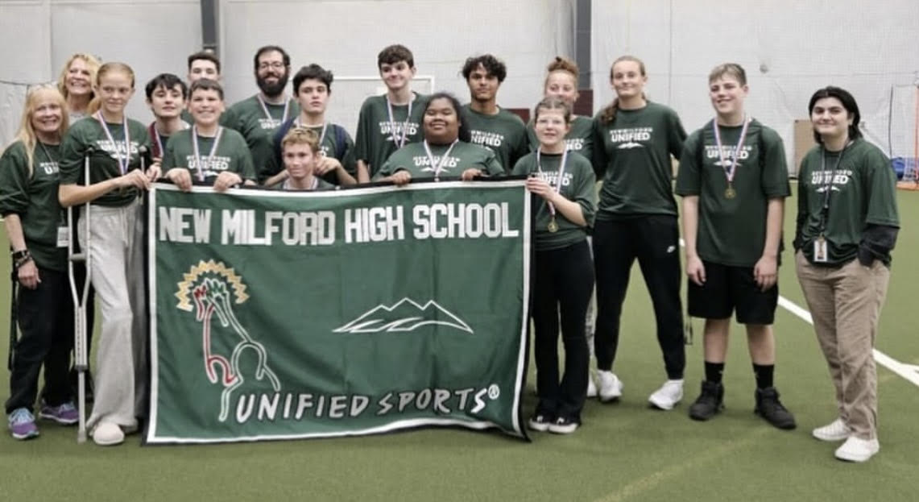
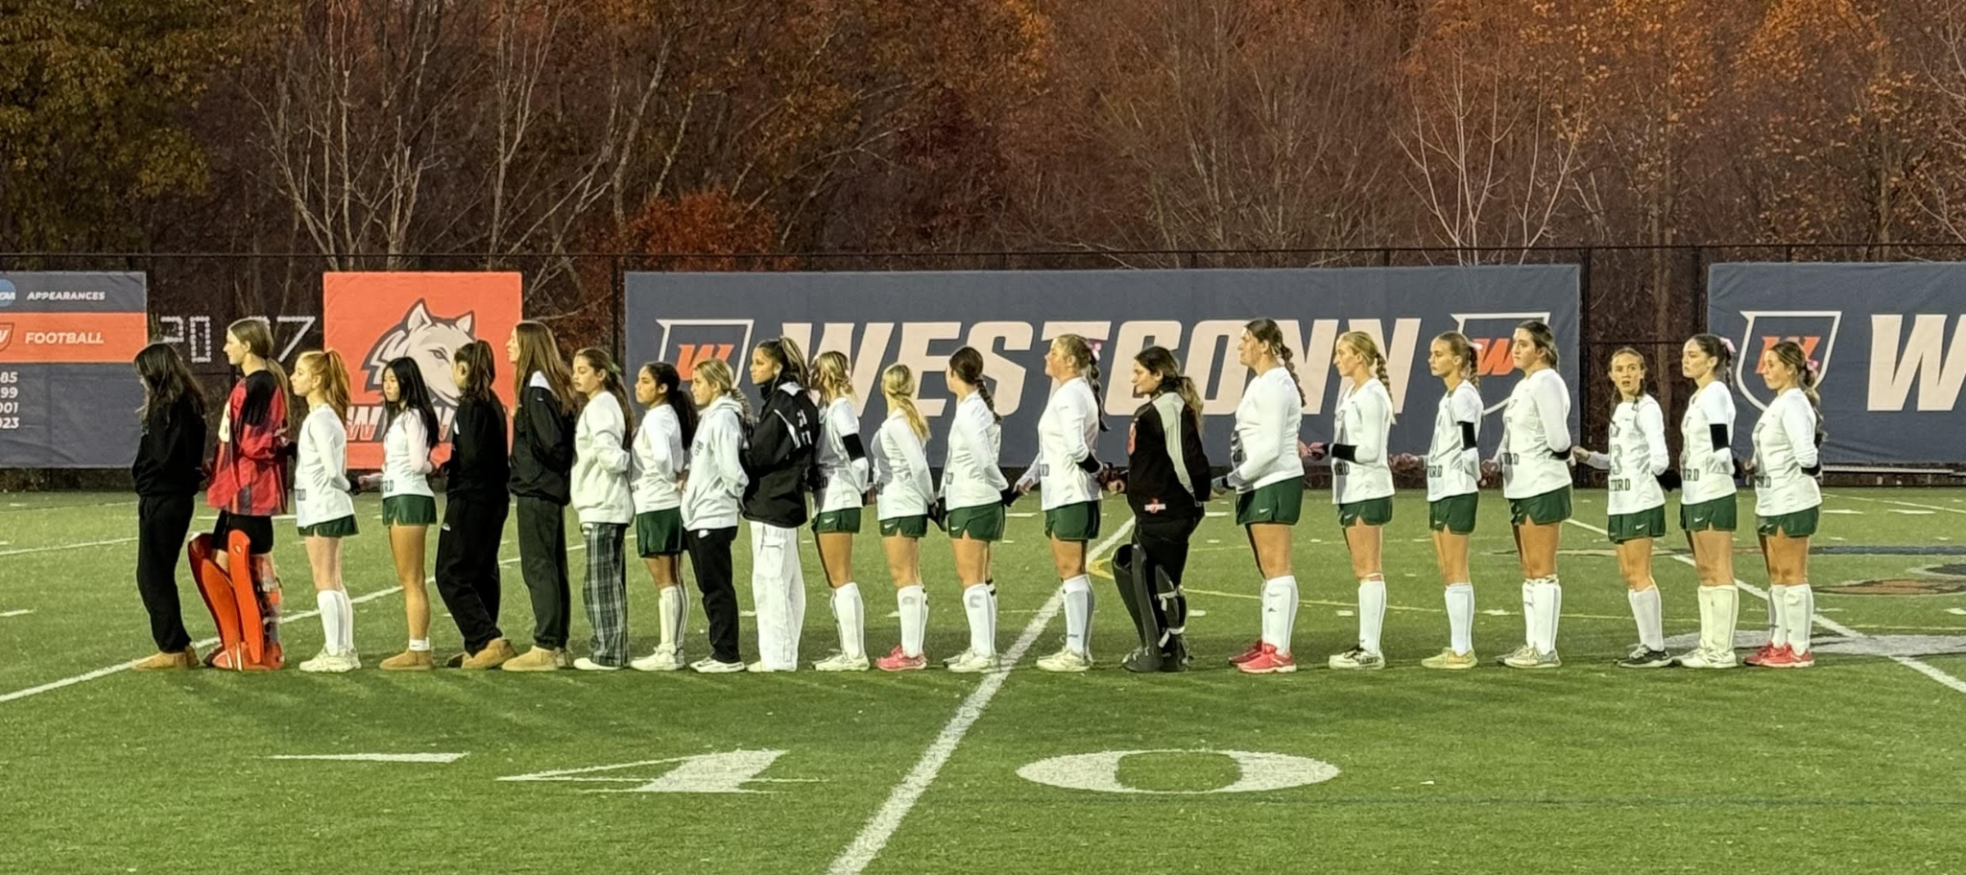
New Milford Public Schools
Budget Overview for 2025-2026
New Milford High School Athletics
New Milford High School
Keith Lipinsky - Athletic Director

Slide 15
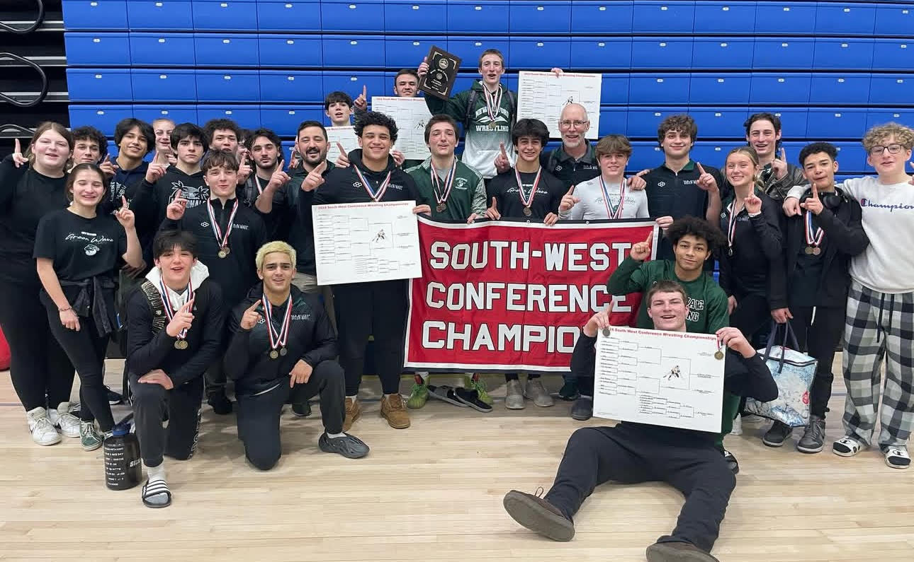
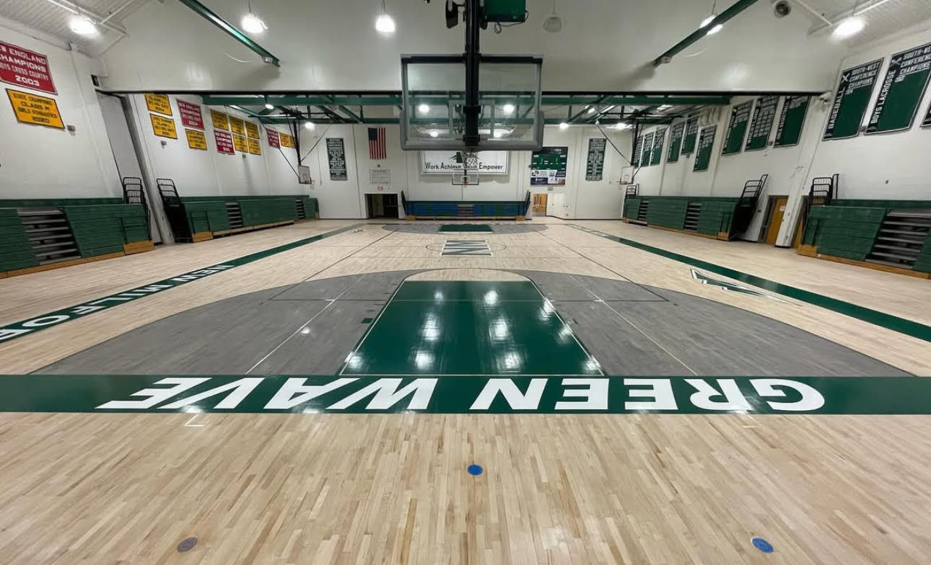
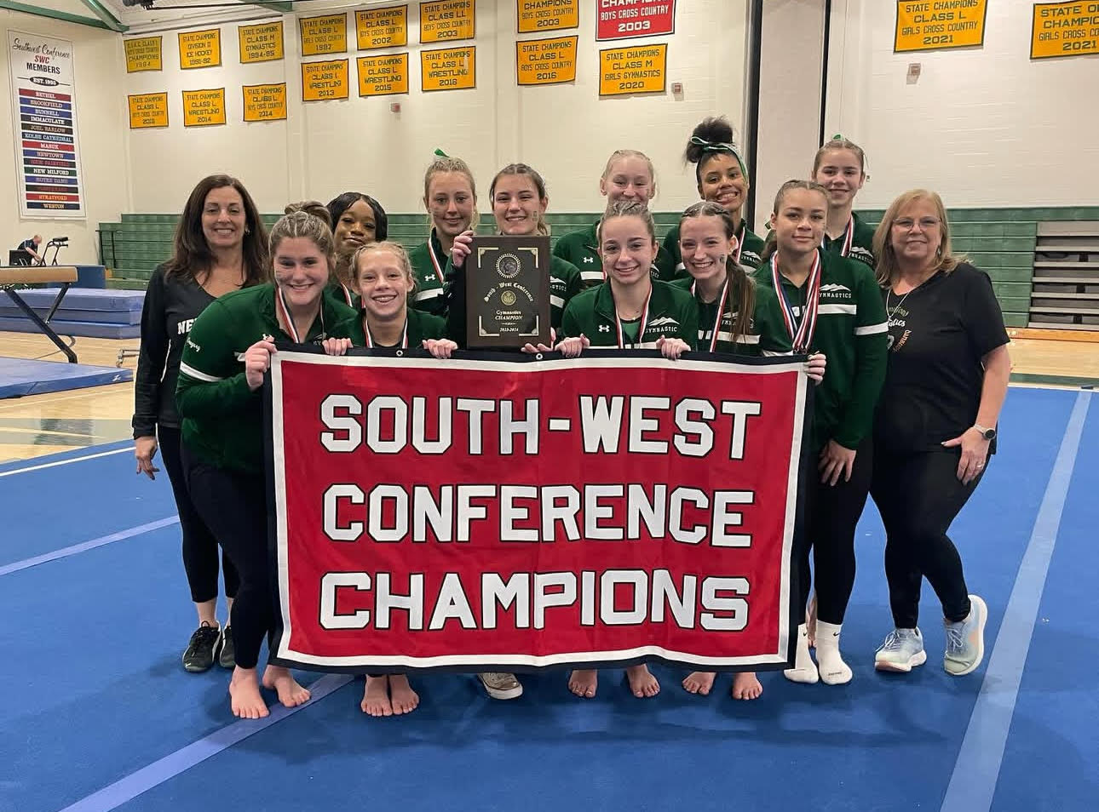
New Milford Public Schools
Budget Overview for 2025-2026
New Milford Public Schools Mission Statement and Ideas We Live By
The mission of the New Milford Public Schools, a collaborative partnership of students, educators, family and community, is to prepare each and every student:
To compete and excel in an ever-changing world;
To embrace challenges with vigor;
To respect and appreciate the worth of every human being,
To contribute to society by providing effective instruction and dynamic curriculum, offering a wide range of valuable experiences, and inspiring students to pursue their dreams and aspirations.

Slide 16
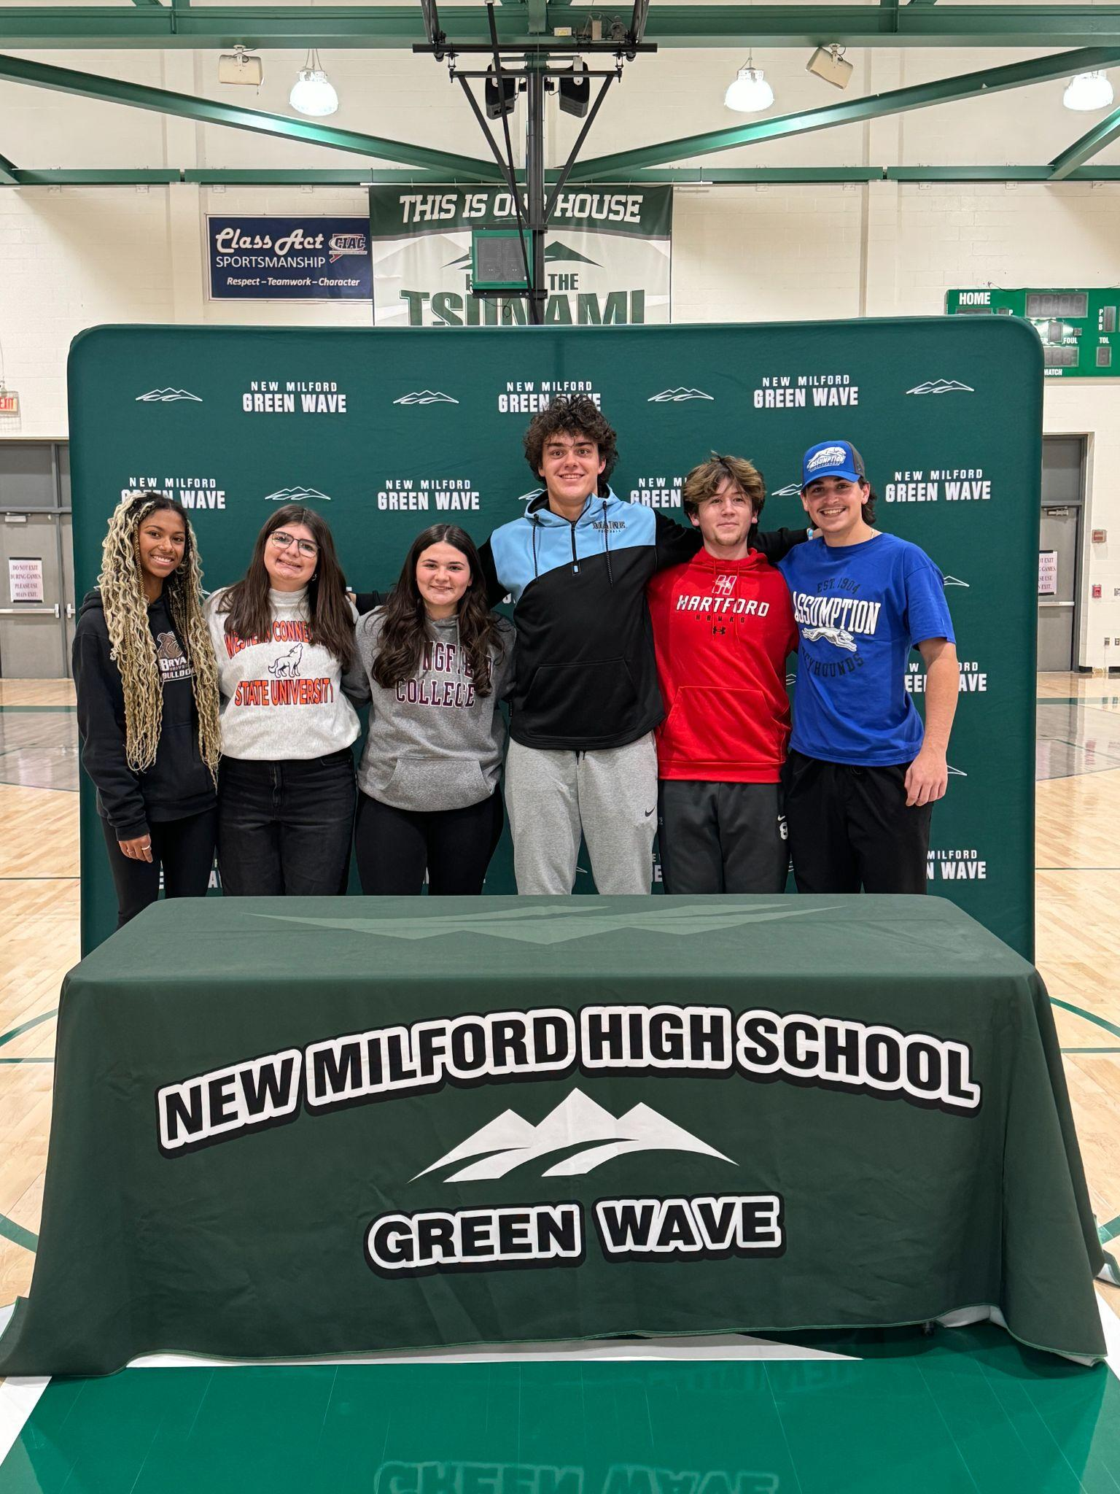
New Milford High School Athletic Beliefs:
High school athletics is an extension of our education where we learn sportsmanship, fair play, and respect for others.
Michaels Cup award recipient for the third straight year (2022, 2023, 2024) for the work we have done to promote sportsmanship, citizenship, community involvement, and positive school spirit.
Athletics reinforces the life skills of teamwork, self discipline, dealing with adversity, handling both success and failure, goal setting, time management, commitment/dedication, respect, integrity, responsibility, compassion

Slide 17
New Milford Public Schools
Budget Overview for 2025-2026
NMHS Athletics Sport Offerings - 2025-2026
Fall Sports Winter Sports Spring Sports
Boys Cross Country Boys Basketball Baseball
Girls Cross Country Girls Basketball Softball
Cheerleading Cheerleading Boys Lacrosse
Dance Dance Girls Lacrosse
Field Hockey Gymnastics Boys Tennis
Football Ice Hockey Girls Tennis
Golf Boys Indoor Track Boys Track and Field
Boys Soccer Girls Indoor Track Girls Track and Field
Girls Soccer Boys Swimming and Diving Boys Volleyball
Girls Swimming and Diving Wrestling
Girls Volleyball
*There were 575 student-athletes participating in athletics in the 2023-2024 school year (47.7% population)

Slide 18
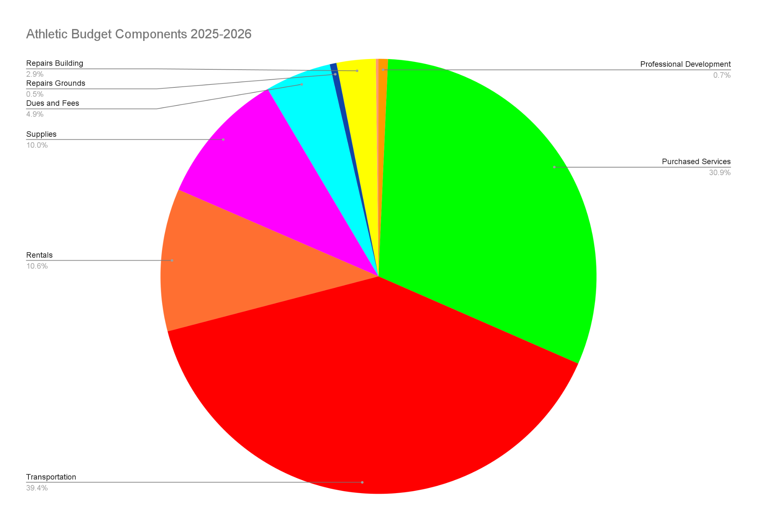
New Milford Public Schools
Budget Overview for 2025-2026
Athletic Budget Components - 2025-2026

Slide 19
Academic Eligibility for Student-Athletes
Academics is and should always be the #1 priority for all student-athletes at New Milford High School. We expect that our student-athletes pass all classes on their schedule. To ensure that the student-athletes at New Milford High School are performing well in the classroom and staying On Track to graduate, we have an academic eligibility plan in place for any student who may be struggling or having difficulty in his/her courses.
Periodic grade checks
Notification of student and coach any grade below a C
Student utilizes Flex time, after school to meet with teachers, make up work, etc.

Slide 20
New Milford Public Schools
Budget Overview for 2025-2026
NMHS Athletics
The 2025-2026 Athletics Budget Request ensures:
Equipment for our 28 Athletic Programs
Transportation to Away Athletic Events
Event Staffing including Referees, Police, Ambulance Services, Game Workers for Home Events
Dues and Fees for SWC and CIAC Membership, Tournament Entry Fees
Rental Fees for the sports of Golf, Boys and Girls Swimming, Ice Hockey, and Gymnastics

