Slide 1
Unit 4
Arrangement of Electrons in Atoms

Slide 2
Properties of Light
The wave description of light
Electromagnetic radiation–a form of energy that exhibits wavelike behavior as it travels through space.
Wavelike behavior—what does this include??
Reflection
Refraction
Interference
Together, all forms of electromagnetic radiation form the electromagnetic spectrum.

Slide 3
The electromagnetic spectrum

Slide 4
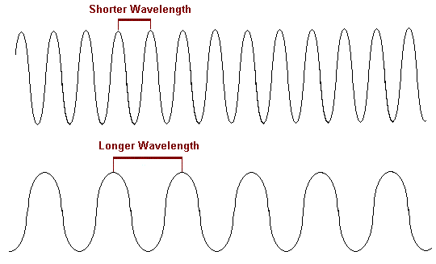
Wavelike behavior = repetitive nature
Wavelength (λ)
Expressed in m or nm.
Frequency(s⁻¹ or Hertz, Hz) —the number of waves that pass a given point in a specific time.
Shorter Wavelength = higher frequency
Longer wavelength = lower frequency

Slide 5
Frequency and wavelength
Mathematically related to each other.
c = λν
c = speed of light (2.998 × 10⁸ m/s) (constant)
λ = wavelength in meters (m)
ν = frequency in s⁻¹

Slide 6
practice
What is the frequency of green light, which has a wavelength of 4.90x10⁻⁷ m?
An X-ray has a wavelength of 1.15x10⁻¹⁰ m. What is its frequency?

Slide 7
practice cntd.
What is the wavelength of an electromagnetic wave that has a frequency of 78x10⁶ Hz?
A popular radio station broadcasts with a frequency of 94.7 MHz. What is the wavelength of the broadcast? (1 MHz = 10⁶ Hz)

Slide 8
Nuclear Atom and Unanswered Questions
Rutherford’s nuclear model of the atom was not complete:
Distribution of electrons?
What prevented attraction between nucleus and electrons?

Slide 9
The Photoelectric effect
In the early 1900s, scientists studied experiments that could not be explained by the wave theory of light.
The photoelectric effect—The emission of electrons from a metal when light shines on the metal.
Light must be at a minimum frequency to knock an electron loose from the metal
If light was wavelike only, any frequency of light would cause a loss of an electron.

Slide 10
Recall
What is the speed of an electromagnetic wave that has a frequency of 78x10⁶ Hz?
A popular radio station broadcasts with a frequency of 94.7 MHz. What is the wavelength of the broadcast? (1 MHz = 10⁶ Hz)

Slide 11
Max Planck
Studied emission of light by hot objects.
Proposed that hot objects do not emit electromagnetic energy continuously, but in small, specific packets called quanta.
A quantum is the minimum quantity of energy that can be lost or gained by an atom.
E = hν

Slide 12
Dual wave-particle nature of light
Light exhibits both wave and particle-like behavior
Each particle carries a quantum of energy
A photon is a particle of electromagnetic radiation having zero mass and carrying a quantum of energy.
E_{photon} = hv
Einstein—EM radiation is absorbed by matter only in whole numbers of photons.

Slide 13
Calculating the energy of a photon
What is the energy for the following photon?
1.05x10⁻⁷ m

Slide 14
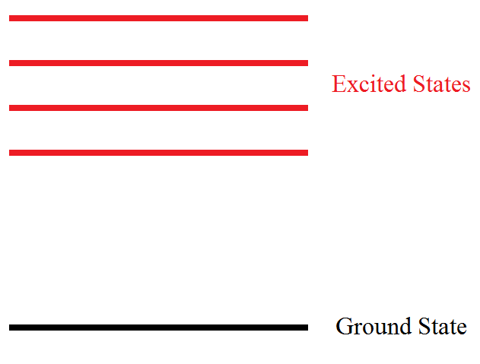
Atom Emissions
Ground state—the lowest energy state of an atom
Excited state—A state in which an atom has a higher potential energy than it has in its ground state
Different “jumps” of energy provide different frequencies of emission and therefore, produce different colors.
Photon
Photon

Slide 15
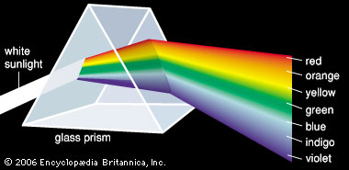
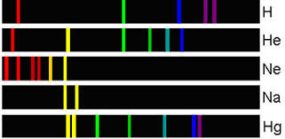
Line Spectra
A prism can separate light into isolated colors.
These separate colors are known as the line emission spectrum of that particular element.
Represents the spectrum of frequencies of EM radiation emitted.

Slide 16
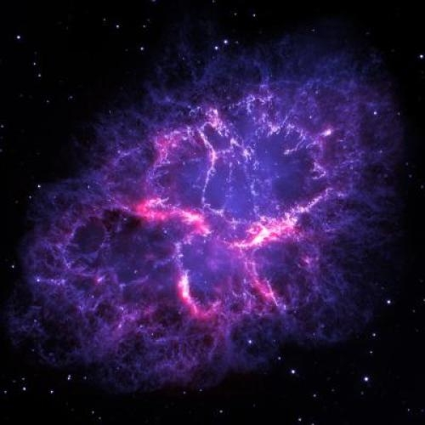

Slide 18
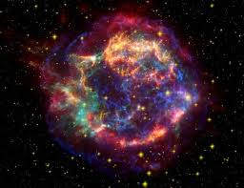

Slide 19
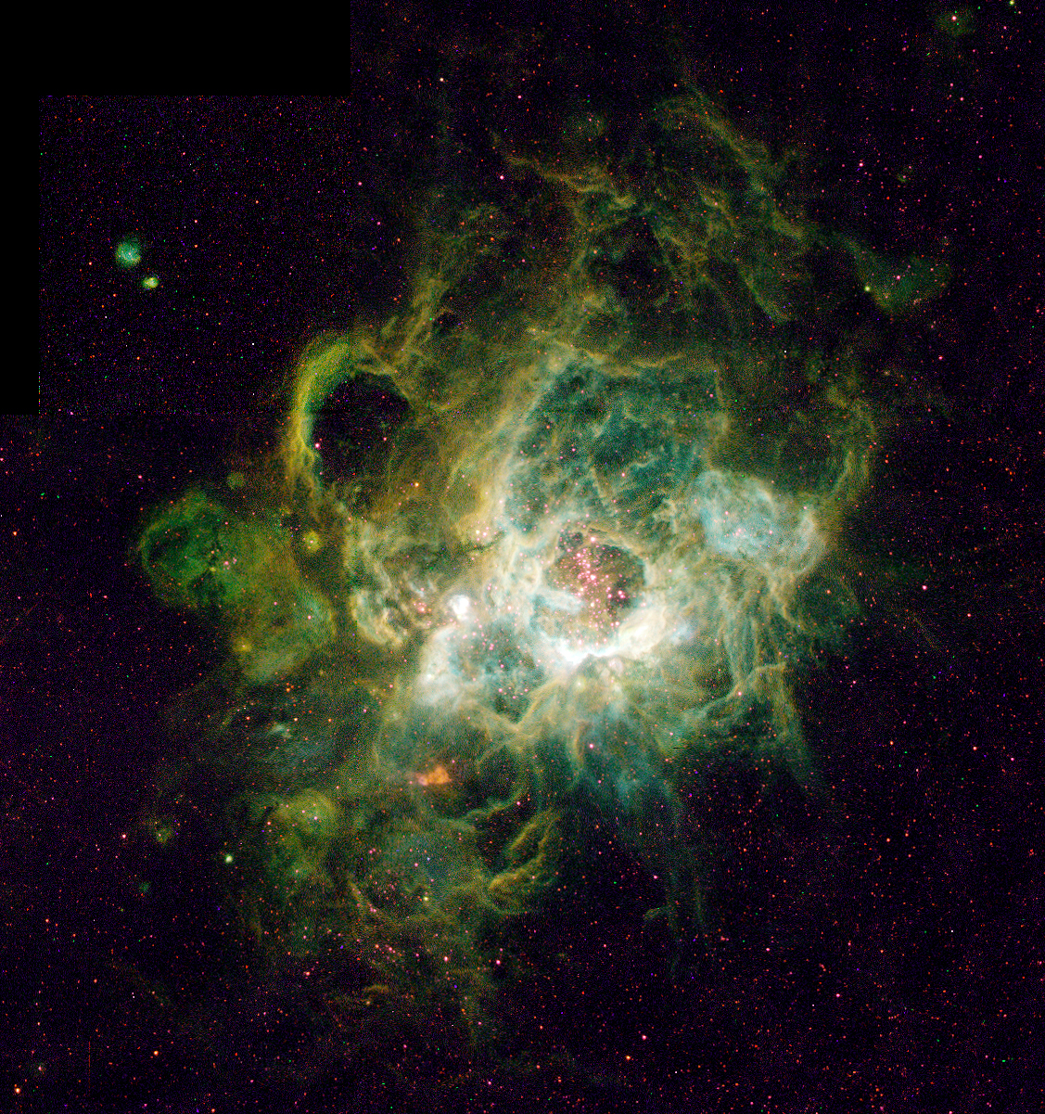

Slide 20
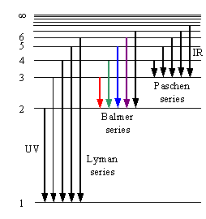
The Hydrogen Line emission Spectra
Three series
Lyman
Emission occurs in the ultraviolet region
Balmer
Visible light region
Paschen
Occurs in infrared region

Slide 21
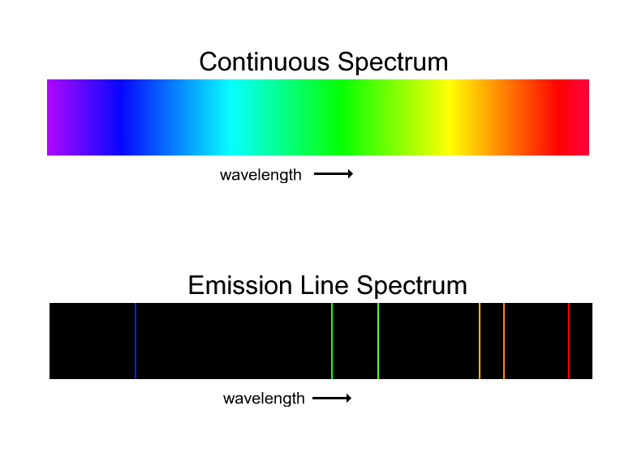
Wave theory—predicted H to have a continuous spectrum.
Quantum theory was developed to explain the line emission spectra of H.
Since H only emitted specific frequencies of light, the energy differences between energy states must be fixed as well.
Provided the idea for the Bohr model of the atom.

Slide 22
Bohr Model of Hydrogen atom
Niels Bohr model of the atom
Electrons can only circle nucleus in paths or orbits (like planets around the sun)
Each orbit level has a fixed amount of potential energy.
Electrons have higher energy the further away from the nucleus they are.
E₃
E₃
E₂
E₂
E₁
E₁
Absorption
Emission

Slide 23
One problem…
Bohr’s model only worked for Hydrogen, a single electron atom.
It did not apply to atoms with more than one electron.
Did not explain the chemical behavior of atoms

Slide 24
Section 2
The Quantum Model of an Atom

Slide 25
Why do reactivities of atoms vary?

Slide 26
Electrons as waves
1924—Louis de Broglie proposed that electrons also carried dual wave-particle nature.
Suggested that electrons behaved as waves in that they could only exist at specific frequencies.
These frequencies corresponded to the quantized energies of Bohr’s orbits.
How??
Combined Planck’s E = hc/λ and E = mc².
Suggested that anything with mass and velocity has a λ.
Therefore, electrons behave as waves also.

Slide 27
Heisenburg Uncertainty Principle
If electrons behave as both particles and waves, where are they in the atom??
Heisenburg Uncertainty Principle—it is impossible to determine simultaneously both the position and velocity of an electron or any other particle.

Slide 28
Schrodinger Wave Equation
Quantization of electron energies was a natural outcome of the equation.
Laid the foundation for quantum theory, which describes the wave properties of electrons mathematically.
Solutions are known as wave functions and give the probability of finding an electron in a given place around the nucleus.

Slide 29
Schrodinger Cont.
Proposed that electrons do not travel around the nucleus in neat orbits, such as the planets around the sun.
Electrons exist in regions called orbitals, or a 3D region around the nucleus that indicates the probable location of an electron.

Slide 30
Atomic orbitals and Quantum numbers
Quantum numbers—specify the properties of atomic orbitals and the properties of electrons in orbitals
Four numbers:
Principle quantum number—main energy level
Angular momentum—shape or orbital
Magnetic—orientation of orbital
Spin of electron—fundamental spin state of electron

Slide 31
Section 3
Electron Configurations

Slide 32
Electron configurations
What are they??
The arrangement of electrons in an atom
All electrons want to be in as low of an energy state as possible (ground-state electron config).
Simple rules allow us to easily determine the electron configs of atoms

Slide 33
Rules governing electron Configs
Aufbau principle—an electron occupies the lowest energy orbital that can receive it.
Pauli exclusion principle—no two electrons in the same atom can have the same set of four quantum numbers.
Hund’s rule—orbitals of equal energy are each occupied by one electron before any orbital is occupied by a second electron, and all electrons in singly occupied orbitals must bear the same spin state.

Slide 34
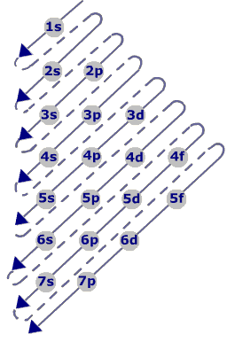
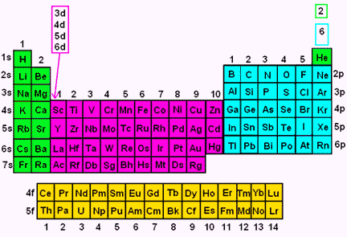

Slide 37
Representing Electron configs
Three ways
Orbital Notation—Uses arrows for electrons to show spin states.
Electron-configuration notation—number of electrons in a sublevel is shown as a superscript
Noble gas notation—symbol for noble gas is enclosed in brackets

Slide 38
Orbital diagram practice
Draw the orbital diagram for fluorine.
Draw the orbital diagram for bromine.

Slide 39
Electron configuration practice
Write the ground state electron configuration for nickel.
Write the ground state electron configuration for lead.

Slide 40
Noble gas notation practice
Write the noble gas notation for nickel.
Write the noble gas notation for lead.

