Slide 1
2nd/3rd grade open House
Mrs. Graham
Ms. Bozeman

Slide 2
Welcome
We are pleased to welcome you to the 2023-2024 school year! We are looking forward to having your child as a student. We will have a fun year with so many learning opportunities. We are committed to creating a classroom environment where your child is a valued, trusted, and essential part of our family of learners. It is our hope that you will support and encourage this vision at home as well.

Slide 3
Take Home Binder & Tuesday folder
Your child will have a binder that contains a number of resources such as word lists & math charts. This notebook should be brought to school daily with their behavior calendar.
Please check their binder daily to keep up with their behavior chart as well as for possible homework.
Students were given a Power School login. You will be able to log in at any time and view your child's grades.
Graded papers will be sent home weekly in Tuesday folders. Please sign the attached signature sheet and return papers the following day. Graded papers must be kept on file, therefore,failure to return graded papers will result in papers not being sent home.

Slide 4
Class Schedule
Mrs. Graham’s 2nd/3rd Grade Schedule
7:30-8:00 Breakfast/Character Education/Homeroom
8:00-8:30 3rd Grade SOAR Time (RTI Math)
8:30-9:30 3rd Grade Math
9:30-10:00 3rd Grade Science
10:00-10:45 Physical Education
10:45-11:00 3rd Grade Technology
11:00-11:20 Lunch
11:20-12:00 3rd Grade Social Studies/Technology
12:05-12:10 Transitional Time
12:10-12:40 2nd Grade SOAR Time (RTI Math)
12:40-1:40 2nd grade Math
1:40-2:10 2nd Grade Science
2:10--2:40 2nd Grade Social Studies
2:40-2:55 Daily Review/ Snack
2:55-3:00 Pack Up/ Load Buses

Slide 5
Class Schedule
Ms. Bozeman’s 2nd/3rd Grade Schedule
7:30-8:00 Breakfast/Character Education/Homeroom
8:00-9:30 2nd Grade Language Arts
9:30-10:00 2nd Grade SOAR/RTI
10:00-10:45 Physical Education
10:45-11:00 2nd Grade Language Arts
11:00-11:20 Lunch
11:20-12:05 2nd Grade Language Arts
12:05-12:10 Change Classes
12:10-2:40 3rd Grade Language Arts
2:40-3:00 3rd Grade SOAR/RTI

Slide 6
Discipline Plan
Mrs. Graham’s and Ms. Bozeman’s Discipline Plan In our classroom, we always work hard so that each child has an opportunity to learn in the best setting possible. This will require self-discipline from each student. Therefore, acceptable behavior will be rewarded while consequences are imposed for unacceptable behavior. Our Class Rules: Respect Others Work Hard Be Responsible Use Self-control Rewards for positive behaviors Special Privileges Stickers Small treats Prizes Participate in school-wide PBIS Consequences for negative behaviors Verbal Warning Color changed to yellow Student/Teacher Conference Color changed to red Parental Contact: Parent Square, e-mail, or phone call Office Referral

Slide 7
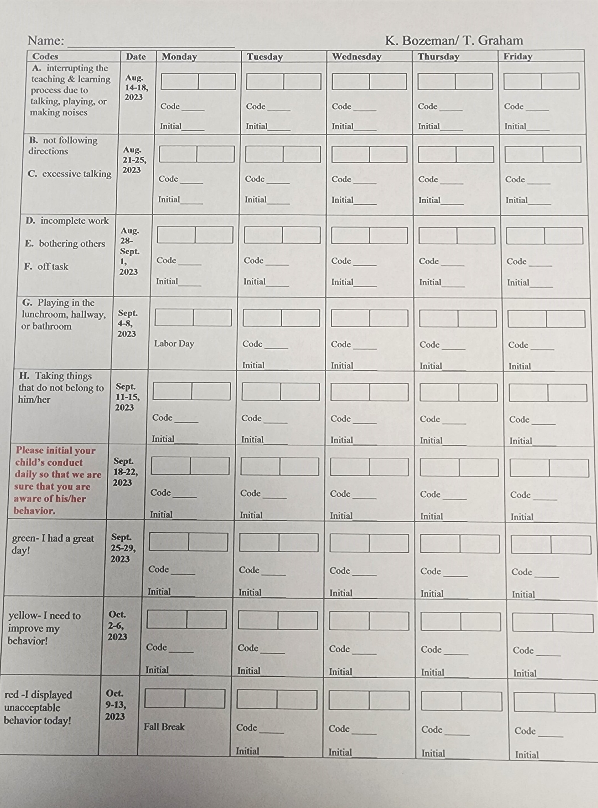
Discipline Plan

Slide 8
2/3 Grade Supply List
2023-2024
1 binder- 1 in. with pockets and clear sleeve on front cover
2 wide ruled composition books
2 packages of white copy paper
1 pack of wide ruled notebook paper
1 large pack of pencils
1 box of 24 count crayons
1 zipper pencil pouch with 3 ring binder holes
1 pair of headphones
1 bottle of hand sanitizer
1 box of Kleenex
1 container of Lysol wipes
1 roll of paper towels
Girls-1 box of quart Ziploc bags
Boys- 1 box of gallon Ziploc bags

Slide 9
Ways to contact Us
Email address:
Tameko.graham@acboe.net
Keviva.bozeman@acboe.net
You can also setup Parent Square to send and receive text or email message.

