Slide 1


Indian Creek Elementary
Title I Annual Parent Meeting
August 25, 2022

Slide 2

Purpose of Title I
Title I is a federally funded program under the Every Student Succeeds Act (ESSA)
The purpose of Title I under the ESSA is to ensure that all children have a fair, equal, and significant opportunity to obtain a high quality education and reach, at a minimum, proficiency on challenging state academic achievement standards and state academic assessments.
What is a Title I school?

Slide 3

Family-School Partnership Program
Ensuring that high-quality academic assessments, accountability systems, teacher preparation and training, curriculum, and instructional materials are aligned with challenging State academic standards so that students, teachers, parents, and administrators can measure progress against common expectations for student academic achievement.
Affording parents substantial and meaningful opportunities to participate in the education of their children.

Slide 4


We believe….
Parents play an integral role in assisting their child's learning.
Parents are full partners in their child's education and are included, when appropriate, in decision-making as well as being a part of the advisory committees to assist in the education of their child.
We encourage and invite
parents to be actively
involved in their child's
education at school.

Slide 5


Parent and Family Engagement Funds
Title I schools have to set aside money for parent and family engagement. Parents have input into how money is spent.
Budget for Title I parent involvement money:
        Teachers, Intervention Providers, and Parent Involvement Coordinator salaries
        Classroom materials
        Technology
        Parent Resource Center Items
        Materials for Parent Involvement
        Activities
2. How is the Title 1 and Family Engagement money spent?

Slide 6

Indian Creek’s Participation in Title I
Indian Creek Elementary, along with all schools in Coffee County, receives schoolwide assistance from Title I.
  Qualifications: Schools qualify for funds based on economic need.
  Schoolwide Requirements:
  Comprehensive Needs Assessment—The school must identify areas of greatest need.
    Schoolwide reform strategies
    Instruction by highly qualified teachers
    Professional learning for teachers
    Parent involvement strategies
How does our school participate in the Title I program?
What are our school’s Title I requirements?

Slide 7


Designation Status of ICE
Due to the implementation of the new federal law, the Every Student Succeeds Act (ESSA), the designations of Priority Schools and Focus Schools as well as the Flexible Learning Program (FLP) are no longer required after the 2016-2017 school year.
Beginning in the 2018-2019 school year, the Georgia Department of Education will use a new method to identify schools that need additional support and improvement. As required by ESSA, the new designations will be:
Comprehensive Support and Improvement (CSI) schools
Targeted Support and Improvement (TSI) schools.

Slide 8


Our School-wide Plan at ICE
            A schoolwide plan has been developed based upon:
            Needs assessment completed in the Spring of 2022.
Parent Advisory Committee
Revisions Meeting
Suggestions made by parents
5. School-wide Program

Slide 9

Our School-wide Plan at ICE (cont’d)
Goals for the upcoming school year:
  In grades 3rd-5th, increase the number of students scoring level 3 and level 4 on the Georgia Milestones Assessment in ELA, Math, and Science by 4% using the Spring 2022 Milestones score as a baseline.
  Increase the overall performance of subgroups by 3% on GMAS using Spring 2022 GMAS data as a baseline. (English Learners, Students with Disabilities, Black, Hispanic, and Mixed Races)
  In 2nd-5th Grades, 75% of students will meet their individual literacy goal as measured by Renaissance Learning. (STAR Assessment)
  To help us reach these goals, we will connect with families by…
  Conducting Family Night Programs (homework & study skills, reading, math,
  social studies and science)
  Provide monthly school newsletters
  Hold Parent/Teacher Conferences
  Provide parents with learning materials that can be checked out from the Parent Resource Center
5. Explain what the schoolwide program is and how the schoolwide plan will be assessed for effectiveness

Slide 10

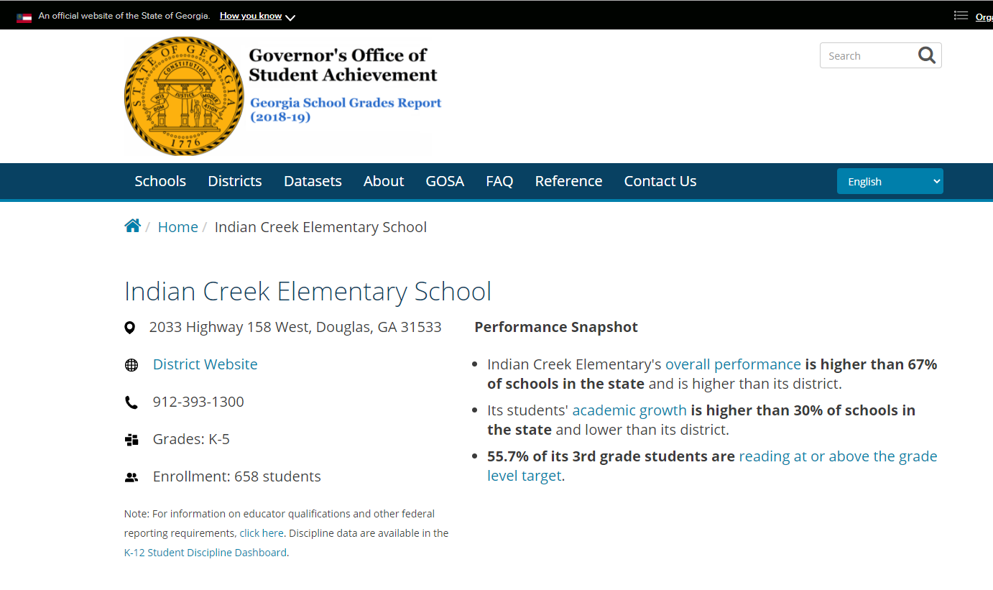
School Wide Program- Past and Present
https://schoolgrades.georgia.gov/indian-creek-elementary-school
What is the state’s grades report for our school?

Slide 11
Title I Annual Parent Meeting
Curriculum | Ga. Standards of Excellence
Core Programs | Bookworms, Journeys, Envision Math, Stemscopes, Social Studies Weekly, Developing Strategic Writers with Dr. Zoi Philippakos
Additional Programs | System 44, Read 180, iRead, ESOL support, IXL, Study Island, Reflex Math, etc.
Assessments | GKIDS, DIBELS, STAR Reading, Math Computation, GA Milestones Assessment, ACCESS Testing for ESOL students
Spring GMAS Testing Dates | April 25-May 4, 2023
What curriculum does our school use?
What tests will my child be taking?

Slide 12

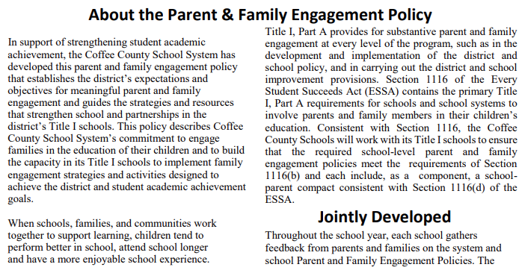
District Parent & Family Engagement Policy
https://tinyurl.com/3824f2hs
8. What is required by law for Parent and Family Engagement?

Slide 13

District Parent & Family Engagement Policy
https://tinyurl.com/3824f2hs
8. What is required by law for Parent and Family Engagement?

Slide 14
District Parent & Family Engagement Policy
https://tinyurl.com/3824f2hs (English)
https://tinyurl.com/3byvvm8y (Spanish)
8. What is required by law for Parent and Family Engagement?

Slide 15



ICE’s Parent and Family Engagement Policy
Jointly developed between school and families
Revised yearly
Content and purpose of the policy and compacts
Copies of the Parent Involvement Policy and the
Parent Compacts can be found on our school
website and in the front
office.
8. What is required by law for Parent and Family Engagement?

Slide 16





Parent and Family Engagement Compacts
Gr. K-2
Gr. 3-5
8. What is required by law for Parent and Family Engagement?

Slide 17
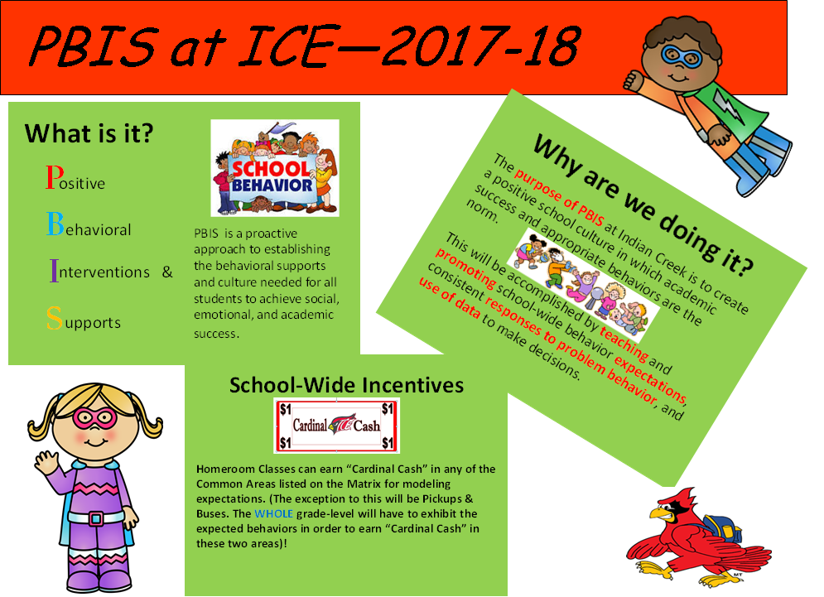
PBIS at ICE

Slide 18
Parents’ Right to Know
Right to request teacher and paraprofessional qualifications
Notified if child has been taught by a non-highly qualified teacher for more than four weeks
ESSA allows us to follow Georgia’s Intradistrict Transfer option.
9. Does my child’s teacher meet professional qualifications? What is a parent’s right to know?

Slide 19
Parental Rights
Parents have the right to become involved in the school
Parents have the right to request opportunities for regular meetings to formulate suggestions and to participate, as appropriate, in decisions about the education of their children
The school must respond to any such suggestions from parents as soon as practicably possible
9. Does my child’s teacher meet professional qualifications? What is a parent’s right to know?

Slide 20
Family Engagement Opportunities
OPEN HOUSE
AUGUST:
  Annual Title I Meeting & Back to School Bash
SEPTEMBER:
  ESOL OVERVIEW
  PARENT/TEACHER CONFERENCES
OCTOBER:
  SPOOKY SCIENCE/STEAM NIGHT
DECEMBER:
  CREEK FAMILY CHRISTMAS
February:
  PARENT/TEACHER CONFERENCES
10. What opportunities does the school provide for family engagement?

Slide 21
What Research says…
When parents are involved, students achieve more, regardless of socio-economic status, ethnic/racial background, or the parents’ education level.

Slide 22
Ways parents can monitor their
children’s progress:
    Progress Reports sent home every 4 ½ weeks
    Report Cards send every 9 weeks
    Parent/Teacher Conference Days
    (Sept 13th, February 7th)
    Graded papers sent home weekly
    Appointments can be made with teachers (389-1300)
    Observe homework completion
    Access to Parent Portal
11. How responsive will the school be to my questions when staff is contacted?

Slide 23
Parent and Family Engagement Coordinator & Academic Coach
Works with the staff & parent advisory groups
Oversees the Parent Resource Center
Plans effective parent involvement nights and activities.
Family Engagement activities are based on the results of the spring parent survey.
Communicates with parents through KINVO, PeachJar, Facebook, and Class Dojo.
Please feel free to contact:
Kim Spain
Kim.spain@coffee.k12.ga.us or 389-6897

Slide 24
Mission:
“Destination Graduation
for College, Career and Life”
Vision:
“Creating a stronger community through an equitable and excellent education for every student.”

