Slide 1
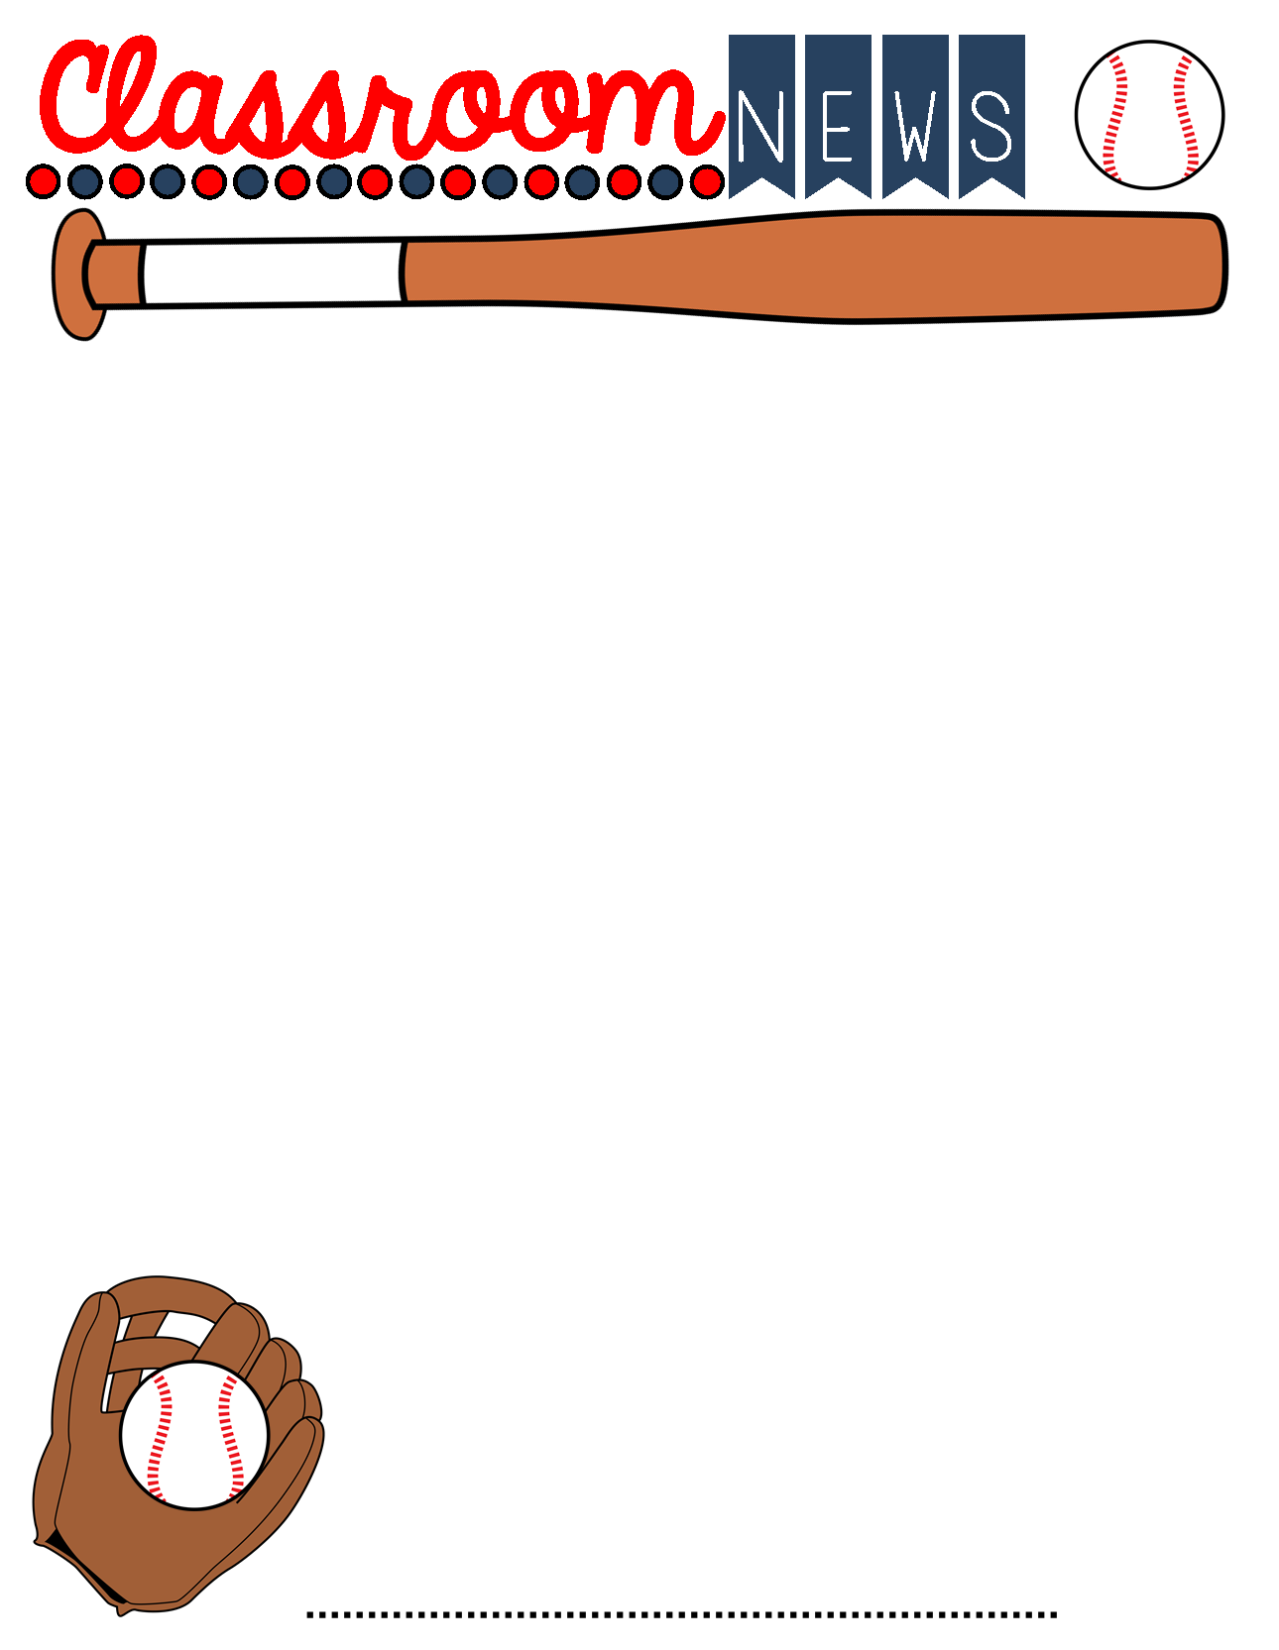
November 15th-19th
Important Info
Calendar
Parents,
I cannot believe we are beginning week 6 of the 2nd quarter. Please help me encourage your child to read over the Thanksgiving break. We are working hard to reach our AR goals.
If you have any questions or concerns, please contact me: pphillips@mcpss.com
Please be sure to send a note if your child is absent. After three days, it’s an unexcused absence.
Please Note:*Quiz = Minor grade *Test= Major grade
Good Luck to Bradlee and Julian! The school wide spelling bee is on Friday. We are rooting for you!
Monday, November 15th -homework assigned and sent home
Wednesday, November 17th - ICE CREAM DAY ($1.00)
Friday, November 19th – SNO CONES IN PE- Bring $3.00
Friday, November 19th - Homework Due
November 22nd-26th – Thanksgiving Holidays
This week:
Library- Wednesday
ART- Thursday
Congratulations to our November Character Kid: Natalie Johnston
What We Are Learning this Week
Reading – Novel-Magic Tree House: Thanksgiving on Thursday –
Sequencing Quiz- Wednesday Book TEST Thursday
Language Arts- Similes and Metaphors – Quiz Wednesday
Math- Basic Division with remainders- Test Wednesday
Multiplication Drill Thursday (will include 10,11, and 12 facts) 6 minutes
Alabama History- Three Branches of Government- Test Thursday
Things to Know
*Please encourage your child to READ and practice their Multiplication and Division Facts EACH NIGHT.
Thanksgiving break would be the perfect time for reading a book. Your child has library books and will have an opportunity to check out more before the break.
Mrs. Phillips 4th Grade

