Slide 1
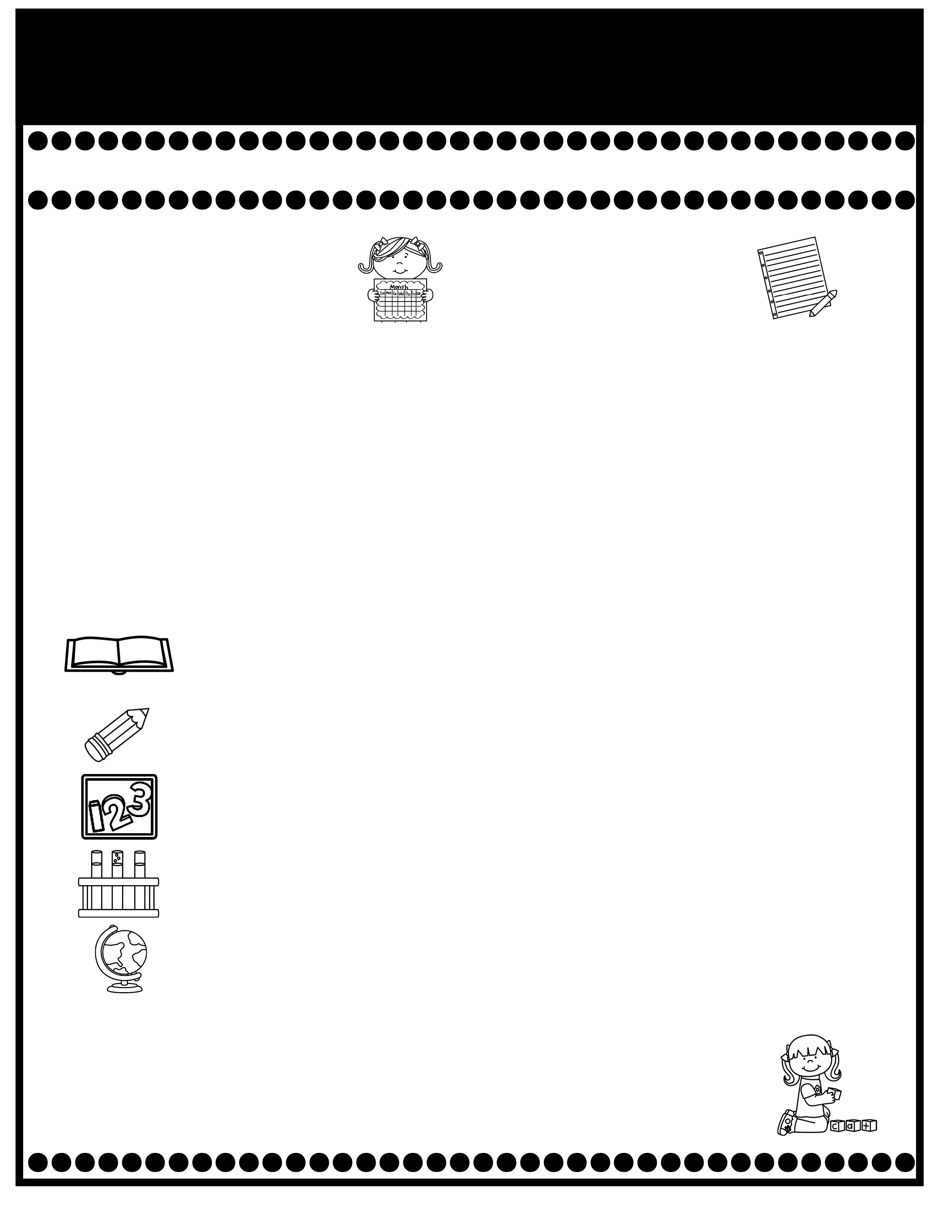
Branning’s Buzz
Week of: November 12-15, 2024
What’s Happening
This Week
Upcoming Events
Tuesday Folders will be sent home Tuesday.
Impact Aid Forms were sent home on Nov. 4th . Please
complete and return by Nov. 18th.
Please send in a dark gray long (or short) sleeve t-shirt labeled with your child’s name by Dec. 2 for our Christmas Program in December.
The cost for snack is $.1.00 each. Please send exact change.
A Weekly Reading Overview page will be sent home each week to help you practice skills and vocabulary words with your child. Also, nightly reading homework will be assigned in your child’s Take Home Binder. Please don’t remove pages.
Special Snack Friday: Slushy for $1.00.
Nov. 18-22 Book Fair in the Library
(Please send money in a labeled envelope.
Students won’t be able to check out books but will bring one from our class library home).
PPS Spirit Day: Nov. 22 Camo Day
Nov. 25-29 Thanksgiving Holidays
Please review test papers & return them to school. Sign the back of the folder. Please don’t take the test papers out. I keep them on file for the entire year. You don’t have to sign each test paper, unless I have stamped it.
If you have questions or concerns, you may email me at Wendy.branning@acboe.net.
A Peek At What We Are Learning
Reading | Phonics: v,-ve and y Comprehension: Sequence, Problem and Setting 1/15 Read the Words/Sentence & Comprehension Story
Writing/ Grammar | Imperative sentences, Writing: Prewriting, drafting, revising, editing Penmanship: Lowercase letters d and g 11/15 Dictation, Imperative Sentences grade,
Math | Topic 3: Addition Facts to 20 11/13 Topic 3 Test (Review pages will be sent home Monday & Tuesday for you to practice.
Science | The Design Process
Social Studies | NA (We will alternate weeks for SS/ Science).
Spelling Words
No Spelling Test will be given until Unit 7.
.

