Slide 1


VOICES FOR THE
VISION!!!
Shared Decision Making Parent Meeting

Slide 2
Agenda
  Welcome and Introductions
  Parent Input form
  Our FE Program (highlights)
  Achievement Data
  2026 Parent Survey Results
  Family Engagement Plan
  School-Family Compact
  Program Supports
NEXT

Slide 3
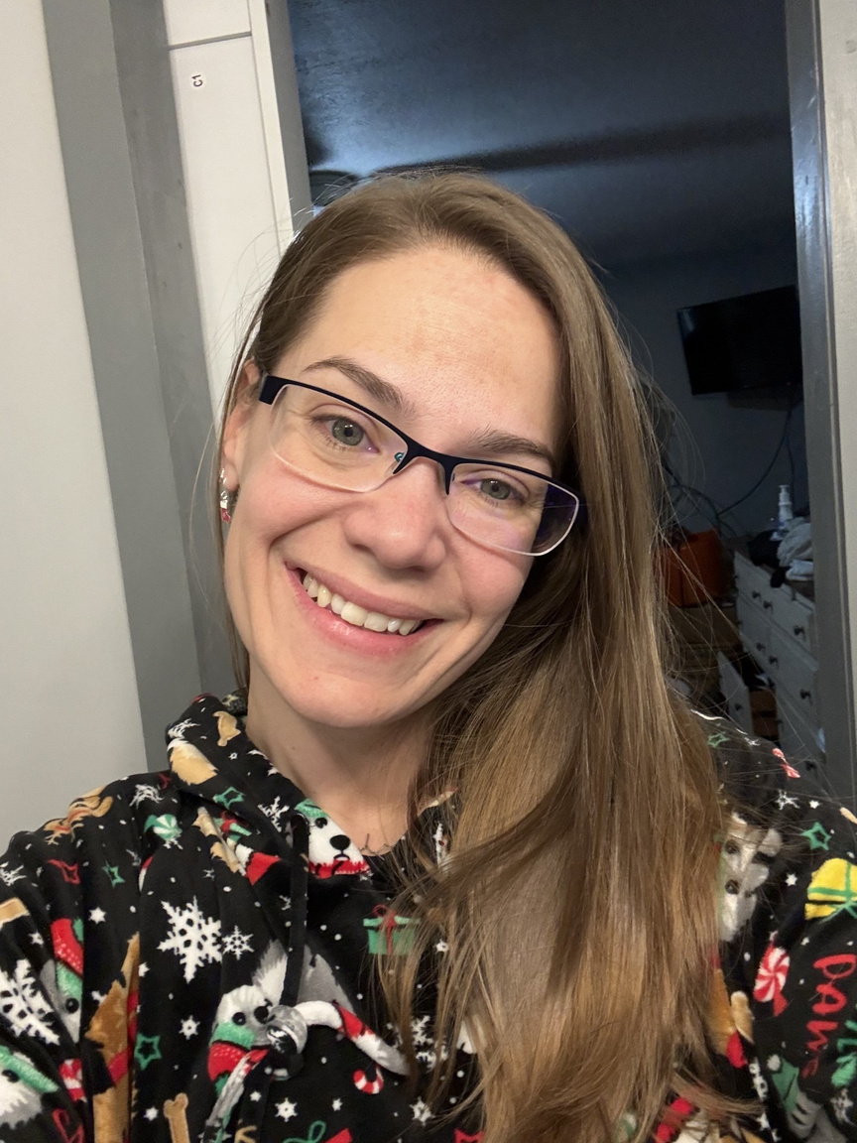
Welcome and Introductions
Hello everyone, I'm so glad that you're able to join me!
I’VE BEEN WITH CENTERVILLE ELEMENTARY SCHOOL SINCE 2024, WHICH MEANS THIS IS MY SECOND FULL SCHOOL YEAR WITH ALL OF YOU—AND I COULDN’T BE MORE EXCITED! 💙🐴
I’M LOOKING FORWARD TO CONTINUING TO BUILD RELATIONSHIPS WITH OUR FAMILIES AND STUDENTS. NOW I’D LOVE TO LEARN MORE ABOUT YOU!
TELL ME A LITTLE ABOUT YOURSELF—YOUR FAMILY, YOUR STUDENT(S), OR ANYTHING YOU’D LIKE ME TO KNOW. I CAN’T WAIT TO CONNECT! 😊

Slide 4
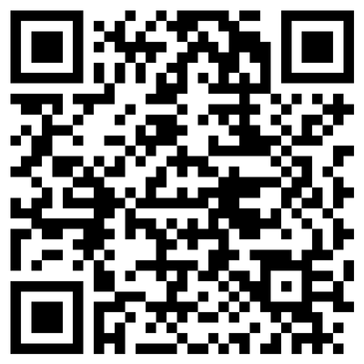

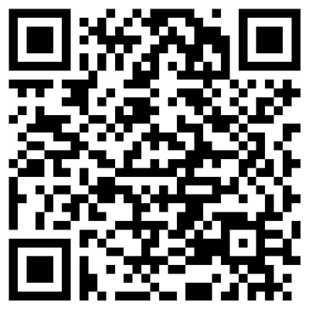
Parent Input Form
Paper Copy or QR Code
English
Espanol
Your input is extremely important to us! 💙
As we go through this presentation, please take a moment to record your responses on the Parent Input Form. Your feedback helps us continue to grow and strengthen our Family Engagement Program, making it the very best it can be for our students and families.
Thank you for partnering with us—we truly value your voice! 🐴✨

Slide 5
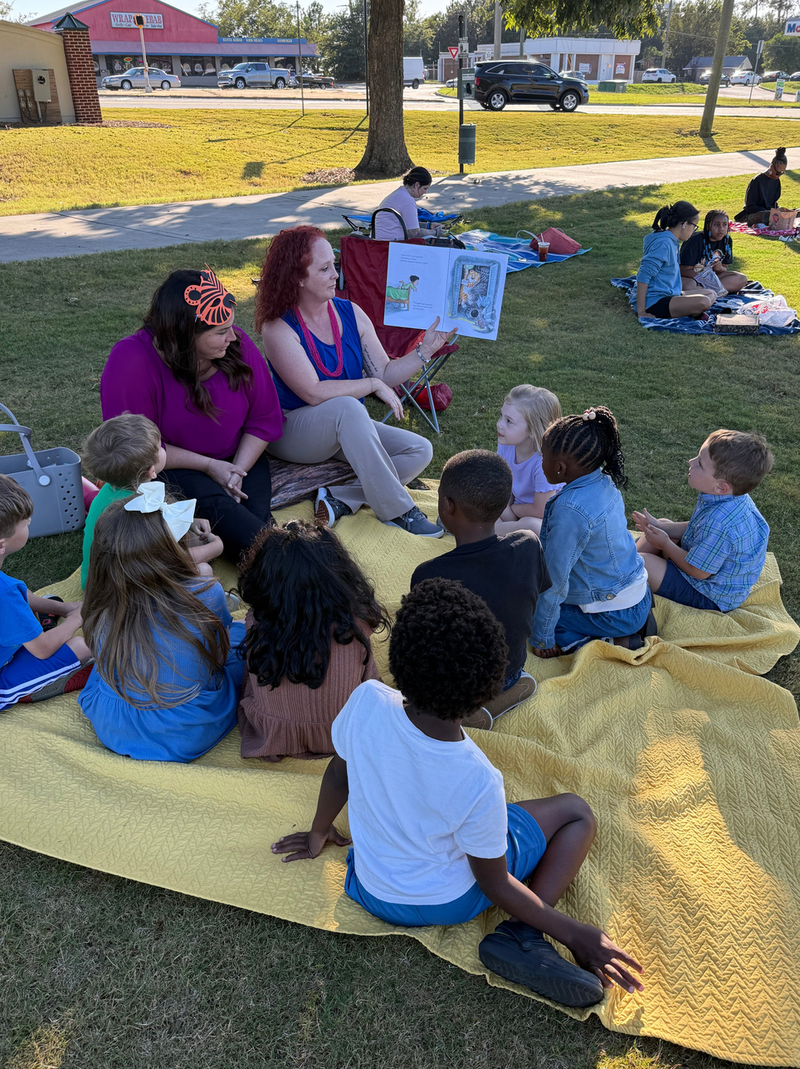
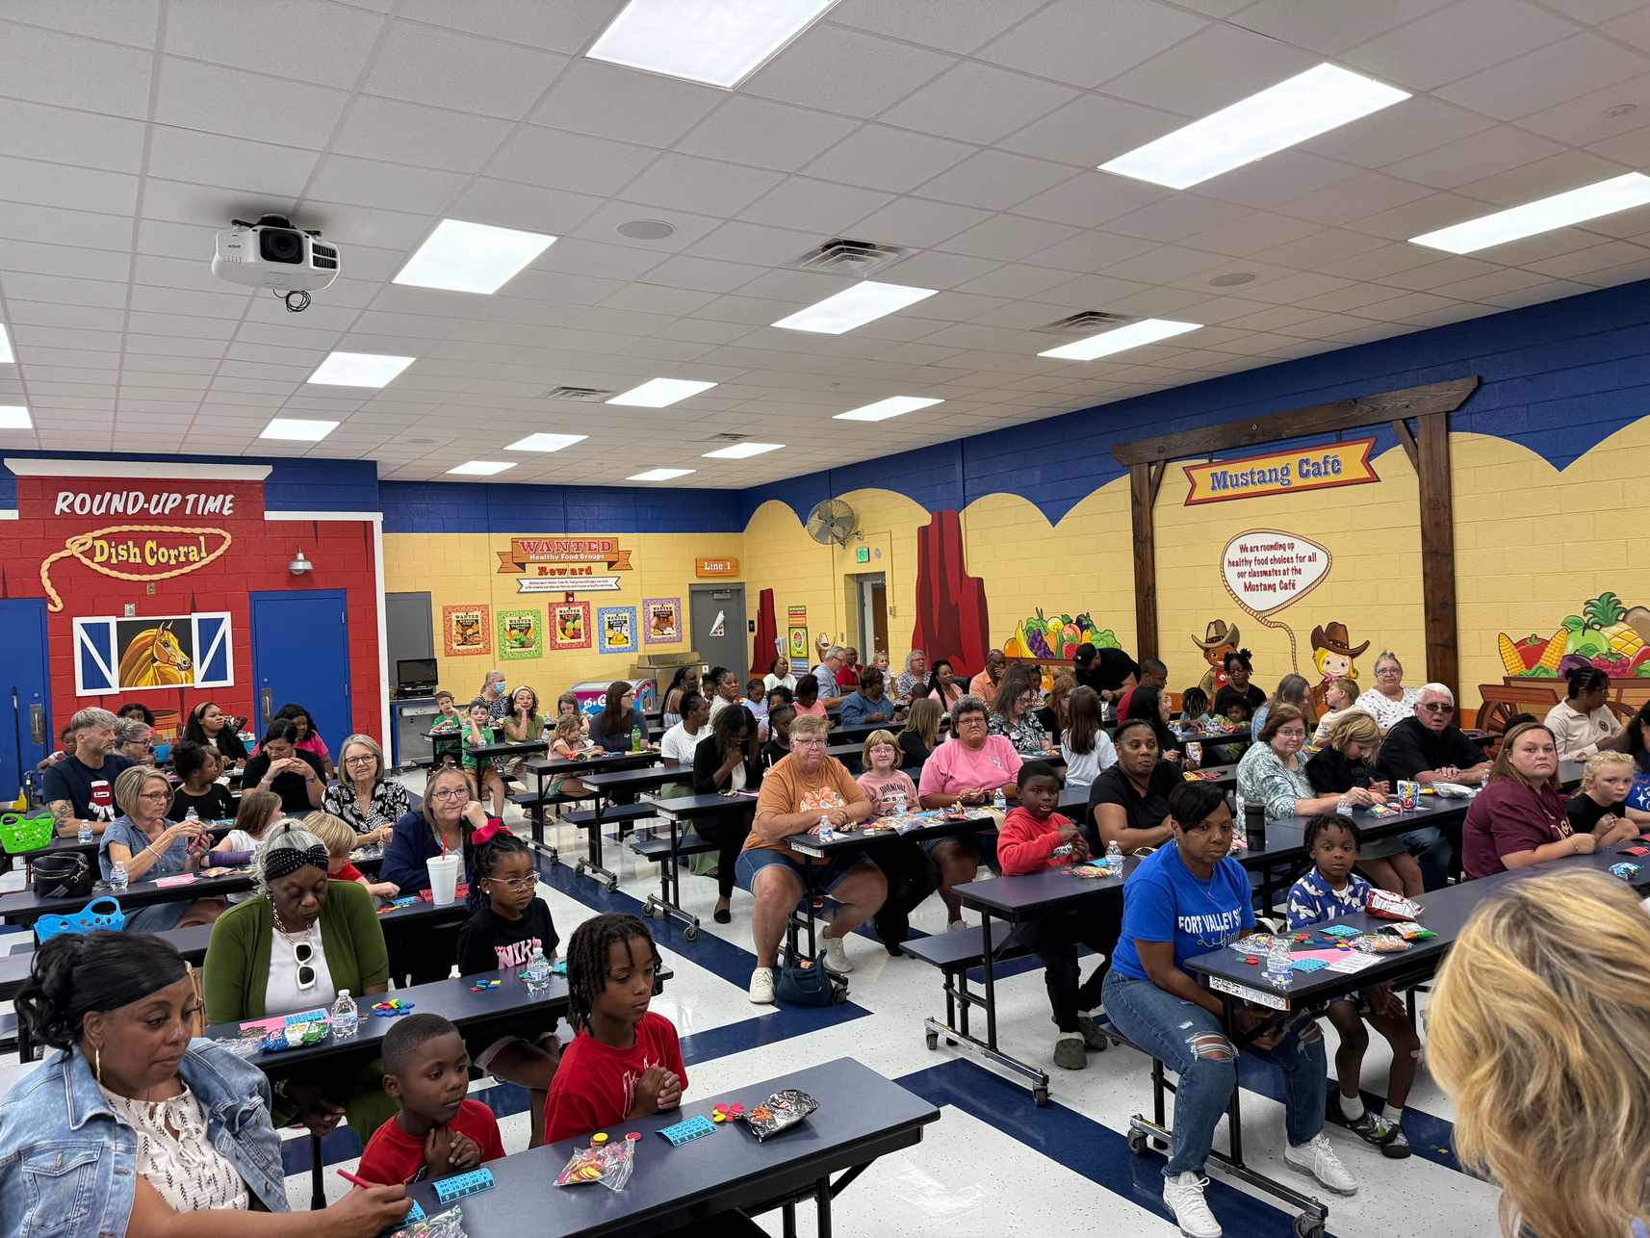
A Glimpse at Family Engagement at Centerville
Bingo
Book-Nic

Slide 6
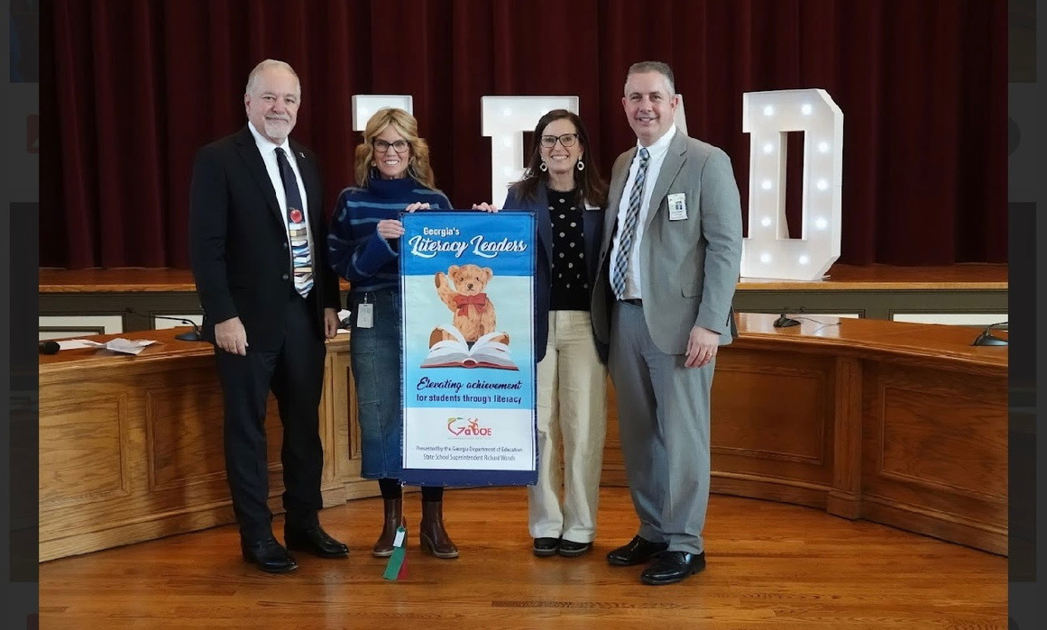
ACHIEVEMENT DATA
NEXT

Slide 7

2025-2026 Parent/Guardian Satisfaction Survey Results
Students Enrollment:
749 Students
416 Surveys Completed:
389 English
27 Spanish

Slide 8
I am comfortable communicating with administrators at my child’s school.
All/MOST OF THE TIME
91%
SOME OF THE TIME
8%
NONE OF THE TIME
1%

Slide 9
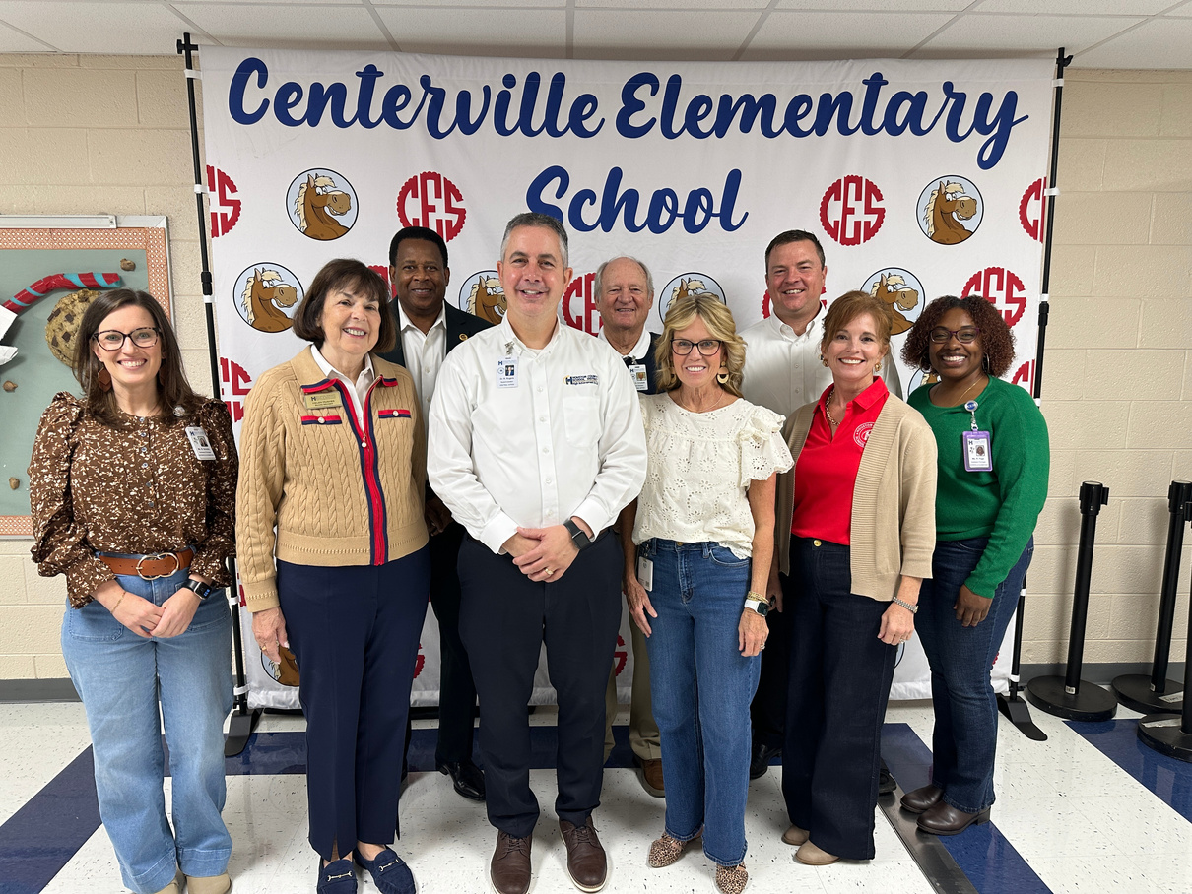
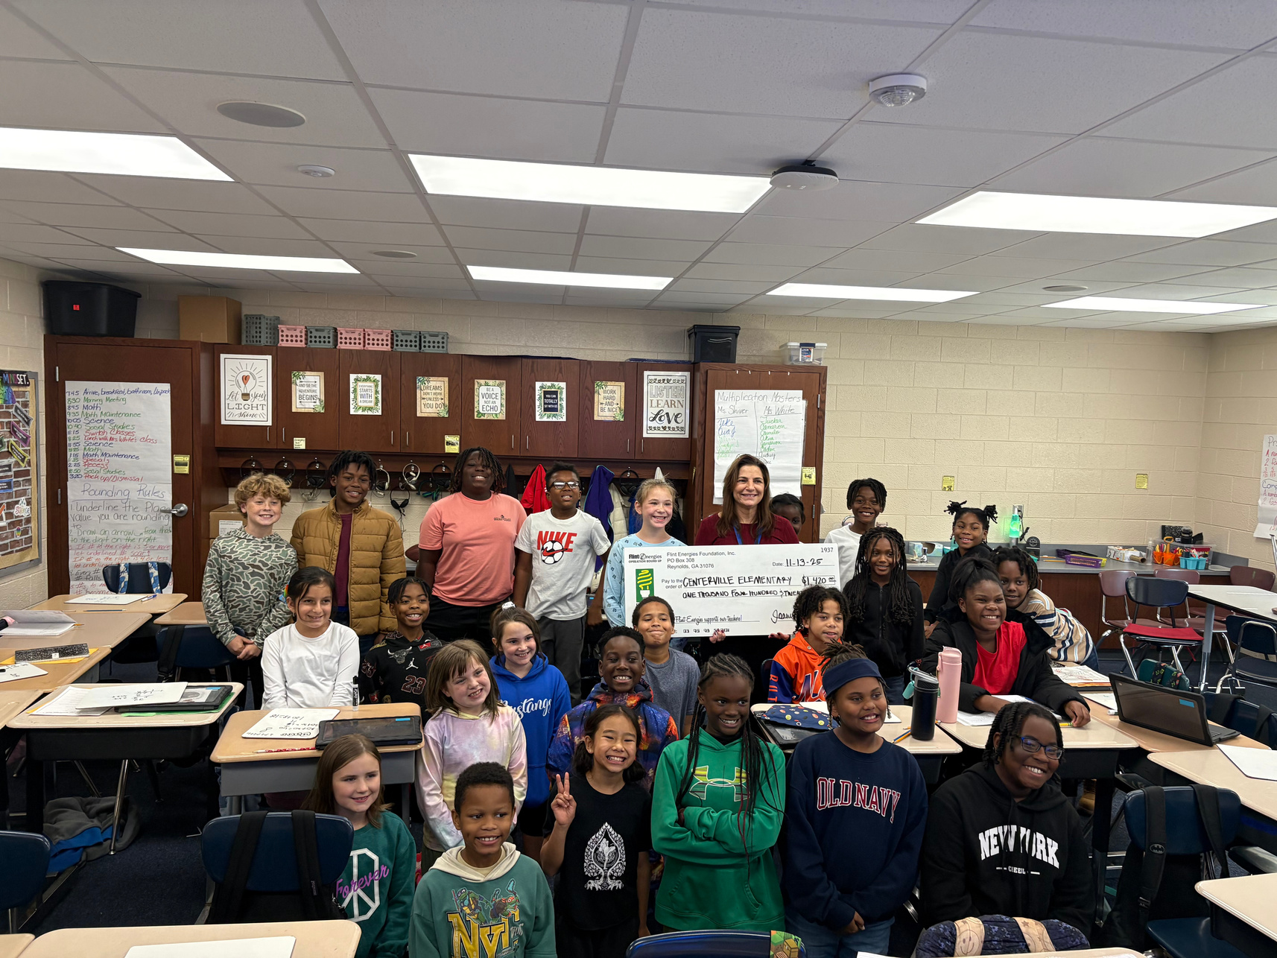
How would you like to see family
engagement funds used?
To Fund a Family Engagement Liaison who supports families and plas and executes family engagement activities and events.
29%
To provide academic materials for parents to use with their student at home.
29%

Slide 10

Preferred Method of Communication
TEXT MESSAGES
35%
HSCD APP
27%
EMAIL
19%

Slide 11

ADDITIONAL SUPPORT NEEDED TO ASSIST MY STUDENT
READING
30%
MATH
22%
ENGLISH/LANGUAGE ARTS
18%

Slide 12


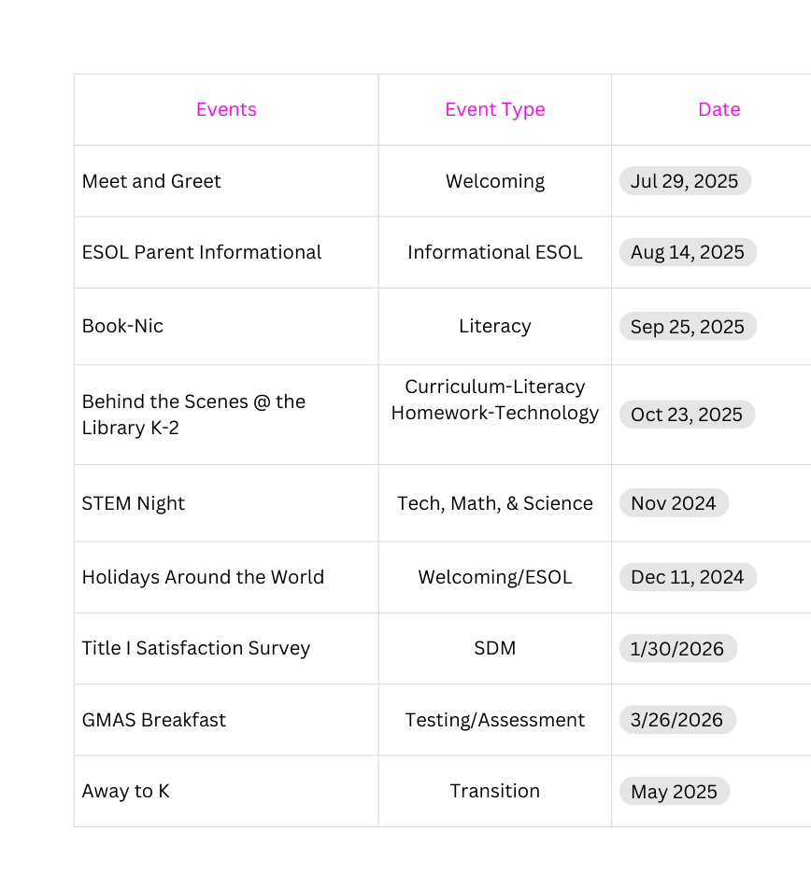
The Connection
Family Engagement Plan
We’d love to hear from you! 💙🐴
Were you able to attend any of our family engagement events this year? If so, what did you enjoy—and how can we make future events even better?
Looking ahead, what academic-based activities or family-fun events would you like us to consider offering? Your ideas help us plan events our Mustang families truly enjoy!

Slide 13
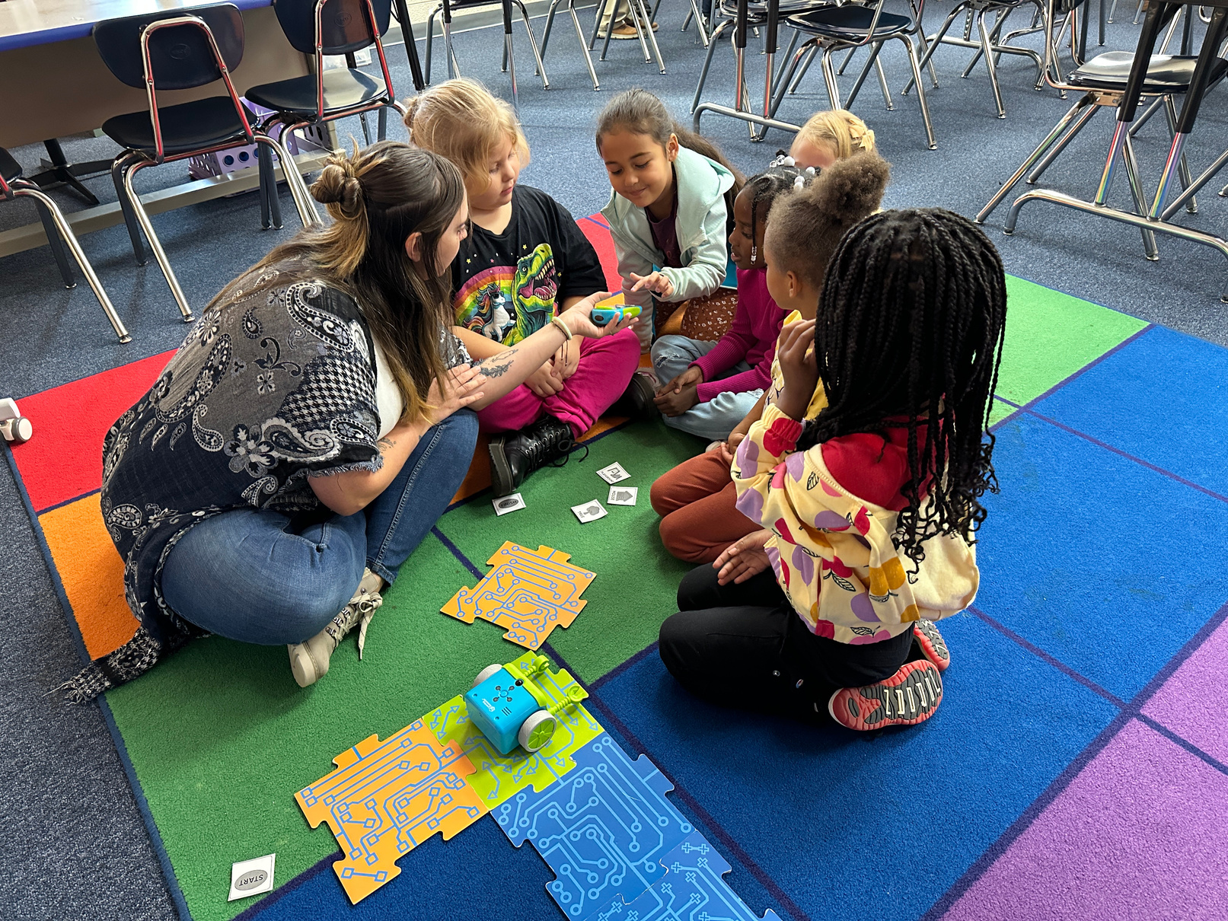
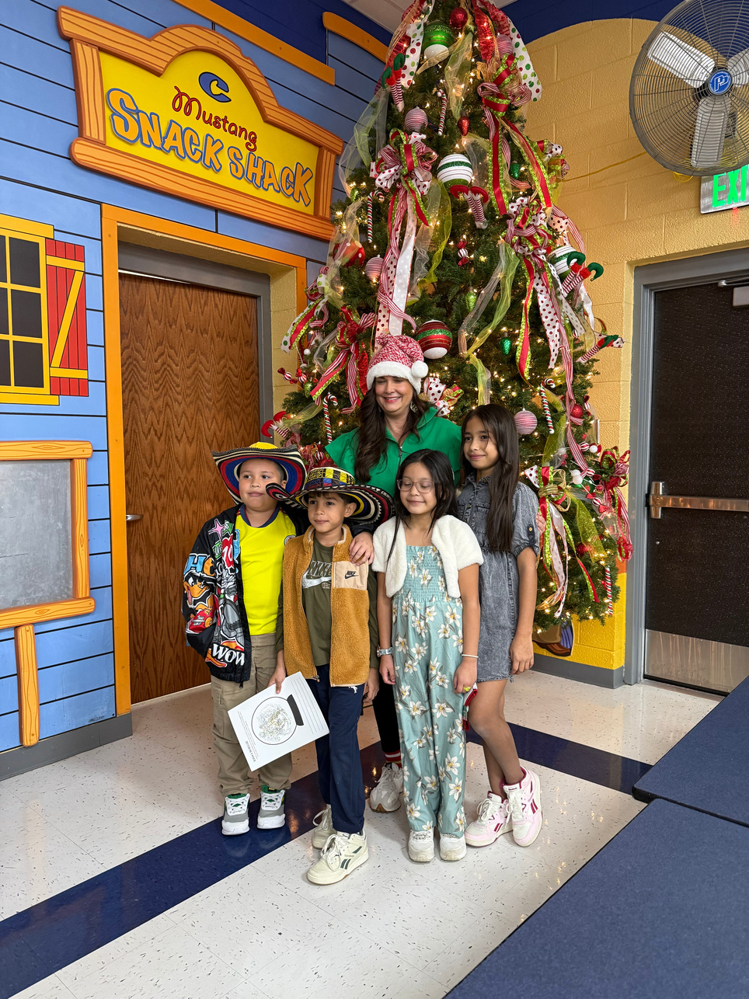
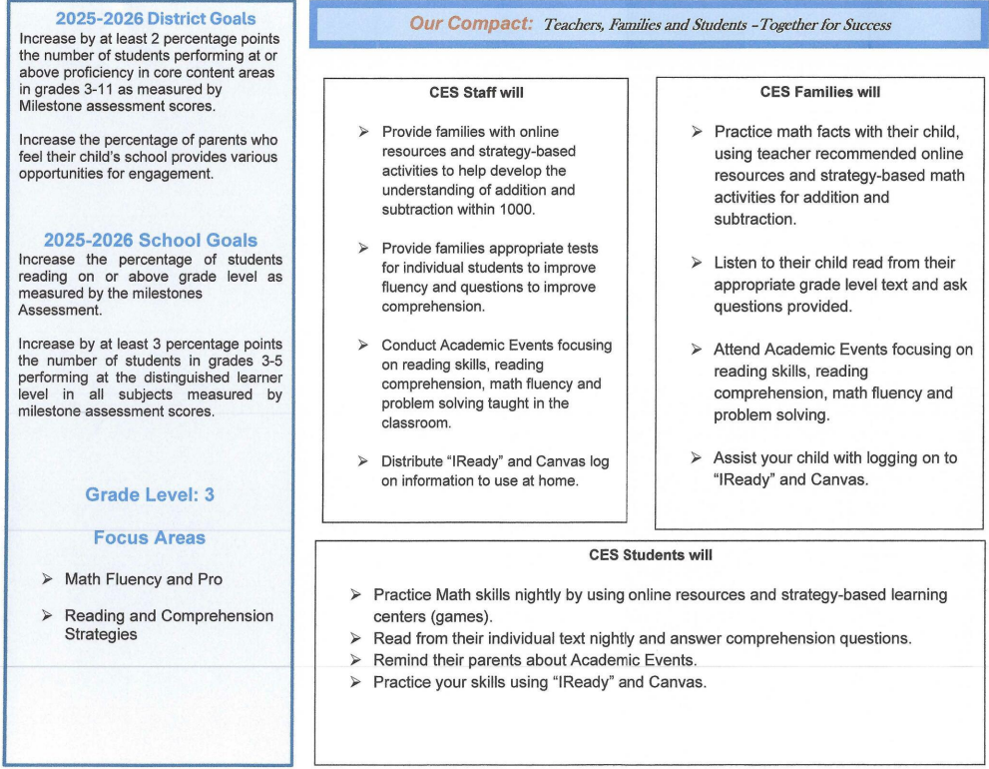

The Connection
School-Parent Compact
1️⃣ 😊 What subject or skill is the hardest for you at school right now?
2️⃣ 🏫💙 How can your school help you get better at this?
3️⃣ 📚👨‍👩‍👧 What are some things you and your family can do to help you improve?
(like practicing at home, reading together, or asking for extra help)

Slide 14
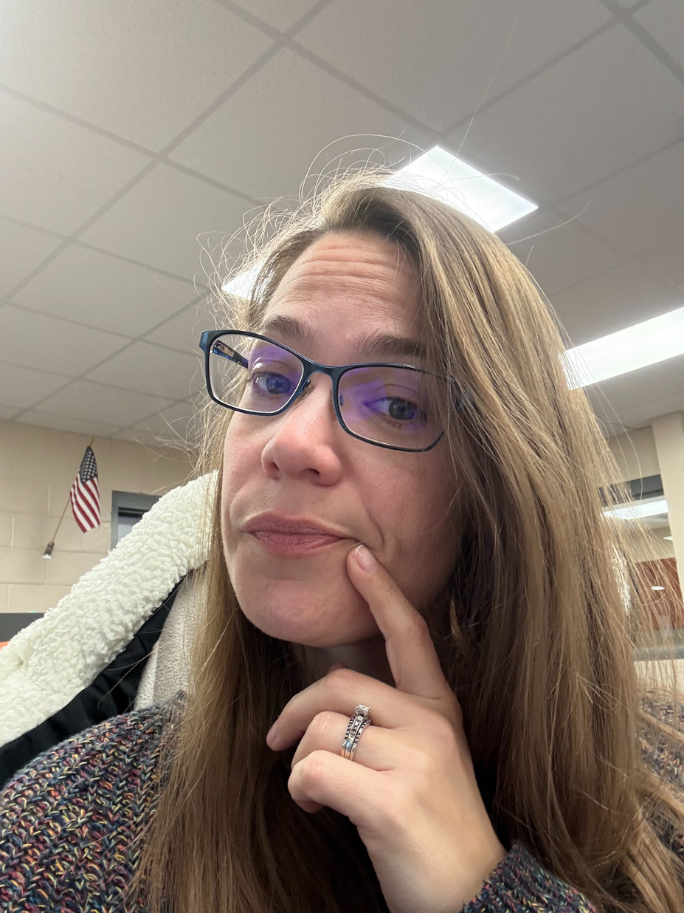
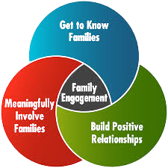
Program Supports
How can we make our school events and activities more welcoming and engaging for you and your family?
Suggestions on how the funds could be used to improve/support our Family Engagement Program.

Slide 15

FEL Contact Information
JESSICA GARDNER
EMAIL ADDRESS:
jessica.garder@hcbe.net
Please get in touch for any comments and questions
PHONE NUMBER:
478-953-0400 EXT: 1328

