Slide 1
Cell Structure and Function
Chapter 7

Slide 2
Life is cellular
Cell: smallest living unit of life.
The Discovery of the Cell
Early Microscopes (1500s)
1665 Robert Hooke—cork

Slide 3
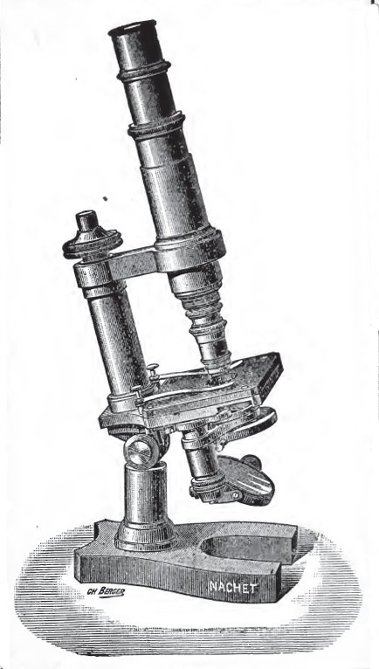
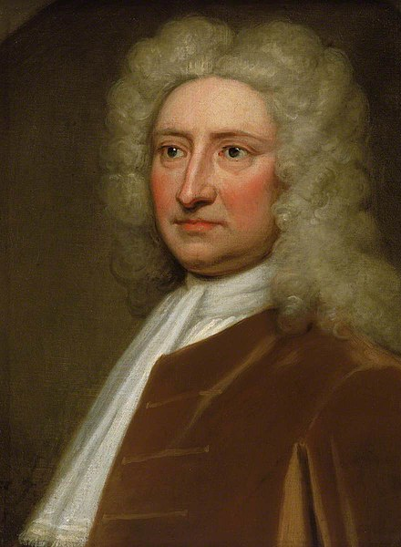
Robert Hooke
Seen with compound microscope
Tiny Chambers→cells
Actually not empty chambers
This Photo by Unknown Author is licensed under CC BY-SA
This Photo by Unknown Author is licensed under CC BY-SA

Slide 4
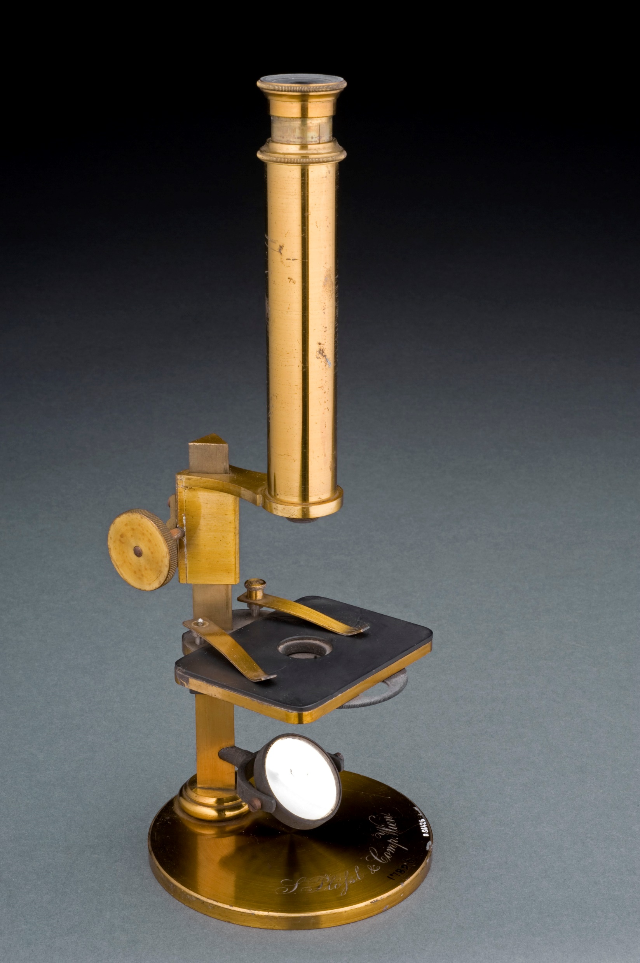
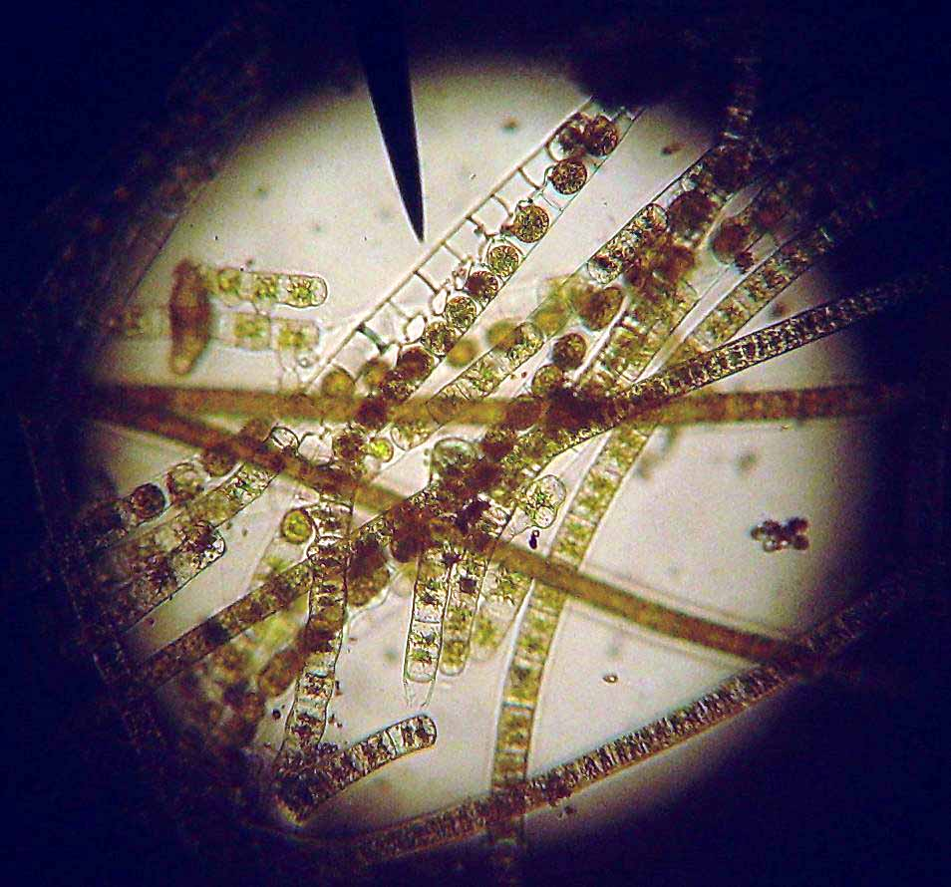
Anton van leeuvenhoek
holland
Single lens microscope→ pond water
This Photo by Unknown Author is licensed under CC BY-SA
This Photo by Unknown Author is licensed under CC BY-SA
This Photo by Unknown Author is licensed under CC BY-SA

Slide 5
The cell theory
1500s
add multiple lenses to magnify
1665
Robert Hooke-cork cells
1660s
Anton van Leeuwenhoek
1838
Matthias Schleiden said all plants made of cells
1855
Rudolf Virchow said cells divide.

Slide 6
The Cell Theory
All living things are made up of cells.
Cells are the basic units of structure and function in living things.
New cells are produced from existing cells.

Slide 7
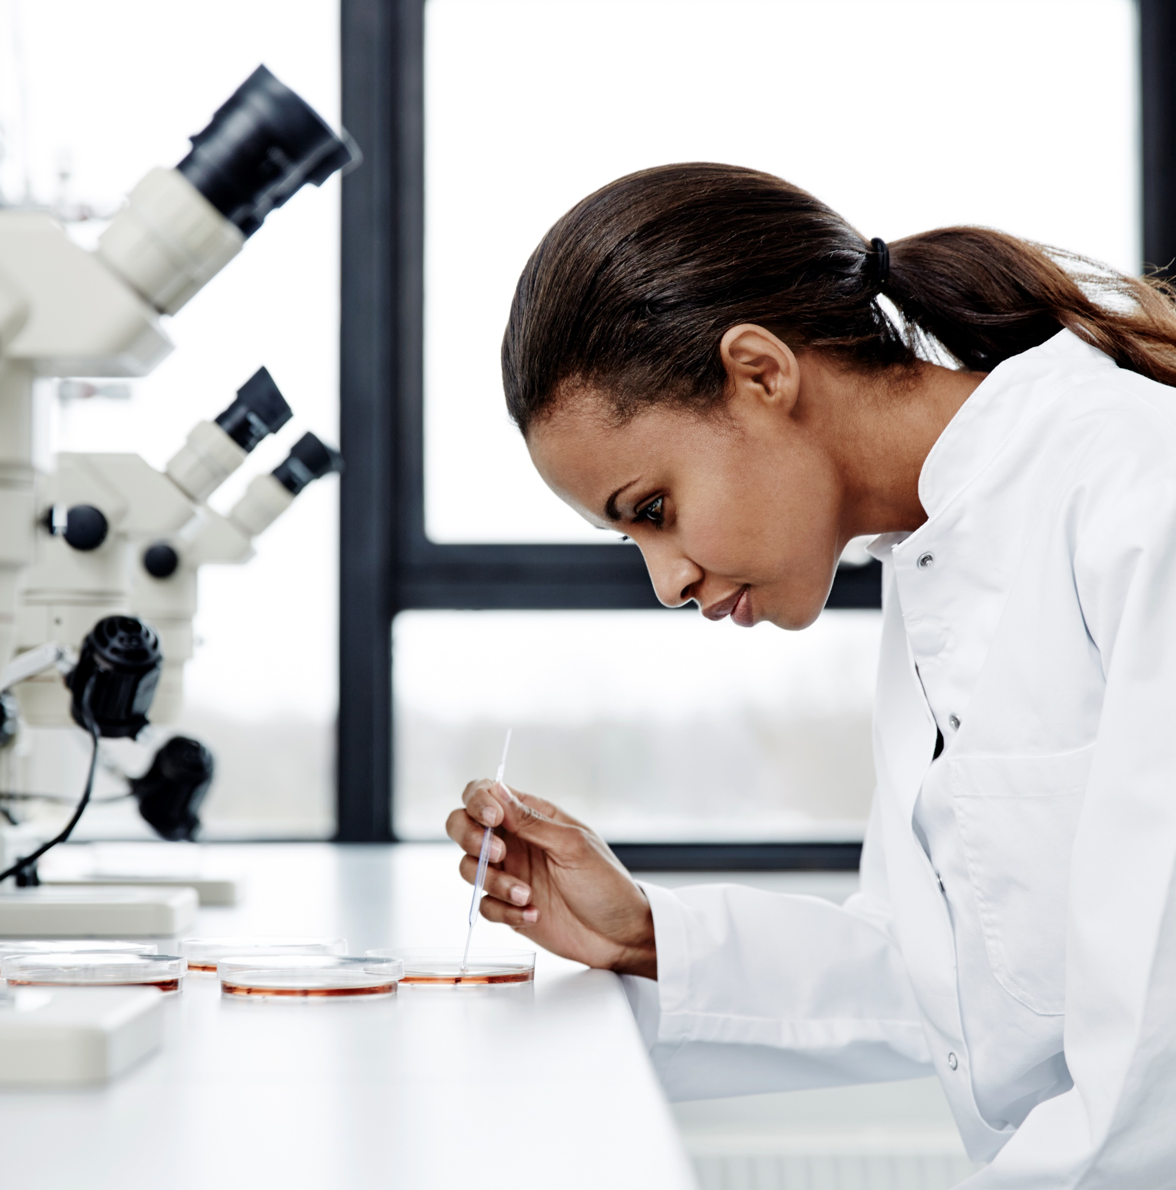
Exploring the cell
How do microscopes work?
They use lenses to magnify the image of an object by focusing light or electrons.

Slide 8
The MicroScope

Slide 9
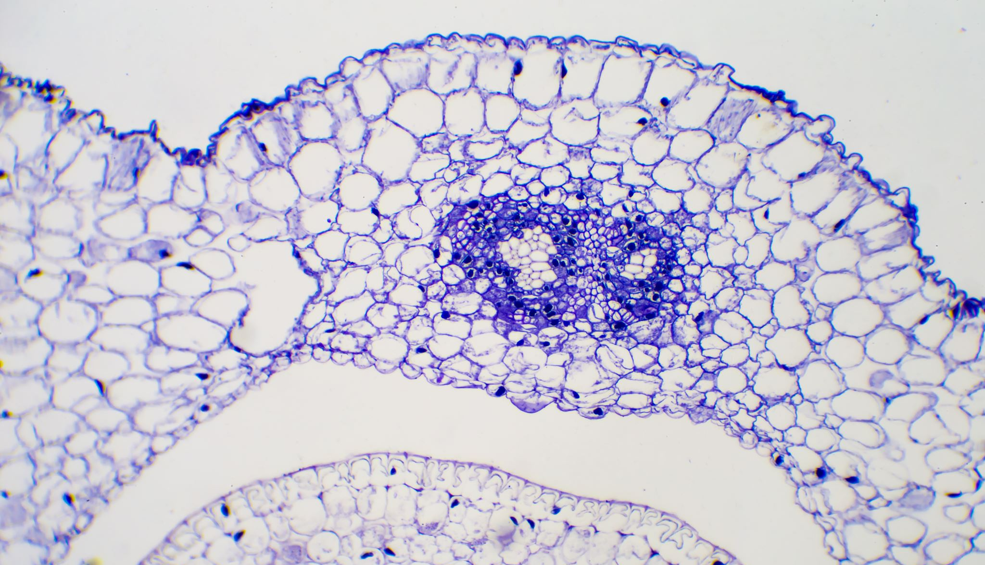
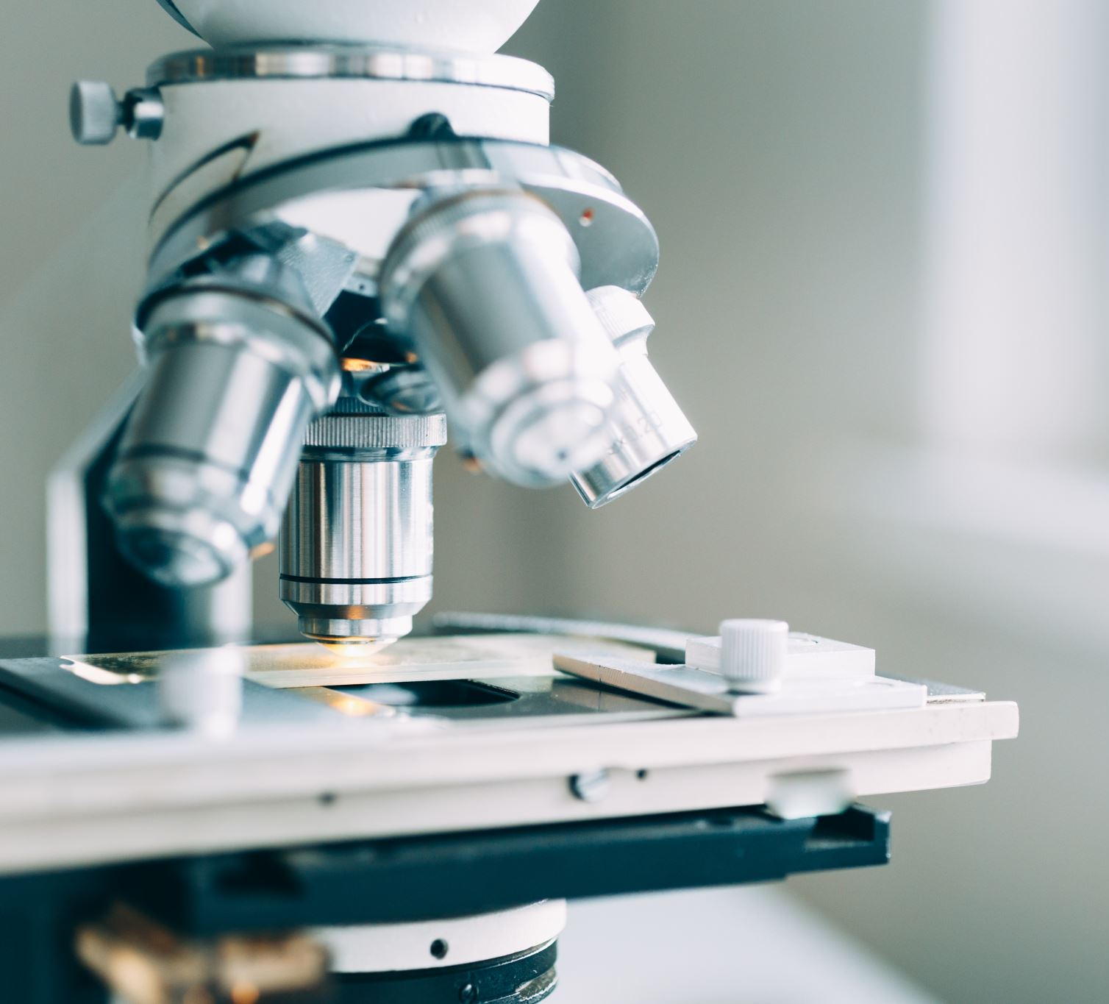
Light Microscope
Light passes through specimen
2 lenses form an image
1st lens-objective lens allows for varying magnification
2nd lens-ocular lens
Up to 1000x magnification
Must use dyes

Slide 10
Electron Microscope
Use beams of electrons that are focused by magnetic fields
2 types
Transmission and scanning
Scanning: scans specimens surface
Transmission: allows for view of inside the cell
Samples must be placed in a vacuum

Slide 11
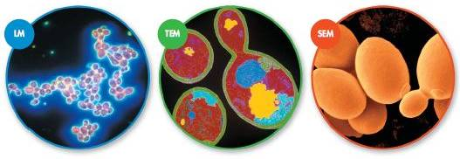
Microscope Variety

Slide 12
Prokaryotes vs Eukaryotes

Slide 13
Prokaryotes
Cells that have no nucleus
Smaller and Simpler
Carry out all activity associated with living things
Ex. bacteria

Slide 14
Eukaryotes
Larger and more complex
Organelles: structures with internal membranes
Unicellular and multicellular
Ex. Plants, Animals, and Fungi

Slide 15
Review Questions
What is a cell?
What 3 Statements make up the cell theory?
How do microscopes work?
What features do all cells have?
What is the difference between Eukaryotes and Prokaryotes?

Slide 16
Cell Organization

Slide 17
The Cytoplasm
The portion of the cell outside the nucleus
Prokaryotes and Eukaryotes have cytoplasm
Contained by the cell membrane

Slide 18
Organelles
Specialized Structures within the cell surrounded by a membrane.
Examples: nucleus, vacuoles, vesicles, Lysosomes, cytoskeleton, ribosomes, endoplasmic reticulum, golgi apparatus, chloroplasts, mitochondria, cell wall

Slide 19
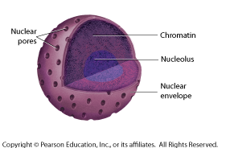
Nucleus
Control center
Contains the genetic info
Surrounded by nuclear envelope
Nuclear pores allow movement across envelope
Nucleolus inside—place where Ribosome assembly begins

Slide 20
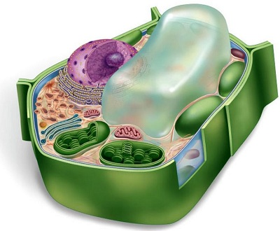
Vacuole
Sac-like, membrane enclosed storage organelle
Store water, salts, proteins, carbohydrates, fats
This Photo by Unknown Author is licensed under CC BY-NC

Slide 21
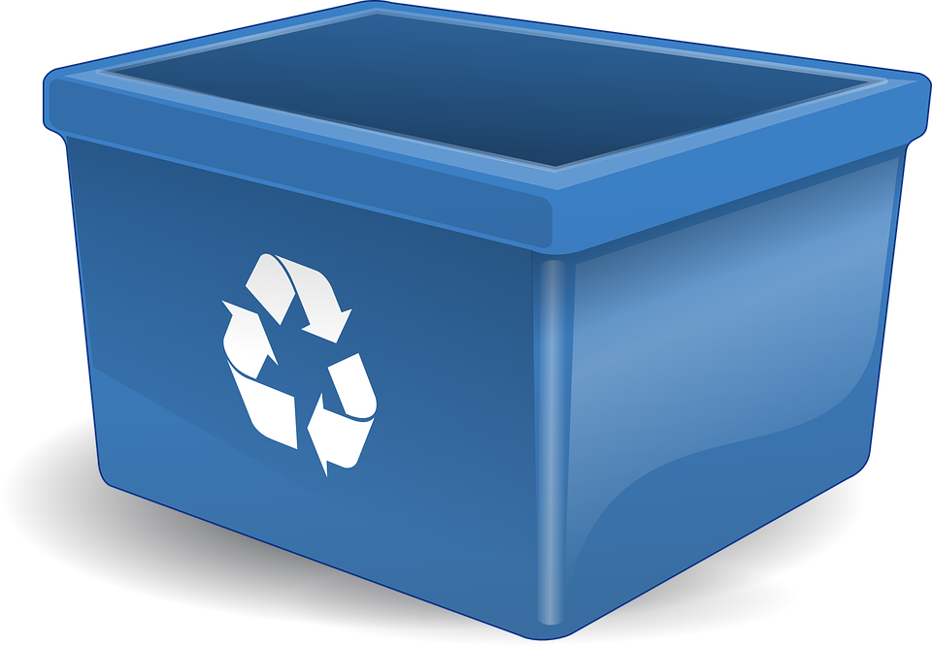
Lysosomes
“Clean up Crew”
Smallest of the organelles
Filled with enzymes
Break down lipids, carbs, proteins so cell can use
Break down old organelles
Common in animal cells, a few plant cells

Slide 22
Cytoskeleton
Network of protein filaments
Gives structure and shape to cell
Allows movement through cilia and flagella
This Photo by Unknown Author is licensed under CC BY-SA

Slide 23
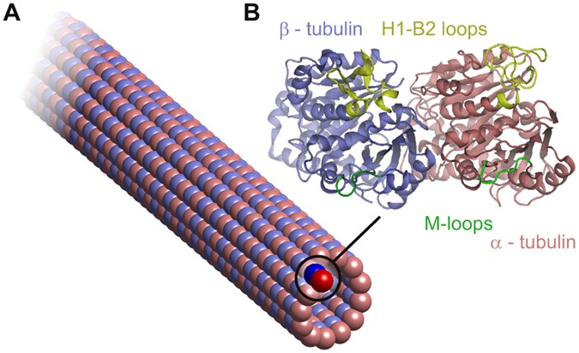
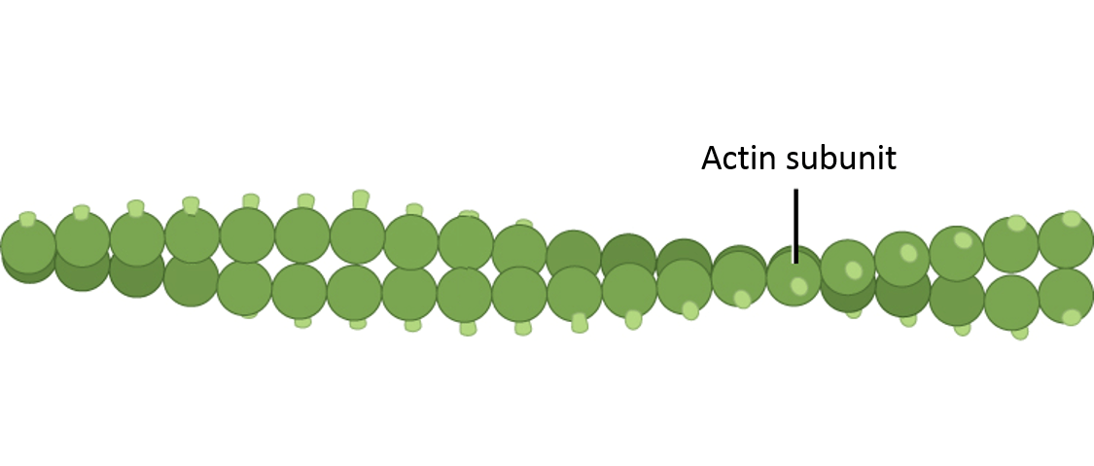
Cytoskeleton
Microfilaments
Threadlike structures
Protein actin
Provide cytoplasmic movement
Microtubules
Hollow structures
Protein tubule
(9+2) pattern
Maintain cell shape
Important in cell division
This Photo by Unknown Author is licensed under CC BY-SA-NC
This Photo by Unknown Author is licensed under CC BY

Slide 24
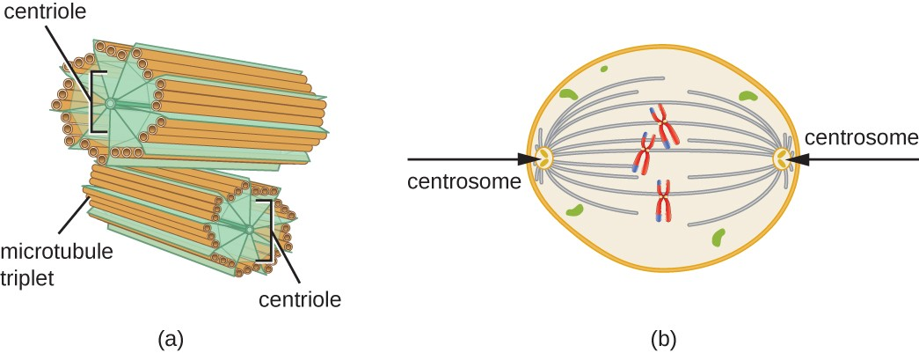
Cytoskeleton: Centrioles
Form the mitotic spindle which helps separate chromosomes
Located near nucleus
This Photo by Unknown Author is licensed under CC BY

Slide 25
Ribosomes
Assemble proteins
Found in cytoplasm of all cells
Small particles of RNA and protein
This Photo by Unknown Author is licensed under CC BY-SA

Slide 26
Endoplasmic Reticulum
Internal membrane system
Assemble lipid components of cell membrane and proteins
Proteins sent here will be exported from cell

Slide 27
Rough ER vs Smooth ER
Rough ER has ribosomes on surface
packages proteins in vesicles to go to Golgi Apparatus
Smooth ER does not have ribosomes
Contains enzymes that help make lipids for membranes and detoxify drugs

Slide 28
Golgi Apparatus
Receives proteins from Rough ER
Stack of flattened membranes
Modifies, sorts, and packages proteins for storage in cell or release
This Photo by Unknown Author is licensed under CC BY-NC

Slide 29
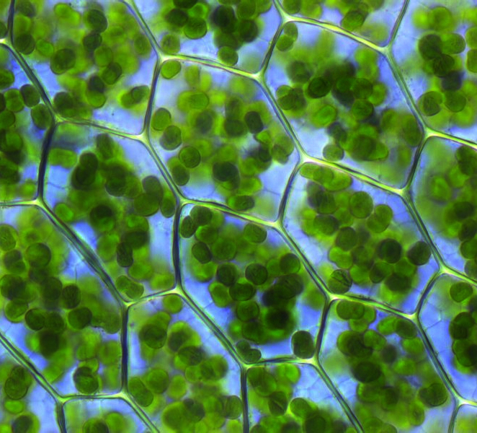
Chloroplast
Found in plant cells
Solar Power Plant
Capture energy required for Photosynthesis
Chemical energy→Food
Double Membrane
This Photo by Unknown Author is licensed under CC BY
This Photo by Unknown Author is licensed under CC BY-SA

Slide 30
Mitochondria
“Power Plant of Cell”
Double Membraned
Convert chemical energy in food into compounds that cell can use
Contain its own DNA
This Photo by Unknown Author is licensed under CC BY-NC

Slide 31
Cell Wall
Many organisms produce walls in addition to cell membranes
Provides support, shape, and protection for cell
Animal cells do not have wall
Porous
Critical for Plants
This Photo by Unknown Author is licensed under CC BY-SA-NC

Slide 32
Cell membrane
Made of a lipid bi-layer
Flexible but strong
Regulates what enters and leaves cell
Protects and supports the cell
This Photo by Unknown Author is licensed under CC BY-SA-NC

Slide 33
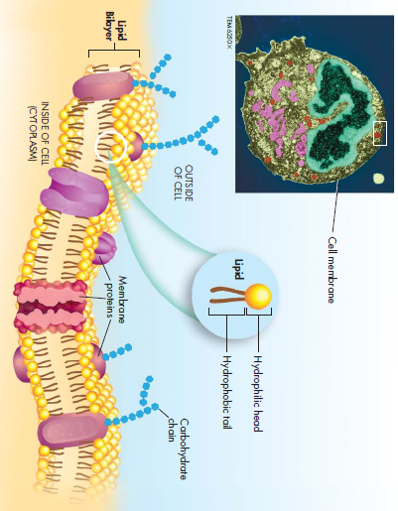
Cell Membrane
Phospholipid bi-layer
Fatty acid tails are hydrophobic (water fearing)
Phospho- end is hydrophilic (water loving)

Slide 34
Fluid Mosaic Model
Cell membrane has proteins
Carbohydrates attach to the proteins
Proteins can move around the membrane layer
Proteins for channels and pumps
Carbs act as ID cards
Selectively Permeable AKA semi-permeable

Slide 35
Review Questions
What are two major parts of the cell?
What is the function of lysosomes?
What is the difference between rough and smooth ER?
What is the function of mitochondria?
Why is the cell membrane referred to as fluid mosaic?

Slide 36
Cell Transport: Passive Transport
Passive Transport: movement of materials across the membrane without using energy.
Examples: Diffusion, facilitated diffusion, osmosis

Slide 37
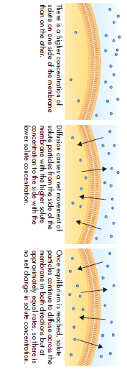
Passive Transport
Diffusion: Substances move from an area of higher concentration to lower concentration.
High
Low
EQUILIBRIUM

Slide 38
Diffusion

Slide 39
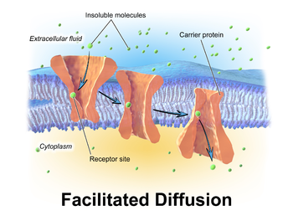
Passive Transport
Facilitated Diffusion: Diffusion through protein channels.
High to Low concentration
High
Low
Low
This Photo by Unknown Author is licensed under CC BY-SA

Slide 40
Facilitated Diffusion

Slide 41
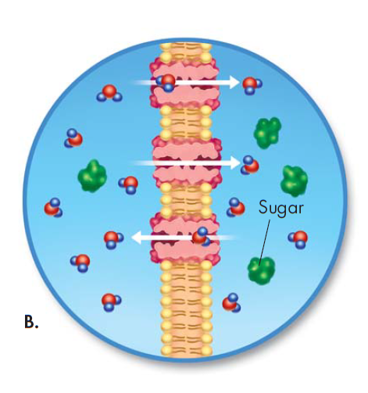
Passive Transport
Osmosis: Diffusion of Water.
An Example of Facilitated Diffusion.
Water moves through aquaporins.
High water
Low water
Low Solute High Solute

Slide 42
Osmosis

Slide 43
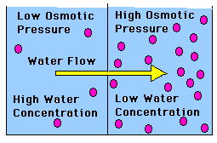
Osmosis
Osmotic Pressure: The pressure created by the net movement of water out of or into a cell
This Photo by Unknown Author is licensed under CC BY-SA

Slide 44
Osmosis
Isotonic: Concentration of solutes is the same inside and outside cell.
Hypertonic: Solution has a higher solute concentration than the cell.
Hypotonic: The solution has a lower solute concentration than the cell.

Slide 45
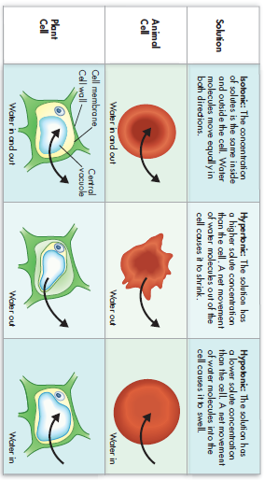
The Effects of Osmosis on Cells

Slide 46
Active transport
Active Transport: the movement of materials against a concentration difference.
It requires Energy!
Examples: Molecular Transport, Bulk Transport

Slide 47
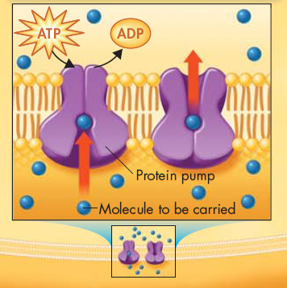
Molecular Transport
Proteins in cell membrane act like pumps.
Small molecules and Ions are transported
Energy Required! (ATP)

Slide 48
Bulk Transport
Large Molecules moved into cell
Examples:
Endocytosis: process of taking material into cell by infoldings of membrane
Exocytosis: process in which a vacuole surrounding a material fuses with cell membrane pushing contents out

Slide 49
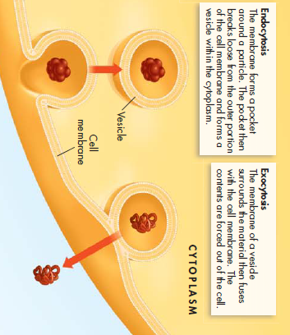
Endocytosis vs Exocytosis

Slide 50
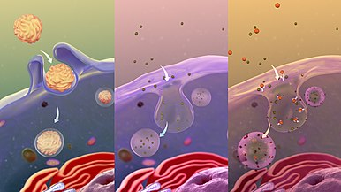
Phagocytosis
Type of Endocytosis
Cell membrane extension surround exterior substances
This Photo by Unknown Author is licensed under CC BY-SA

Slide 51
Review Questions
What happens during Diffusion?
Describe the process of osmosis?
How is Active Transport different from passive transport?
Describe 2 major types of active transport.
How is endocytosis different from exocytosis?

Slide 52
Homeostasis and cells
Cells are basic living units in organisms.
Sometimes the cell is the organism.
Single Cell organism is called unicelluar.
Cells must maintain homeostasis.

Slide 53
Homeostasis
Homeostasis: maintaining stable internal conditions despite changing environment.
Unicellular organisms must grow, respond to environment, transform energy and reproduce.
This Photo by Unknown Author is licensed under CC BY

Slide 54
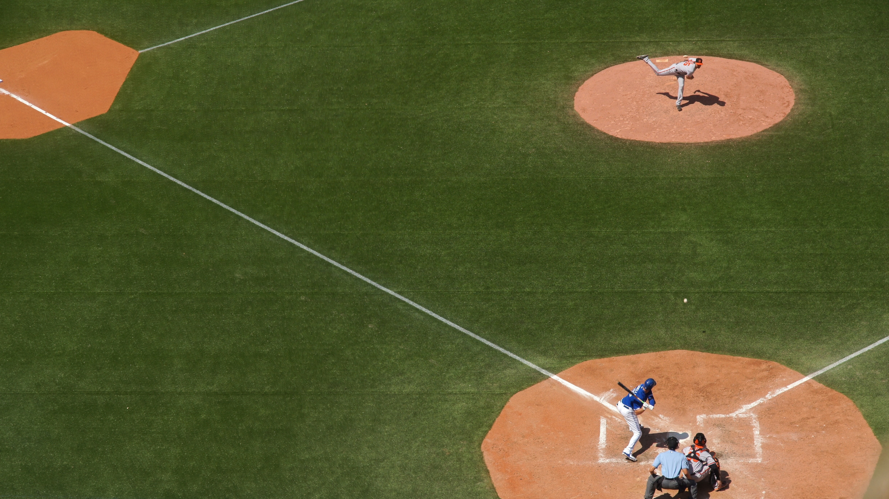
Homeostasis in Multicellular Organisms
Cells are interdependent.
Cells are specialized.

Slide 55
Levels of Organization
Organism
Tissues
Cells
Organs
Organ Systems

Slide 56
Levels of Organization
Cells are specialized.
Dependent on other Cells.

Slide 57
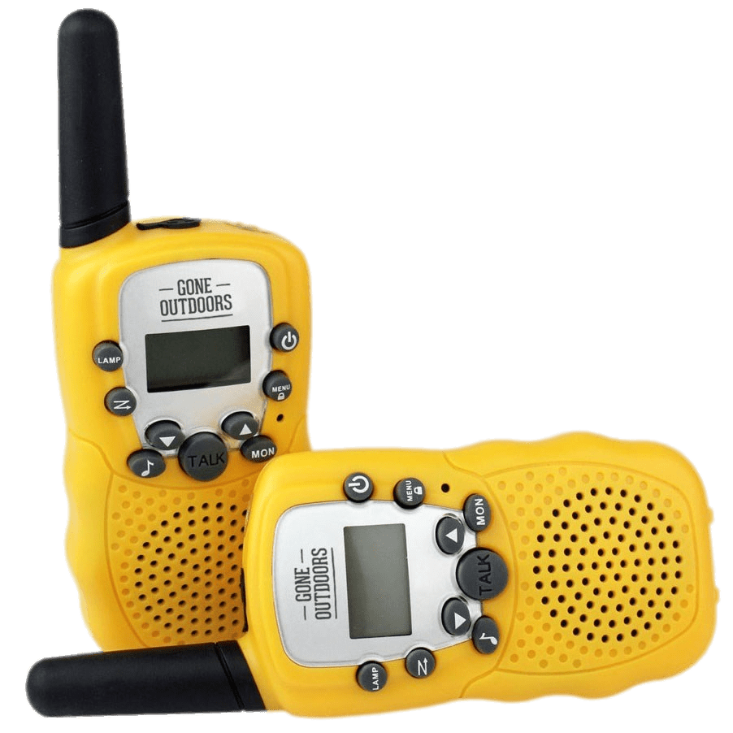
Cellular Communication
Cells communicate with signals.
Cells must have receptors to receive signal.
This Photo by Unknown Author is licensed under CC BY-NC

Slide 58
Review Questions
What is homeostasis?
What is cellular speciali

