Slide 1
Group Benefits 2022-2023 plan perFORmance
November 28, 2023
Andrea Kowalski
© 2021 USI Insurance Services. All rights reserved.

Slide 2
2022 -2023 Year End Highlights
Net Paid Claims were down 16.9% compared to 2021-2022
Net Claims Per Employee Per Year were down 19.5% compared to 2021-2022
2022 Plan Year—Ended Year at 72.4% compared to budget—Surplus of $1.246m
Greater transparency & better, timely access to claims data, much more insight into claims
One member exceeded stop loss—represented 27% of total claims--$990K paid (Lake Wales responsible for $175K, Stop loss carrier paid $815,335
Pharmacy claims:
Account for approx. 18.4% of claim costs to date in 2023. Prior year (2022) pharmacy accounted for 11.5% of claims (norm is 25-30%).
RX claims for 22-23 have increased approx. 25.1% over prior 21-22 year

Slide 3
Performance Highlights

Slide 4
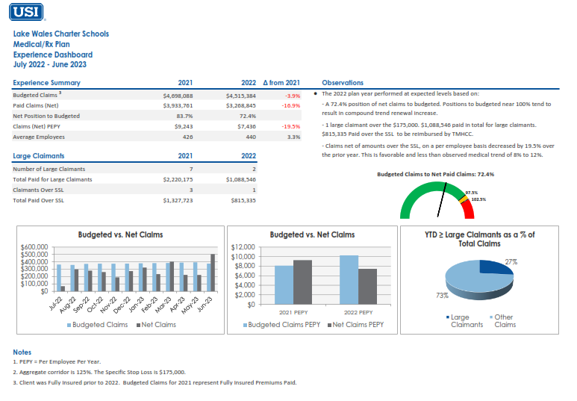
Year to Year Overview

Slide 5
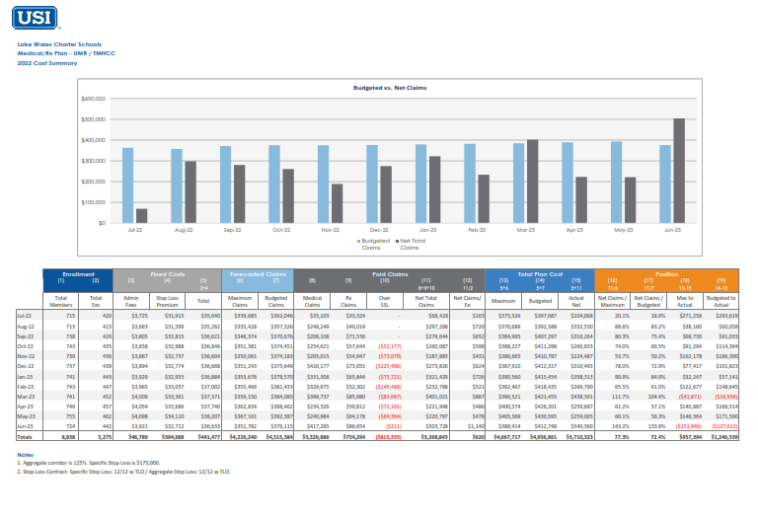
2022-2023 Medical Experience

Slide 6
2022-2023 Claimants

Slide 7
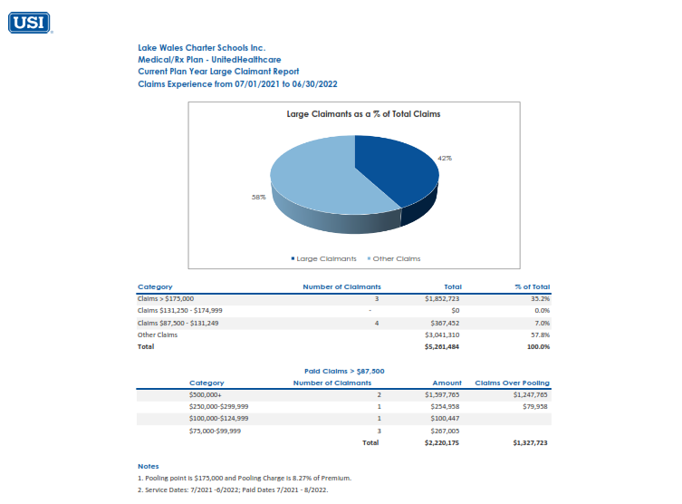
2021-2022 Claimants (Fully Insured)

Slide 8
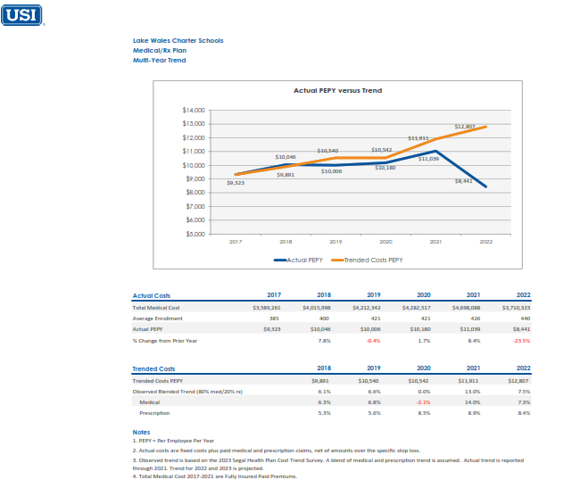
Trend

Slide 9
2023 Marketing Edge
Being self-funded we are able to get Monthly Case Management reports on high claimants to try to engage member with UMR support & programs to ensure better health outcomes
We learned that the high claimant had completed his treatments just as we were negotiating the 2023 stop loss renewal. We were able to work with UMR to get updated nurse notes which were submitted to the stop loss carriers. Carriers initially wanted to impose a laser (specific stop loss level just for one claimant) on this individual; after reviewing case notes, we were able to get that provision removed from one of the two final stop loss options.
If Fully Insured, we would have had no insight into this unique situation. We would have likely been facing at least a trend (8-9%) renewal, plus we don’t know how much more they would have loaded into the renewal for this significant claimant, but it would have been substantial. (Potentially 20% overall).
We were able to keep the medical rates flat for 2023-2024 plan year even while extending stop loss contract to cover claims from 2022 that may not have been paid. Changed stop loss carrier to SunLife (no effect on member experience).
For 2024—considering using some of the $1.2m reserve for wellness/primary care engagement program, mammogram bus, blood drive, diabetes management programs, or MSK (Musculo-skeletal) management programs, etc. Reducing claims in these areas will save Lake Wales Charter Schools money in the long term and will help to better manage the overall cost of the program.

Slide 10
Marketing Summary

Slide 11
Renewal Summary – 7/1/23
The following analysis summarizes Lake Wales Charter Schools’ July 1, 2023 renewal activities. Medical/Rx experience is also included within.
Summary of July 1, 2023 Renewal
Renewal Carrier | Decision | Renewal Savings
UMR TPA | Under multi-year fee agreement | No change to rates
Sun Life - Stop Loss | Carrier change from TMHCC | $15,276 in stop loss premium
Mutual of Omaha – Dental | Renewed w/ incumbent; negotiated +12% increase down to +8% | $11,134 from initial renewal
Mutual of Omaha / EyeMed - Vision | Renewed w/ incumbent; received rate pass until 7/1/2025 | No change to rates
Mutual of Omaha – Life/AD&D, Vol. Life | Under rate guarantee until 1/1/2024 | No change to rates
Mutual of Omaha – Vol STD, LTD | Under rate guarantee until 1/1/2024 | No change to rates
Mutual of Omaha – Worksite | Renewed w/ incumbent | No change to rates
Web Benefits - Ben Admin & COBRA | Renewed w/ incumbent | No change to rates
Asure - FSA | Renewed w/ incumbent | No change to rates
Total Savings |  | $26,410
Additional
Completed: 2023 Renewal Projection at Pre-renewal Meeting
Marketing of stop loss options
USI provided contribution modeling for medical plans
Completed: Prepared customized open enrollment communications/Benefits at a Glance Booklet
Completed: Provided USIeb Mobile App
Completed: Quarterly meetings & claims review
USI provides unlimited access to USI’s in-house ERISA Attorney
USI provides unlimited access to ThinkHR for HR Staff
USI provides the “Benefit Resource Center” to HR Staff & employees for benefits related questions and issues

Slide 12
Stop Loss Analysis Highlights
Stop Loss contract language to compare:
1. Monthly accommodation:
Included on current TMHCC and Sun. This is a stop loss enhancement that protects the plan where claims paid may be higher than normal; it is a monthly max exposure cap
2. Minimum attachment: difference between 90% (TMHCC) and 100% (Sun)?
90% is a richer benefit. Stop loss carriers do it differently so either based on the enrollment at renewal or at the first month of the year an estimated annual attachment point is calculated (Enrollment x Attachment Factors x 12). At 100% that is the lowest the maximum attachment point can go if the group were to decrease in size. At 90% that attachment factor is multiplied by 90% so the group has some wiggle room to decrease in size.
3. Annual reimbursement max: Unlimited vs $1M cap:
Specific stop loss usually has an unlimited reimbursement benefit because large claimants can vary substantially in size and impact. This allows for a group to be fully protected from large and unpredicted catastrophic large claimants.
Aggregate stop loss tends to have a $1M cap on the benefit. This means if the group were to have a year where they run in excess of the carrier’s maximum set claims they will be reimbursed up to a total of $1M. Aggregate stop loss hits happen on average about 3-5% of the time and even more rarely do they ever exceed the $1M cap.
4. Automatic Stop Loss Reimbursements:
This benefit allows for a stop loss reimbursement to be paid quickly once a member exceeds the specific stop loss deductible. The speed of the reimbursement varies from carrier to carrier but are usually reimbursed within a week of the carrier receiving notice of the claim.
Renewal rate cap:
May be negotiated on stop loss carriers shown; this is a USI enhancement and is negotiated on a year by year basis. Rate cap is typically a 50% max for stop loss premiums (only).
6. No new lasers:
May be negotiated on stop loss carriers shown for minimum of first year as a USI enhancement.

