Slide 1
24-25 Edition
2nd Grade
Lesson 2
Copyright – Monique Burr Foundation for Children, Inc.

Slide 2





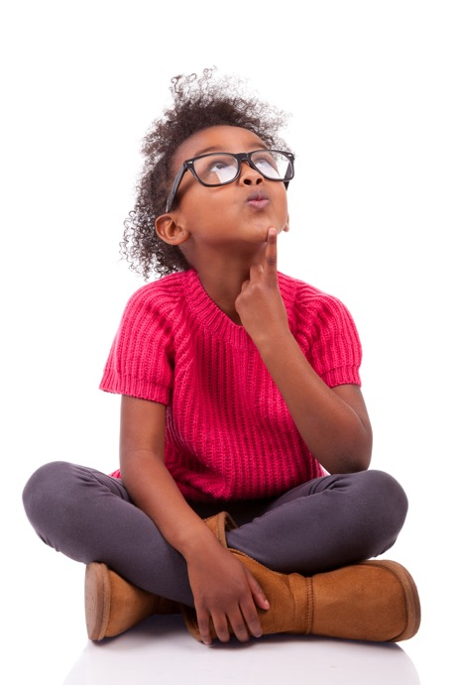
Safety Check
TRUE
SAMPLE
FALSE

Slide 3

Safety Check
SAMPLE

Slide 4

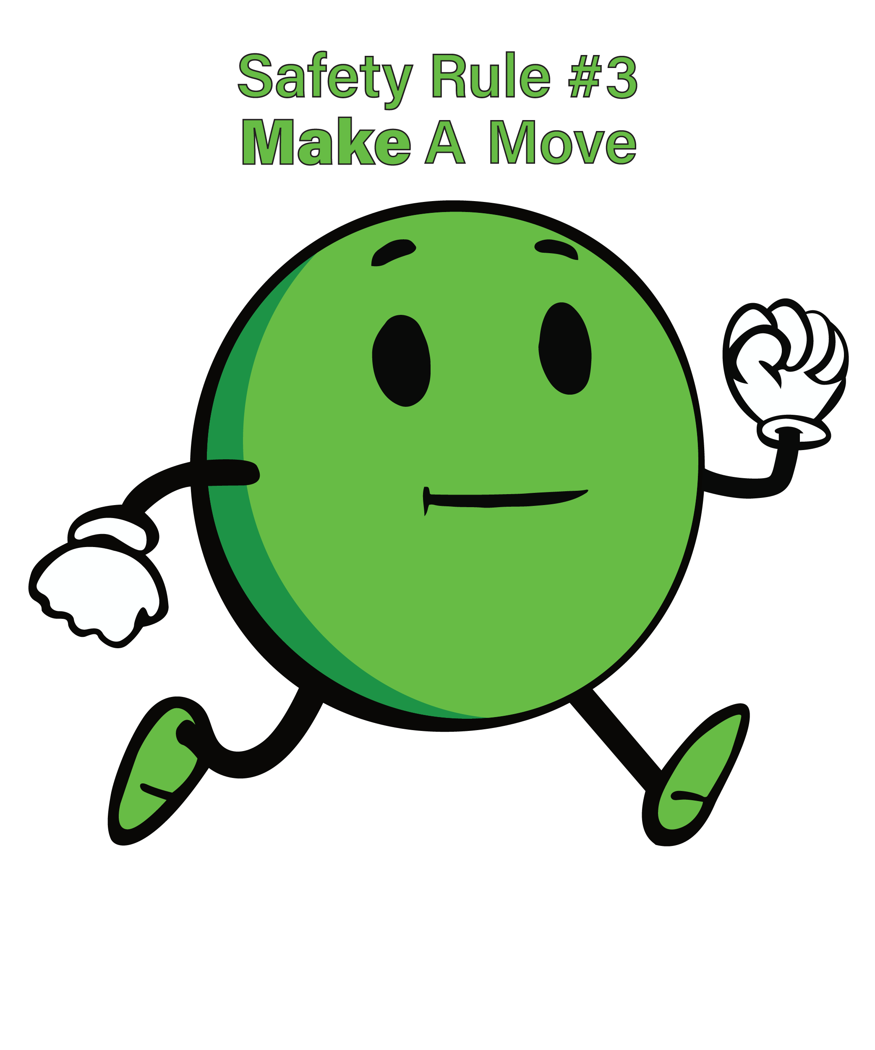
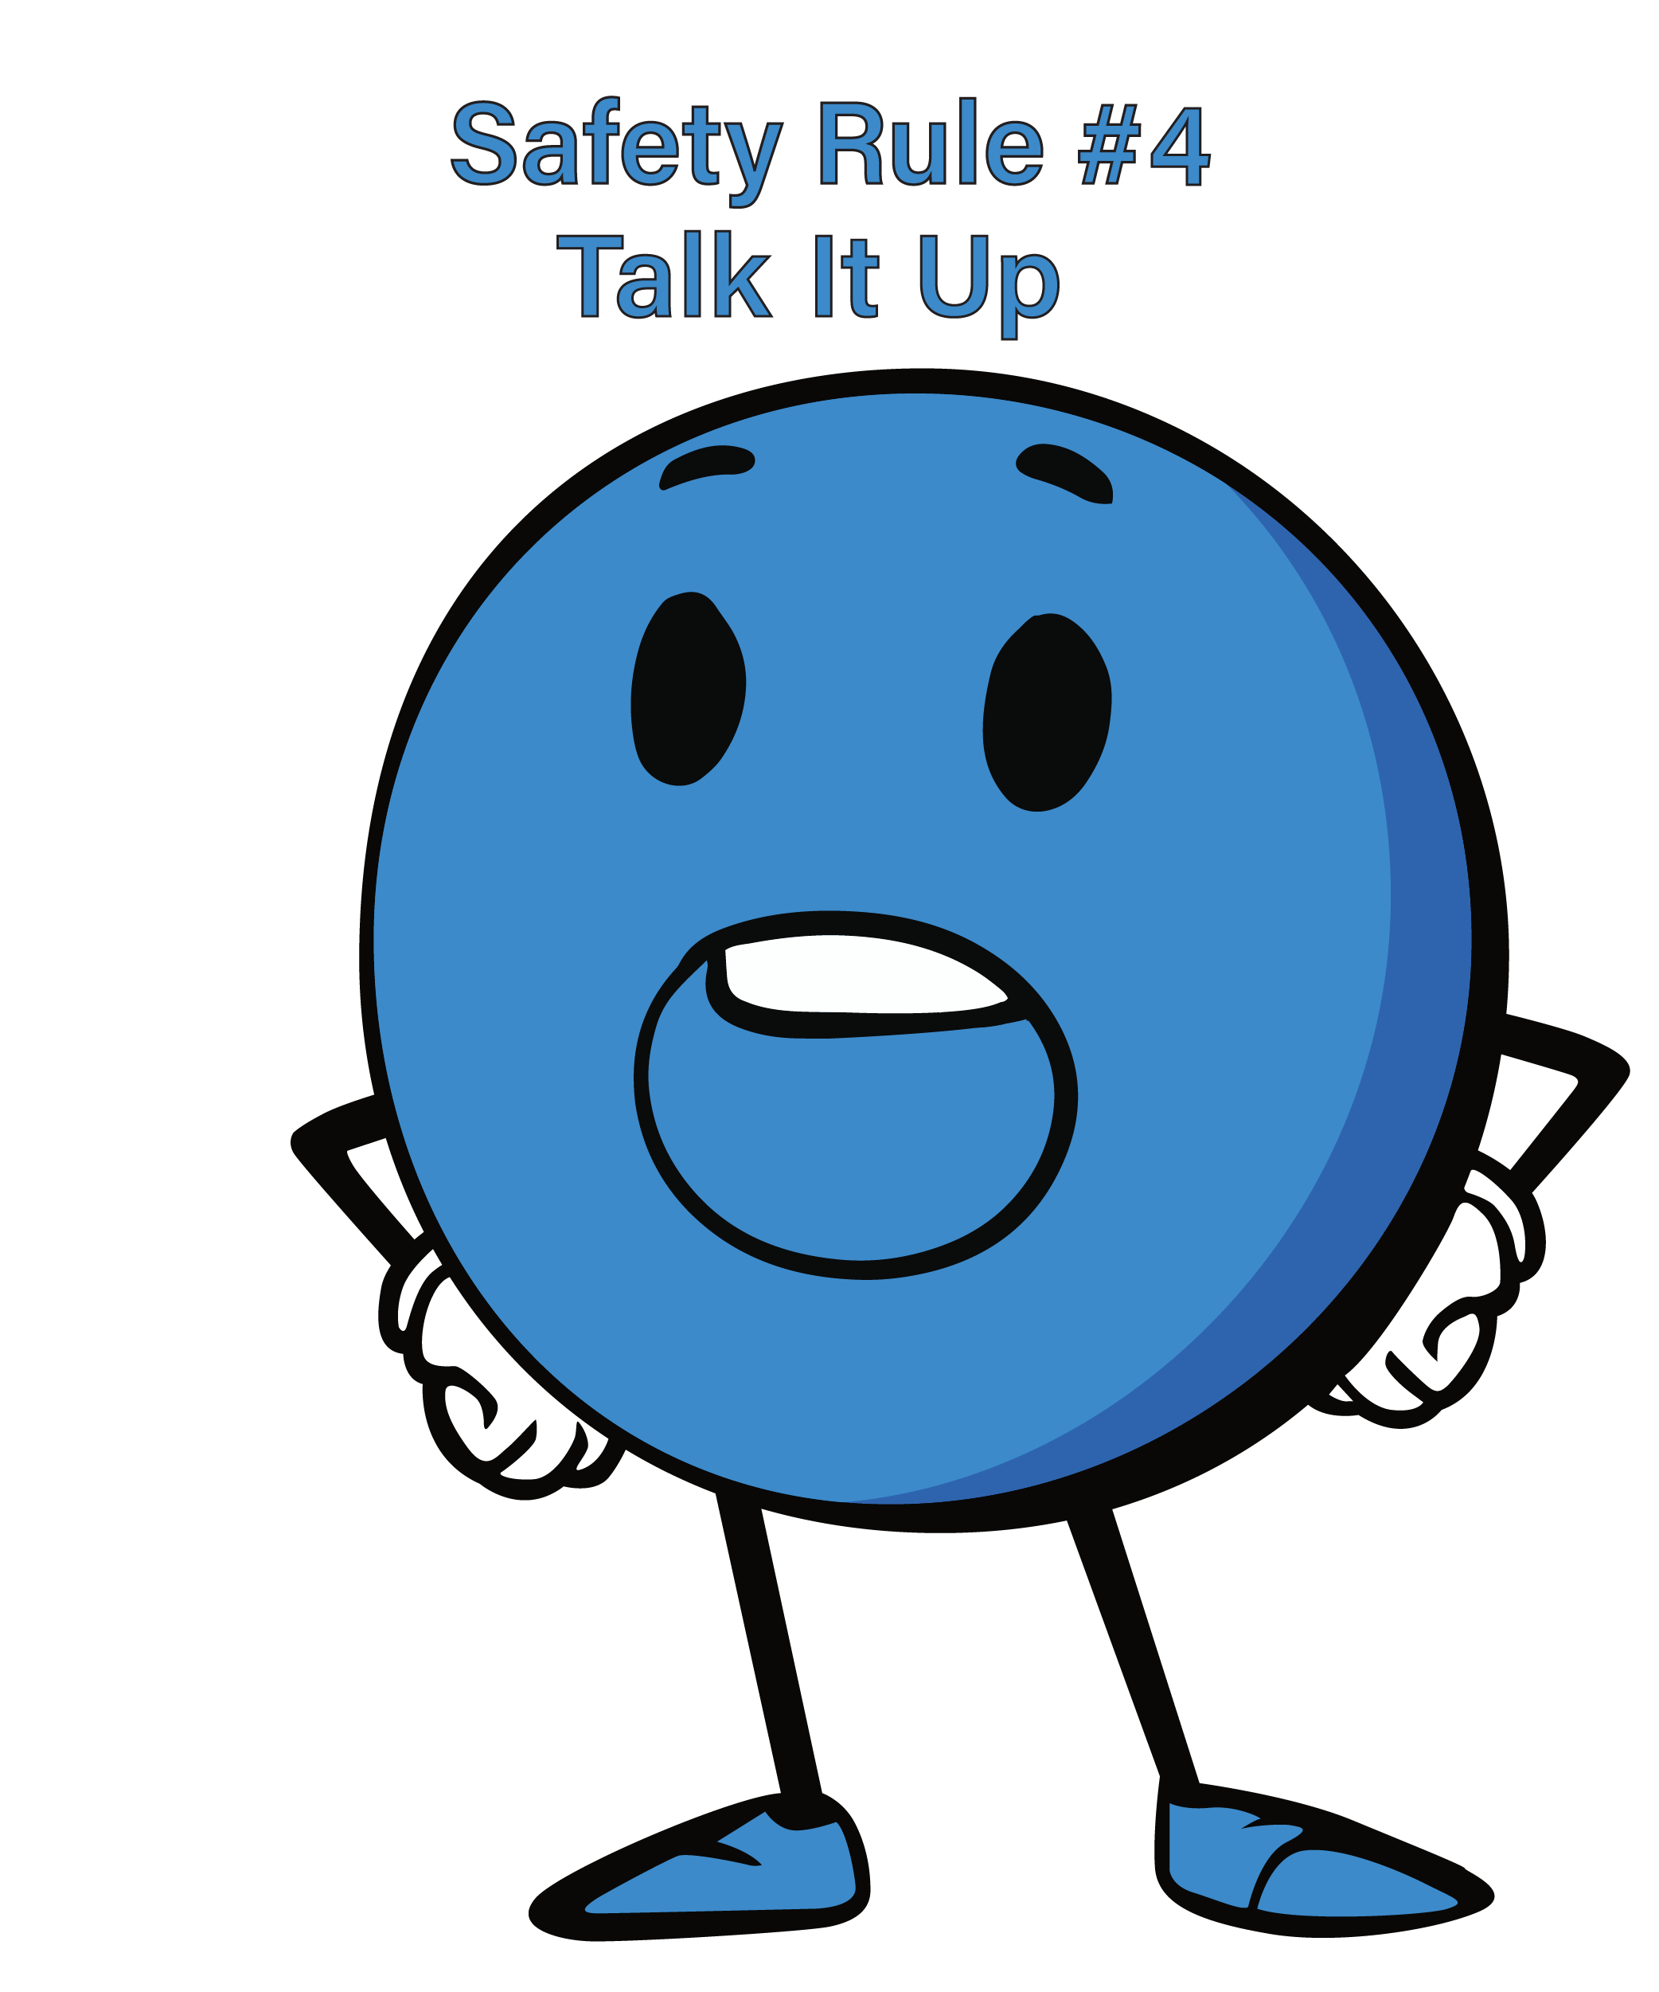
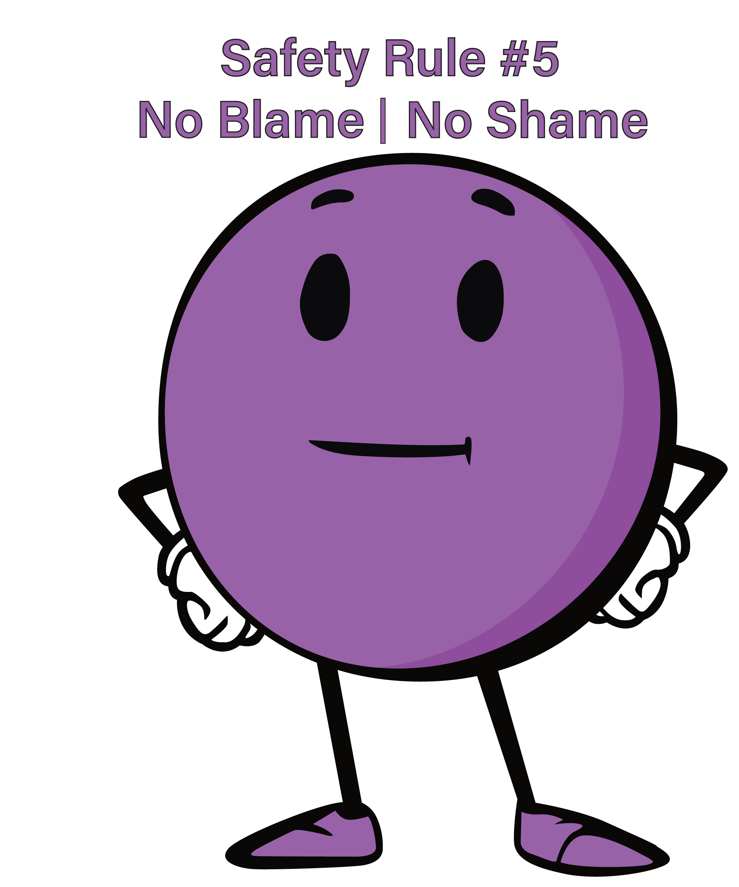




MBF 5 Safety Rules

Slide 5
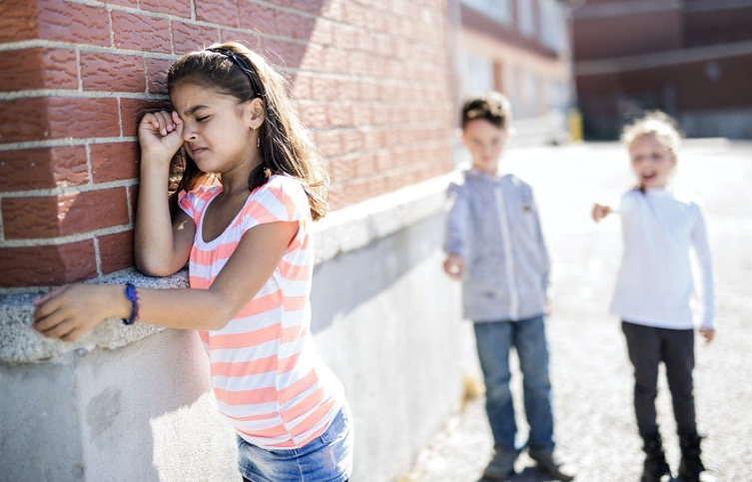
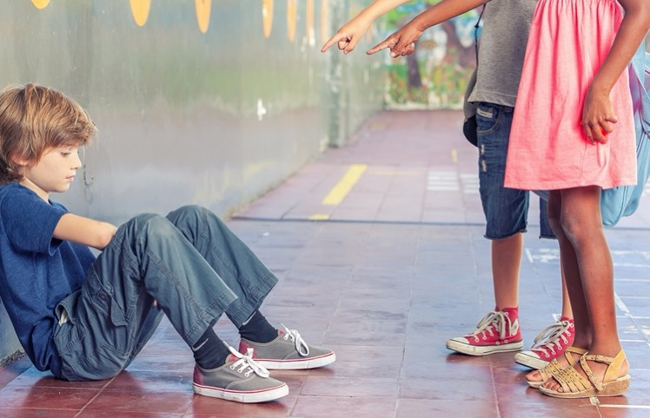
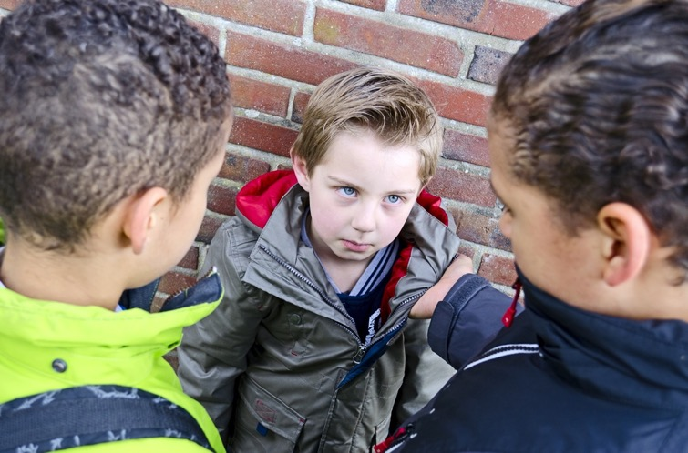
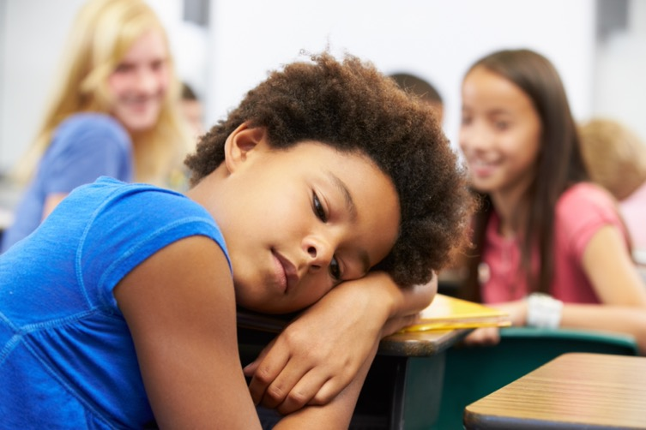
Bullying
SAMPLE
Bullying can hurt us with words
or can hurt our bodies.

Slide 6
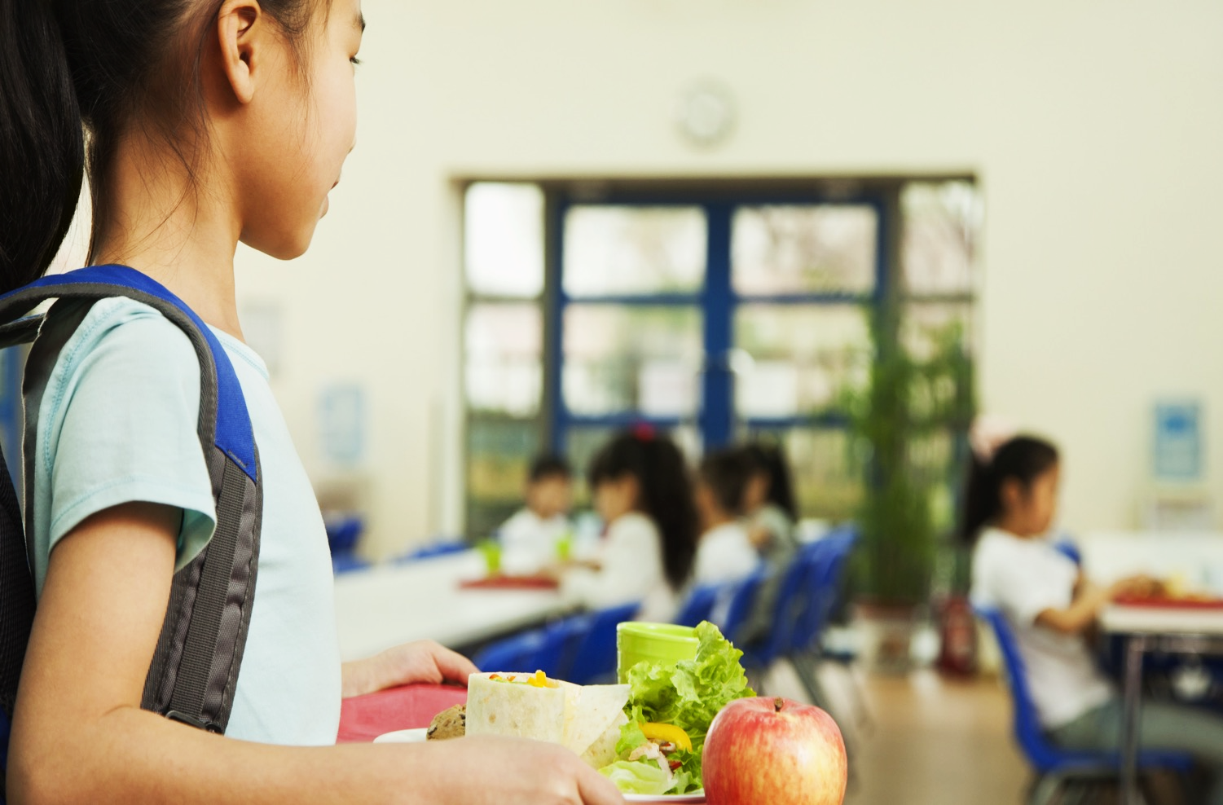
Bystanders
SAMPLE
Who are the Bystanders?

Slide 7
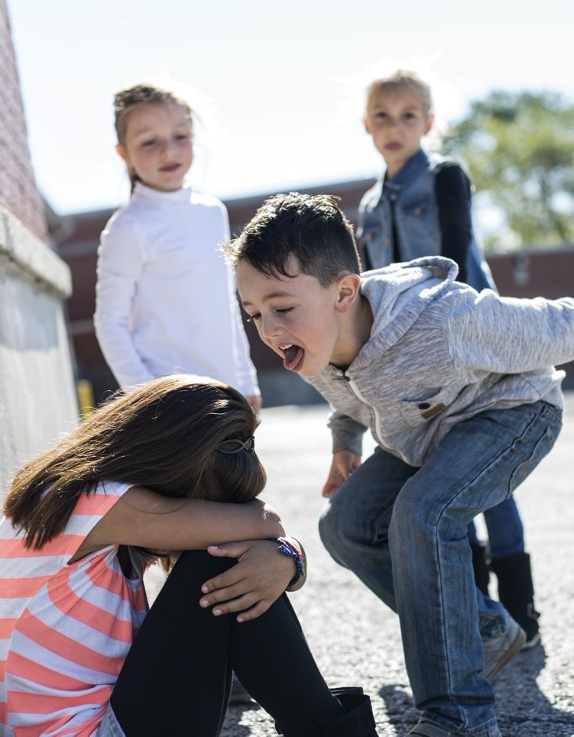
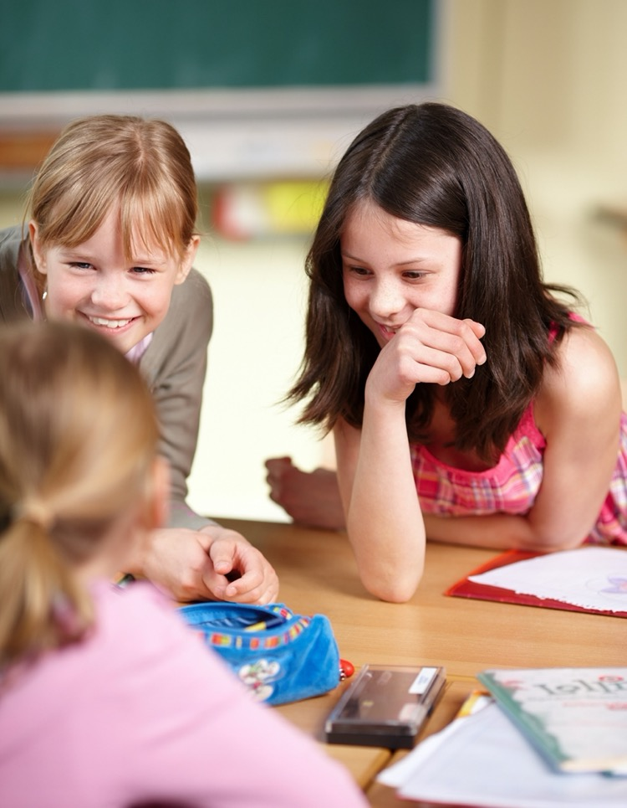






Bystanders vs. Upstanders
Bystanders
Upstanders

Slide 8
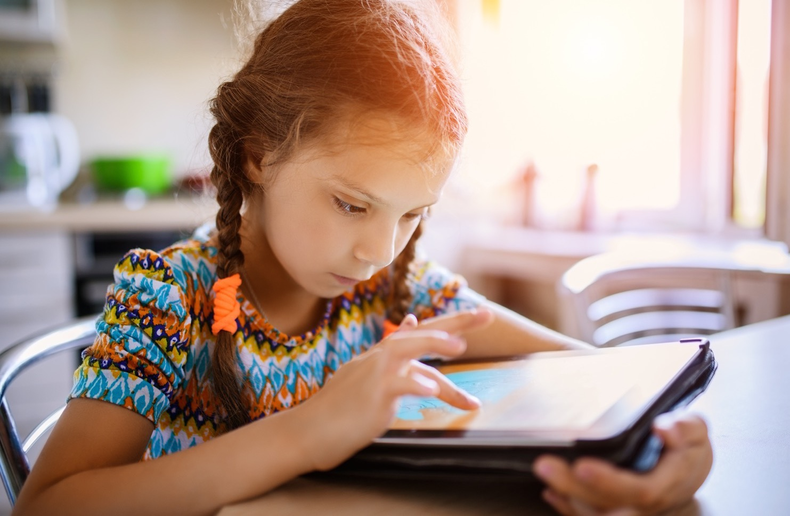

Cyberbullying
SAMPLE
Digital Devices
Digital Dangers
Cyberbullying

Slide 9

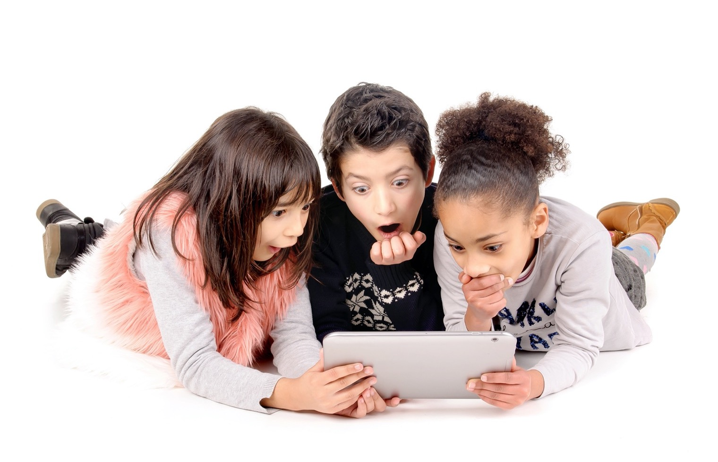
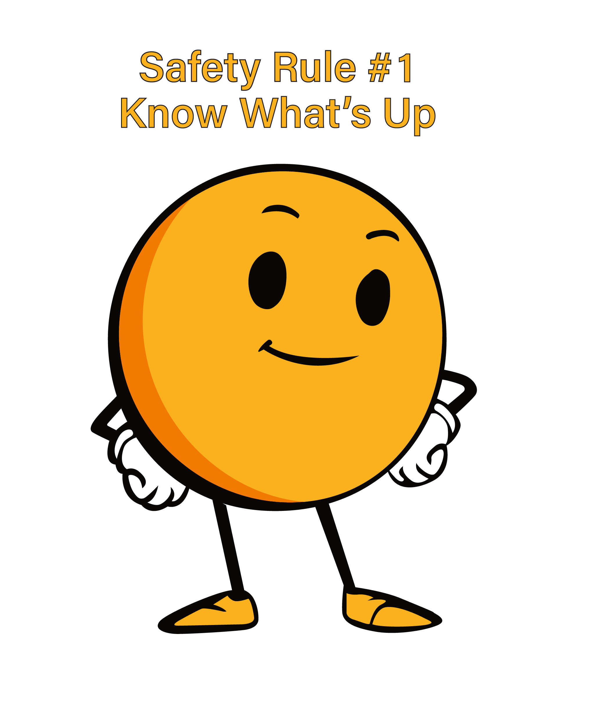
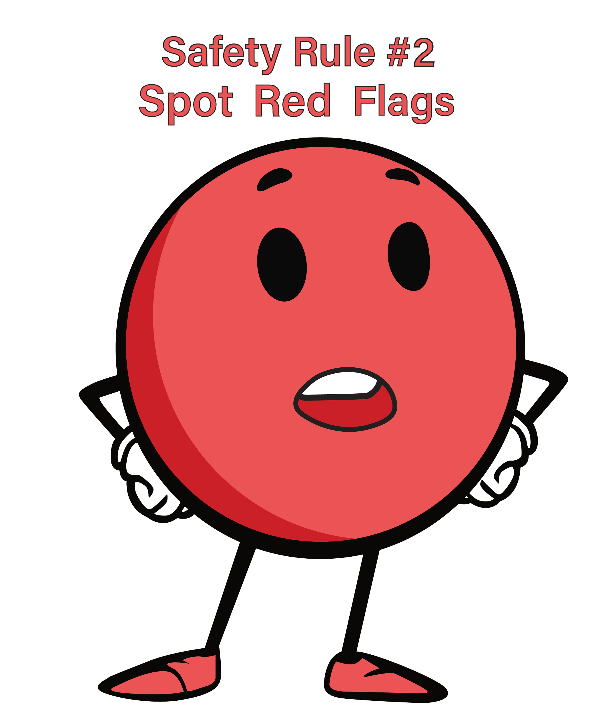
Digital Dangers
SAMPLE

Slide 10
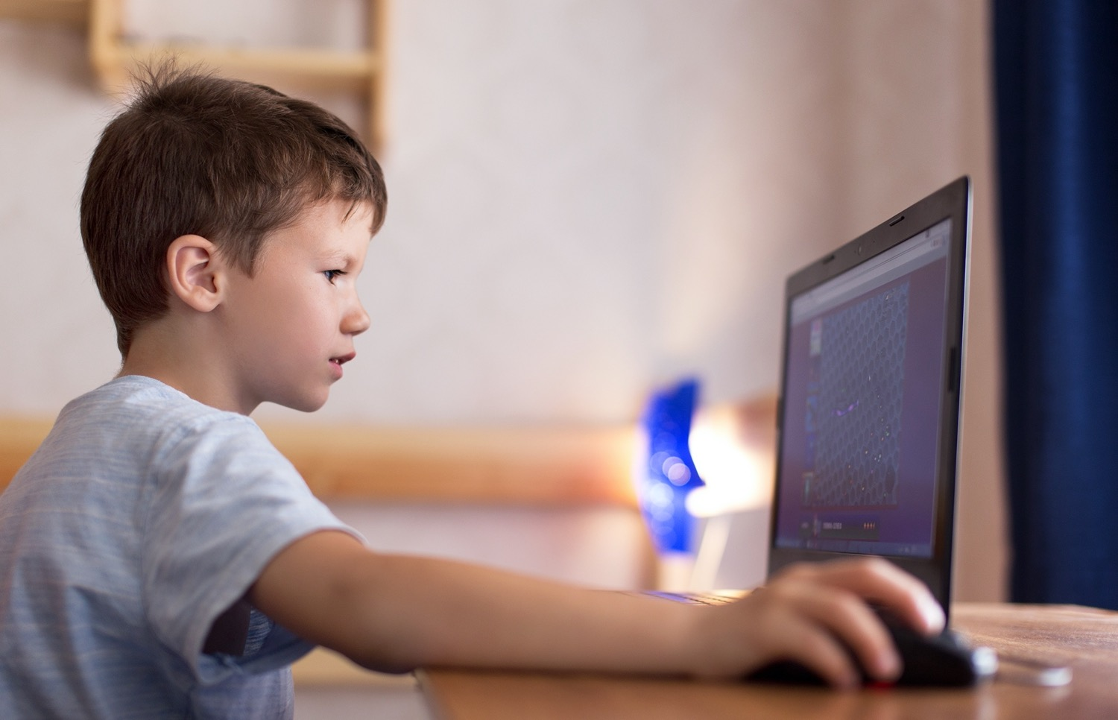


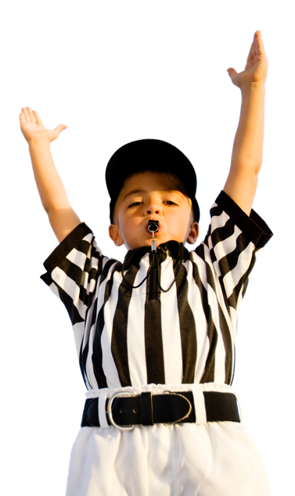
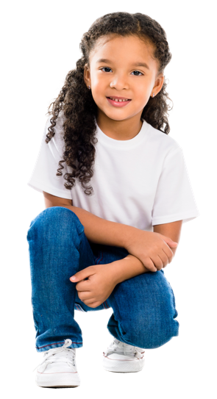
Touchdown/Squat Down
SAMPLE
TOUCHDOWN
TOUCHDOWN
SQUAT DOWN
SQUAT DOWN

Slide 11
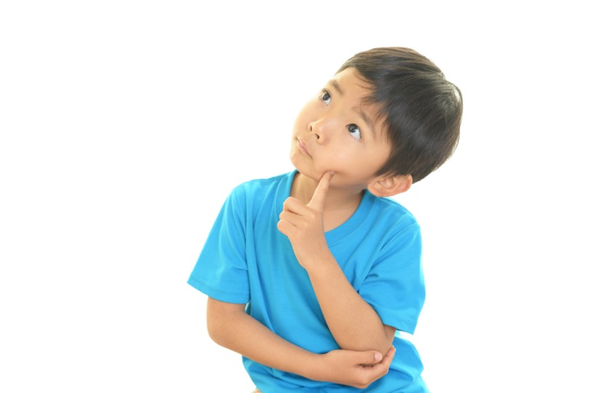
Final Review
TRUE
SAMPLE
FALSE

Slide 12
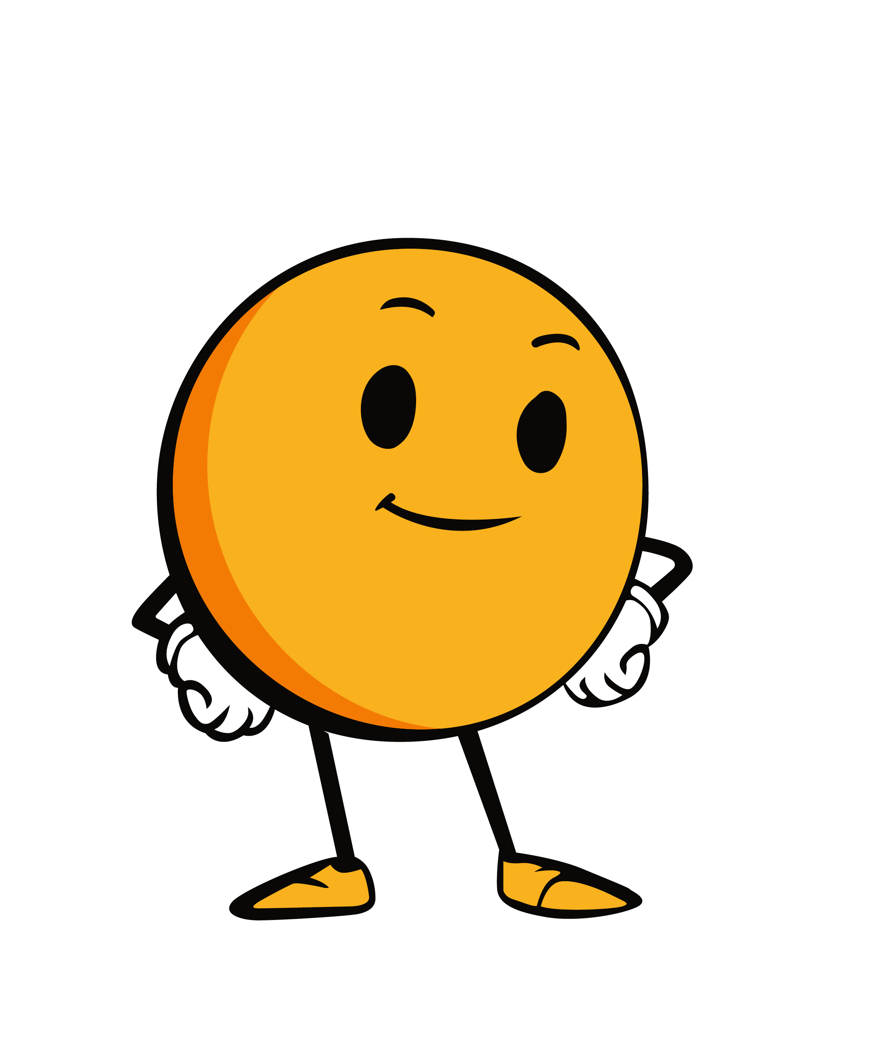
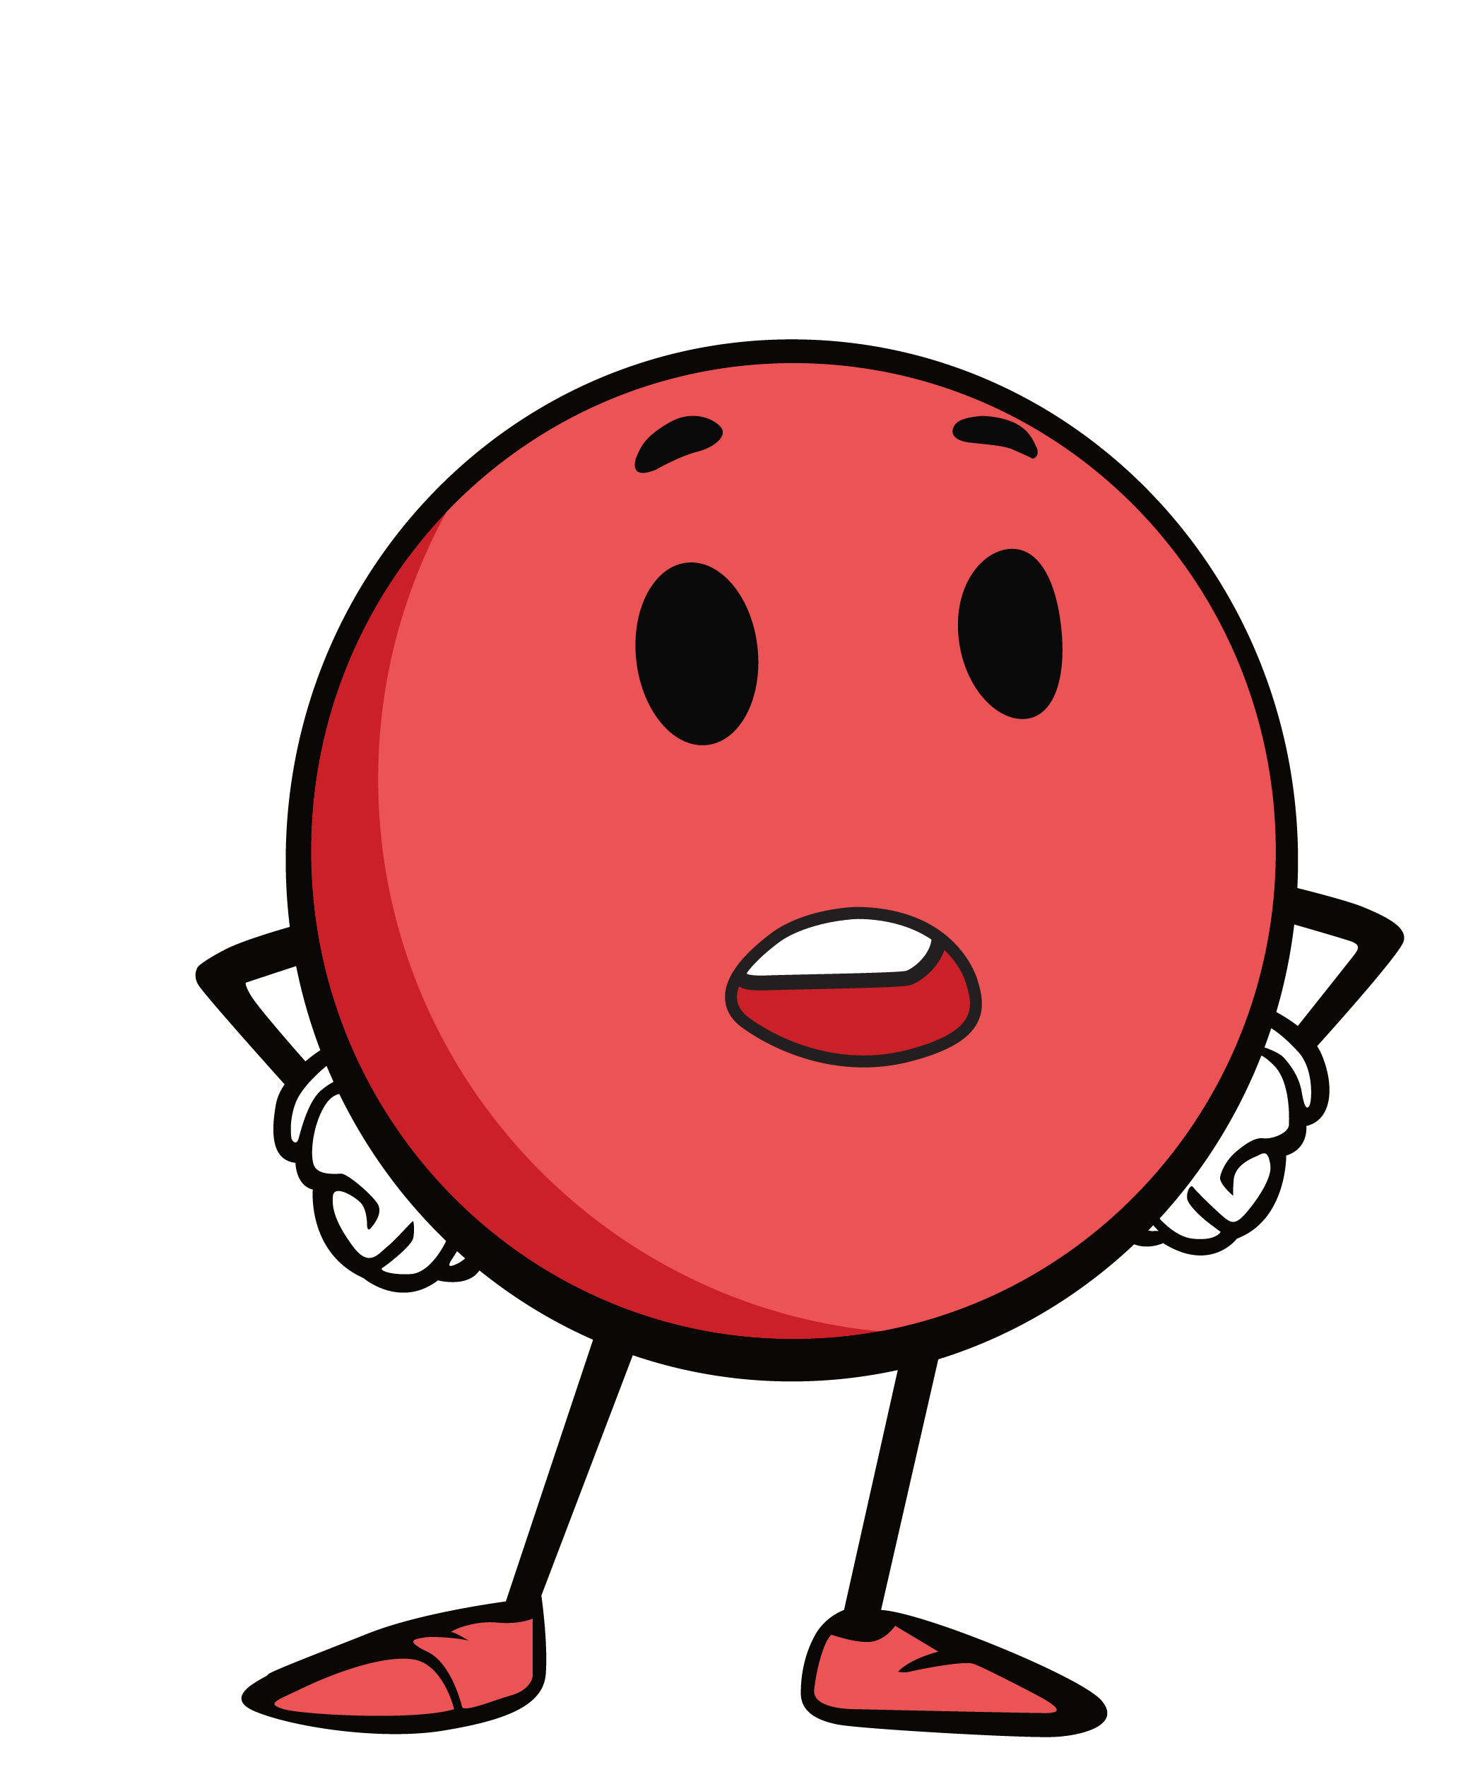
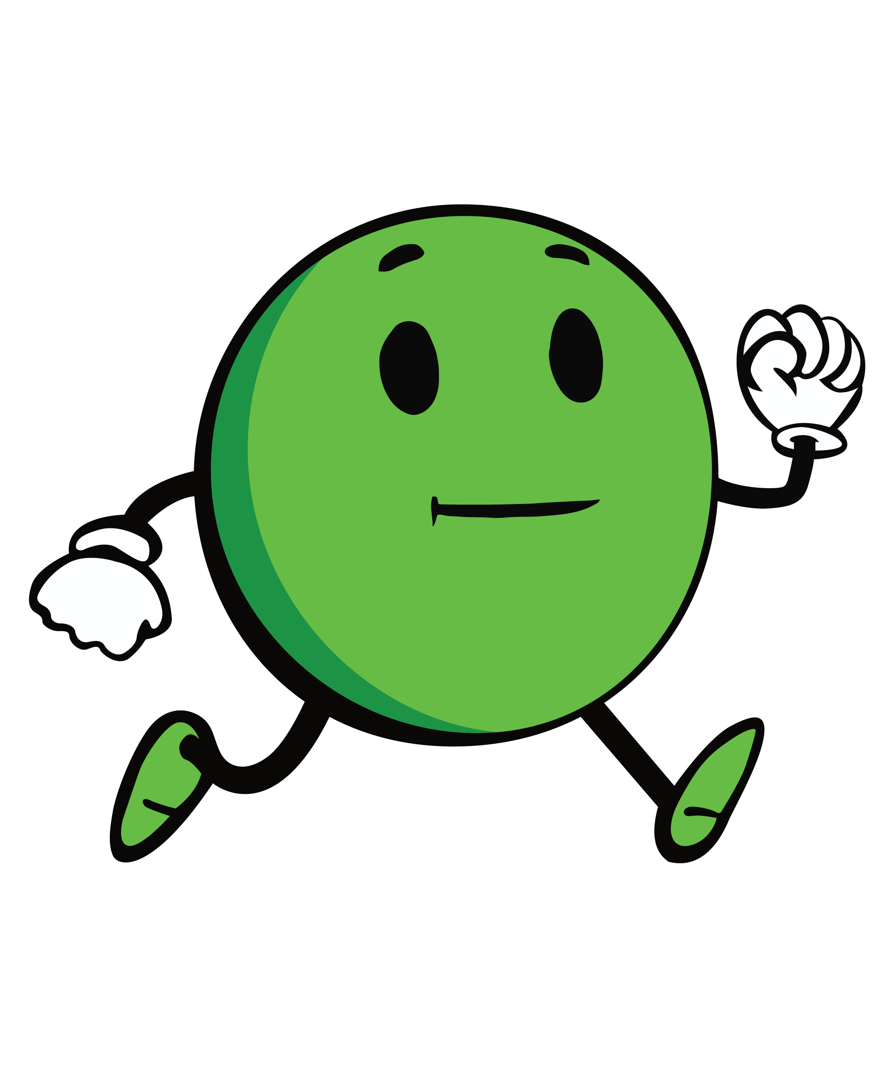
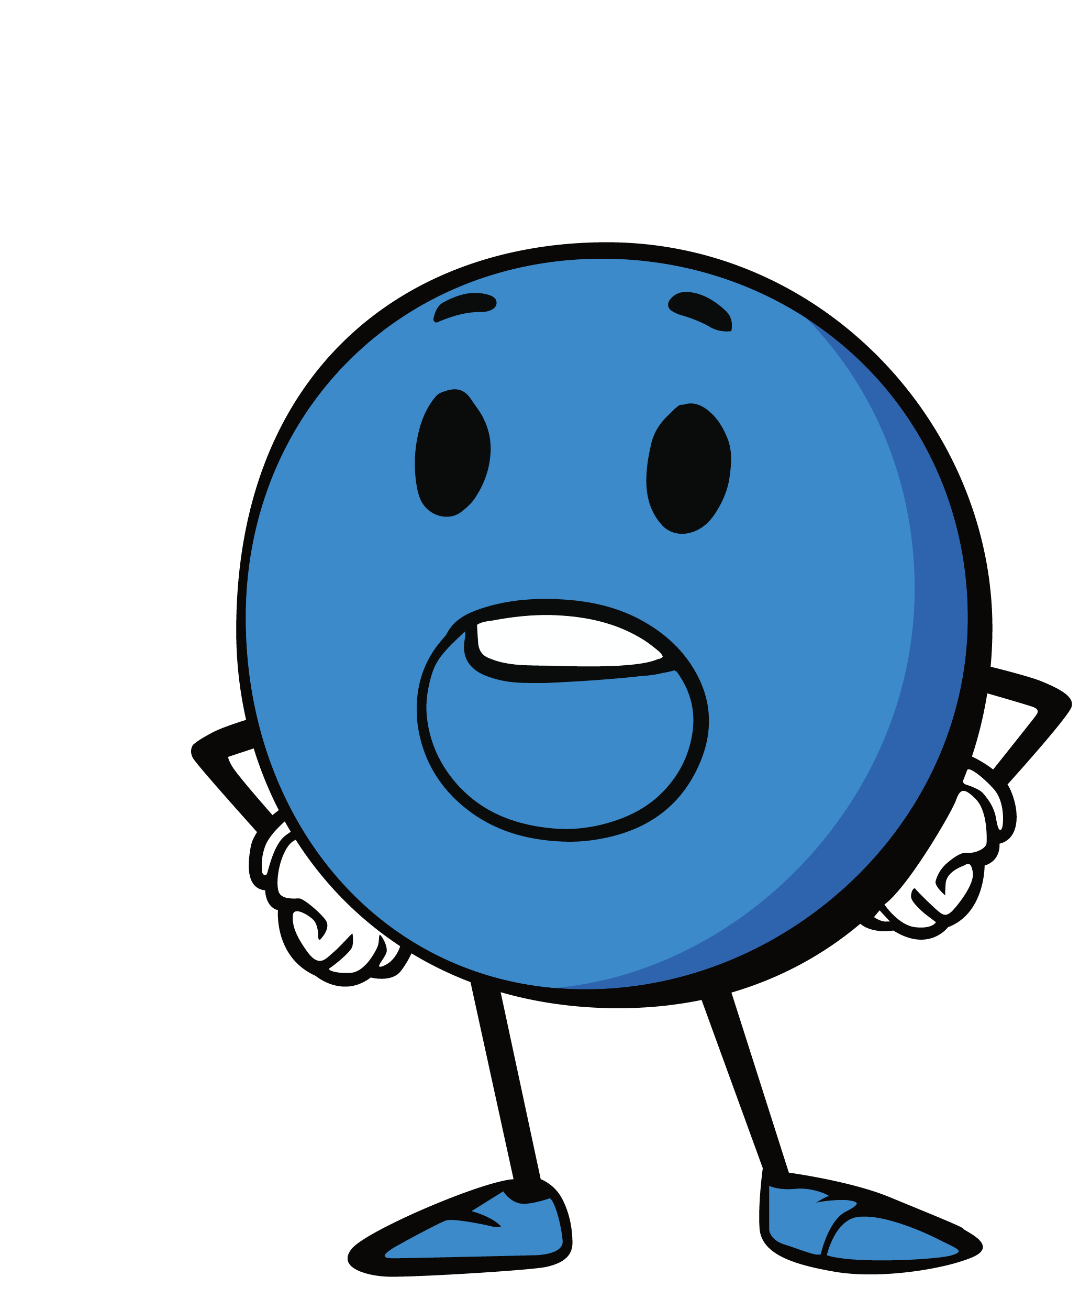
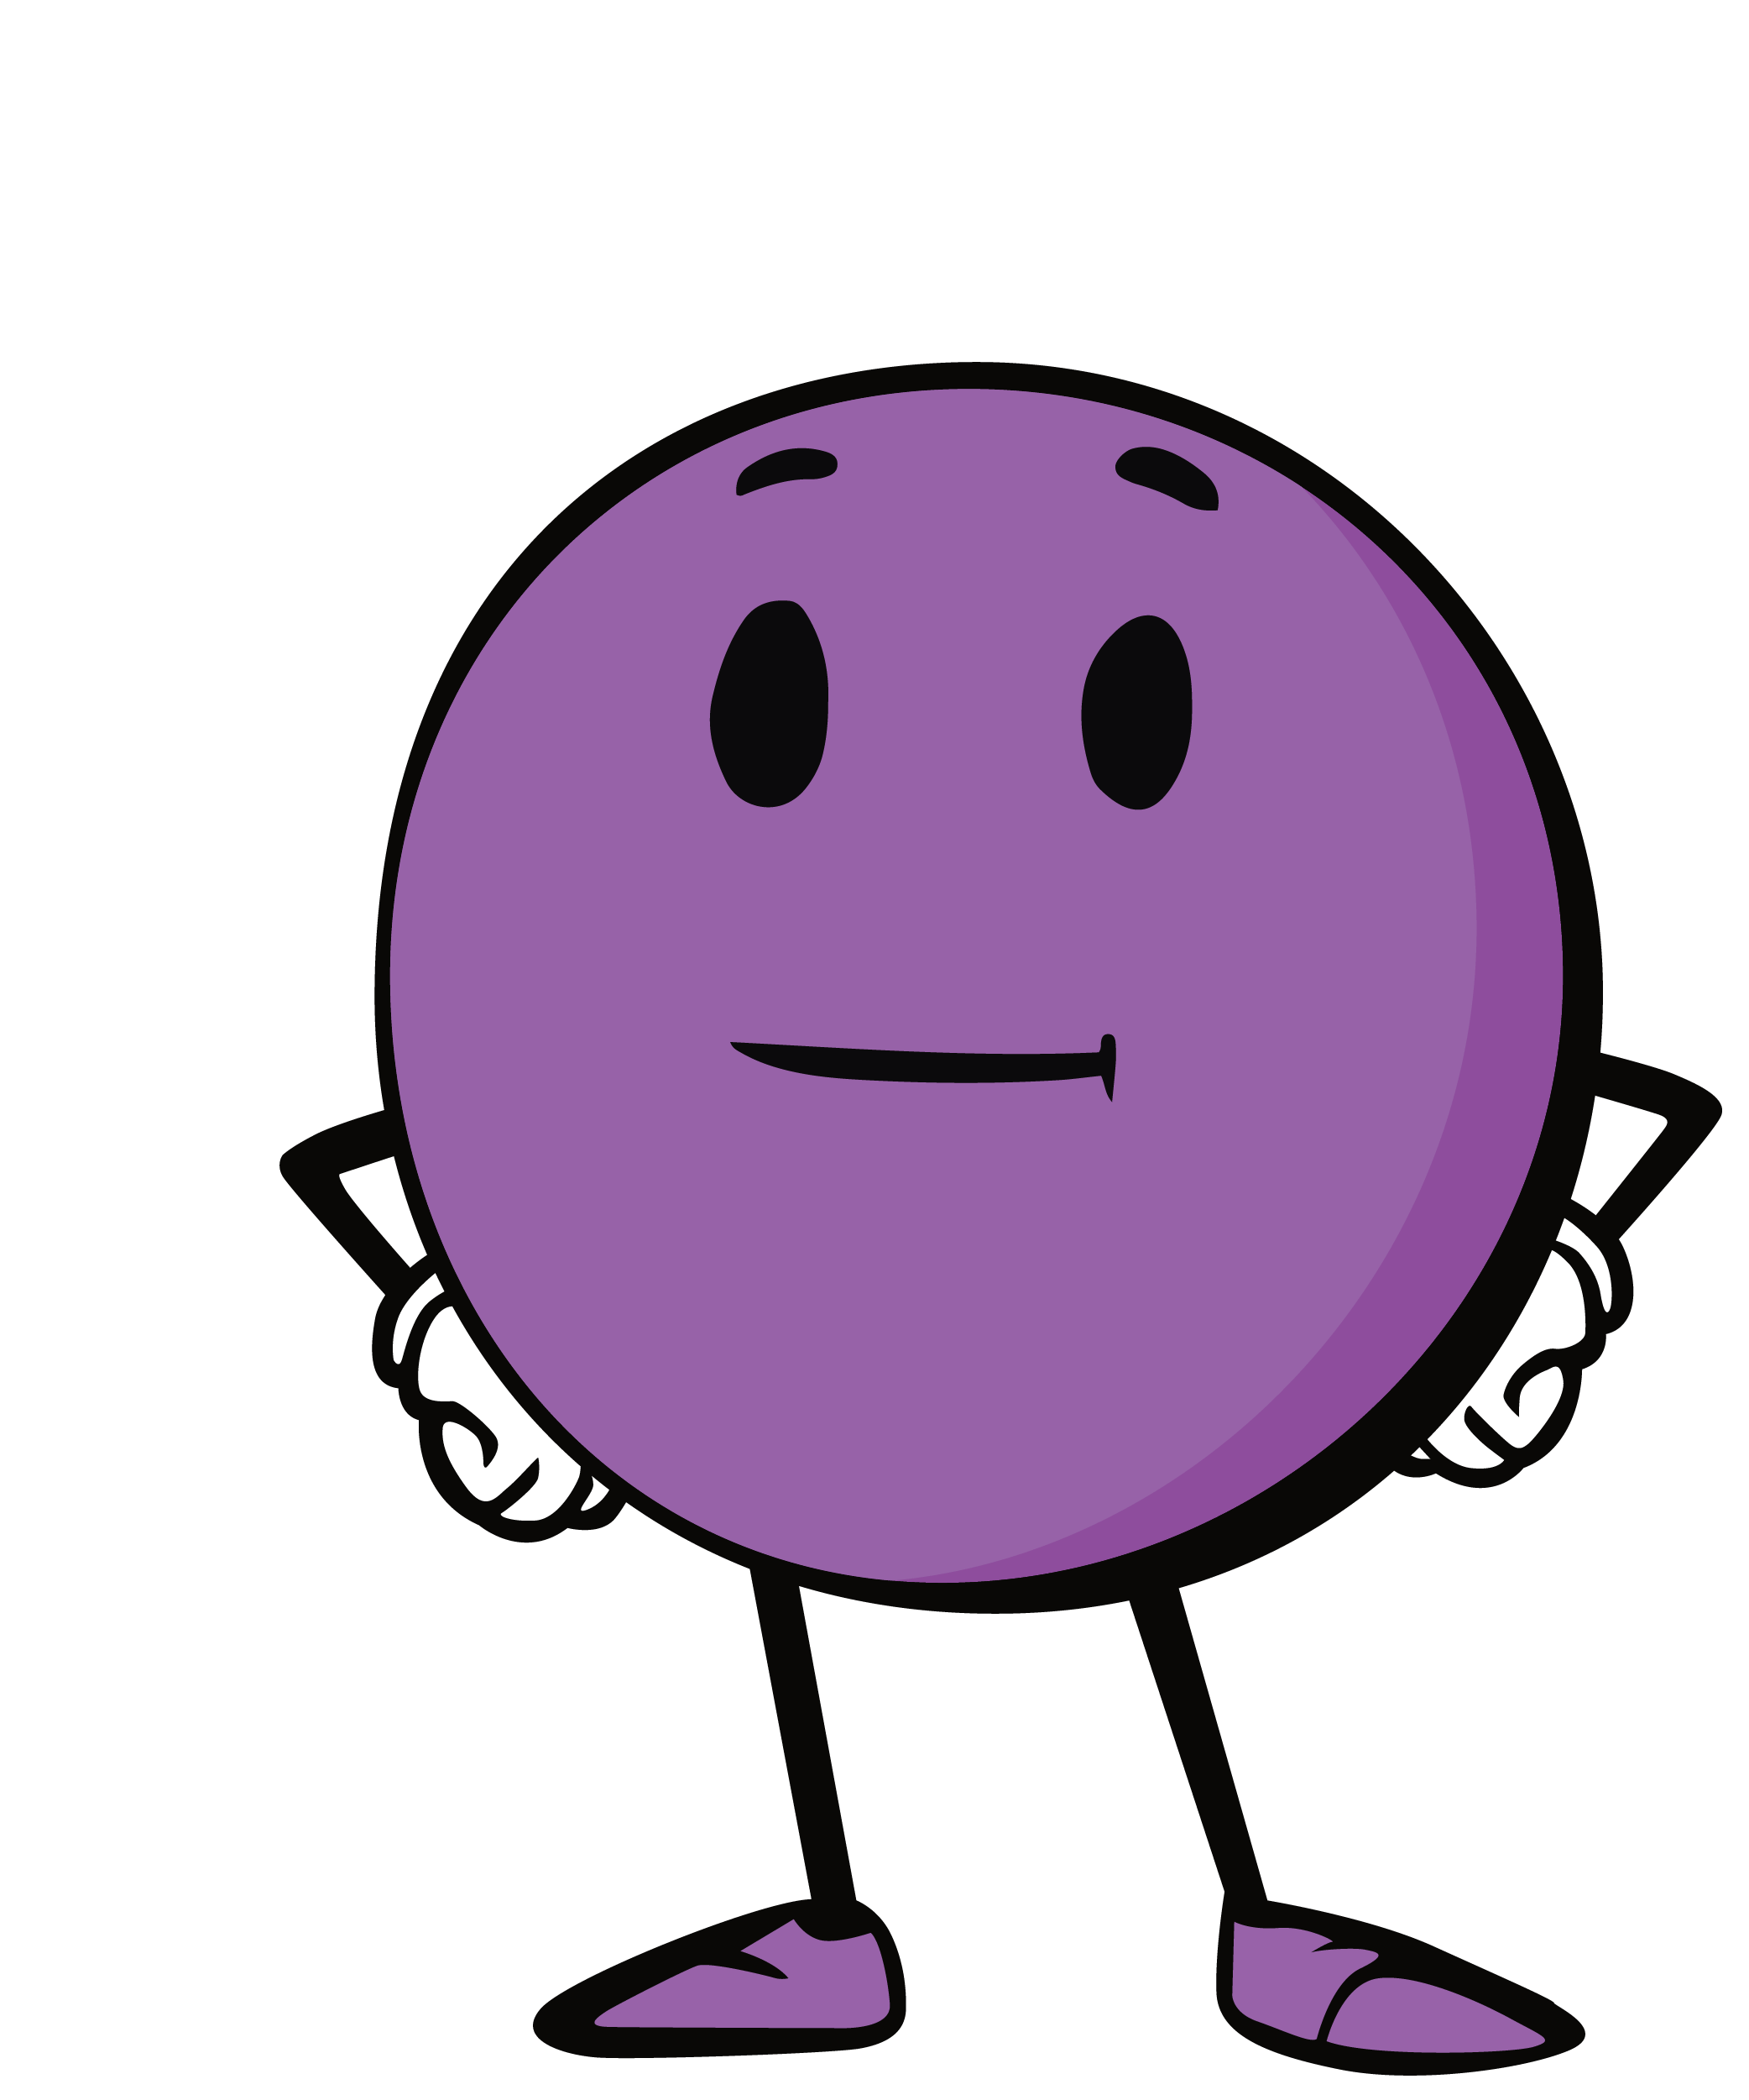
MBF 5 Safety Rules

Slide 13
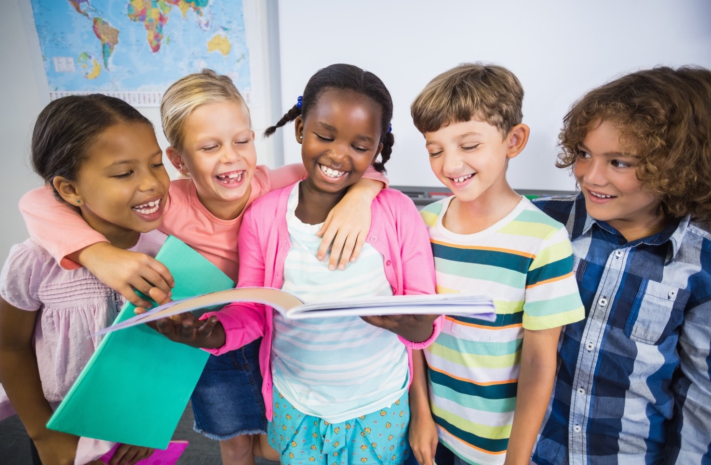
Great job!

