Slide 1
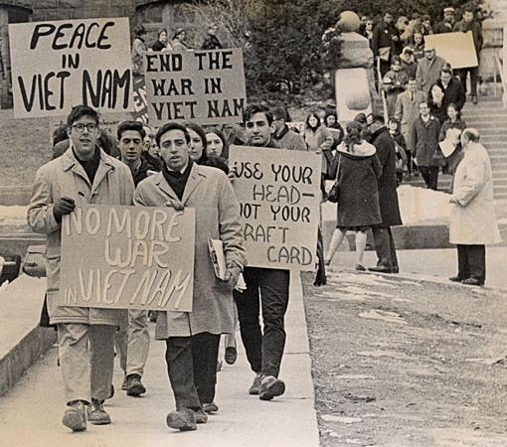
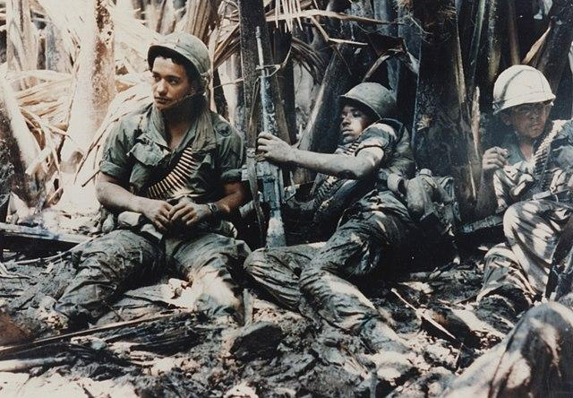
Vietnam War
10/12/2021

Slide 2
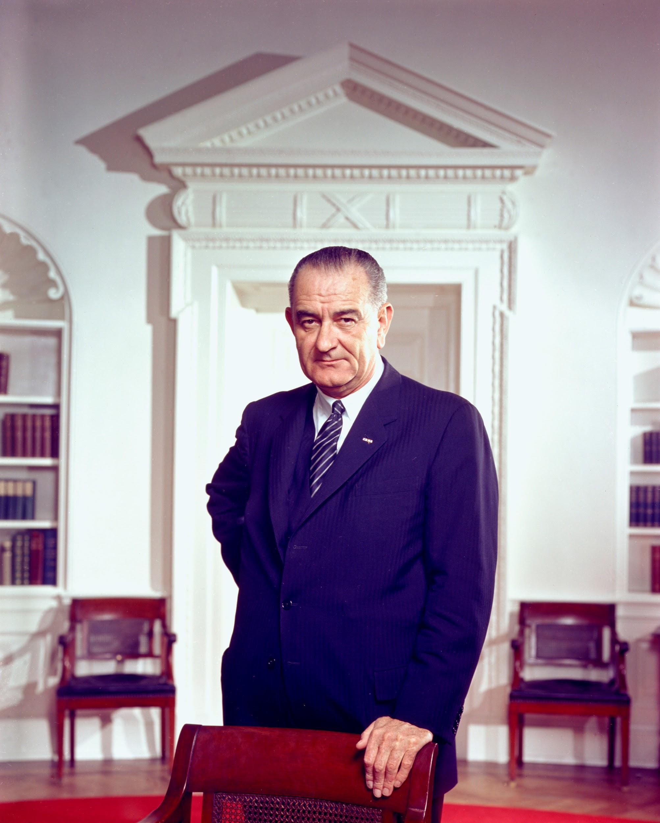
The Great Society- President Johnson’s Domestic Program
Funded Head Start and provided school lunches
Created now AmeriCorps VISTA program
Created Medicare and Medicaid
Ended quotas on immigrants based on where they’re from
Provided funds to build low income housing
Protected 9 million acres of wilderness from development

Slide 3
Communism Characteristics
State ownership of land
Classless society
Seeks to eliminate religion
Income redistribution

Slide 4
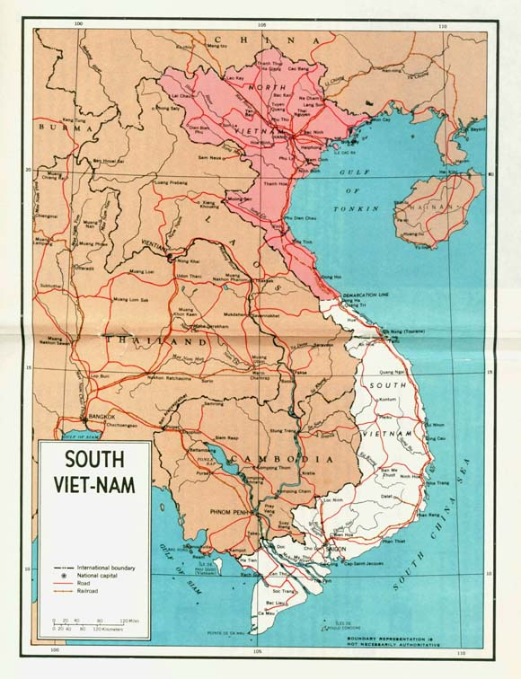
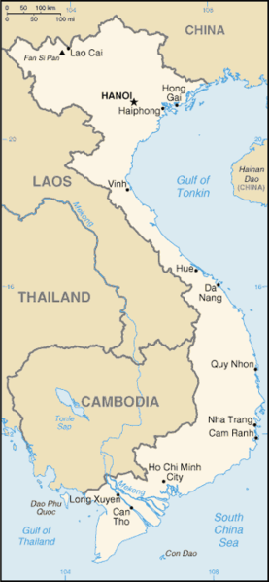
Map of Vietnam-North Communist

Slide 5
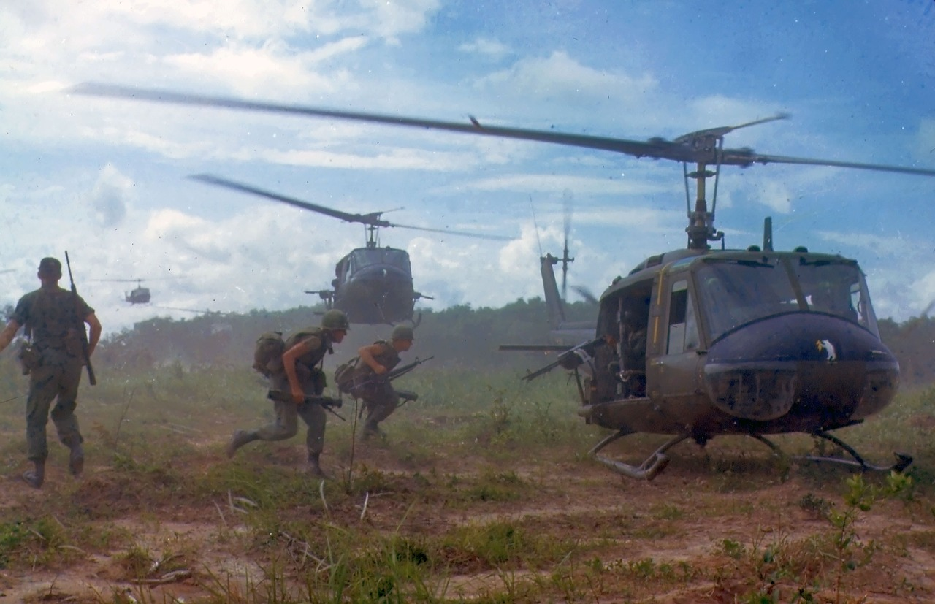
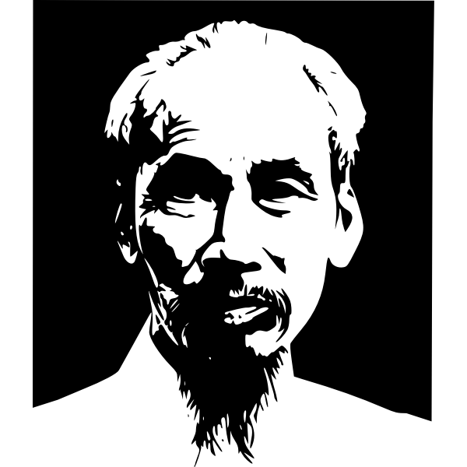
Vietnam War 1955-1975
Vietnam was a French colony
Northern Vietnam was controlled by a communist leader, Ho Chi Minh
Southern Vietnam was controlled by a French backed leader, Ngo Dinh Diem
“Domino theory” -if one nation becomes communist in a region others will follow

Slide 7
Vietnam & The Gulf of Tonkin Resolution
President Eisenhower pledged to oppose communism
North Vietnam’s Viet Cong began attacking Southern Vietnam
Ngo Dinh Diem was a religiously oppressive leader to the Vietnamese and was assassinated by the Vietnamese
August 1964 in the Gulf of Tonkin off the coast of Northern Vietnam the US ship Maddox was hit with machine gun fire from North Vietnamese
2 days later it was claimed that the North Vietnamese attacked again
This lead congress to pass the Gulf of Tonkin Resolution and officially began the US involvement in Vietnam
In 2003 then Secretary of Defense, McNamara admitted that the second attack never happened

Slide 9
US Leaves Vietnam
President Nixon and Henry Kissinger agree to get of Vietnam and at the Paris Peace Agreement US agrees to leave
Nixon reduced the number of US troops by half by 1969
Vietnam war between the North and the South continues with the Communist North winning and creating a communist Vietnam
Americans didn’t understand until later that the Vietnamese were not fighting for communism, but were fighting for independence from the French the entire time

Slide 10
Nixon and the Watergate Scandal
June 17, 1972 burglars broke into a Democratic office at the Watergate Office building in Washington DC.
October 10, 1972 The Washington Post published a story based on a mysterious informant that the burglars were sent by the Nixon campaign to steal documents and tap phones.
The American public believed Nixon and re-elected him in November 17972
Nixon later ordered the CIA to interfere with the FBI investigation of the Watergate break in-this was the abuse of power that Nixon resigned over
Proof that Nixon interfered was available on recordings that were set up throughout the White House

Slide 11
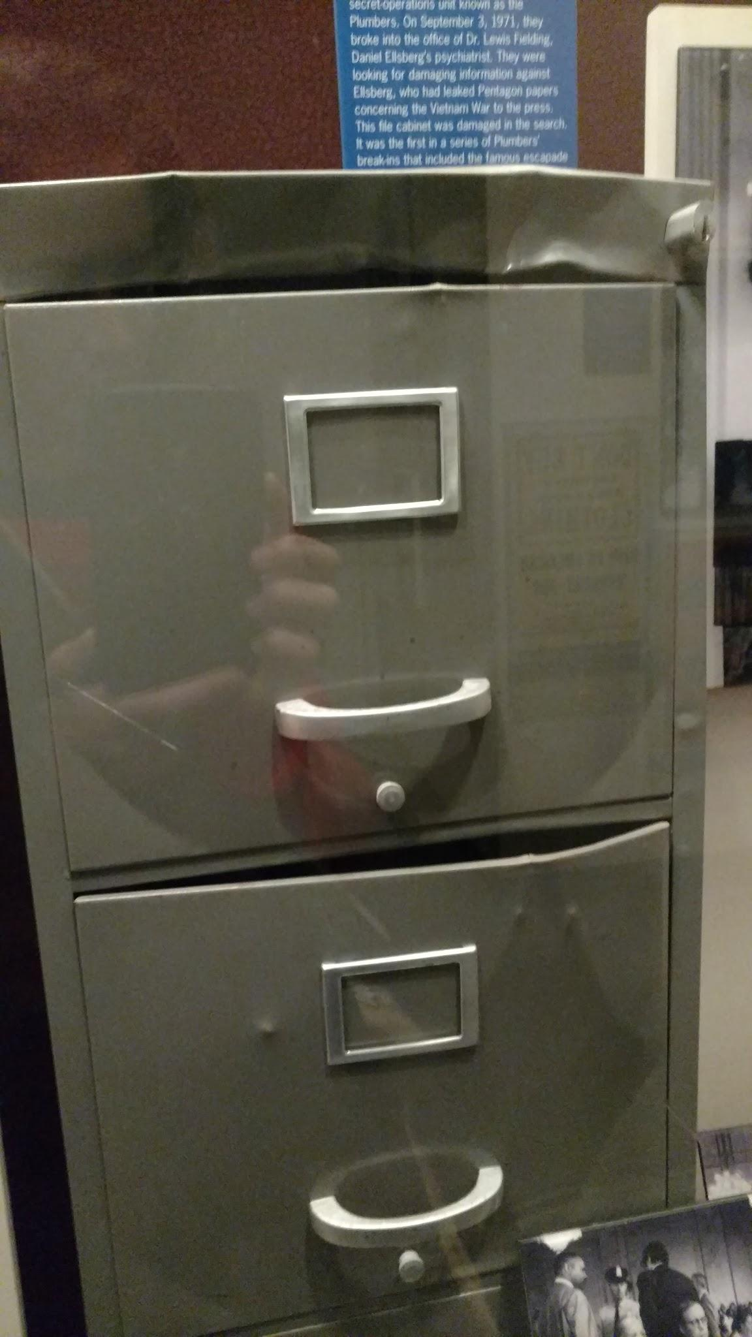
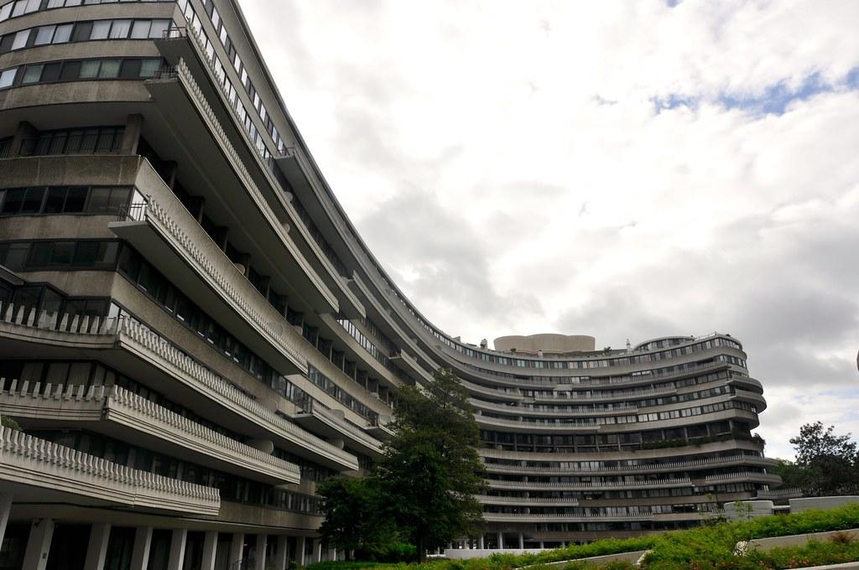

Slide 12
Notes:
Answer: A

Slide 13
Notes:
Answer: D

Slide 14
Notes:
Steck-Vaughn Unit 3, Lesson 16

Slide 15
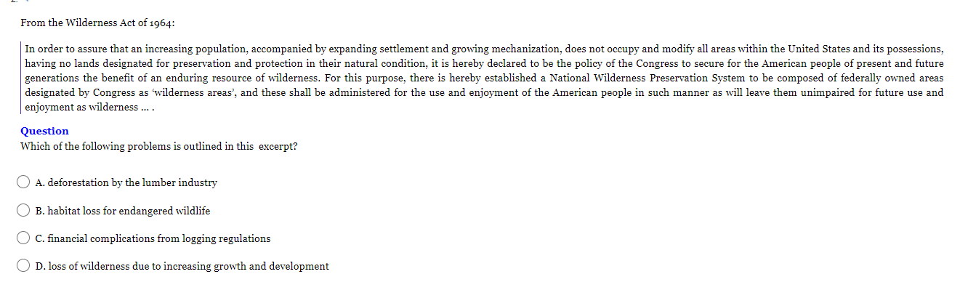
Notes:
Answer: D

Slide 16
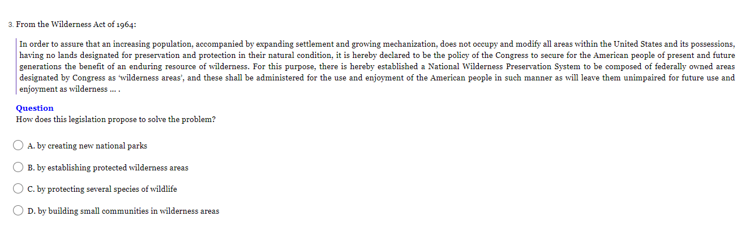
Notes:
Answer: B

Slide 17
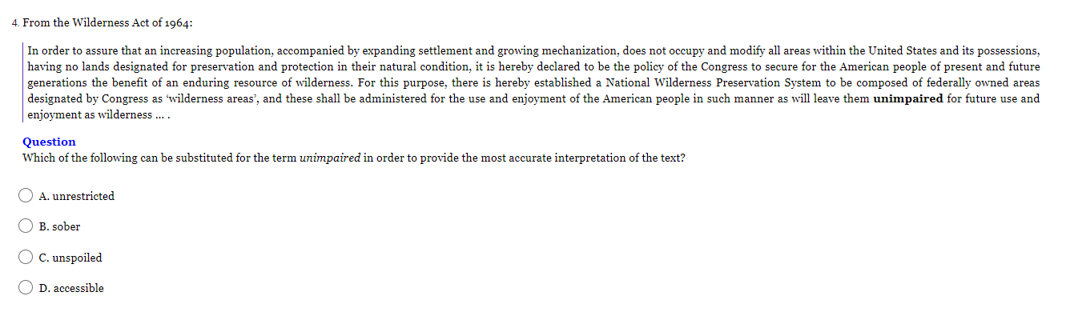
Notes:
Answer: C

