Slide 1
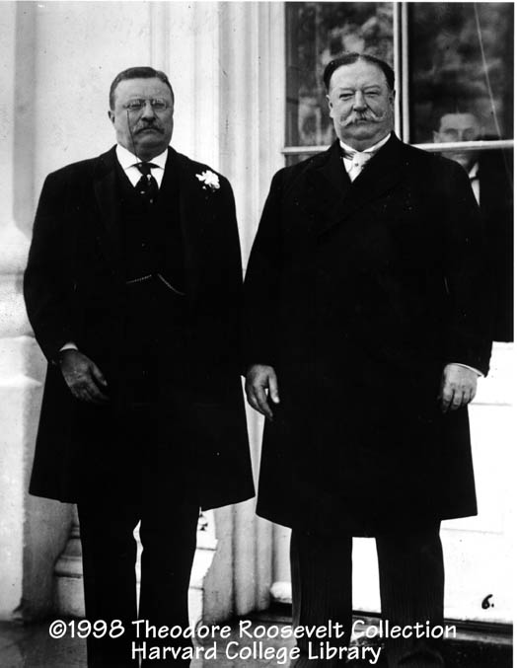
Taft and Election of 1912
Republican William Howard Taft easily defeated Democrat William Jennings Bryan to win the 1908 presidential election.
Fun fact – Taft is the only President to also serve on the Supreme Court.
Taft was Roosevelt’s Secretary of War

Slide 2
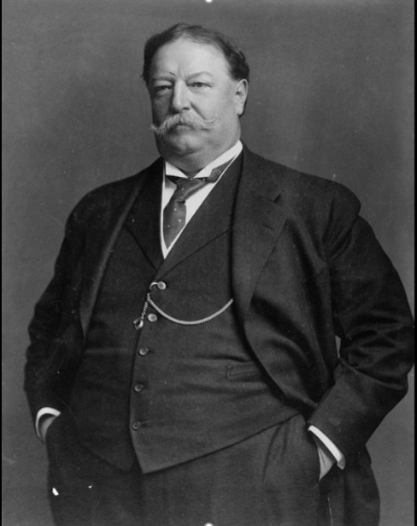
Taft’s Achievements
Taft busted twice as many trusts as Roosevelt.
Established the Children’s Bureau to fight against child labor.
Did a lot of good things towards conservationism.

Slide 3
Taft Loses Power
Taft signed the Payne-Aldrich Bill which raised tariffs and that angered Progressives in his own party.
He angered them again by firing Roosevelt’s Secretary of Interior (Gifford Pinchot) who was a big time conservationist.
Americans were unhappy with Taft too, so the Democrats won a majority in Congress in the 1910 midterm elections.

Slide 4
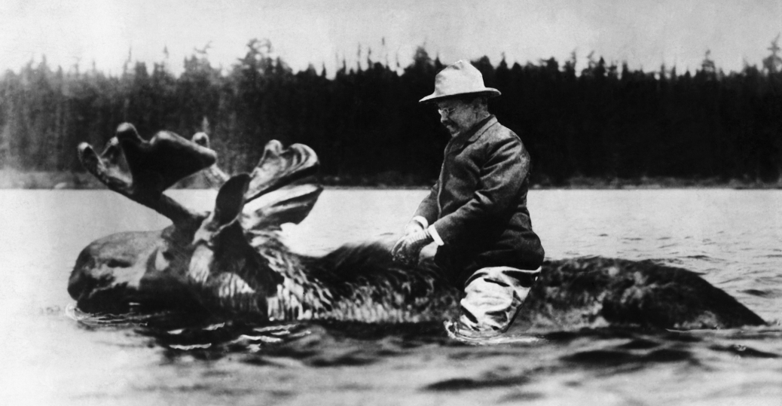
The Return of Teddy
Roosevelt was furious that Taft was undoing some of his work.
TR decided to run for President again in 1912.
Created the Progressive Party, which became known as the Bull Moose Party.

Slide 5
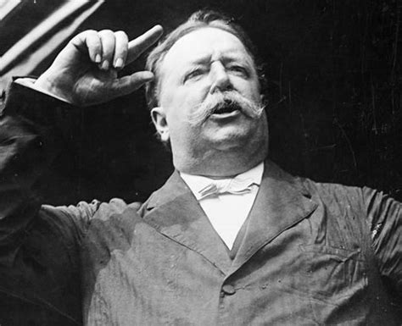
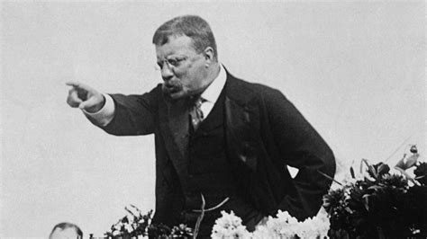
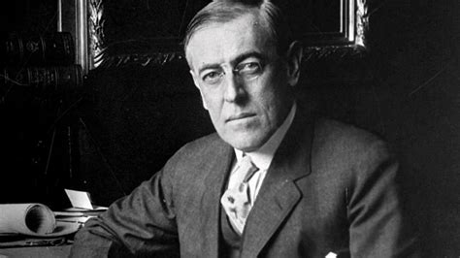
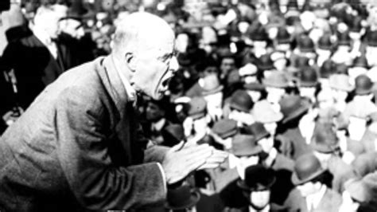
Election of 1912
William Taft – Republican
Teddy Roosevelt – Bull Moose Party
Woodrow Wilson – Democrat
Eugene Debs – Socialist Party

Slide 6
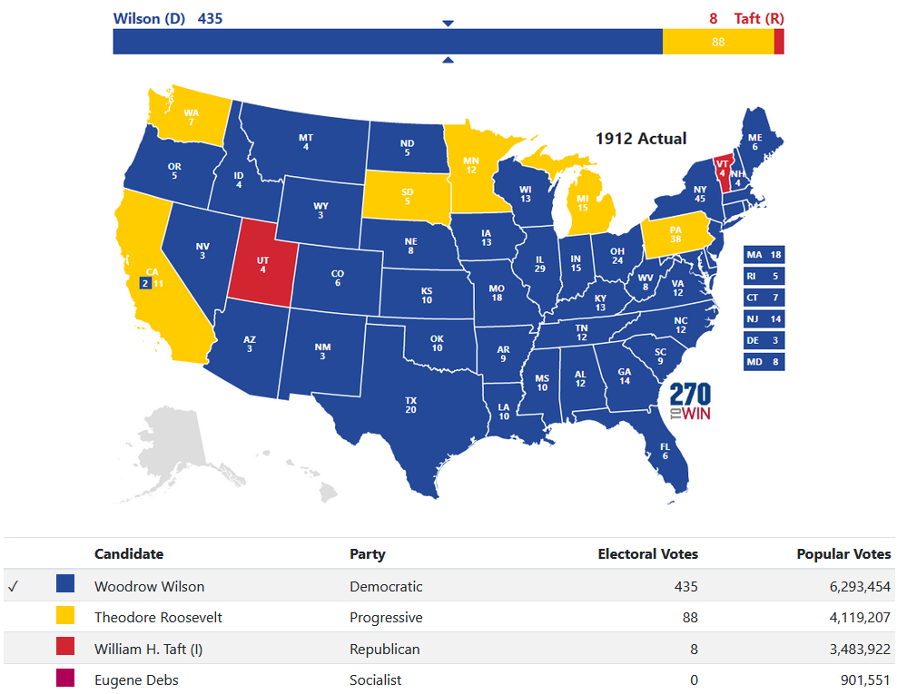

Slide 7
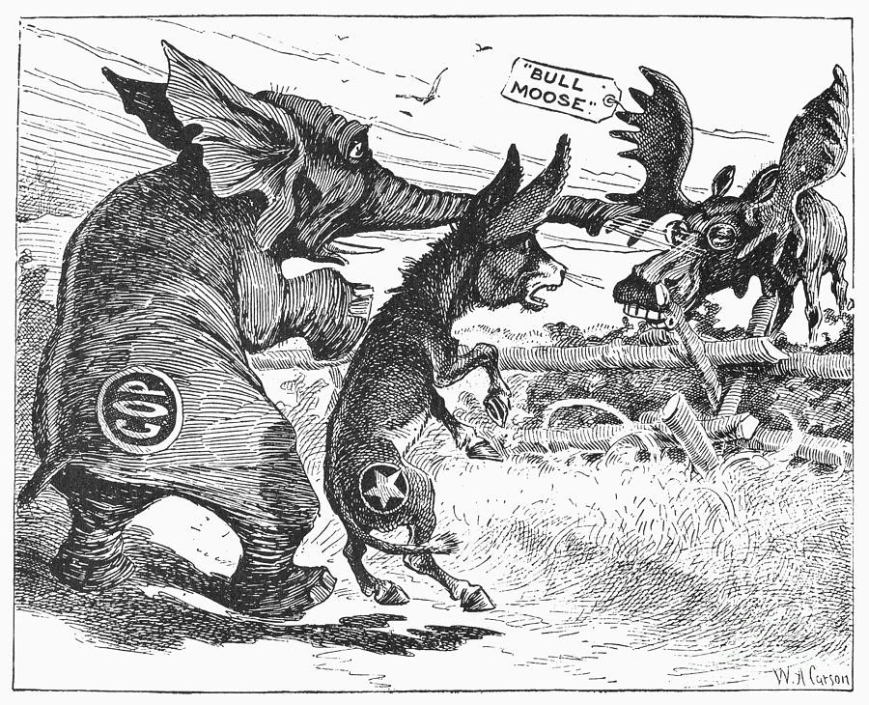

Slide 8
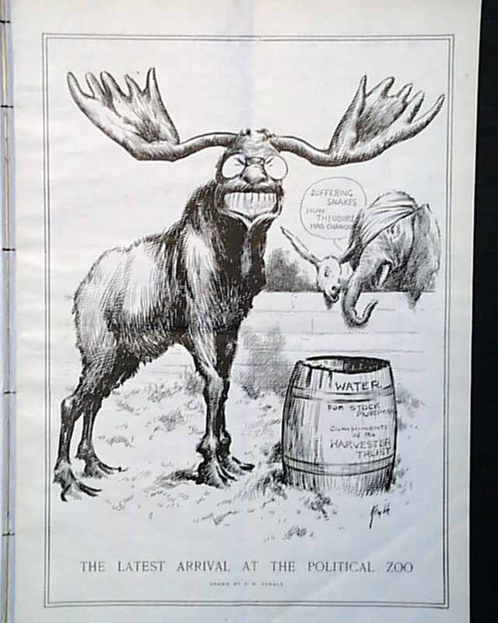

Slide 9
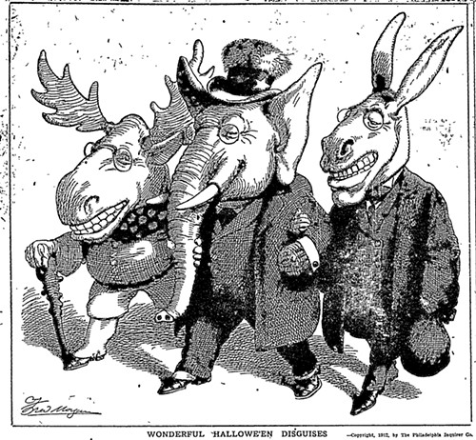

Slide 10
