Slide 1

Voices for the Vision
Shared Decision Making FAculty Meeting
Quail Run Elementary
3/18/2026

Slide 2

Agenda
Faculty Input Form
Our FE Program (highlights)
Achievement Data
2026 Parent Survey Results
Family Engagement Plan
School-Family Compact
Program Supports and Use of Funds

Slide 3
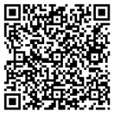

Parent Input Form
All school staff members must complete the Feedback Questionnaire

Slide 4
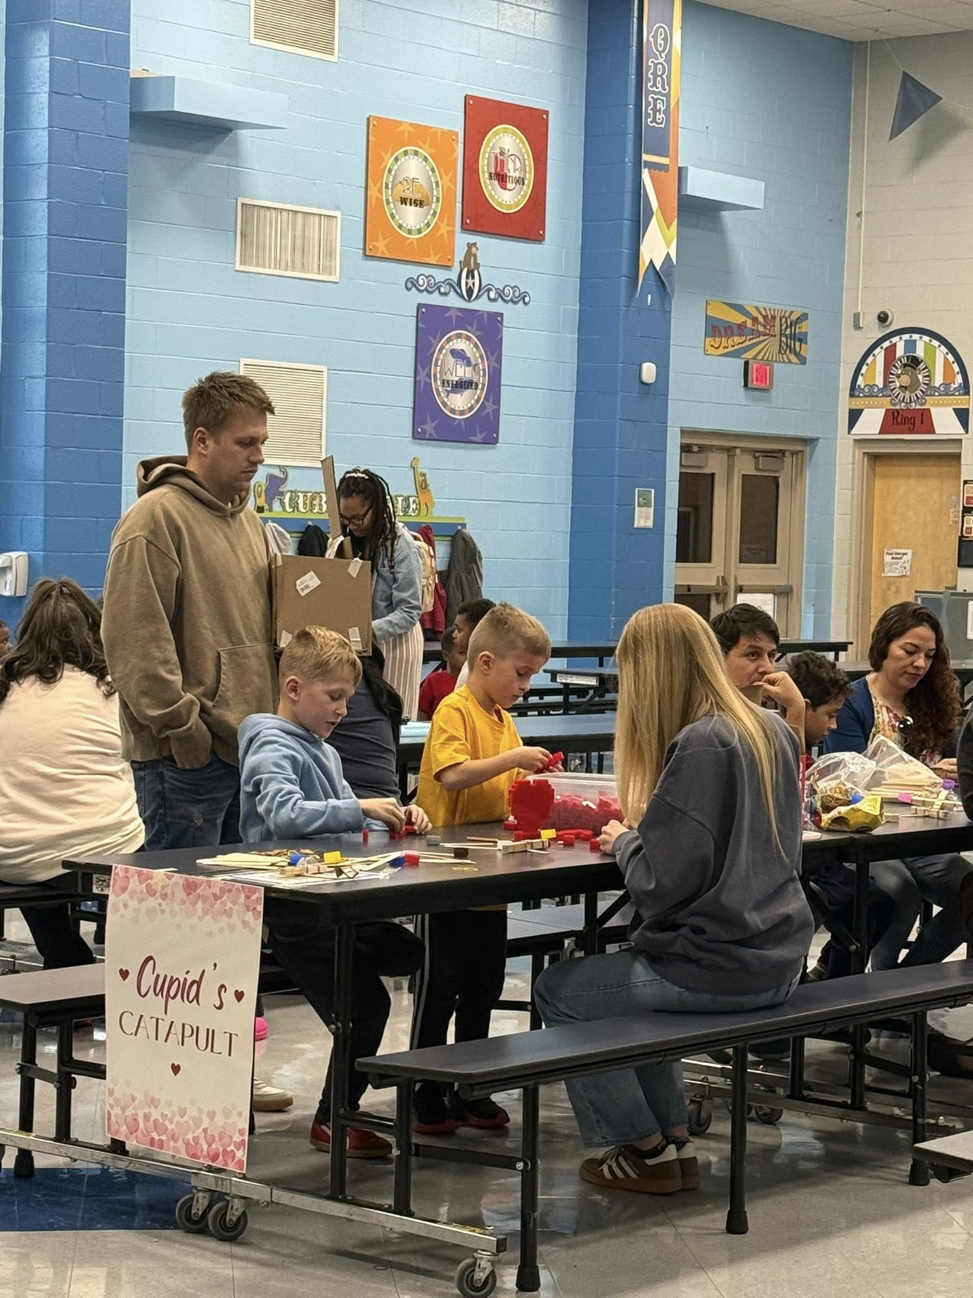
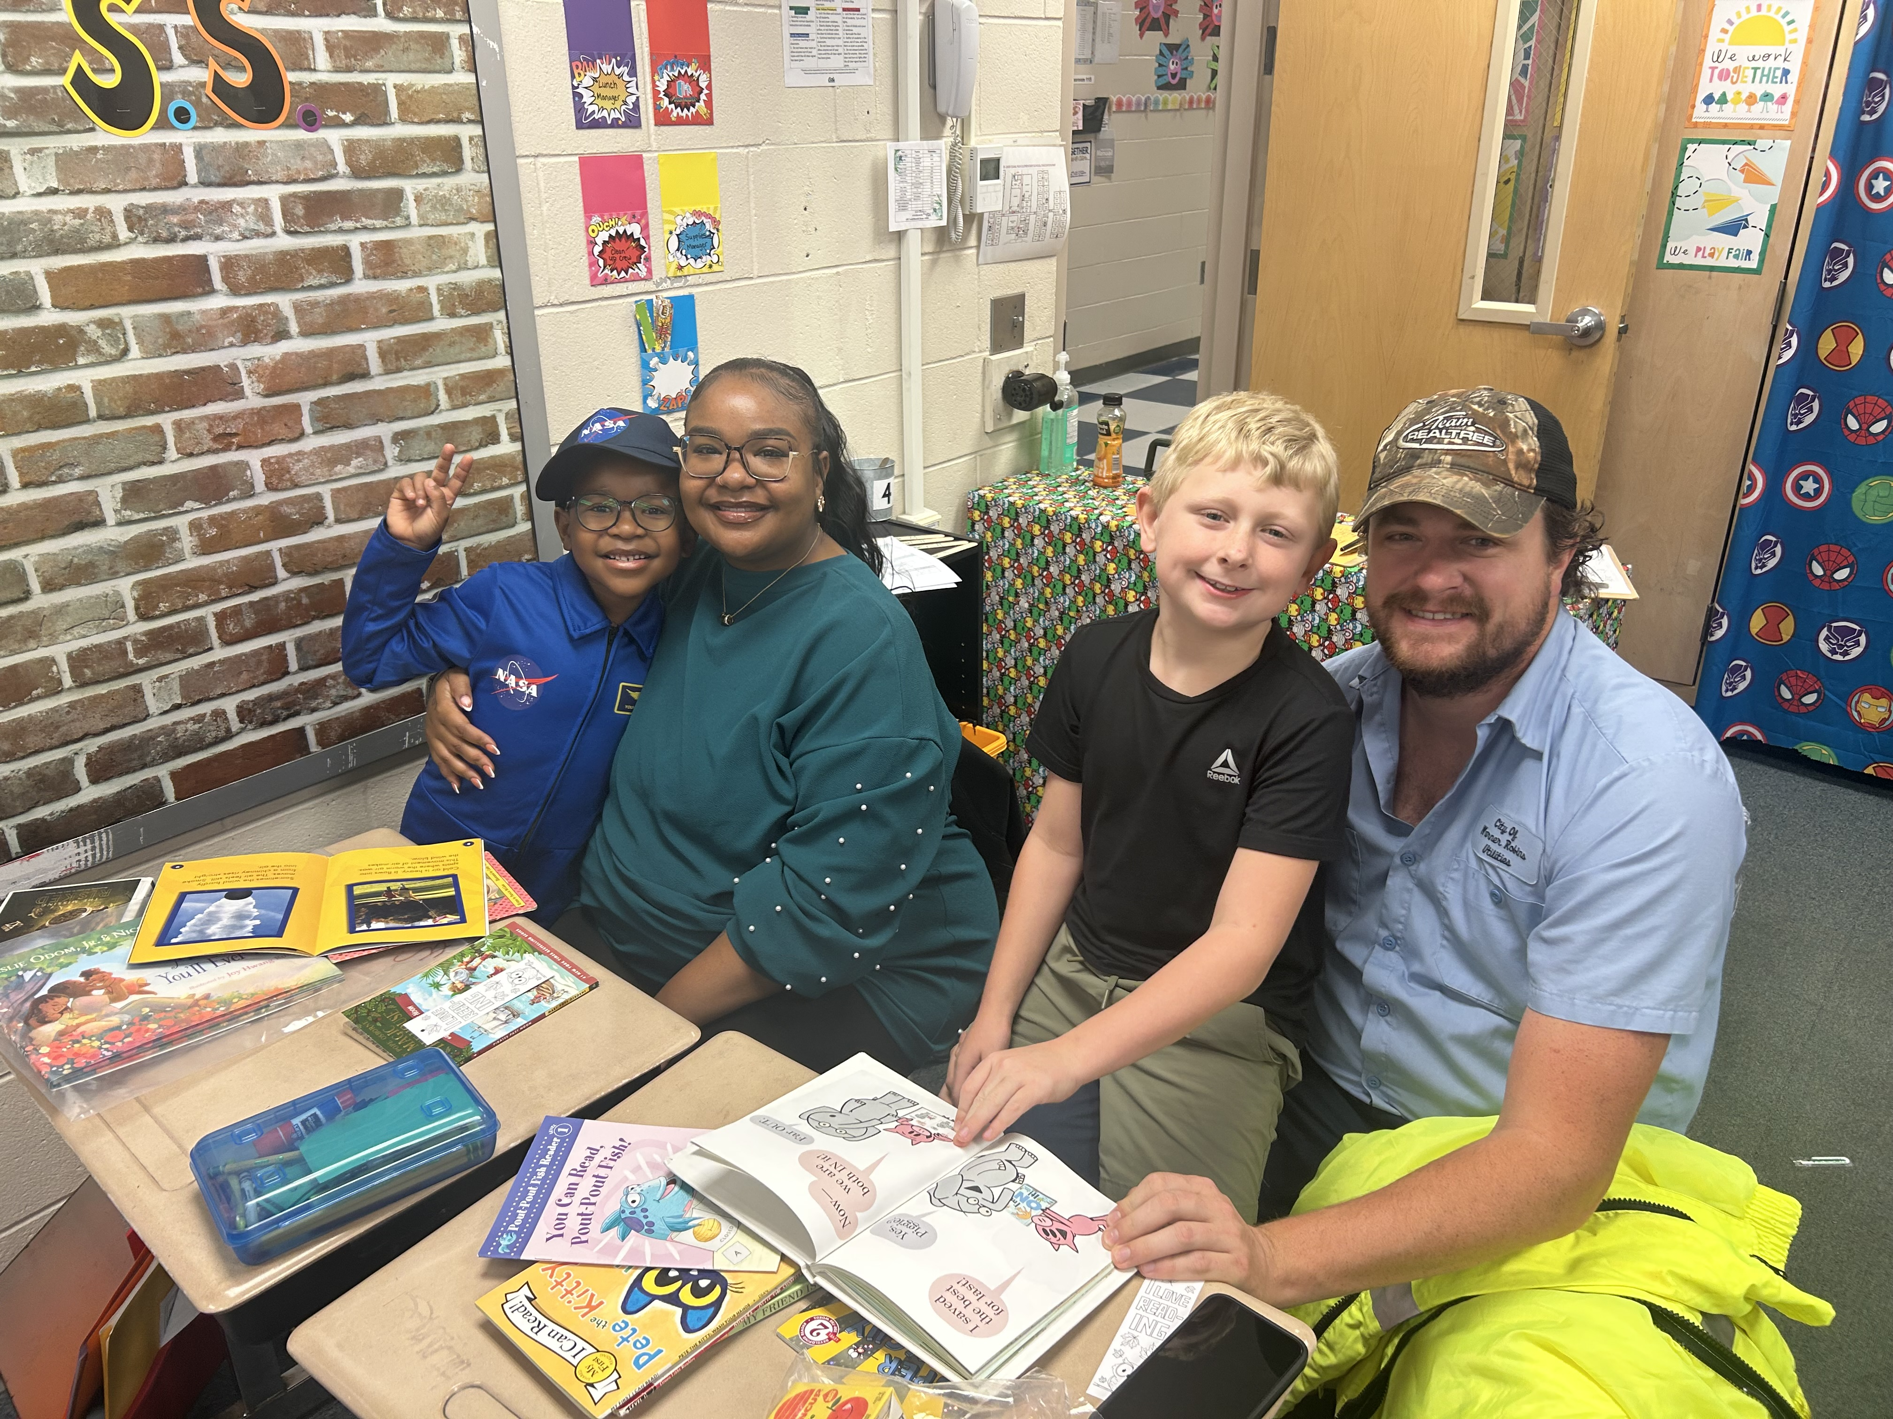
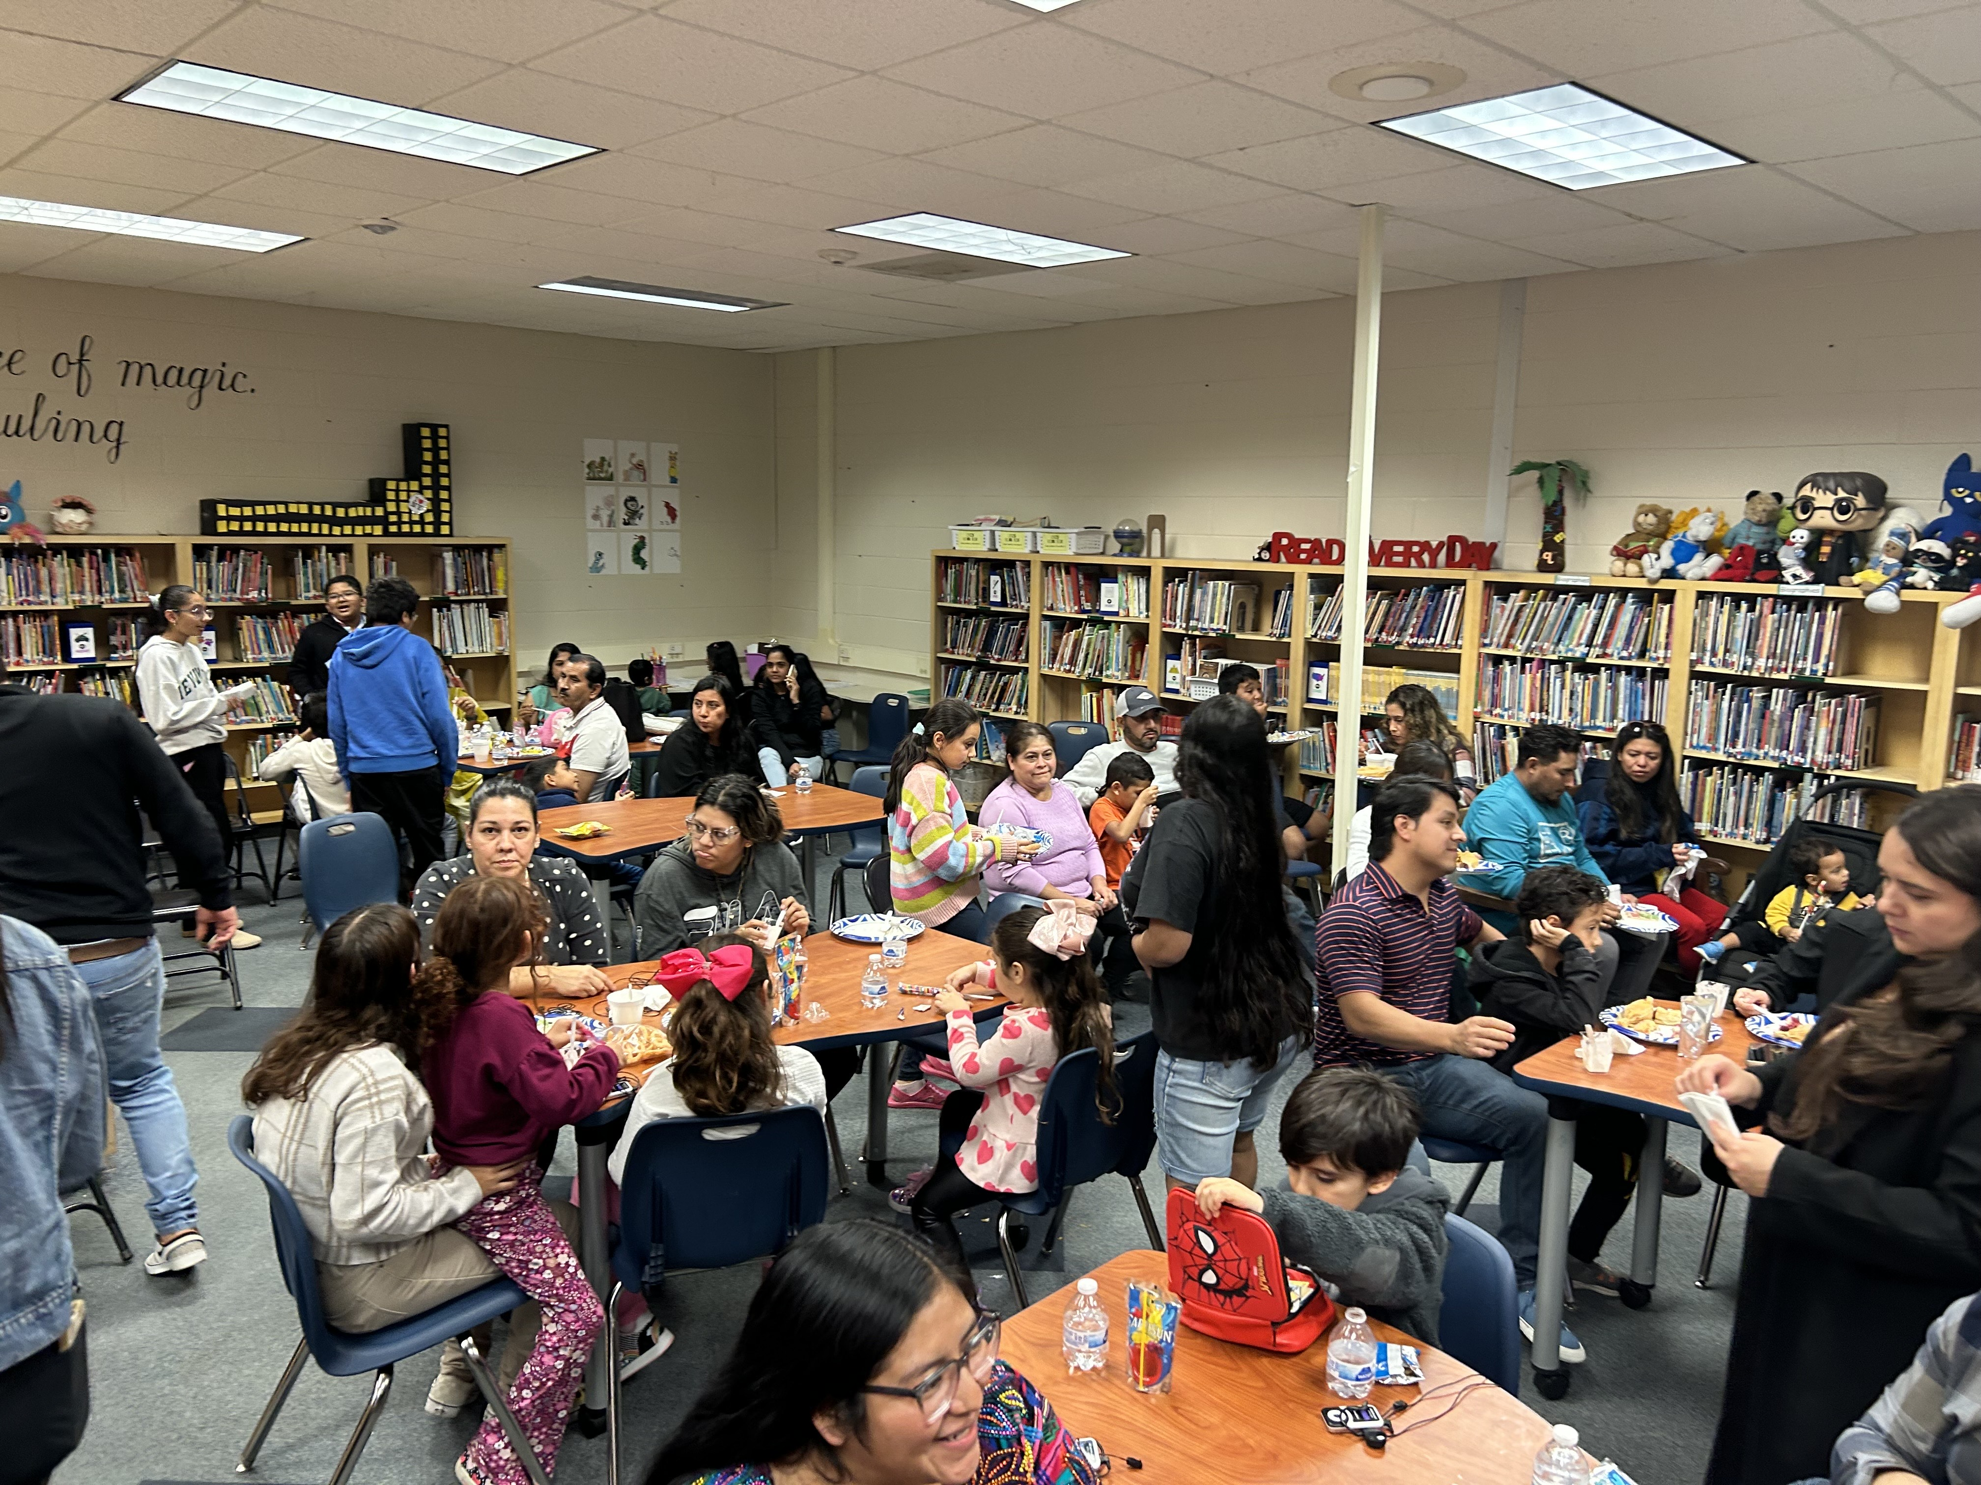
A Glimpse at Family Engagement at
Quail Run Elementary!
Bridging Languages, Building Learners
Fall Into Reading!
Love, Logic & Learning

Slide 5


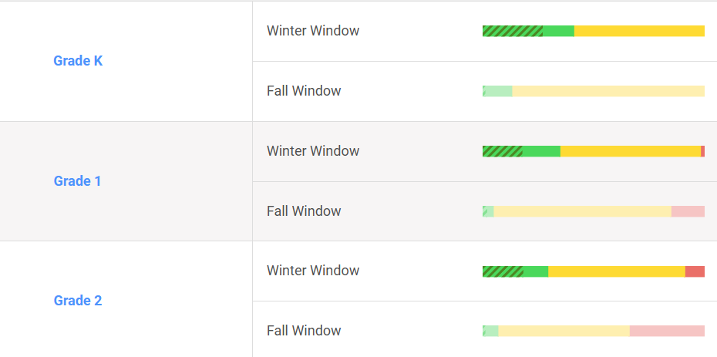
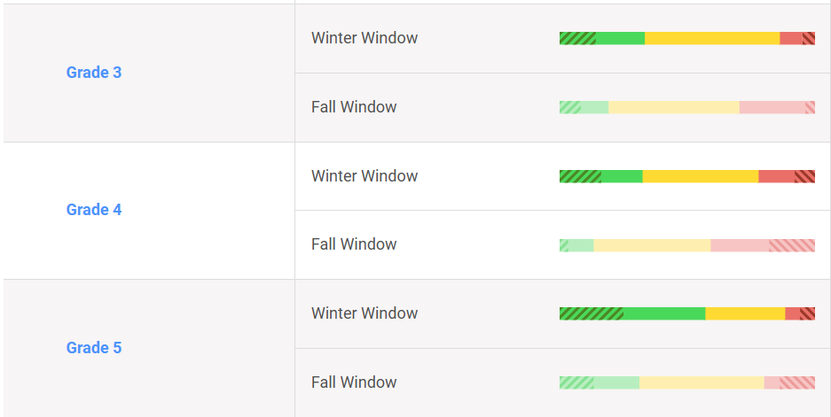
Achievement Data
Math
iReady K-2 Math Fall to Winter Growth
iReady 3-5 Math Fall to Winter Growth

Slide 6
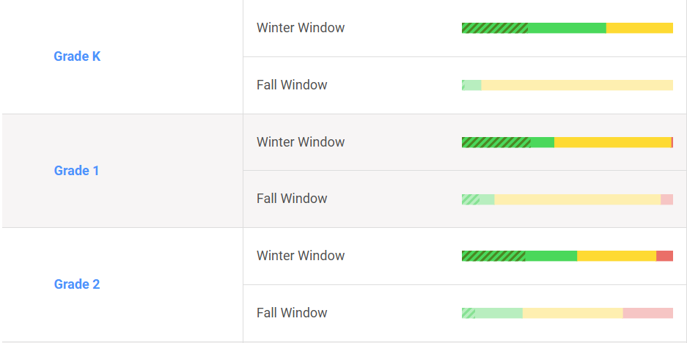
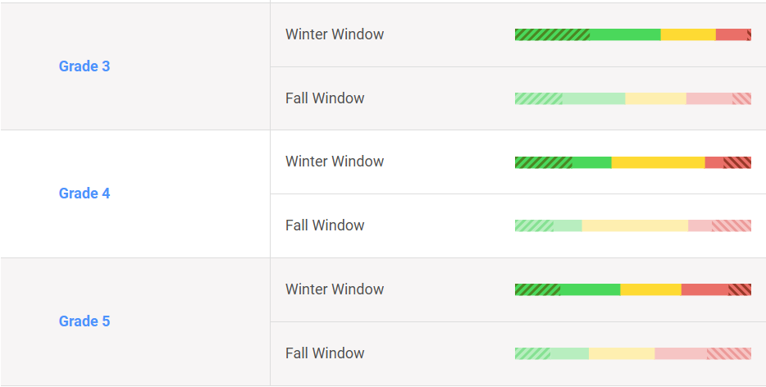
Achievement Data
Reading
iReady K-2 Reading Fall to Winter Growth
iReady 3-5 Reading Fall to Winter Growth

Slide 7
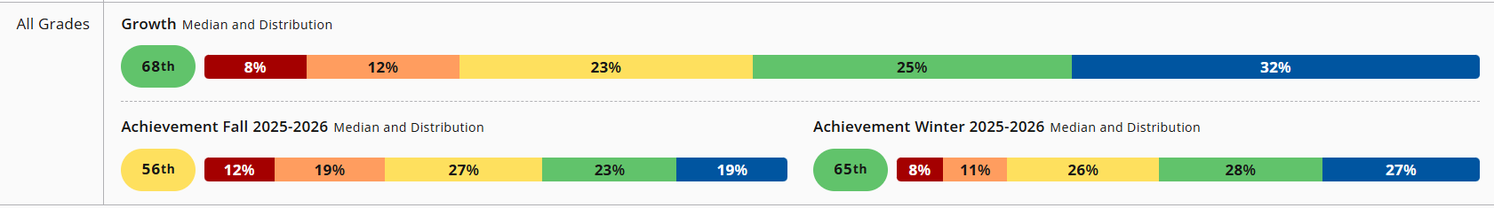
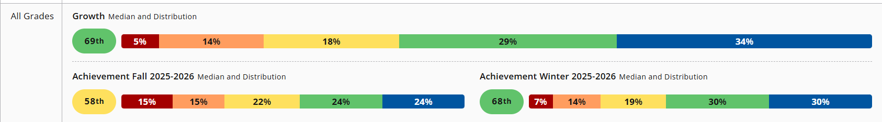
Achievement Data
MAPs
MAP Math school growth
MAP Reading School Growth

Slide 8




2026 Parent Satisfaction Survey Results
Received Information about Academic Requirements
School Offers Parent Workshops
Preferred Method of Communication
Preferred Day and Time for Academic Family Events
Text Message – 32.65%
Email -10.20 %
HCSD App – 22.45%
Social Media -4.08 %
Wednesday -19.80 %
Friday -29.70 %
Morning – 31.25%
Evening – 47.92%
All/Most of the Time – 75.51%
Some of the Time -22.45 %
All/Most of the Time: 75.51%
Some of the Time – 24.49%
None of the Time - 0%

Slide 9
Family Engagement cOnnection
Events | Event Type | Date
Fall Into Reading | Literacy | 10/29/25
ESOL Night | ESOL | 11/17/25
Thanksgiving Lunch (K&2nd) | Welcoming Climate | 11/20/25
Christmas Lunch (1st & 4th) | Welcoming Climate | 12/11/25
Valentine Lunch (3rd & 5th) | Welcoming Climate | 2/10/26
The Sweet Side of Technology | Tech | 1/16/26
Love, Logic and Learning | MATH/STEM | 2/12/26
Were you able to attend any of these family engagement events this year?
If so, in what ways can we improve the event(s)?
What other academic-based or family-fun type activities would you like us to consider offering?

Slide 10
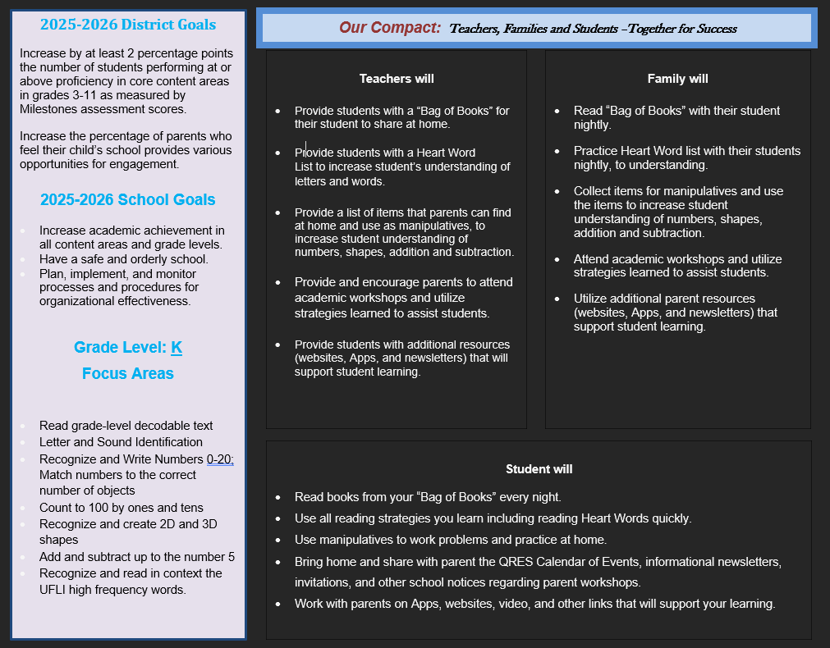
School-Parent Compact
What is the ONE academic concept you believe every student in your grade level should master before going to the next grade?
What can our school do to better support students and their families in meeting this goal?
What are some things parents and students can do to help students obtain mastery of the concept?

Slide 11


Program Supports
And Use of Funds
How can we increase family engagement and participation?
What family engagement topics do you think teachers and administrators need to discuss or learn more about in order to support our students and their families?

Slide 12

FEL Contact Information
Eric Baker
Eric.baker@hcbe.net
478-953-0415 ext 8802

