Slide 1
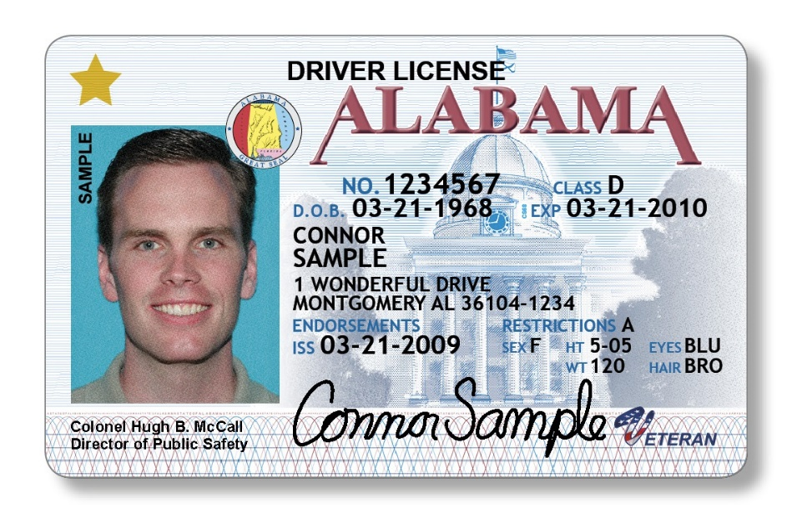
THIRD PARTY TESTING PROGRAM
The Alabama Driver Education Cooperative

Slide 2
BACKGROUND
Joint Venture between ALEA (Alabama Law Enforcement Agency) and SDE (State Department of Education)
Began in 1998, with Senator Lowell Barron initiating the idea of Driver Ed. Teachers administering tests to their students.
After two years of successful trial runs, using select teachers throughout the state, the bill was introduced and passed.
Law 2000-241 allows Driver Education teachers to administer the examination to their students.
Training and monitoring is to be done by the Alabama State Department of Education.

Slide 3
THE LAW
Elective program for driver education teachers.
Must have permission of the Superintendent to participate.
Act 2000-241 allowed public schools to administer testing.
Act 2012-501 allowed private schools to administer testing.

Slide 4
IMPORTANT POINTS TO REMEMBER
A student may pass Driver Education but fail the driving test of skills necessary for a Third Party Certificate.
This program is an added benefit of taking Driver Education, but is not a regular part of the curriculum.
Students can pass both the classroom and driving portion of the class and fail or not be ready for the road test.

Slide 5
IMPORTANT INFORMATION
The instructor must keep documentation of road test skills on file until student has graduated.
These are legal documents that can be challenged in a court of law.
It is the responsibility of the instructor to keep accurate documents, stored in a secure area.
Be prepared to produce these documents during on-site monitoring by SDE personnel.

Slide 6
RATIONALE FOR PROGRAM
Reduce lines and work load for ALEA
Saves parents time and money
Student does not have to provide a
vehicle to take test
Student more comfortable with teacher
Same skills tested at school as at ALEA

Slide 7
PROS AND CONS
CONS
Extra work for teachers
Make families angry at teacher—pressure from others
PROS
Good for the students
Helps the parents
Helps ALEA

Slide 8
2021-2022 INFORMATION
It is being administered in almost every school system offering driver education.
This past year 19,312 certificates were issued throughout the state during the Fall/Spring. 35,630 students were enrolled in Driver Ed.

Slide 9
GETTING STARTED
Announce that you will be administering the driver license test to eligible students
Explain the requirements: skills, learners license, and parent permission
Set a cut off date for students to become eligible to aid in planning your tests
Teach the required minimum of 30 hours of classroom instruction
Teach the driving skills as required in Alabama Course of Study
Decide who has the skills to be tested and set up your testing plan.

Slide 10
PARENTAL PERMISSION FORM
You must have parental permission for each student enrolled in the 3rd Party Program.
Keep these forms on file, along with the students’ skills checklist
These forms must be available during on-site monitoring by SDE personnel.

Slide 11
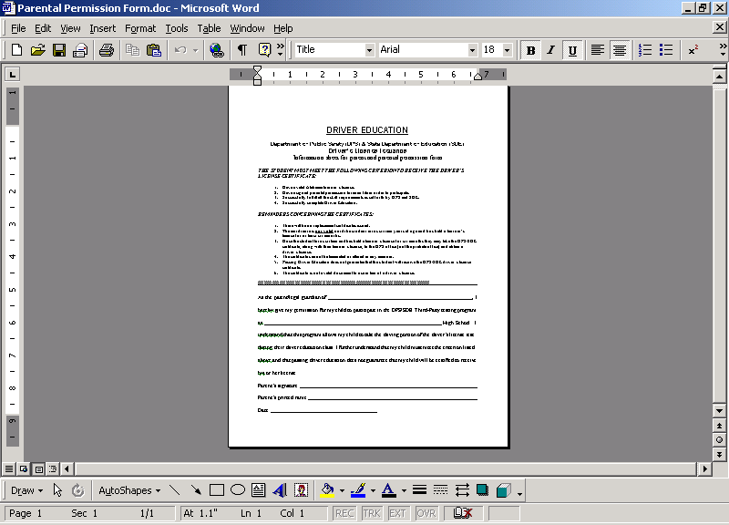
PARENTAL PERMISSION FORM
You must have parental permission for each student enrolled in the 3rd Party Program.
Keep these forms on file, along with the students’ skills checklist
These forms must be available during on-site monitoring by SDE personnel.
SEND THESE HOME AT BEGINNING OF SEMESTER AND HAVE
A CUT-0FF DATE TO TURN BACK IN FROM EACH STUDENT.
Staple this form to the skills checklist.
Encourage parents to cut and keep the top portion for their own information

Slide 12
SDE/ALEA THIRD PARTY TESTING PROGRAM
SKILLS CHECKLIST

Slide 13
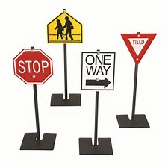
SKILLS TESTED
Form is a pass/fail type test
Came directly from the ALEA form
Combined “needs training” and “acceptable” into pass
Fail for same things as ALEA
Suggest each teacher have “routes” or areas for each when testing
May re-test at discretion of teacher
Have at least 2 students in the car at all times.

Slide 14
SKILL REQUIREMENTS
PLAN A ROUTE/AREA THAT INCLUDES THE FOLLOWING SKILLS:
Reacting at two stop signs
Reacting at two red traffic lights
Three left and right turns
Starting and stopping
Backing in a straight line
Stopping and starting on a hill
3 Point Turnabout

Slide 15
OTHER REQUIREMENTS
Also, check the following skills:
Proper posture
Proper following distance
Being attentive at all times when behind the wheel
Reacting at signs other than the stop signs
Being able to keep the car in the proper lane
Understanding the right of way rules

Slide 16
SKILLS TEST
Read carefully the actions that are cause for failure of the skills test.
If a student makes any of these dangerous actions during their test then it is a failure.
A student MUST have all checks in the “pass” column to receive a certificate.
You may test skills cumulatively or have one test day set aside for all the skills.
Remember: You are giving your “Stamp of Approval” on the students’ driving skills—take this responsibility very seriously.

Slide 17
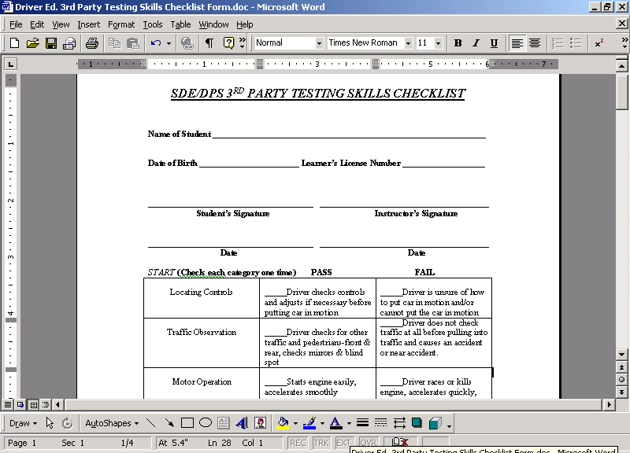
SKILLS CHECKLIST
FILL OUT THE REQUIRED PERSONAL DATA. USE THE LEARNER’S LICENSE FOR THIS INFORMATION.
Michael Wayne Smith
06/18/2000
1234567
MAKE A COPY OF THE LEARNERS LICENSE AND
ATTACH TO THIS FORM TO USE AS A REFERENCE

Slide 18
THE TEST
Make sure you test on ALL skills.
Do not short cut on any skills. LIABILITY
If a student fails the test at some point then you can cut it off at that time or finish the test.
Only test those that, in your opinion, are ready to be tested. You will know from your teaching of the skills and riding with them previously if they are ready.
Have 2 -3 testing routes. Maybe have a test route that you take on the way out with one student and then another coming back with the 2nd student. It is okay to teach the ALEA route but try to find a different route for your testing.

Slide 19
THE TEST
Try to avoid using the same route(s) after a student has failed and is being tested for the 2nd time.
Know where you will score each skill, but if the student commits a violation of the law or does a dangerous action anytime during the test then they should fail.
If you don’t have areas for all required skills – then simulate them
Ex. No traffic lights, use a “simulated” situation at an intersection, but explain it well to the students

Slide 20
GIVING INSTRUCTIONS
Give the directive as far in advance as possible.
Tell them WHERE before WHAT.
Ex. At the next intersection please make a right turn.
Avoid pointing out the traffic control device, try to use landmarks.
Ex. Try to say “at the red building or at the next street to the left, instead of at the traffic light or at the stop sign”.
Give instructions clearly. If you say turn right then point or gesture in that direction.

Slide 21
IMPORTANT
NEVER INSTRUCT OR COACH WHEN TESTING!! Do not tell or show them how to do a maneuver.
You are basically riding as a passenger merely observing their driving skills.
But still take normal cautions and take control of the vehicle if needed.

Slide 22
FAILURES ON THE ROAD TEST
Violation of a law
A dangerous action
Any accident that could have been prevented, regardless of legal fault
Lack of cooperation or a refusal to perform any maneuver
Note: Rather the student be mad at you for 99 years than dead in one year.

Slide 23
GETTING STARTED
Give a “pre-speech”
Tell them that today your are not the “teacher” but the “examiner”. Remind them to drive as they normally would. Tell them that you will give them instructions on what to do well in advance of the skill, turn, etc. Remind the student that they can ask you questions if they do not understand what you have ask them to do but you CANNOT GIVE THEM ANY ASSISTANCE in performing the skills.
Give the student the chance to ask any questions prior to beginning the test.

Slide 24
SHOULD BE THE SAME STATEWIDE
SKILLS TO BE TESTED
EACH SKILL SHOULD BE PERFORMED SEPARATELY, DO NOT COMBINE SKILLS
Exception: Backing following Quick Stop

Slide 25
STARTING
Locating controls – student should know the location of all controls. It is up to you how to handle this. But you should at least observe that they adjust their seat and mirrors and put on their safety belt. (New: brake check)
*Traffic Observation – watch to make sure that they check traffic and surroundings, both front and rear, before moving. Should involve more than just the mirror checks (blind spot).
Mirror, Mirror, Blind Spot
Motor Operation – observe that they start the motor easily, can put the vehicle in the proper gear and gives smooth pressure on the accelerator as they move out. Should move out quickly and smoothly.

Slide 26
STOPPING
Test a smooth, quick, emergency stop
Stop the vehicle as quickly and safely as possible from a slow rate of speed.
*Traffic observation – the student should look into their rear view mirror before braking and as they start to brake.
Distance – observe that the student brings the vehicle to a stop in a reasonable distance with smooth, even pressure on the brakes.
Lane – observe that the student keeps the car in their lane and maintains control.
Simulate a child running out in front of the car or a ball rolling into the roadway

Slide 27
BACKING IN A STRAIGHT LINE
Minimum distance 50 ft. at less than 10 mph -hand position 12 o’clock
*Traffic observation – student should look over their right shoulder UNTIL STOPPED.
Speed – observe that the student uses smooth acceleration and a constant speed under 10 mph.
Lane – observe that the student stays in their lane of traffic and moves in a straight line. (2 attempts allowed).

Slide 28
STOPPING ON A HILL (UPGRADE)
Wheel turn – observe that the student turns the wheel in the direction that would prevent the car from rolling into traffic. (don’t fail if this is done incorrectly)
Placement – the vehicle should be parallel and near the curb or side of the roadway (within 18 inches). You can teach to “brace” your tires against curb (2 attempts allowed).
*Parking brake – observe that the parking brake is applied correctly.
No hills in your area – simulate a situation

Slide 29
STARTING ON A HILL (UPGRADE)
Traffic observation – observe that the student checks front and rear using more than just the mirrors (blind spot).
*Brake control – observe that the student remembers to release the parking brake and does not roll back more than 12 inches.
Motor operation – make sure the student can move smoothly and safely into traffic.

Slide 30
TURNABOUT
3 point turnabout Use a regular 2 lane size area. Teach pulling to the side of the roadway and performing this skill within the confines of the roadway-no running off the pavement.
*Traffic observation – make sure the student checks in all directions before moving from the roadside.
Maneuvering – observe that the student knows which way to turn the steering wheel and how much turning is needed to complete the skill
*Positioning – make sure the student positions the vehicle correctly to complete the turn and does the skill in a smooth quick manner without running off the pavement or hitting the curb.

Slide 31
3 PT. TURN
SIGNAL TO RIGHT AND PULL TO EDGE
OF ROADWAY

Slide 32
READY TO START TURNABOUT
SIGNAL LEFT
GEAR, STEER, LOOK, GO
Drive, turn sharply right, mirror, mirror, blind spot

Slide 33
PULL TO EDGE OF ROADWAY AND STOP
GEAR, STEER, LOOK, GO
Drive, turn sharply right, mirror, mirror, blind spot

Slide 34
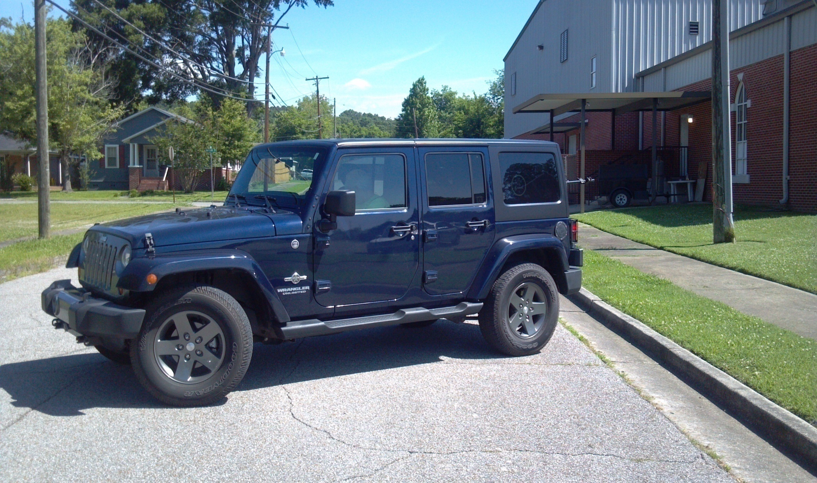
BACK UP, WITHOUT RUNNING OFF ROADWAY
GEAR, STEER, LOOK, GO
Drive, turn sharply right, mirror, mirror, blind spot

Slide 35
GO FORWARD IN YOUR LANE
COMPLETE TURNABOUT AS QUICKLY AS POSSIBLE

Slide 36
POSTURE
Observe throughout test
Observe that the student sits squarely behind the steering wheel with both hands on the wheel and able to reach all controls.
--Hand position
8 -4
10-2
9-3

Slide 37
FOLLOWING DISTANCE
Observe that the student keeps the minimum following distance for the conditions.
Testing in inclement weather??
Stopping behind another vehicle - how far back?

Slide 38
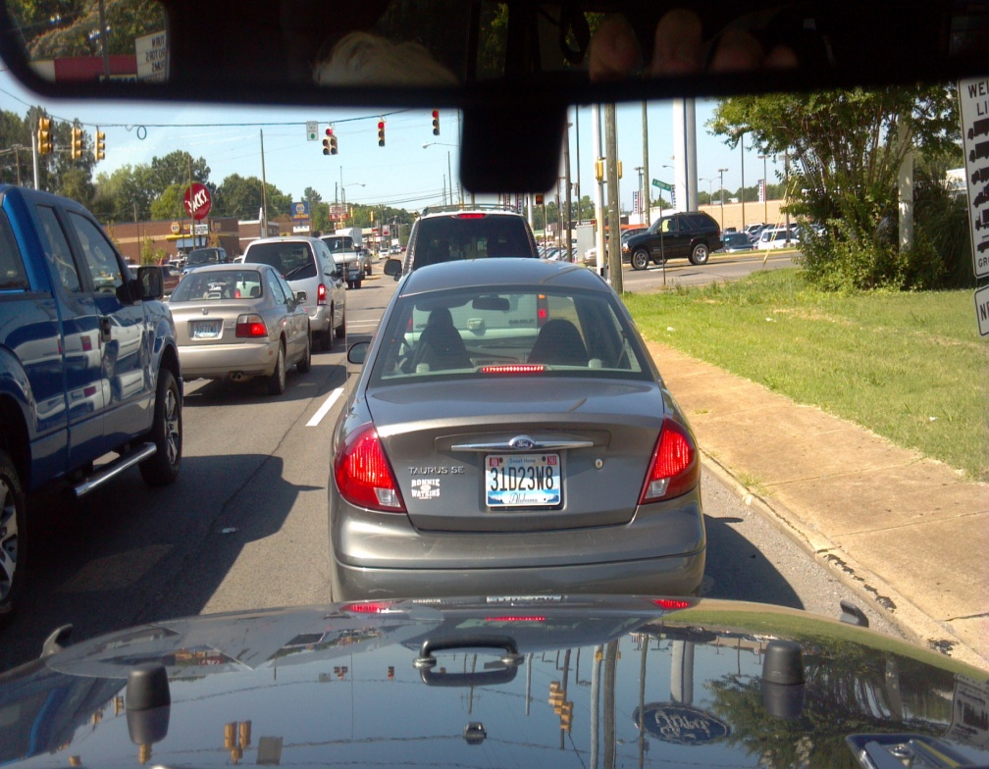
HOW FAR SHOULD YOU STOP BEHIND ANOTHER CAR?
TOO CLOSE BEHIND THE CAR
BE ABLE TO SEE THEIR REAR
TIRES TOUCHING THE ROADWAY
(where the rubber meets the road)

Slide 39
RIGHT OF WAY
Yielding and taking
Try to put the student in a “right of way” situation to observe if they know and understand this concept.
4 – way stop, yield sign, right on red, emergency vehicles, left turns, etc.
May have to simulate situation/ask for a correct response

Slide 40
OTHER SIGNS
Action - observe students’ response to posted signs
Ex. Speed limit – check speedometer
Observation – check to see if student is observing the driving environment.
May have to ask if they observed a previous sign

Slide 41
KEEPING IN LANE
Observe that the student knows and stays in the proper lane
Ex. Turning onto a 4 lane highway, observe that the student knows to turn into the far right lane
Ex. Instruct to turn left and observe that the student knows to turn into the left lane on a multi lane highway and then move to the right lane.
(basic rule of the road “keep right unless passing or turning left”).

Slide 42
ATTENTION
Observe that the student if attentive behind the wheel
Maybe ask about things occurring around the environment – without distracting the driver
*Watch for the student checking rearview mirrors often enough (every 5-10 seconds, more traffic=more often}

Slide 43
STOP SIGN
need 2 “graded” stop sign situations
*Braking – observe that the student comes to a COMPLETE stop smoothly and correctly.
*Placement – make sure the stop is completely behind the white stop line/stop sign/crosswalk.
Watch for checking mirror as slowing and stopping
What is a complete stop?

Slide 44
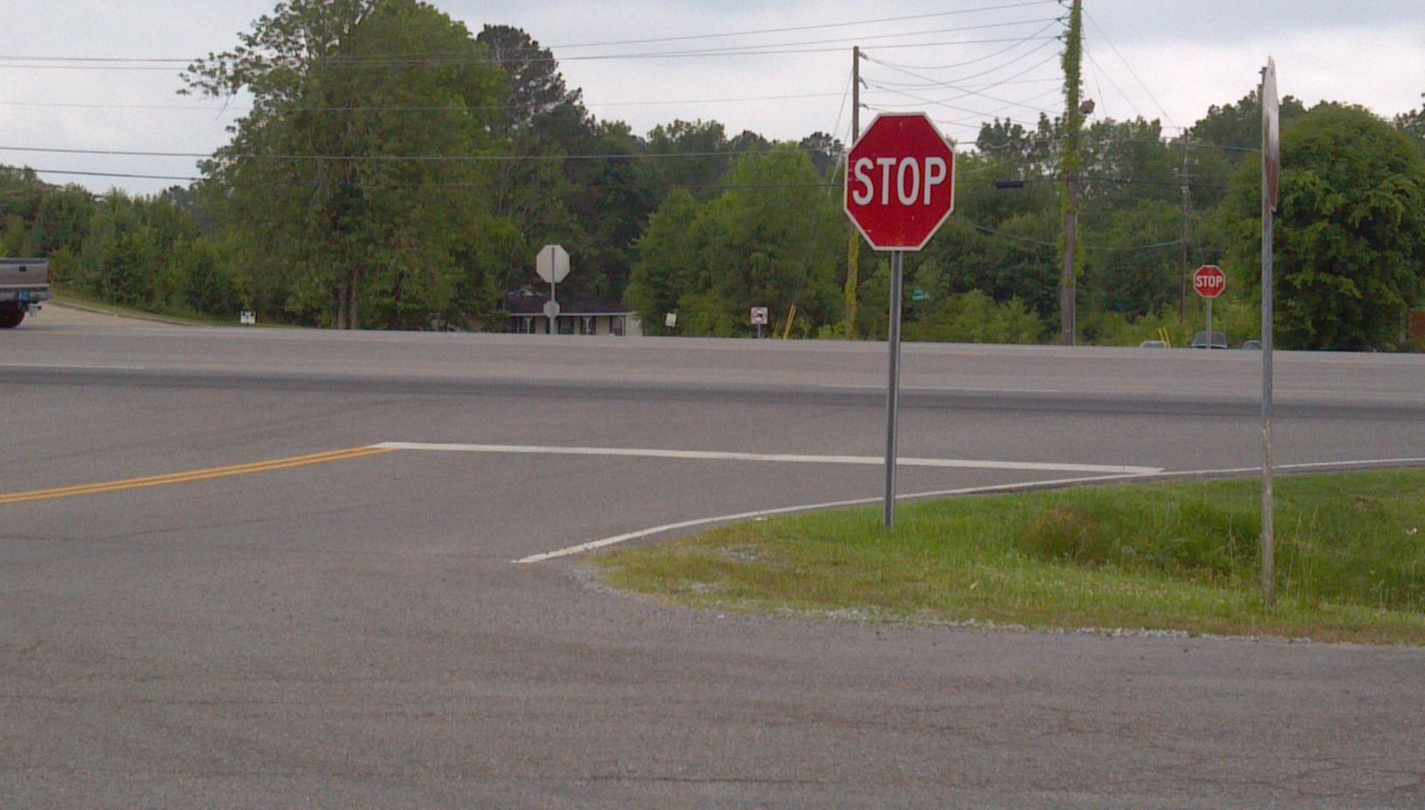
WHERE DO I STOP?
WHAT IF MY VIEW IS BLOCKED?

Slide 45
STOPPING FROM ALABAMA DRIVER MANUAL
At a STOP sign. A vehicle approaching a STOP sign must stop at the marked stop line.
If there is no stop line, the vehicle must stop before entering the crosswalk, if no crosswalk, the vehicle must stop before entering the crossing street. Stop at least even with STOP sign. (No line, read the sign.)
You MAY have to stop a second time if your view was blocked at the first stop AND there is conflicting traffic.

Slide 46
TRAFFIC LIGHTS
Need 2 situations – may have to simulate
Braking – observe that the student approaches the light correctly (stale/fresh) and comes to a smooth stop.
Placement – make sure the vehicle is stopped behind the white stop line/crosswalk.
Watch for turning right on red without stopping.
Teach correct approach to light – stale/fresh light

Slide 47
RIGHT TURNS
3 “graded” right turns required for testing, try to have a variety of situation (stop before turning, no stop before turning, traffic light turn, stop sign turn)
Signal – observe that the student signals well in advance of turn (100 ft./ ) and in correct direction. Also should signal before changing lanes.
Lane – observe that the student positions their vehicle correctly (near the right side of the lane) well in advance of the turn.
Speed – Observe speed control when turning, not too fast nor too slow, stops when necessary
Turn – Make sure student turns into correct lane without
swinging too wide or cutting too closely to the curb.
Two ways to communicate your intentions: signal and lane position.
Before braking
Telephone poles are approximately 100 feet apart
Turning right – keep it tight

Slide 48
LEFT TURNS
3 “graded” left turns required for testing, try to have a variety of situation (stop before turning, no stop before turning, traffic light turn, stop sign turn)
Lane – observe that the student positions their vehicle correctly (near the left side of the lane) well in advance of the turn. Gets into turning lane at proper time.
Speed – Observe speed control when turning, not too fast nor too slow, stops when necessary
Turn – Make sure student turns into correct lane without swinging too wide. Should turn left of center point and not cut across oncoming traffic lanes
Remember to move to right lane after completing turn unless passing or turning left again (soon).
Waiting – Observe that the student correctly positions car when waiting for oncoming traffic and does not hold up traffic.
Elbow on the yellow
Pull into intersection to wait, keep wheels straight.
Do not pull into an intersection when there is a protected left
turn function on the traffic signal.

Slide 49
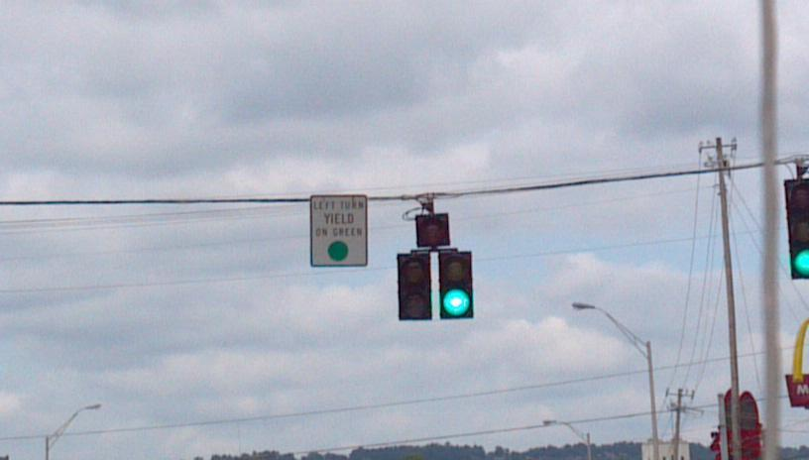
PROTECTED LEFT TURN

Slide 50
POST TEST
Have a post test conference
Go over what they did wrong and what they did well.
Do a one on one talk- don’t discuss results in front of other students
Use the form and check off the skills as you review their performance of each skill
Double check that their personal information is correct.

Slide 51
AT END OF TEST
Be sure to sign and date and have the student
sign and date the form at the completion of the
test.
Have student double
check their info
Michael Wayne Smith
Mary Teacher Jones
05/23/2018
05/23/2018

Slide 52
MOST COMMON FAILURES

Slide 53
EXAMPLES
Speeding
Turns into or from wrong lane (4-lane)
No signal (or wrong signal)
Not stopping completely
Stop signs (behind the stop line)
Traffic lights (behind the stop line)
Before turning right on red

Slide 54
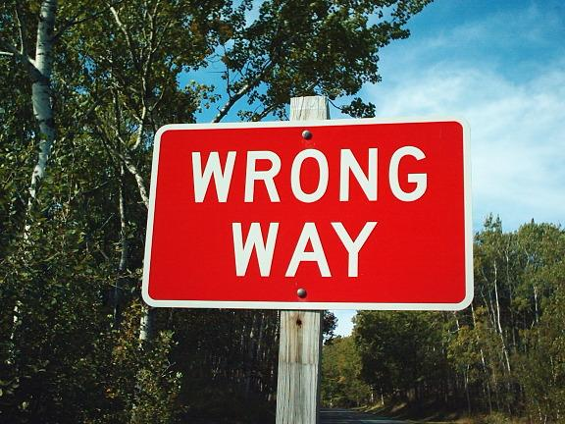
EXAMPLES - CONTINUED
Drives in wrong lane of traffic
Runs over curb
Fails to check traffic (especially blind spots)
Accelerating too quickly
Yielding incorrectly
Goes too fast or too slow
Falls to check mirrors when stopping

Slide 55
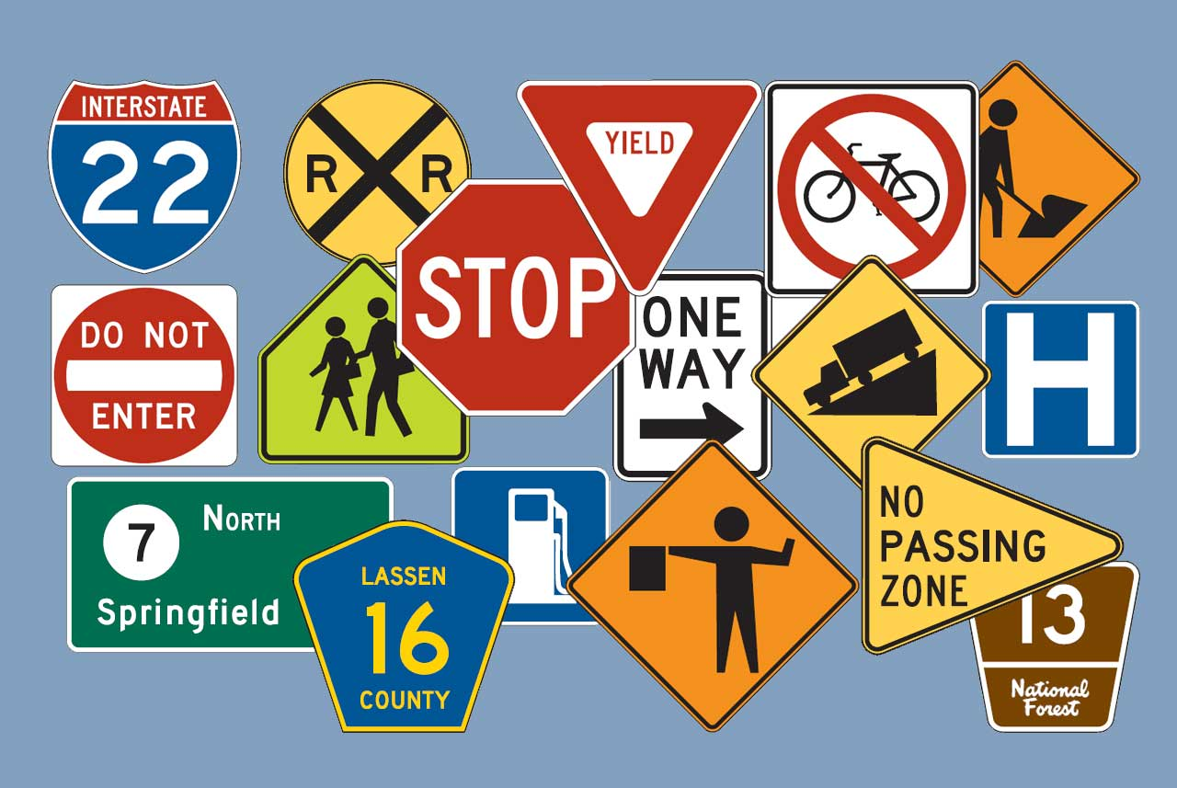
MORE EXAMPLES
Can’t stop smoothly and quickly
Doesn’t look back when tracking to the rear (uses mirror)
Swerves when backing or can’t track in straight line
Doesn’t set parking brake on hill
Doesn’t release brake when starting

Slide 56
FAILURES
One check in failure column means that they do not pass.
Can retest at teacher’s discretion—entire test or skill missed
Don’t expect everyone to pass

Slide 57
ON LINE INSTRUCTIONS
ALEA/SDE Third Party Testing Driver License Issuance Form
AIM: ALSDE Identity Management

Slide 58
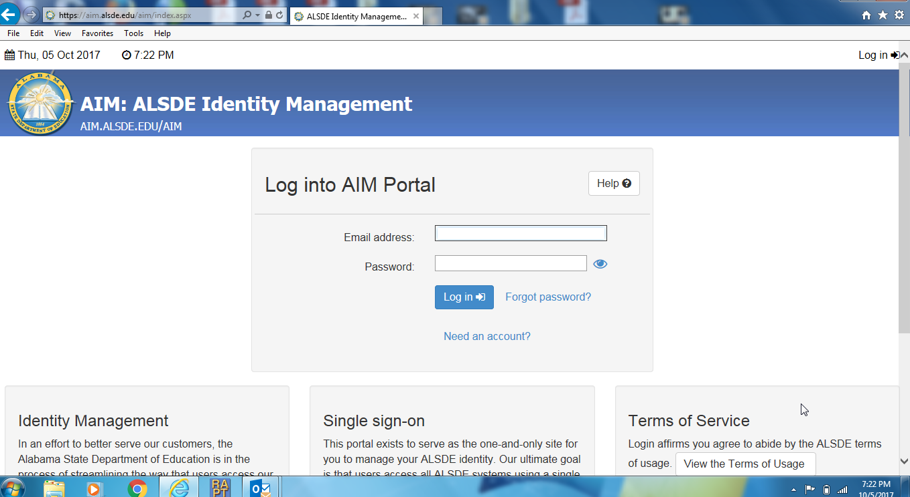
Go to: aim.alsde.edu
From here you will enter your school email address and password.*
*If you don’t have access to your password, you will need to contact your local system
administrator.
If you are not sure who to contact, check with your principal.
*** ALSDE staff WILL NOT have your password. ***

Slide 59
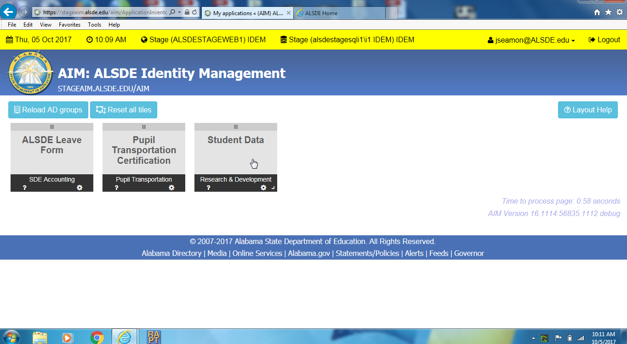
You MUST be labeled as “Student Data Pupil Transportation” in the Education Directory to have access to the student data tile that will give you access to the new 3rd party input program.
Contact your LEA’s Education Directory supervisor and request that they label you “Student Data Pupil Transportation”

Slide 60
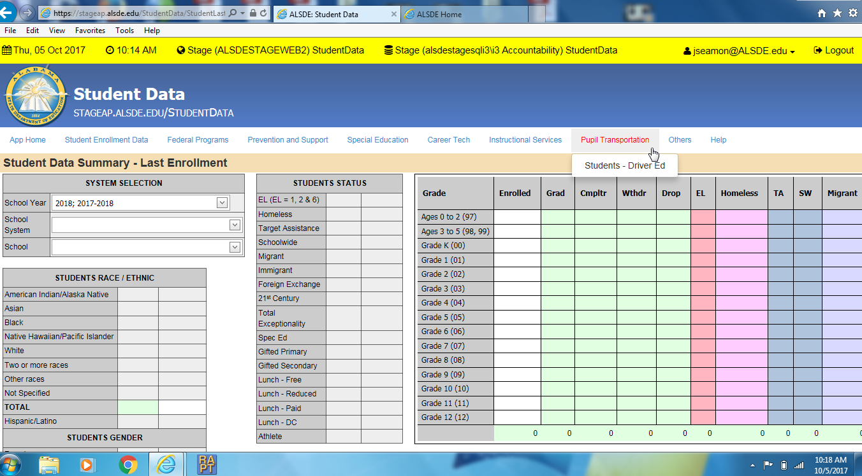
Once you open the “Student Data” tile you will see the information above.
Scroll over “Pupil Transportation” and the select “Students – Driver Ed”

Slide 61
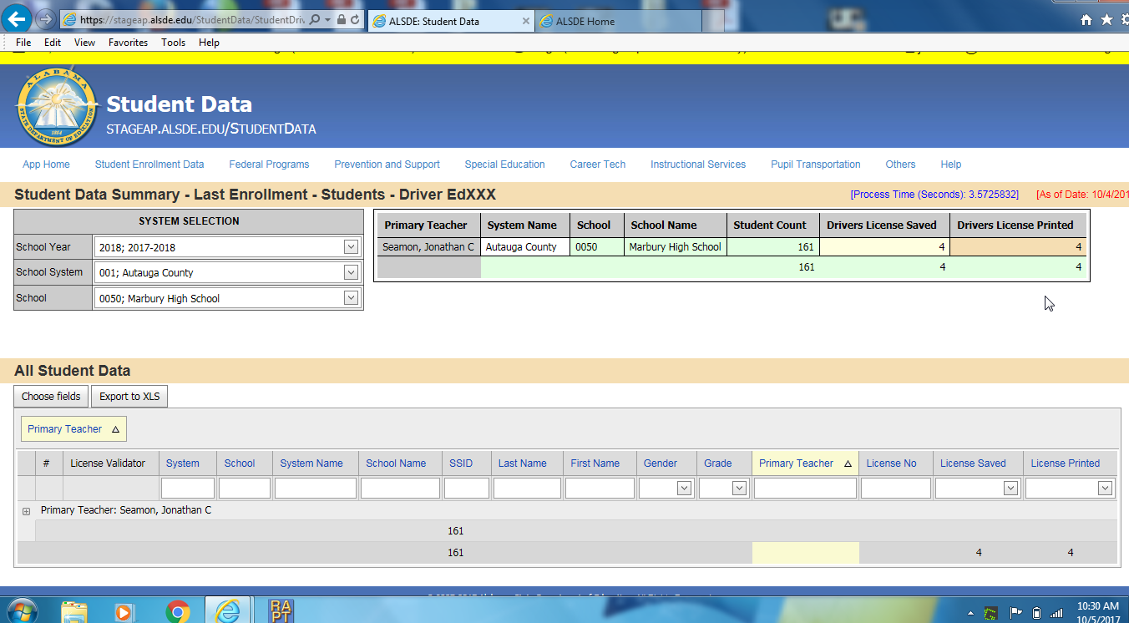
You will then select your system and school on the left hand side of the page which should bring up your name at the bottom of the page. Select your name as you will see the teacher name being selected with the “plus (+)” sign on the next slide.

Slide 62
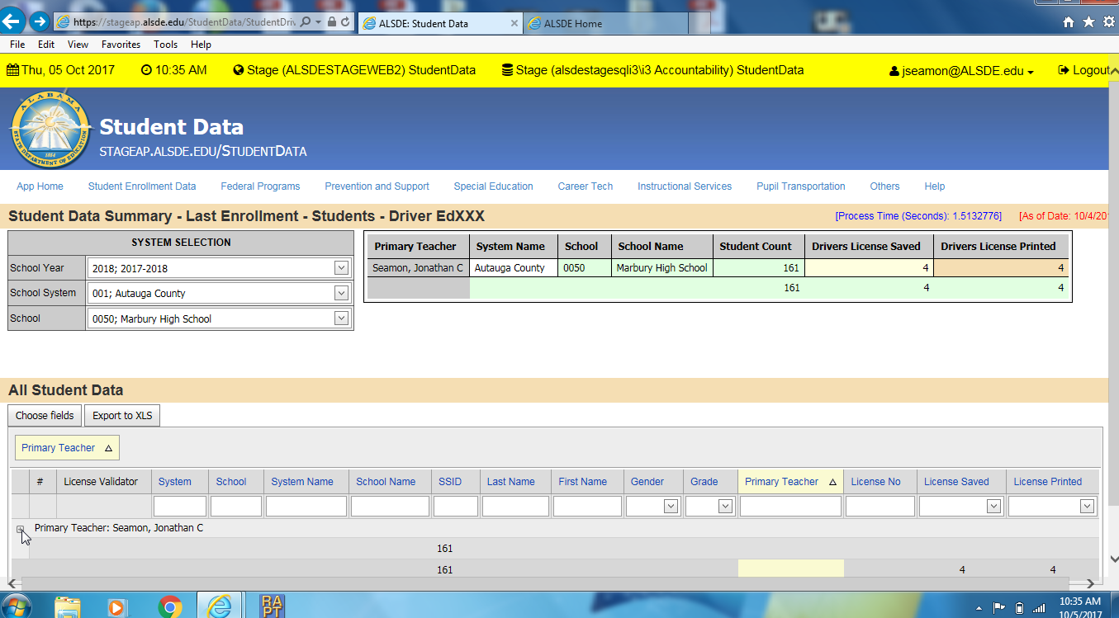

Slide 63
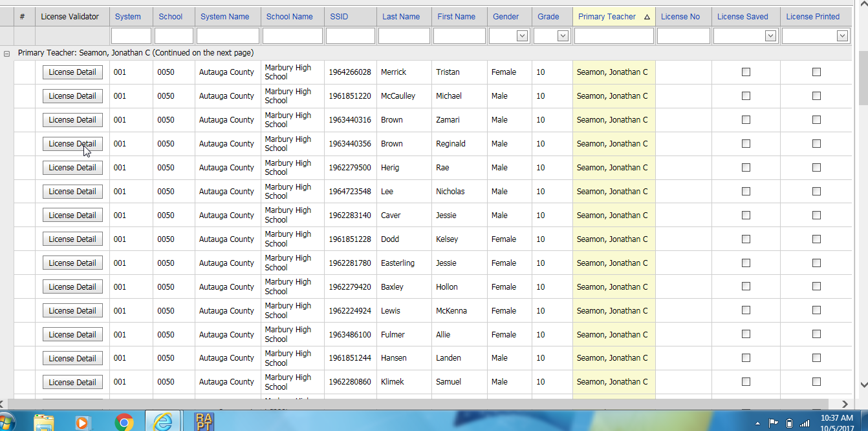
Your roster will be displayed with the “License Detail” button on the left hand side of the page.
Note*- From this page you can search for a student by using any of the query’s above. i.e. “Last Name”

Slide 64
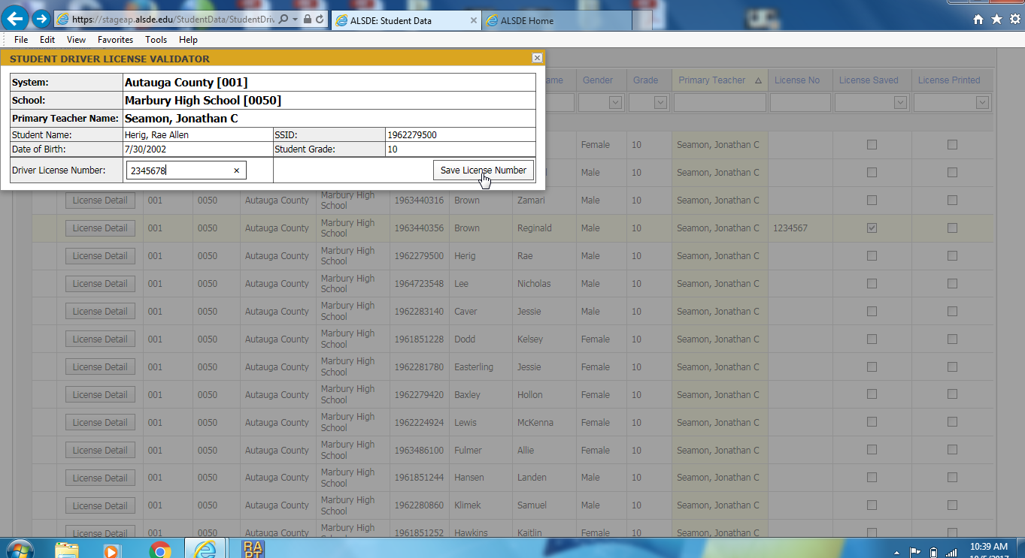
After selecting “license detail” you will put the students permit number in the lower left hand box. Make sure you put the correct number in the system. You WILL NOT be able to change the number once you select “save license number”.

Slide 65
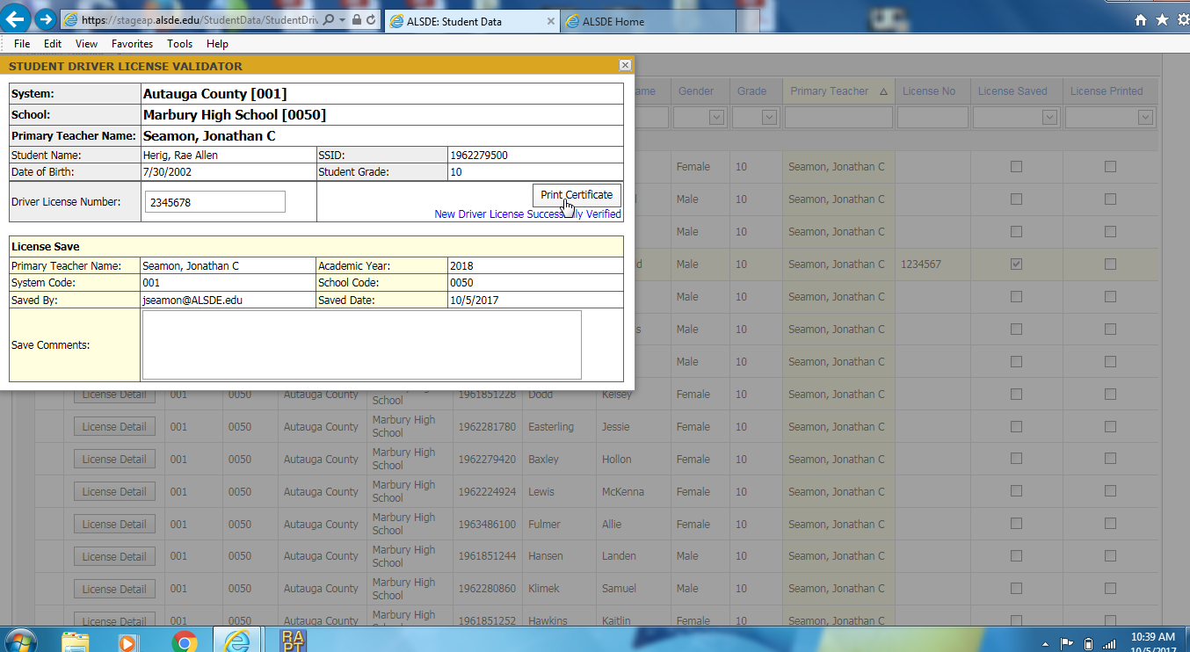
After you have saved the permit number you will have the opportunity to print the certificate for the student.
Make sure the student has…
Passed your driver education class.
Passed their road test with you and…
You have their parental permission form and 3rd party skills checklist on file.

Slide 66
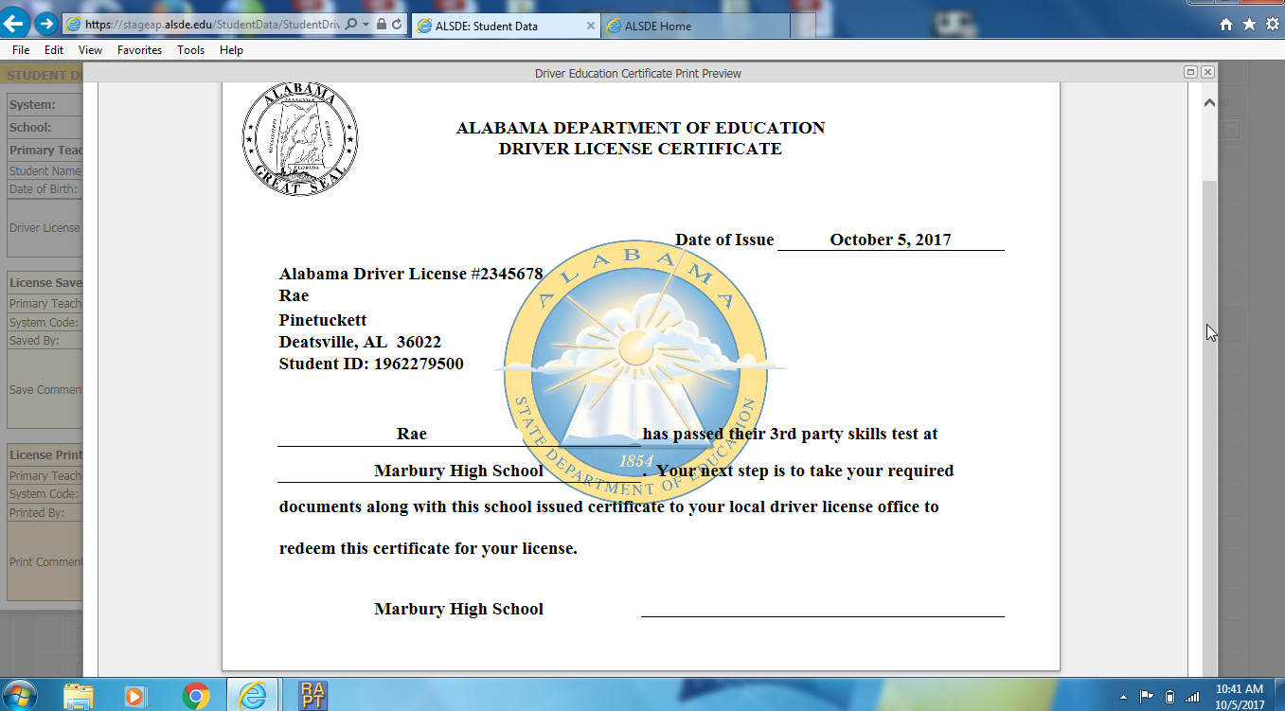
The certificate will auto generate with the students information and your name in the bottom right hand corner.
Print the certificate and sign it in BLUE INK ONLY!!!!
The student can take the certificate to get their license in place of the yellow card.
As always, the student must be 16 and have had their permit for 6 months before the can redeem their 3rd party certificate for their license.

Slide 67
IMPORTANT POINTS TO REMEMBER
Remind students that the certificates are not valid until they turn 16 years of age and have held a valid learner’s license for at least six months. These certificates CANNOT be used in place of a license.
Students MUST have a valid Alabama learner’s license before they can be tested.
Students must successfully complete Driver’s Education before they can receive the certificate.
Students must have parental permission in order to participate in the program.

Slide 68
REMINDERS
ALWAYS have more than one student in the car during the test (and when teaching)
Wait until end before discussing results.
Can only test those students CURRENTLY in your class.
Do not “shortcut” any part of the test. Test all the required skills
Only test those students that you feel are ready.

Slide 69
REMINDERS
Certificates have no expiration date.
Certificates must be signed in BLUE ink.
Certificates can be reprinted by the teacher.
ALEA WILL NOT accept yellow cards (used in the summer) that do not match the learners license EXACTLY!!
Don’t use nicknames (unless it is on the LL)
Add suffix if it is on the learners license (Jr., III, etc).

Slide 70
MONITORING OF THE THIRD PARTY TESTING PROGRAM
SDE will visit at least twice per school year

Slide 71
MONITORING THIRD PARTY TESTING PROGRAM
Procedure:
A representative from SDE will call you to let you know they are coming.
They will tell you the dates that will be checked or that they want to ride with you as you test.
Have the correct folder(s) available for viewing or the best time for driving with you.
If you are driving, leave folders in the office or in an area that can be accessed.

Slide 72
MONITORING THIRD PARTY TESTING DOCUMENT CHECK
File by School Year
Example: Names submitted in 2018-19 school year would all be in one folder in alphabetical order.
Each student’s skills checklist and parent form will be stapled together. (2 sheets for each student)

Slide 73
MONITORING THIRD PARTY TESTING PROGRAM
1. A “clean” copy of the skills checklist for each student that was submitted.
Make sure there are no erasures, mark outs, “white outs”.
Make sure there is a check mark in each “passing” box on the skills checklist form.

Slide 74
MONITORING THIRD PARTY TESTING PROGRAM
2. Copy of each student’s signed parental permission form.
Staple this form to the skills checklist
Put these forms in alphabetical order.

Slide 75
MONITORING THIRD PARTY TESTING PROGRAM
SDE will check:
- to make sure each student submitted is on your class roster
- to make sure that you have parental permission forms
and completed “passing” skills check list for all students submitted.

Slide 76
MONITORING
IN THE VEHICLE
Have no more than two students in the car
Test as you normally would be testing
We want to observe all phases of the testing process
Pre-trip conference
During the ride - route
Post trip conference

Slide 77
MONITORING
Let SDE representative know if you are testing/teaching all skills or just certain skills.
Discuss with SDE the results after the testing is finished.
Demonstrate the testing route or areas where skills are tested.
You will receive a copy of the SDE Monitoring Form to keep for your records

Slide 78
THIRD PARTY TESTING
There are still questions asked everyday about the program
The SDE staff visited as many schools as possible this past year to evaluate where we are with the program.
We came up with some questions and some ideas to improve the program and keep it growing.
Next are Frequently Asked Questions that we encountered during our visits.

Slide 79
FAQ
Do I have to test all my students?
No, we suggest you only test those students that you feel, using your professional judgment as a driver education instructor, have the skills to pass the exam.

Slide 80
FAQ
Can I test a student with an out of state learners license?
No, you can only test students with a valid Alabama learners license.

Slide 81
FAQ
Can I test former students or students in another driver education class?
No, you may only test students currently enrolled in your driver education class.
You cannot test another teacher’s students without permission from SDE.

Slide 82
FAQ
Can I be held personally responsible if, after I pass a student, they have a wreck with damages, injuries or deaths?
If you have followed the training and guidelines set forth by SDE and ALEA and the student successfully completed all skill requirements, you would not be liable for the students actions after their license has been issued. Proper documentation and complete testing is a must!

Slide 83
FAQ
Can I test foreign exchange students?
Yes, IF they have at least 6 more months left in the country. They will need to get their Learner License immediately upon arriving in the US.
If they do not have a SS card they must have a denial letter from the Social Security Administration

Slide 84
FAQ
Can I re-test a student?
If time permits and you think the student could pass with another opportunity you may test them again. Remember that they can still go to ALEA for their test.
OTHER QUESTIONS?????

Slide 85
HINTS AND TIPS
Have a cut off date for learners license and parent permission forms if they want to be tested.
Remind the student that when they turn 16 and have had their learners license for at least 180 days they take their learners license to ALEA to “redeem” them for a regular drivers license.
Remember you are a teacher FIRST – testing is secondary. Teach the skills correctly and completely before testing (either cumulatively or in one test).

Slide 86
??????????????????????????
QUESTIONS ON 3RD PARTY TESTING????

Slide 87
GENERAL TEACHING INFORMATION

Slide 88
Refrain from using brakes prior to pulling into a turning lane or exit ramp (can release accelerator).
On lane changes, don’t slow/brake before moving over.
Checking blind spot – chin not past shoulder.
Remind students to make sure a vehicle is actually turning before pulling out of a side street. Don’t trust the turn signal.

Slide 89
STAY TO THE RIGHT IN CROSSOVERS
/

Slide 90
http://www.dothaneyenews.com/featured/correct-median

Slide 91
TEACHING TIPS
Teach to make a complete stop before turning right on red.
Teach how to properly approach a traffic light – stale/fresh green.

Slide 92
ADVISORY SPEED LIMIT SIGNS
These signs are advisory. Unlike speed limit signs, they do not represent a legal requirement; drivers cannot be ticketed for not heeding the advice given on them.

Slide 93
PROPER HAND POSITION ON STEERING WHEEL. THUMBS OUT. NO REACHING INSIDE ON TURNS.

Slide 94
YIELD SIGN PAVEMENT MARKINGS

Slide 95
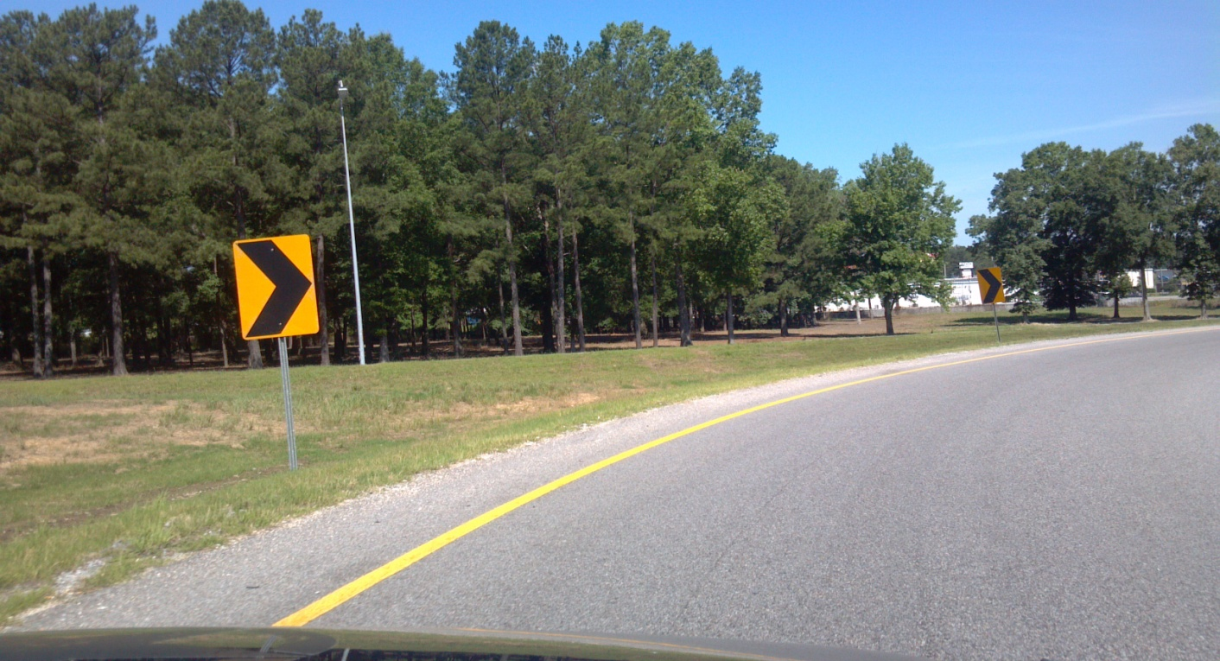
CHEVRON SIGNS ON CURVES ARE LARGER THE SHARPER THE CURVE.

Slide 96
QUESTIONS????
Contact the SDE office @ 334-694-4845 - Felicia
Jeremy Seamon
jseamon@alsde.edu
Brian Carter
bcarter@alsde.edu
Stewart Mosley
smosley@alsde.edu
Dale Barnes
barnesd522@comcast.net

