Slide 1
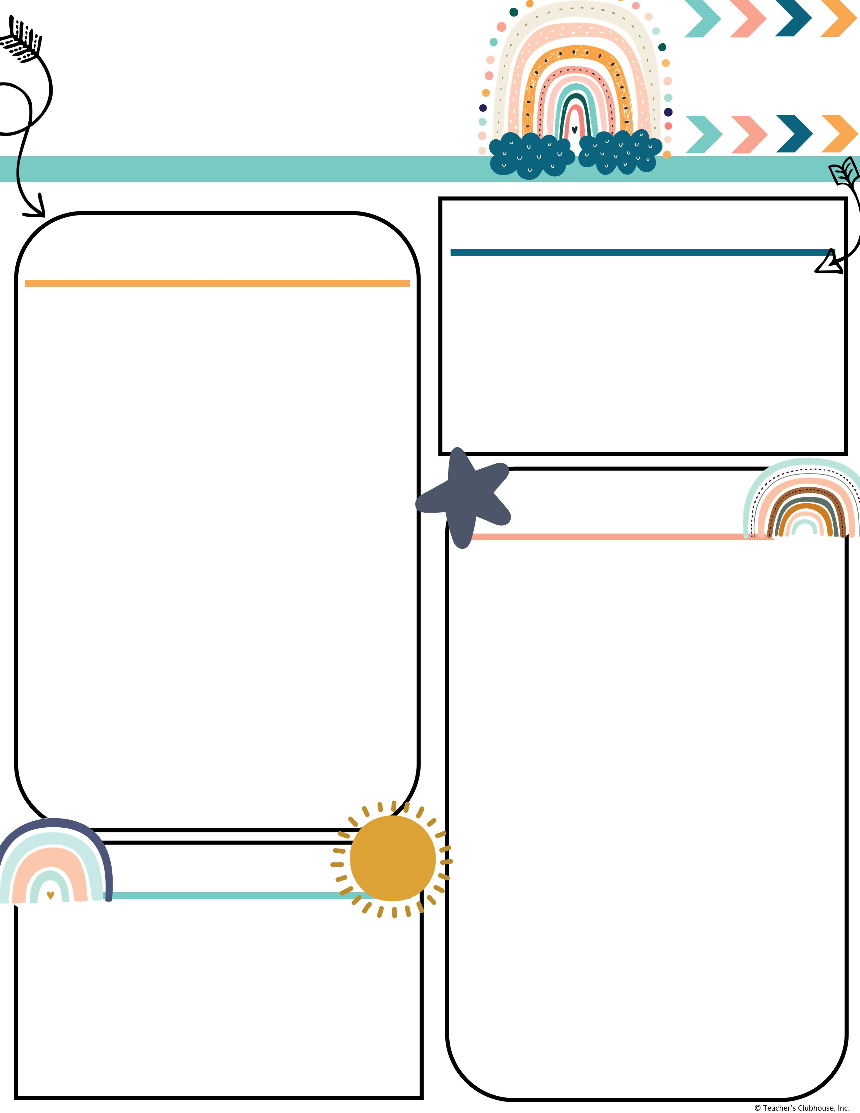
Every Student Empowered. Every student succeeds.
Second Grade, E122
334.285.0273
Remind App @6bc96eg
joan.johnston@elmoreco.com
Ms. Johnston’s
Newsletter
Week of December 2-6, 2024
Upcoming Events
A Peek at Our Week
Reading:
Reading:
Benchmark
r controlled vowel → air, are, ear
  EX: fair, share, bear
Great link to decodable books! I encourage you to utilize this free resource:
https://portal.flyleafpublishing.com/learners-resources/
Word Study: bear, share, care, square, chair, stairs, hair, wear, pear, where
Grammar:
Adjectives/Adverbs
Comprehension:
Ask questions about characters and events in a folktale
Differences in Points of View
Central Message
Compare 2 versions of the same story
Math:
Two Digit Addition → Solving addition problems using different strategies (Number line, hundreds chart, break apart number, partial sums, mental math)
Measurement
Writing/Language:
Writing complete sentences
Informative/Explanatory Essay
Journal/Diary Entries
Science/Social Studies:
3 branches of Government
Holidays around the world
December 4th ~ Wonderful Wednesday Snack
December 5th ~ Field Trip
December 9th - 13th ~ Penguin Patch (our day TBD)
December 10th ~ Vision Screening
December 16th ~ Breakfast with Santa
December 20th ~ ½ Day for students
Weekly Homework
Please check your child's folder for their homework that will be due on Friday
Tests this week
3 Minute Timed Math Addition Facts (Tuesday & Thursday)
Math Topic 4 → addition problems using different strategies (Tuesday)
Quarter 2 Sight Words:
Week 1: again, below, carry, does, eight, find, house, laugh, mother, school
Week 2: move, their, never, too, once, walk, round, where, small, year
Week 3: all, done, away, even, better, found, by, learn, change, only
Week 4: long, through, now, upon, our, was, some, when, them, work
Week 5: always, draw, any, four, blue, great, buy, how, city, live
Week 6: another, from, boy, hurt, could, out, every, over, far, these
Reminders
Every Wednesday is Wonderful Wednesday Snack. All items are $2.

