Slide 1
Welcome to Fourth Grade!
Pine Level Elementary School 2024-2025

Slide 2
Welcome Fourth Graders!
Fourth Grade is a year when students are able to build upon the foundation of reading and math skills and concepts they learned in third grade. They will also be encouraged to become more independent and responsible.
The information in this presentation will make you aware of various skills for language arts and math as well as personal and social responsibilities that students should have as they enter fourth grade.
Thank you for taking the time to review this presentation. We hope the information will be useful to you and your child.

Slide 3
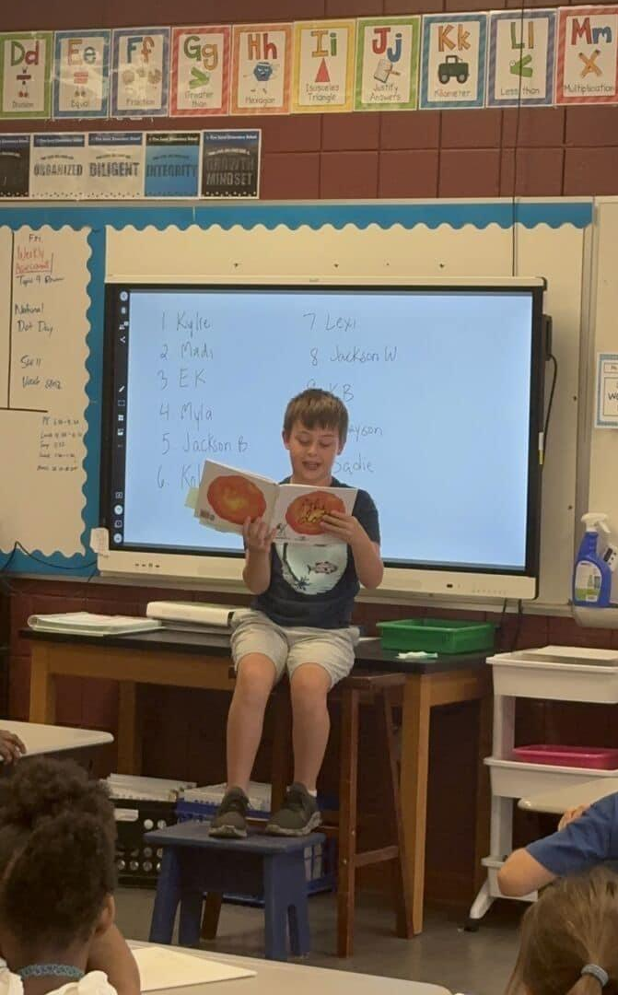
Language Arts
Describe basic elements of stories (characters, events, & settings) by drawing on specific details in the text
Pay close attention to key features of informational books and articles, including main and supporting details; compare and contrast information; and explain how an author uses facts, details, and evidence to support particular points
Compare ideas, characters, events, and settings in stories and myths from different cultures

Slide 4
Language Arts (continued)
Write summaries or opinions about topics supported with a set of well-organized facts, details, and examples
Read fiction and non-fiction daily
Write complete and compound sentences with correct capitalization, spelling, and punctuation
Write legibly in cursive
Read with expression while pausing at commas and stopping at periods
Read for 30 minutes in one sitting without pause to build endurance

Slide 5
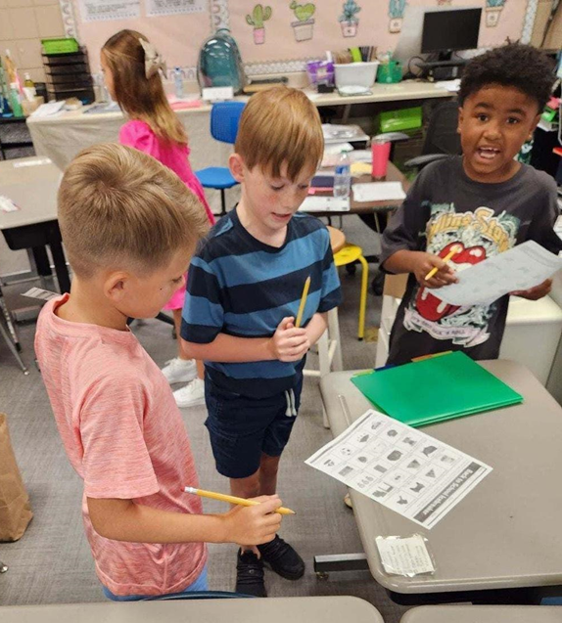
Math
Memorize all multiplication facts
Use whole-number arithmetic to solve word problems, including problems with remainders and problems with measurements
Add and subtract whole numbers quickly and accurately (numbers up to 1 million)
Multiply and divide multi-digit numbers in simple cases (e.g., multiplying 1,638 × 7 or 24 × 17, and dividing 6,966 by 6)

Slide 6
Math (continued)
Understand and apply equivalent fractions (e.g., recognizing that 1 ⁄4 is less than 3 ⁄8 because 2 ⁄8 is less than 3 ⁄8)
Add, subtract, and multiply fractions in simple cases (such as 2 3 ⁄4 − 1 1 ⁄4 or 3 × 5 ⁄8), and solve related word problems
Understand simple decimals in terms of fractions (e.g., rewriting 0.62 as 62⁄100)
Measure angles and find unknown angles in a diagram

Slide 7
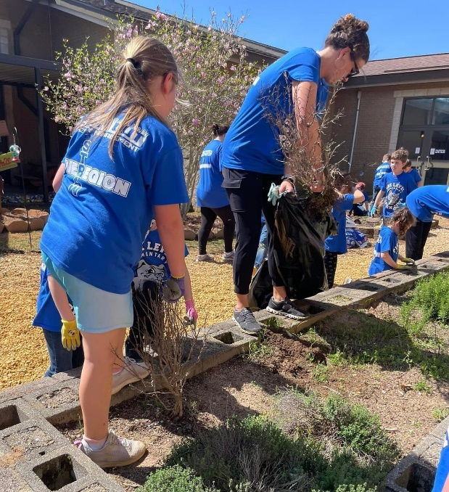
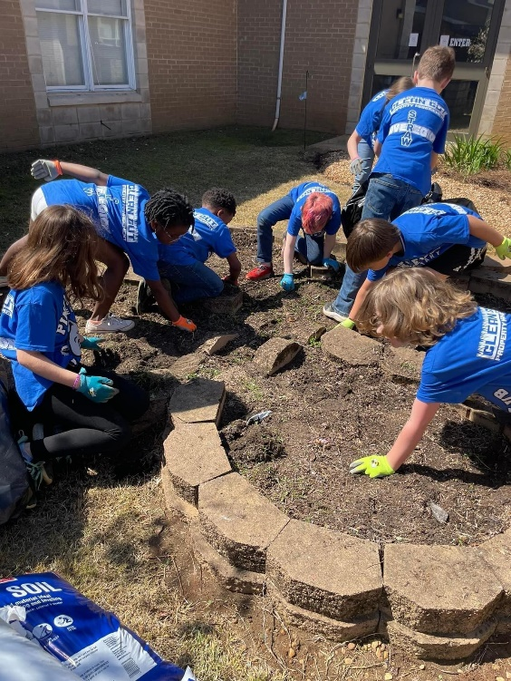
Personal and Social Responsibilities
Treat others kindly and with respect
Has a good attitude and is responsible for their
learning
Listens and follows directions
Completes assignments in class and at home
Converses with others using the rules of
listening, asking questions and waiting their
turn to respond
Remains on task during independent work

Slide 8
Parent Expectations and Suggestions
Speak positively about school and staff. If you are excited about learning, your child will be too.
Communicates with teachers and signs weekly folder.
Take time to talk about the school day.
Help with homework.
Make sure student is prepared for school with needed items and supplies.
Make sure the student gets plenty of rest each night.
Makes attendance at school a priority.
Take time each day to talk to your child about anything and everything.
Have your child read independently every day. Ask them to tell you about the reading.

Slide 9
Expectations and Suggestions (continued)
Watch the news together and discuss it.
Urge your child to use logical arguments to defend his or her opinion.
Involve your child in activities and games that require listening and following directions.
Support your child’s independence and encourage responsibility by having them pack for a trip or weekend outing, care for belongings, help prepare meals, complete chores around the house, and assist with other everyday activities.
Provide opportunities to interact with other children.
Encourage work values such as effort, persistence, and initiative.

Slide 10
Back to School Events
Tentative Back to School Event: August 5th - 2:00-6:00 pm
First Day of School: August 7th
Open House: TBD

