Slide 1


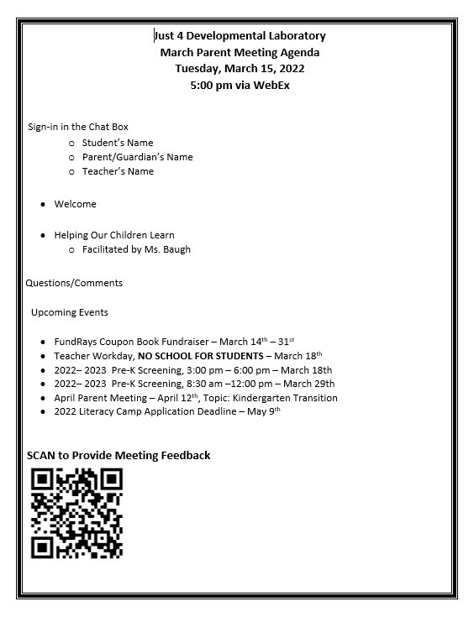

Slide 2
Helping Our Children Learn
Parent Meeting
March 15, 2022
5:00 pm

Slide 3

Learning Styles

Slide 4
Children have different ways of learning. education experts have roughly grouped these into four basic styles – auditory, visual, kinesthetic and Reading & Writing.
parents knowing Your child's best way to learn, Will Allow you to help Them learn more effectively.
But before you pigeonhole yourself or your child, it’s worth remembering that while you may have a dominant style of learning, everyone borrows a little bit from all the styles to learn about the world around them.
Notes:
Bullet 2 - part of this process is for parents to understand their own learning style, because we tend to teach in that style.
Bullet 3 - I will provide some information to help discover the type of learner both you and your child are
We will view a short video to help determine your style.

Slide 5

Learning Styles – How do you learn best
https://youtu.be/_IopcOwfsoU

Slide 6


Slide 7
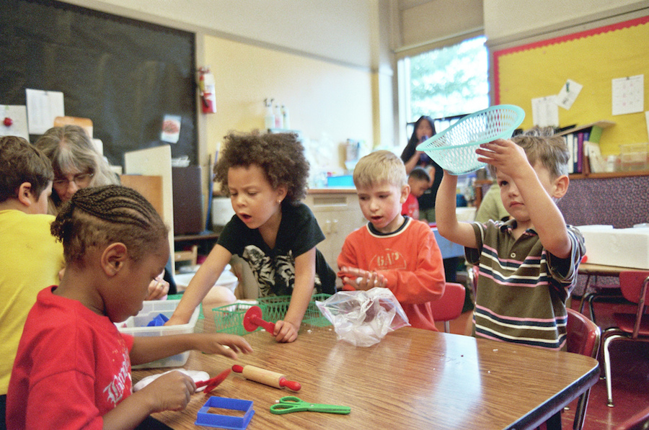
Most common learning styles in early childhood
Visual: Students with a visual style of learning will remember information best when presented with pictures or graphics. Visual learners will often recognize numbers and letters better than peers with another type of learning style.
Auditory: Auditory learners are best able to understand when they hear information. In early education, auditory learners are more likely to prefer listening to stories and music.
Kinesthetic: Students with a kinesthetic learning style learn best by manipulating objects and engaging in physical activities to learn the material.
Notes:
Open - Although different learning styles might develop as children get older, students generally learn in one of three ways
Close- As children continue to learn reading, writing, logic, and socializing skills, they may adapt to different learning styles. But these changes often won’t develop until later and are less common during early childhood development stages.

Slide 8
How can I help my child learn?
Knowing how your child learns and processes information is a valuable tool you can use to help him do better in school and develop a love of learning.

Slide 9
What can I do to help my Visual child excel In preschool and beyond?
The best way to support your visual child is to indulge his interests and provide him with the materials he needs to learn.
Pay attention to what your child likes and try to approach learning from that point. If your child likes games, for example, card games can hone his memory and concentration skills.
Have a lot of books available, so he or she can look at the pictures or make an attempt to read the words. One of the best predictors for school success is the number of books children have access to at home and how much time is spent reading with them.
Even though we must be mindful of screen time with children, visual learners may benefit from educational television because watching helps them learn.

Slide 10
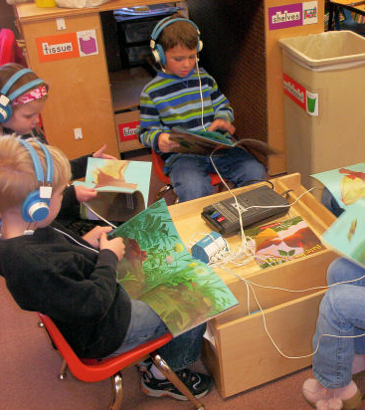
What can I do to help my auditory child excel IN preschool and Beyond?
Have lots of audio materials, such as books-on-tape and music, readily available at home.
If she or he is working on a project or playing a game, go over the directions orally.
Ask your child lots of questions and encourage them to do the same if help is needed to understand something.
Talking about subjects as much as needed will help your child grasp new concepts.

Slide 11

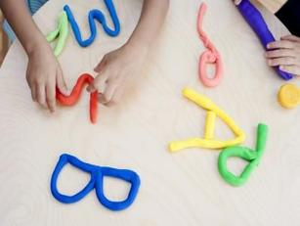
What can I do to help my kinesthetic child excel in preschool and beyond?
The best way to support your physical child is to indulge their need for activities that allow them to use their hands and body to explore. Pay attention to activities your child enjoys and try to approach learning from that point.
If your child prefers to use art supplies or play with LEGOs to learn about shapes and colors, go with the flow.
If your child tends to count using his fingers, let them.
If your child enjoys stories when you act them out with him/her, encourage this dramatic side.

Slide 12

In the end, what matters most is that you nurture and support your child's learning, no matter what the style. Follow their lead and focus not on how great they are becoming at certain subjects, but on how great your child is in general!

Slide 14

A Great Start
Try these ideas to help your child be organized and responsible
In- and Out-Boxes
  Establish a time to go through the papers your child brings home. If you arrive home after your prekindergartner does, have an in-box for your child. Review the materials, and those that go back to the school can be put in an out-box.
Chores
  Take time to establish age-appropriate chores and responsibilities with your child.
School at Home
  Keep a regular time of 15 to 20 minutes for reading or looking at picture books
Notes:
Getting Organized is a great start in helping your child success

Slide 15
Listen Up!
Your prekindergartner is learning to listen attentively. Create daily routines that will help your child focus and develop his or her attention span.
One last thought...
Use simple games when you are in the car,
such as saying, “I’m going to say three words.
You tell me which one starts with a different
sound: cat, cow, ball.”
Notes:
Try these activities that combine learning with working out the wiggle: .Go Fish, Patterning, simon says

Slide 16

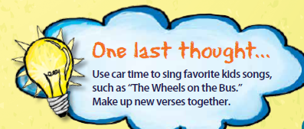
Talk It Up!
Try some of these ideas to help build vocabulary:
Guess Where
  Give your child a small object, such as a button or ball, to hide while you leave the room. When you return, your child should give one clue at a time to help you find the object. Then, trade roles.
Guess My Picture
  Place pictures in a box or bag. Have your child choose a picture at random and describe it without saying its name, such as, “This has stripes.” The other players try to guess what the picture is. After three guesses, another clue is added, such as, “It purrs.
Notes:
For most parents, the first few words uttered by their child were
magical. Before long, those single words turned into sentences
and even paragraphs! Your child’s vocabulary is still growing, and
conversations are a great way to continue vocabulary development.

Slide 17
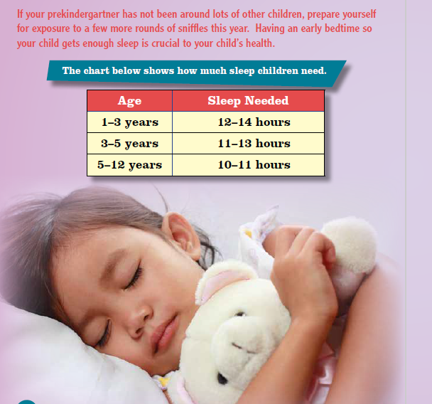
Sleep, Is Good for You!
These tips will help your
prekindergartner get enough sleep:
Routine
Create a routine with the same bedtime, lighting, and temperature each night.
Be Prepared
Make setting out the next day’s clothes part of your child’s nightly routine.
Quiet Time
Make it a relaxing time without TV or videos.
Read Aloud
Read aloud a favorite picture book.

Slide 18

A Print
Rich Environment
Capitalize on learning new words with these ideas when you are out in the community.
  Traffic Signs
  Bilingual Signs
  Food Labels
  Maps
Your prekindergartner probably already reads many words. Some words may have been learned at school and others from the world around them. Many children can recognize their favorite store names and other common signs.

Slide 19
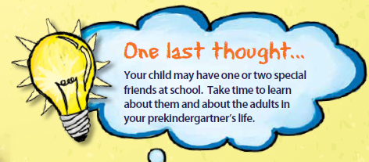
The Social World
Prekindergartners have learned that their social network is more than their immediate family. They are fascinated with the people, such as community workers, whom they observe or encounter.

Slide 20
Learning To Go
Use these activities to build your child’s knowledge:
Counting
  Have your child count as you drive: animals, white vans, people on bikes, squares, stop signs.
Favorites
  Play the Favorites game. Begin by asking each person in the car to identify his or her favorite color. Pass the turn to another to ask for a favorite video game, board game, ice cream flavor, book, movie, etc.
Notes:
Learning can happen anywhere. Take advantage of your time spent outside of the home and turn it into learning opportunities for your child.

Slide 21
Keep
Playing!
Try some of these group games with family and friends to keep the fun going:
Hug Tag
  For Hug Tag, you can stay “safe” by hugging someone else for a count of five seconds.
Fruit Basket Upset
  To play Fruit Basket Upset, choose three or more fruit names. Assign fruit names to players by counting off, such as apple, pear, banana, apple, pear, etc. Have a circle of chairs for all but one of the players. “It” calls out the name of a fruit, and the players assigned to that fruit change spots. When “It” calls “fruit basket upset,” everyone races to a chair, including the leader. The person who is without a seat becomes “It.”
One last thought...
Keep the focus on having fun, not on winning or losing.
Notes:
Ralph Waldo Emerson once said, “It is a happy talent to know how to play.”
Luckily for us parents—we get to keep playing with our kids.

Slide 22

Final Thought
Your prekindergartner has been learning so much, and you have been learning, too. Remember to stay in touch with your child’s teacher and other adults that interact with him or her each day. Everyone wants the same thing—to ensure that your child is ready for that next big milestone—kindergarten!
Believe it or not, it’s right around the corner!

Slide 23

Questions/Comments

Slide 24
Sign-in in the chat box to receive credit
Include the following:
Student’s First and Last Name
Teacher’s Name
Attending Parent’s First and Last Name

