Slide 1
Types of Governments
3/9/2022

Slide 2
Types of Democracy
Democracy
Developed by Greeks in 500 BCE
Means “common people” and “strength”
Direct Democracy
A vote by all citizens to make a decision
Local American elections are direct democracies (when voting on issues)
4 types of Democracies
Direct Democracy
Parliamentary Democracy
Presidential Democracy
Representative Democracy

Slide 3
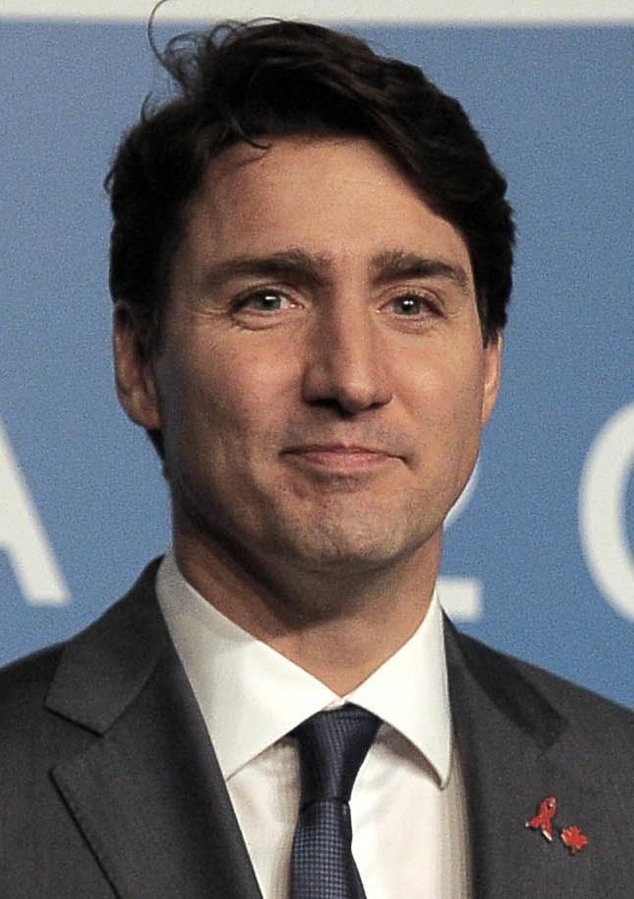
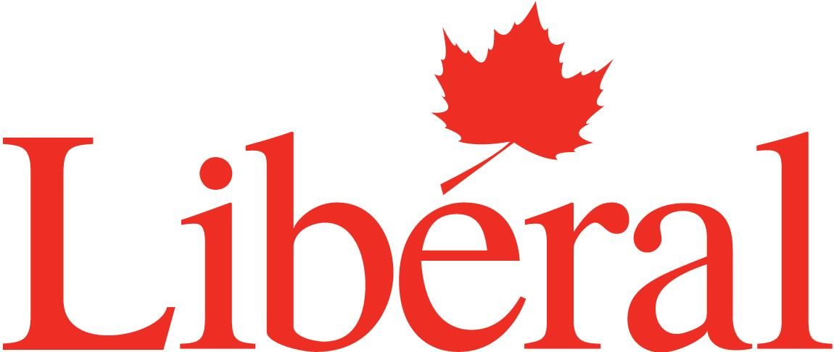
Parliamentary
Democracy
Parliament
Leaders are elected or appointment to make laws in parliament
Parliament Democracy
Government is formed by holding a majority of seats in parliament
The majority party appoints their leader/president
Parties form a coalition to make a majority

Slide 4
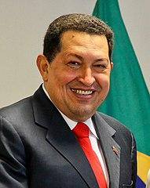
Presidential Democracy
Presidential Democracy-the president is elected by the people not the parliament
Presidential Democracies may not have a legislature to balance the power making presidential democracies easy to turn into dictatorships

Slide 5
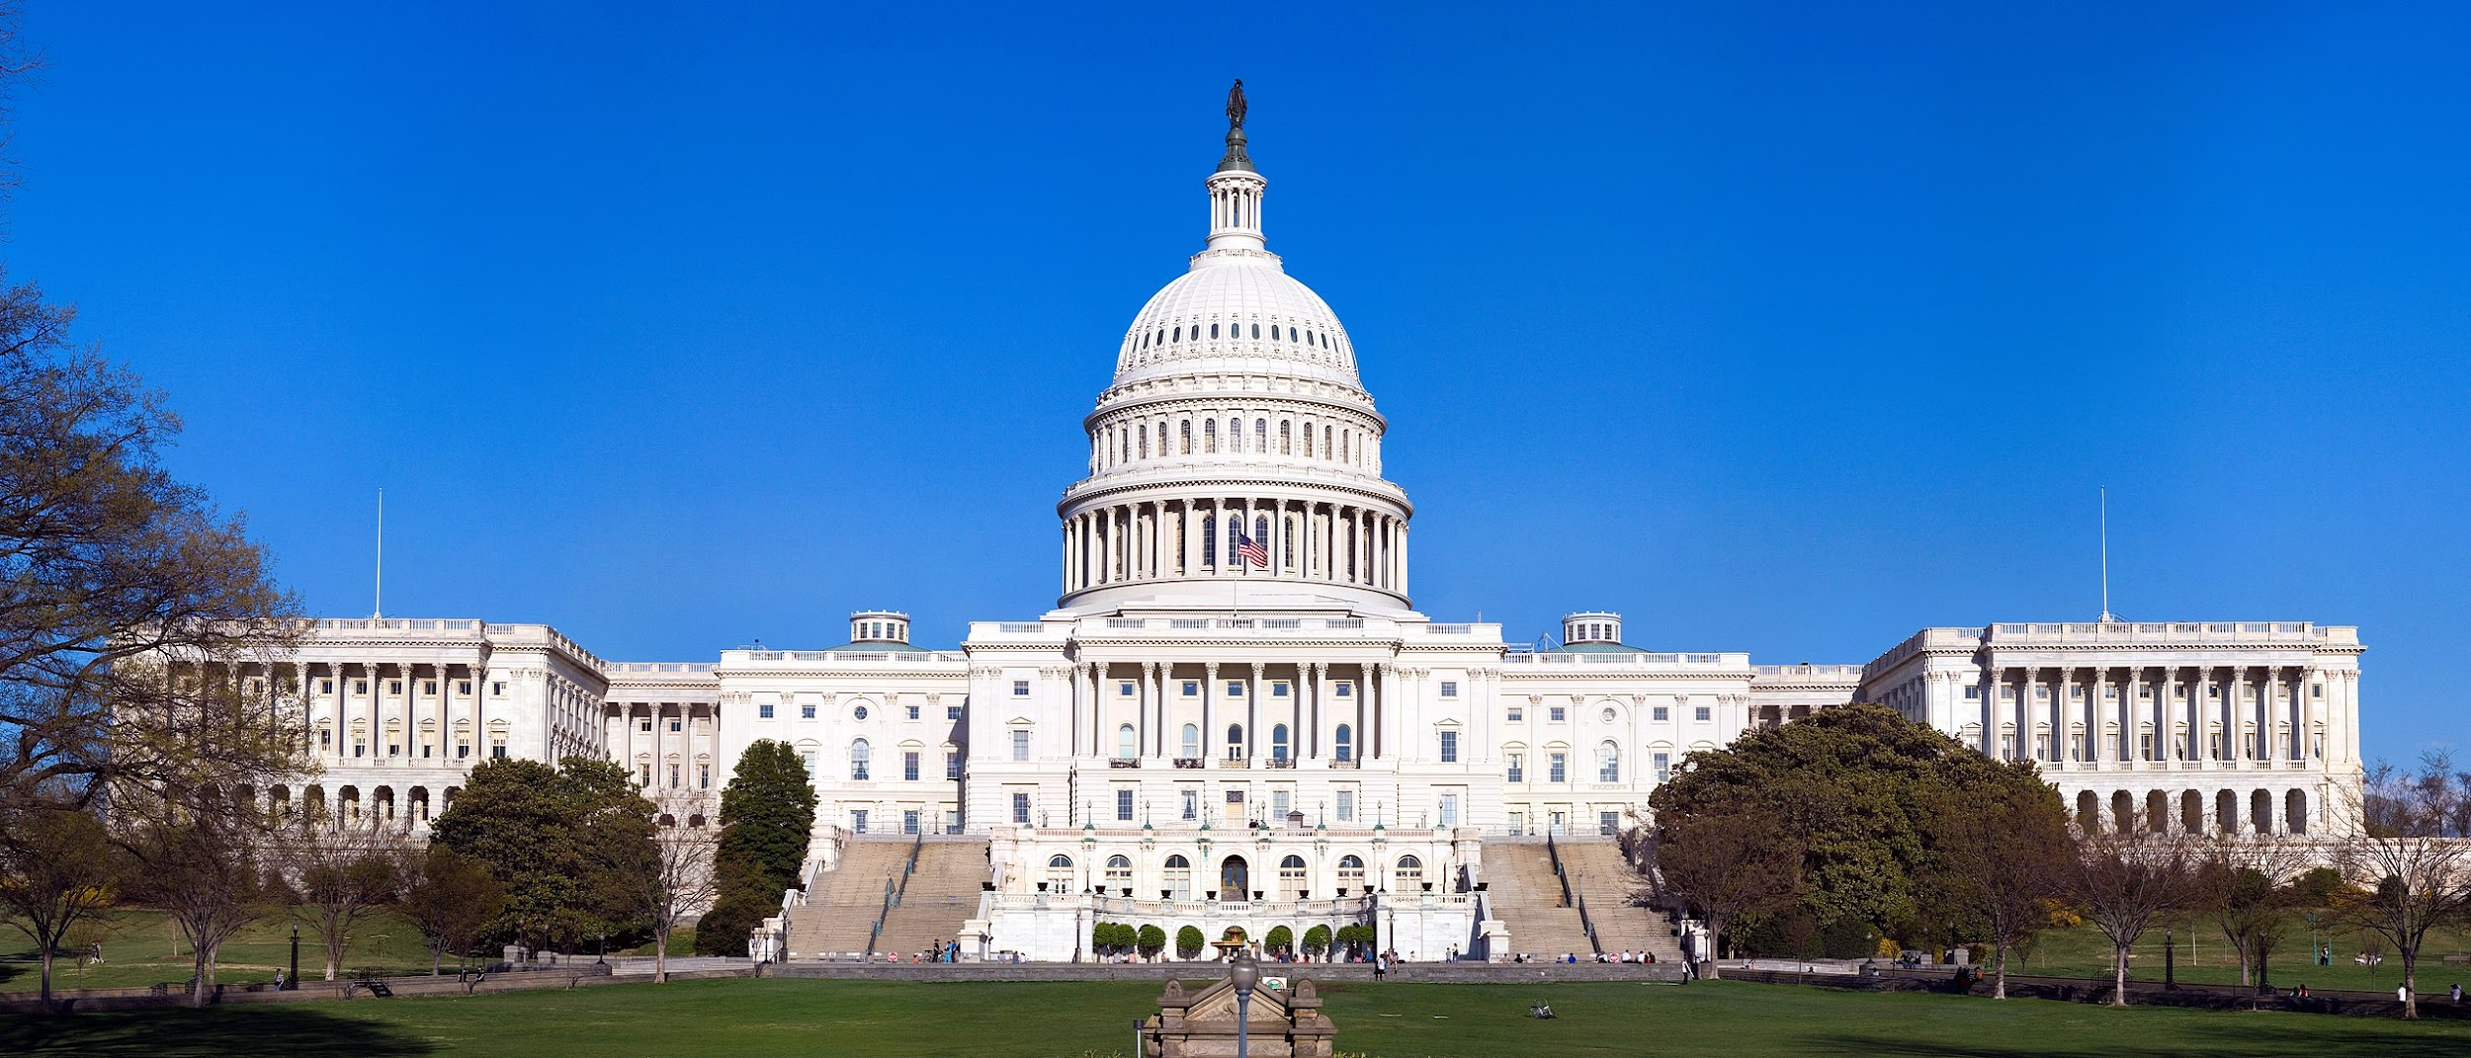
Representative Democracy or Republic
Representative Democracy
Leaders are elected directly to represent the people in Congress and makes laws
Current US government system
Developed by Rome

Slide 6
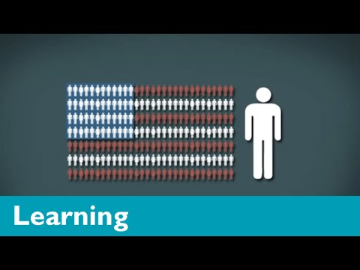
American Government

Slide 7
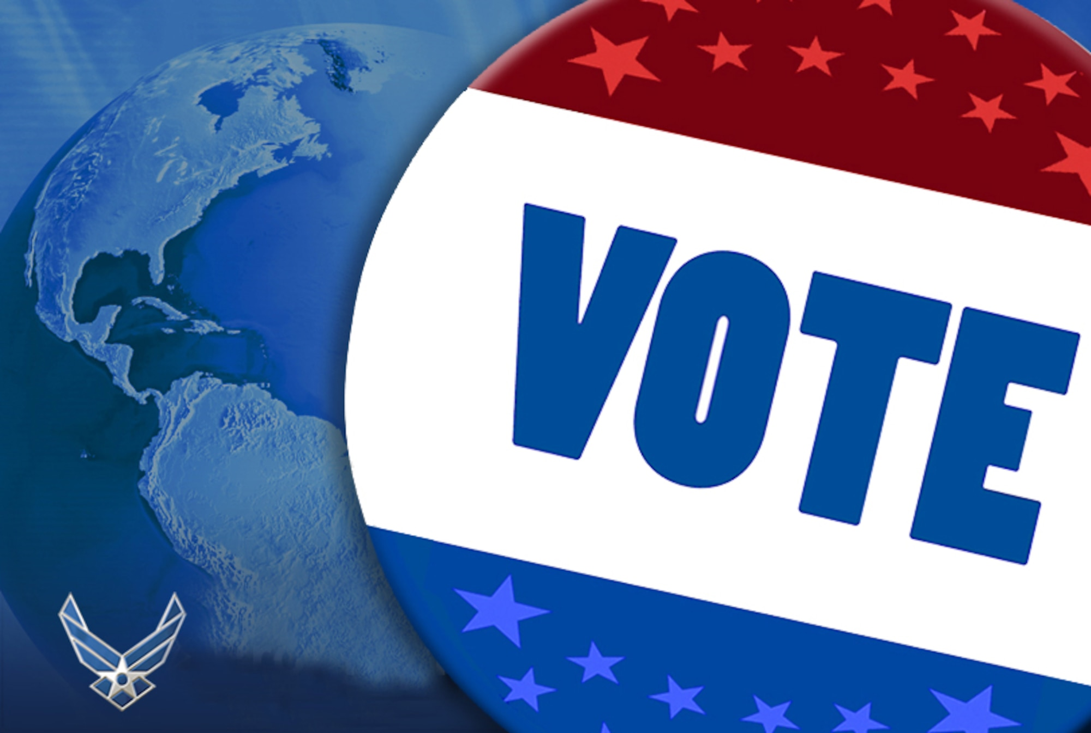
Popular Sovereignty
Power rests in the power of the people and the people can change their leaders in government

Slide 8
Minority and Majority Rights
Tyranny of the Majority-some rights are taken away from a minority by the majority

Slide 9
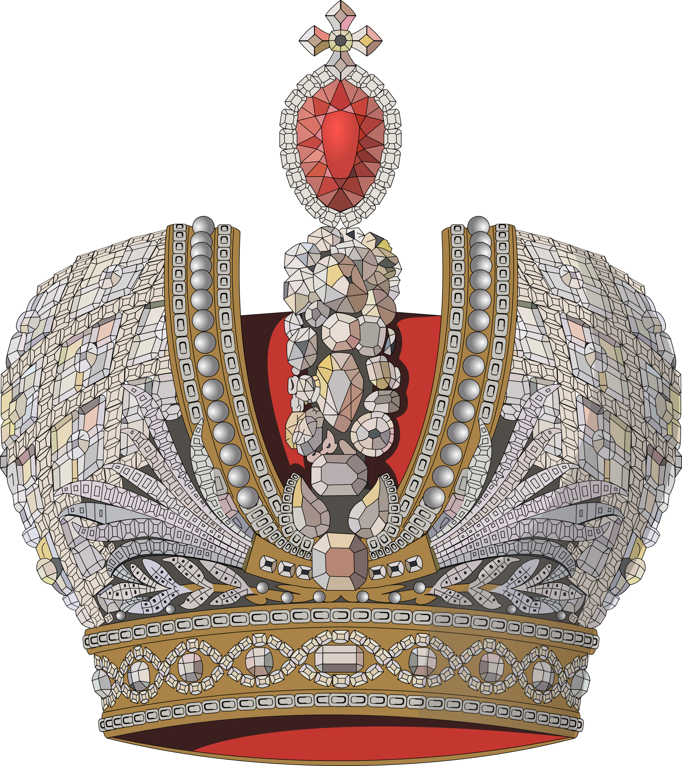
Monarchies
Absolute Monarch-king or queen have all the power
Before the Magna Carta kings and queens ruled with absolute power

Slide 10
Magna Carta 1215
England was a monarchy, but some questioned their absolute authority
Magna Carta limited the king’s rule
King’s decisions became subject to review
Overtime the review of the king’s laws became parliament
Introduced Rule of Law-everyone has to follow the law, including Monarchs
Without Rule of Law monarchs and rulers could be cruel to citizens

Slide 11
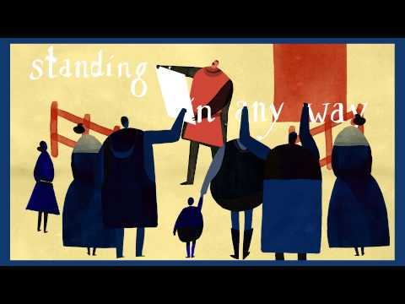

Slide 12
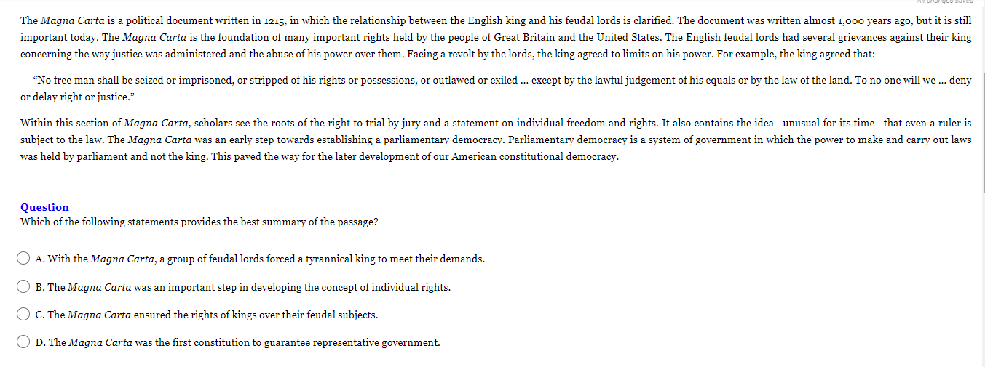
Notes:
Answer: B

Slide 13
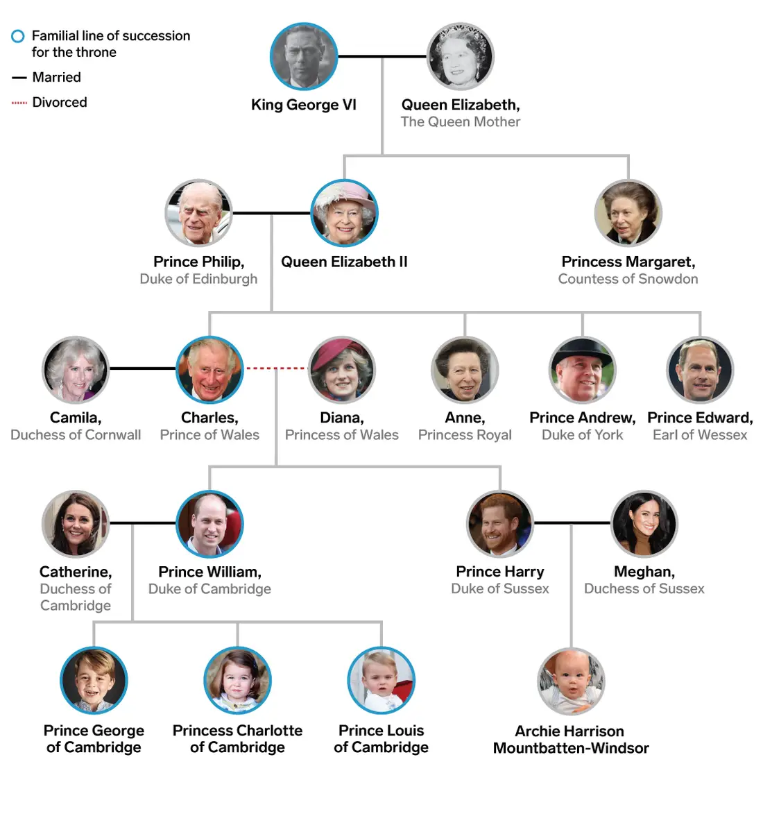
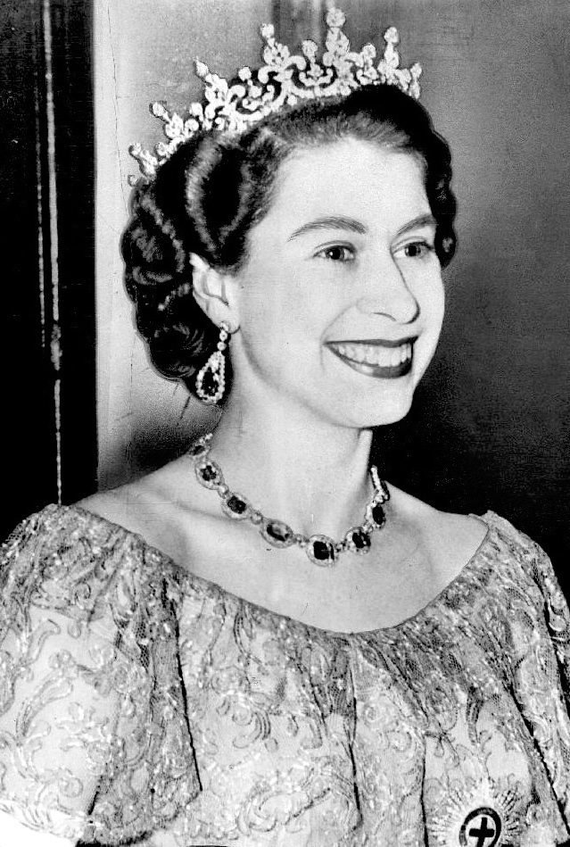
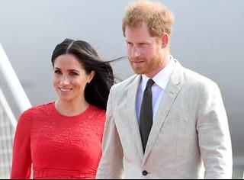
Monarchy
Inherit the role through family
Typically a king or queen

Slide 14
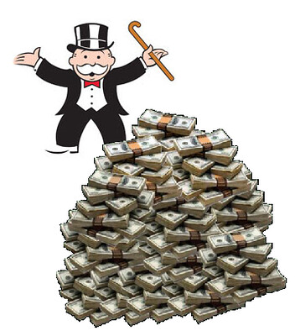
Plutocracy
Plutocracy-power in society and government is in the hands of the wealthy
Typically results in bad treatment of the poor.

Slide 15
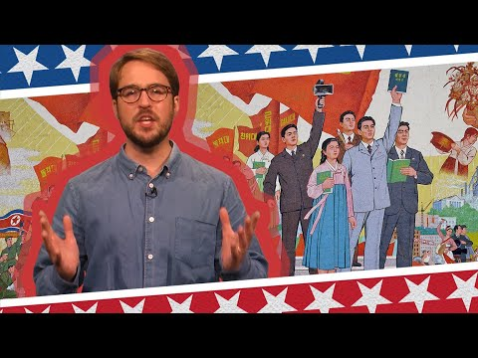
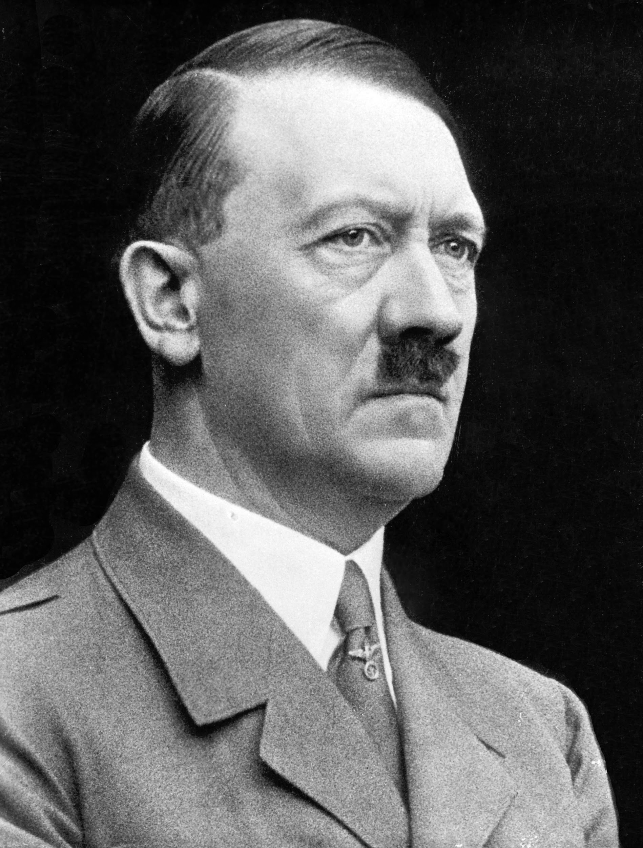
Other Types of Government
Authoritarian
Dictatorship, military rule, fascism

