Slide 1
Welcome to 1st Grade!
Mrs. Marks’ Class
August 6, 2024
Orientation

Slide 2
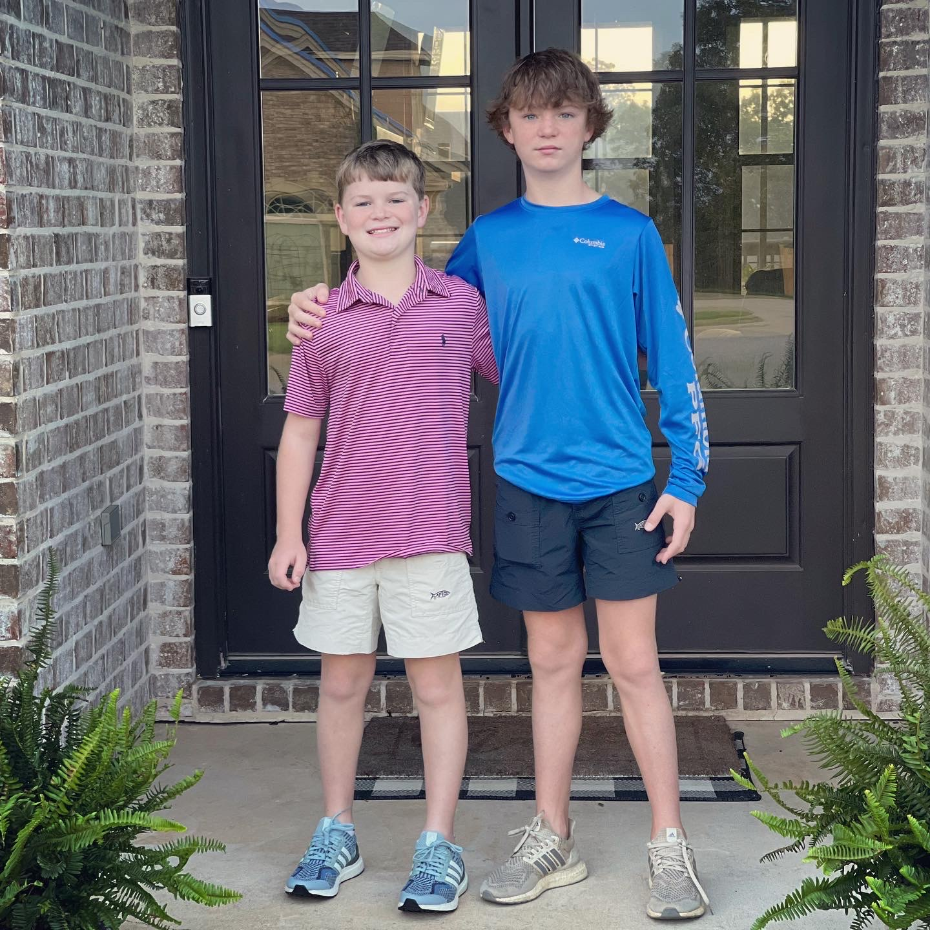
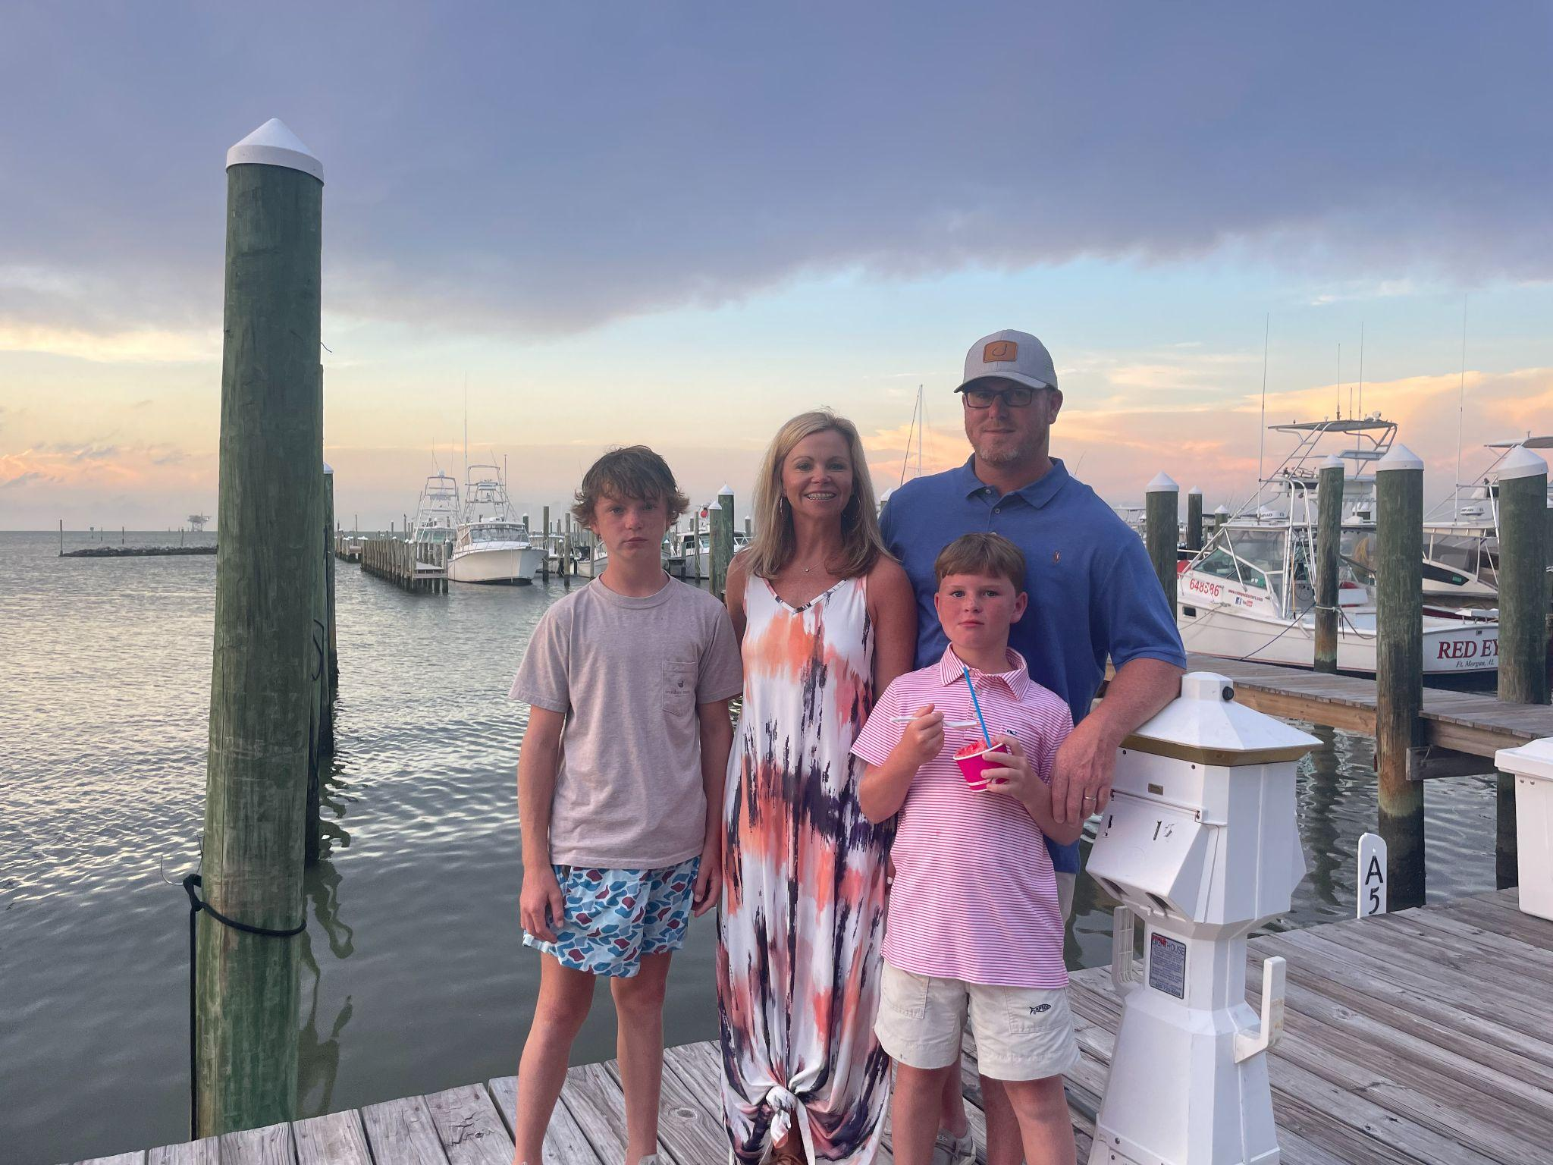
This is my family!

Slide 3
Mrs. Marks as a 1st Grader!

Slide 4
Components of Our Day
Reading binder (D.O.T.) will go home every day.
Weekly Newsletters will be sent home on Mondays.
A copy of the schedule will be sent home by the end of the first week of school.
Graded papers will be sent home in a timely matter, check folders daily.
Lunch –11:16-11:39
PE – 12:25-1:05
Snack – 1:35

Slide 5
Grading Policy
Students will be given letter grades in Reading/Language Arts and Math.
60% major, 40% minor for Reading and Math.
Students will be given S, N, or U in Handwriting, Science, and Social Studies.
Students will have to pass Reading/Language Arts and Math with a yearly average of 60% or higher to be promoted to second grade.

Slide 6
Arrival/Dismissal
Carpool drop off will be in the front of the school starting at 7:10 and ends at 7:55.
Child’s name needs to be visible in car window using the DPES carpool tag.
If your child needs to eat breakfast, please remind them to go directly to breakfast.

Slide 7
Arrival/Dismissal
Dismissal Times:
Walkers- 2:50
Car Riders- 2:52
1st Load Bus Riders- 2:55
YMCA- 3:07 3:08
2nd Load Bus Riders-
**Carpool tags are passed out in the lunchroom. Additional tags are $5.

Slide 8
Money
Please send ALL money in an envelope with your child’s name, reason for money, amount, and teacher’s name.
Snack can be purchased daily, the average cost is $1.00-$1.50 (No carbonated beverages or candy during this time).
Money will not be taken unless it is an envelope or Ziploc bag with the above information.
All money must be taken up before 8:00.

Slide 9
Snack
We will have snack every afternoon. You can send a snack from home or purchase from the school.
Snack can be purchased daily, the average cost is $1.00-$1.50
(No carbonated beverages or candy during this time).

Slide 10
Communication
ParentSquare, email, or notes sent to school.
Conferences will have to be scheduled.
amy.marks@acboe.net (school)
I will respond to all messages within 24 hours.

Slide 11
Behavior System
Students will start the day with their clothespins on green. They will move up or down according to behavior.
Behavior will be marked daily in conduct folder.
Initial if there is orange/red.
Sign at the end of the week.

Slide 12
Meeting & Exceeding!
Students will be rewarded by moving their clothespins up to blue and purple.
Students who have PHENOMENAL behavior may have their pin “jump” off of the clip chart to my shirt! They will be rewarded with Treasure box, etc.

Slide 13
Consequences
Yellow: Verbal Warning
Orange: loss of centers or reward
Red: Note sent home/phone call– No Fun Friday

Slide 14
Other Information
Yellow Transportation Tags will be attached to your child’s backpack for the entire first week.
Label all items with your child’s name!
Please notify me in writing with any changes in transportation, address, or phone number.
Label all items, especially jackets, with your child’s name.
The transportation department’s number is (334)-361-3897. They can help with 1st or 2nd load.

Slide 15
How can I help my child with reading?
Read to your child daily for 10-15 minutes.
Read with your child.
Start with reading the Kindergarten high frequency words.
Read the story passages in their binders.
Don’t limit reading only books, use the Internet, magazines, etc.
Practicing their spelling words.

Slide 16
Questions?
Please fill out bus tags
(leave on their desks or wear them Wednesday morning).
Leave the completed Rolodex cards.
Please make sure your child knows how he/she will get home the first day.

