Slide 1
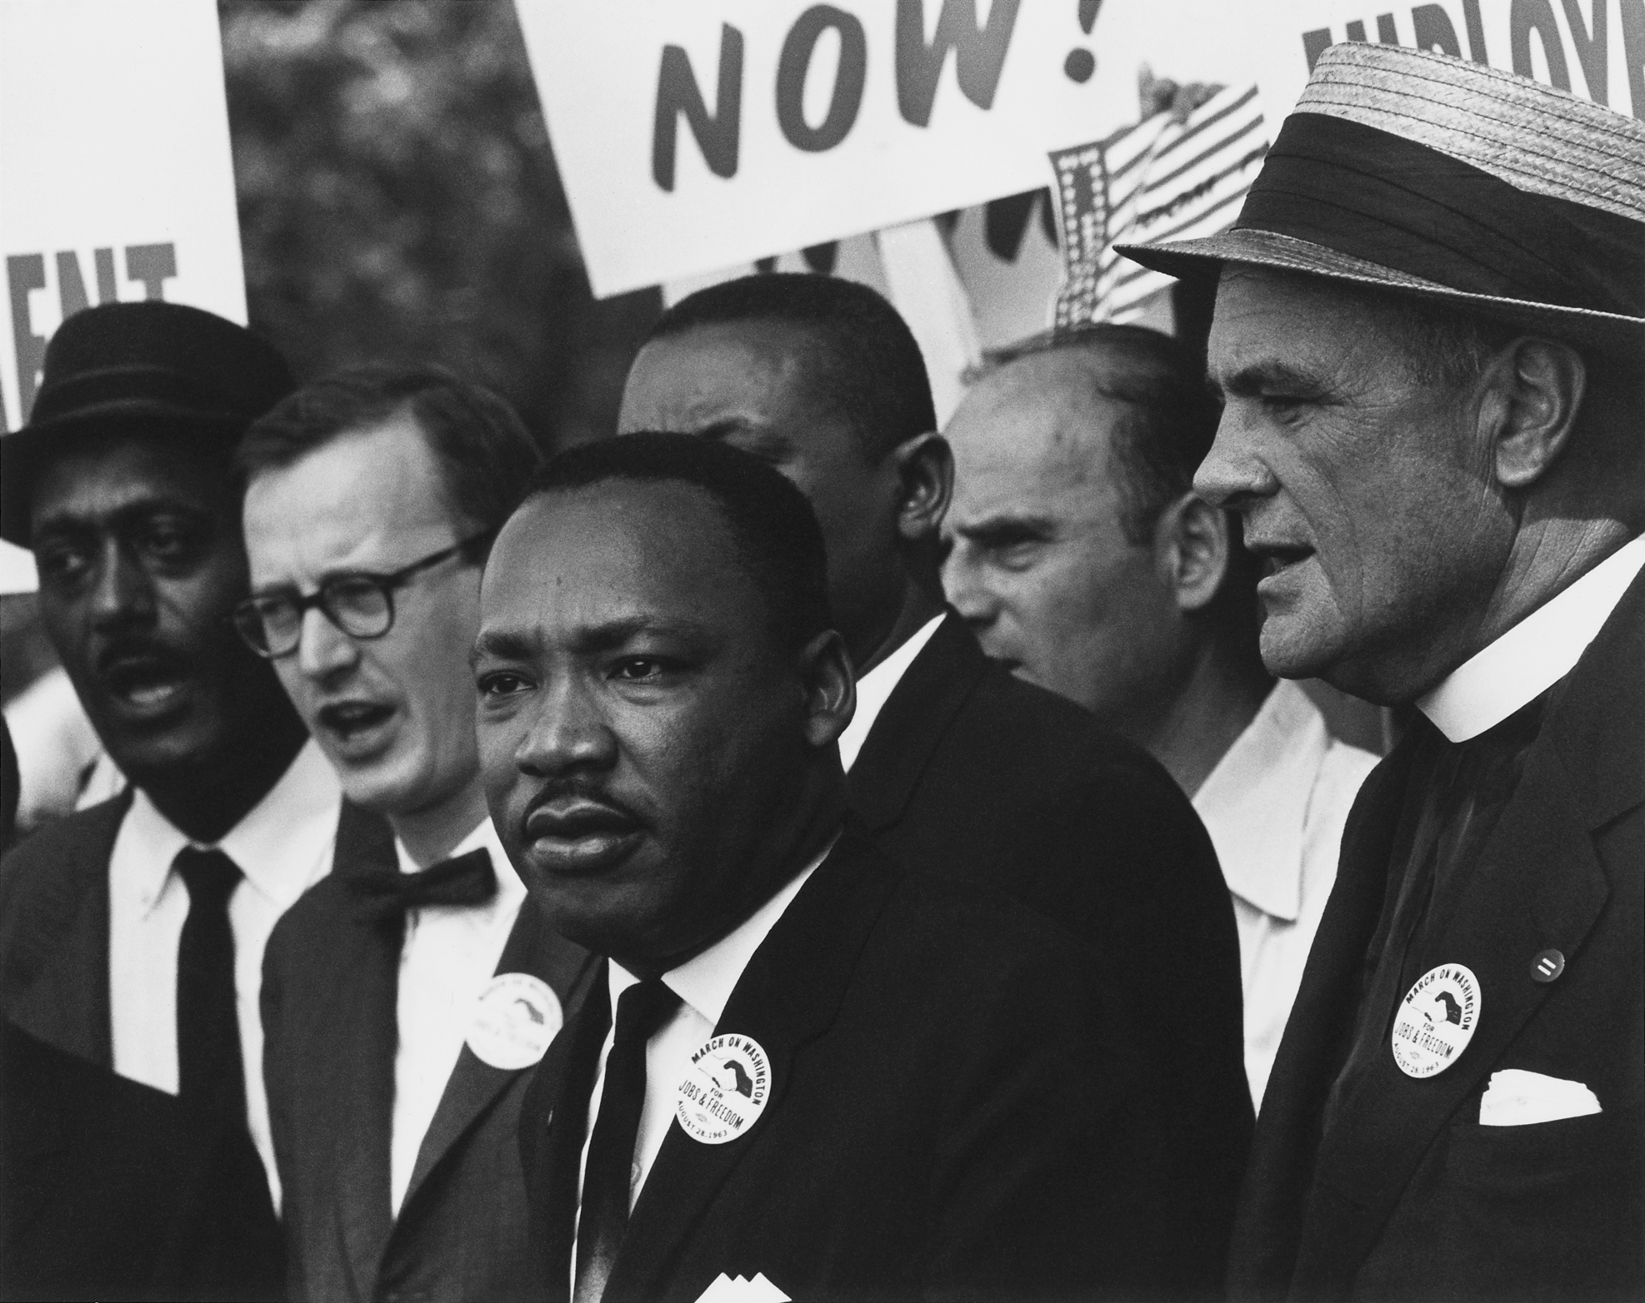
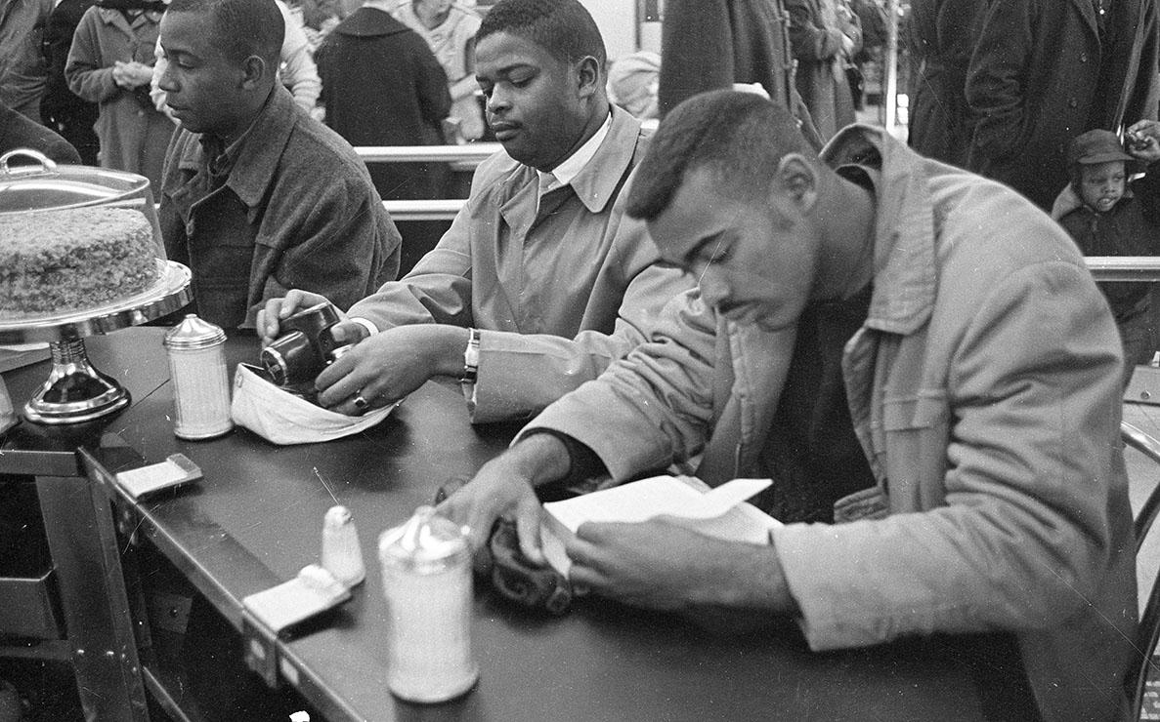
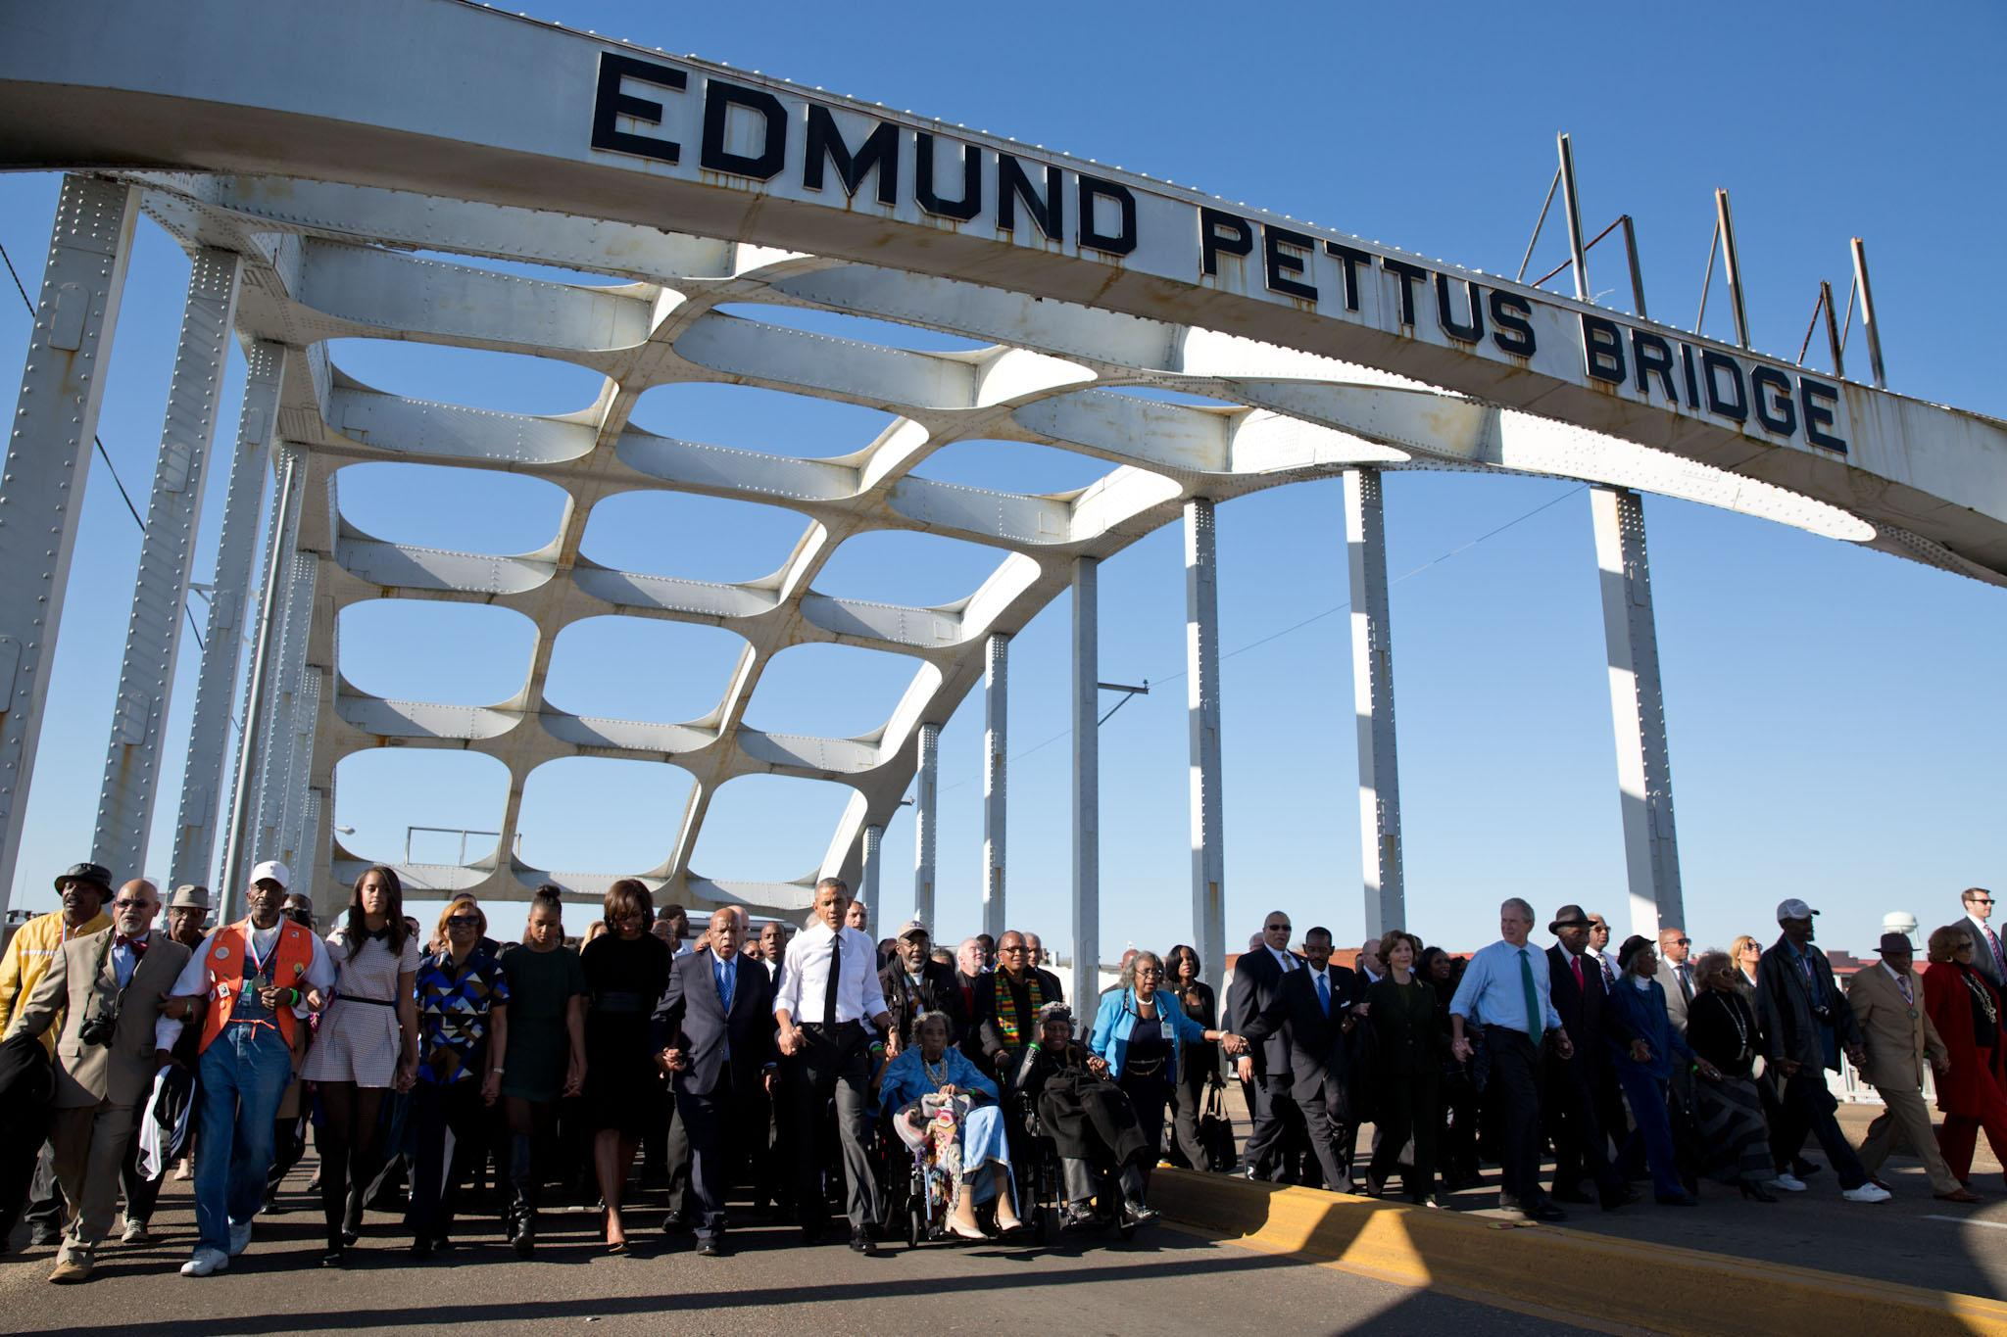
The Civil Rights Movement
1946-1968
1/18/2022

Slide 2
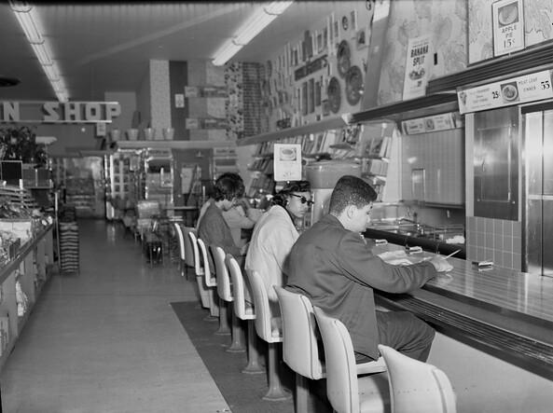
What are Civil Rights?
Civil rights are personal rights guaranteed and protected by the U.S. Constitution and federal laws enacted by Congress, such as the Civil Rights Act of 1964 and the Americans with Disabilities Act of 1990. Civil rights include protection from unlawful discrimination.

Slide 3
Separate but Equal
After fighting in World War II for freedom and equality, Black Americans wanted freedom and equality at home
Racial Segregation- the systematic separation of people into racial or other ethnic groups in daily life, was legal in the south
Laws in the South that treated Black residents unfairly are Jim Crow Laws-state and local laws that enforced racial segregation in the Southern United States.
Supreme Court decision Plessy v. Ferguson (1896), had declared “separate but equal” Jim Crow segregation legal.

Slide 4
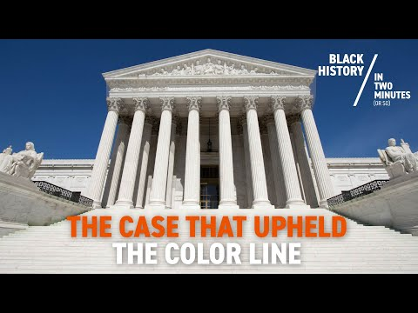
Separate But Equal

Slide 5
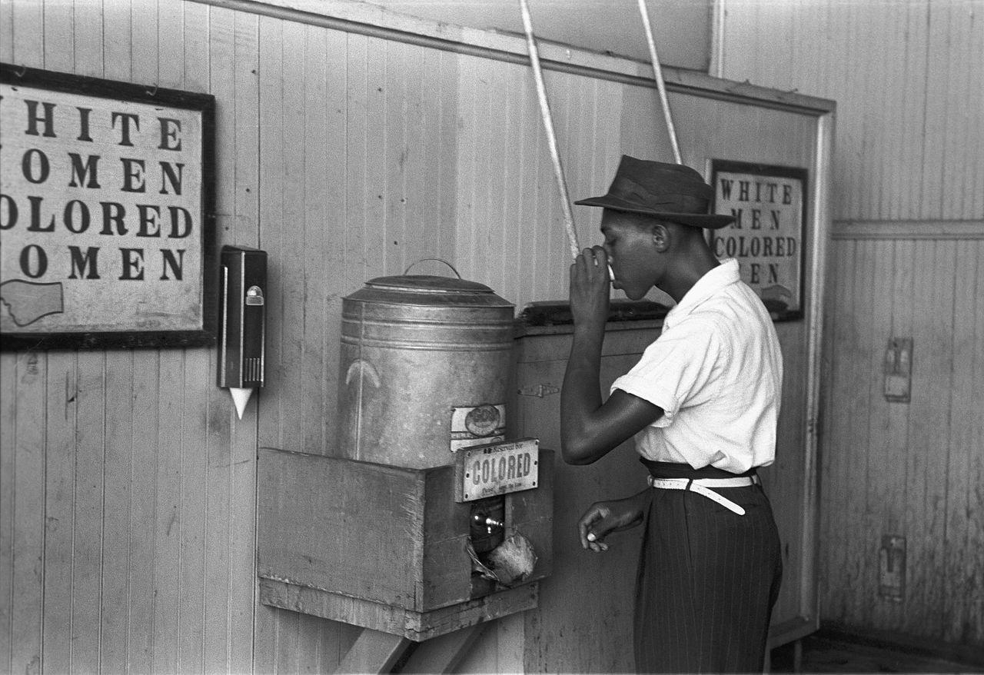
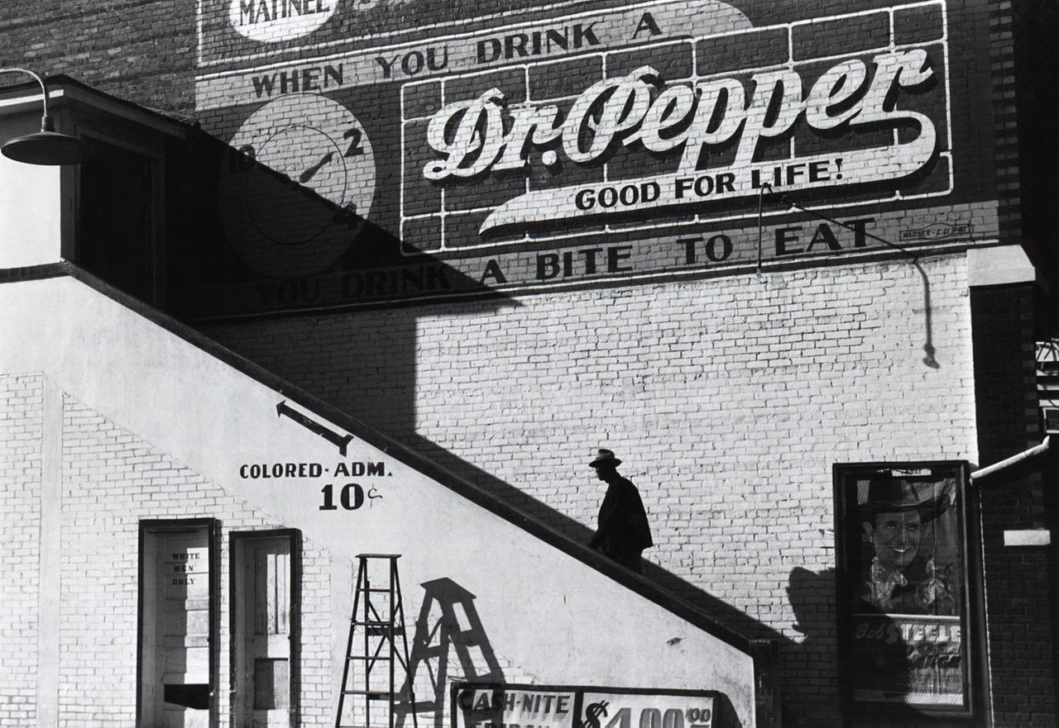
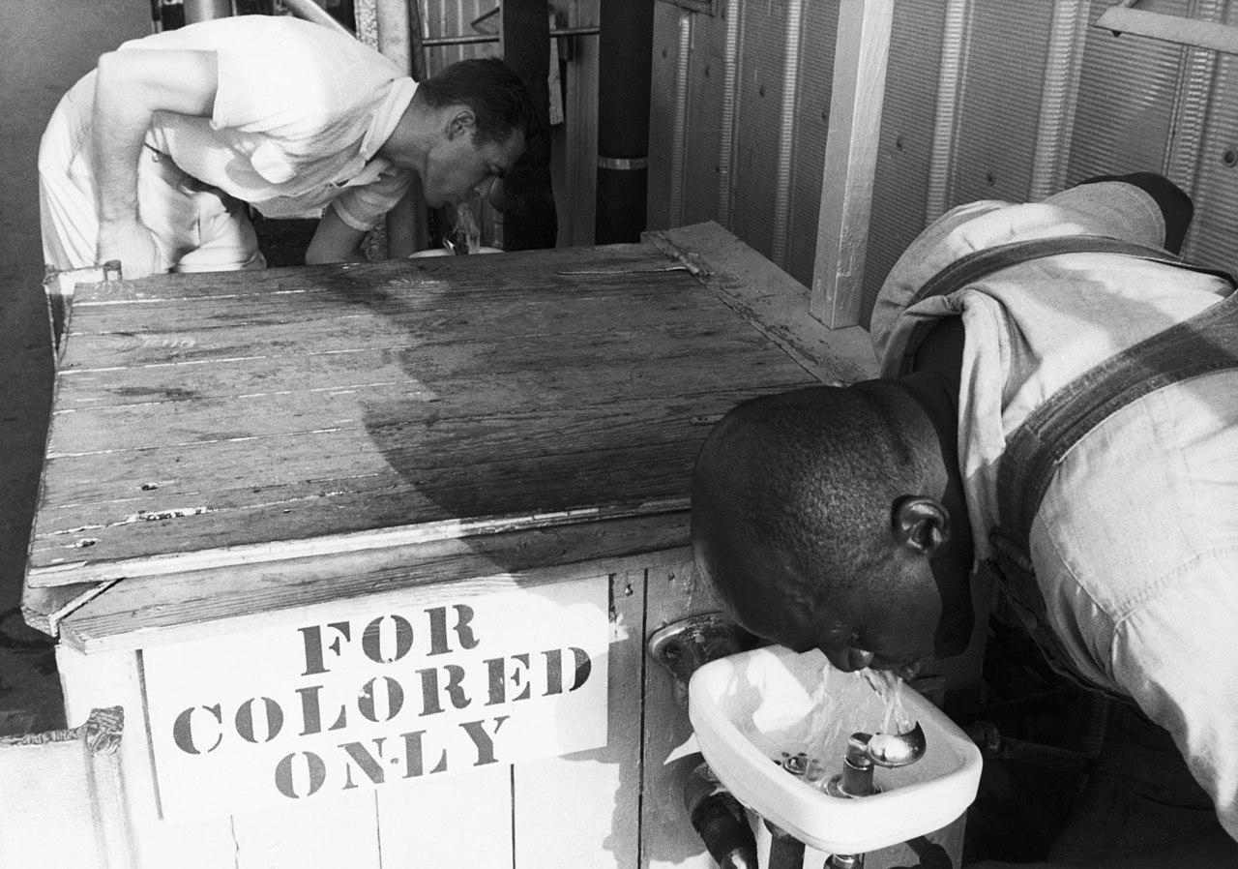

Slide 6
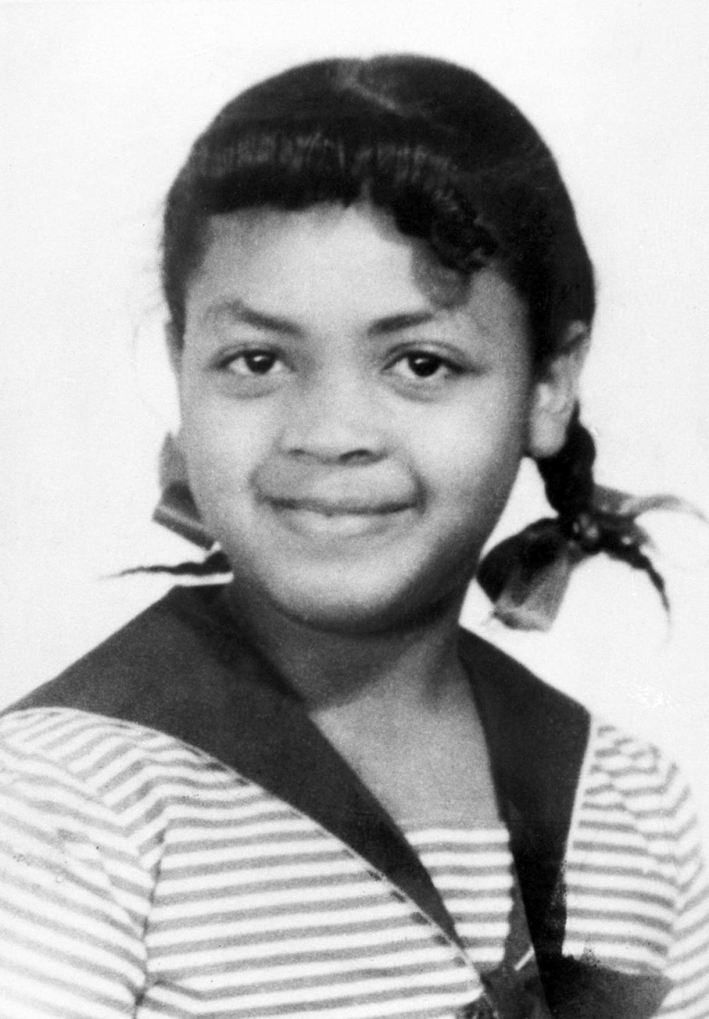
Separate But Equal Overturned (1954)
Brown v. Board of Education of Topeka (1954) a unanimous Supreme Court declared that racial segregation in public schools is unconstitutional
Linda Brown, a third grader, was required by law to attend a school for Black children in Topeka, Kansas.
Only seven blocks from her house was Sumner Elementary, a school attended by white children.
The Court agreed with Thurgood Marshall and the NAACP lawyers that segregated schooling violated the 14th Amendment

Slide 7
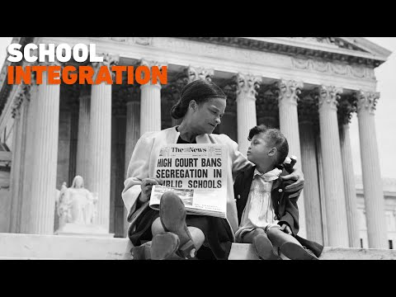

Slide 8
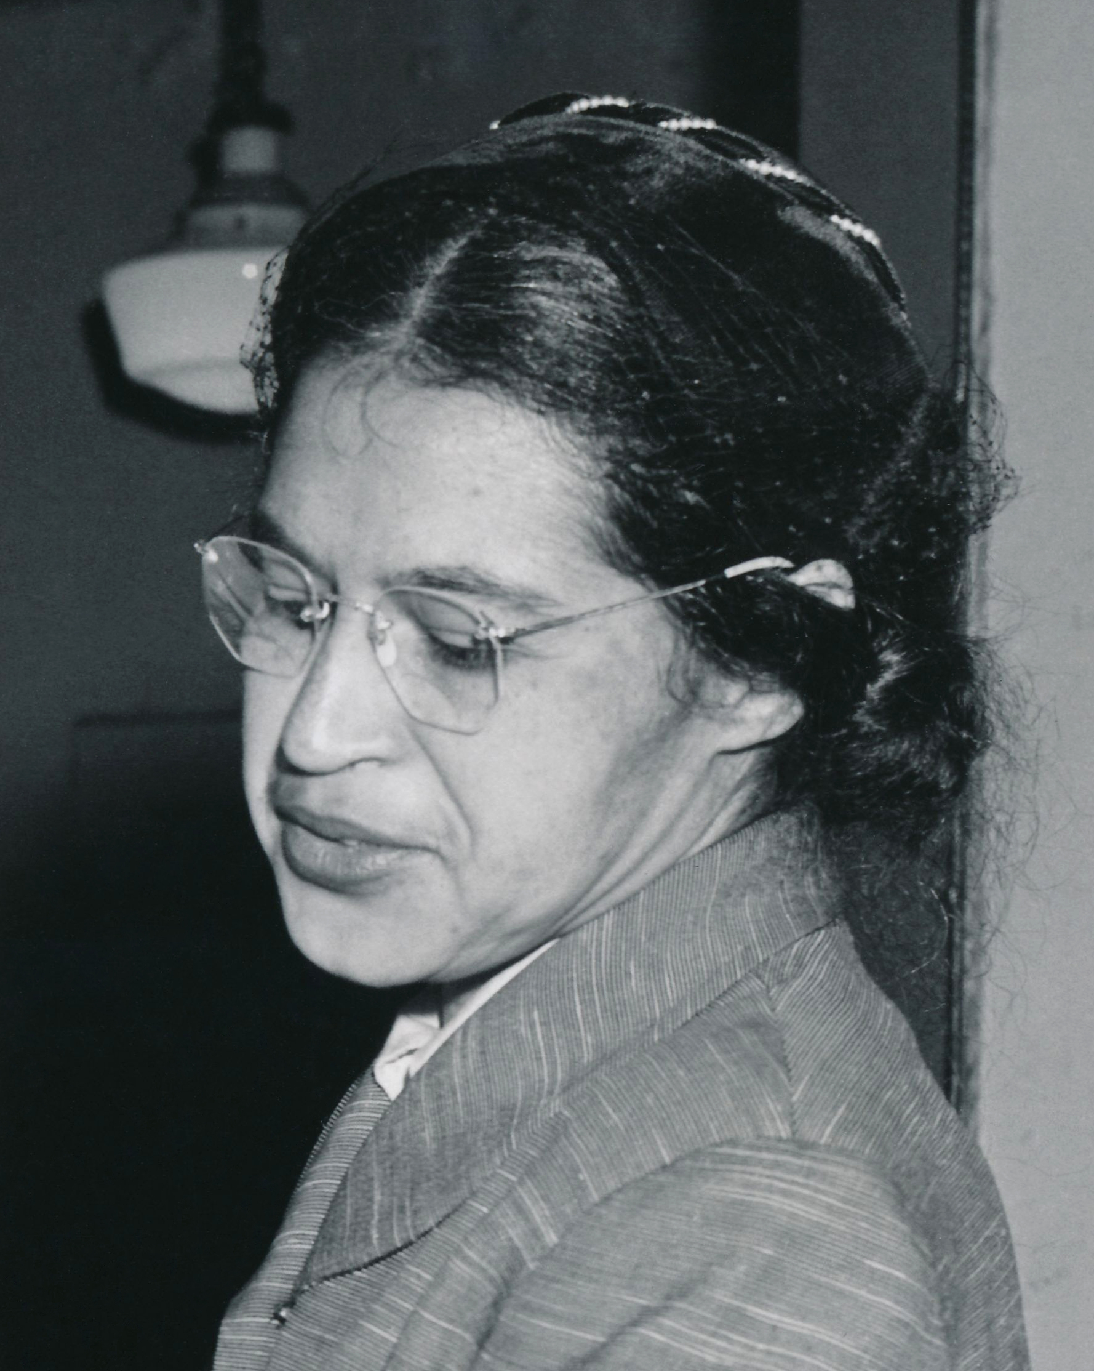
Montgomery Bus Boycott (began December 1955)
December 1, 1955 Rosa Parks was arrested for refusing to give up her seat on the bus to a white customer
Distributed flyers in black churches that called for a bus boycott on December 5
Bus revenue collapsed
In 1956 the District Court ruled that bus segregation violated the 14th Amendment in Browder v. Gayle
Notes:
4

Slide 9
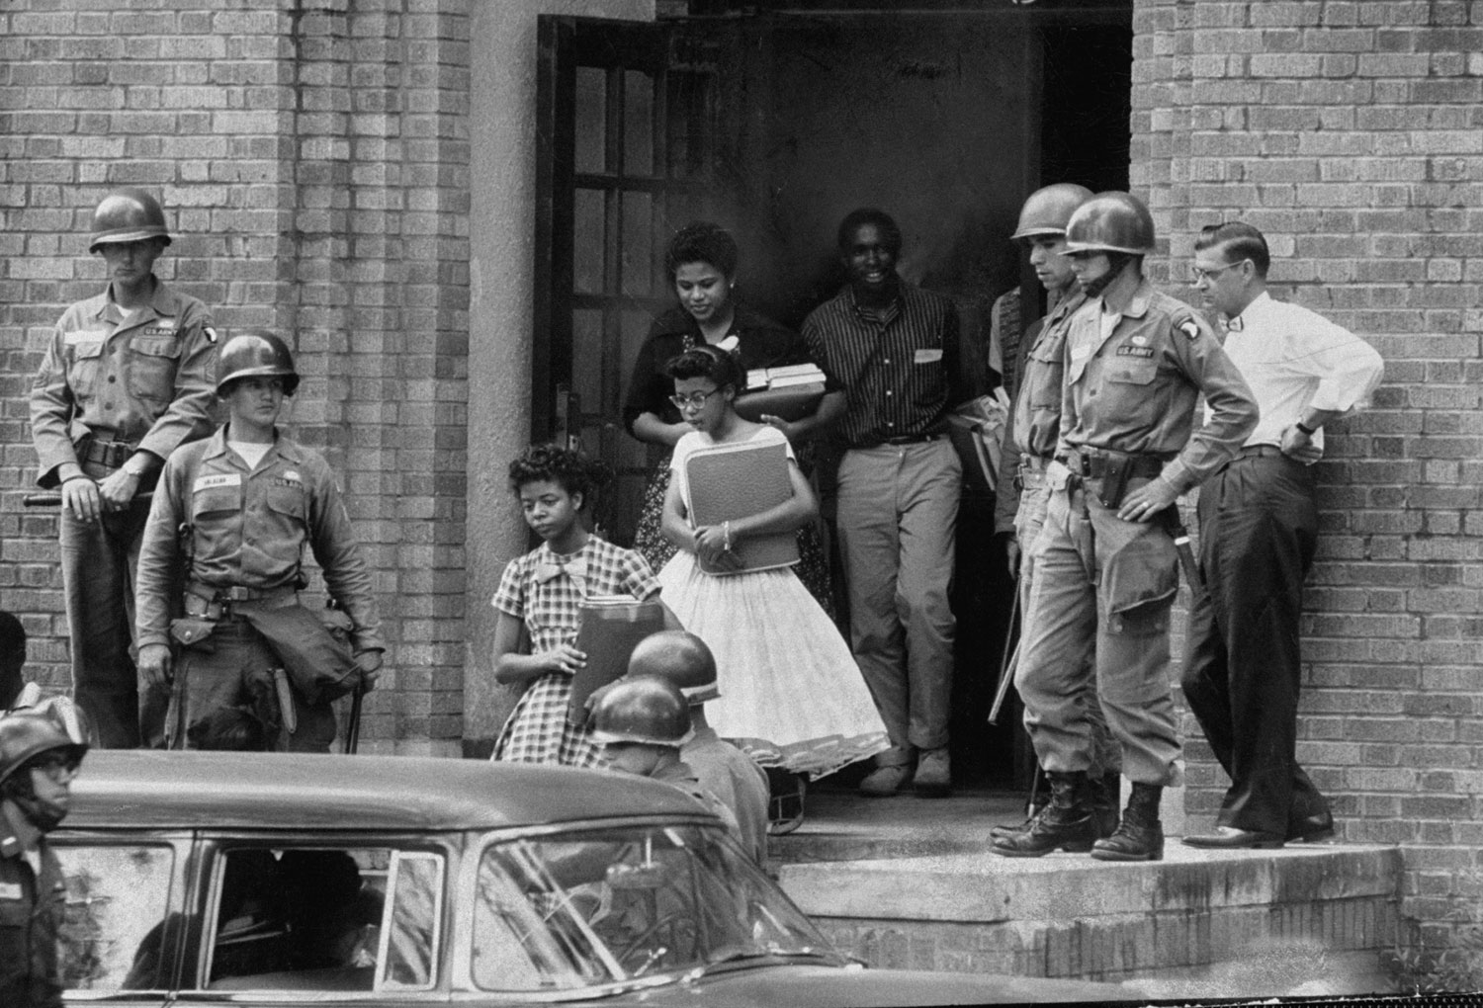
School Desegregation-Little Rock Nine (September 1957)
White Southerners resisted the Supreme Court ordered desegregation of schools
In the Summer of 1956 crowds of white people prevented Black children from attending school
Ministers escorted Black children to their new schools, but Arkansas’s governor sent the National Guard to prevent the children from entering
President Eisenhower sent the 101st Airborne to escort the children to school

Slide 10
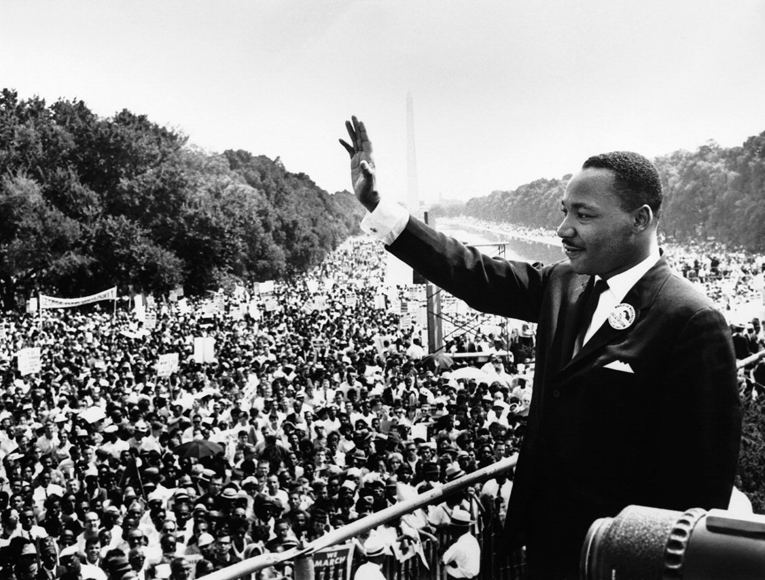
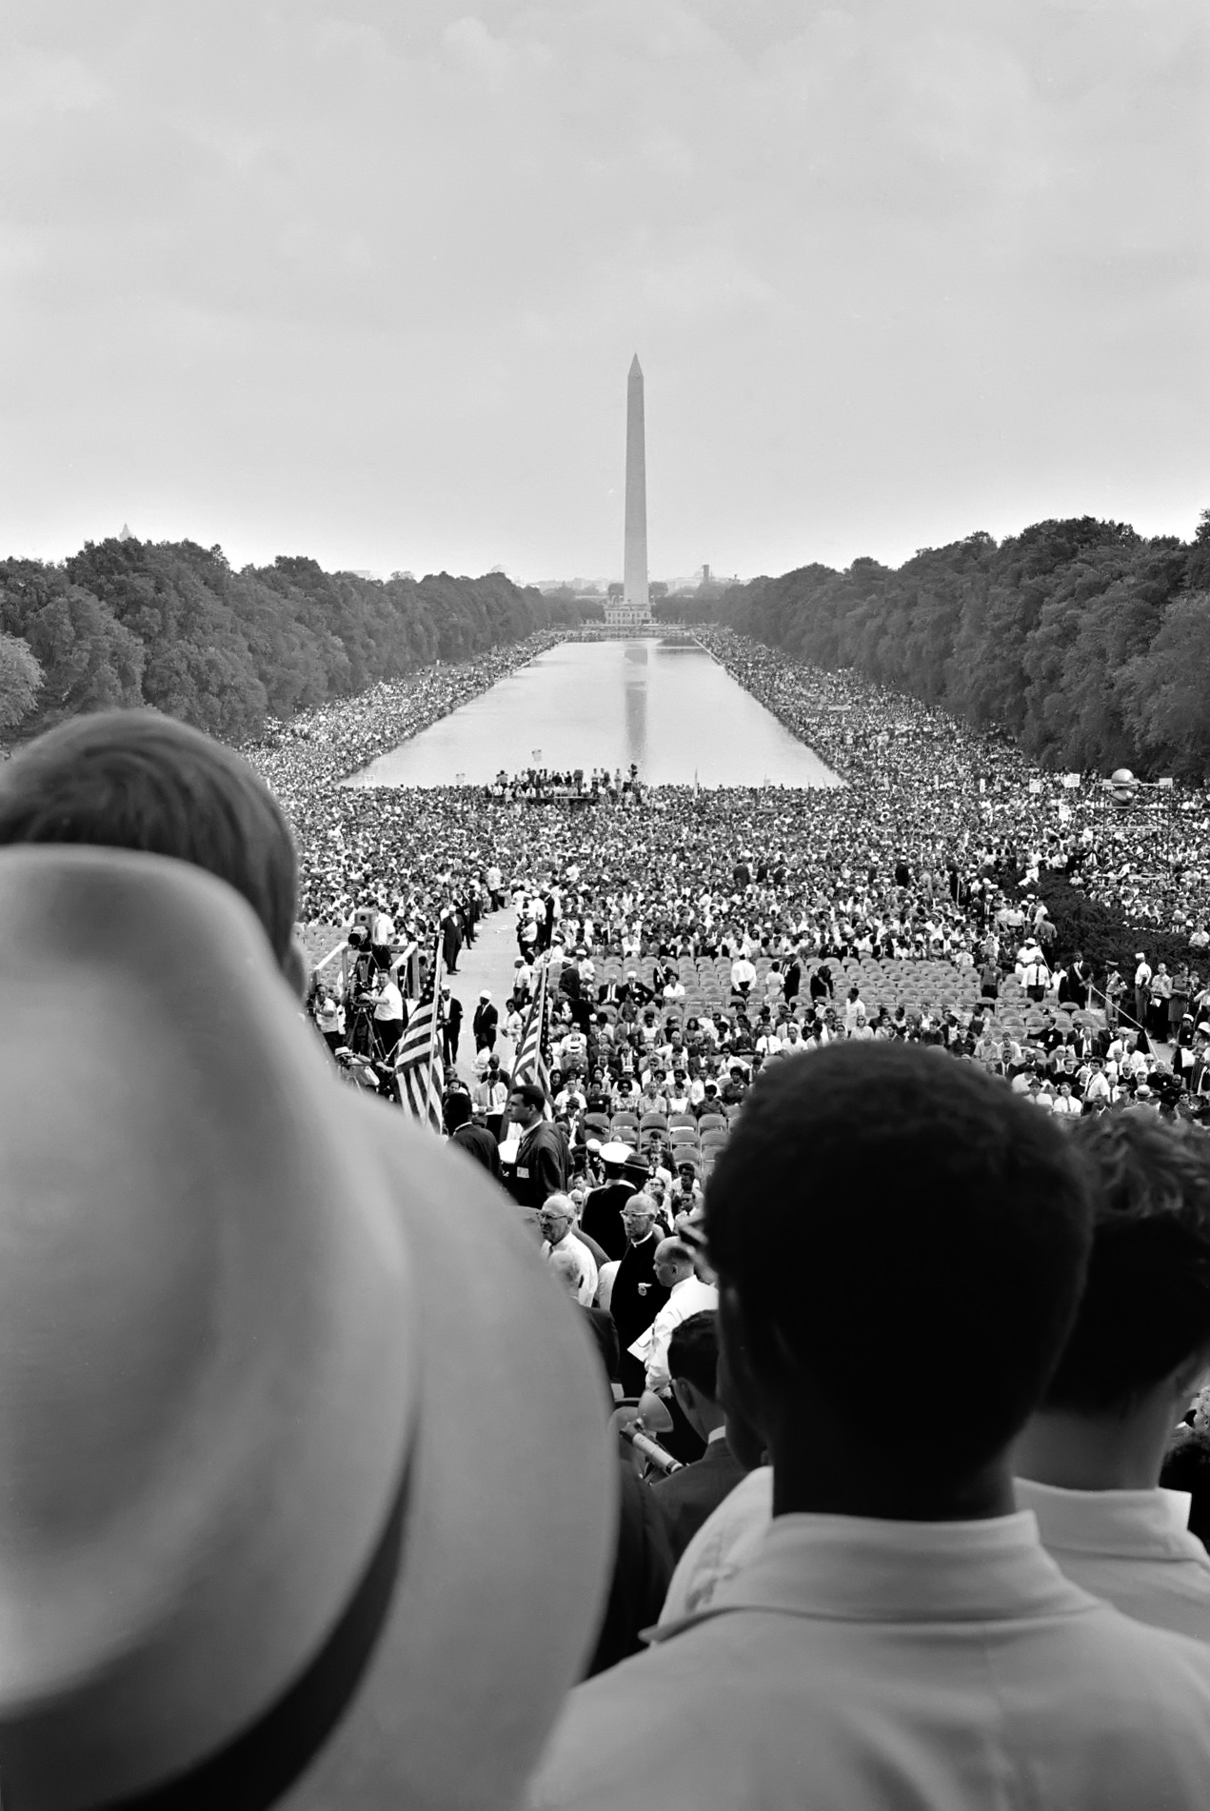
March on Washington (1963)
August 28, 1963 250,000 people came to protest for Black rights
Martin Luther King Jr. delivered his “I Have a Dream” speech
Demands revolved around issues of economic justice – like equal access to public facilities and accommodations, housing, education, and jobs.
Widespread news coverage helped popularize their message

Slide 11
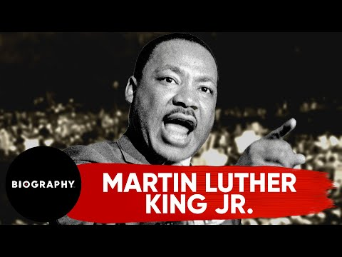

Slide 12
Civil Rights Act of 1964
Ended discrimination and segregation in education, public facilities, jobs, and housing.
Equal Employment Opportunity Commission to ensure fair hiring practices, and established a federal Community Relations Service to assist local communities with civil rights issues.
Authorized the US Office of Education to distribute financial aid to communities struggling to desegregate public schools
Upholding the new equality laws were resisted in the South
Voting rights were not strong enough in this law

Slide 13
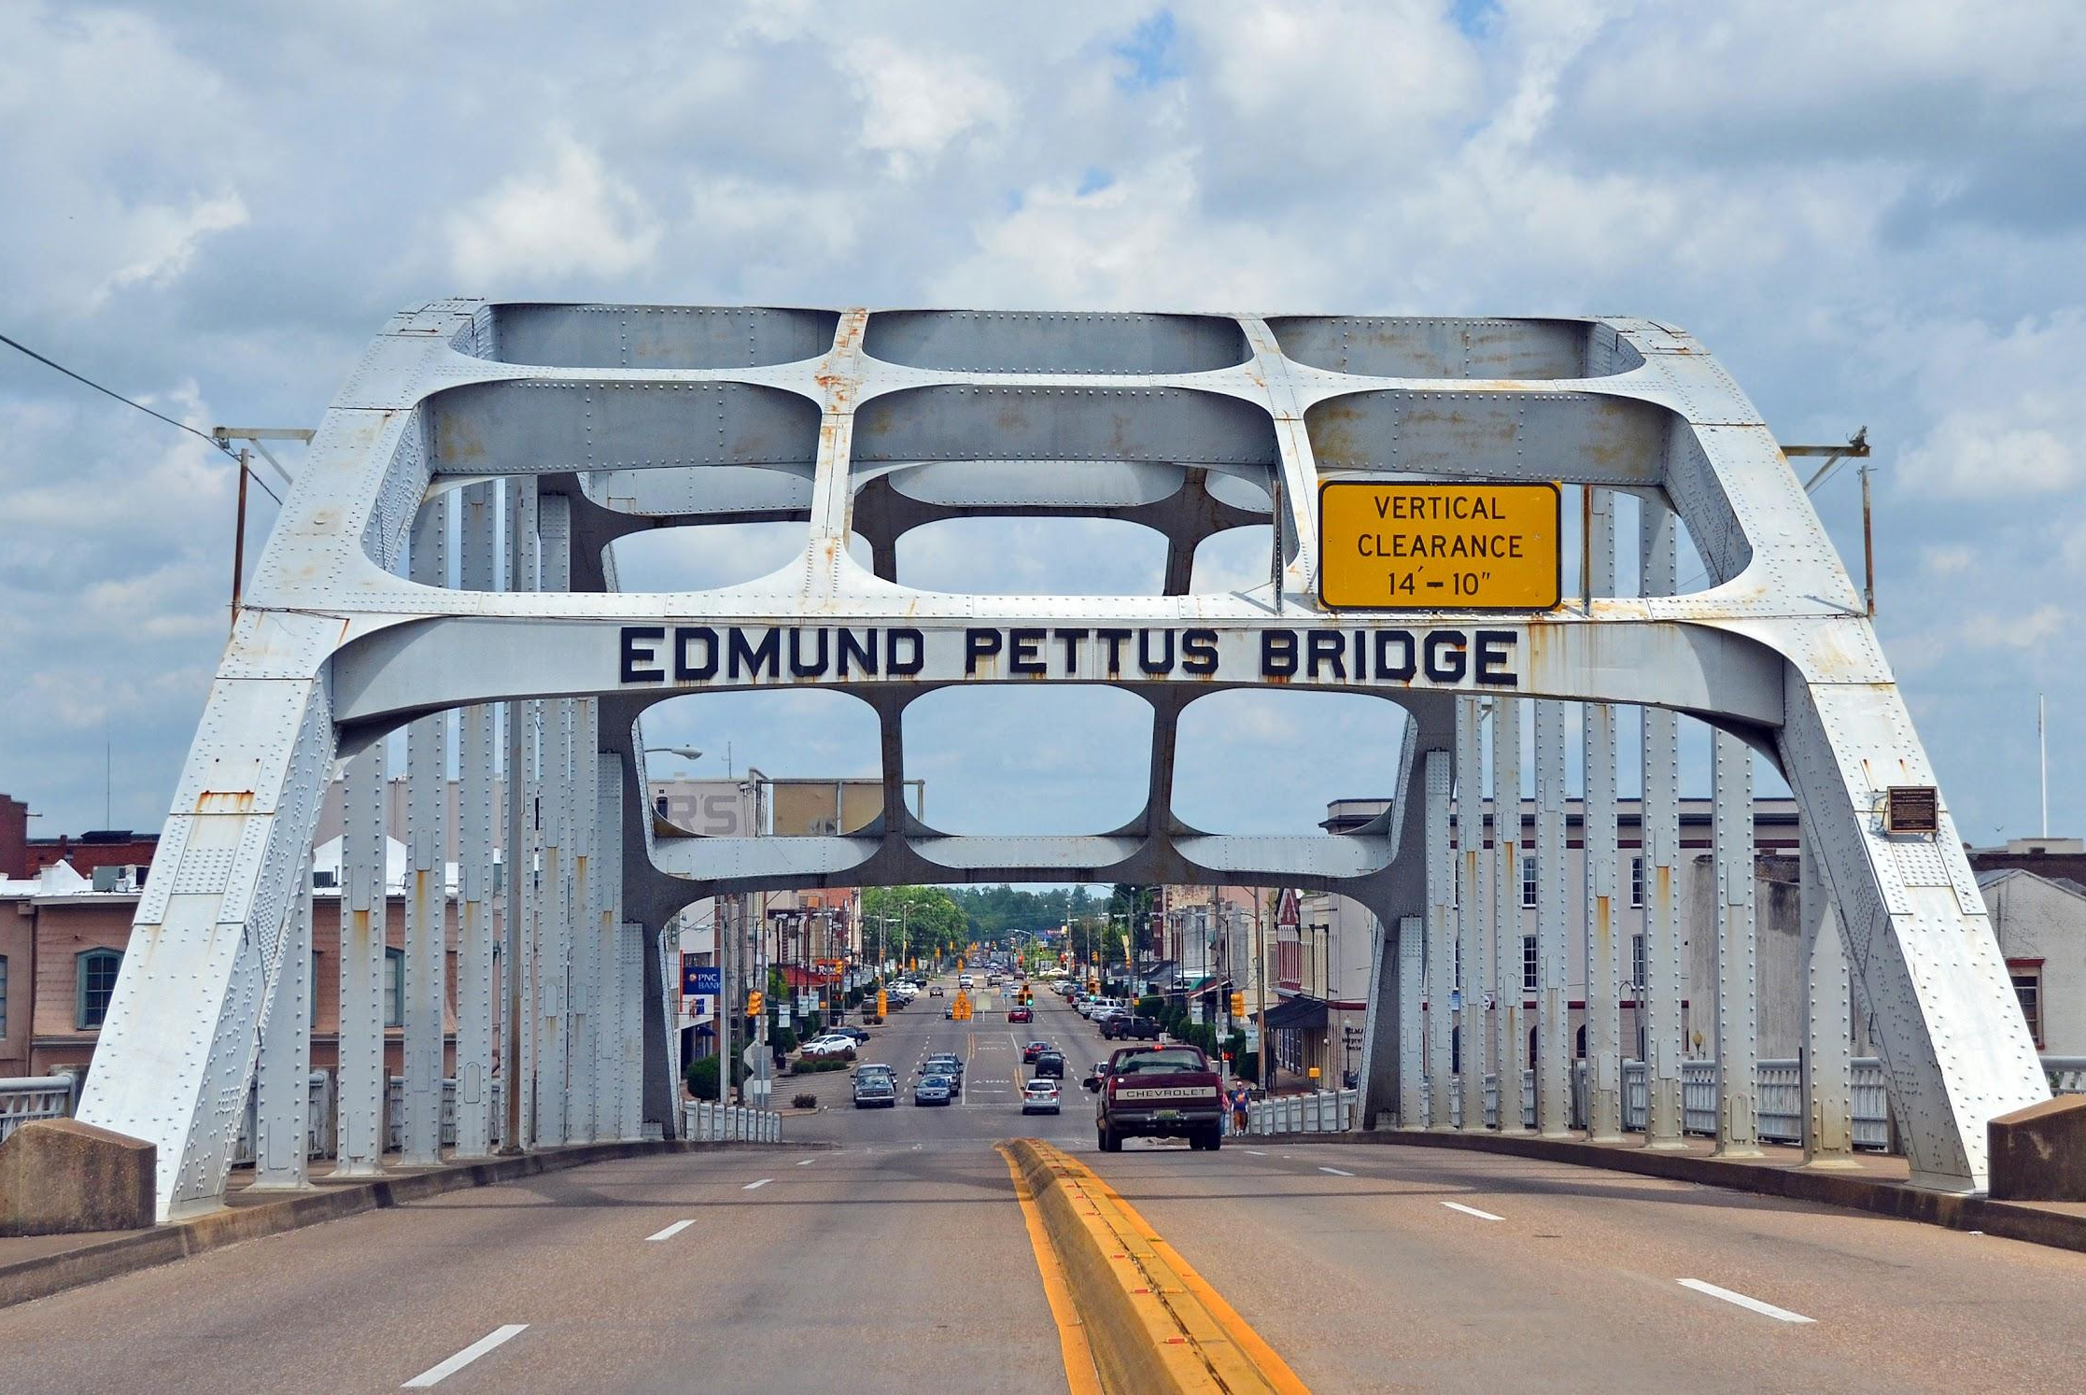
Bloody Sunday March 7, 1965
Violence toward Black citizens in the South rose
600 activists in Selma, Alabama marched across the Edmund Pettus Bridge and were beaten on TV by police to the horror of the television audience at home

Slide 14
Voting Rights Act of 1965
A week after Bloody Sunday, on March 15, 1965, President Johnson delivered a nationwide address in which he declared that “all Americans must have the privileges of citizenship regardless of race.”
Outlawed poll taxes, literacy tests, and other practices that had effectively prevented southern Blacks from voting
Authorized the US attorney general to send federal officials to the South to register black voters in the event that local registrars did not comply with the law
By the middle of 1966, over half a million Southern Blacks had registered to vote
By 1968, almost four hundred black people had been elected to office

Slide 15
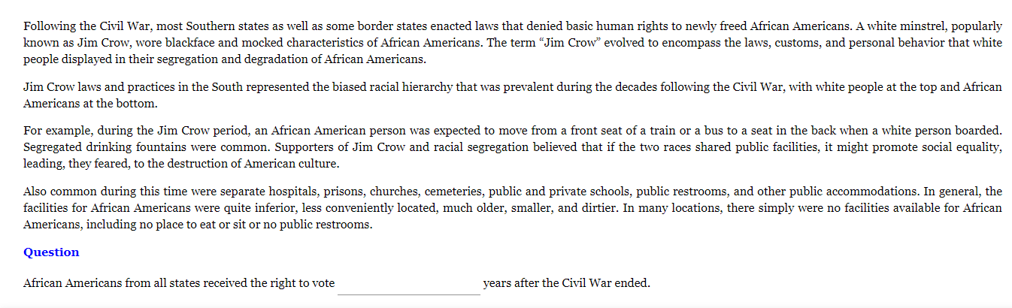
Notes:
Answer: 5

Slide 16
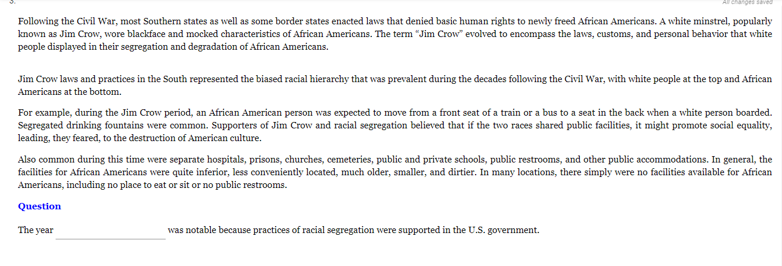
Notes:
Answer: 1913

Slide 17
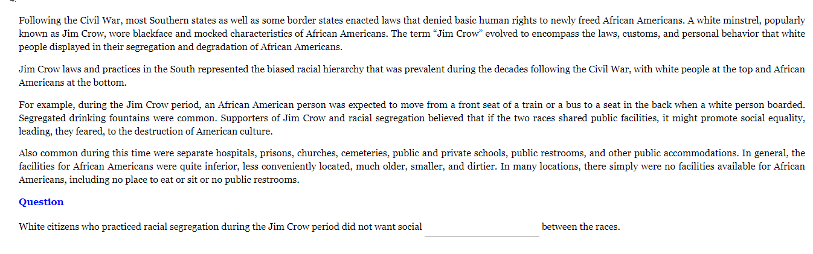
Notes:
Answer: Equality

Slide 18
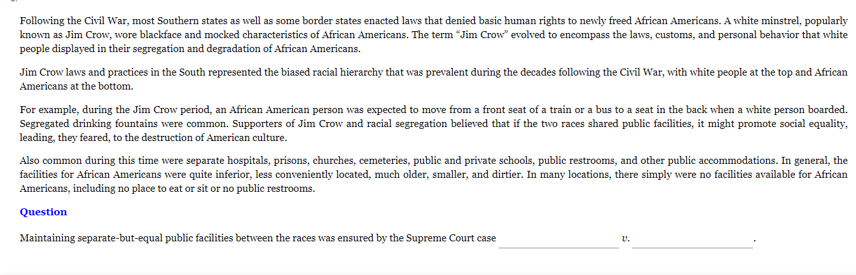
Notes:
Answer: Plessy v. Fergueson

Slide 19
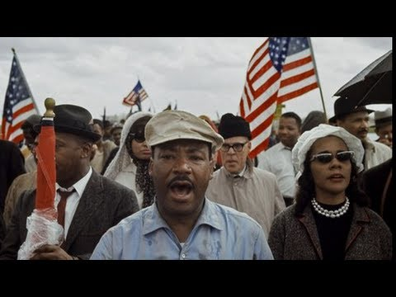

Slide 20
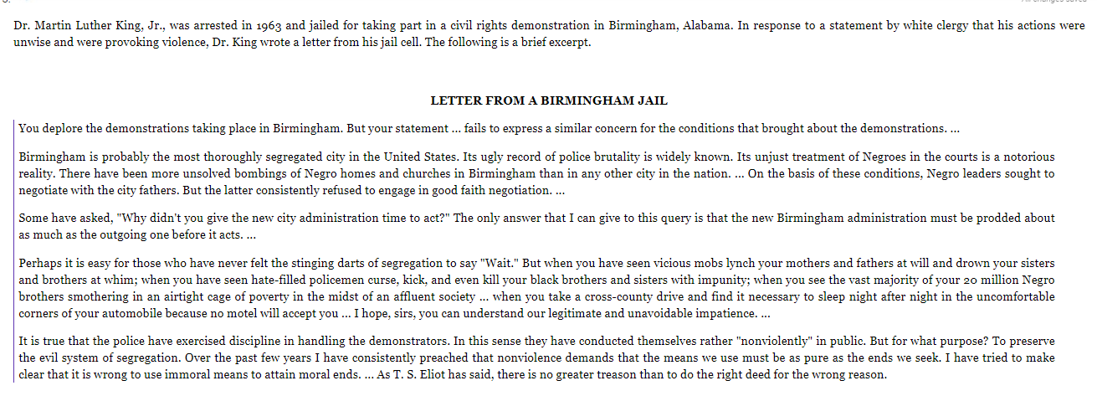
Notes:
Answer: B

Slide 21
Notes:
Answer: C

Slide 22
Notes:
Answer: D

Slide 23
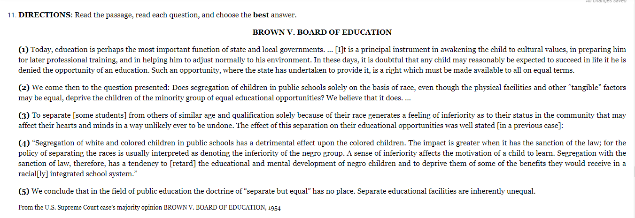
Notes:
Answer: C

Slide 24
Notes:
Answer: A

Slide 25
Notes:
Answer: D

Slide 26
Notes:
Answer: A

