Slide 1
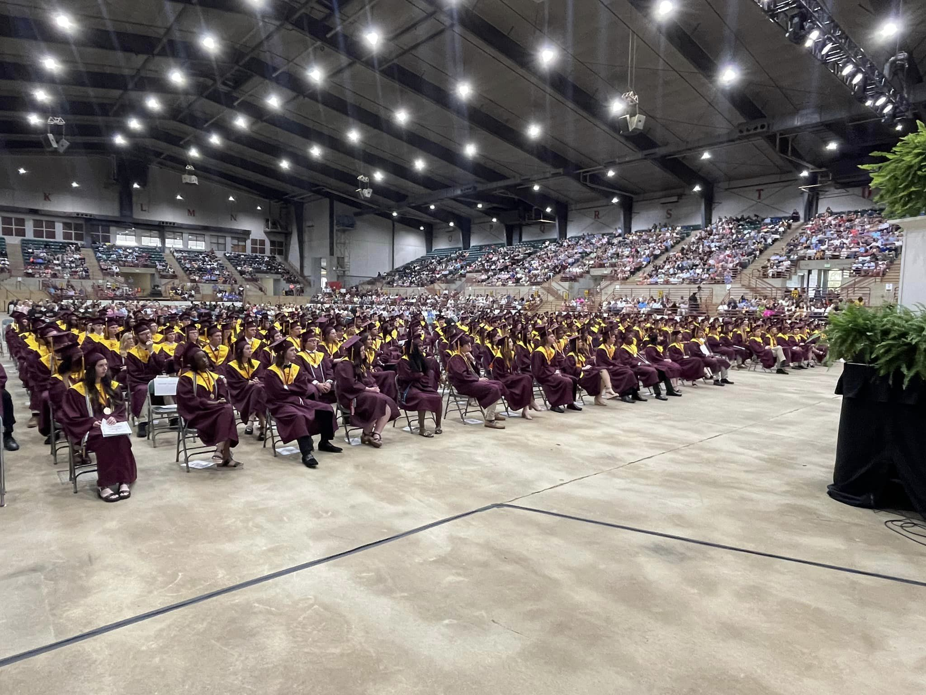


UNDERCLASSMEN Parent University
Perry High School

Slide 2

How do I keep up with information?
Perry High School Facebook page
Perry High School Counselors, GA Facebook page
PHS website (phs.hcbe.net)
Canvas classroom
Thrillshare App

Slide 3

Grading Procedures
Students have the opportunity to complete test corrections or the ability to retake tests when they receive a failing grade.
Teachers will ask students to complete remediation. No retakes or test corrections will be completed and given additional points without a completed remediation activity.
This is not the case for our DE classes or our Advanced Placement classes as grading is controlled by entities outside of Perry High School.
Teachers may ask students to come to tutoring after school, complete the remediation in class, or assign the remediation for homework.
Students have 6-weeks to turn in assignments. This is from progress report-to-progress report. Teachers do not have to allow students to turn in assignments after this 6-week period.

Slide 4

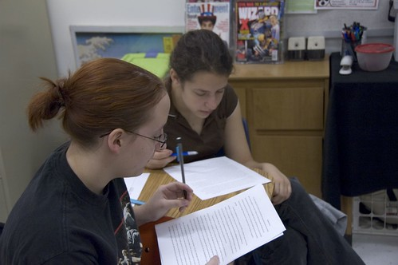

Response To Intervention Procedures
How We Determine when a student Needs Intervention?
PHS also has intervention teams for attendance, behavior, and academics.
Students are assigned multiple levels of intervention based on the above criteria.
Students under the age of 16 are referred to a social worker for attendance issues.
Teachers gather data from common formative assessments, common summative assessments, daily practice, and standardized test data to determine when students need intervention.
Intervention can be given in tutoring, during PAWS, Saturday school, or in the classroom setting.
Intervention can be given digitally, in station format, with alternate assignments, and test corrections to name just a few of the many options.

Slide 5
Academic Opportunities for Students At Perry High
PAWS
This happens on Tuesdays and Thursdays after 2nd period. Students have 35 minutes to either attend a class their teacher has assigned them or choose a class they are struggling in where they need more assistance.
Speak to your student about making good choices during this time.
Students who have As in all their classes can attend a study hall in the cafeteria.
Students must attend a specific PAWS if their teacher assigns them. If they are assigned and purposely do not attend, they will receive detention.
Academic Priority Time
We have four different APT times:
Mondays-3:15-4:30
Wednesdays-3:15-4:30
Mondays-7:15-7:50
Wednesdays-7:15-7:50
During these times students can get caught up on tests, quizzes, homework, and finish assignments.
Their teacher will not be in attendance, but a Perry High School teacher will be running the program.

Slide 6

Tutoring
Each teacher has a scheduled tutoring time. These tutoring times can be found posted in each teacher’s room, on our Facebook page, or on our website under tutoring schedule. Please have your student give his or her teacher 24-hours notice of their attendance.
Saturday School
Saturday school is on Saturdays from 8:00-11:30 in the PHS library.
Students who have failing grades will be assigned by their teachers. However, students also have the option of signing themselves up for Saturday school. Students can receive tutoring during this time.
An administrator is always present at Saturday school.
Parents will receive a call out if their student does not attend Saturday school but was assigned.
Saturday school can also be assigned for discipline if a student has an excess amount of tardies or for other infractions.

Slide 7
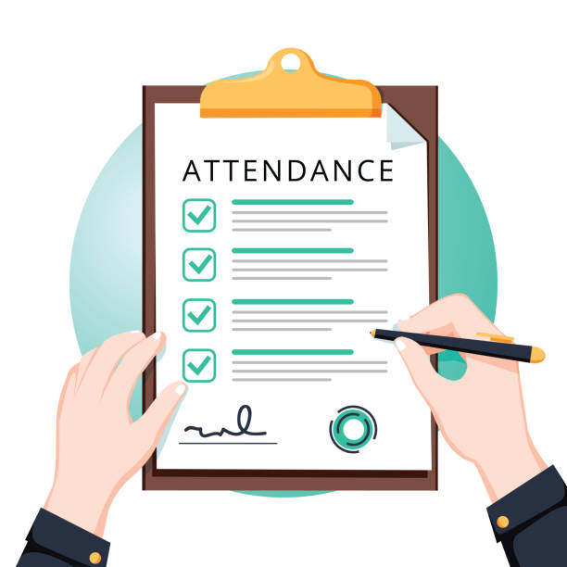
Attendance
The Importance of Attendance
Attendance is very important.
It is a priority at the high school level because getting caught up is very difficult and grades follow students to college.
Please help us with your student's attendance.
Students will have to take their final and midterm exams if they have more than five absences in a semester. This is determined per class period.

Slide 8

Gradebook and Assessments
For Classes that are not dual enrolled:
Perry uses revolving gradebooks.
Tests replace quizzes for the same standards in the same unit.
Students can revise essays for higher grades.
All subjects do test corrections, test retakes, or test redemptions.
Teachers take off 10-points for late assignments.
M's (missing) will be put in once an assignment has been missed so that grades will be accurate.
Students can make up tests and quizzes in tutoring, APT, PAWS, and Saturday School.

Slide 9

Technology policies and procedures
Student may not have their phone out during a test or quiz. This means the phone cannot be on the desk or in their lap.
All essays are run through the same software programs used by most colleges along with AI software that detects essays that are written by AI software.
On standardized testing days students should have their Chromebooks fully charged and bring their chargers in case the computer dies.
If your child comes to Saturday school, please have them bring their Chromebook and all necessary work along with their book bags.

Slide 10




Test Taking Strategies
COME TO SCHOOL!
Be prepared for class.
Take advantage of retest opportunities and test corrections.
Study at a table out of your bedroom
Make notecards to help with difficult vocabulary.
Read information out loud.
Take advantage of all videos and practice tests in Canvas Classrooms even if they aren't for a grade.
Complete study guides.
Ask for help if you are having issues all teachers have tutoring times.
Study every night even if you don't have homework.
Complete all classroom assignments.
Copy examples and use them to study from.
Complete all remediation activities the information will come up again.
Don't cram the night before the test. Crammed information does not stay in your brain.

Slide 11


Studying Tips/Homework
Use a daily planner so you are always prepared for tests and quizzes.
If you don't understand the lesson, ask questions.
Note-taking should be in a form that's most helpful to you. If you're more of a visual person, try writing notes on different colored index cards.
Music can also be a good memory aid if you don't find it distracting.
Re-writing your notes daily is a good strategy.
Feel free to get creative. Draw pictures, thought bubbles, or anything that pulls your attention to important topics.
Draw arrows from the cause to the effect.
Use different colored highlighters.
Mind mapping is a great technique to help visually organize information you need to study.
First, make a conscious effort to stay away from distracting websites that can suck up your day. If you have trouble with this, you can download an app that will allow you to shut out distracting websites when you choose, like Self Control for Mac users. Strict Workflow is a Chrome extension that will block distracting websites for 25 minutes at a time and give you 5-minute breaks.

Slide 12


How a GPA is Determined and What it Means
There are different types of grade point averages.
School GPA – This includes all the courses you take in high school.
HOPE GPA – This is found on gafutures.org and only includes math, science, social studies, English, and foreign language classes. Extra points awarded for AP and Honors classes are removed from the HOPE GPA.
Weighted vs. Unweighted GPAs
Weighted – The extra points earned for AP and Honors classes are included.
Unweighted – The extra points earned for AP and Honors classes are not included.

Slide 13

Hope Rigor
In order for your student to be eligible for the HOPE or Zell Miller Scholarship the following must be met:
The student must have a 3.0 CORE GPA for HOPE. For Zell Miller a student must have a 3.7 CORE GPA.
A student must have four rigor courses – These can be found on gafutures.org and will be discussed at evening advisement.
Zell Miller – Requires an SAT score of 1200 or an ACT score of 25 (ACT cutoff score determined every January).

Slide 14

Advisement Tips and Why it is important for your student
Evening advisement is March 2-4.
Your student will begin advisement in January.
Each week a different topic will be introduced such as DE, AP, and Houston College and Career Academy.
Your child will choose his or her classes during the month of February.
When you come in during advisement in March, you will look at what your child chose to take.
You may ask his or her advisor any questions you have and if you disagree with a course selection, you can let us know at that time.
More details about evening advisement will be sent out next semester.
Stay plugged into our Facebook page for more information.

Slide 15
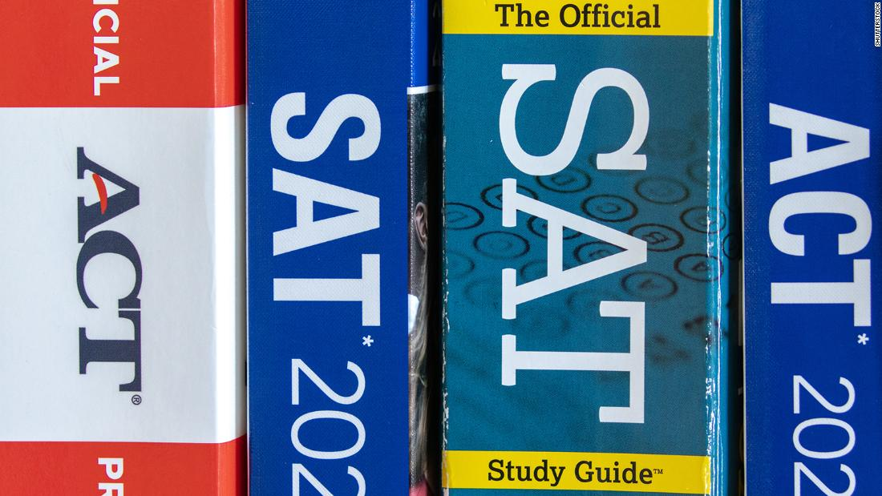
SAT and ACT Scores and Signing up for Tests
SAT/ACT testing is optional at many institutions.
The schools requiring SAT/ACTs for the class of 2026 are UGA, Ga Tech, GC&SU, Augusta University, Georgia Southern (Statesboro, Armstrong), Georgia State (Atlanta), and Kennesaw University.
Class of 2027 and beyond SAT/ACT requirements have not been released
To register for the SAT, please go to collegeboard.org
To register for the ACT, please go to ACT.org

Slide 16
AP Classes
Advanced Placement classes are classes that are taught on a college level. The student takes the class both semesters and has an exam in May.
Scores can range from a 1 to a 5. Please check the college website to find qualifying scores.
The score earned on the test will not affect a student’s grade in the class.
5 quality points are added to AP classes
There will be an AP Parent Night in January to go over more information.
Chemistry Statistics
Environmental Science US History
Biology World History
Computer Science Psychology
Human Geography Language
Literature Music Theory
Statistics
Precalculus
Calculus

Slide 17
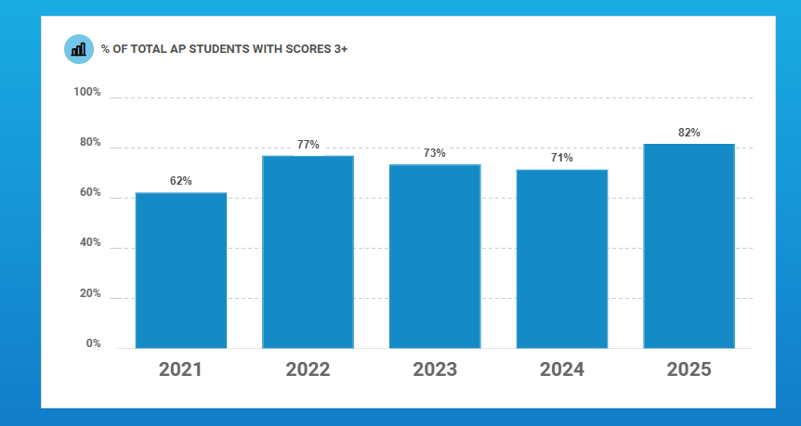
AP Scores past and present
Scoring an AP 5 is the highest score you can get on an AP 5 test.
Last year, we had 77 students score an AP 5 in 1 or more classes.
Most of our AP classes outscore the state in percent of students who score a 3 or above on their AP Exam.

Slide 18

DE Classes
For juniors, our Dual Enrollment classes offered on the PHS Campus through Central Georgia Technical College are US History 2111 and 2112. Senior year, students may take Economics 1101, sociology 1101, English 1101, English 1102, Math 1111 (College Algebra), Psychology 1101, and Sociology 1101.
On campus DE classes are taught by a PHS teacher working as an adjunct professor for CGTC.
Students may take classes off campus at a participating college. We will offer a DE night in January for more information on off campus DE.
DE will not fund a college class until a student’s junior year unless the student has a qualifying GPA and earns a 1200 on the SAT or a 26 on the ACT.

Slide 19

DE Classes
According to the Georgia Student Finance Commission, a Dual Enrollment student is only allotted two withdrawals, beginning summer 2020. After the second withdrawal, a Dual Enrollment student is no longer eligible for the dual enrollment program. In addition, the courses withdrawn from are calculated in the cap hours and the student will not be able to register for the same course during a later term while participating in dual enrollment.

Slide 20
Houston County College and Career Academy
HCCA offers courses not available at PHS.
A student must have a qualifying GPA to attend.
Students in 10th -12th grades are eligible
DE classes are offered to 10th-12th graders.
Registration will take place in March of 2026 for the 26-27 school year.
Seats are limited

Slide 21
CLASSES OFFERED AT hcca
Audio, Video Technology, and Film
Automotive
Barbering
Computer Programming
Cosmetology
Criminal Justice
Culinary Arts
Cybersecurity
Emergency Medical Responder
Engineering
Fine Furniture
Introduction to Healthcare Science
HVAC
Industrial Systems
Information Technology
Latin
Nurse Aide
Teaching as a Profession
Welding

Slide 22
Freshmen – what’s next?
Remember that your grades beginning in 9th grade will affect your ability to get into college, participate in DE, and attend HCCA.
Create your account on Gafutures.org. It is a one-stop shop for college and career planning in the state of Georgia.
Find your place! Join after school activities including clubs and/or sports.
As you get ready for your sophomore year, decide if you’d like to take AP classes.
Begin your resume! Keep track of anything you do during 9th grade including volunteer work, awards, and leadership opportunities.

Slide 23
Sophomores – what’s next?
Continue to add to your resume! Sophomores may be invited into Beta Club or National Honor Society. Keep track of your community service hours.
Start thinking about what you want to do when you graduate. Do you want to attend a Technical College, 4-year university, or join the military? Begin to tailor your classes towards what you want to do.
Decide if you’d like to take DE or AP courses.
Keep your grades up! Come to school everyday and when you are here, focus and get your work done. Take advantage of any tutoring opportunities, APT, PAWS and the revolving gradebook.

Slide 24
Juniors – what’s next?
Continue building your resume. Start working on strong paragraphs that you can use to apply for college and scholarships. These may include: why you need money for school, one event that changed your life, why you want to go to a particular school, and what you want to major in.
If you plan to attend college, begin researching what you would like to major in and what colleges offer the major.
Keep up your grades! Decide if you want to take DE/AP classes your senior year.
Most students who plan to attend college will schedule visits beginning their junior year and the summer after their junior year.
If you plan to go in the military, sign up for the ASVAB and speak with a recruiter

Slide 25
Please contact your counselors with any questions!
Megan Newell (A-F) megan.newell@hcbe.net
Alicia Rogers (G-J) alicia.rogers@hcbe.net
Ashlee Pullins (K-Q) ashlee.pullins@hcbe.net
Kayren Cannon (R-Z) kayren.cannon@hcbe.net

