Slide 1
WELCOME
Tonight's agenda
TO
WELCOME
Targeted Assistance Review
-Mr. Pacchioni
Title I Curriculum Review
-Title I Reading Specialist
SPAC Skits
Compact Review
Mr. Pacchioni
Title I Parent Engagement Workshop
w
Reminders
Food
Bingo (prizes)
Handouts
Free items

Slide 3
IMPLEMENTING TITLE I, PART A TARGETED ASSISTANCE PROGRAMS
Wyoming Area School District
Kindergarten and Primary Center
Parent Information Meeting
November 8, 2023

Slide 4
Exploring The Components of The Targeted Assistance Program

Slide 5
ESSA, PUBLIC LAW 115-224
Every Student Succeeds Act (ESSA) requires every Title I school to develop a Title I Schoolwide or Targeted Assistance Plan;
Plans are designed to capture, in writing, a focused and coherent course of action to provide for all of the students in a Title I program the opportunity to meet the challenging State academic standards.

Slide 6
Additional ESSA Requirements
Title I Targeted Assistance Plans:
Require a Comprehensive Needs Assessment of the entire school;
Require the involvement of parents and other community members (Title I Committee);
Require the plans in effect for the duration of school’s participation in the Title I, Part A program;
Require the plans to be monitored and revised as necessary based on student needs to ensure that all students are provided opportunities to meet the challenging State academic standards.

Slide 7
TARGETED ASSISTANCE PROGRAMS
Schools operating a targeted assistance model must use Title I funds to help educationally disadvantaged students meet state standards. Students are eligible for Title I if they are failing, or at risk of failing, to meet state standards.
In a targeted assistance program, Title I law requires that selection of Title I students be based on objective, educationally related, and uniformly applied criteria given to all students at each grade level.

Slide 8
TARGETED ASSISTANCE PROGRAMS
A school served with Title I, Part A funds in a Targeted Assistance setting will provide services only to eligible children under ESSA, Section 1115(B) identified by the school as failing or most at risk of failing to meet the challenging State academic standards.

Slide 9
Planning Targeted Assistance Programs
Planning is a systematic process of setting priorities, and the steps needed to be taken in order to achieve a desired goal;
Planning the Schoolwide or Targeted Assistance programs will be a collective effort made by the staff, parents and community to bring school changes in order to improve student performance.

Slide 10
Six-Step Planning Process
Step 1: Establishing a Planning Team
Step 2: Conducting a Comprehensive Needs Assessment
Step 3: Clarifying Needs and Finding Evidence-based Strategies
Step 4: Setting Schoolwide or Targeted Assistance Program Goals
Step 5. Writing the Schoolwide or Targeted Assistance Plan
Step 6. Finalizing the Schoolwide or Targeted Assistance Plan

Slide 11
Title I Services/Curriculum
FUNDATIONS
Fundations Standards:
Common Core State Standards
https://drive.google.com/file/d/1IdQMEk4l5ieR06QPCaJbwB5lMObD_2-l/view?ts=65289da1&pli=1
Fundations Curriculum:
https://docs.google.com/presentation/d/1FqjeGZF11ZkyEkWWlLqfcmmcIxfzQDlR/edit#slide=id.p8
https://docs.google.com/presentation/d/1aH2p0PnVeZ8XhonOb9S8_HrYzNuFvJTL3WgKbTeid30/edit#slide=id.g2950bf5172c_0_6
FUN HUB
How does a child qualify for Title I services?
Dibels 8th Edition
i-Ready

Slide 12
The more that you read, the more things you will know. The more that you learn, the more places you’ll go.
Dr. Seuss

Slide 13
SPAC Skits
(State Parent Advisory Council)
Family Engagement Workshop
11/08/2023
6 p.m.
Kindergarten and Primary Center

Slide 14
What are SPAC Skits?
Every Student Succeeds Act (ESSA) requires that all teachers and staff shall annually be educated, with the assistance of parents, in how to better communicate with, or work with, parents as equal partners.

Slide 15
Where can you view SPAC Skits?
All skits can be viewed at https://www.spac.k12.pa.us/spac-skits

Slide 16
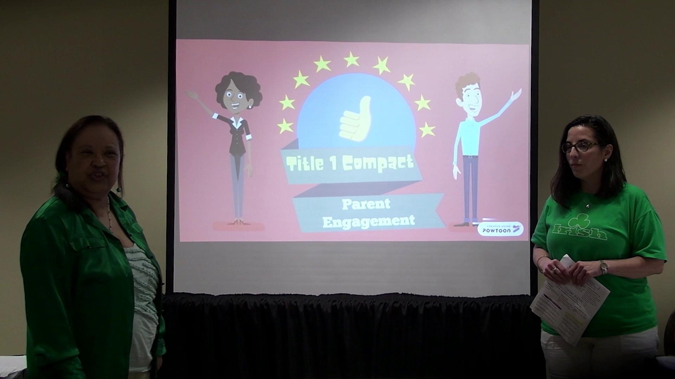
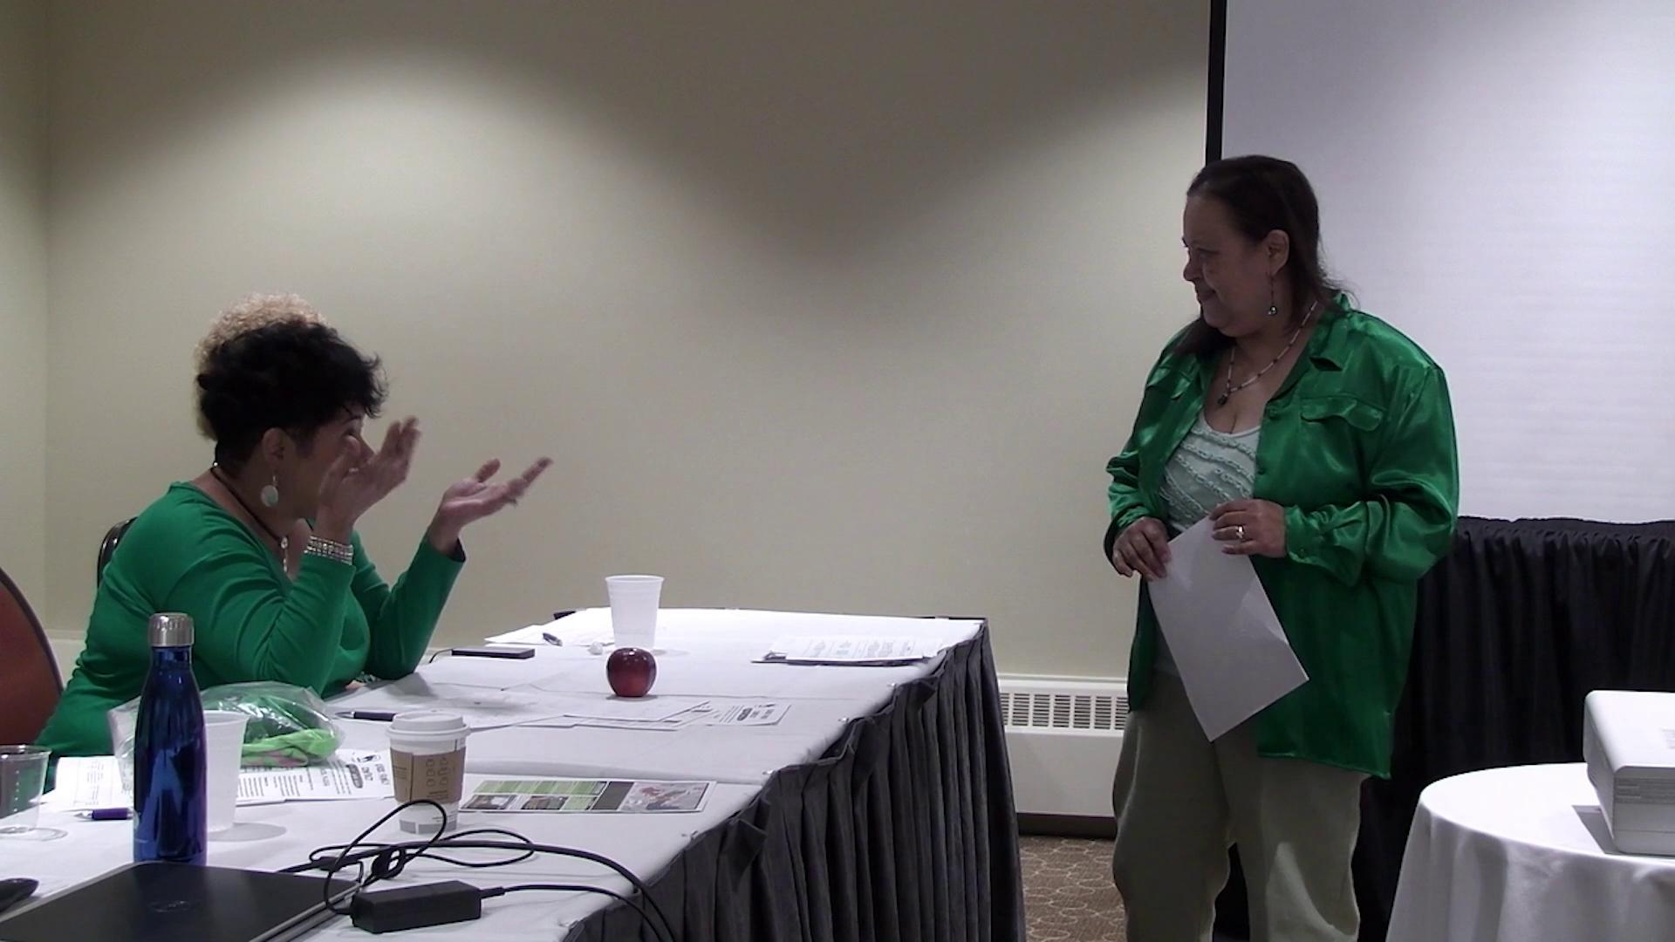
Title I Compact Skit
Good Example: https://drive.google.com/file/d/11TyWQdR1z15d9LZteYlBk0kdUyopund9/view
Bad Example:
https://drive.google.com/file/d/1gKmbG_rtCx5gITDIgQ-xuFtXkw6i7rUa/view

Slide 17
Title I Compact Review
WASD Title Parent-Student-Teacher Compact
https://drive.google.com/file/d/1RY-CQOJhuRYGBFUdiRFKPh87_iuJmaxH/view?ts=651d82df

Slide 18
Please fill out your
Parent Survey &
turn it in for your child to receive a Warrior Way ticket.

Slide 19
Contacts
Carol Tabit
Kindergarten Reading Specialist
ctabit@wyomingarea.org
Jennifer Judge
First Grade Reading Specialist
jjudge@wyomingarea.org
Linda McDermott
Second Grade/WAC Reading Specialist
lmcdermott@wyomingarea.org
Carolyn Flickinger
Third Grade Reading Specialist
cflickinger@wyomingarea.org
David Pacchioni
Curriculum Director/Elementary Principal
dpacchioni@wyomingarea.org
Elizabeth Poor
Secretary of Federal Programs
epoor@wyomingarea.org
Holly Rishko
Title I/Kindergarten Secretary
hrishko@wyomingarea.org

