Slide 1
Matter and Change

Slide 2
What is Chemistry??
Defined as the study of the composition, structure, and properties of matter, the processes that matter undergoes, and the energy changes that accompany these processes.
??What does that mean??

Slide 3
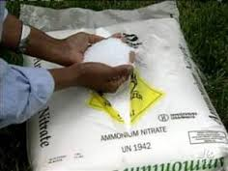
Branches of Chemistry: Inorganic
The study of non-organic substances. Inorganics are used as catalysts, pigments, coatings, surfactants, medicines, fuels, and more.
Example: Ammonia
Industries that hire inorganic chemists:
Environmental science
Fibers and plastics
Mining, Ore, and Metals
Paint, Pigments, and Coatings
Microchips
http://www.acs.org/content/acs/en/careers/college-to-career/areas-of-chemistry/inorganic-chemistry.html
http://large.stanford.edu/publications/crime/references/wilson/

Slide 4
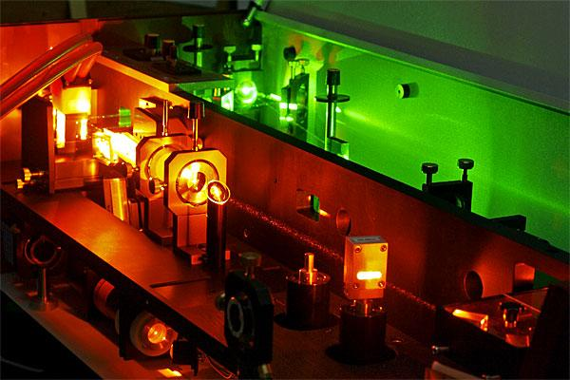
Branches of Chemistry: Physical
The study of understanding physical properties of atoms and molecules by use of instrumentation and equipment.
Example: Lasers
Industries that hire Physical chemists:
Materials
Pharmaceuticals
Wall street, Law firms, venture capital firms
Universities and government labs
http://www.warsash.com.au/products/lasers/DYE-LASERS.php
http://www.acs.org/content/acs/en/careers/college-to-career/areas-of-chemistry/physical-chemistry.html

Slide 5
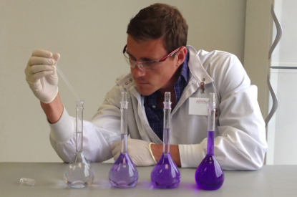
Branches of Chemistry: Analytical
The identification of compounds and composition of materials.
Example: Serial Dilutions
Industries that hire Analytical chemists:
Chemical
Consumer Products
Food
Forensic Labs
Petroleum
Pharmaceuticals
Universities and Government Labs
http://www.ats-labs.com/testing-services/analytical-chemistry-testing-services
http://www.acs.org/content/acs/en/careers/college-to-career/areas-of-chemistry/analytical-chemistry.html
http://www.acs.org/content/acs/en/careers/college-to-career/areas-of-chemistry/analytical-chemistry.html

Slide 6
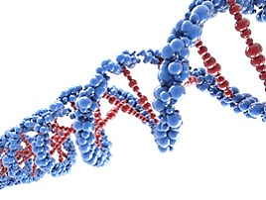
Branches of Chemistry: Biochemistry
Example: DNA
The study of chemical processes and substances in living things.
Industries that hire Biochemists:
Biotechnology
Pharmaceuticals
Universities and Government Labs
http://www.acs.org/content/acs/en/careers/college-to-career/areas-of-chemistry/biological-biochemistry.html
http://www.reading.ac.uk/biologicalsciences/ug/biosci-ugbscbiochemistry.aspx

Slide 7
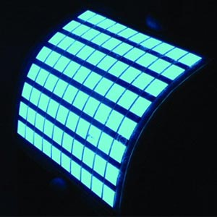
Branches of Chemistry: Organic
Example: OLEDs (Organic Light Emitting Diodes)
The study of compounds containing carbon.
Industries that hire Organic chemists:
Chemical (raw materials)
Consumer
Pharmaceutical
Biotechnology
http://www.acs.org/content/acs/en/careers/college-to-career/areas-of-chemistry/organic-chemistry.html
http://www.plusplasticelectronics.com/lighting/report-highlights-oled-lighting-patent-growth-37829.aspx

Slide 8
Research
3 types:
1.) Basic Research—used for the sake of increasing knowledge (driven by curiosity).
Example: Synthesizing new molecules with interesting properties.
2.) Applied Research—used to solve a problem
Example: Developing new refrigerants to reduce ozone damage.
3.) Technological Development—production and use of equipment to improve quality of life.
Example: Computers and biodegradable materials.

Slide 9
Matter and Its Properties

Slide 10
Properties
Extensive Properties—Depend on the amount of matter that is present.
Examples: Volume, mass, amount of energy in a substance.
Intensive properties—Do not depend on the amount of matter present.
Examples: Density, melting point, boiling point, conductivity of electrical current.

Slide 11
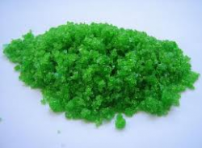
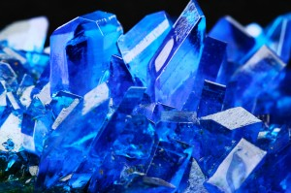
States of Matter
Solid
Has definite volume and definite shape, regardless of container
Particles are tightly packed
Particles are held together by strong attractive forces

Slide 12
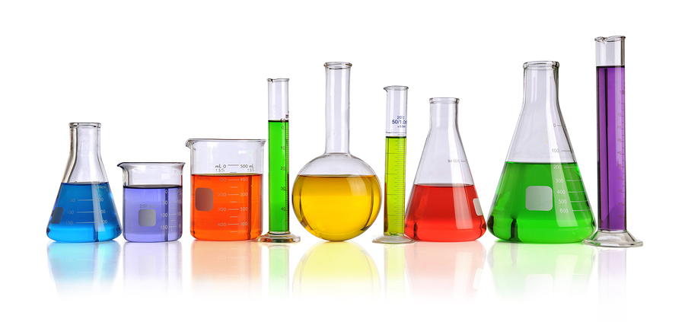
States of Matter
Liquid
Has definite volume, but an indefinite shape (fits shape to container)
Particles are close together, but can move past one another and move faster than the particles in solids
Faster movement = overcoming attractive forces more easily
Allows liquid to flow since particles are not held tightly together

Slide 13
States of Matter
Gas
Has indefinite shape and indefinite volume (fills and takes shape of container)
Particles move very rapidly and have very little attractive forces due to distance from each other.
Examples: Helium, Neon, Argon, Krypton, and Xenon

Slide 14
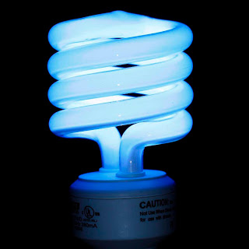
States of Matter
Plasma
A mixture of nuclei and electrons when atoms lose electrons at high temperatures
Example: Ionized Mercury vapor in fluorescent bulbs
http://www.experilab.co.za/catalog/index.php?main_page=index&cPath=90_105

Slide 15
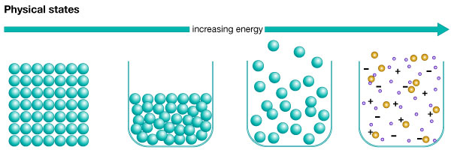
States of Matter
Increasing Energy
Solid
Liquid
Gas
Plasma
http://kids.britannica.com/comptons/art-53637/Physical-states?

Slide 16
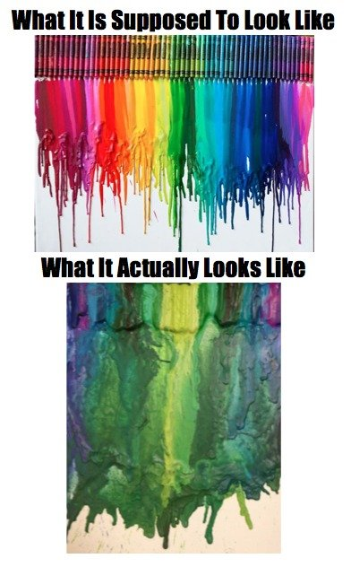
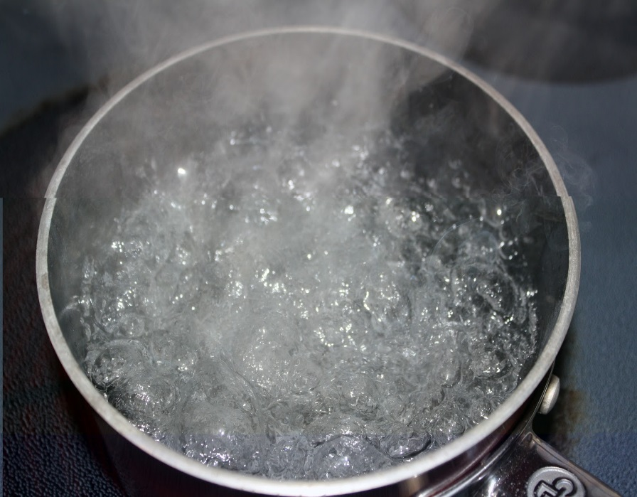
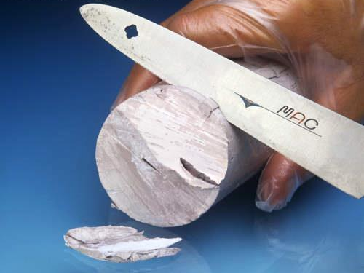
Physical Properties and Changes
Characteristics that can be observed or measured without changing the chemical composition of a substance.
Effects size, shape, and state of matter
Boiling Point
Cutting Sodium Metal
Melting Point
http://www.visualphotos.com/image/1x7916117/cutting_sodium_metal
http://craftsformommas.blogspot.com/2012/08/swiffer-refill.html
http://www.funnyjunk.com/funny_pictures/3322856/crowns/

Slide 17
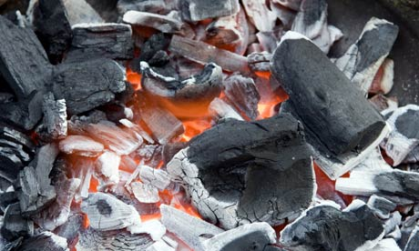
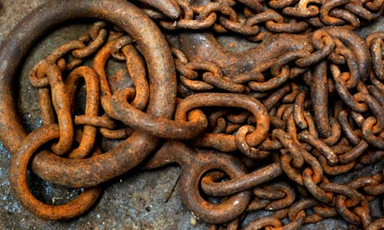
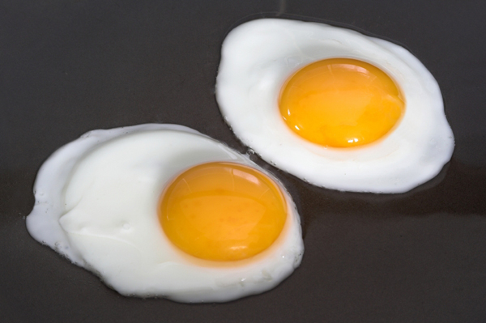
Chemical Properties and Changes
Ability of a substance to undergo changes that transform it into a different substance
Burning of Coal
Rusting of Iron
Cooking an egg
Basically, anything that permanently transforms a substance.
http://www.theguardian.com/environment/2009/mar/13/charcoal-carbon
http://www.theguardian.com/science/2011/apr/28/wellcome-science-writing-prize
http://www.sheknows.com/food-and-recipes/articles/808987/the-best-way-to-cook-eggs-1

Slide 18
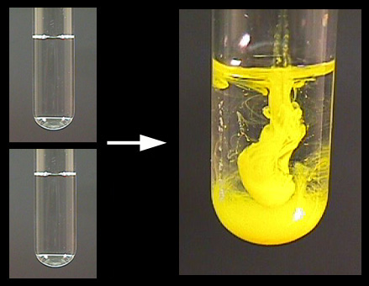
Chemical Reactions
A change in which one or more substances is converted into a different substance.
Reactants
Products
Potassium Iodide_{(l)} + Lead (II) Nitrate_{(l)} 🡪 Lead Iodide_{(s)}
State of Matter
“Yields”
Reactants: Substances that react in a chemical change (left side of arrow)
Products: Substances formed in a chemical change (right side of arrow)
http://www.harpercollege.edu/tm-ps/chm/100/dgodambe/thedisk/chemrxn/7perform.htm

Slide 19
Conservation of Energy and Mass
Energy/Mass can neither be created nor destroyed in a chemical reaction.
Energy can be absorbed or released in a chemical reaction such as giving off heat
Mass (amount of substance) stays the same throughout the reaction

Slide 20
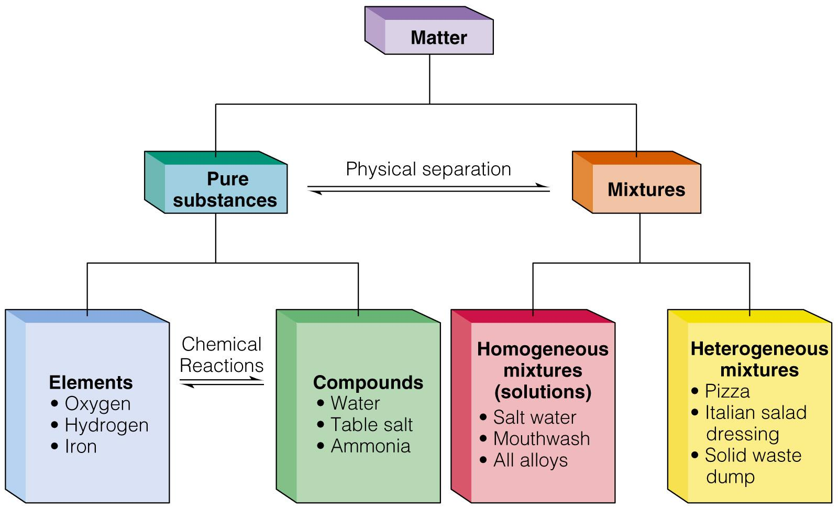
Classification of Matter

Slide 21
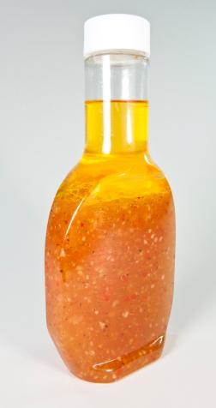
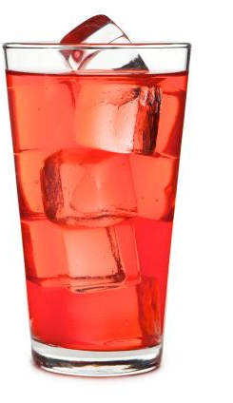
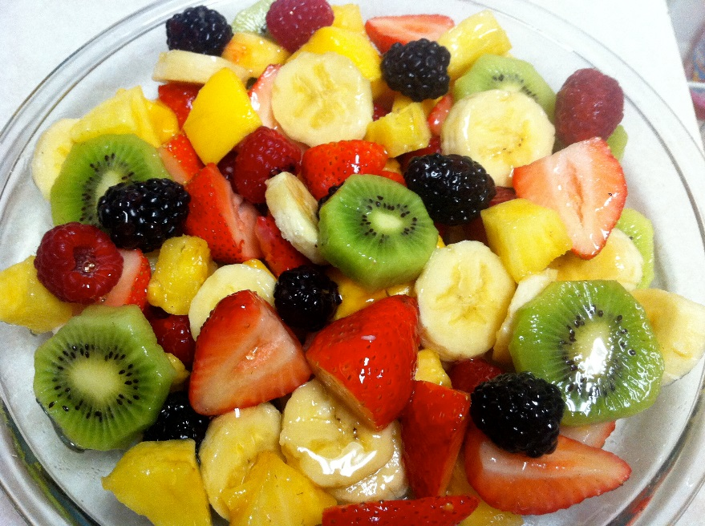
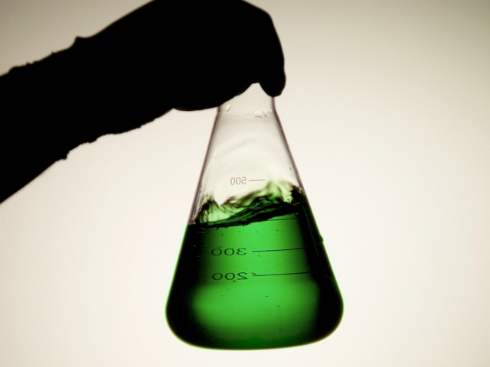
Classification of Matter
Mixtures:
A blend of two or more kinds of matter, each of which retains its own identity and properties.
2 types:
Heterogeneous
Homogeneous aka solutions
http://mar_trio_12016.marquette.blogs.propertysolutions.com/files/2011/08/salad-dressing.jpg
http://iamsimplytia.files.wordpress.com/2011/12/img_1724.jpg
http://blogs.davita.com/kidney-diet-tips/?p=1937, http://www.hawaiiancrown.com/faq.php

Slide 22
Separation Techniques of Mixtures—Solids from Liquids
Filtration
Use of filter paper or funnels to capture solid as liquid is passed through.
Decanting
The solid settles down to the bottom of container and liquid is slowly poured out, leaving solid behind.
Centrifuging
Spins container filled with mixture at extremely high speeds to separate the components.

Slide 23
Classification of Matter
Pure substances
Have a fixed composition and differs from a mixture in the following ways:
Every substance has exactly the same physical and chemical properties.
Every sample has exactly the same composition.
2 Types
Element: A chemical substance that cannot be broken down by chemical means.
Compound: A substance formed when two or more elements are chemically bound together

Slide 24
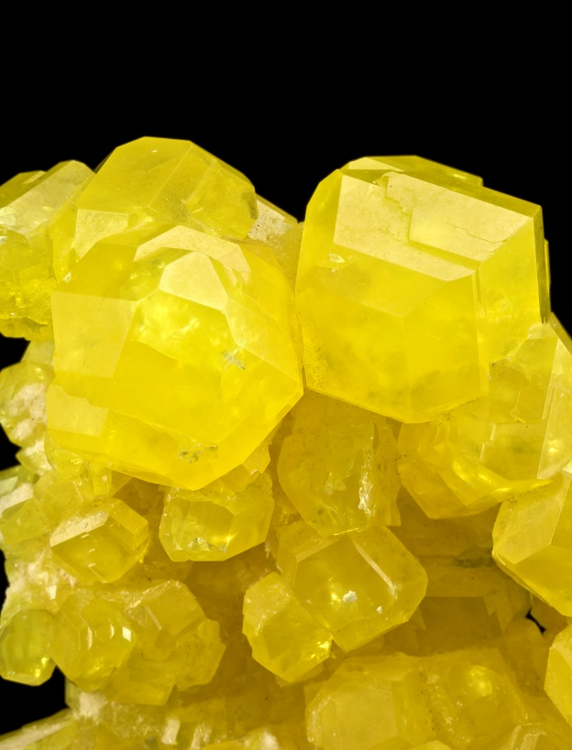
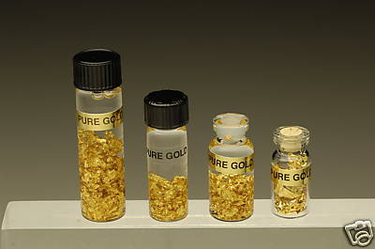
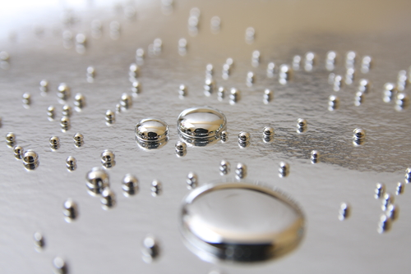
Types of Pure Substances
Element:
A chemical substance that cannot be broken down by chemical means.
Sulfur (S)
Gold (Au)
Mercury (Hg)
http://www.irocks.com/galleries/vault/
http://mallgoldbuyers.ca/index.php/gold-facts/
http://www.kidsdiscover.com/quick-reads/need-fear-mercury-liquid-metal/

Slide 25
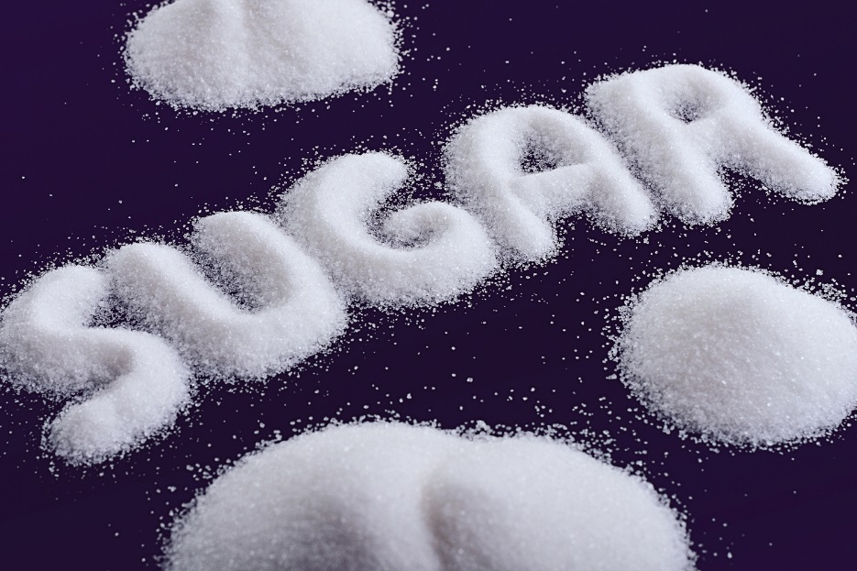
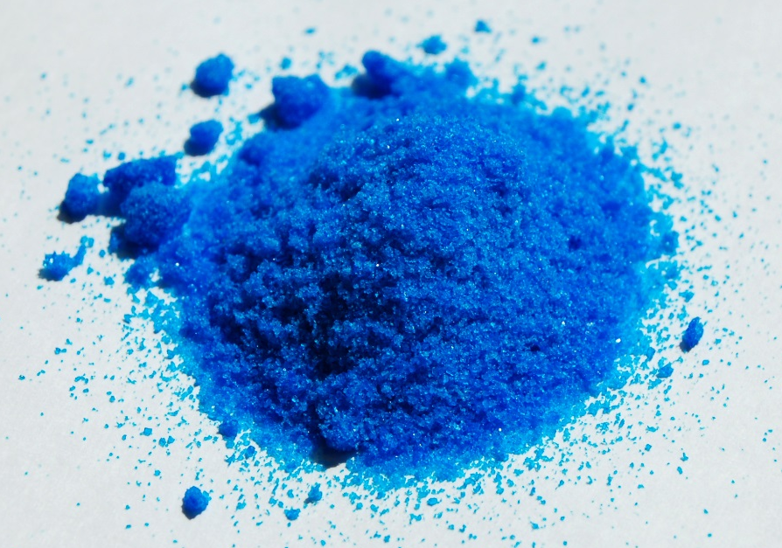
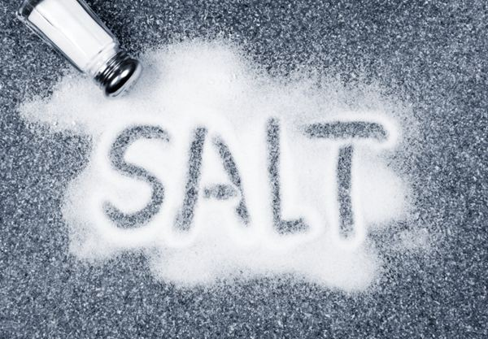
Types of Pure Substances
Compound:
A substance formed when two or more elements are combined.
Carbon, Oxygen, and Hydrogen
Copper, Nitrogen, and Oxygen
Sodium and Chlorine
http://www.hunger-undernutrition.org/blog/micronutrients/
http://en.wikipedia.org/wiki/Copper(II)_nitrate
http://ihwcenter.com/hooked-on-sugar/

Slide 26
Examples Non examples
1. F, Cl, Br Na, K, Ca
2. Ne, Kr, He Ti, Mn, Fe
3. S, Se, O P, S, Cl
4. Be, Mg, Ba Cu, Ag, Pt
5. Al, In, B Li, Be, B
6. Ni, Pd, Pt Y, Mo, Tc

Slide 27
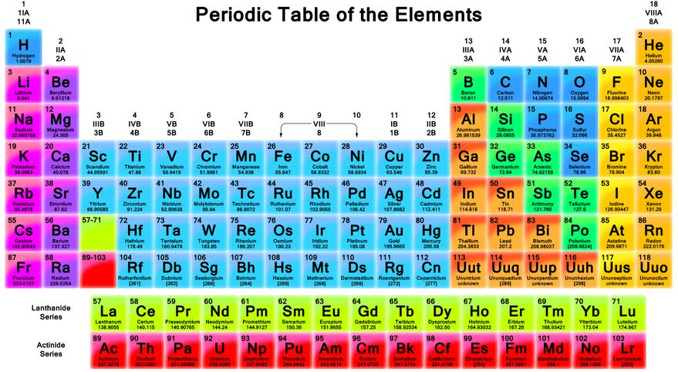

Slide 28
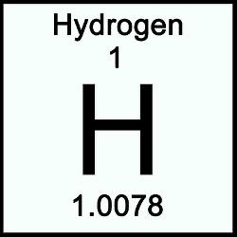
Name of Element
Atomic Number
Chemical Symbol
Atomic Mass

Slide 29
Groups/Families—vertical columns of the Periodic Table
Alkali Metals
Halogens
Noble Gases
Alkaline Earth Metals

Slide 30
Periods—Horizontal rows of elements in the Periodic Table.
1
2
3
4
5
6
7

Slide 31
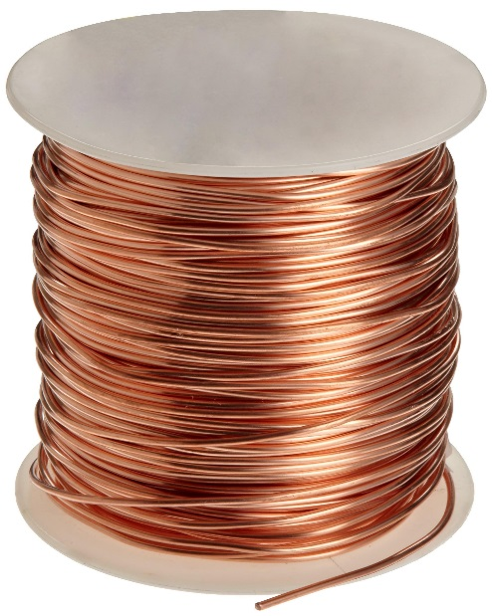
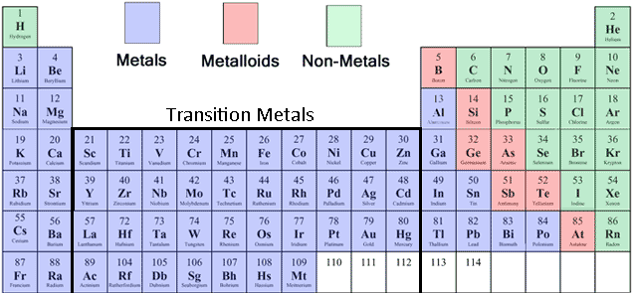
Metals
Solid at room temperature
Shiny
Ductile—Can be drawn into thin wires
Malleable—Can be hammered into very thin sheets
Good conductor of heat and electricity

Slide 32
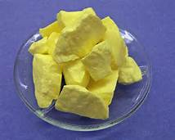
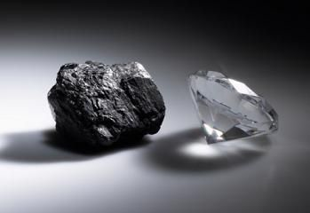
Nonmetals
Poor conductors of heat and electricity

Slide 33
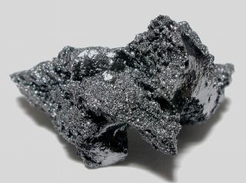
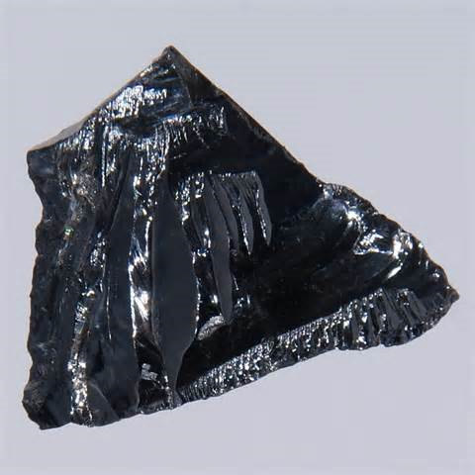
Metalloids
All solids at room temperature
Malleable
Somewhat brittle
Used as semiconductors in circuitry for computers, televisions, etc.

Slide 34
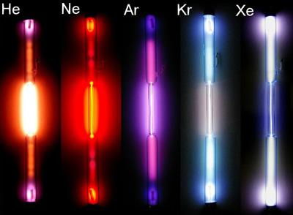
The Noble Gases
http://www.youtube.com/watch?v=QLrofyj6a2s

