Slide 1
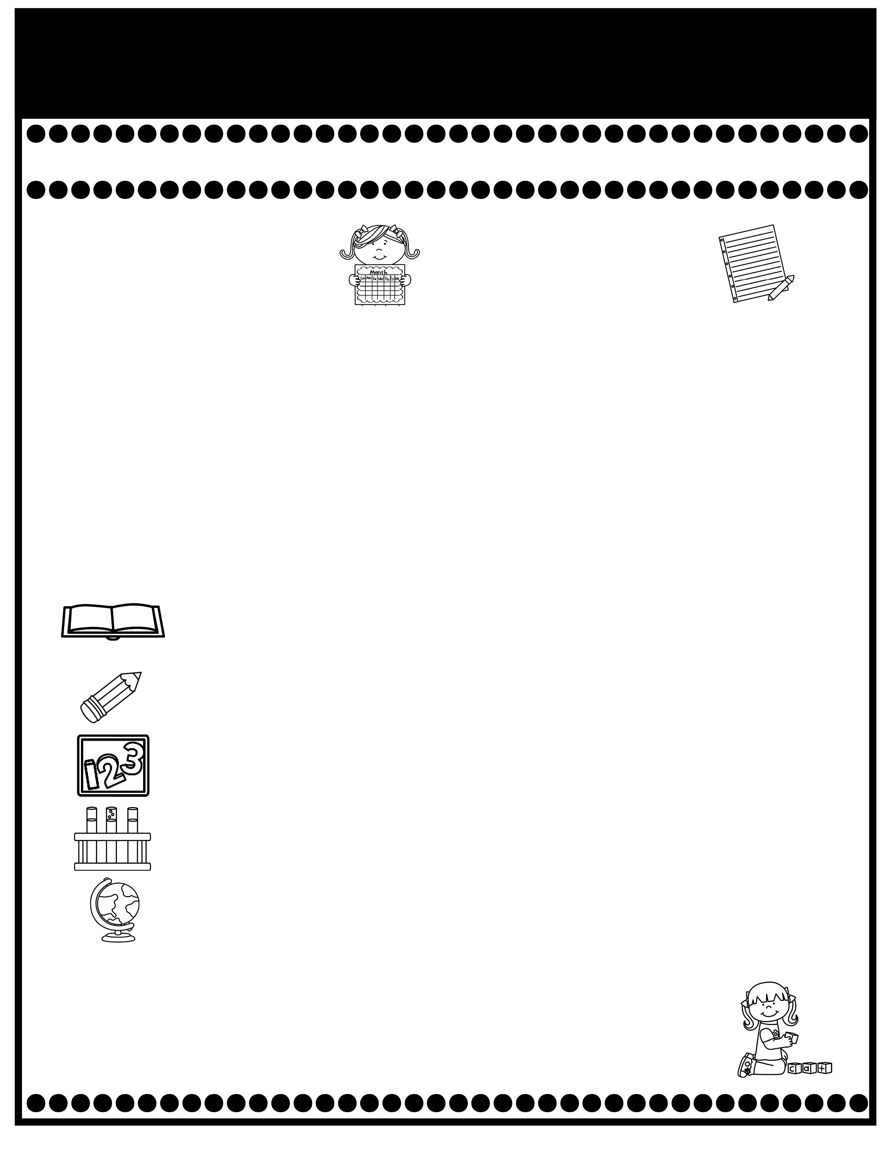
Branning’s Buzz
Week of: August 26-30, 2025
What’s Happening
This Week
Upcoming Events
Curriculum Night will be held Tuesday, August 26th from 5:30-6:30. Important curriculum information will be discussed. Hope you will make plans to join us.
APT Meeting: Aug. 26th at 5:00 p.m.
PPS/PHS Pep Rally Thursday at 9:00. Please complete the attendance form from Mr. Cochran’s Parent Square message if you plan to attend. Students may purchase a shaker ($5) &/or a pin ($3) this week.
Car riders will now dismiss at 2:50.
Pease check your child’s Take Home Binder for daily work and important information. Empty nightly.
Decodable Reader stories will be sent home in your child’s Take Home Binder after reading them in class. Please practice reading them with your child.
The cost for snack is $1.00 each. Please send the exact amount.
PPS Spirit Day Friday: Wear all the same color.
Aug. 29: Special Snack: Pixie Sticks $1.00.
Sept. 2: Labor Day Holiday
September is our Attendance Challenge month. More information to come.
If you have questions or concerns, you may email me at Wendy.branning@acboe.net.
A Peek At What We Are Learning
Reading | Phonics: d, n, i, h, Sequence, Predicting, Cause & Effect 8/29 Dictation Assessment: short i and Read the Words (short a and i)
Writing/ Grammar | Common & Proper Nouns, Practice correct letter formations I & n
Math | Complete Topic 1: Understand Addition and Subtraction 8/29 Minor Grade , 9/02 Topic 1 Test (Review pages will be sent home Friday)
Science | Chapter 1: All About Plants
Social Studies | We rotate Science and Social Studies.
Spelling Words
No Spelling Test will be given until Unit 7.
.

