Slide 1
Welcome to Second Grade!
2024-2025
Pine Level Elementary School

Slide 2
Welcome to Second Grade!
Second grade is a year when students are able to build upon the foundation of reading and math skills and concepts they learned in first grade. They will also be encouraged to become more independent and responsible.
This presentation has been developed to provide you with some general information related to language arts and math skills as well as social and personal responsibility expectations that are important as your child begins second grade.
We hope this information will be helpful to you and your child!

Slide 3
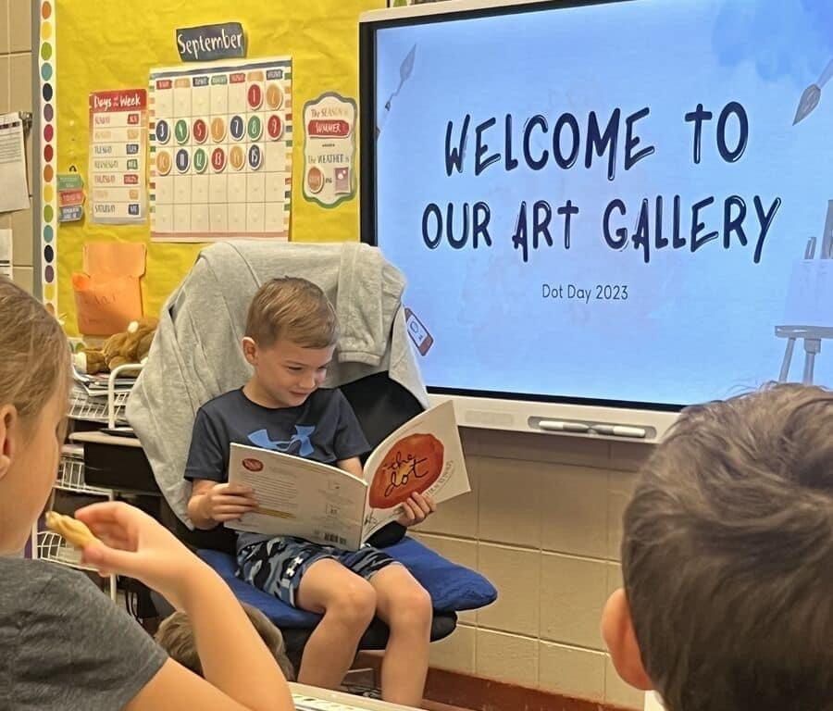
Language Arts
Shows an understanding of the lesson in a story by asking and answering questions about it (who, what, where, when, why, and how)
Reads and spells the first hundred Fry words
Begins reading and spelling the second and third hundred Fry words
Knows and can name the characters, setting, and plot of a story/book during and after reading

Slide 4
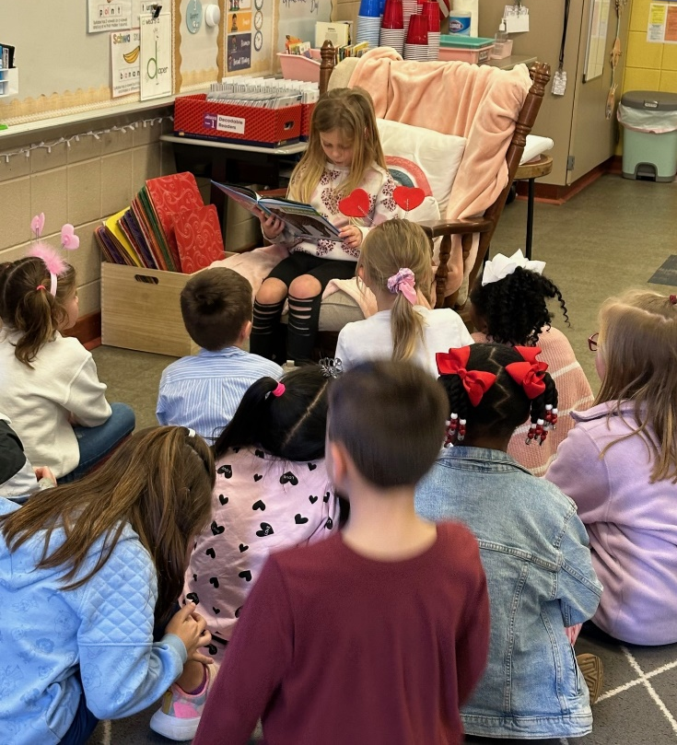
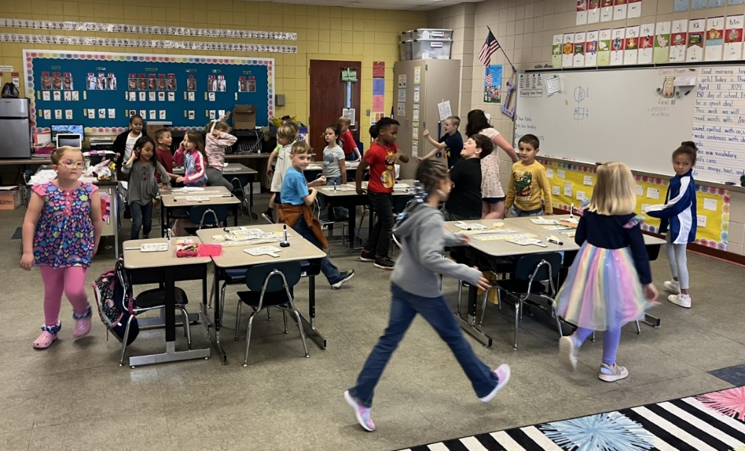
Language Arts (continued)
Reads fiction and non-fiction daily
Writes a simple sentence with a capital letter and end punctuation
Forms upper and lowercase letters correctly
Retells a story after reading
Reads with expression while pausing at commas and stopping at periods

Slide 5
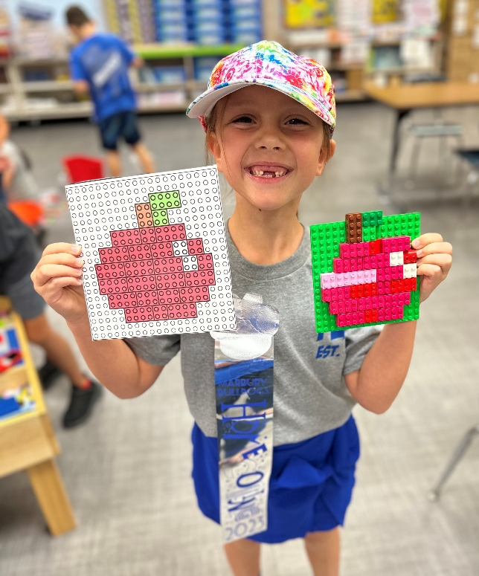
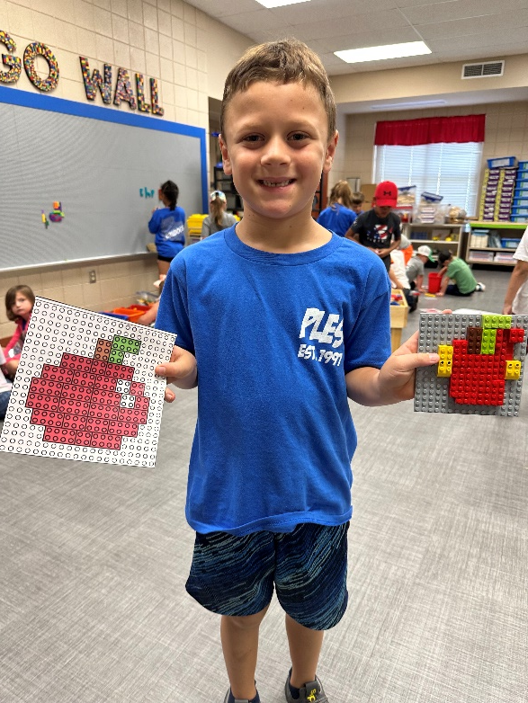
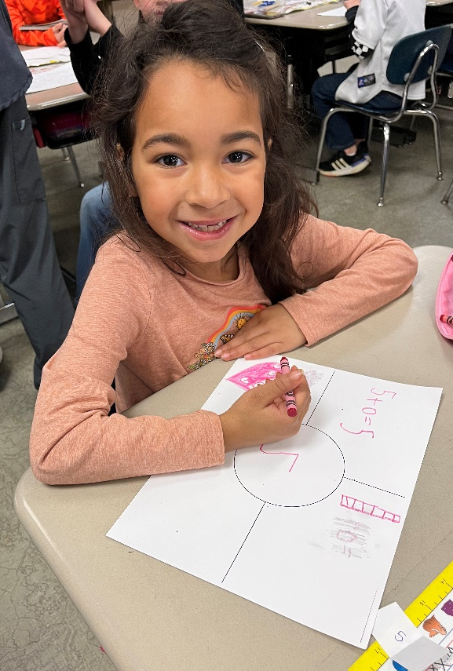
Math
Recognizes shapes
Forms numbers correctly
Counts to 100, skip counts by 2’s, 5’s and 10’s
Writes a number in word form
Knows addition and subtraction facts
Knows place value to 100

Slide 6
Personal and Social Responsibility
Can state full name, address, home phone, and parents’ cell phone numbers, and birthday (month/day/year)
Treats others kindly and with respect
Has a good attitude and is responsible for their learning
Can sit still and pay attention during a lesson
Listens and follows directions
Can manage clothing and belongings such as backpack and binder
Completes assignments in class and home
Can converse with others using the rules of listening, asking questions, and waiting their turn

Slide 7
Parent Expectations
Speak positively about school and staff
Communicate with teacher and sign weekly folder
Take time each day to talk about the school day
Help with homework
Make sure your child is prepared to come to school with needed items and supplies
Make sure your child gets plenty of rest each night
Make attendance at school a priority. However, please be aware of any symptoms your child might have that would indicate illness. Keep your child home if he/she has a fever.

Slide 8
Parent Suggestions
Take time each day to talk to your child
Read to and have your child read independently every day. Ask them to tell you about the reading
Urge your child to use logical arguments to defend his/her opinion
Involve your child in activities and games that require listening and following directions
Support and encourage your child’s independence
Encourage work values such as effort, persistence, and initiative
Encourage responsibility by having your child take care of personal belongings and assisting with simple chores.

Slide 9
Back to School Event
Tentative Back to School Event: August 5th - 2:00-6:00 pm
First Day of School: August 7th
Open House: TBD

