Slide 1
Getting Ready for
Notes:
Welcome
Introductions

Slide 2
Introduction
This year brings many exciting experiences for your child as he/she begins Kindergarten. This powerpoint has been prepared to guide you in ways that you can help your child be ready for this year. We encourage you to read with your child several times a week. Practice opening food items (chip bags, Capri Suns, fruit cups, ketchup packets, etc.) Encourage your child to be independent with personal tasks such as getting dressed and putting away lunch dishes. Encourage your child to make good choices and practice self-control.
Notes:
First grade is more than academics.
Develop social skills, become more responsible, self-sufficient, and independent.

Slide 3
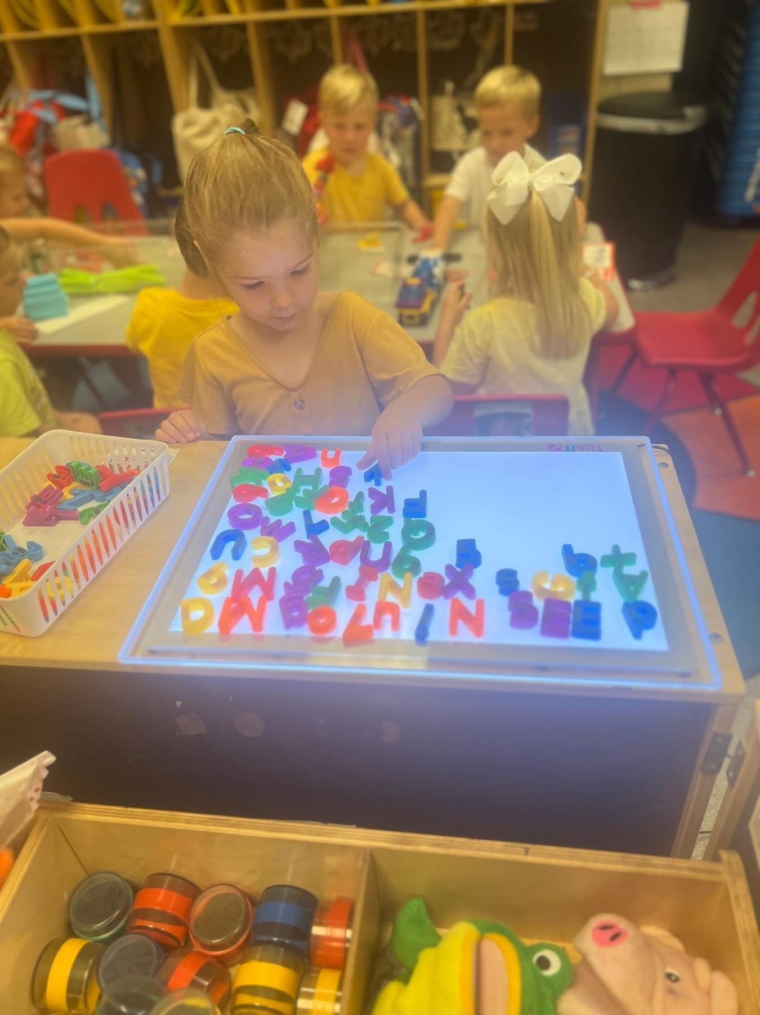
Learning and Thinking
The student:
is willing to complete tasks and try new things.
carries on a conversation using complete sentences.
states full name, address, phone number, and birthday.
shows an interest in books and reading.
matches, recognizes, and names at least 5 colors.
puts together simple puzzles.
Notes:
As you go
What do you think?
How do you think the character felt?

Slide 4
Numbers and Counting
The student:
identifies numbers 0-10.
counts from 1-10 in the correct order. Encourage counting past 10.
counts at least 5 objects.
identifies basic shapes like circle, square, triangle, and rectangle.
identifies two and three dimensional objects.
Notes:
Basic number sense – sense of what numbers mean
Relationship to each other – more/less
Mental math
Symbols + -
#’s in real life situations – cooking, telling time, making purchases – we constantly use math

Slide 5
Language Development
The student:
carries on a conversation using complete sentences.
identifies some letters in random order; including those in their name.
names common things-has a good vocabulary. Talk to you child a lot by answering those “what’s that” questions.
says or sings familiar songs or nursery rhymes.
recognizes when words rhyme, such as ‘cat’ and ‘hat’.
follows directions in a simple game with other children or adults.

Slide 6
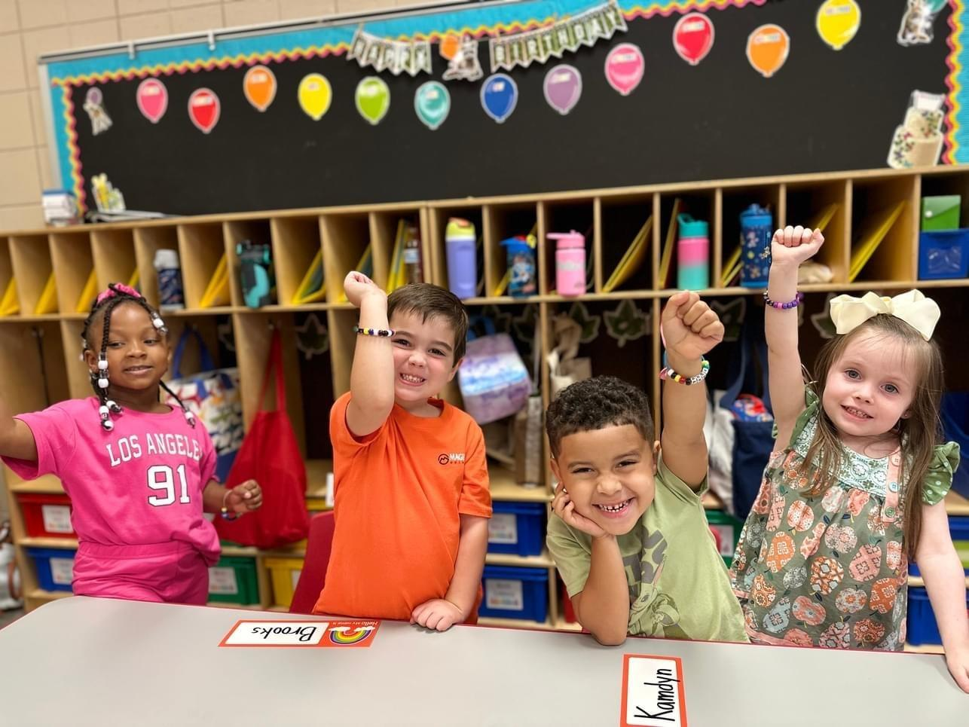
Social/Emotional
The student:
takes care of own needs such as toileting, washing hands, and dressing.
adjusts to new situations without parent being there.
can share toys with other children and is willing to take turns.
listens to an adult and follows directions.
Notes:
Helping others
Independent, confident learners
Responsibility – small job to do – make sure that it’s completed – finish what they start
Make choices
Talk with your child
There are two great things that you can give your children: one is roots, the other is wings.” Hodding Carter

Slide 7
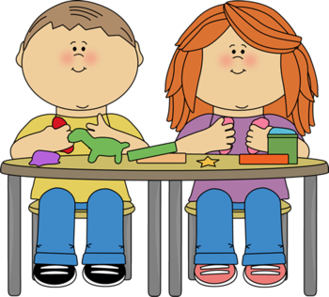
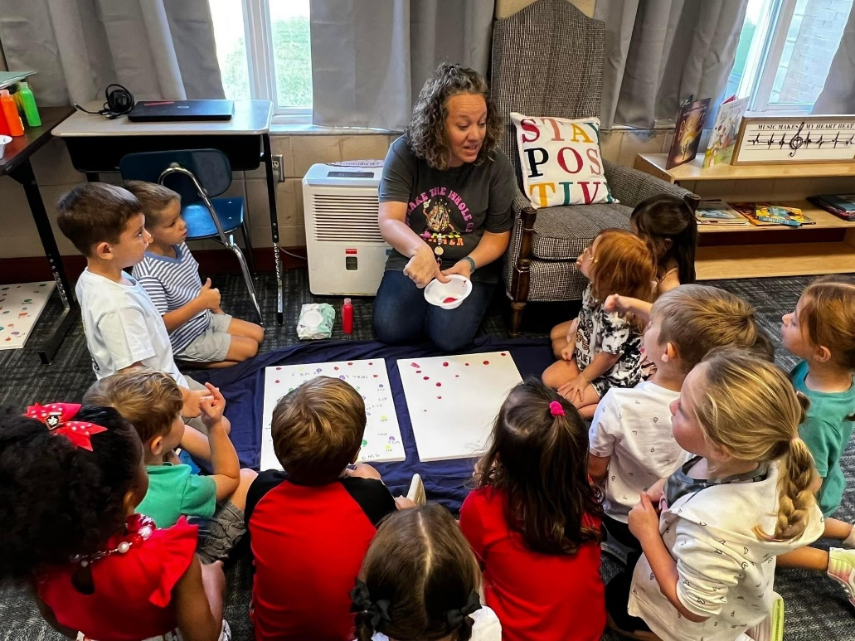
Physical
The student:
holds pencil, marker, crayon correctly.
colors carefully by trying to stay in the lines.
holds child-sized scissors correctly and has had experience cutting straight and curved lines.
practices zipping, buttoning, snapping, and tying.
Notes:
Put puzzles together
Art work
dance, jump rope, ride bikes

Slide 8
Parent Expectations
Speak positively about school and staff.
Communicate with teacher and sign daily folder.
Take time each day to talk about the school day.
Help with homework.
Make sure your child is prepared to come to school with needed items and supplies.
Make sure your child gets plenty of rest each night.
Make attendance at school a priority. However, please be aware of any symptoms your child might have that would indicate illness. Keep your child home if he/she has a fever.

Slide 9
Parent Suggestions
Take time each day to talk to your child.
Read with your child daily and talk about the story.
Urge your child to recognize the colors.
Involve your child in activities and games that require listening and following directions.
Teach your child to make various patterns ie. red, blue, red, blue, etc.
Support and encourage your child’s independence.
Encourage work values such as effort, persistence, and initiative.
Encourage responsibility by having your child take care of personal belongings and assisting with simple chores.

Slide 10
Other Information
Daily Folder
Zipper Pouch
Label Money in Ziploc bag
Tennis Shoes
Velcro or slip on
Snack Procedure
Can bring snack but keep it separate from lunch. Please make sure your child knows which is which.
Give your current phone number to your teacher or the school so in case of an emergency, we can reach you.
Backpack
Seasonal change of clothes
Towel for rest time

Slide 11
Back to School Events
Tentative Back to School Event: August 5th - 2:00-6:00 pm
First Day of School: August 7
Open House: TBD

