Slide 1
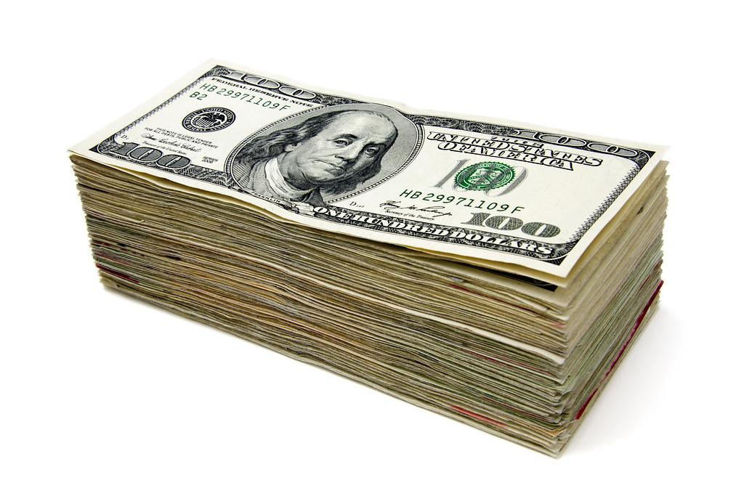
Compare & Contrast and the Minimum Wage
4/29/2021

Slide 2
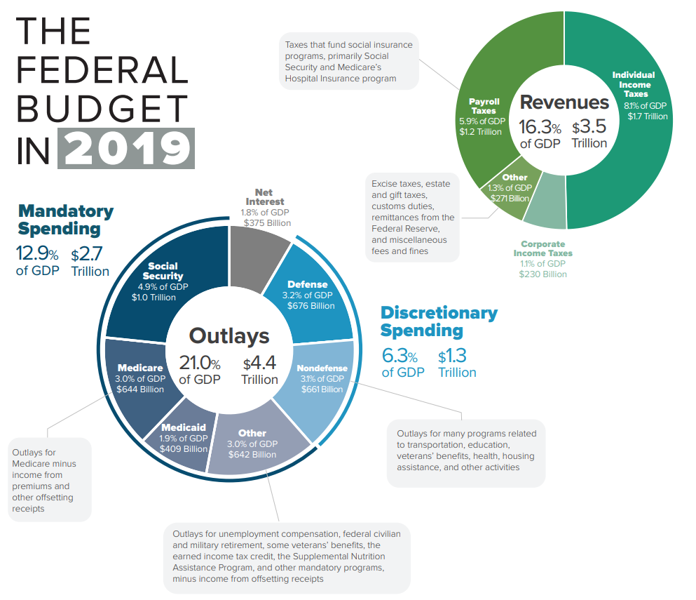
Government Revenue & Expenditures

Slide 3
Notes:
Answer: A

Slide 4
Notes:
Answer: D

Slide 5
Notes:
Answer: B

Slide 6
Notes:
Answer: C

Slide 7
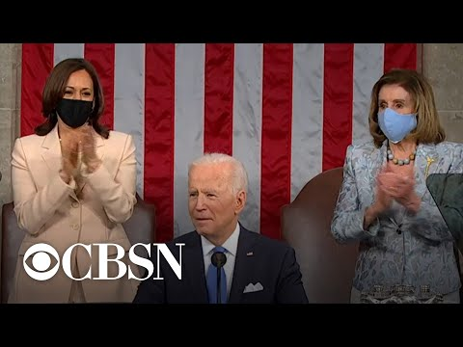
Minimum Wage Discussion
What is the Republican perspective on raising the minimum wage?

Slide 8
Notes:
Answer: B

Slide 9
Notes:
Answer: C

Slide 10
Notes:
Answer: B (pre tax deductions may include health care)

Slide 11
Notes:
Answer: D

Slide 12
Notes:
Answer: D

Slide 13
Notes:
Answer: A

