Slide 1
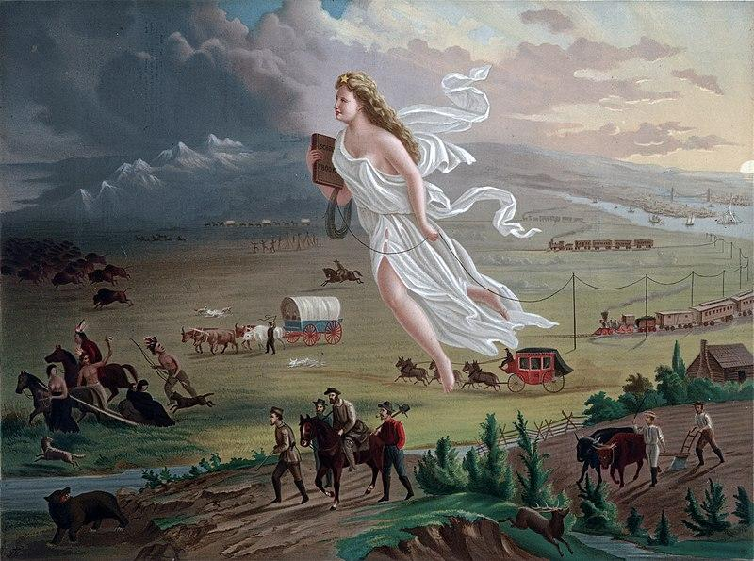
US Western Expansion & Categorize 9/21/21 & 9/22/21
Notes:
How many symbols of wilderness and progress can you find?
By John Gast (painter) - This image is available from the United States Library of Congress &#039;s Prints and Photographs division under the digital ID ppmsca.09855.This tag does not indicate the copyright status of the attached work. A normal copyright tag is still required. See Commons:Licensing for more information., Public Domain, https://commons.wikimedia.org/w/index.php?curid=373152

Slide 3
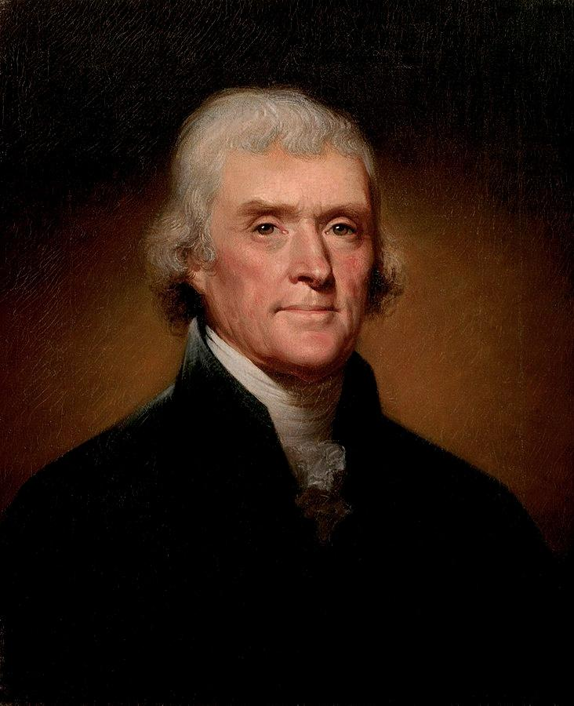
Thomas Jefferson
Wrote the Declaration of Independence
Became our 3rd president in 1801
Expanded the U.S. in the Louisiana Purchase
Thomas Jefferson called slavery a “moral depravity” and a “hideous blot,” but continued to hold human beings as property his entire adult life.
Thomas Jefferson had approximately 600 enslaved people on his plantation “Monticello”

Slide 4
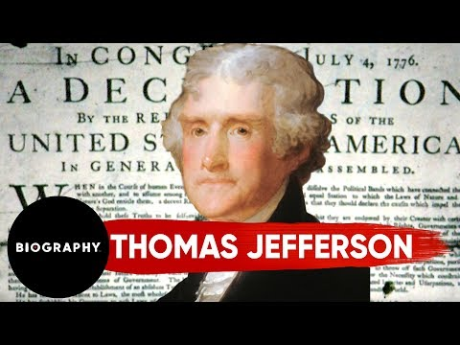
Thomas Jefferson

Slide 5
“the fulfillment of our manifest destiny to overspread the continent allotted by the providence for free development of our yearly multiplying millions.”
-John O’Sullivan, 1845

Slide 6
Manifest Destiny
The belief that white Americans are divinely ordained to settle the North American Continent
1845 John O’Sullivan coined the term in a newspaper article, but the belief that white persons are superior is much older
Often used by President Polk (1845-1849) to justify expansion including negotiating Oregon Territory from Great Britain
Democrats endorsed the idea, others like Abraham Lincoln and Ulysses S. Grant did not
Notes:
Manifest Destiny is the belief that white Americans are divinely ordained to settle North America.

Slide 7
Notes:
Answer: C

Slide 8
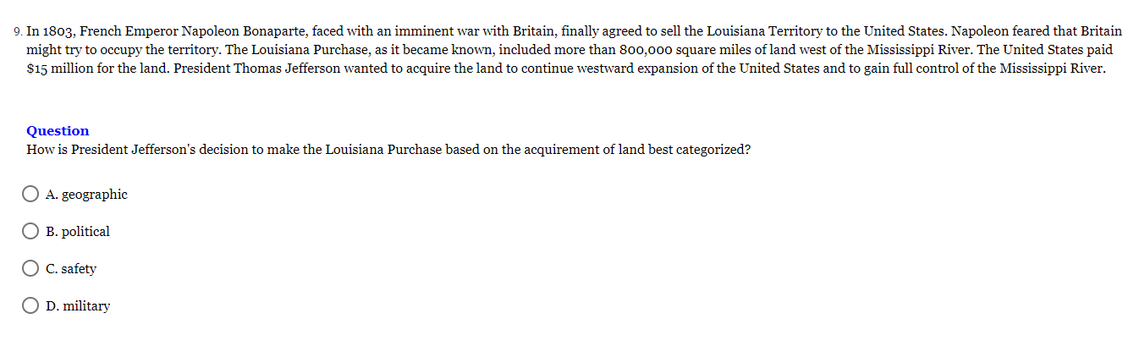
Notes:
Answer: A

Slide 9
Notes:
Answer: B

Slide 10
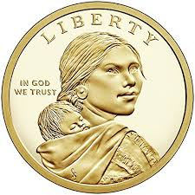
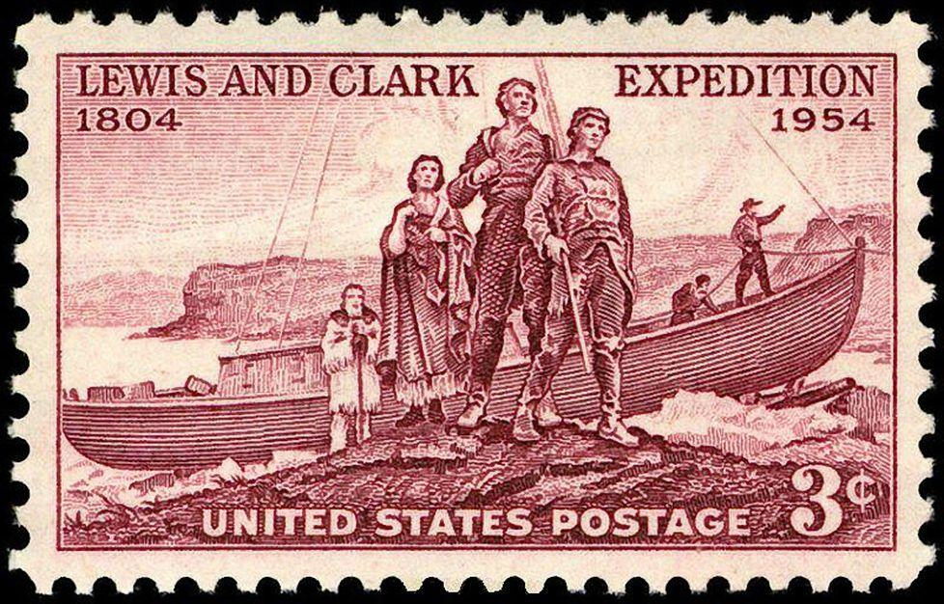
Lewis & Clark Expedition 1803-1806
Sent by Thomas Jefferson to find a waterway to the Pacific Ocean
Wanted to establish presence in the territory before another European country could claim it
Studied the geography, plants and animals
Sacagewea was a Shoshone woman who joined the expedition with her husband and infant
Being a woman with a small child she provided diplomatic role to other tribes they encountered

Slide 11
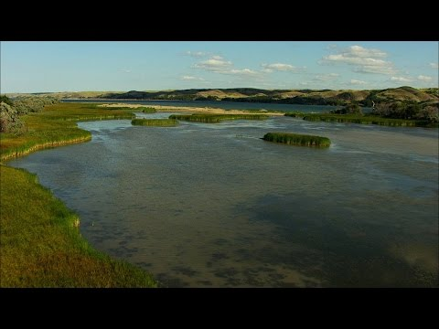
Lewis and Clark

Slide 12
Notes:
Answer: D

Slide 13
Notes:
Answer: B

Slide 14
Notes:
Answer: C

Slide 15
Andrew Jackson 7th US President 1829-1837
Notes:
President Jackson was our 7th President who was the first Democrat, a party we still have today. He transformed the American idea of the President having more power than Congress, even though, if you think back to our discussion about the US Constitution, it speaks more to Congress having most of the power.

Slide 16
Andrew Jackson
First Democrat, the same party that is in US politics today
Led an offensive against Creek Nation in the War of 1812
Participated in the First Seminole War devastating the Seminole Tribe in Florida
Georgia settlers complained about Cherokee and Creek people in land they wanted to obtain
The Indian Removal Act of 1830 authorized the voluntary relocation of Indian nations west of the Mississippi but was abused by the government and relocation was often forced

Slide 17
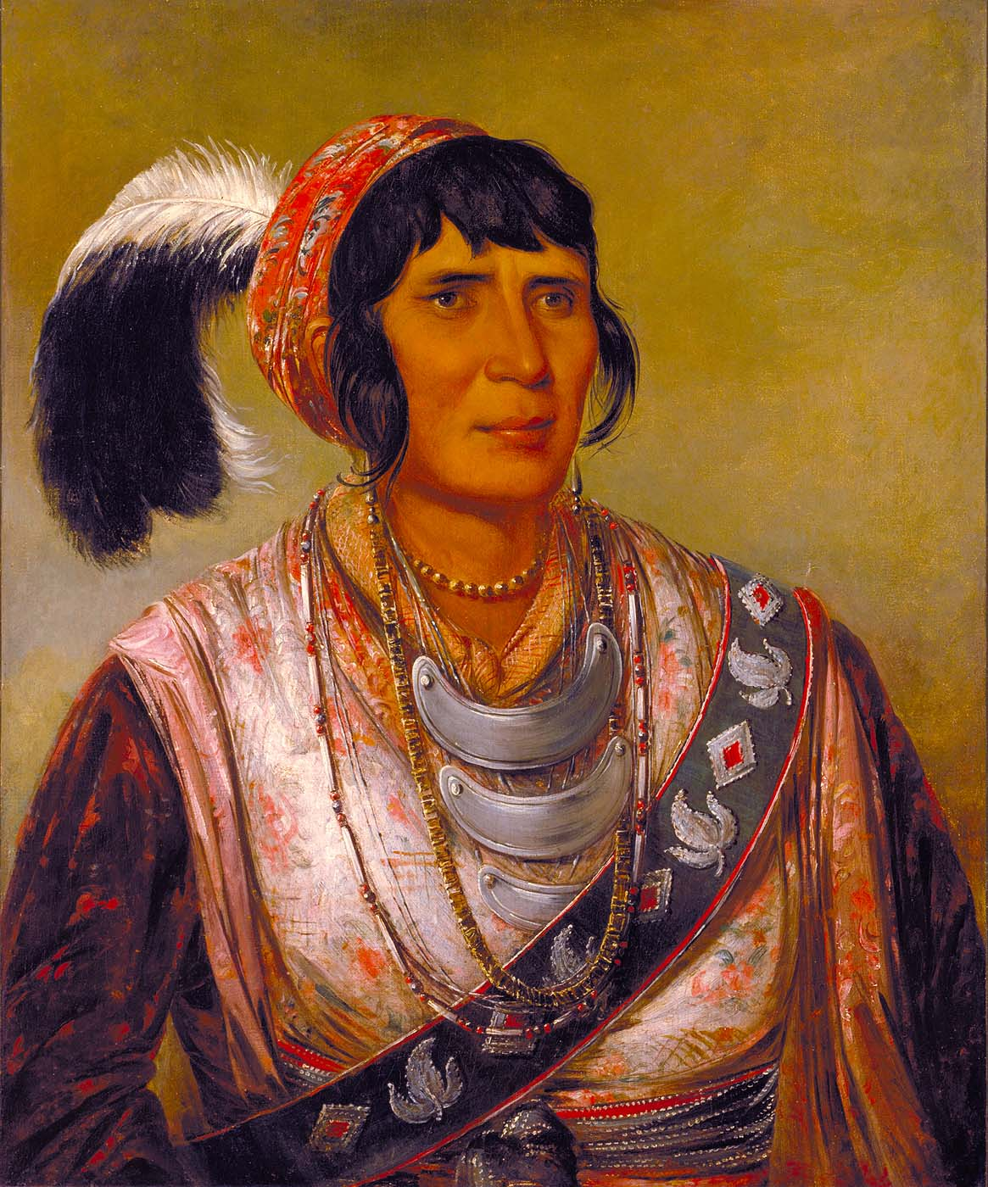
Trail of Tears
Indian Removal Act was applied to the “Five Civilized Tribes”-Choctaw, Chickasaw, Cherokee, Creek & Seminole
Choctaws signed a treaty and voluntarily moved to modern Arkansas
Seminoles resisted, the Second Seminole War raged and they were forced to move
Chickasaw agreed to leave for 3$ million
Creeks signed over their land and left to Indian Territory
Notes:
Pictured, Oscela, who led the Seminoles in the Second Seminole War

Slide 18
Notes:
Answer: D

Slide 19
Notes:
Answer: A

