Slide 1
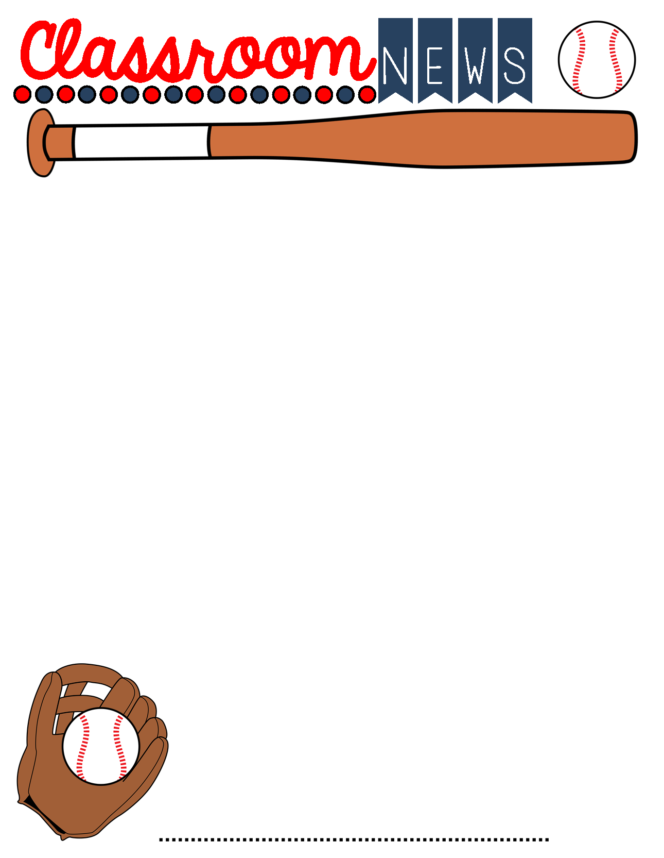
February 21st-25th 2022
Important Info
Calendar
Parents,
Thank you for my Valentine’s goodies. They were such a treat!
Please be sure to send a note if your child is absent. After three days, it’s an unexcused absence.
If you have any questions or concerns, please contact me,pphillips@mcpss.com .
Student Council is collecting new socks for WARM UP MOBILE community service project. Don’t forget your socks! Wednesday is the last day.
We are running low on Clorox/Lysol Wipes and paper towels. Your donations are greatly appreciated!
Monday, February 21st - Homework assigned
Wednesday, February 23rd - ICE CREAM Day $1.00
Friday, February 25th- Homework due
February 28th- March 2nd- Mardi Gras break
March 10th- Spring Pictures
March 11th- Field Trip (Chaperone) Money Due
This week:
Music -Monday, February 21st @ 1:00pm
Library– Wednesday, February 23rd @ 10:15
What We Are Learning this Week
Reading Ralph S. Mouse Novel Study Test Tuesday
Language Arts- Opinion Writing
Math- Two dimensional shapes and Types of Triangles- Test Wednesday
Symmetry Quiz Friday Multiplication and Division Mixed fact Drill Thursday
Alabama History- 1920’s and The Great Depression Test Friday
Things to Know
Tomorrow is TWOSDAY, Tuesday 2-22-22!
Students may dress up in Tie-Dye, Bowties, tutus, but must have uniform bottoms and tennis shoes. Think doubles, twins, and all things 2. If you do not have anything, please have them wear a plain t-shirt. I will have 2’s for our shirts.
SPECIAL SHOUT OUTS:
Kyleigh Valdez- January Character Kid for FAIRNESS
Mrs. Phillips 4th Grade

