Slide 1
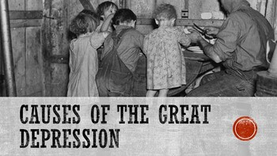

Slide 2
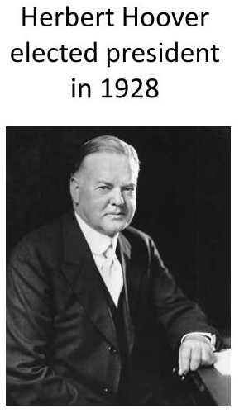
Herbert Hoover

Slide 3
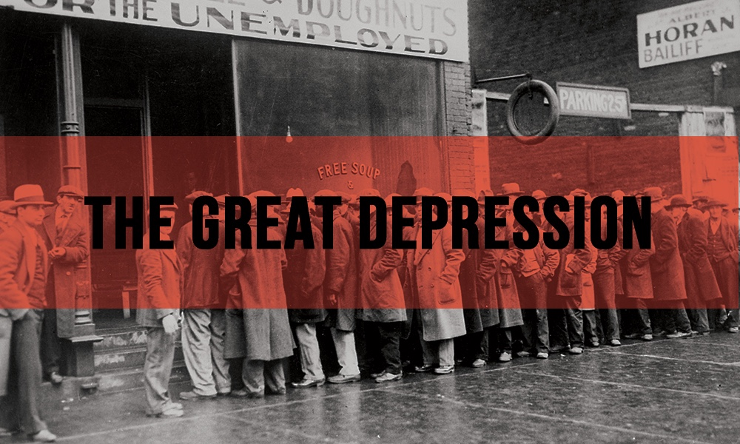
What was the Great Depression?
1929-1941
Worst and longest economic crisis in U.S. History
U.S. economy collapsed
high unemployment
businesses closed
banks failed

Slide 4
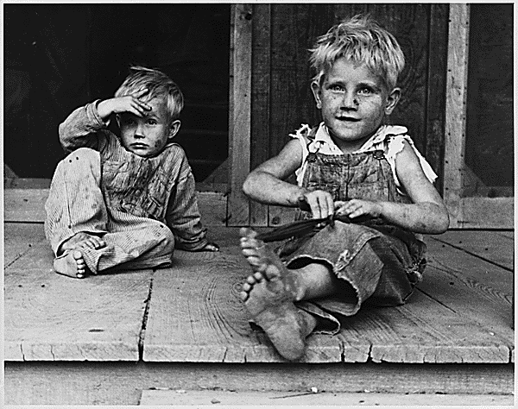
Causes of the Great Depression
low interest rates
uneven distribution of wealth
overproduction and falling demand
high tariffs
stock market speculation

Slide 5
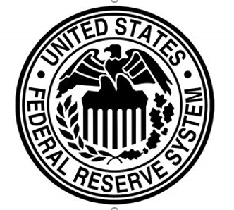
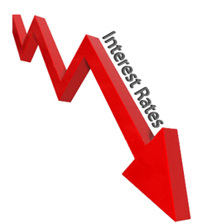
Low Interest Rates
Interest rates are set by the Federal Reserve.
Rates were low in the 1920s.
Businesses took loans to expand, but were reckless.
Banks gave risky loans.
When crisis began, the Fed raised rates, making things worse.

Slide 6
Uneven Distribution of Wealth
aka – income inequality
gap between rich and poor widened.
Wealthiest 1% saw income rise by 75% in the 1920s, while everyone else’s only rose 8%.
More than 70% of families made less than $2,500 per year.
Many people lived off credit.

Slide 7
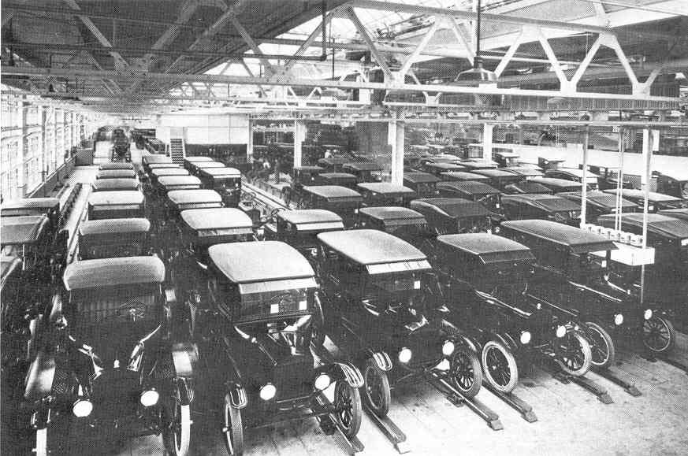
Overproduction and Falling Demand
Factories and farmers were producing more than they could sell.
To make up for the lost money, they produced more which made things worse.
Eventually, had to lay off workers meaning that there were even fewer people buying products.

Slide 8
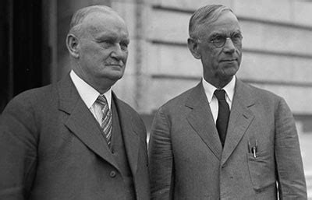
High Tariffs
Congress raised tariffs to help American businesses.
Smoot-Hawley Tariff – 1930, raised tariffs to the highest rate in U.S. history
In response, other countries put a tariff on American goods causing the sell exports to drop.

Slide 9
Stock Market Speculation
By 1929, many Americans were investing in the stock market. (bull market)
Dow Jones Industrial Average – (the Dow) is a way to measure the stock market
Speculation – buying stocks looking for a quick profit
Buying on Margin – buying stocks with borrowed money
Stocks were overvalued (Bubble waiting to burst)

Slide 10
Black Tuesday
The stock market crashed on October 29, 1929.
This was not a cause of the Depression, but signaled its arrival.
16 million shares were sold causing prices to plummet.
The Dow dropped by about 10% and about 30% in month.
$30 billion was lost ($14 billion that day).

Slide 11
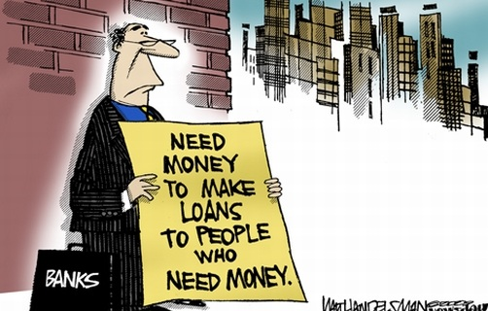
Banks Fail
Banks invested in the stock market too.
People buying stocks on margin couldn’t pay back their loans.
People went to the bank to withdraw all their money.
1 in 4 banks ran out of money and closed permanently.
Many lost all the money they had and their entire life savings.

Slide 12
The Dust Bowl
The topsoil in the Great Plains had been overused.
A severe drought hit in the early 1930s.
Wind storms picked up soil creating huge dust storms, making it impossible to farm for many.

Slide 13
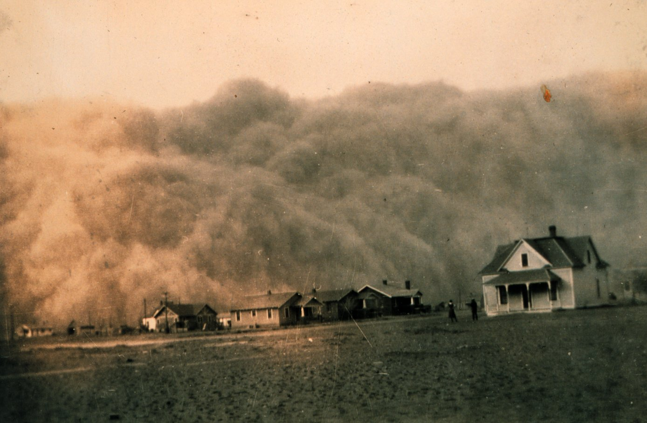

Slide 14
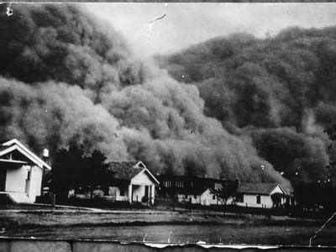
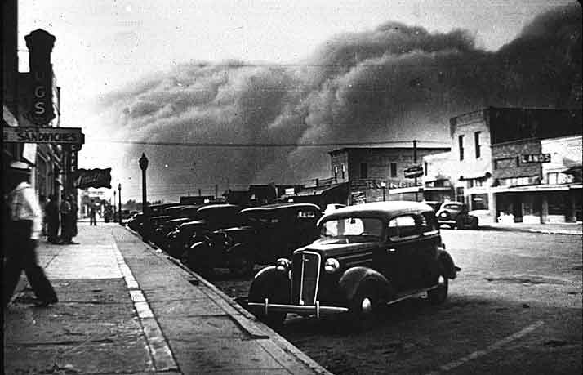
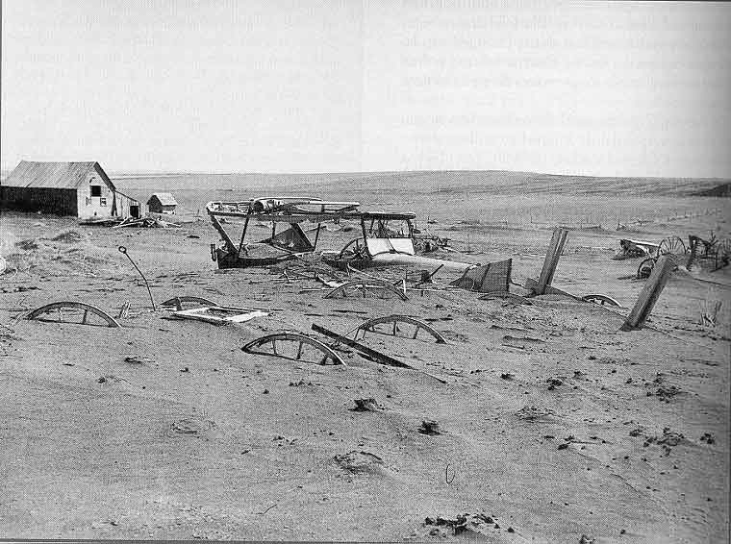
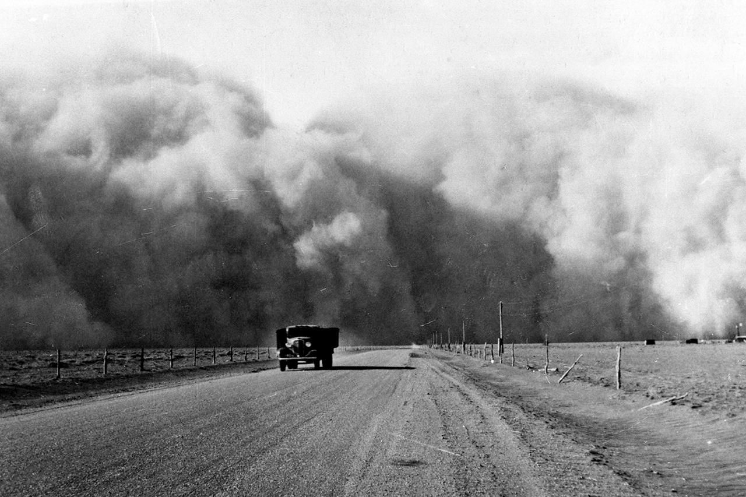

Slide 15
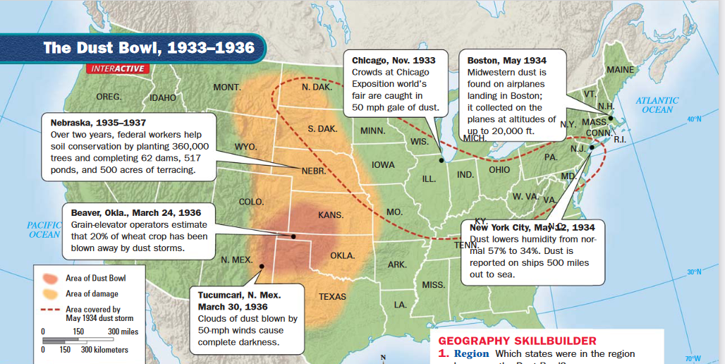

Slide 16
