Slide 1
ATOMIC Structure and periodicity
AP Chem

Slide 2
Objectives
1. Electron configuration and the Aufbau principle | 1.B.2:a
3. Periodic trends | 1.B.1:b, 1.B.1:c, 1.B.2:b, 1.B.2:d, 1.C.1:c, 1.D.1:b, 2.C.1:a, 2.C.1:b
5. Properties of light and study of waves | 1.C.2:e, 1.D.3:a, 5.E.4:b
6. Atomic spectra of hydrogen and energy levels | 1.B.1:d, 1.B.1:e, 1.D.3:b
7. Quantum mechanical model | 1.C.2:d
8. Quantum theory and electron orbitals | 1.C.2:c
9. Orbital shape and energies | 1.C.2:b
10. Spectroscopy | 1.D.2:a, 1.D.2:b, 1.D.2:c, 1.D.3:b

Slide 3
Wavelength, Frequency, and Energy Review
Wavelength—distance between two identical points on a wave
Frequency—how many waves pass a point per unit of time (usually seconds)
Energy—directly correlates to the frequency of the wave.
Three equations you need to know:

Slide 4
Calculation practice with λ, ν, and E.
Calculate the energy of a photon with a frequency of 6.14x10¹⁴ s⁻¹.
Calculate the wavelength of a photon carrying 1.23x10⁻¹⁹ J of energy.
Calculate the frequency of a wave with a wavelength of 789 nm.

Slide 5
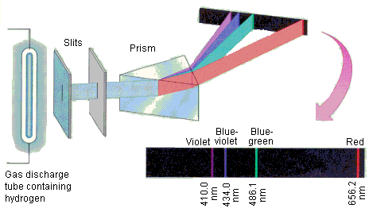
Hydrogen Line Emission Spectrum
Led to Bohr’s model of the Atom!!

Slide 6
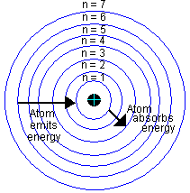
Bohr’s Model

Slide 7
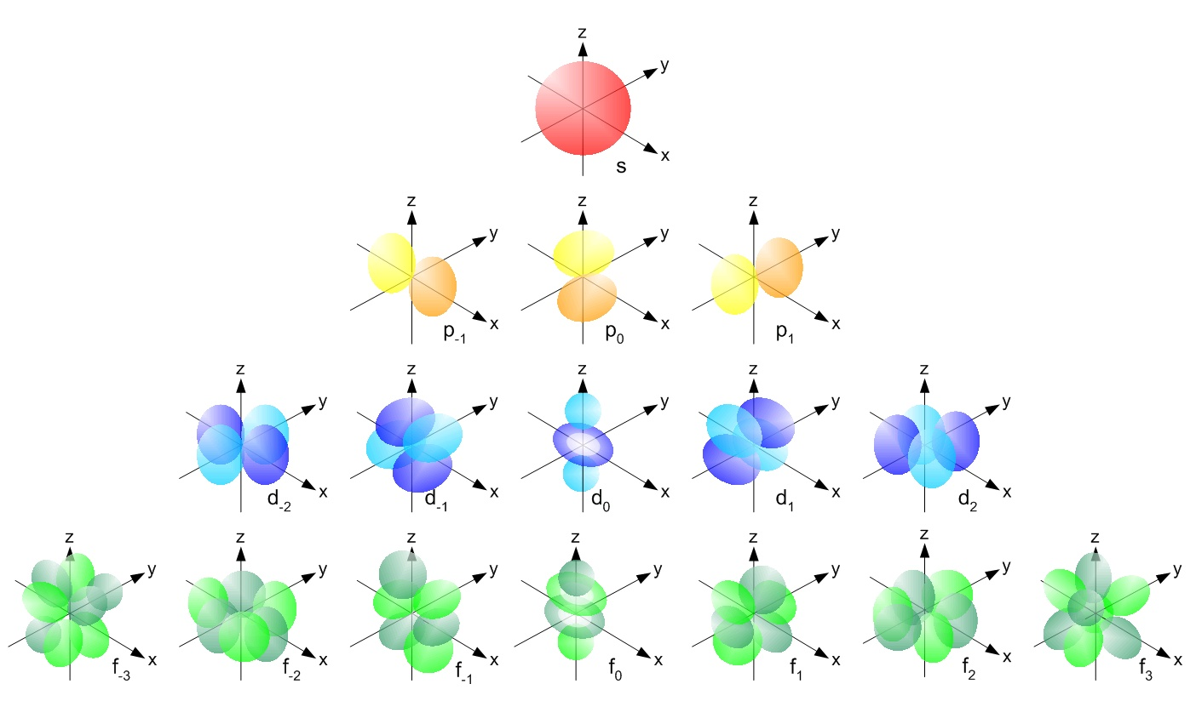
Quantum Mechanical Model

Slide 8
Hierarchy of electron placement
Principal Energy Levels
Sublevels (shape of orbitals)
Orbitals (orientation in space)
Spin of electrons

Slide 9
Electrons within an atom
Represented by electron configurations
Three types
Full Configuration
Noble-gas notation
Orbital notation
Follow three rules to write electron configurations for elements and ions.

Slide 10
Practice
Write the full configuration for the following:
Na
Sn⁴⁺
P³⁻
Write the noble gas notation for the following:
Pb
Cu
C
Write the orbital notation for the following:
Si
Ti²⁺
F⁻

Slide 11
Spectroscopy Techniques
Main ones you need to know:
Mass Spectroscopy
Photoelectron Spectroscopy

Slide 12
Periodic Trends
Need to know for each trend:
General trend across a period and down a group
How each trend relates to Coulomb’s Law
Explain differences using CER format
Trends:
Ionization Energy
Electron Affinity
Atomic Radius
Electronegativity
Ionic Radius

Slide 13
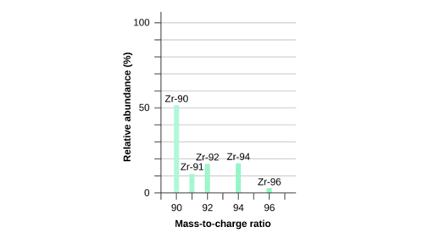
Mass Spectroscopy

Slide 14
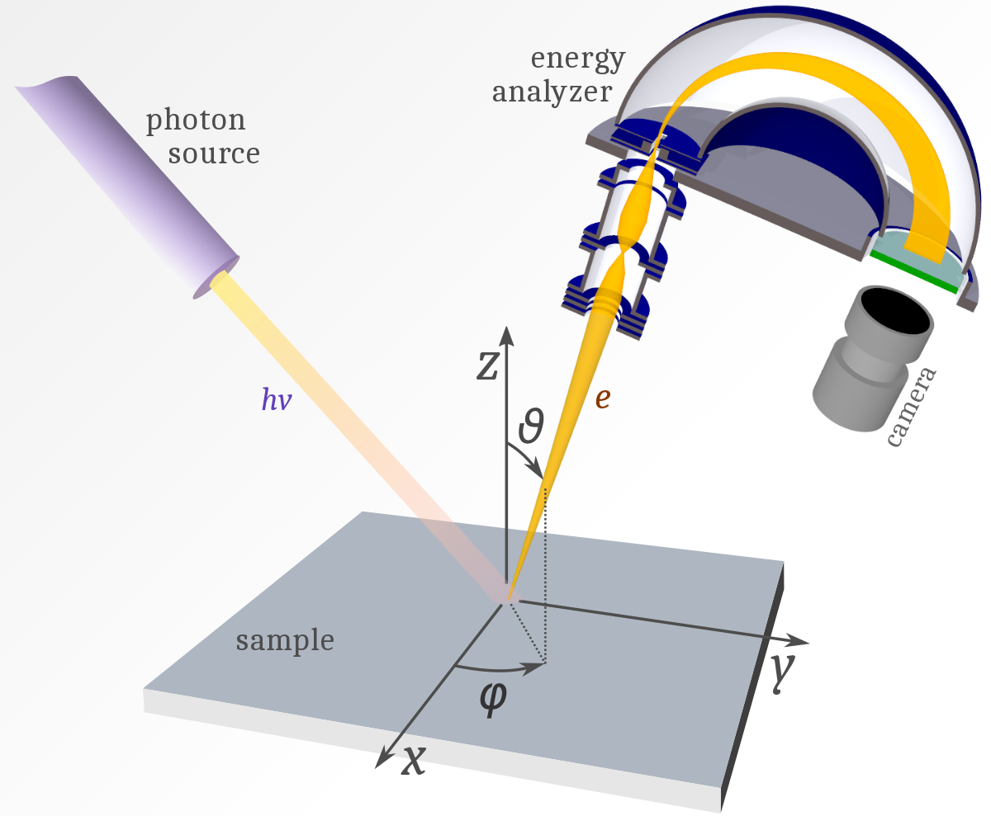
Photoelectron Spectroscopy

Slide 15
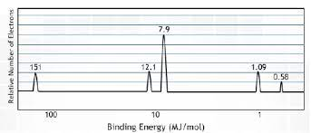
Photoelectron Spectroscopy (PES)
Two main takeaways:
Peak height
Peak positioning

