Slide 1
Daily Math Review
6th grade
Benchmark 4
Week 1

Slide 2
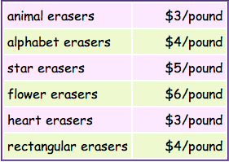
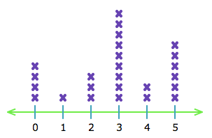
Week 1, Day 1
1. Write out the algebraic equation and solve: At an ice cream parlor, three friends decide to divide the bill evenly. If each friend paid $7, then what was the total bill?
4. A 4-yard piece of fabric costs $7.04. What is the unit price of the fabric per yard?
2. What order should you complete these according to the Order of Operations? Order as 1st, 2nd, 3rd, & 4th.
5. Kelly bought 1/2 of a pound of heart erasers. What was the cost?
Add and Subtract | Multiply and Divide | Evaluate Powers | Completing Expressions inside Parentheses
3. How many students brought two cans of food to donate to the food bank?

Slide 3
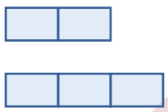
Week 1, Day 2
1. Rachel and Monica are competing for their apartment against Joey and Chandler. Rachel and Monica have a 2:3 ratio in answering questions correctly. Together, the four of them have answered correctly a total of 35 questions. How many questions has each team answered correctly?
3. Your family parked in the third level of the underground parking garage. Luckily, there’s an elevator to take you to the 10th floor of the building. How many levels were you either on or passed by?
Rachel & Monica
=
Chandler & Joey
=
4. What is the range?
3 2 0 8 5
2. Your starting balance is $17.00. You then deposit $35.00. The next day you withdraw $28.63. You find $5.50 and are given the $4.75 that your friend owed you. What is the total you have after these transactions?
5. A shark swims at 140 feet
below sea level. It then descends 20 feet, what is its new position?

Slide 4
Week 1, Day 3
4. What is “Mode”?
1. Write out the algebraic equation: Seven is a quarter of some number.
2. 8 + 34 - 5(20 ÷ 2)
Girls
Boys
3. Write out the algebraic equation and solve: A number squared is 25.
5. Teenagers were polled to see how long they take showers. Which, boys or girls, has the lowest lower quartile?

Slide 5
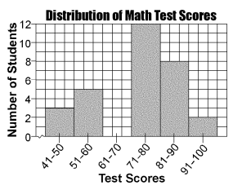
Week 1, Day 4
1. (32 ÷ 8) + 4 = 2x
4. How many students scored
between a 51 and 70 on their test?
2. What is “Mean”?
5. Only three students scored in
what test range?
3. 8 - 3(4 x 3) + 30 ÷ 6

Slide 6
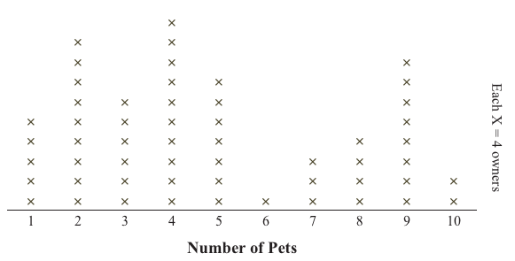
Friday Five
1. Which is the better purchase?
Item | Price | Price per unit
4 pound bag of potatoes | $5.68
9 pound bag of potatoes | $13.32
87, 96, 83, 84, 90, 99, 85, 81, 90
5. How many owners
said they have seven pets?
4. Did more owners
have one pet or eight
pets?
2. Range:
3. Mode:

Slide 7
Daily Math Review
6th grade
Benchmark 4
Week 2

Slide 8
Week 2, Day 1
1. What is area?
4.
Item | Price | Amount of Product | Price per unit
Wheaties | $4.89 | 15.6 oz.
Chex Corn | $5.29 | 14 oz.
Cheerios | $4.69 | 14 oz.
2. Jane needs to know how much soil she needs to purchase in order to fill her flower boxes that are 3.5 feet tall, long, and wide. How much soil can each flower box hold?
5. 89% - 4/9
3. What are nets?

Slide 9
Week 2, Day 2
1. What is volume?
4. 3.25 ÷ 23/25
2. Find the mean:
29 20 27 26 26 24 28 21
5. The following represents the runners’ ages who attended the state competition. How many runners are teenagers?
3. What is the difference between regular and irregular polygons?
x
x
x
x
x
x
x
x
x
x
x
x
x
x
x
x
x
x
x
x
x
x
x
x
x
x
x
9
10
11
12
13
14
x = 4 people

Slide 10
Week 2, Day 3
1. How many vertices
does this purple shape have?
3. Find the median:
29 20 27 26 26 24 28 21
4. 15 - 15 ÷ 3 + 9 - 7 x 2 x 9
2. What is the Surface Area formula for a rectangular prism?
5. Evaluate the expression for x=8
25 ÷ 5 - 16 ÷ x + x
2

Slide 11
Week 2, Day 4
1. Compare these two expressions:
(8 x 6) x 9 ____ 8 x (6 x 9)
4. If you were to build a pyramid with a square base that has a length of 57 feet and was 36 feet tall, what would the volume be of your pyramid?
2. Find the mode:
29 20 27 26 26 24 28 21
3. A charity has made an agreement with a local business that if they can raise 80% of the $1,000 goal, then the business will provide the other 20%. So far the charity has received donations of $243, $78, $95, and $330. Write an inequality to find the minimal amount of money they need in order receive the 20%.
5. What is the area of a rectangle whose perimeter is 24 cm and the width is 5 cm?

Slide 12
Friday Five
1. What is area?
4. What is the Surface Area formula for a rectangular prism?
2. 3.25 ÷ 23/25
3. What is the difference between regular and irregular polygons?
5.
Item | Price | Amount of Product | Price per unit
Wheaties | $4.89 | 15.6 oz.
Chex Corn | $5.29 | 14 oz.
Cheerios | $4.69 | 14 oz.

Slide 13
Daily Math Review
6th grade
Benchmark 4
Week 3

Slide 14
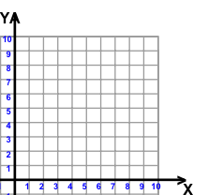
Week 3, Day 1
4. Name the polygon and its number of vertices.
1. Trista (3, 6) and Laura (8, 2) both are heading to Diana’s house (8, 6) for a sleep over. Who lives the farthest away from Diana?
T
D
L
5. 45/6 - 3.95
2. Which variable is typically the dependent variable?
3. Solve and show -4.5 + 7

Slide 15
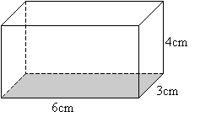
Week 3, Day 2
4. The following line graph represents the ages of the members of the Tucson Adolescent Band, or TAB. What is the difference in the number of twelve and sixteen year olds?
1. Name the polygon and number of vertices.
2. 87% x 2.98 - 2
x
x
x
x
x
x
x
x
x
x
x
x
x
x
x
x
x
x
x
x
x
x
x
x
x
x
x
3. Find the Surface Area of the cylinder.
11
12
13
14
15
16
x = 7 people
5. 8 - 9(4 + 19 - 30)

Slide 16
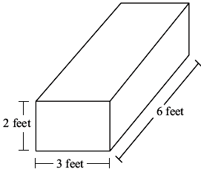
Week 3, Day 3
3. Create an expression that matches this line diagram.
1. Name the polygon and number of vertices.
4. Evaluate the expression for x = 3
(9x - 8) + 2(4x + 5)²
2. Find the surface area of the rectangular prism.
5. Graph (5, 3),
(8, 3), (8, 7), (5, 7).
If you connect all vertices, what polygon have you made?
3
8
5

Slide 17
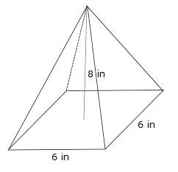
Week 3, Day 4
1. Evaluate the expression for x=8
(2x + 4) 5 - x (32 ÷ x)
4. Name the polygon and number of vertices.
2. Show the solution of 3.5 + (-4)
3. What is an independent variable?
5. Find the surface area of the pyramid.

Slide 18
Friday Five
1. The following line graph represents the ages of the members of the Tucson Adolescent Band, or TAB. What is the difference in the number of twelve and sixteen year olds?
4. Find the surface area of the rectangular prism.
x
x
x
x
x
x
8
x
x
x
x
3
x
x
x
x
x
x
x
x
x
x
x
x
x
x
x
x
x
5
11
12
13
14
15
16
x = 7 people
5. Name the polygon and number of vertices.
2. 45/6 - 3.95
3. Evaluate the expression for x = 3
(9x - 8) + 2(4x + 5)²

Slide 19
Daily Math Review
6th grade
Benchmark 4
Week 4

Slide 20
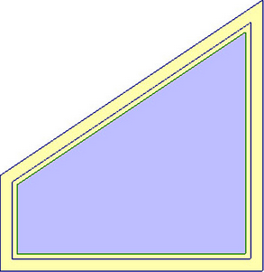
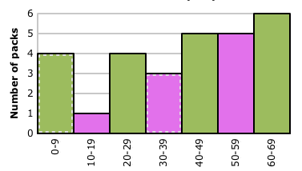
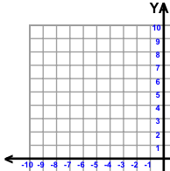
Week 4, Day 1
1. Find the area for the shape below.
5. A candy company is monitoring how many chocolates go into packaging unwrapped by randomly selecting bags from each batch.
Use the data to judge whether the histogram below is accurate.
9 cm
3 cm
8 cm
2. What is the interquartile range of the following?
3 8 2 9 1 0 4 5 8 2 1
3. -9 + 3 =
4. Graph
A (-4, 7)
B (-7, 4)
Number of Candies Unwrapped

Slide 21
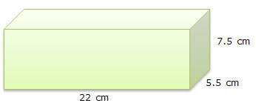
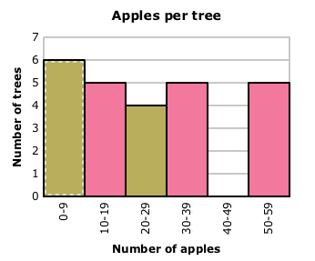
Week 4, Day 2
1. Find the volume.
3. What are quadrants?
4. Mrs. Guenther’s second grade class planted apple trees. They’re tracking the number of apples on each tree. How many trees did they plant?
2. Find the area of the shape below.
5. Is the histogram correct?
3 mm
6.7 mm
6 mm

Slide 22
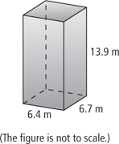
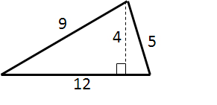
Week 4, Day 3
1. -8 + 12 =
4. Find the volume.
2. What is a reflection?
3. Target is measuring the wait time to check out during Black Friday’s sale rush right after Thanksgiving.
What is the minimum value?
5. Find the area of the triangle
(units in cm).
Wait time at Target (minutes)

Slide 23
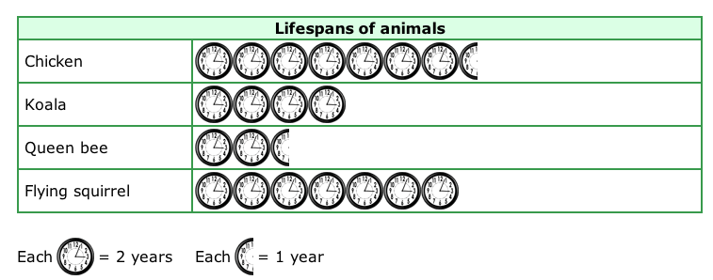
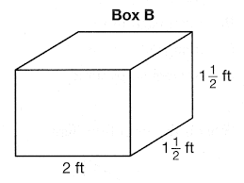
Week 4, Day 4
1. -11 - -8 =
4. Find the area of the rectangle.
2. What is the lifespan of a flying squirrel?
3 mm
11 mm
5. Find the volume of the prism.
3. 87 - 23 + 45 ÷ 9 + (4 x 3)
2

Slide 24
Friday Five
1. Find the area for the shape below.
4. Target is measuring the wait time to check out during Black Friday’s sale rush right after Thanksgiving.
What is the maximum value?
9 cm
3 cm
8 cm
2. What is the interquartile range of the following?
3 8 2 9 1 0 4 5 8 2 1
Wait time at Target (minutes)
5. Find the volume.
3. What are quadrants?

Slide 25
Daily Math Review
6th grade
Benchmark 4
Week 5

Slide 26
Week 5, Day 1
4. 42
1. 13 - 42 + 56 ÷ 7 + (13 x 9)
2. Write an equivalent expression.
1/2 + 5/7 - 1/3
___/10 + 25/___ - ___/15
5. If there is a class of 30 students and two thirds of them are allergic to peanut products, how many students is that?
3. Create the inverse operation for:
18 ÷ 6 = 3

Slide 27
Week 5, Day 2
1. Put in order of Least to Greatest value.
63/65, 92%, 4.12, 10:17
4. 87 - 43 + 3 x 9 - 2 x 8 + 13
2. Evaluate the expression for w = 20%
4w - 12w + 50w x 60w
5. Create a Fact Family for:
4, 8, 12
3. If the temperature is 61 degrees Fahrenheit at 7:30 am, and the temperature rises 2 degrees every hour, what will the temperature be at 5:00 pm?

Slide 28
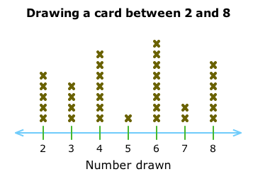
Week 5, Day 3
1. Find the unit rate for:
3 lightbulbs for $15.66
4. Evaluate the expression for s = .5
13 + 60 - (9s + 78s) + 90s
2. Create a Fact Family for:
24, 4, 6
5. What is a variable?
3. Looking at the line diagram, how many students drew a number greater than 6?

Slide 29
Week 5, Day 4
3. There are 22 violets. There are 4 times the number of violets for the total number of flowers in the flower bed. Write the equation to solve for the number of daisies.
1. What is a better rate of measurement for a car:
ounces or tons?
4. If the rest are daisies, then how many are there?
2. Put in order of Greatest to Least values.
9:15, 72/83, 23%, .35
5. Evaluate the expression for y = 3.5
32 - 8y + (-12 x 8)y

Slide 30
Friday Five
1. Find the unit rate for:
3 lightbulbs for $15.66
3. Evaluate the expression for w = 20%
4w - 12w + 50w x 60w
4. If the temperature is 61 degrees Fahrenheit at 7:30 am, and the temperature rises 2 degrees every hour, what will the temperature be at 5:00 pm?
2. Create the inverse operation for:
18 + 6 = 24
5. Write an equivalent expression.
1/2 + 5/7 - 1/3
___/10 + 25/___ - ___/15

Slide 31
Daily Math Review
6th grade
Benchmark 4
Week 6

Slide 32
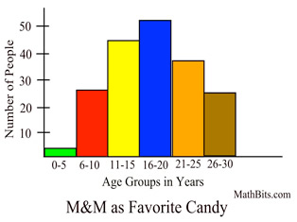
Week 6, Day 1
1. 24/25 ÷ 8/9
4. Put the following in order from GREATEST to LEAST.
4/17, 0.66, 1.20, 80%
2. Find the Mean.
45 20 16 64 32 34 29 50
5. The histogram below represents M&M as a favorite candy for various age groups. How many people under
the age of 11 chose
M&M’s as their
favorite candy?
What’s your
favorite candy?
3. 5,432 x 38 =

Slide 33
Week 6, Day 2
1. 3,380 ÷ 52=
4. Write the ratio and do not simplify.
2. 5/6 ÷ 9/10=
Red to triangles.
3. Determine the perimeter and area of the rectangle.
5. A secretary works 5 days/week and 8 hours/day. She earned $1180.80 every two weeks. What was her hourly rate of pay?
5 inches
9 inches

Slide 34
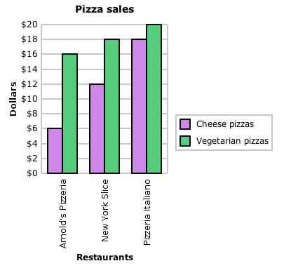
Week 6, Day 3
1. What is absolute value?
5. What is the difference between total cheese and vegetarian pizza sales?
2. You’re going to the movies with your dad, grandpa, and little brother. Your dad’s and grandpa’s ticket together is six dollars more than your brother’s and yours. A child’s ticket is $6.99. How much is each adult’s ticket?
3. -5 + 12 + 4((14-2) x 3)
4. 84 x 24%=

Slide 35
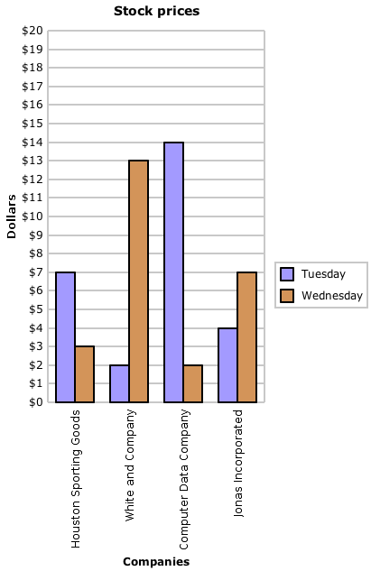
Week 6, Day 4
1. Which day of the week is more monetarily productive for the companies on average?
2. Use the Distributive Property on 8(9+2)
3. (7 + (36 ÷ 4 + 17) x .5)
4. What property is xy - 2 = yx - 2 ?
5. If 7 is 20% of a value, what is the value?

Slide 36
Friday Five
1. Put the following in order from GREATEST to LEAST.
4/17, 0.66, 1.20, 80%
5. What is the difference between total pizza sales of Arnold’s Pizzeria and New York Slice?
2. 5,432 x 38 =
3. Find the Mean. 45 20 16 64 32 34 29 50
4. A secretary works 5 days/week and 8 hours/day. She earned $1180.80 every two weeks. What was her hourly rate of pay?

Slide 37
Daily Math Review
6th grade
Benchmark 4
Week 7

Slide 38
Week 7, Day 1
1. Convert 75% to
a fraction.
2. What would correctly represent x < 2?
3. 7 pt = ____qt
-2
-1
0
1
2
4. 4:7 = __:14 = __:21 = 16:__ = __:35 =24:__
5. Find the mean absolute deviation of the maximum speeds of theme park rides.
Maximum Speeds of Theme Park Rides (mph)
30 | 45 | 25 | 82
48 | 52 | 80 | 75

Slide 39
Week 7, Day 2
1. Find the mean absolute deviation of the maximum speeds of electronic speed boats.
Maximum Speed | of Electronic | Speed Boats (mph)
12 mph | 15 mph | 22 mph
20 mph | 13 mph | 16 mph
2. Convert 1.75 miles
=________yds.
4. 1344 oz = ____ gal ____qt ____ cups
2
5. Find Quartiles 1, 2, and 3 for the following set of data.
8 5 6 9 8 7 9 5 8 6 7
3. 7(28 - 17) + 12 x 2 - 7

Slide 40
Week 7, Day 3
1. What are four signs which represent inequalities? Label what they stand for.
2. 4 cups = ____ pints = 1 qt = ____ gal.
3. Find the unit price for each item in the group. Which item offers the consumer the most product for his/her money?
5. Everyone gets a basket with 15 apples. If there are 7 baskets, how many apples are there altogether?
Item | Size | Price | $ Price /per Ounce
Lucerne Ice Cream Cones | 8 - 4.6 fl. oz. | $5.49
Drumstick Ice Cream Cones | 4 - 4.6 fl. oz. | $4.99
15
7
baskets
4. When reading an ordered pair to put on a graph, which number has you following which axis?

Slide 41
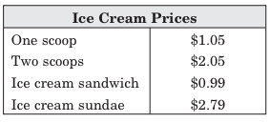
Week 7, Day 4
1. (48 - 6) ÷ 7 + 5
3. The sum of forty and a number
2
2. John took his younger cousins for ice cream. He was determined not to spend over $5. Does he have enough for two ice cream sandwiches, one sundae, and two scoops of ice cream? If not, how much is needed?
4. Find the interquartile range for the following set of data.
8 5 6 9 8 7 9 5 8 6 7
5. What would correctly represent x ≥ -2
-2
-1
0
1
2

Slide 42
Friday Five
1. What are four signs which represent inequalities? Label what they stand for.
4. John took his younger cousins for ice cream. He was determined not to spend over $5. Does he have enough for two ice cream sandwiches, one sundae, and two scoops of ice cream? If not, how much is needed?
2. What would correctly represent x < 2?
-2
-1
0
1
2
3. Find Quartiles 1, 2, and 3 average for the following set of data.
8 5 6 9 8 7 9 5 8 6 7
5. 1344 oz = ____ gal ____qt ____ cups

Slide 43
Daily Math Review
6th grade
Benchmark 4
Week 8

Slide 44
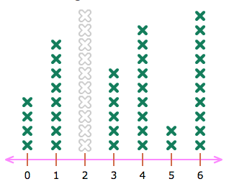
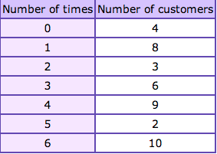
Week 8, Day 1
1. 8(4)-7(24÷8)+2
4. How many students brought more than 2 cans of food to donate to the food bank if each x represents one student?
2. What would correctly represent x > 3
3. An ice cream shop wanted to know the
number of scoops that customers ordered
over the last month. Use the info in the
chart to fill in the line plot.
scoops
6
5. The product of 7 and a number increased by six

Slide 45
Week 8, Day 2
1. Starling has $250 in her bank account at the beginning of the second semester. Her goal is to have at least $150 in the account when school lets out for summer. She withdraws $8 each week for food and movie rentals. Write an inequality problem based on the above information.
2. Write out the algebraic equation and solve: The quotient of a number and thirty is equal to 6.
5. Write an inequality to represent the following situation:
The trampoline allows jumpers who weigh up to 250 pounds.
2
3. 26 ÷ 2 + 4 (8 + 3 - 4 x 2 ) + 17
87, 96, 83, 84, 90, 99, 85, 81, 90
4. Range:
100
150
200
250
300

Slide 46
Week 8, Day 3
1. Show on the number line 7+ -6 = ?
2. A tiger shark was swimming 500 feet below sea level. If it ascends 160 feet, what is its new swimming level?
4. 3/4 + 332 - 5 (14 ÷ 7)
5. What order should you complete these in according to the rules of Order of Operations? Put 1st, 2nd, 3rd, 4th.
3. Compare 6 and 8 as inequalities.
Add and Subtract | Evaluate Powers | Completing Expressions inside Parentheses | Multiply and Divide
5
6
7
8
9

Slide 47
Week 8, Day 4
1. How many students scored
between a 51 and 90 on their test?
3. What is the median cost of the erasers per pound?
4. Kelly bought 1/2 of a pound of heart erasers, 1/4 of a pound of flower erasers, and one pound of star erasers. What was the total cost?
2. Compare -4 and -6 as inequalities.
5. What are reflections?
-7
-6
-5
-4
-3

Slide 48
Friday Five
1. How many students brought more than 3 cans of food to donate to the food bank if each x represents one student?
4. How many students scored
between a 41 and 80 on their test?
2. Show on the number line 7+ -6 = ?
3. Write out the algebraic equation and solve: The quotient of a number and thirty is equal to 6.
5. What would correctly represent x > 3

Slide 49
Daily Math Review
6th grade
Benchmark 4
Week 9

Slide 50
Week 9, Day 1
1. 8 2/5
+2 1/2
4. Rachel and Monica are competing for their apartment against Joey and Chandler. Rachel and Monica have a 2:3 ratio in answering questions correctly. Together, the four of them have answered correctly a total of 45 questions. How many questions has each team answered correctly?
2. -6 in + 13 in
=
Rachel & Monica
Chandler & Joey
=
3.
Item | Price | Price per unit
2.5 gal. of ice cream | $4.98
3 gal. of ice cream | $3.82
5. A clown fish was swimming 60 feet below sea level. If it ascends 52 feet, what is its new swimming level?

Slide 51
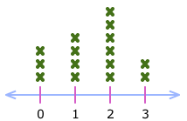
Week 9, Day 2
1. The Sugar Rush sweet shop wanted to track the number of pounds of candy that people purchase at a time. Use the data in the line plot to complete the frequency chart.
3. Evaluate (5x - 28)+3x
if x = 6
Sugar Rush Purchases
Pounds of Candy | Number Purchased
2
3
4
5
Text
4. Evaluate
(35÷x - 17)+3-x
if x = 5
Text
Text
Text
Text
2
3
4
5
Number of Pounds
2. What is the mean of the total number purchased in the first problem ?
5. What would correctly represent x ≥ -4
-4
-3
-2
-1
0

Slide 52
Week 9, Day 3
1. Jacob dove from the diving board and descended to 8 feet below sea level. He then swam to the surface and got out of the pool. When he we went back up to the diving platform he was six feet above sea level. What is the total number of feet Jacob travels from diving to being in the water as far as he descends?
3. What is a polygon?
-8 + 6
4. Find the area of the triangle.
2. What are the types of triangles?
5.6 cm
4 cm
4 cm
5. Put the following in order of Least to Greatest value. 89.4, 65%, 7 5/6, 8:3

Slide 53
Week 9, Day 4
1. What are vertices?
4. What is the perimeter of this square?
13 mi
2. How many times did people score more than 7 points playing the board game?
x
x = 5 people
x
x
5. Name 4 different quadrilaterals.
x
x
x
x
x
x
x
x
x
x
x
x
x
x
x
5
6
7
8
9
10
3. Twenty is twelve less than four times a number.

Slide 54
Friday Five
1. A clown fish was swimming 60 feet below sea level. If it ascends 52 feet, what is its new swimming level?
4. What are vertices?
2. What is a polygon?
5.
Item | Price | Price per unit
2.5 gal. of ice cream | $4.98
3 gal. of ice cream | $3.82
3. What would correctly represent x ≥ -4
-4
-3
-2
-1
0

