Slide 1

Financial Aid Information Session
Presented by:
Mount Union
Student Financial Aid

Slide 2

Topics
Financial Aid Basics
What do I need to apply?
FSA ID Username and Password
FAFSA
How do I read and compare financial aid awards?
What if my financial situation changes?
What are the questions I should be asking?
Where can I get help filing my FAFSA?

Slide 3
What is Financial Aid?
Notes:
Funds earned or provided to students and families to help pay for postsecondary education

Slide 4
Scholarships
Talent and Athletic Awards
Grants
Loans
Federal Work Study

Slide 5
Federal Government
State Government
Colleges and Universities
Private Sources
Employers

Slide 6

Notes:
-FAFSA not available until at least December

Slide 7







2022 Federal Tax Returns/W-2’s for student and contributor(s)
Recent bank statements
Records of untaxed income
Records of investments and assets
Social Security Numbers and email addresses for the student and contributor(s)
Driver’s License (if you have one)
Alien Registration Number (if you are not a U.S. Citizen)
Notes:
-they have limited the number of untaxed income questions

Slide 8
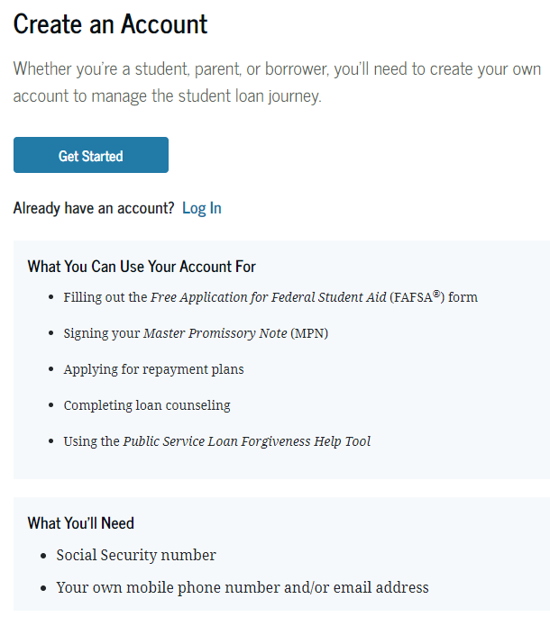
Apply for FSA ID at studentaid.gov

Slide 9


This Photo by Unknown Author is licensed under CC BY
Notes:
- Be careful in choosing emails

Slide 10
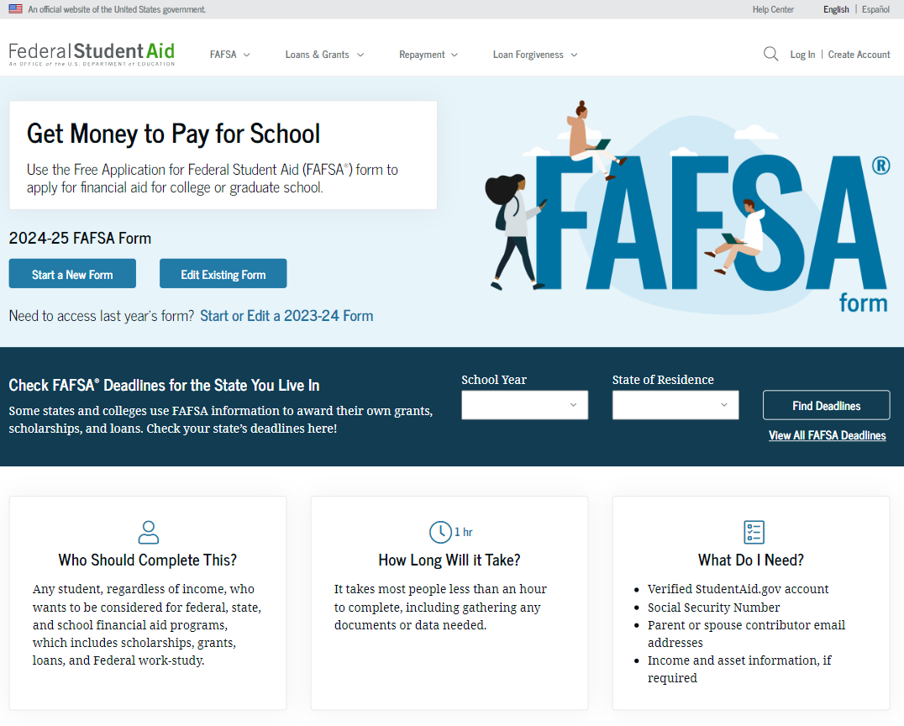
2024-2025
December

Slide 11
Parent Contributor Section
Personal Identifiers
Personal Circumstances
Demographics
Financials
Colleges
Signature

Slide 12
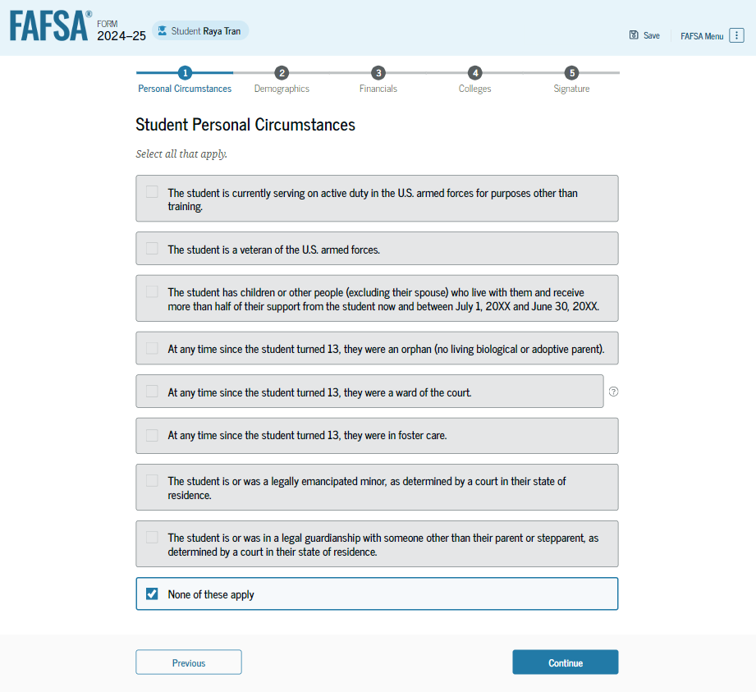

Slide 13
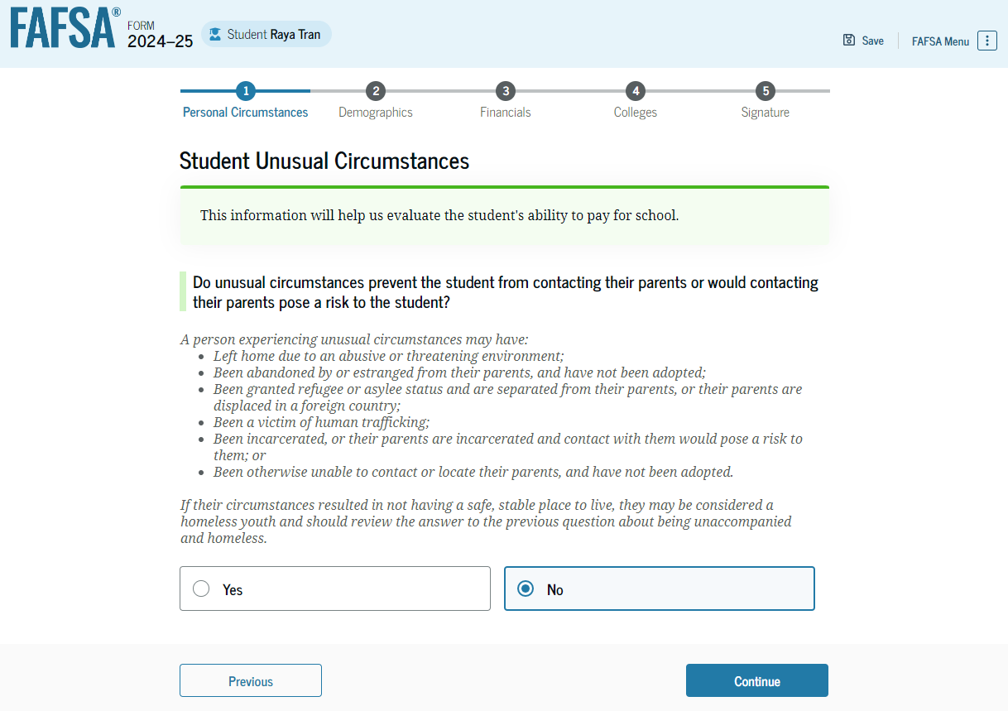

Slide 14
Parent of Record on the FASFA ​
Biological or Adoptive Parents ​
​
    If not married but living together report BOTH parents ​
Biological Parents are Divorced or Never Married:​
​
    Provide information for the parent that provides most financial support in 12 months prior to completing the FASFA​
    Even if the student does not live with that parent ​
    If support provided is equal, report for the parent with the greater income and assets ​
    If parent is re-married, report information about their spouse (student step –parent)
Notes:
Parent Wizard

Slide 16
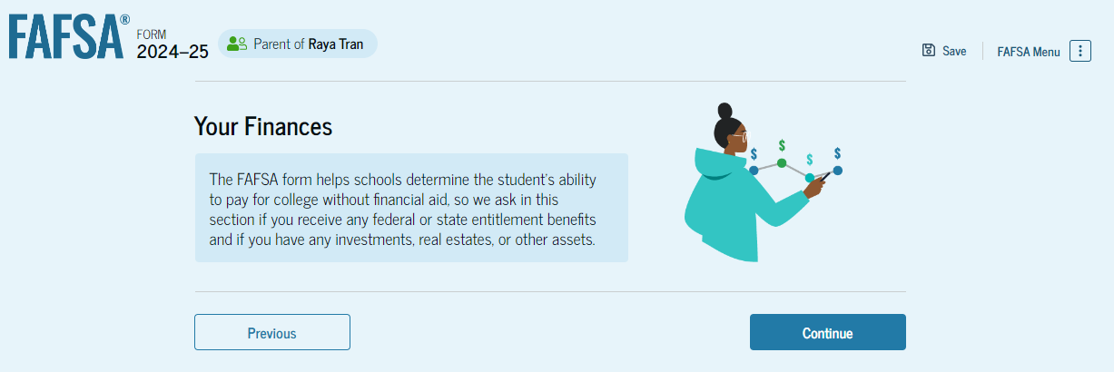
Notes:
Contributor will need to give consent
DDX

Slide 17
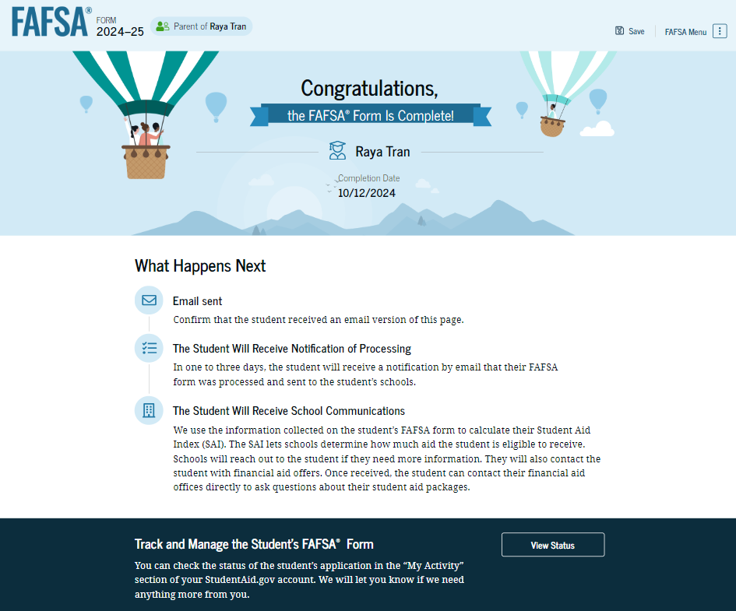
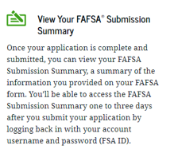
Notes:
- FSS (FAFSA Submission Summary)

Slide 18


Slide 19
FAFSA determines SAI
(Student Aid Index)
School(s) receive FAFSA and offer financial aid award
Student accepts award(s) and completes
necessary requirements

Slide 20
Direct Costs
Indirect Costs
* Not Billed
Cost of Attendance
Tuition & Fees
Food & Housing
Equipment
Course Materials/Supplies
Transportation

Slide 21

Cost of Attendance
SAI
Financial Need

Slide 22
Federal Pell Grant
Federal SEOG Grant
State Grants

Slide 23


Slide 24
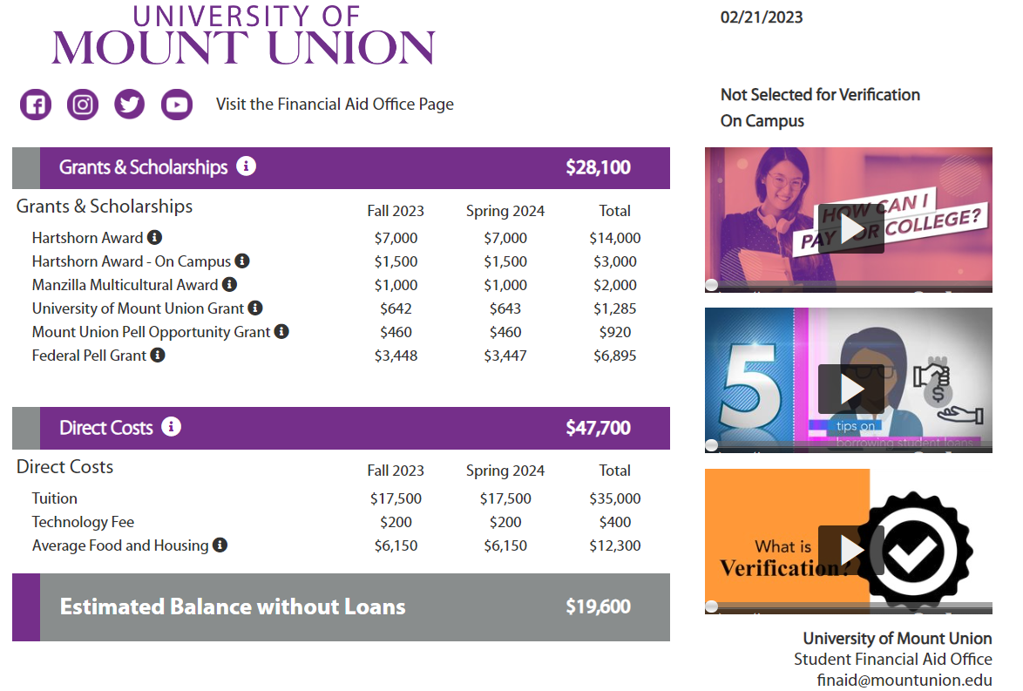

Slide 25
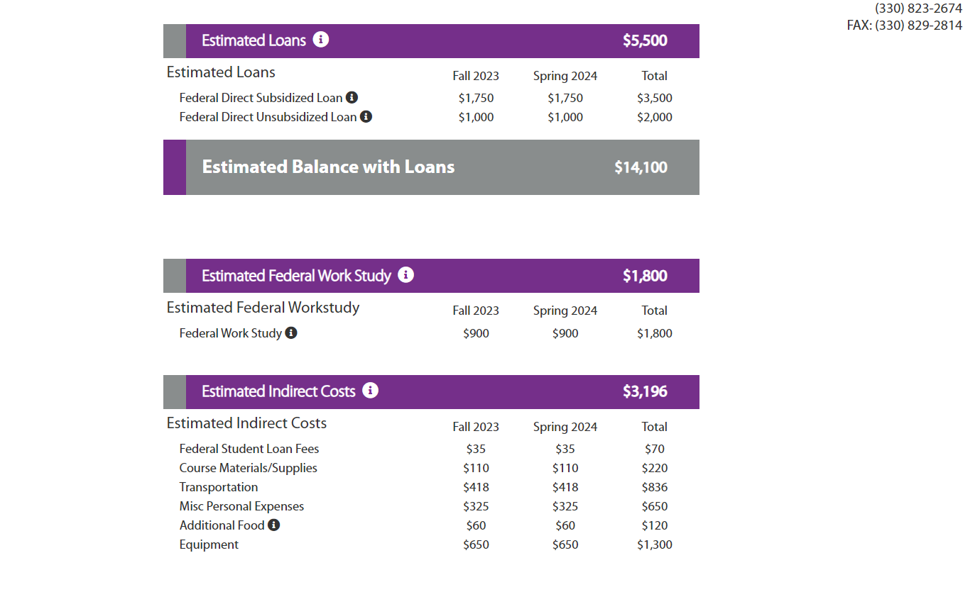

Slide 26
Direct Costs
Scholarships/Grants
Net Price

Slide 27

school
sticker price

Slide 28
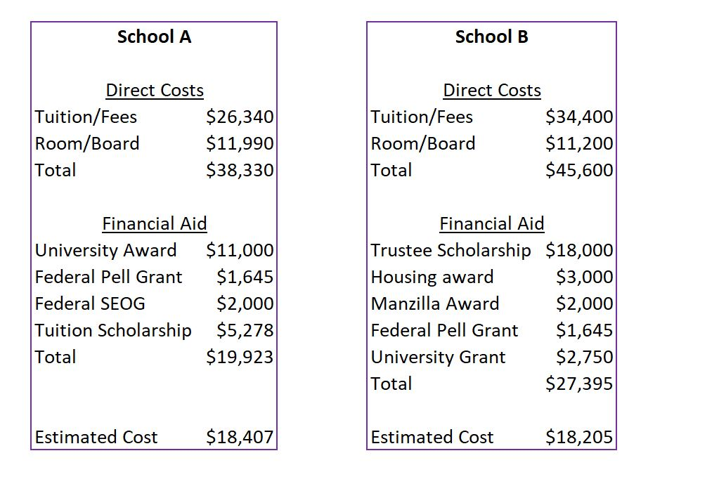

Slide 29


Slide 30


Slide 31


Slide 32


Slide 33


Slide 34
When will my financial aid offer be ready to view?
How will I receive my financial aid offer? Mail/email/portal?
Are there scholarship deadlines?
Will my financial aid change if my housing status changes? (commuting vs. living on campus)
What documents do I need to complete to receive my financial aid offer? What are the deadlines? (FAFSA, institutional application, CSS Profile, etc)
Is there a FAFSA deadline? If not, do they have a preferred deadline?

Slide 35
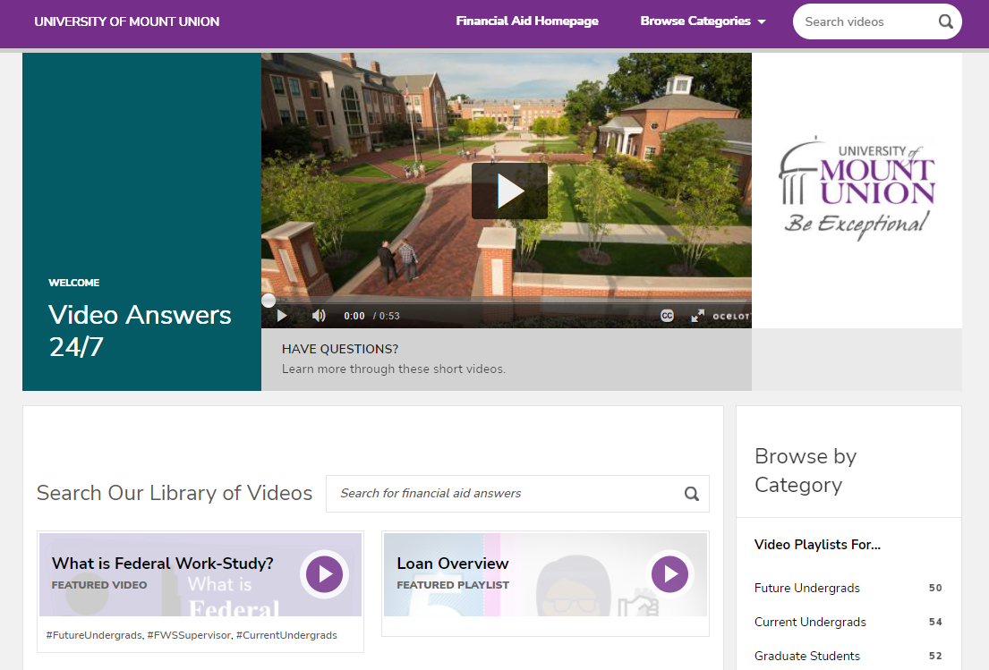
mountunion.financialaidtv.com

Slide 36
To do Items:
FSA ID
FAFSA
Review Award Offers
Complete Requirements
Enroll

Slide 37
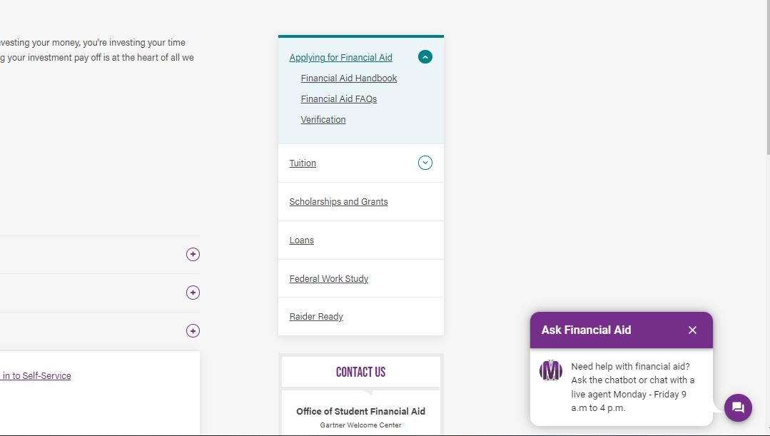
Chat with us!
mountunion.edu/applying-for-financial-aid

Slide 38


Slide 39

Financial Aid Team
Kathleen Thomas
Assistant Vice President
Reagan Stull
Assistant Director
Jenni Chadwell
Assistant Director
MacKenzie McKay
Representative
Kendra Mazzei
Assistant
Jamie Ruth
Data Coordinator
Contact Information:
Office of Student Financial Aid
University of Mount Union
finaid@mountunion.edu
330-823-2674

