Slide 1
Houston Virtual
Elementary School

Slide 2
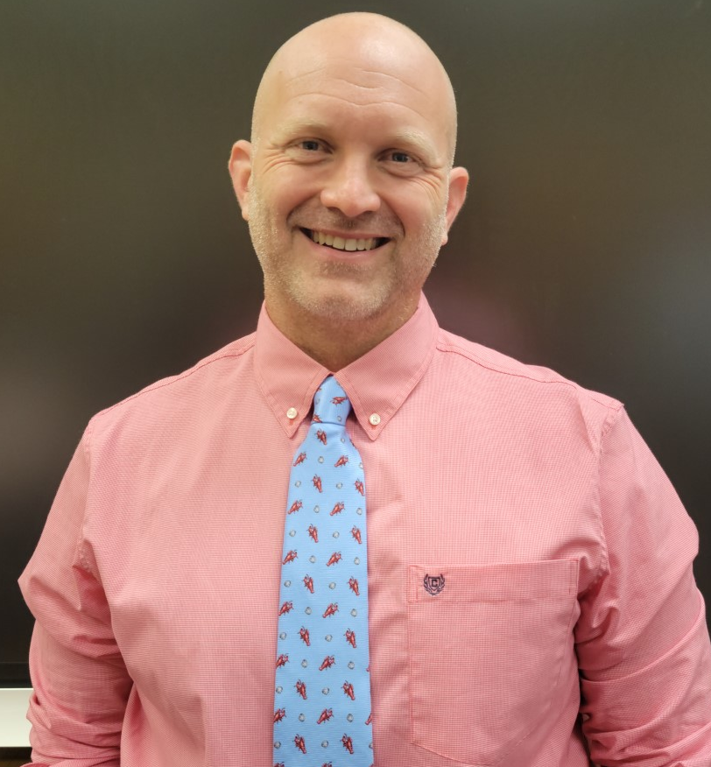
Dr. Dave Gibbs
Virtual Learning Coordinator
Dave.Gibbs@hcbe.net
Mrs. Gracie Barnes
Assistant Principal of Houston Virtual
Gracie.barnes@hcbe.net

Slide 3
Houston Virtual Overview
Virtual Learning is offered through Houston Virtual to Houston County School System students.
Middle school virtual learning students and teachers (grades 6-8) will utilize Google Classroom, video conferencing via Zoom, and the Apex digital learning program.

Slide 4
Student Expectations
Maintain appropriate course progress.
Attend all scheduled Zoom meetings.
Maintain a passing grade in all course
Attend support/tutoring sessions as needed
Must log-in and complete assignments daily.
Please follow the sample student schedule as needed
Check messages daily and respond to teachers in a timely manner.
Correspondences between student and teacher will be respectful.
*Classroom teachers may have additional rules and expectations in place.

Slide 5
Parent Expectations
Review the weekly report from Apex.
Email any concerns to teacher(s).
Report any expected long term absence to Kim Green (kimberly.green@hcbe.net)
Report any changes in address and phone numbers promptly to central registration office.
*It is important to have parental support to help students achieve academic success.

Slide 6
Assessments
The Georgia Milestones Assessment System is a comprehensive summative assessment program and represents a single system of summative assessments that span all three levels of the state's educational system – elementary, middle, and high school.
Administered in the spring
Students will go to zoned schools
Must bring district assigned Chromebook
NWEA is a research-based, not-for-profit organization that supports students and educators worldwide by creating assessment solutions that precisely measure growth and proficiency—and provide insights to help tailor instruction.
Administered fall, winter and spring
MATH and ELA zoom times
Will be remote

Slide 7
Strike System
Behavior
Academic Integrity
Attendance
Course Progress
Houston Virtual students are expected to follow the expectations and rules set by the Houston Virtual and their teachers.
All work must be completed by the student alone.
Plagiarism will not be allowed in any form.
This will include copying or using the ideas or words of others and presenting them as one’s own.
Content from the Internet will not be misused or misrepresented.
Plagiarism can result in expulsion from Houston Virtual.
Houston Virtual students will follow the same attendance guidelines as face to face students.
Houston Virtual students are expected to stay on track according to teacher and program due dates on all assignments.

Slide 8
Attendance
Attendance will be taken daily.
Students must be present for all zoom sessions to count as present.
Cameras must be on and students faces must be showing
If your child(ren) has a planned absence, please email Mrs. Kimberly Green :
Kimberly.green@hcbe.net

Slide 9
Student Handbook
Houston County School District student handbook:
https://www.hcbe.net/districtstudenthandbooks
Houston County School Parent Information Center:
https://www.hcbe.net/parentinfocenter

Slide 10
Chromebooks
All Houston Virtual students will be issued a district Chromebook.
Houston County Career Academy
1311 Corder Road Warner Robins, GA 31088
Wednesday, July 27, 2022
8:30 AM-11:00 AM
1:00 PM-4:00 PM
Thursday, July 28, 2022
8:30 AM-11:00 AM
1:00 PM-4:00 PM

Slide 11
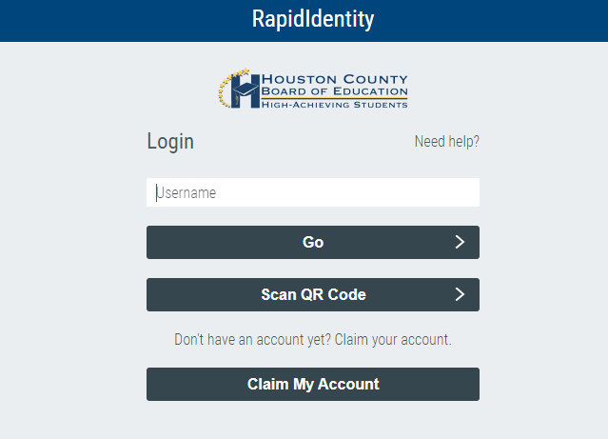
Student Log-in using district Chromebook
Step One: Students will login using their credentials.
Username: First initial + Last initial + Person ID
Password: First initial capitalized + Last initial lowercase + StudentID + '"h"

Slide 12
Student Login for personal devices ONLY
Step one: Access district homepage.
Step two: Click on the SSO Portal tab.

Slide 13
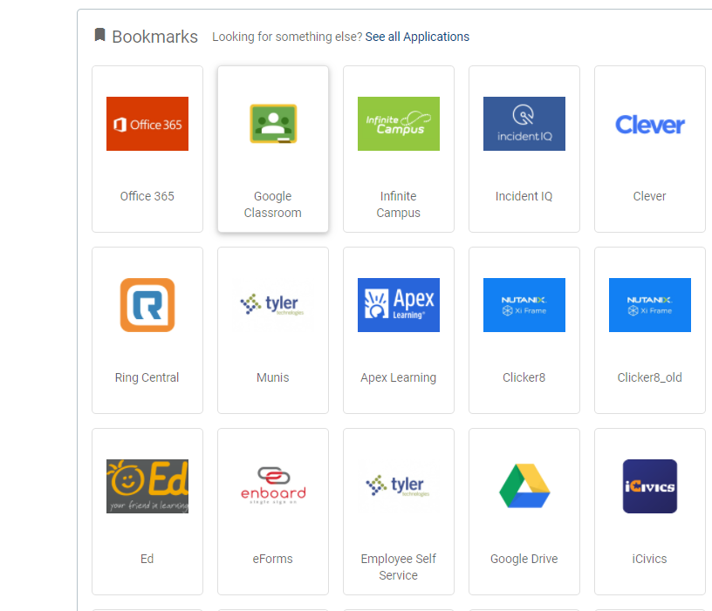
Step Two: Click on the appropriate tile.

Slide 14
Step three: Students will login using their credentials.
Username: First initial + Last initial + Person ID
Password: First initial capitalized + Last initial lowercase + StudentID + '"h"

Slide 15
Step four: Click on the appropriate tile.

Slide 16
District Help Desk
Parents and students may contact the technology help desk at 478-988-6145 from 8:00 a.m. -3:30 p.m.
Support@apexlearning.com
1(800) 453- 1454

Slide 17
Google Classroom
Google Classroom is a web-based learning environment. When logged into Google Classroom, students can collaborate with their peers and teachers. Google Classroom offers a digital safe space for students to view class announcements, access posted course content, view posted assignments, and turn in completed work. Only authorized Houston County users (students, teachers, and other designated staff members) can have access to an Houston County Google Classroom. Google users outside the Houston County network are not granted permission to any Houston County Classroom.

Slide 18
Houston Virtual Google Classroom for Parents...1,2,3
As a guardian, you will receive an email invitation to the Google Classroom for parents(we will use the email address on infinite campus)
In your email program, open your email invitation.
Click Accept. (You can choose the frequency of the emails, such as daily or weekly..)
This will serve as location for:
Pertinent information as it relates to Houston Virtual
Tutorial videos for parents and students
Important documents for parents and students
All zoom links for all courses
Communication between administrators of Houston Virtual and parents
Communication between teachers and parents

Slide 19
Zoom
Zoom meetings are meant to be a time for students and teachers to see each other and learn together. Please follow rules in order to have successful zoom meetings!
Expectations:
Find a quiet space and dress appropriately.
Let all household members know when and where you will be in class, and ask them not to disturb you.
Make sure your full name shows up appropriately.
Be aware of your background, lighting, and noise.
Mute until you are required to talk.
*Classroom teachers may have additional rules in place.

Slide 20
Zoom Tips for Parents
Please have your child log on 2-3 minutes before meeting time.
Set up your child in a well-lit area away from noise and distraction (for example, a table & chair facing away from the TV/electronics or a room separate from where family business is occurring).
Make sure your child is wearing appropriate clothing and is comfortable.
To minimize interruption in learning please have your child sit with water to drink and have them use the restroom beforehand.
If the connection is spotty, or in the event of technical difficulties please exit the meeting and try to reload, contact the county help desk at (478)-988-6145 and/or email your child’s teacher.

Slide 21
Training Resources
HoustonVirtual.net
For training resources on i-Ready, Google Classroom, Zoom, APEX, please log onto www.houstonvirtual.net to view videos available for students and teachers.

Slide 22
Reminder about Zoom Links
All zoom links will be located inside of Google Classroom.
Individual teacher google classroom
Houston Virtual-Middle School

Slide 23
Infinite Campus
All parents should have a parent portal for Infinite Campus.
Please make sure to keep all contact information up to date.
PARENTS FILL OUT PARENT HANDBOOK FORMS INSIDE OF INFINITE CAMPUS.

Slide 24
Grades
Grades will be posted on the 3rd, 6th, 9th and 18th week of each semester inside of Infinite Campus.
Grade weight distribution will be aligned with the district.
Report cards will be mailed home.

Slide 25
For additional questions please contact:
Gracie Barnes
Assistant Principal of Houston County Virtual Learning
Gracie.barnes@hcbe.net
215-8920 ex. 4406

