Slide 1
John Day School District
2025-27 Integrated Application
Notes:
Suggestion: Add district/applicant logo

Slide 2
Contents
Purpose of Presentation
Background & Context
Planning Team
Plan Inputs
Plan Overview
What’s Next
Notes:
Suggested Speaker Notes: Explain that ‘’plan’’ includes your application, budget, and all materials submitted under the IG

Slide 3
Purpose for Presentation
To share what was prioritized in the plan given the range of inputs
To explain how the plan was developed
To hear additional feedback on the plan now that it has been developed
To seek board approval

Slide 4
Background
Integration effort was responsive to requests from educational leaders and state legislators
Combined processes for community engagement, needs assessment, planning, budgeting and evaluation for nine programs
Designed to reduce burden and redundancies and improve the framework by which progress can be measured over time

Slide 5
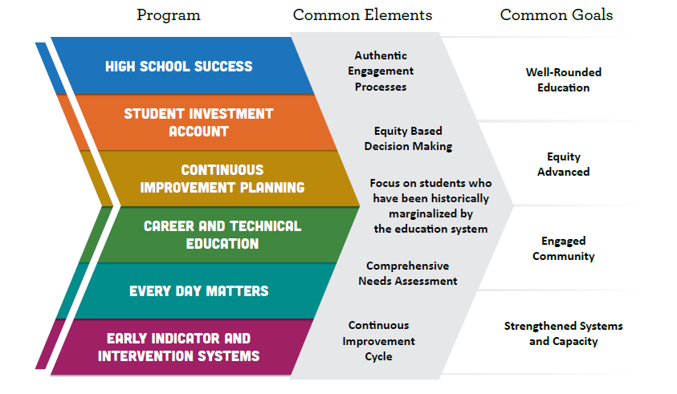
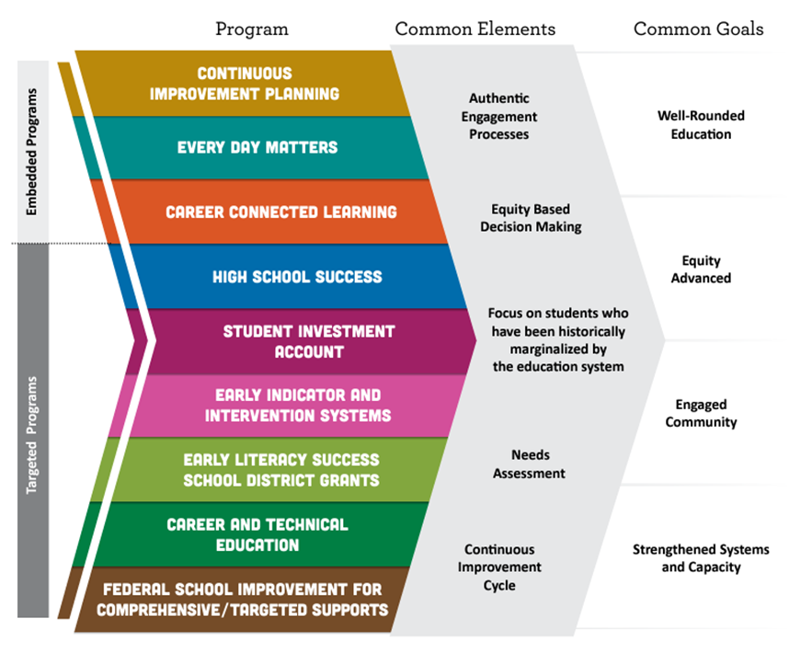
Programs & Common Goals
2023/25 Biennium
2025/27 Biennium

Slide 6
Summary of Program Purposes
High School Success (HSS) - Systems to improve graduation rates and college/career readiness.
Student Investment Account (SIA) - To meet students’ mental health, behavioral needs and increase academic achievement/reduce disparities for student focal groups.
Early Literacy Success School District Grants (ELGSSG) - Grants to school districts in order to Increase early literacy for children from birth to third grade, reduce literacy academic disparities for student groups that have historically experienced academic disparities, increase support to parents and guardians around literacy, and to increase access to early literacy learning through support that is research-aligned, culturally responsive, student-centered and family-centered.
Early Indicator and Intervention System (EIIS) - The development of a data collection and analysis system, in which educators collaborate, to identify supports for students.
Notes:
Link to Integrated Guidance
Focal Student Groups:
Students of color;
Students with disabilities;
Emerging bilingual students;
Students navigating poverty, homelessness, and foster care;
Migrant students;
Students with experience of incarceration or detention;
LGBTQ2IA+ students;
Students recently arrived;
Other students who have historically experienced academic disparities.

Slide 7
Community Engagement/Needs Assessment Highlights
What we see through survey engagement
Improvement is happening
Testing Issues
Improve Communication
Appreciation for Elective Options
Need to Have Everyone Know the System
Notes:
Speaker Notes:
Critical in sharing information about engagement with focal groups is care about ensuring privacy and safety (additional notes below).
Detail which focal groups your district team engaged with.
Describe a few of the strategies and activities you used to engage with the community. Additional slides may be added with photos or other artifacts.
Summarize key learnings from engagement and how that information was used when assessing needs and considering priorities for planning.
Notes on Safety/Privacy
Since many focal groups have historically and/or are currently experiencing incidents of violence and harm due to their identities, special care must be taken when undertaking engagement efforts with these groups. For LGBTQ2SIA+ students, it is important to not inadvertently out a student’s sexual orientation or gender identity when they may otherwise not be out to their family, peers, and/or some school staff. Migrant students and emergent bilingual students and their families should not have immigration status, refugee status, or other information become public. This is particularly important in communities that have experienced unwelcoming or traumatic events against undocumented immigrants.
An excellent resource to consider when planning engagement efforts and sharing with the community, such as at board meetings, is the ODE Ensuring Focal Student Group Safety and Privacy resource. In one example, working with a trusted community partner or intermediary is recommended as a strategy to gather and share back student feedback in a safe manner.
In many cases, the data that is needed to make assessments about plan creation and implementation does not need to include identifiers like name, place, grade level, etc. Patterns from the data collection can still be analyzed and reported upon in a board meeting without these identifiers.
Above all, it is critical to maintain confidentiality, ensure that your data security practices are maintained, and to honor any agreements you made in the engagement space, (for example not sharing any stories or anecdotes that were expressed.)

Slide 8
These priorities emerged:
Continue mental/emotional support
Continue intervention support
Support well-rounded education
Support after-school activities
PD for Teachers
Continue community engagement
Notes:
Suggested Speaker Notes: Through our community engagement efforts, our needs assessment process and examination of data, these priorities emerged.
Offer transparency where there may have been competing interests or limits to funding (tiered funding coming in a later slide) and how the district considered input and possible impact in order to make decisions

Slide 9
Our intended outcomes are:
Greater student mental well-being through increased access to timely and high-quality mental health support in schools
Reduce the disparities of achievement for our students served by IDEA & demonstrate proficiency in meeting state benchmarks for all students
Create a well-rounded education for students
A system and culture is established where the school is the nucleus of the community and fosters ongoing community engagement, and develops a strong positive culture with students
K–3 students will demonstrate increased proficiency in early literacy skills
Notes:
Suggested Speaker Notes: These reflect the priority work we are setting forward in our plan. These are our long term goals or outcomes.

Slide 10
These key strategies will help us achieve our intended outcomes:
Create a clearly aligned, research-based, high-quality system of social, behavioral, emotional, mental, and physical health support for K-12 students
Greater student mental well-being through increased access to timely and high-quality mental health support in school
Create & maintain supports to administer specially designed instructions by specialists for students served by IDEA
Invest in professional development opportunities for staff to create high quality educators to enhance curriculums
Continued investment in curriculum, class electives, and afterschool activities to enhance classes to create new options for students.
Invest in community engagement
Strengthen school cultures throughout schools creating school pride with a safe and welcoming building
Notes:
Suggested Speaker Notes: These are the specific projects, tactics and approaches that will help us achieve our outcomes. You may wish to organize this share by grade band strategies, focal group strategies or even name some of the program specific strategies.

Slide 11
Key Investments:
Program Amounts
SIA | HSS | Early Literacy | EIIS | Total:
$587,630.70 | $152,498.27 | $62,546.20 | $1,441.98 | $804,117.15
Counselors / Intervention programs
Curriculum and supplies
Technology upgrades
Summer learning opportunities
Community engagement support
After school opportunities
Professional development opportunities
Maintain programmatic offerings
Investment in school culture/pride
MAP and AIMSWEB
Early literacy high dose tutoring
AVID
CTE program development
Link to Full Budget
Notes:
Suggested Speaker Notes: Share key investments and offer time for participants to view the complete planning and budget template while offering context for how the major investments/categories forward your strategies and support positive growth toward your intended outcomes.
This is where the district has posted our application and Integrated Planning and Budget Template on its website

Slide 12
Longitudinal Performance Growth Targets (LPGTs)
ODE will co-develop Longitudinal Performance Growth Targets with grant recipients, based on:
Data available for longitudinal analysis;
Guidance established by the department; and
Overall and disaggregated rates for the following metrics:
Third-grade reading proficiency rates measured by ELA
Ninth-grade on-track rates
Regular attendance rates
Four-year or on-time graduation rates
Five-year completion rates
*Grantees may also set local optional metrics
Notes:
Suggested Speaker Notes: Applicants at or under 80 ADMr OR Applicants who do not receive SIA funds can delete this slide
For the Student Investment Account, growth targets are required in the areas shown.
We have been asked to develop draft LPGTs to submit with our Integrated Application due this March. Once ODE reviews and approves our plan, they will partner with us, as required by SIA legislation to further co-develop and finalize these growth targets. Our finalized growth targets will then need to be reviewed and approved by the board within the context of our grant agreement.
[You may add slides to show the draft targets or a hand-out if you wish to present them as drafts now, reminding participants that the final targets will need to be reviewed by the school board in the grant agreement coming later this spring or summer. ]

Slide 13
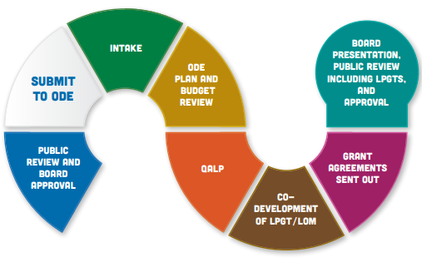
What Happens Next?
WILL RETURN TO PRESENT TO
THE BOARD
*
WE ARE HERE
‹#›
Notes:
Suggested Speaker Notes: Each application will undergo a thorough evaluation process for approval; after which, it will be known as an integrated plan. The timing for this process is outlined on the slide. There are a number of variables, including when applicants submit their initial application and any required follow up of submissions, that can impact these processes.
Additional information as necessary: *QALP(Quality Assurance Learning Panel) will occur simultaneously as the ODE Plan and Budget Review for a randomly selected number of districts. QALP is composed of community members who observe as a quality measure overseeing the review process and requires no additional input from districts.

Slide 14
Questions & Comments
‹#›

