Slide 1
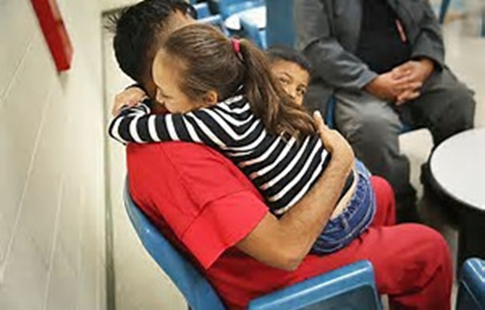
Community Resources
Counseling for students with incarcerated parents/family members
This is for students ages 10 to 16. For more information contact Catholic Social Services 251-434-1550

Slide 2
Community Resources
Food Assistance
At the Love Mission (in the old Wilmer Elementary Bldg.) on Tuesday, Thursday, and Saturday mornings at 6:00- a.m.
First come, first serve basis

Slide 3
Community Resources
A program designed to help you deal with addictions, hurts, habits, and hang-ups
Monday Evenings at 6pm in the old Wilmer Elementary Bldg.
For more information contact 251-649-0985

Slide 4
Community Resources
Family and/or Financial
Counseling Services
For more information contact Lifelines Counseling Services at 251-602-0909

Slide 5
Community Resources
Adult & Youth Service Provider
Substance Abuse Services
Inpatient mental health services
Outpatient mental health services
For more information contact Alta Pointe at 251-450-2211

Slide 6
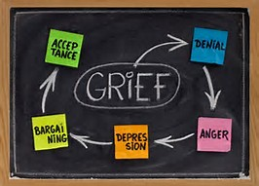
Community Resources
Grief Counseling
For more information contact Bay Area Grief Coalition at 251-721-2209

