Slide 1
Aloha! E Komo mai!
Mrs. Lam’s 1st Grade 2023-2024

Slide 2
Our Ohana
“Ohana means ‘family’. Family means nobody gets left behind. Or forgotten.”

Slide 3
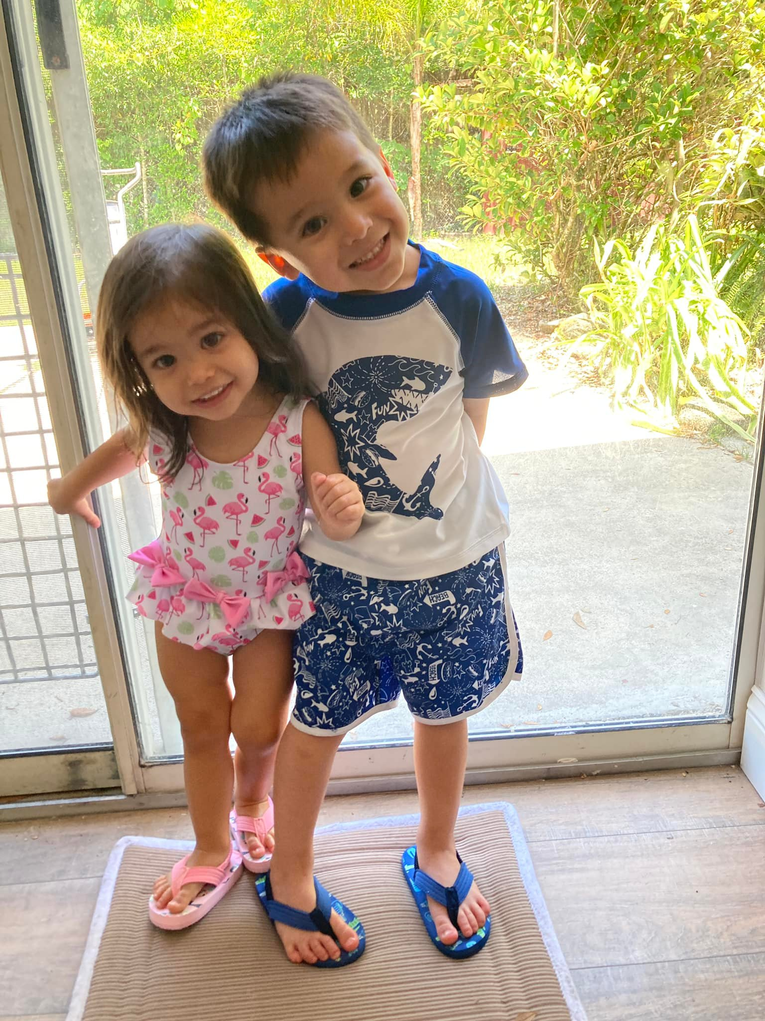
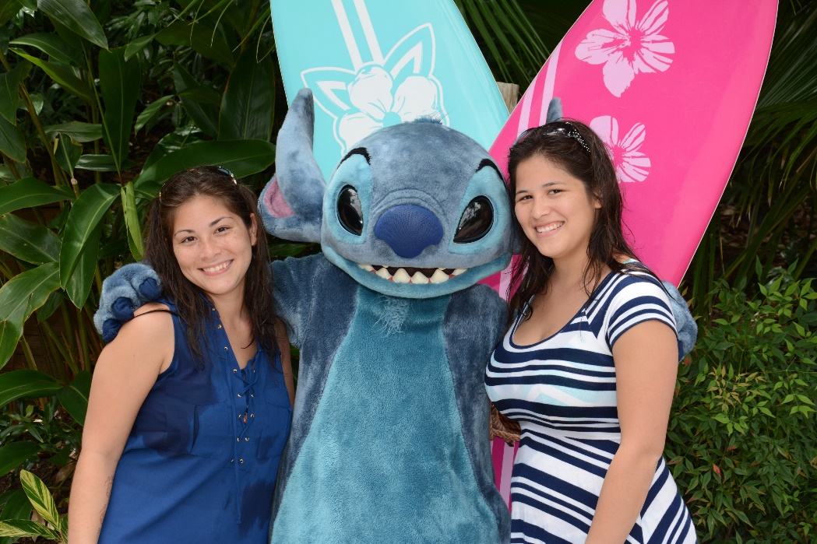
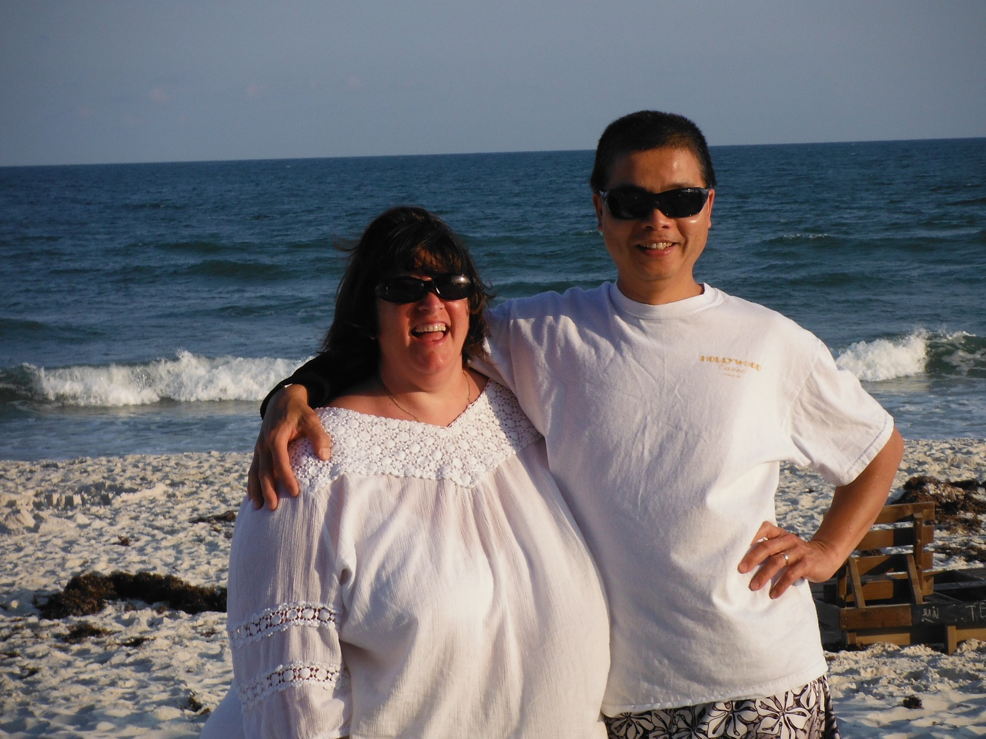
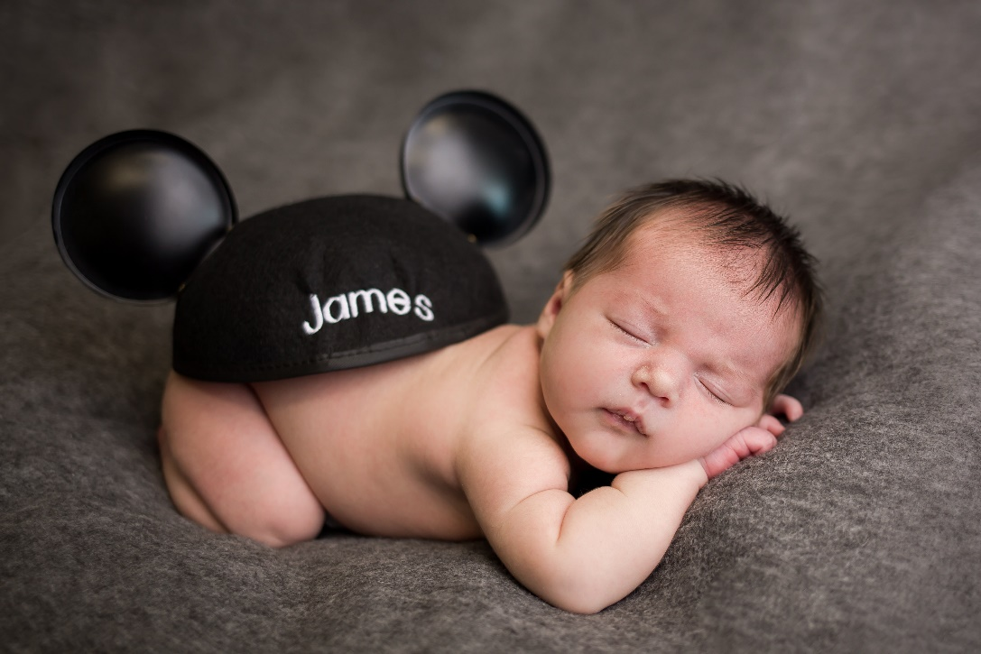
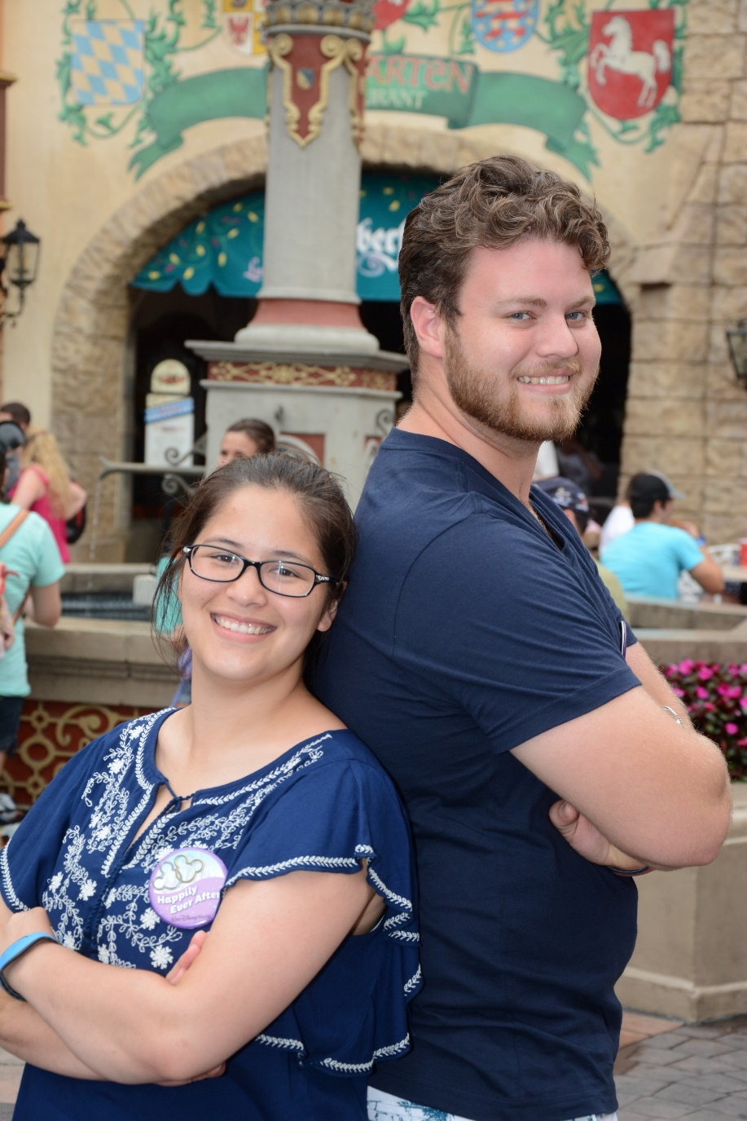
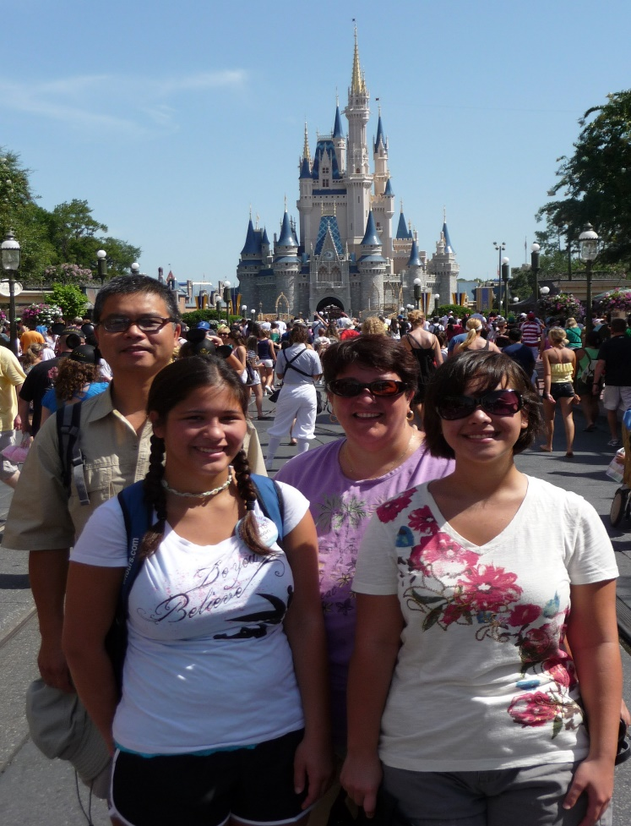
Welcome to my family

Slide 4
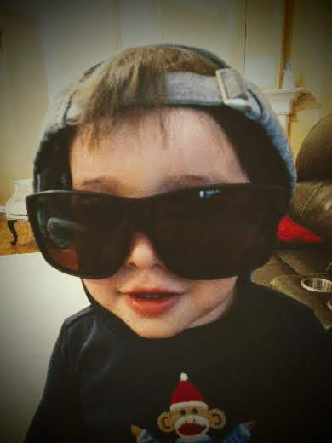
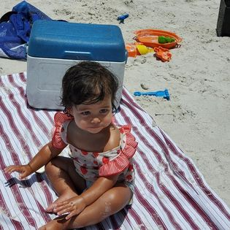
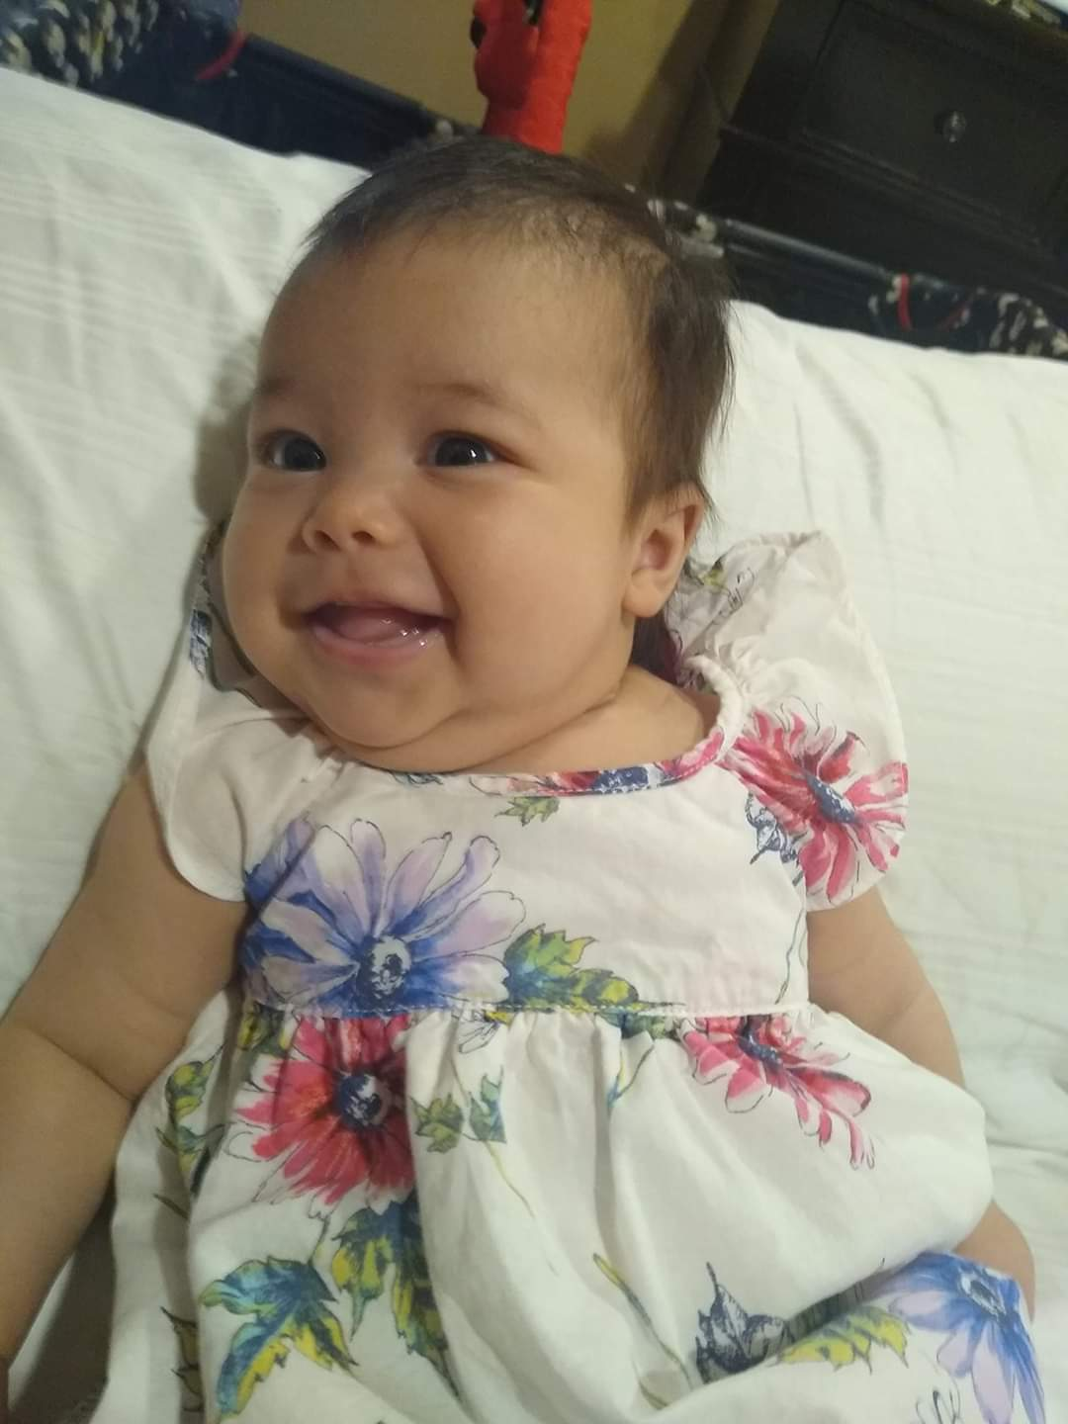
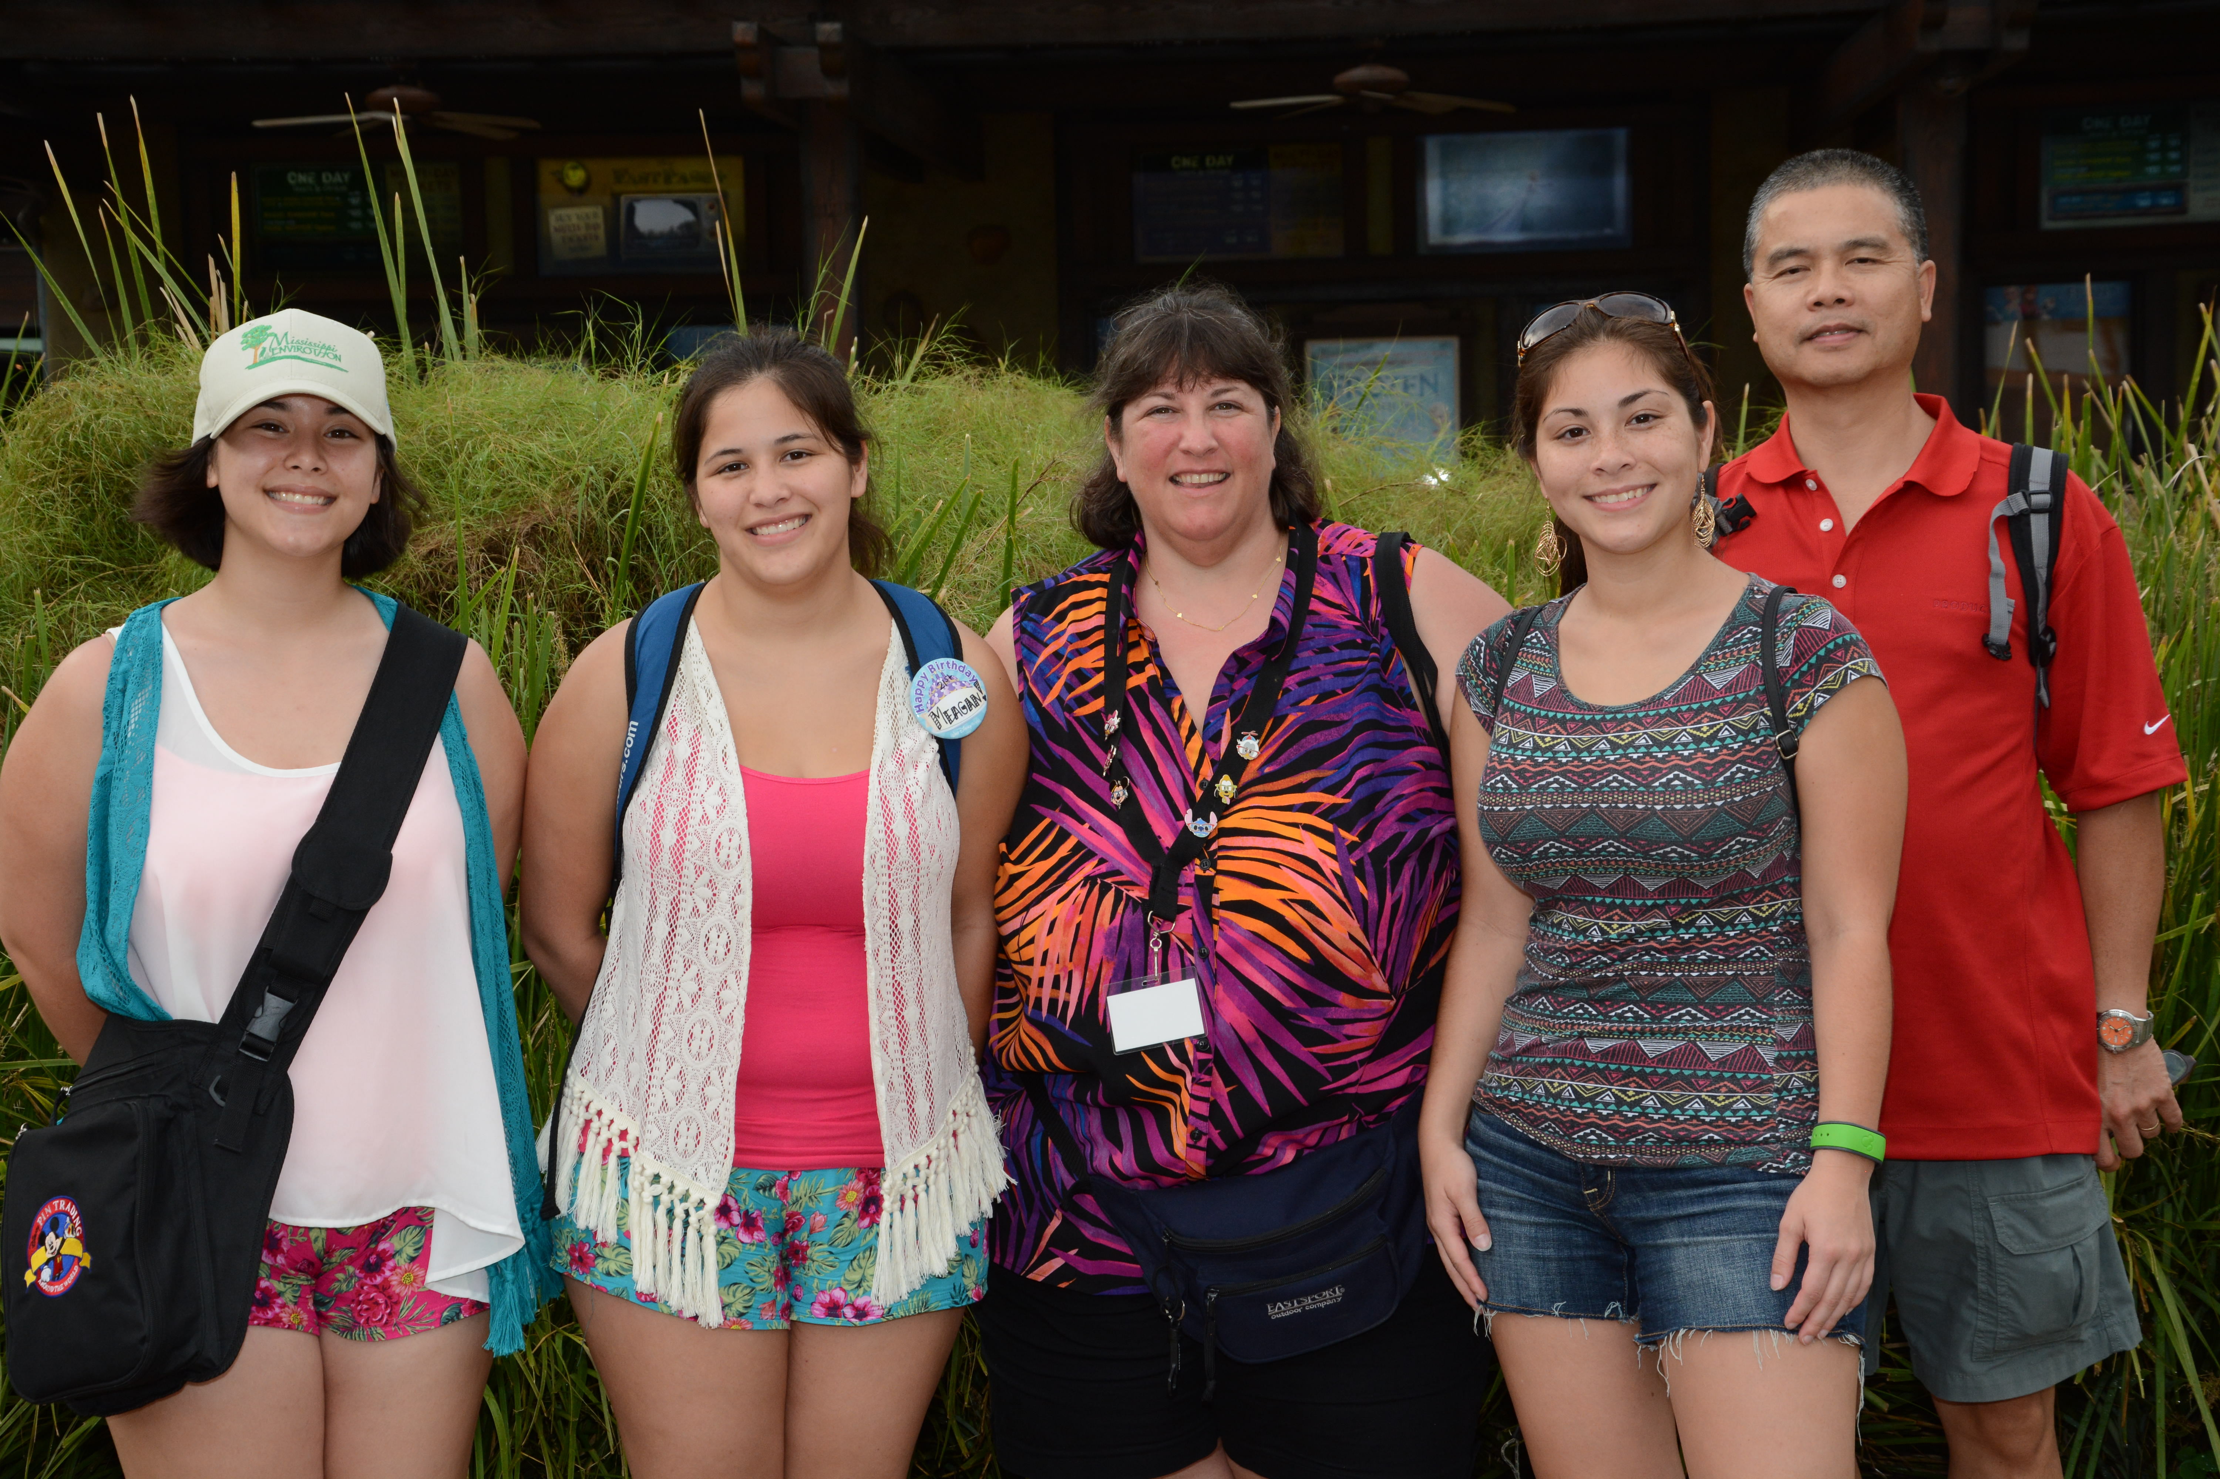
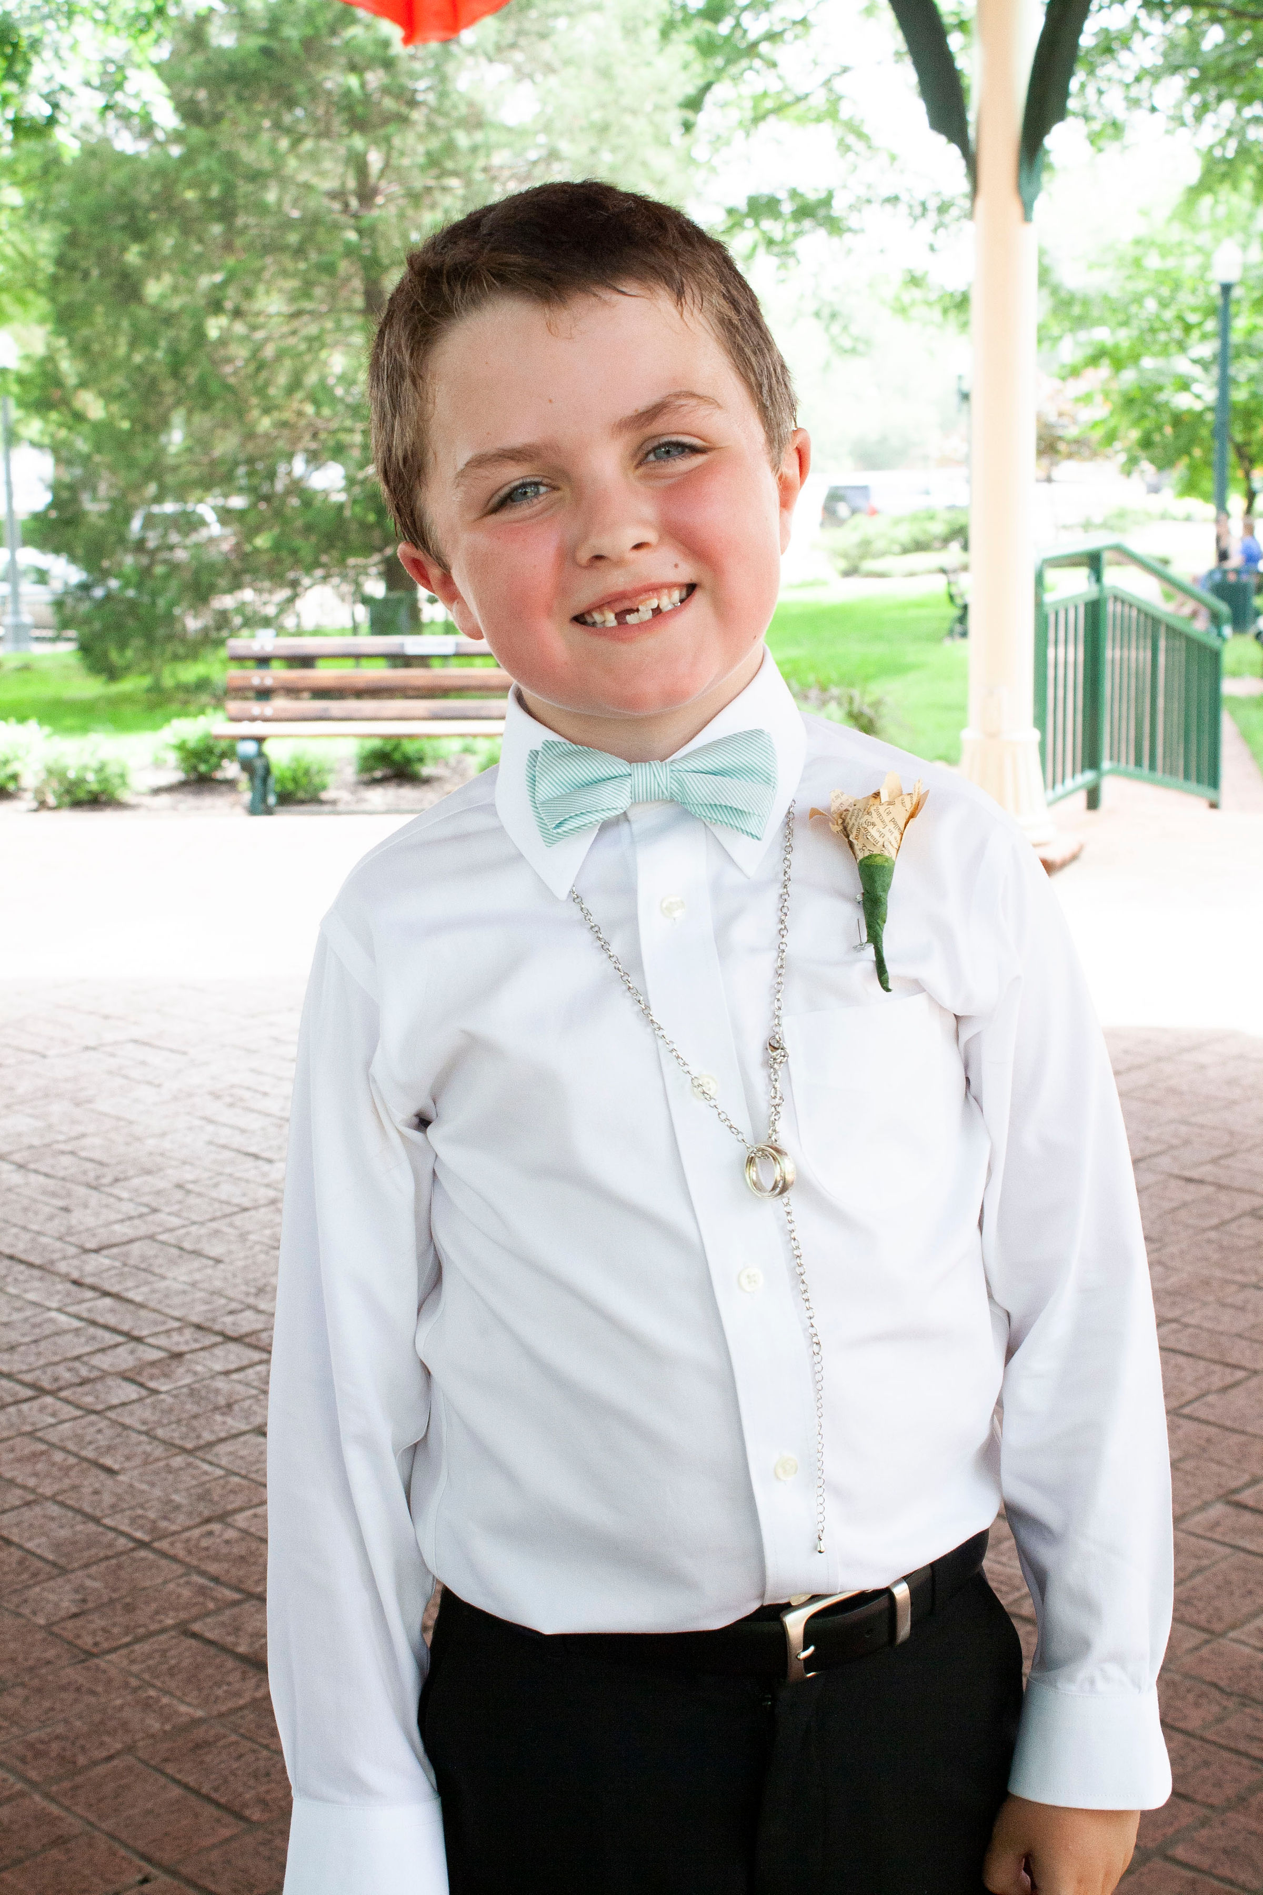
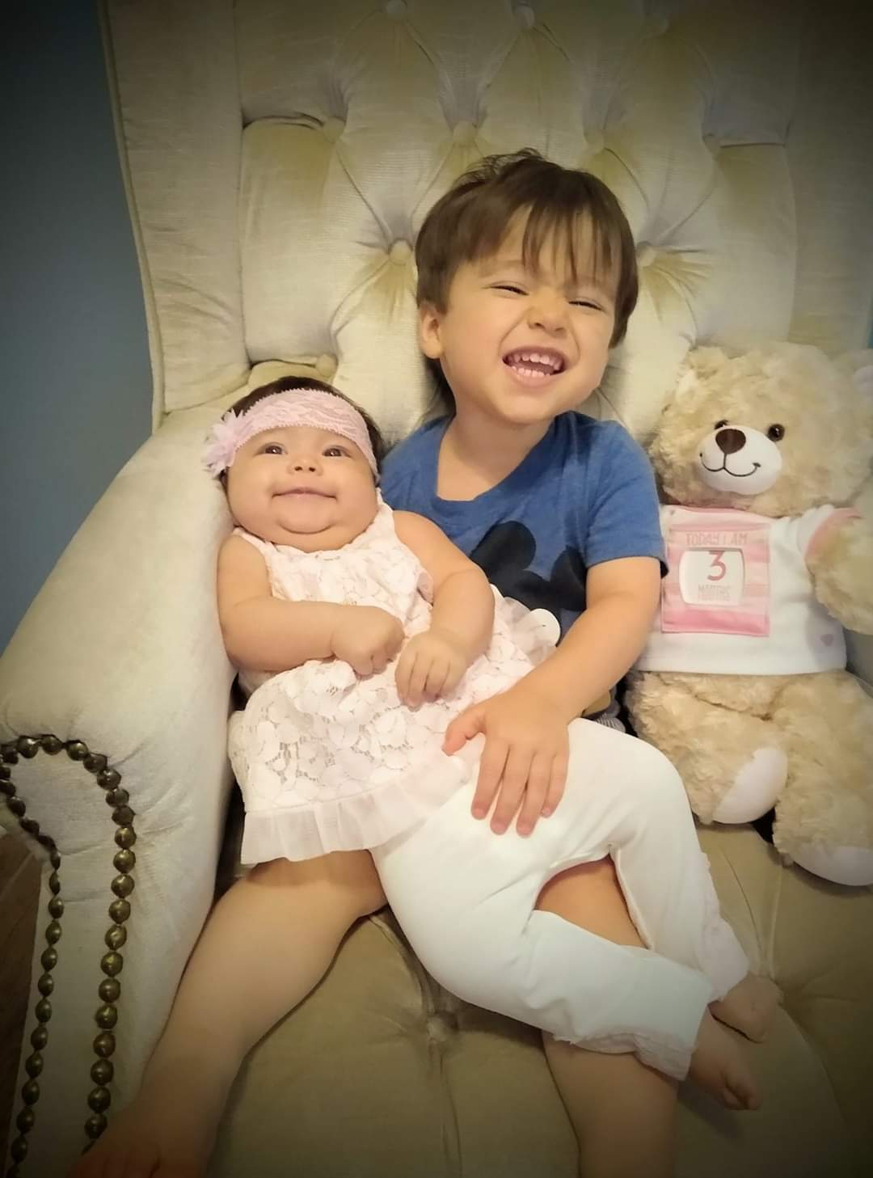
Welcome to my family

Slide 5
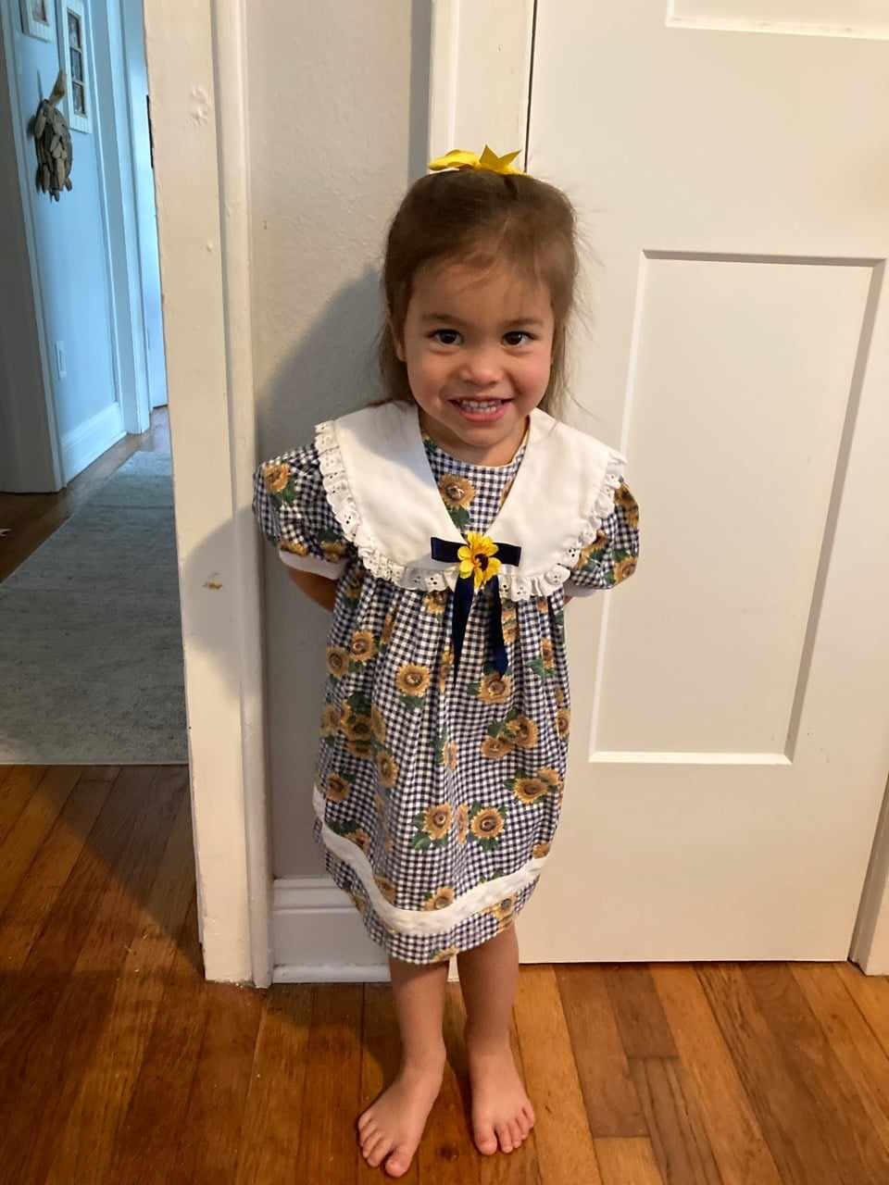
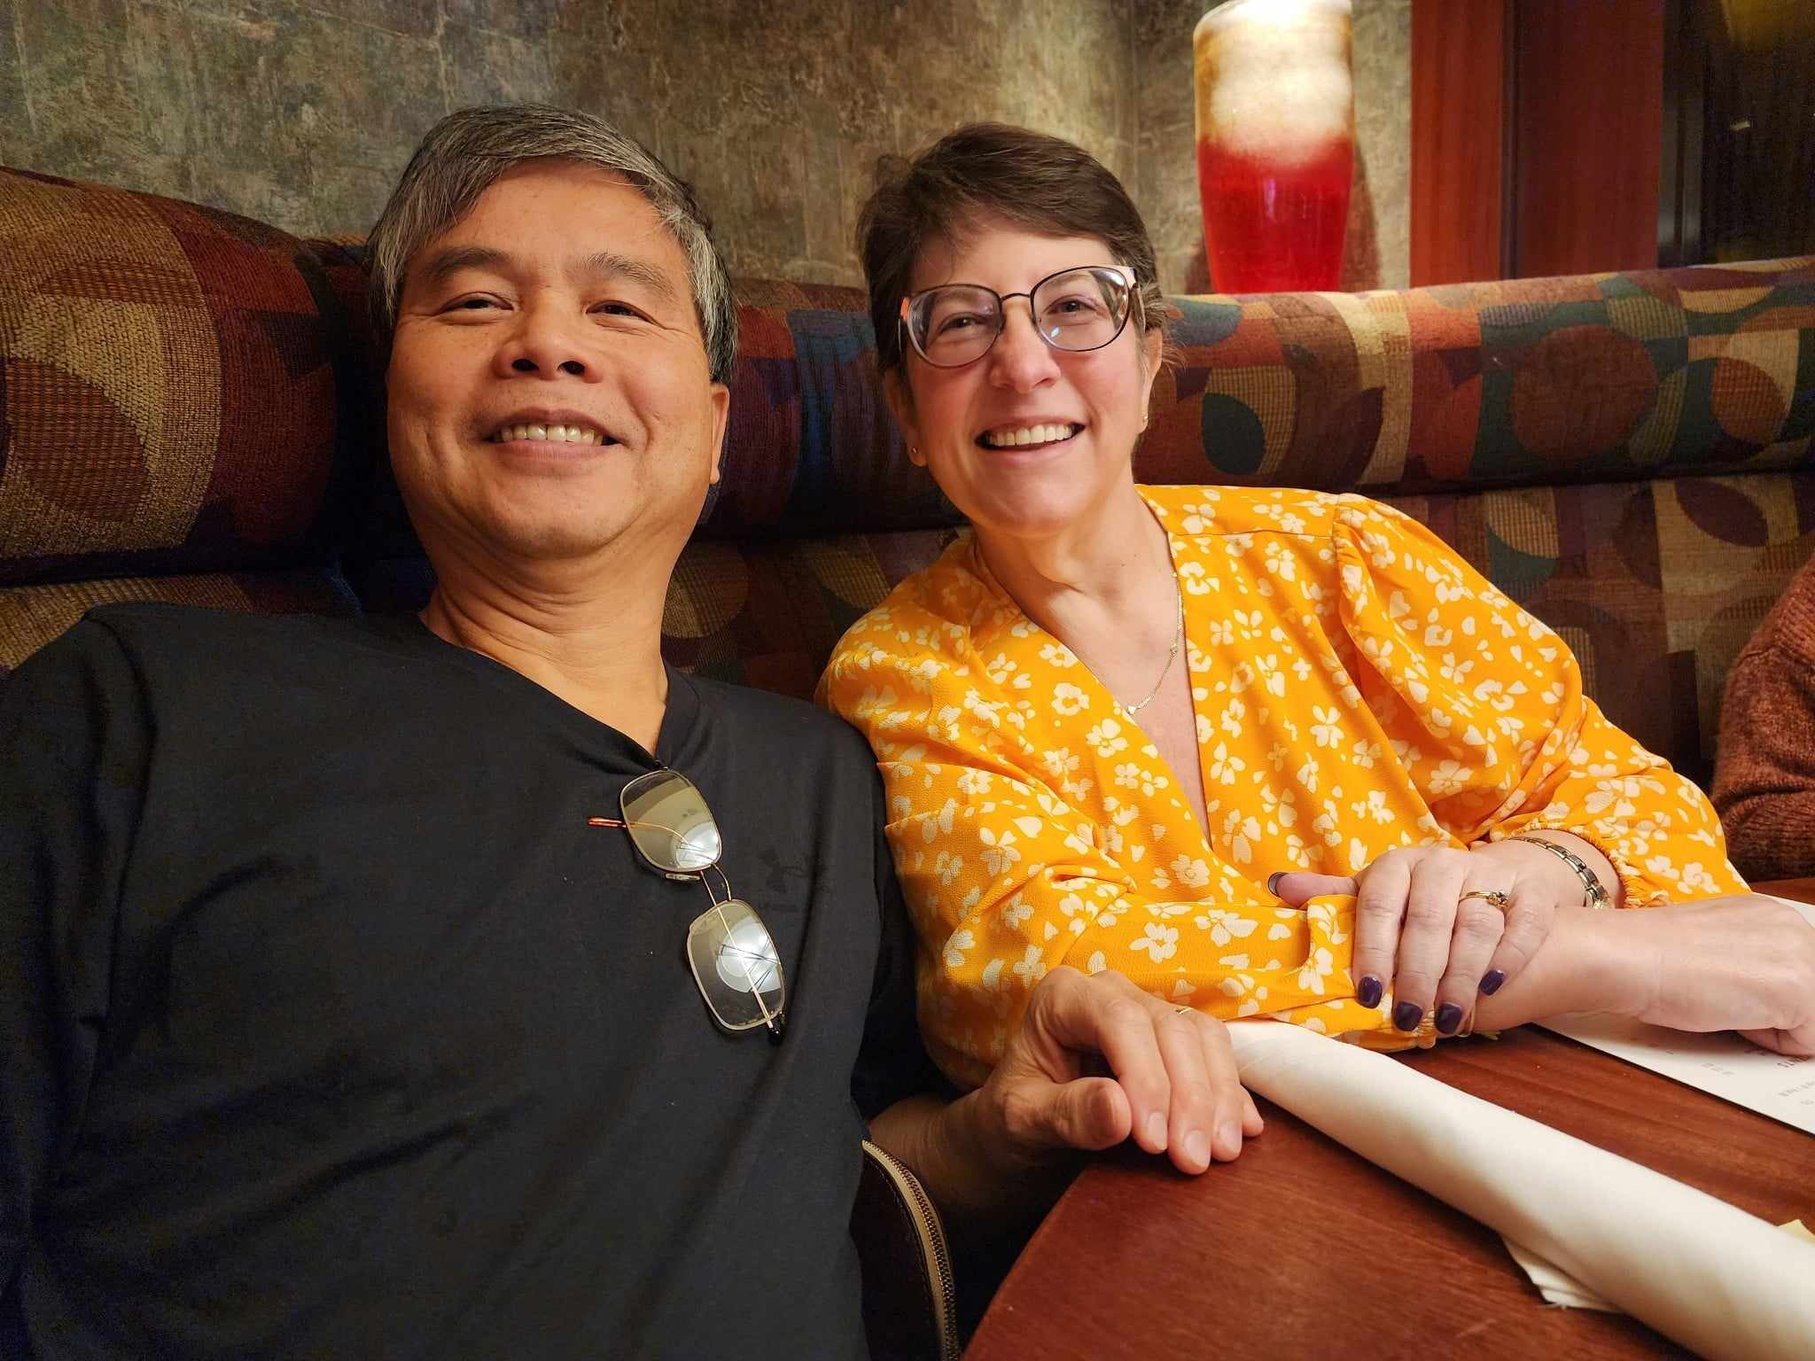
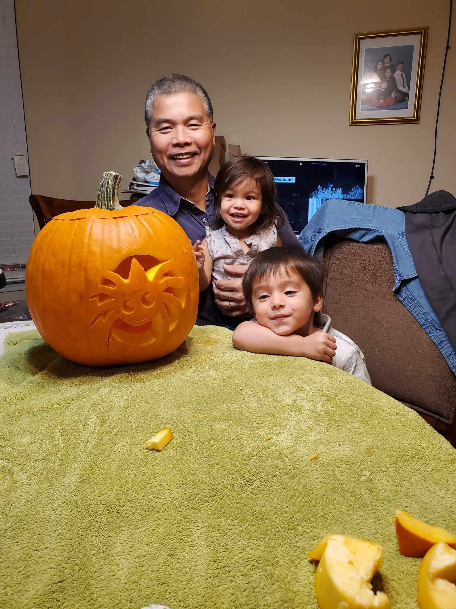
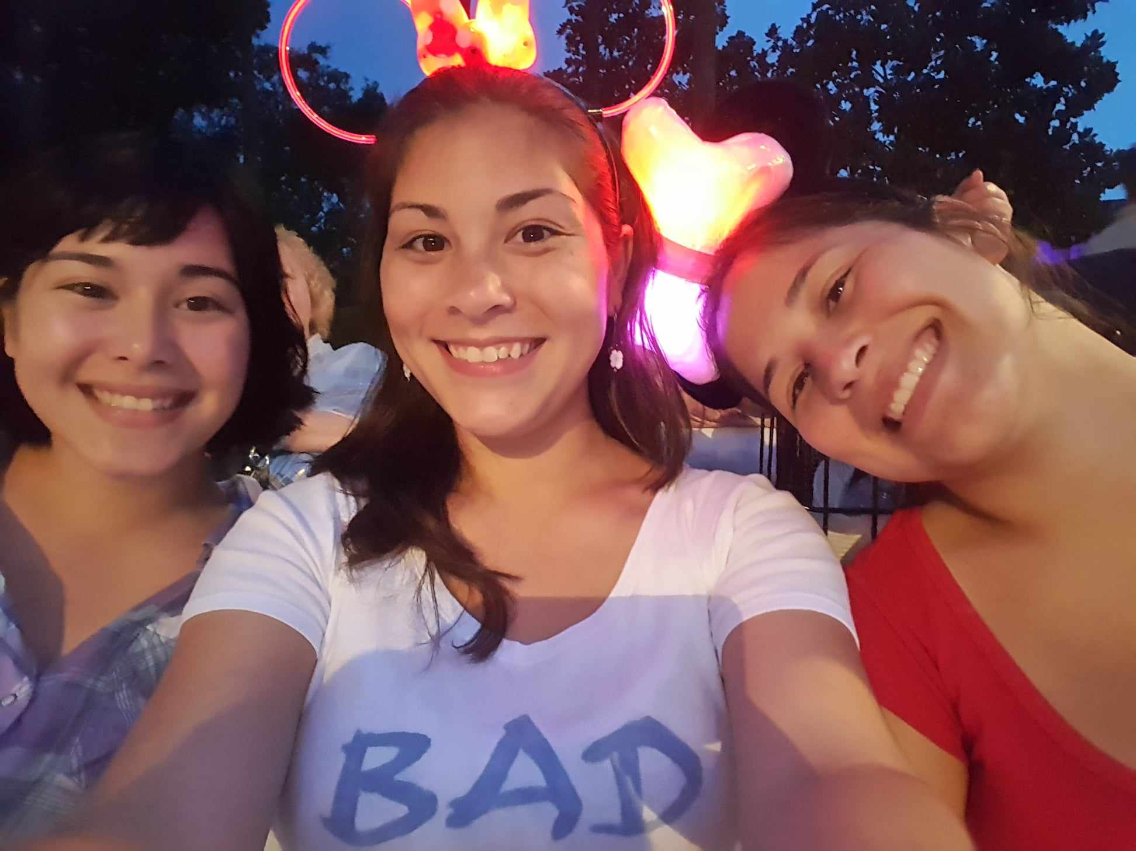
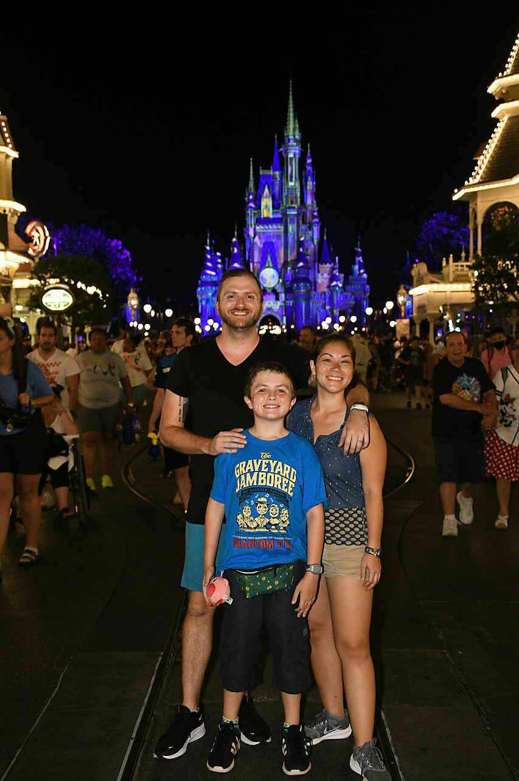
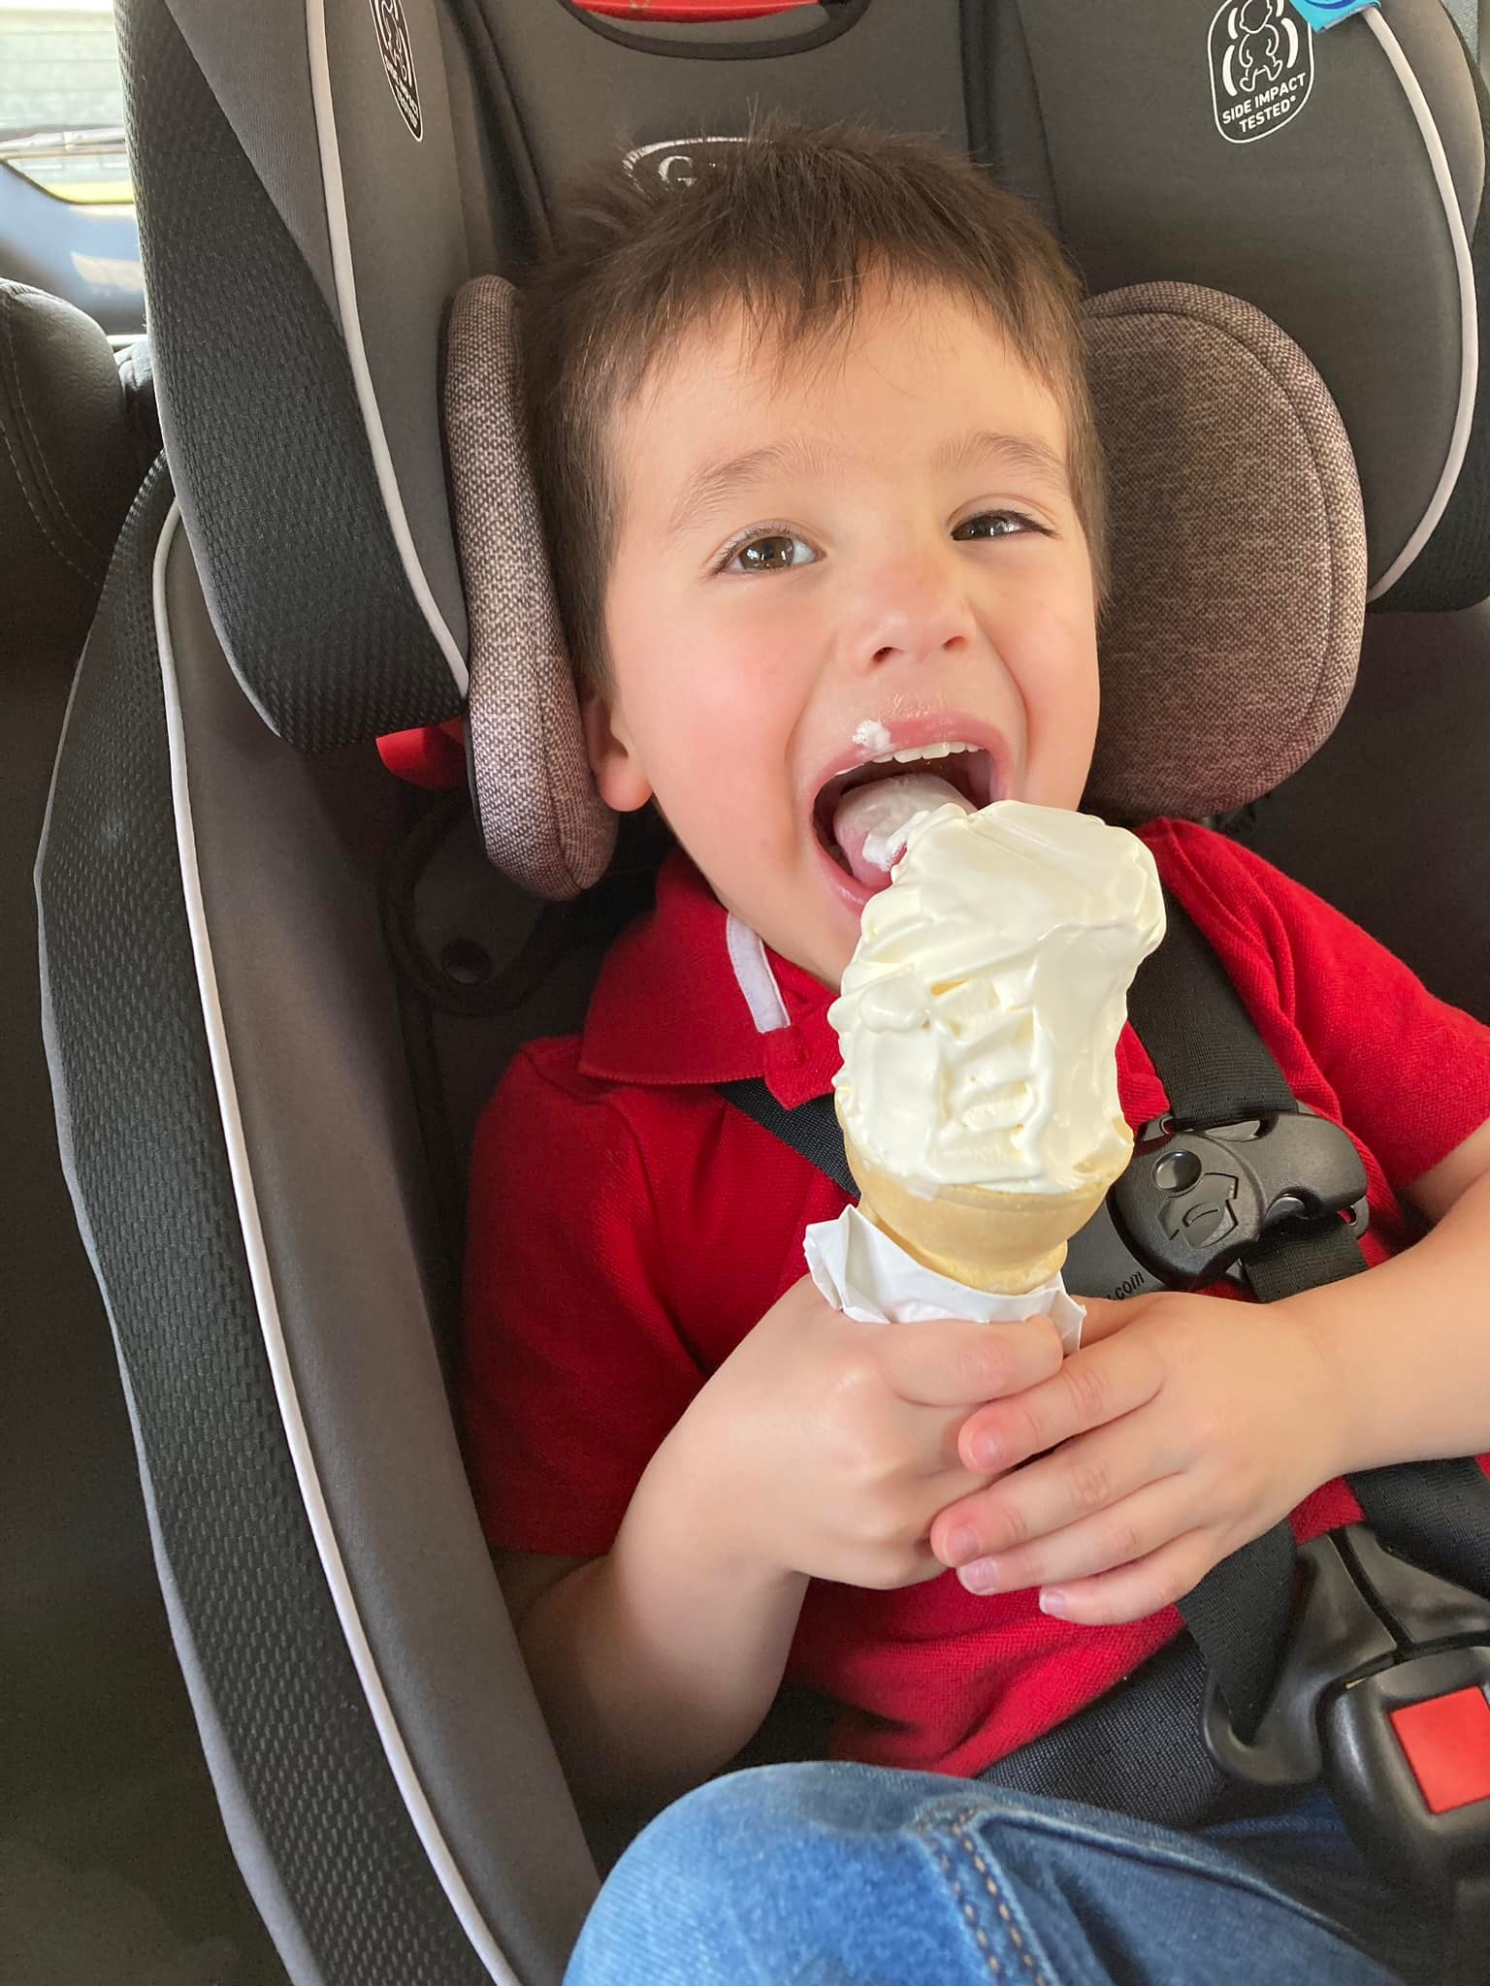
Welcome to my family

Slide 6
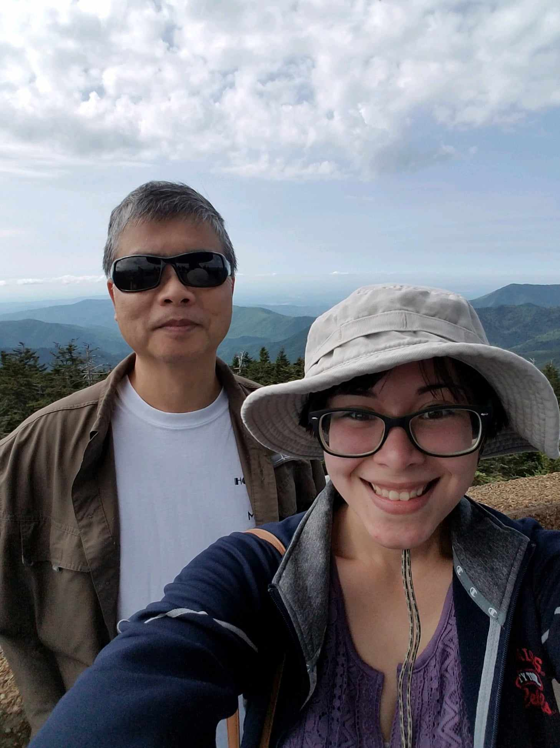
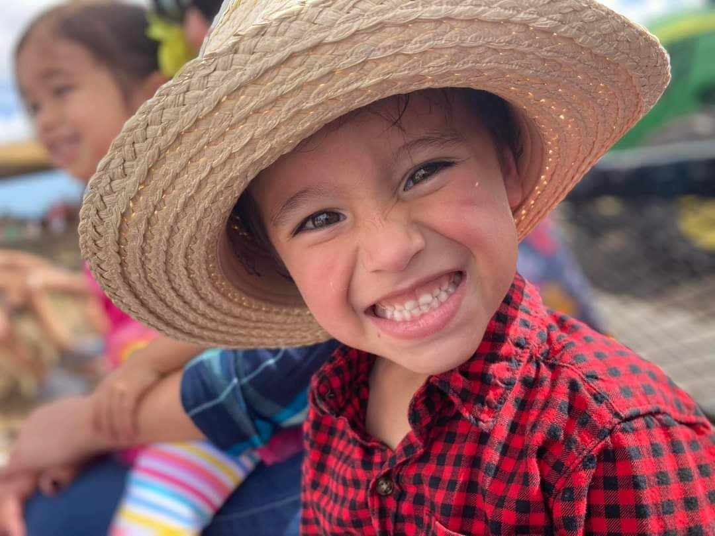
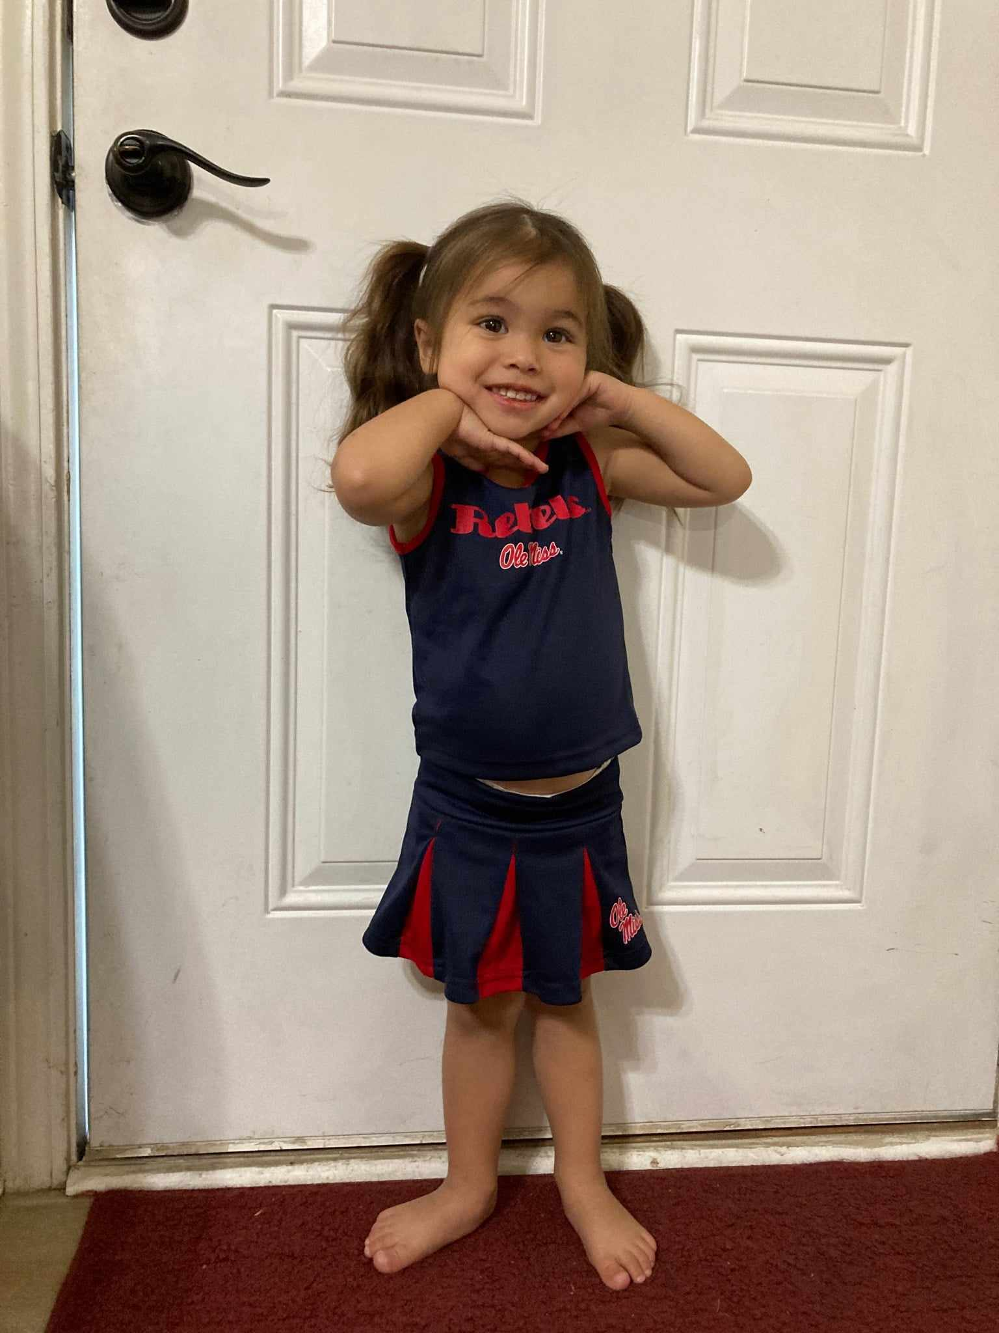
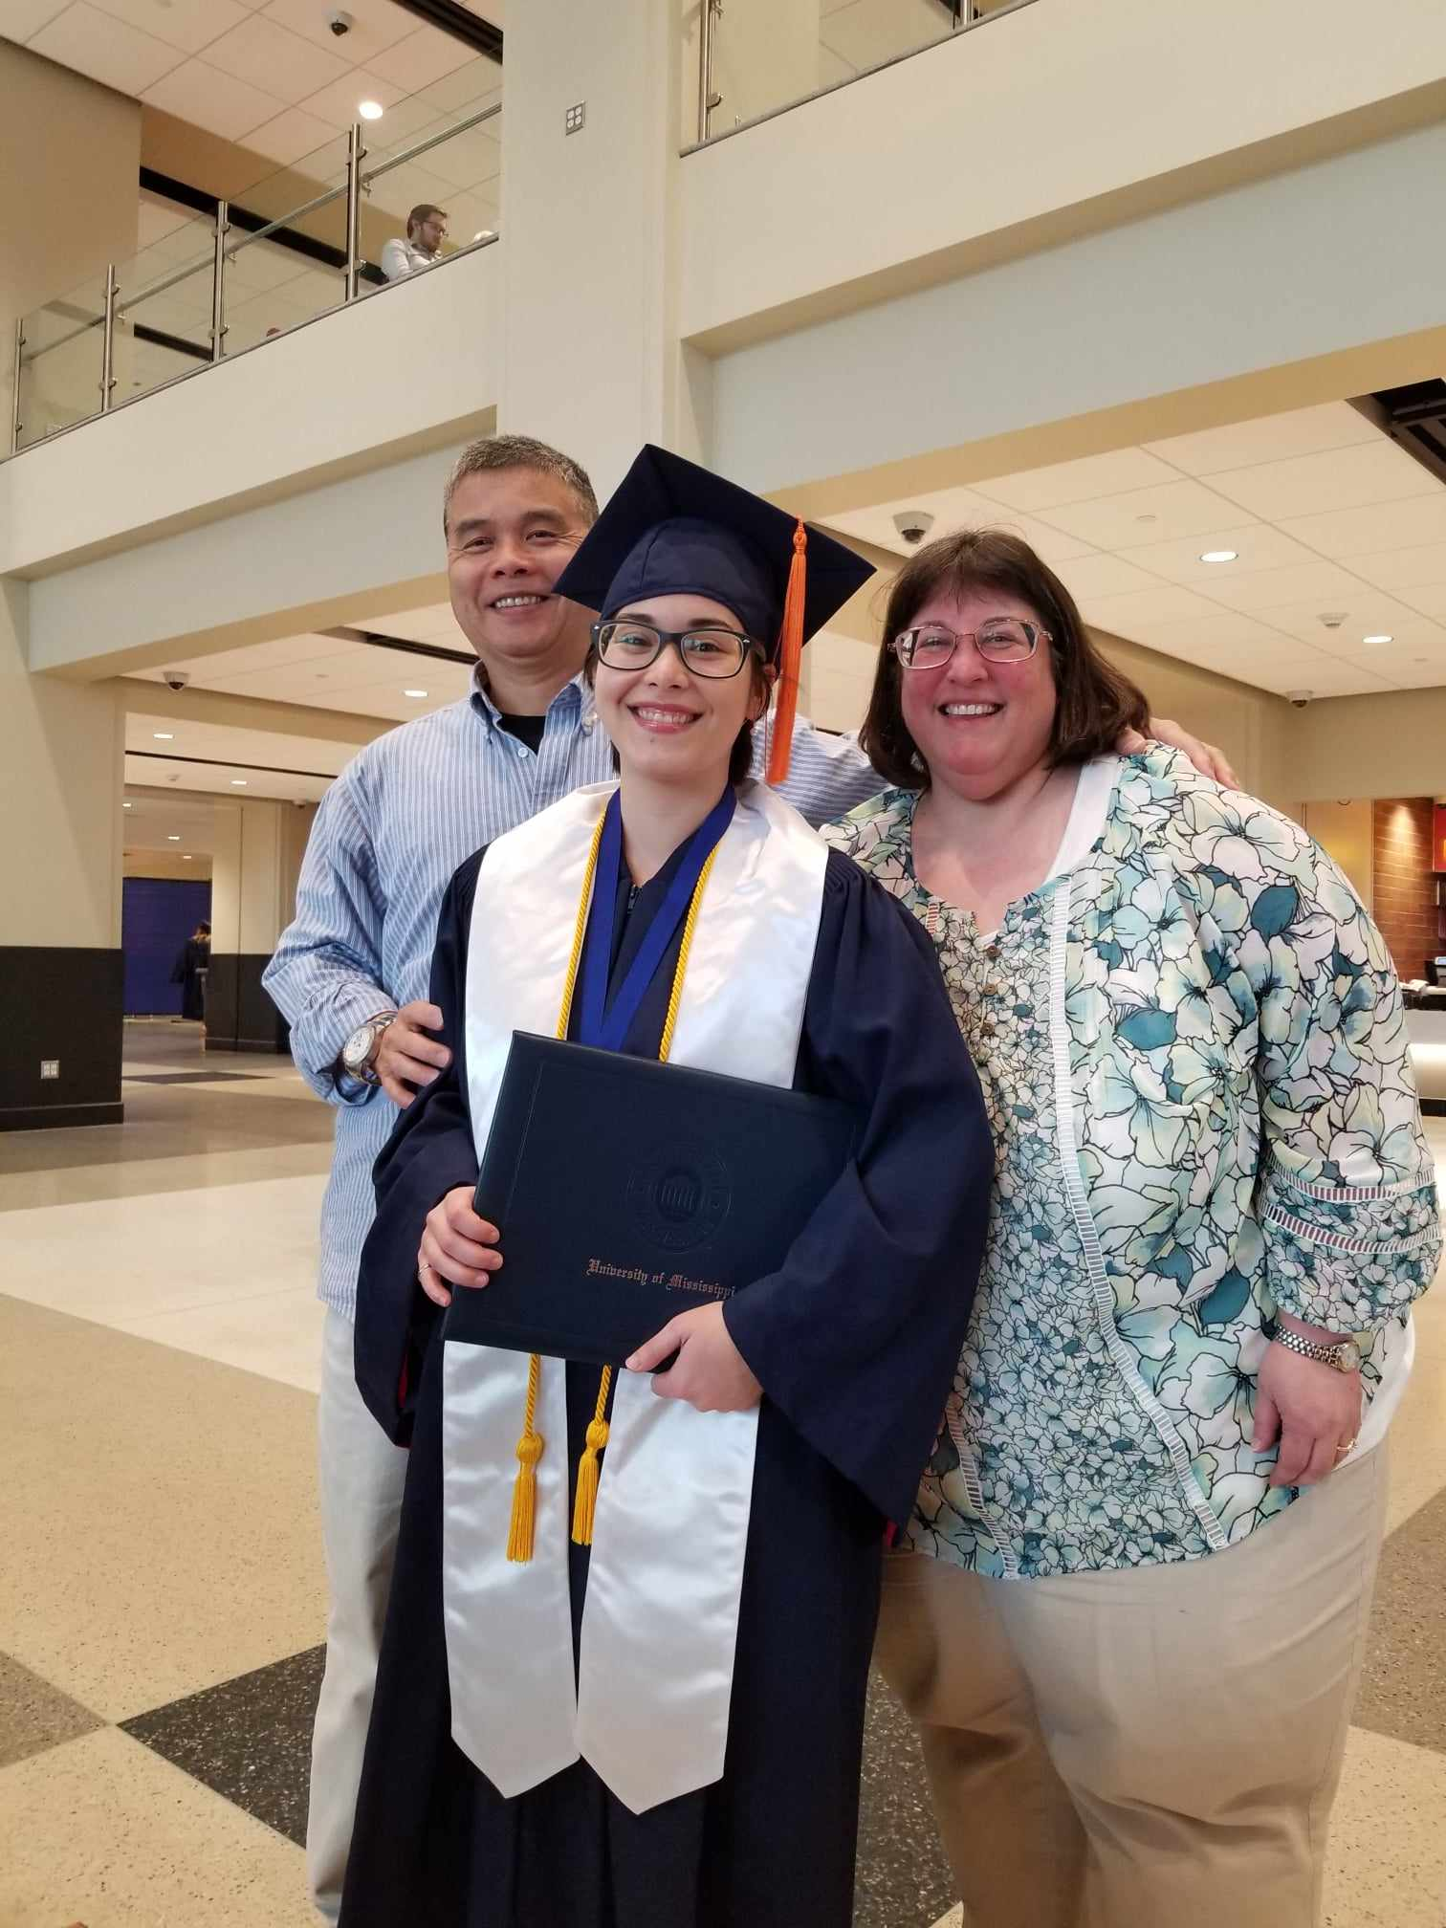
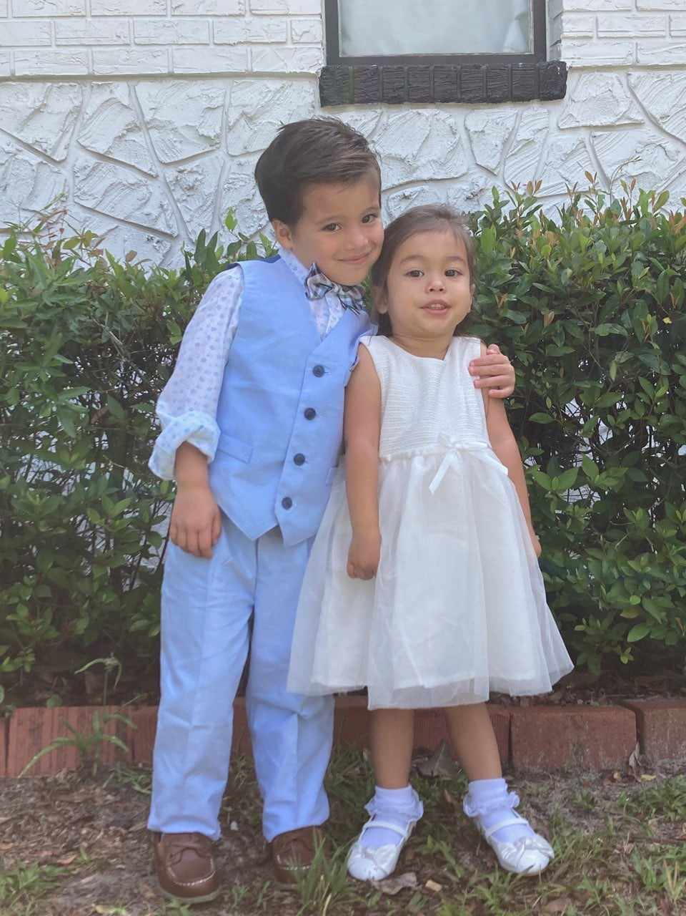
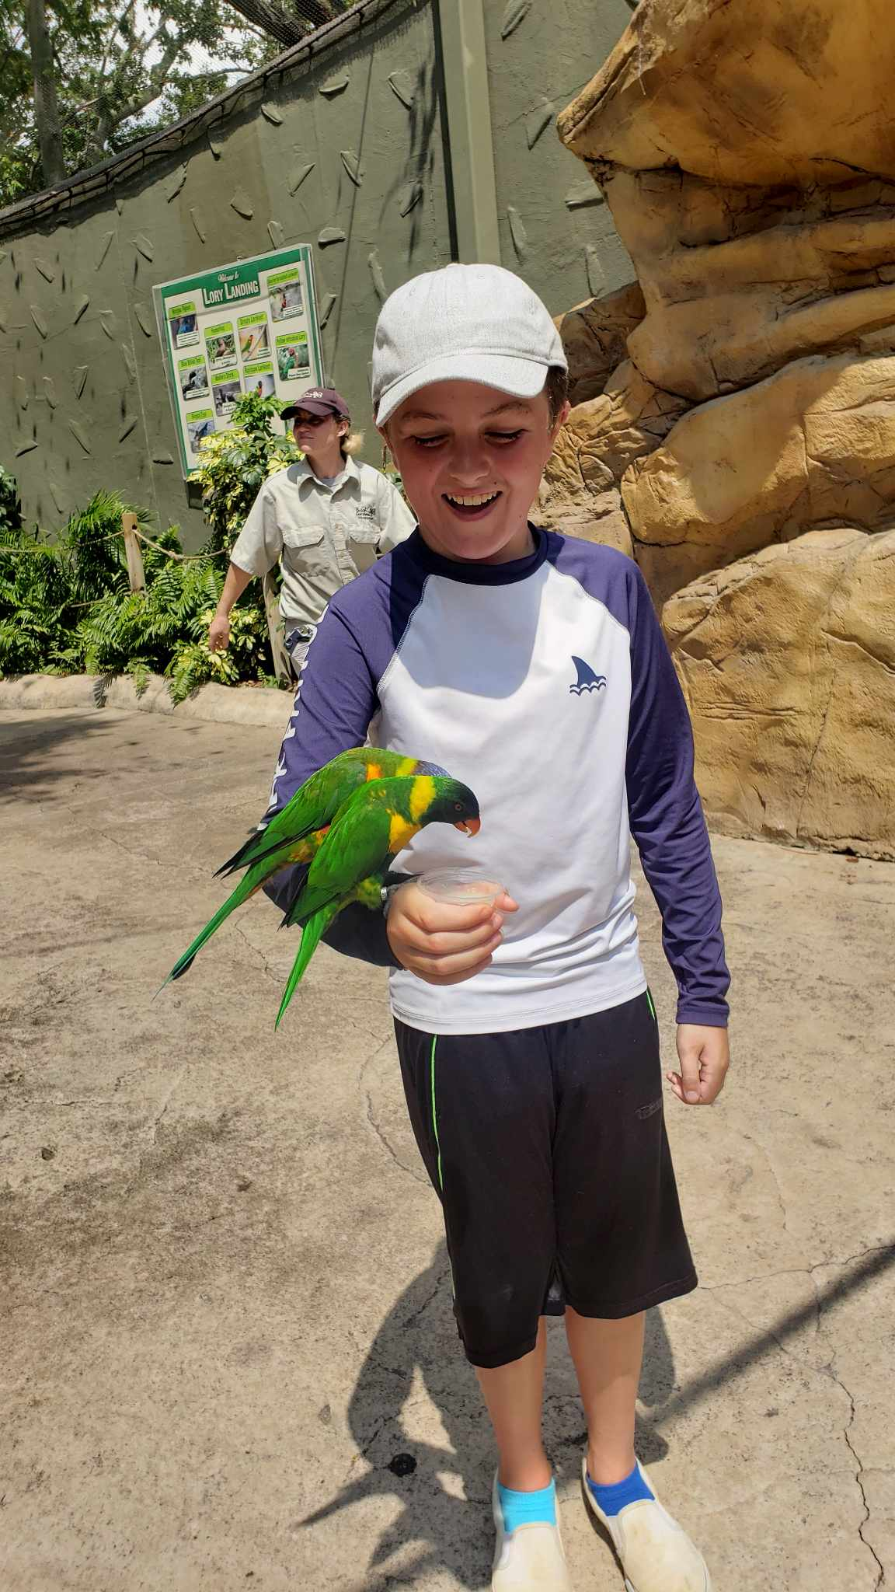
Welcome to my family

Slide 7
Our family mission:
Mrs. Lam’s class is a family. We are bound together to build a foundation for excellence through academic, behavioral, and social success.

Slide 8
Contact Information:
WES phone number: 662-781-1280
Access to Mrs. Lam’s website is through WES.
wes.desotocountyschools.org
Click on “School Staff & Teacher Websites”
Find “Lam, Shannon”
It is best to email me if you have immediate questions:
Shannon.Lam@dcsms.org

Slide 9
Classroom Expectations:
Pay attention to teachers
Listen carefully and follow directions
Use a quiet, inside voice
Keep hands, feet, and objects to yourself
ALWAYS be kind
Follow the Gator Goals

Slide 10
Classroom Consequences:
Green: Good day
Yellow: Warning
Orange: Verbal warning AND march 5 minutes of recess
Red: Verbal warning AND march 10 minutes of recess AND parent contacted
Blue: Verbal warning AND march all of recess AND parent contacted
Mrs. Lam reserves the right to forego warnings depending on severity of actions.
All offenses will be documented in a discipline log.

Slide 11
Classroom Procedures:
Entering the classroom:
Enter the classroom quietly.
Unpack backpack.
Eat breakfast.
Keep out Take Home Folder so Mrs. Lam can look at it.
Get out iPads and headphones.
Complete morning work.

Slide 12
Classroom Procedures:
Visitors:
From time to time, other adults will come into the classroom to observe us. When there are visitors in the classroom, you must remain focused on your assignment. You are not to acknowledge when visitors come into the classroom, unless told otherwise by Mrs. Lam.
There will also be times when I may stop momentarily to answer a question for another adult. In these instances, it is imperative that you remain quiet and respectful.
Substitute Teachers are to be treated with the same respect and kindness as Mrs. Lam and Mrs. Nikki.

Slide 13
Classroom Procedures:
Getting Your Attention:
When I say, “Give me 5,” raise your hand and get quiet.
When I say, “Waterfall, Waterfall,” Respond by saying, “SHHHHHHH.”
Walking in the hall:
Walk in a single file line.
Walk on the squiggle line or 3rd block.
Remain quiet in the hall at all times.

Slide 14
School Status and Clever:
School Status
This is a school sponsored app I will use to text and call parents. I will send a text from this number when school starts so you will know the number to text me back if needed.
Clever
This is the website that your children will use to access all the apps we use in class. Thy may access this from home as well as school. Their usernames and passwords will be printed and placed in their Take Home Folders for use at home.

Slide 15
Let's have a FABULOUS year!!!!

