Slide 1
Curriculum Night 2021-2022

Slide 2
Daily Binder
Homework is assigned nightly in the binder. Please complete only what is assigned. Do not work ahead.
A unit overview sheet is placed in the front of the binder listing all Spelling Words and phonics skills taught for each week.
Language skills are practiced in the homework and help reinforce the weekly tested grammar skill.
Comprehension activities are also completed to prepare for our weekly Reading tests.
Please send all money, field trip forms, notes, etc. in the zipper pouch in your child’s binder. I am training them to look for correspondence in their binders. I suggest giving them a “heads up” when placing something in their binder. It helps them remember to place it on my desk in the mornings.

Slide 3
Reading
Each Friday, we have a Read the Words/Sentences Assessment. Students are tested individually on reading words with the weekly phonics skills and High Frequency Words.
A weekly reading test is given on Friday that contains phonics skills, High Frequency Words, a Comprehension Passage and Questions about the story. Please note that the amount of material on the test your child must read independently increases for each unit.
A phonics and High Frequency Word fill in the blank assessment will also be taken each week.
Unit Tests will be given at the end of each unit.

Slide 4
Math
Each week a minor grade is taken based on the skills taught for the week.
Topic Tests are given at the end of each Topic.
Please help your child by reviewing the daily math pages that are sent home. Look carefully at the Independent Practice side to see if your child worked the problems successfully.
Begin practicing flash cards to help your child learn basic addition facts. Reflex Math is a fun, beneficial tool to use as well.

Slide 5
Grading Policies
Reading:
Major Grades: Weekly Skills test and Unit test
Minor Grades: Read the Words, Fluency and Phonics/High Frequency page
Language Arts:
Spelling test
Grammar daily grade
Math:
Major Grades: Topic test
Minor Grades: Weekly skill sheet
Science and Social Studies:
S (satisfactory), N (needs improvement), U (unsatisfactory)

Slide 6
Technology
Lexia-
It is a literacy program used daily in the classroom.
Students may use it at home. Usernames and passwords will be given.
Students are working on their reading level. They have a weekly minutes goal.
They will be rewarded if they meet their weekly minutes or pass a level.
Reflex Math-
It is a math program used weekly in the classroom.
Students may use it at home. Usernames and passwords will be sent home.
Students are building their math facts fluency.
Powerschool-
Grades are entered weekly.

Slide 7
Retention Policy
Grades 1 - 2
Regular education students in grades one (1) through two (2) will be retained if they do not pass both reading and mathematics in a given school year. A yearly numerical average of 60% or above constitutes a passing grade.

Slide 8
Tuesday Folders
Tuesday Folders will be sent home every Tuesday. Please return all papers and sign the form indicating that you have seen the folder. Please do not change any answers. All test papers will be kept on file for documentation.

Slide 9
Accelerated Reader
.
Students will check out books from the library on their reading level.
Once they have read the book thoroughly, they may take a quiz on the computer at school. I recommend reading the book at least 3 times because some of the questions ask specific details.
Each nine weeks the students will have a goal.
If your child meets their goal, they will be rewarded.

Slide 10
Attendance
Prattville Primary expects families to ensure their children are in school and on time every day, all day. This is an important life skill! Missed instruction can affect your child’s overall success in first grade.
If your child is absent, please send in a written excuse or doctor’s excuse within three days.
Check outs may not occur after 2:40. All parents must present identification when entering the school building.

Slide 11
Snack and Lunch
The snack cart visits classrooms daily from 7:45am-8:05am. Each item is 75 cents. We sell water, juice, chips, goldfish and fruit snacks.
On Fridays, we will sell a special snack for $1. Please look for the given schedule to know what is offered. This will be an additional snack eaten in the afternoon during our Recess time. We will continue to sell regular snacks from the Snack Cart. These snacks will be eaten at our regular scheduled time.
Birthday celebrations- Please let me know in advance if you plan on providing a special snack for your child’s birthday. It helps me plan the day. Parents may only send in one special treat per child. The treats should be store bought or individually wrapped. Parents are asked to send the treats with the student or drop them off in the office. No presents, balloons, etc. will be allowed. Parents are not allowed to join us for the birthday snack.
Lunch: Please discuss with your child whether they are getting lunch at school or one is provided from home.

Slide 12
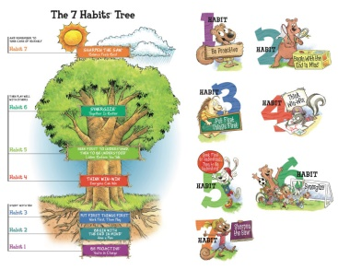
Leader in Me
August 30-September 10: Habit 1 Be Proactive
September 13-24: Habit 2 Begin with the End in Mind
September 27-October 8: Habit 3 Put First Things, First
October 11-22: Habit 4 Think Win-Win
October 25-November 5: Habit 5 Seek First to Understand, Then to be Understood
November 8-19: Habit 6 Synergize
November 29-December 17: Habit 7 Sharpen the Saw
Please check out the Leader in Me PowerPoint on the PPS website.
Students may earn a Positive Office Referral for living out the Leader in Me lifestyle!

Slide 13
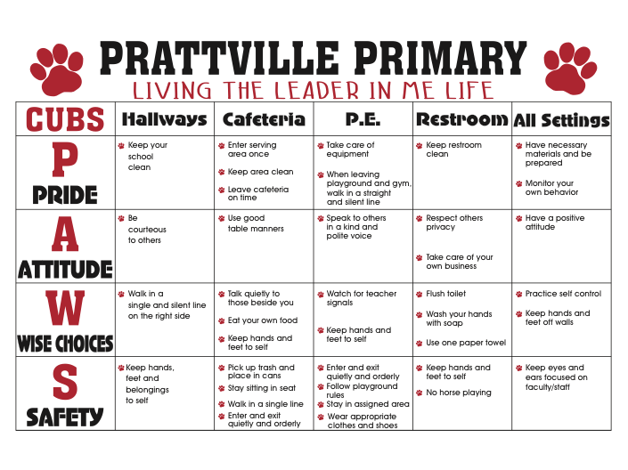
School Wide Expectations

Slide 14
Important Resources
Mrs. Coker- school nurse
Please contact her for any health concerns
Mrs. Hardy- school guidance counselor
Mrs. Hardy focuses on services that address academic, career, and social/emotional development.
Children may face difficulties, which can prevent them from doing their best in school. These difficulties can include school adjustment issues, family change, fears, grief, or difficulties with friendships. Having support through tough times can be essential to a child’s educational success. Please contact Mrs. Hardy for assistance
Mrs. Schooley- parent resource center
If your child is struggling, we have many learning resources in our Parent Resource Center. You may check them out to use at home. Please contact me or use the link on our website if you would like to utilize this resource. Mrs. Schooley is happy to help us!

