Slide 1
Thermochemistry

Slide 2
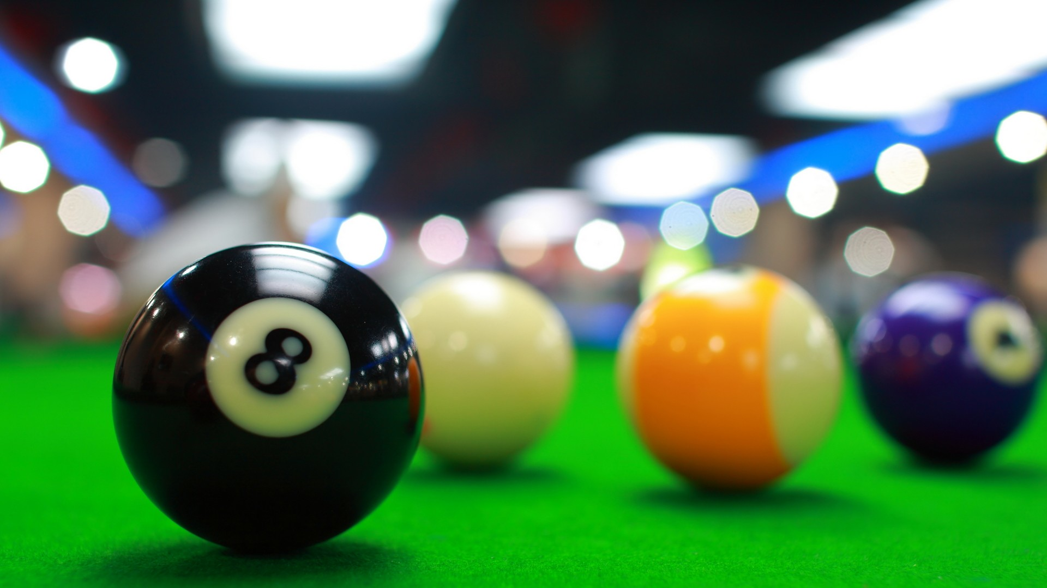
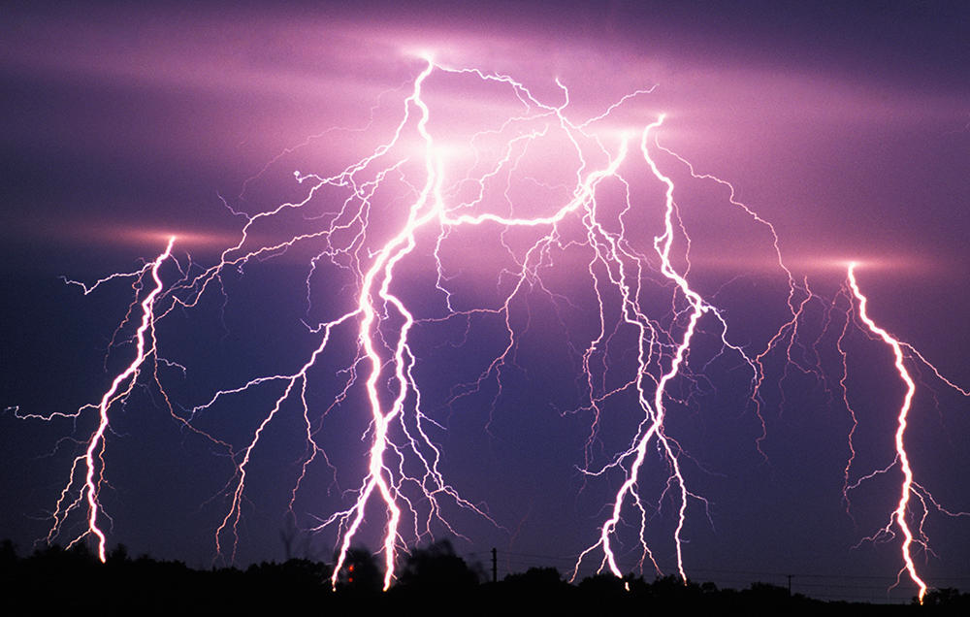

Slide 3
Energy Transformations
Energy = capacity to do work
Work = energy change resulting from a process
Thermal energy—KE associated with motion of particles
Chemical energy—potential energy stored within the structural units of chemical substances.
Units
4184 Joules (J) = 1000 calories (cal) = 1Calorie (kcal, C)

Slide 4
Energy Transformations
First Law of Thermodynamics—law of conservation of energy.
ΔU = q + w
ΔU = change in internal energy (state function)
q = heat
w = work (F x d)

Slide 5
Sign Conventions
Process | Sign
Work done by the system on surroundings | −
Work done by surroundings on system | +
Heat absorbed by system from surroundings | –
Heat absorbed by surroundings from system | +

Slide 6
Identify each energy exchange as heat or work and determine the sign.
An ice cube melts and cools the surrounding beverage (ice cube is the system).
A metal cylinder is rolled up a ramp (cylinder is the system)
Steam condenses on skin, causing a burn (condensing steam is the system)

Slide 7
Practice
The work done when a gas is compressed in a cylinder is 462 J. During this process, 128 J of heat is transferred from the gas to the surroundings. Calculate the internal energy change for this process.
A gas expands and does work on the surroundings equal to 325 J. At the same time, it absorbs 127 J of heat from the surroundings. Calculate the change in internal energy of the gas.

Slide 8
Pressure-Volume Work
Work done by gases
w = −PΔV
P = gas pushing against external pressure
Gas pushes against external pressure (expansion), or external pressure pushes against gas (compression)
Gas expansion—ΔV = +, work is -
Gas compression—ΔV = -, work is +
1 L • atm = 101.3 J

Slide 9
Practice
A balloon is inflated to its full extent by heating the air inside it. In the final stages of this process, the volume of the balloon changes from 4.00×10⁶ L to 4.50×10⁶ L by the addition of 1.3×10⁶ J of heat. Assuming the balloon expands against a constant pressure of 1.0 atm, calculate the change in internal energy for this process.

Slide 10
Practice
A certain gas expands in volume from 3.0 L to 5.0 L at constant temperature. Calculate the work done by the gas if it expands
A. against a vacuum
B. against an external pressure of 1.5 atm.

Slide 11
Practice
Calculate the work done when 50.0 g of tin dissolves in excess acid at 1.00 atm and 25ºC. Assume ideal gas behavior.
Sn(s) + 2H⁺(aq) → Sn²⁺(aq) + H₂(g)

Slide 12
Heat
Heat (q) = energy that transfers from one object to another because of a temperature difference.
Only changes in heat can be detected.
Zeroth Law of Thermodynamics—no heat is transferred between objects at thermal equilibrium.

Slide 13
Quantifying Heat
Thermal equilibrium—heat transfer from system to surroundings or visa versa stops.
Measure of heat transfer based on two things:
Number of molecules
Heat capacity of system

Slide 14
Quantifying Heat
Heat capacity (C)—the amount of heat required to change to temperature of a substance by 1ºC.
Unit = J/ºC
Extensive property—depends on amount of substance
Specific heat (s)—the amount of heat required to raise the temperature of 1 gram of substance by 1ºC.
Units = J/g•ºC
Molar heat capacity
Intensive property—depends on kind of substance

Slide 15
Quantifying Heat
q = mcΔT
Used to calculate the amount of heat being transferred with a given temperature increase.

Slide 16
Practice
Suppose you find a penny in the snow. How much heat is absorbed by the penny as it warms from the temperature of the snow, -8ºC, to the temperature of your hand, 37ºC? Assume the penny is pure copper and has a mass of 3.10 g, and the specific heat of copper is 0.385 J/g•ºC.

Slide 17
A home solar energy storage unit uses 400 L of water for storing thermal energy. On a sunny day, the initial temperature of the water is 22.0°C. During the course of the day, the temperature of the water rises to 38.0°C as it circulates through the water wall. How much energy, in joules, has been stored in the water? (The density of water at 22.0°C is 0.998 g/mL, and the specific heat of water is 4.18 J/g•°C)

Slide 18
Heat Transfers
Objects will transfer energy until they reach thermal equilibrium.
Assume substances are thermally isolated.
Two conditions:
Isobaric—constant pressure
Isochoric—constant volume

Slide 19
Isobaric conditions
aka Coffee-cup calorimetry
A 32.5 g sample of aluminum initially at 45.8ºC is submerged into 105.3 g of water at 15.4ºC. What is the final temperature of both substances at thermal equilibrium?
C_{s,Al} = 0.903 J/g•ºC
C_{s,H2O} = 4.18 J/g•ºC

Slide 20
Specific Heat Quiz
What is the specific heat of a material if a 6.0 gram sample absorbs 50.0 joules when heated from 30°C to 50°C?
A piece of metal weighing 59.047 g was heated to 100.0 °C and then put into 100.0 g of water (initially at 23.7 °C). The metal and water were allowed to come to thermal equilibrium, determined to be 27.8 °C. Assuming no heat lost to the environment, calculate the specific heat of the metal.

Slide 21
Measuring ΔU for reactions
Bomb calorimeter—measures change in internal energy for combustion reactions.
Reaction under constant volume
q_{cal} = C_{cal} × ΔT
C_{cal} determined in separate experiment by burning substance that gives off a known amount of heat.

Slide 22
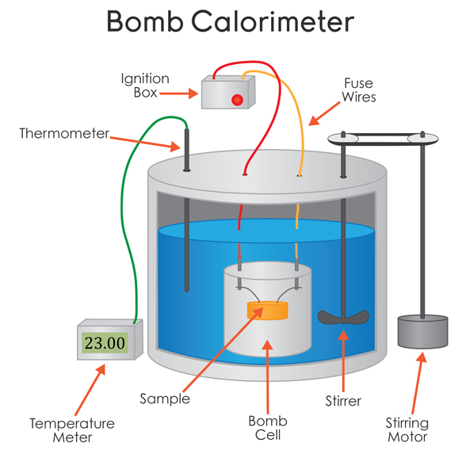

Slide 23
Bomb Calorimetry
q_{cal} = −q_{rxn}
When 1.010 g of sucrose (C₁₂H₂₂O₁₁) undergoes combustion in a bomb calorimeter, the temperature rises from 24.92ºC to 28.33ºC. Find ΔU for the combustion of sucrose in kJ/mol of sucrose. The heat capacity of the bomb calorimeter is 4.90 kJ/ºC.

Slide 24
Bomb Calorimetry
A 1.000 g sample of octane (C₈H₁₈) is burned in a bomb calorimeter containing 1200. grams of water at an initial temperature of 25.00ºC. After the reaction, the final temperature of the water is 33.20ºC. The heat capacity of the bomb is 837 J/ºC. The specific heat of water is 4.184 J/g ºC. Calculate the heat of combustion of octane in kJ/mol.

Slide 25
Enthalpy
∆H = ∆U + P∆V
In an isobaric process, enthalpy = change in heat
Useful for chemical reactions at constant pressure (open systems)
Can be found from:
Stoichiometry
Standard enthalpy of formation
Hess’s Law
Calorimetry
Bond energies

Slide 26
Stoichiometrically
Upon adding solid potassium hydroxide pellets to water the following reaction takes place:
KOH(s) → KOH(aq) + 43 kJ/mol
Answer the following questions regarding the addition of KOH to water:
Does the beaker get warmer or colder?
Is the reaction endothermic or exothermic?
What is the enthalpy change for the dissolution of the 14.0 grams of KOH?

Slide 27
Heats of Formation
For reaction:
aA + bB → cC + dD
ΔH_{rxn} = [cΔHº_{f}(C) + dΔHº_{f}(D)] – [aΔHº_{f}(A) + bΔHº_{f}(B)]
Note*--ΔHº_{f} of a pure element is in its reference form is 0.

Slide 28
Example
Between Br₂(l) and Br₂(g) at 298.15 K, which substance has a nonzero standard enthalpy of formation?

Slide 29
Example
A + B ⇋ C
ΔH_{f}º[A] = 433 KJ/mol
ΔH_{f}º[B] = -256 KJ/mol
ΔH_{f}º[C] = 523 KJ/mol
Find ΔH_{rxn}º

Slide 30
Hess’s Law
Enthalpy is independent of the reaction pathway.
If you can find a combination of chemical equations that add up to give you the desired overall equation, you can also sum up the ∆H’s for the individual reactions to get the overall ∆H_{rxn}.

Slide 31
Example
Calculate the ∆H for this overall reaction
2 H₃BO_{3(aq)} → B₂O_{3(s)} + 3 H₂O_{(l)}
given the following equations:
H₃BO_{3(aq)} → HBO_{2(aq)} + H₂O_{(l)} ∆H = −0.02 kJ/mol_{rxn}
H₂B₄O_{7(aq)} + H₂O_{(l)} → 4 HBO_{2(aq)} ∆ H = −11.3 kJ/mol_{rxn}
H₂B₄O_{7(aq)} → 2 B₂O_{3(s)} + H₂O_{(l)} ∆ H = 17.5 kJ/mol_{rxn}

Slide 32
Using Bond Energies
Bonds broken – bonds formed = enthalpy of reaction
Use the following data table to calculate ∆H_{rxn}
Bond | Bond enthalpy (kJ mol⁻¹)
C-H | +413
Cl-Cl | +243
C-Cl | +346
H-Cl | +432

Slide 33
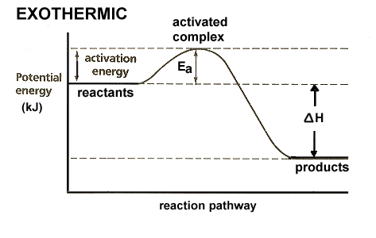
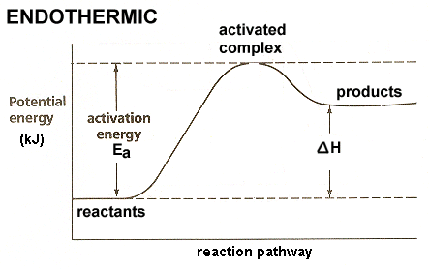
Energy Diagrams

Slide 34
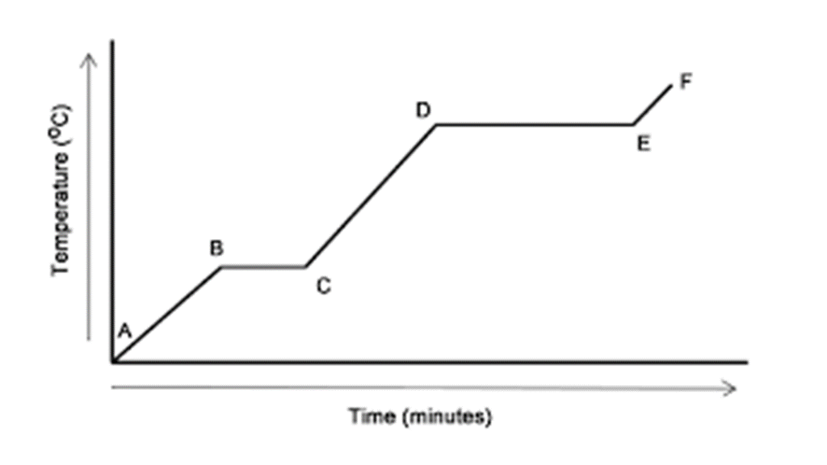

Slide 35
In a coffee cup calorimeter, 100.0 mL of 1.0 M NaOH and 100.0 mL of 1.0 M HCl are mixed. Both solutions were originally at 24.6°C. After the reaction, the final temperature is 31.3°C. Assuming that all solutions have a density of 1.0 g/cm³ and a specific heat capacity of 4.184 J/g°C, calculate the enthalpy change for the neutralization of HCl by NaOH. Assume that no heat is lost to the surroundings or the calorimeter.

