Slide 1
Help keep your
school and community safe

Slide 2
allows students to report tips to police and school leaders.
Notes:
Suggested by DOE: allows students to report tips to police and school leaders a trusted adult.

Slide 3
See something, say something!
If you or someone you know is in a dangerous situation, is a way to get help.
Notes:
Suggested by DOE: If you or someone you know is in a dangerous situation,

Slide 4
What are some dangerous situations that should be reported?
A student threatening serious harm to themselves or others
A child that is being hurt by an adult
Someone having dangerous drugs or weapons
Notes:
Suggested by DOE:
A student who says they will hurt themselves threatening serious harm to themselves or others
A child that is being hurt by an adult
Someone having dangerous drugs or weapons

Slide 5
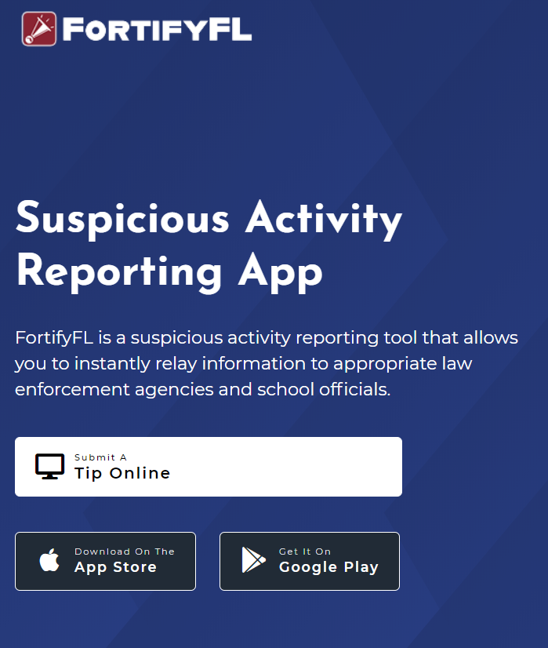
How Do I Submit A Tip?
From any computer go to the link:
GetFortifyFL.com

Slide 6
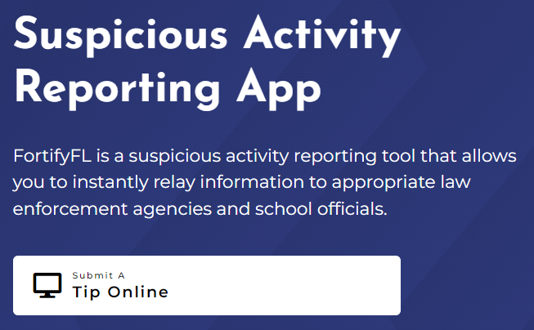
How Do I Submit A Tip?
Go to GetFortifyFL.com and Click “Submit a Tip Online”

Slide 7
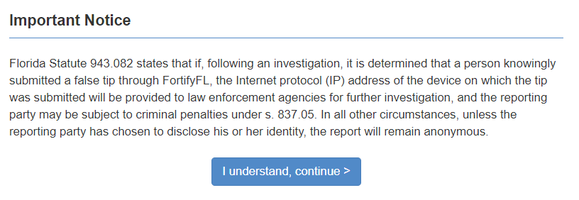
FortifyFL is for Serious Tips Only
If anyone uses FortifyFL to send a fake tip, the police will investigate. Fake tips could lead to serious consequences.
Notes:
FortifyFL is not for jokes. Tips that are sent through FortifyFL are taken very seriously. Joking around or sending fake stories can mean serious trouble.

Slide 8
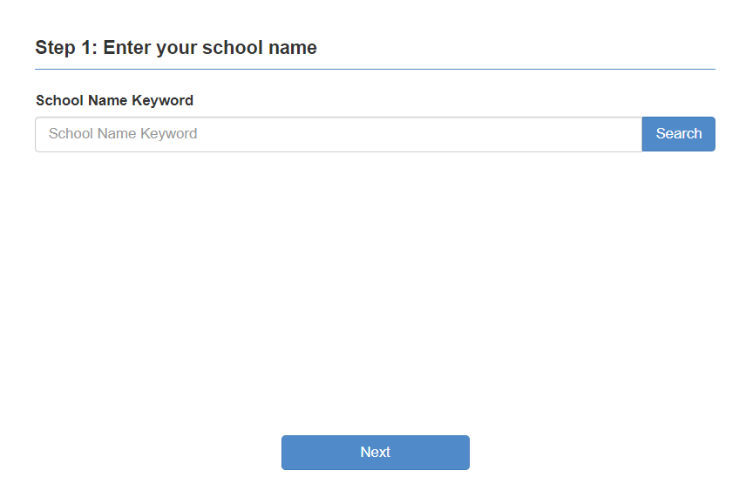
How Do I Submit A Tip?
Step 1: Select Your School

Slide 9
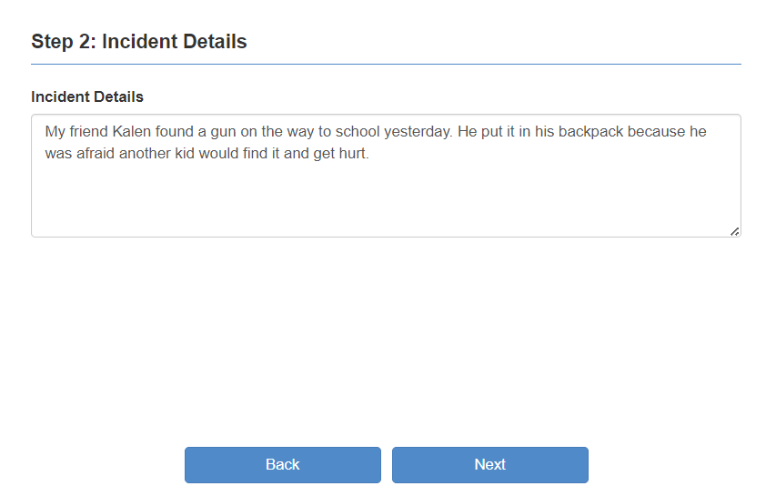
How Do I Submit A Tip?
Step 2: Provide Your Tip
Notes:
A student typed “My friend Kalen found a gun on the way to school yesterday. He put it in his backpack because he was afraid another kid would find it and get hurt.”
Is this a good example of a tip?

Slide 10
Good Tip or Bad Tip?
Notes:
Which of these tips are good, and make students and our school safe?

Slide 11
Tips must have useful information
This means including WHO did WHAT, WHERE it happened and WHEN.
More information will get help faster.
Notes:
“My friend Kalen (WHO) found a gun (WHAT) on the way to school yesterday (WHEN). He put it in his backpack (WHERE) because he was afraid another kid would find it and get hurt.”
This tip gives trusted adults what they need to know to keep students safe.

Slide 12
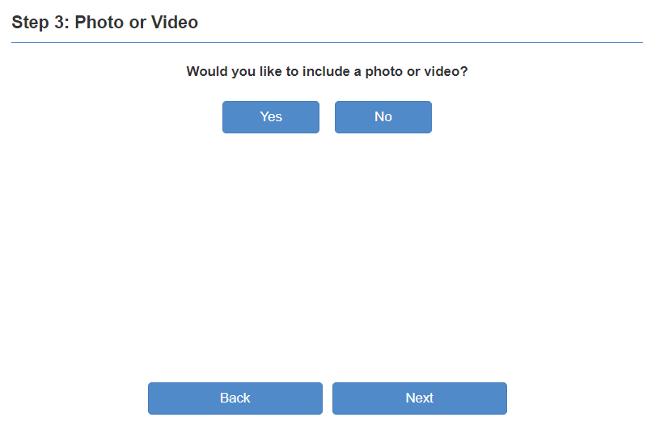
How Do I Submit A Tip?
Step 3: Attach a Photo or Video
Notes:
FDLE note: include a photo that would be helpful

Slide 13
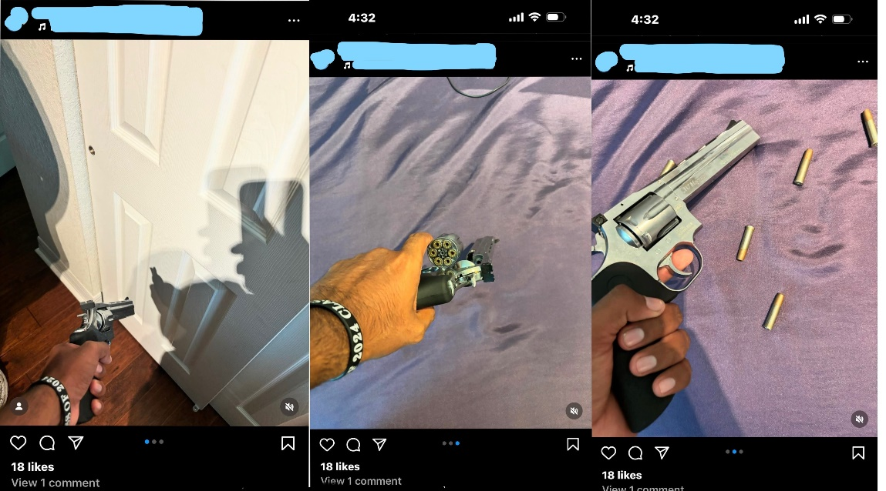
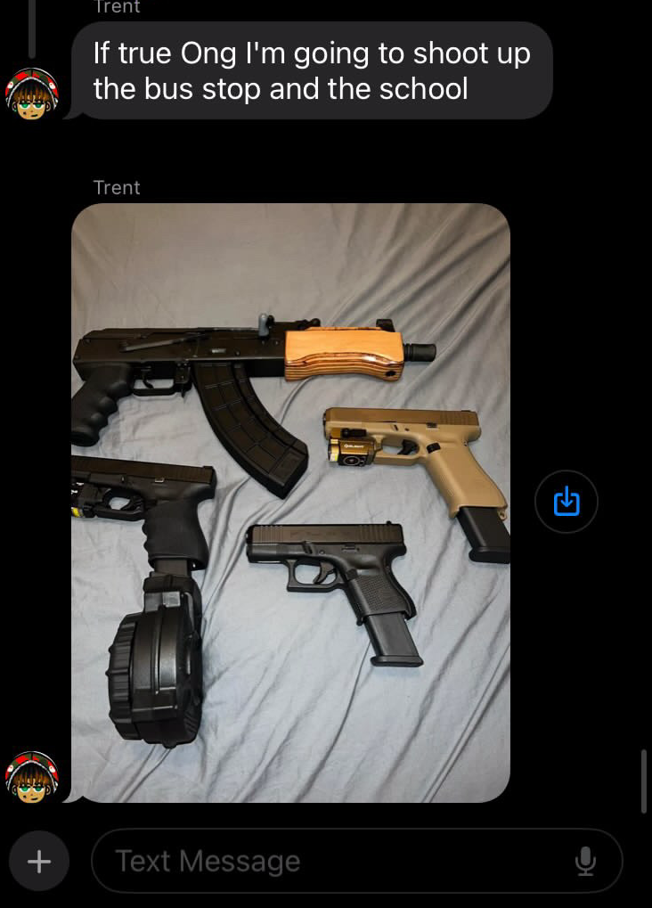
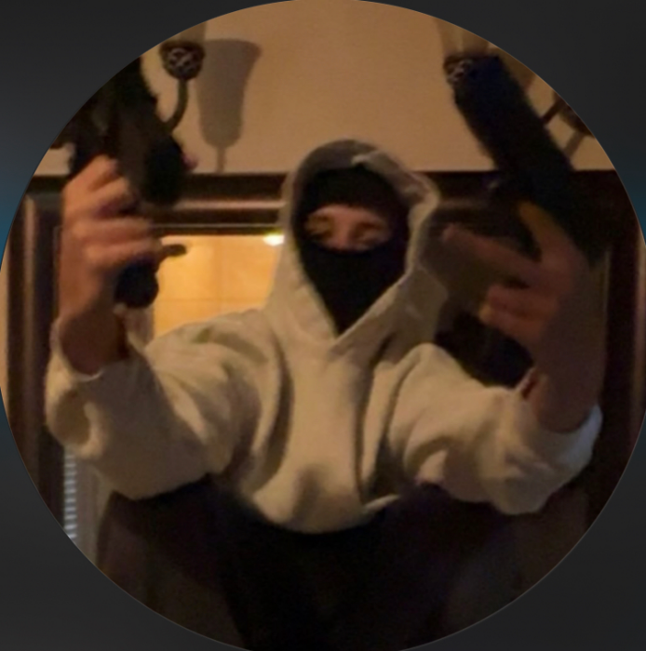
Photo or Video
Notes:
FDLE note: Examples of Photographs and video sent to Fortify Florida

Slide 14
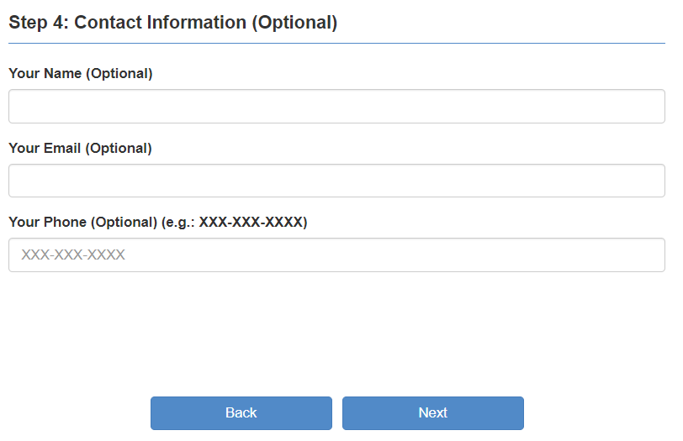
How Do I Submit A Tip?
Step 4: Provide Contact Information and Submit
Notes:
If you are scared that others will know about your tip, just remember that your tip is not public. When you include your name and other information, you help the trusted adult who may need to ask you questions.

Slide 15
Remember: FortifyFL is only for reporting dangerous situations or suspicious behavior
There are serious consequences for reporting fake tips

Slide 16
What should you do?
Call 911 for an emergency
A strange car follows you home when you walk home from school or the bus stop.
Your parent is lying on the floor and looks very sick. You cannot wake them up.
A girl on your bus has lots of bruises and cries every morning.
Go to GetFortifyFL.com
and enter a tip
You know an older student at your school that likes to hurt animals.
You hear a boy in your grade say that there are no adults at his house so he can do what he wants.
Two boys on the bus talk about having a gun.
A student in your class says they have drugs.
Three older girls are vaping in the restroom
Ask an adult for help
You forgot the password to get on to the computer at school.
You cannot find your backpack anywhere.
Notes:
How do you get help?
Call 911 for an emergency, when someone needs help right away because of an injury or serious danger. If you need the police, an ambulance or the fire department, call 911.
FortifyFL is for dangerous situations or when you see suspicious behavior that is not an emergency
For everything else, ask an adult for help
So, let’s talk about getting the right kind of help. What should you do if:
You cannot find your backpack anywhere.
Three older girls are vaping in the restroom.
You know an older student at your school that likes to hurt animals.
Your friend is lying on the floor and looks very sick. You cannot wake them up.
A girl on your bus has lots of bruises and cries every morning.
You forgot the password to get on to the computer at school.
You hear a boy in your grade say that there are no adults at his house so he can do what he wants.
Two boys on the bus talk about having a gun.
A student in your class says they have drugs.

Slide 17
See something, say something!
Notes:
Please remember, if you see something, say something!

Slide 18
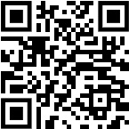
Thank you for helping to keep our school and community safe!
Notes:
For the teacher - If there are questions about why we have FortifyFL, here is the history:
FortifyFL was created in 2018 by the Florida Legislature after a tragedy at Marjory Stoneman Douglas High School.
FortifyFL was named by students from Marjory Stoneman Douglas High School. Many people worked together to create FortifyFL as a way for students to get help and keep their school and community safe.

