Slide 1
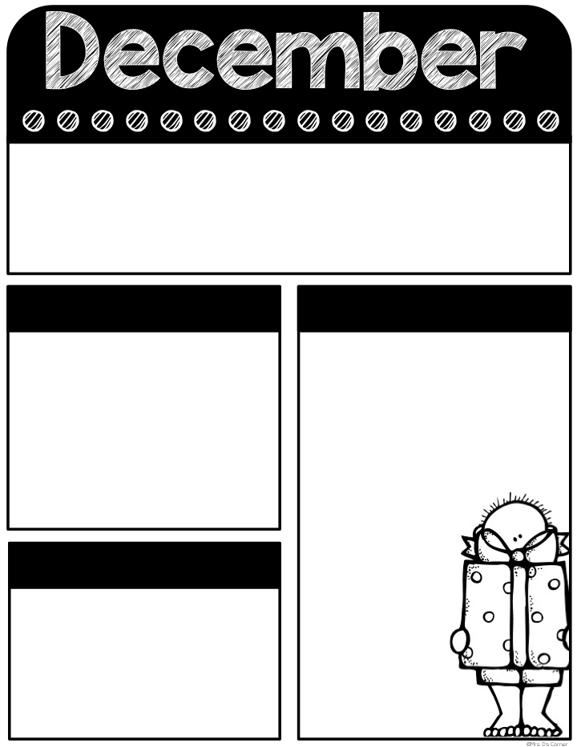
Dec
17 - 20
Classroom Reminders
Transportation changes must be in written form. No texts/emails/phone calls.
Don’t forget PE shoes every day.
Graded work will be sent home every Thursday and needs to be returned every Friday.
Yearbooks are on sale!
Don’t forget your car rider pro tag! Car rider line closes at 7:35 in the morning and 2:55 in the afternoon.
Tardy bell rings at 7:40. Students must be on time to receive breakfast in the classroom.
Please send a snack every day. If your child is purchasing snack, send in exact change ($1.50) daily.
Special snack will only take place on Friday.
If you have any questions, please don’t hesitate to contact me on remind. Have a great week!
Remind class code: @holena23
Mark your Calendar
What we’re learning
12/18- western wear
12/19- Class Party (11:30)/Polar Express Day
12/20- Early Release (11:30)
12/21-1/8- Christmas Break
1/9- Students return
Math-
review
Reading-
review
Social Science-
Holidays around the world
Helpful Hints
No homework over the Holiday break.
Enjoy this time as a family!
I hope everyone has a safe and FUN Holiday break!
Sight Words
Review unit 3 words
Tests this week:
Makeup tests if your kiddo was absent
Every Student Empowered. Every Student Succeeds.

