Slide 1
Johnsonville Elementary School
SIC Meeting
February 5, 2024

Slide 2
MTSS (Multi- Tiered System of Support)
JES School
Goals
ATSI Recovery Plan
Capturing Kids’ Hearts
Academic Growth

Slide 3
JES After School
The after-school program has so many fun and exciting things happening this time of year.
First Tee Program just helped work with the program for two weeks to help students learn and understand the fundamentals of golf. A big thanks goes to the golf team for all of the help!
February 20,21,26 will be our field trips to Barnes & Noble. The grant provides money for every child in the program to receive some educational books.
We have a well-known baseball player coming in from February 5th to the 15th to help teach them the fundamentals of baseball/softball.
On March 4th through the 15^{th -} Johnsonville Alumni will be coming to help teach the kids fundamentals of volleyball.
March 16th – The JES After School trip to Wonderworks!
This program has many benefits to it. However, the best part of our program is seeing all of the students grow and come out of their shell.

Slide 4
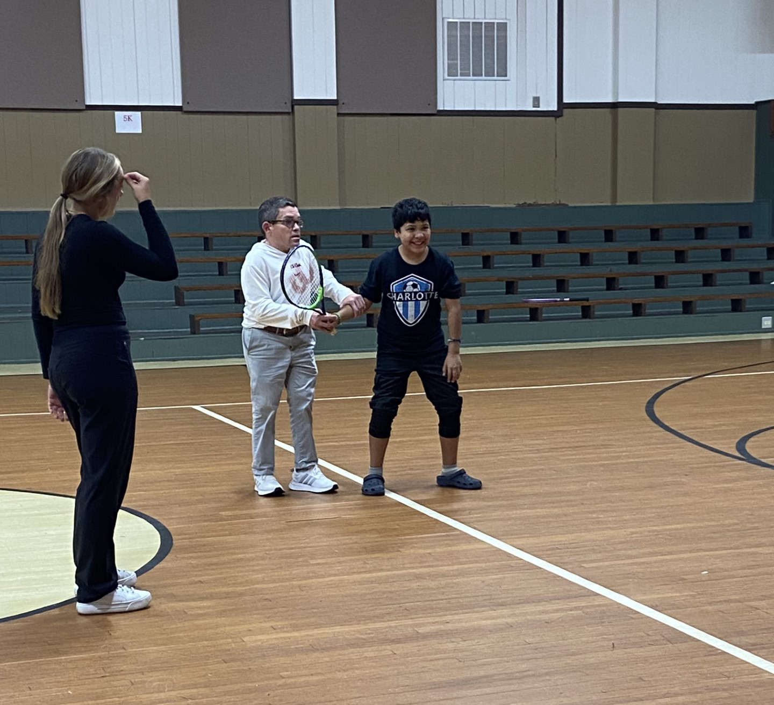
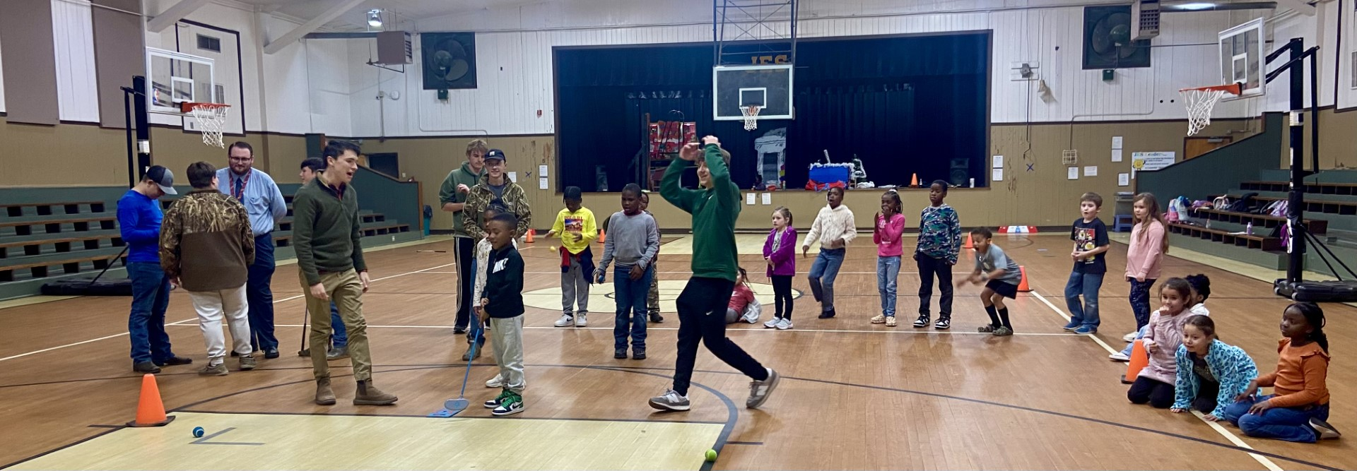
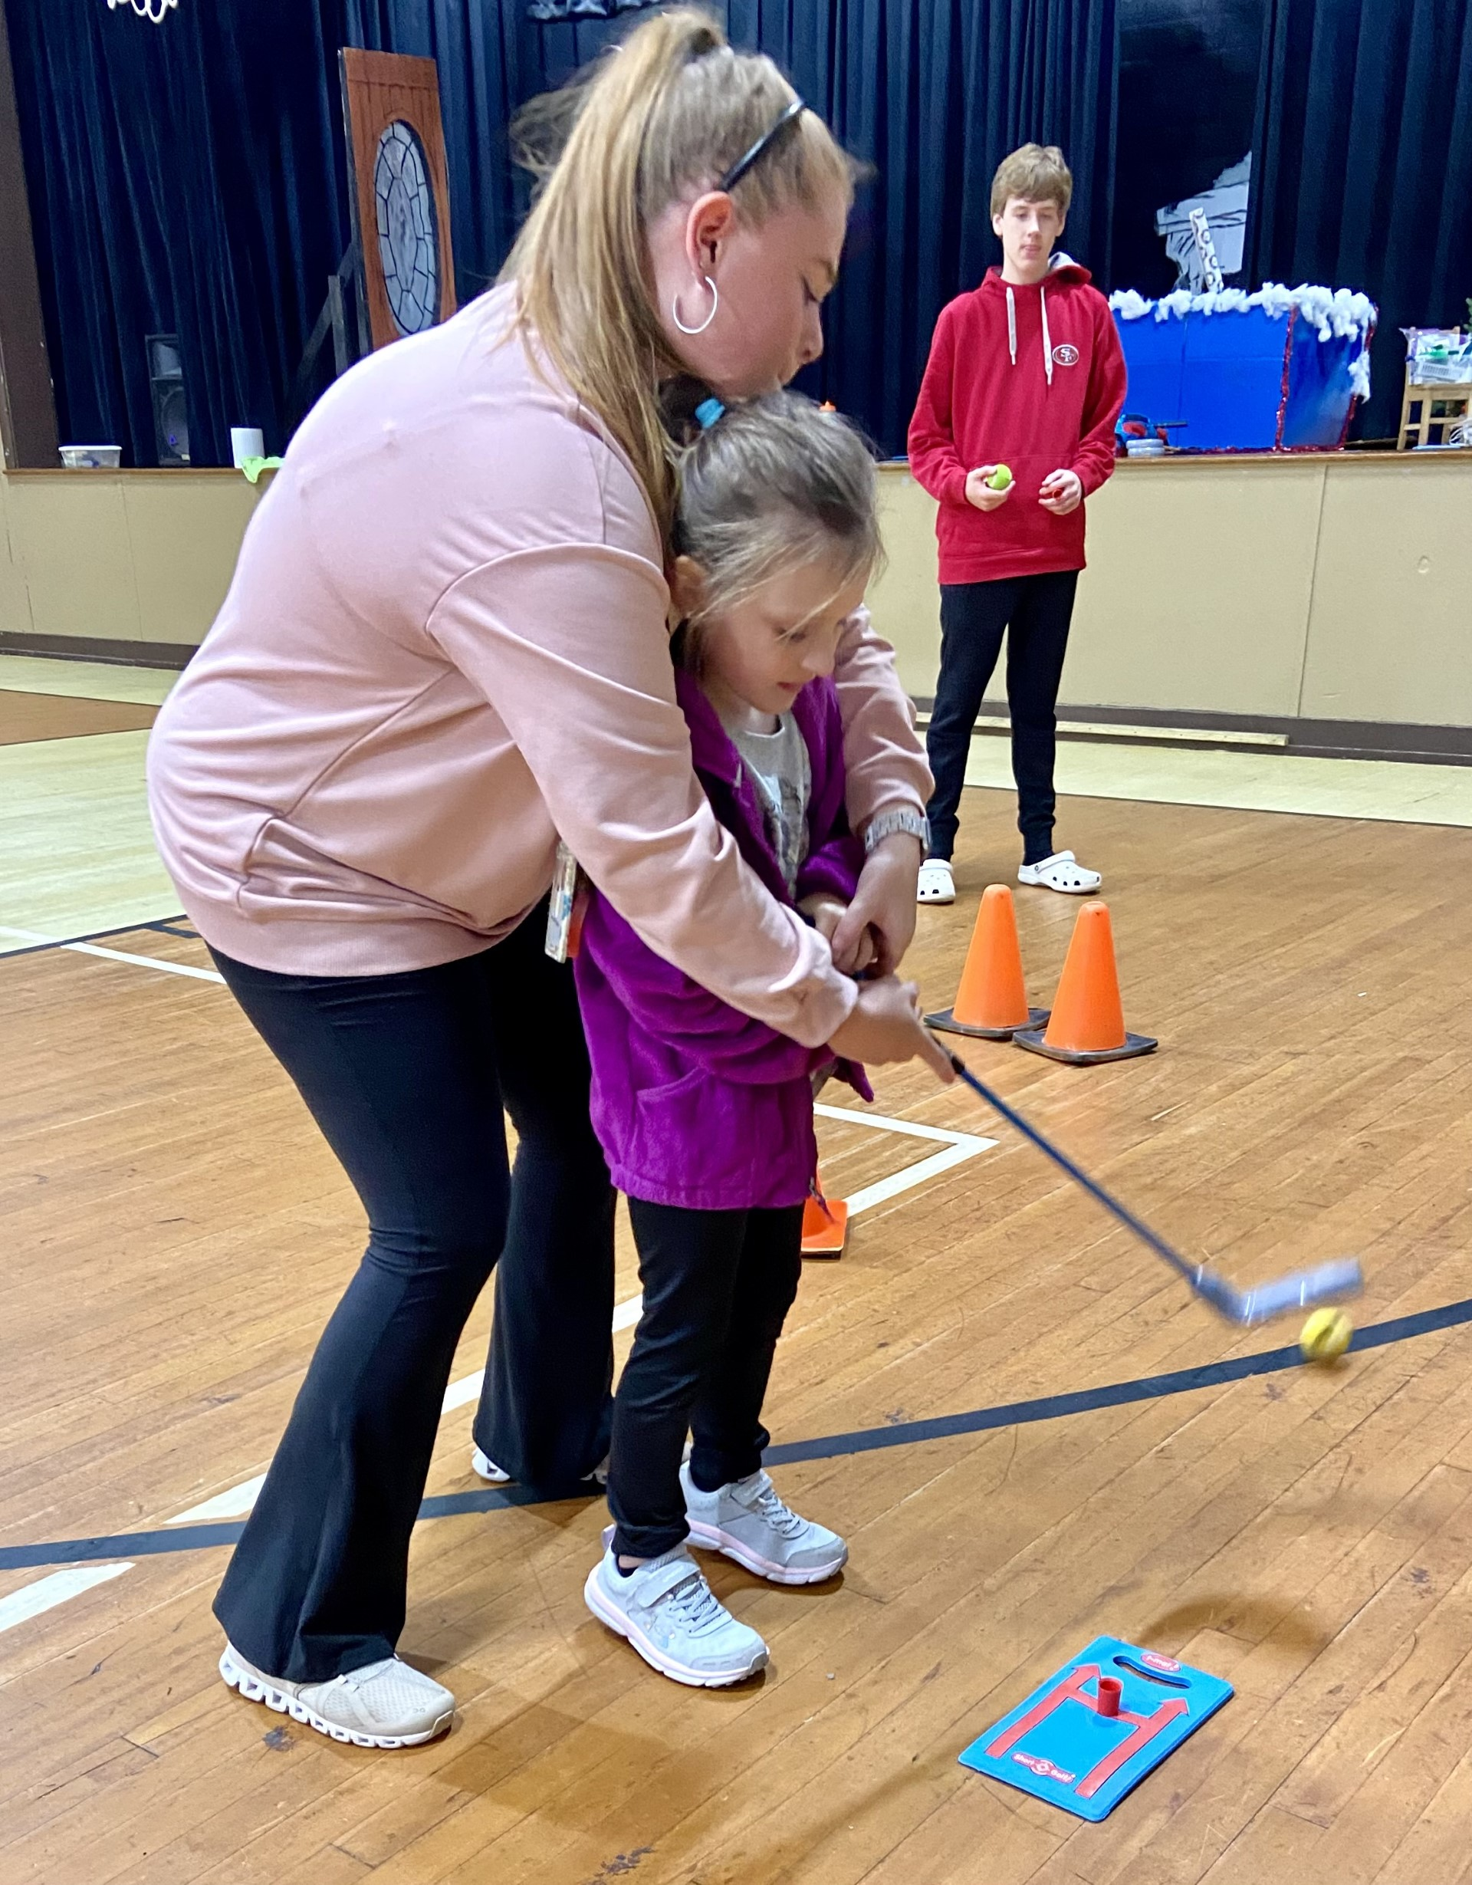
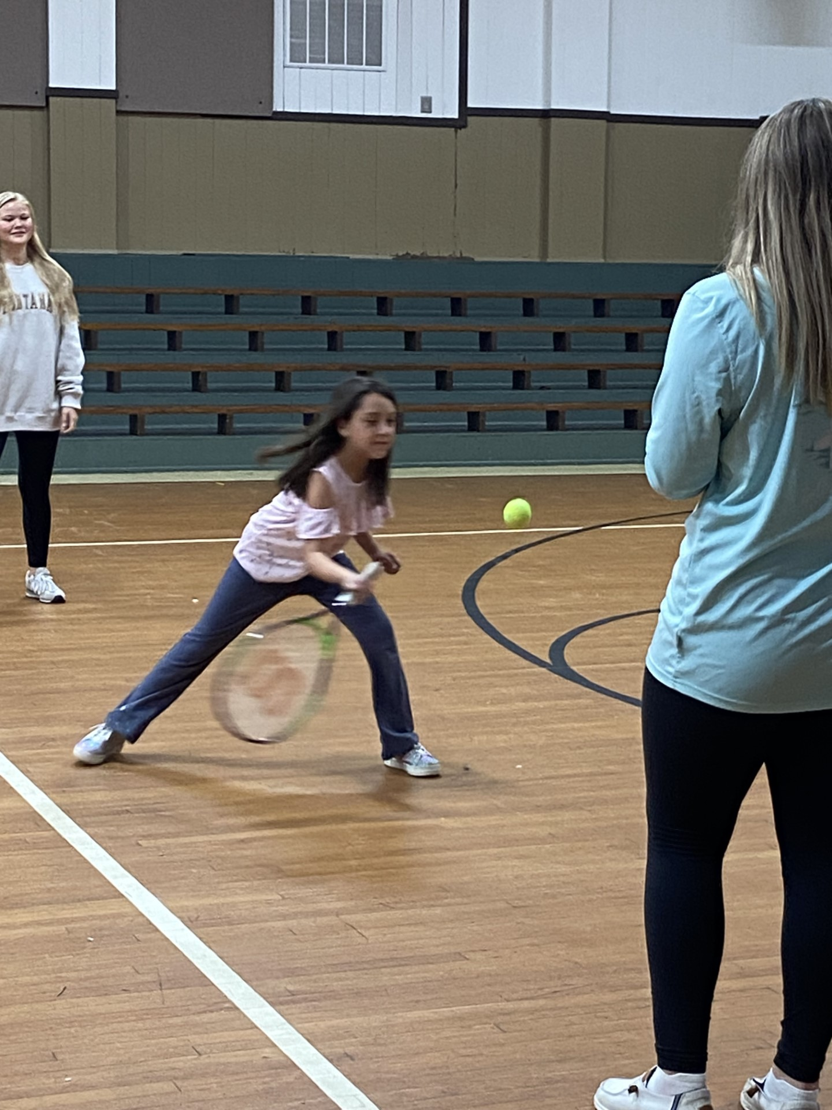
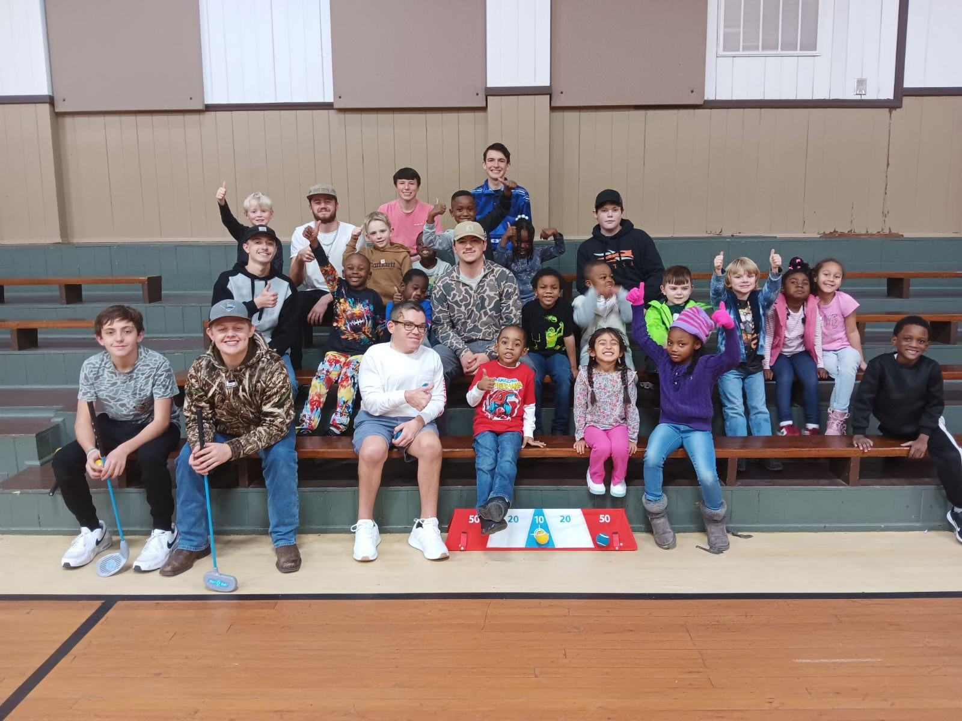

Slide 5
Curriculum Goals
New Text Book Adoption for ELA- Aligned with State Standards
Math Scores
Small Groups
Tutors within the classroom
Intervention
After School Tutoring – 2nd Grade

Slide 6
iReady Data - JES

Slide 7
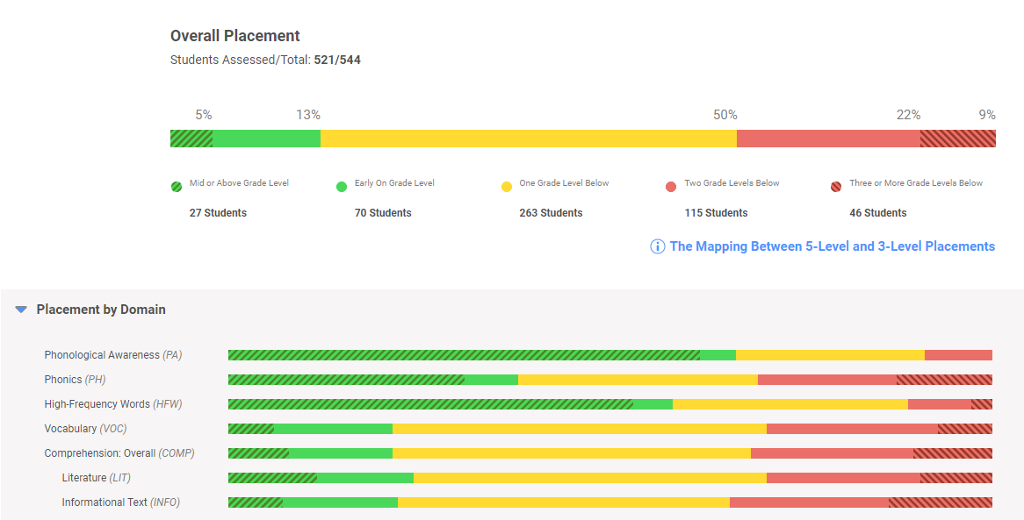
Fall Diagnostic - Reading

Slide 8
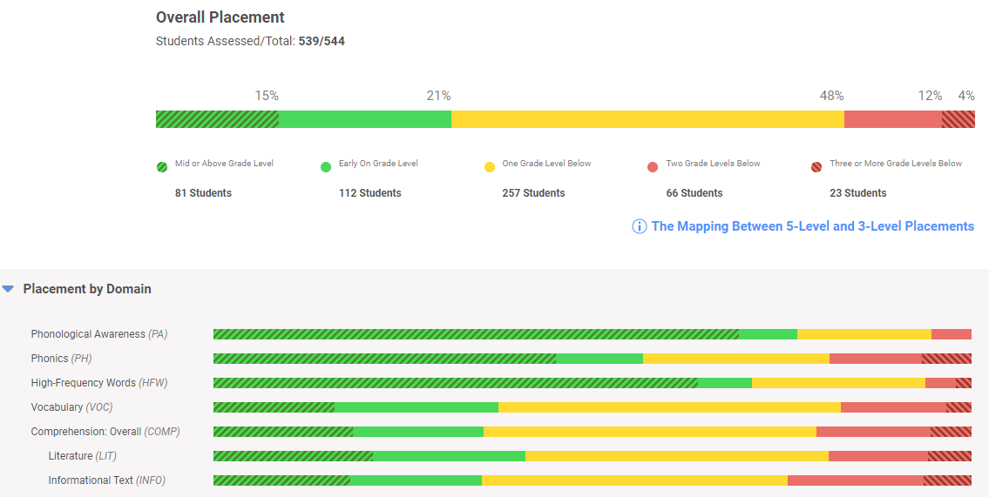
Winter Diagnostic - Reading

Slide 9
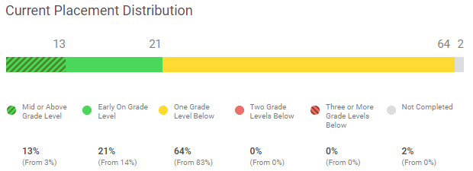
Reading Diagnostic – 5K

Slide 10
Math Diagnostic – 5K

Slide 11
Reading Diagnostic – 1st Grade

Slide 12
Math Diagnostic – 1st Grade

Slide 13
Reading Diagnostic – 2nd Grade

Slide 14
Math Diagnostic – 2nd Grade

Slide 15
Reading Diagnostic – 3rd Grade

Slide 16
Math Diagnostic – 3rd Grade

Slide 17
Reading Diagnostic – 4th Grade

Slide 18
Math Diagnostic – 4th Grade

Slide 19
iReady Reading - Tiered Grouping
Fall
Winter

Slide 20
iReady Math - Tiered Grouping
Fall
Winter

Slide 21
Projects
Academic Growth
Playground
Beautification
$

