Slide 1
Welcome
To
MUSIC

Slide 2
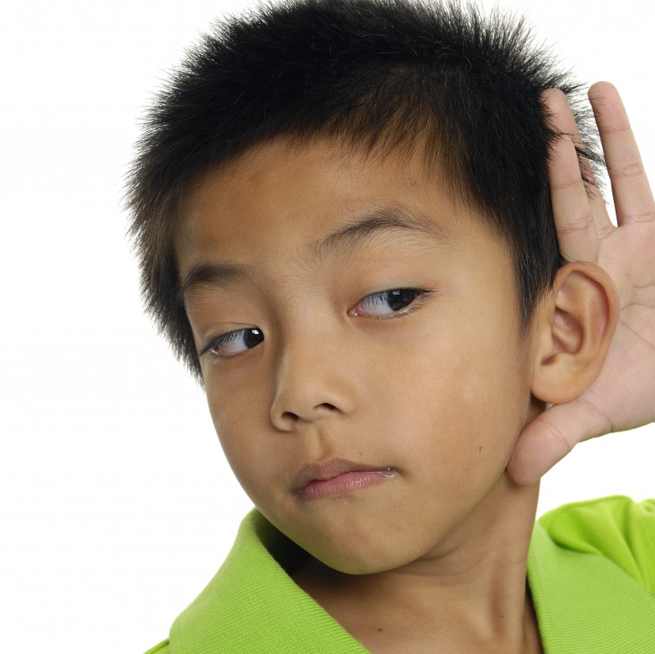
LISTEN while others are talking.

Slide 3
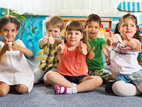
FOLLOW DIRECTIONS.

Slide 4
USE KIND WORDS.

Slide 5
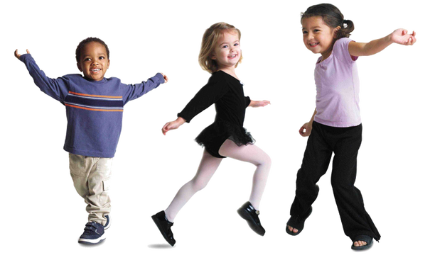
STAY in your space.

Slide 6
Don’t touch the instruments.
YET!

Slide 7
KINDER
12:25 – 1:10

Slide 8
HAPPY SONG Students sing and dance in place. Remind them “stay in your space” and “singing voices not screaming voices.” Stop video after the second song then sit down crisscross applesauce hands In your lap.
Click here for the HAPPY Song

Slide 9
TEACHER count off (not too fast) ONE – TWO – READY – READ. (You read it rhythmically with them three or four times. They know the rhyme and hand movements. Each time you do it, go a little faster then slower and make the last one very very slow.)
Rain on the green grass
Rain on the tree.
Rain on the house top,
But not on me!

Slide 10
PRACTICE RHYTHM & BEAT Teacher, pass out “Beat Buddies” from white basket. Remind students to hold them gently. Tell them they will bounce their Beat Buddy to the steady beat as they say the words with their mouth. They can bounce on hand, knee, shoulder, head . . . Any body part, as long as they are not tossing them or touching others.
Click Here for Egg-Bunny Rhythms

Slide 11
MORE SONGS WITH BEAT BUDDIES
Click here for Little Flea (sitting, TWO TIMES, Beat Buddy will crawl up and back down again as students sing)
Click here for Here You Are (standing, turn to a neighbor and switch beat buddies each time you sing “Here You Are”.
Pick up Beat Buddies while students sit criss cross applesauce hands in your lap.

Slide 12
LET’S SING!
Click here for Mi Cuerpo (standing, sing & dance in your space)
Sing About Martin (standing, call & response song)
Click here for Teach Me How to Read (sing & dance in your space)

Slide 13
Calm Down Time
Click here for RELAXING MUSIC
Students sit quietly in their place and listen as teacher reads: WE WILL ROCK OUR CLASSMATES.

