Slide 1
Voices for the Vision
Shared Decision Making Parent Meeting
Morningside Elementary School
03/20/2024

Slide 2
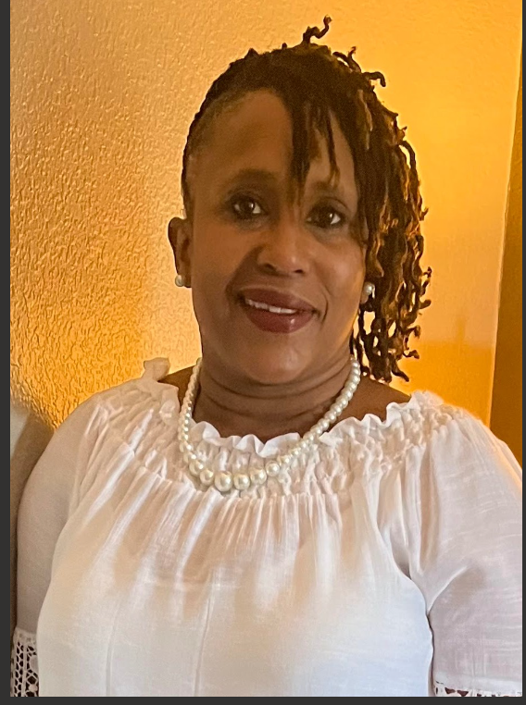
Welcome and Introductions
FEL – LaWanda Mason
Parents- Introduce yourselves and tell what grade level your child is in.

Slide 3
Agenda
Welcome & Introductions
Our FE Program (highlights)
Achievement Data
2024 Parent Survey Results
Family Engagement Plan
School-Family Compact
Program Supports
Parent Input Form

Slide 4
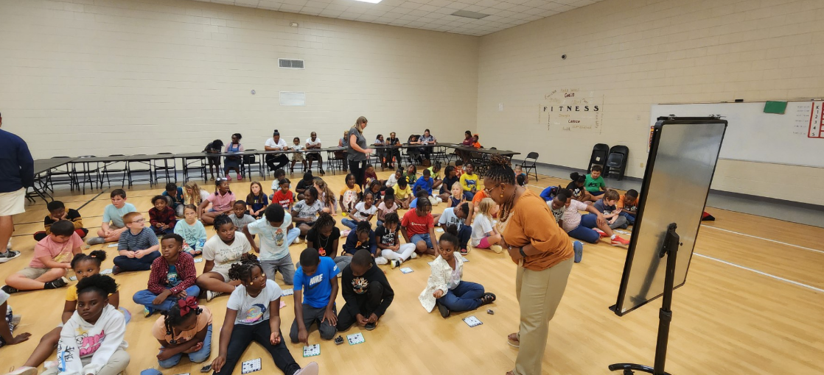
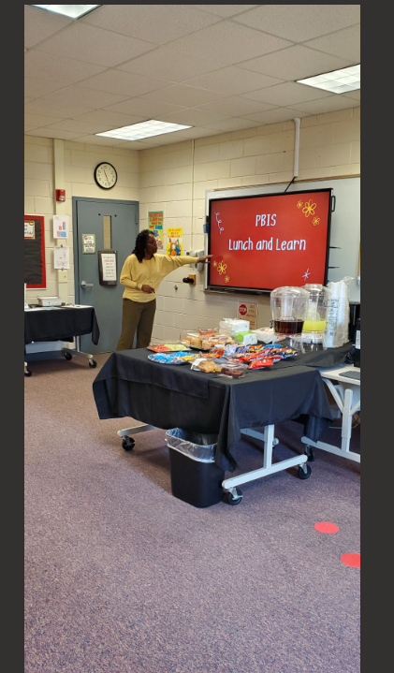
A Glimpse at Family Engagement at Morningside Elementary
Bingo for Books
Coffee, Lunch and Learn

Slide 5
Achievement Data

Slide 6
2024 Parent Satisfaction Survey Results
Received Information about Academic Requirements
School Offers Parent Workshops
Preferred Method of Communication
Additional Support Needed to Assist my Student
Class Dojo – 70.33%
Email – 5.49%
Text Message – 18.68%
Help with Homework – 31.25%
Math – 42.50%
Reading Skill – 42.5%
All of the Time – 82.42%
Most of the Time –10.99%
All of the Time: 81.32%
Most of the Time – 10.99%
Some of the Time – 7.69%

Slide 7
The Connection Family Engagement Plan
Events | Event Type | Date
Meet & Greet | WC | 7/31/2023
Open House | A | 8/24/2023
Bingo for Books | A | 9/21/2024
Grandparent Day | A | 9/8/2023
Coffee & Conversation /Title I | WC | 9/12/2023
Parent & Student Reading Together | A | 10/27/2023
Parent –Teacher Conference | MP | 10/6-30/2023
Merry Moments | WC | 12/5/2023
100 Day of School | A | 1/23/2024
Fall in Love with Reading | A | 2/14/2024
Were you able to attend any of these family engagement events this year?
If so, in what ways can we improve the event(s)?
What other academic-based or family-fun type activities would you like us to consider offering?

Slide 8
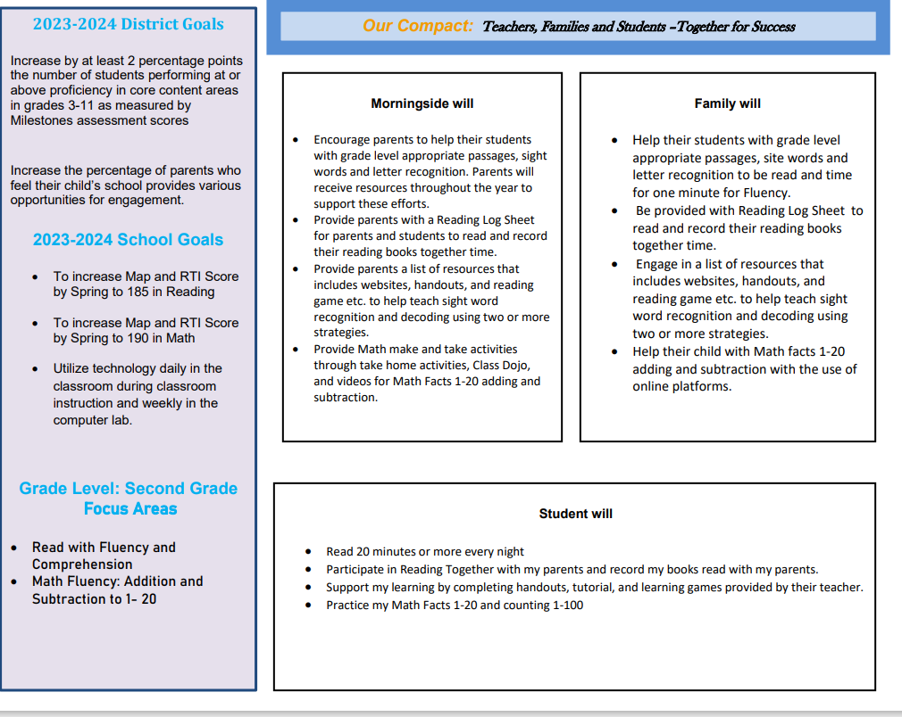
The Connection School-Parent Compact
In what subject area or concept does your child have the most difficulty?
What can the school do to better support you and your child in that area?
What are some things you and your child would be willing to do in order to see improvement in that area?

Slide 9
Program Supports
How can we increase family engagement and participation?
Are you interested in joining our Parent Action Team or working with school staff on Professional Development?

Slide 10
Parent Input Form
Please complete the short Feedback Questionnaire. Your input is extremely important in helping us to improve our parent program.

Slide 11
FEL Contact Information
LaWanda Mason
lawanda.mason@hcbe.net
478-210-7857

