Slide 1
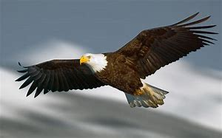
DPES Student Assembly
Vision Statement
DPES Students Will…
Respect
Integrity
Self-Control
Effort
Mission Statement
Daniel Pratt Elementary is committed to empowering ALL students to grow socially and academically in a positive , nurturing environment that shapes lifelong learners in an ever changing world.

Slide 2
Arrival Information
Morning Help
The benches on the Red Hallway are there if you need to take a break in the mornings. Mrs. Finch may ask you to sit on a bench, but that does not mean you are in trouble. ☺
The nurses’ office is on the Red Hallway. You may wait for the nurse in the mornings on the benches in the Red Hallway.
You may let Mrs. Finch know if you left something on the bus. She will call the transportation department to ask them for help.
You may let Mrs. Finch know if you forgot something at home. She will let you use the front office phone to call home.
Mrs. Finch stands in the center of the Red Hallway every morning. She is there to help you. You may come up to her anytime.
Morning Behavior
No talking in the hallways
Walk on the purple arrows
Keep the hallway lines straight and quiet
Remember to obey all of the supervision teachers every morning.
You may bring your own water bottle to school. You can fill it up at the water fountain stations. You may also purchase a DPES water bottle for $10.00.
Great morning behavior earns the school a green gumball for the day!

Slide 3
Arrival Directions
Students | Times | Student Directions | Parent Directions
Walkers | 7:10-7:55 | *Enter through Red Hall Front Doors *Go directly to breakfast (Optional) *Wait in classroom hallway until 7:45 bell | N/A
Carpool | 7:10-7:55 | *Enter through Red Hall Front Doors *Go directly to breakfast (Optional) *Wait in classroom hallway until 7:45 bell | *No student drop-offs in the parking, before the doors open or after they close. *After 7:55, walk student to the front office to check-in.
Bus | 7:15-7:45 | *Enter through Yellow Hall Side Doors *Follow breakfast schedule *Dismiss to classroom at the 7:45 bell | N/A
Daycare | 7:15-7:45 | *Enter through Yellow Hall Side Doors *Go directly to breakfast (Optional) *Wait in classroom hallway until 7:45 bell | N/A

Slide 4
Morning Information
Snack Shack
The Snack Shack is located on the Red Hallway near to the lunchroom.
All Students: Buy your snacks before you go to class. Please bring
exact change or small bills. We cannot break $20.00 bills or above.
Restrooms
Use the Red Hallway restrooms ONLY when you get to school between 7:15 and 8:00. You do not have to ask for permission. ☺
Bus Students: Do not use any other student restroom before 8:00.
Breakfast
Breakfast is free!
Eating breakfast gives you a better start to your day. ☺
Breakfast is in the lunchroom.

Slide 5
Breakfast Schedule
Start Times | Students
7:10 | Carpool, Daycare, and Walkers enter lunchroom on arrival
7:15 | Bus Riders: 1st & 2nd Grades
7:20 | Bus Riders: 6th Grade Boys
7:25 | Bus Riders: 3rd & 4th Grades
7:30 | Bus Riders: 5th Grade Girls
7:35 | Bus Riders: 5th Grade Boys
7:40 | Bus Riders: 6th Grade Girls
7:10-7:55 | Baker & Ramspeck students enter lunchroom based on teacher/aides discretion
7:55 | Students who arrive after 7:55 may pick up a grab and go breakfast

Slide 6
Dismissal Information
Mrs. Walker will announce when to dismiss school each day. Listen carefully to all afternoon announcements so you will not miss your ride, and keep the lines straight and quiet. ☺
Car Riders:
Stay on the sidewalk and stay in your lane. ☺
Do not cross the yellow line or the white dotted lines until you reach your car.
Stay quiet in the hallways and listen for your name.
1st-3rd: Green Hall
4th-6th Blue Hall
Bus Riders:
1st Load: Go directly to buses at the side of the building near the gym.
2nd Load: Go to the gym.
Obey your supervising teachers & bus driver.
Walkers:
A parent must walk with you if you go through the Tara Street Gate.
Follow the supervisor to the crosswalk if your parent parks on Tara Street.
Stay on the sidewalks.
YMCA: Stay quiet in the hallways and go to the gym.
IMPORTANT: Do not choose a different dismissal other than the one approved through your teacher.

Slide 7
Behavior Expectations
Classroom
Be respectful to all of your teachers and Daniel Pratt employees.
Never Stop Working!
When you finish early start on homework or classwork you still need to finish.
Read a book☺
You must do all you can to complete your work. You are expected to TRY on every assignment. Your effort matters!
Come to school every day unless you are sick. We love it when you are here, and great attendance helps you perform better in school.
Office Referrals: Teachers work hard to teach you. They turn in office referrals to the assistant principals when students will not follow the rules.
Any Daniel Pratt faculty or staff member may write demerits to students who do not following the rules.
Lunch
Only go through the line once.
Remain seated and no horse-playing.
No shouting or loud talking is allowed.

Slide 8
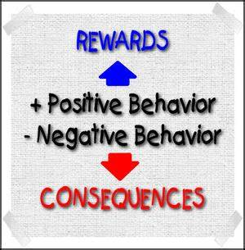
Behavior Expectations
Restrooms
Flush toilets
Put trash in garbage cans
Wash hands
Only one paper towel at a time. Two pumps only☺
No playing around! Handle your business and leave the restroom.
Take pride in your school!
Do not enter a restroom if the closed sign is in front
of the restroom door.
Hallways
All students are expected to walk on the tiles with the purple arrows at all times.
Lines should always be straight and quiet.
Please do not walk side-by-side with a friend.

Slide 9
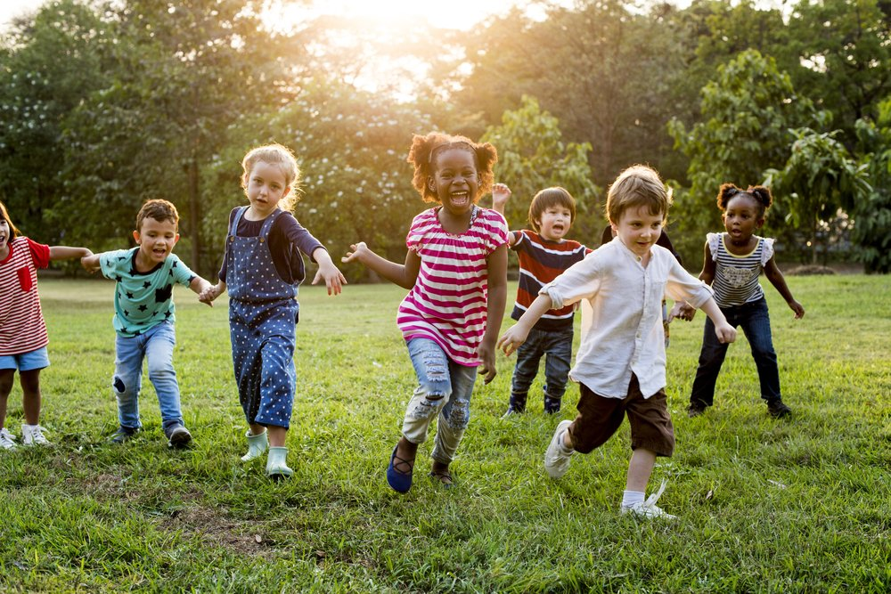
Brain Breaks
*Pick up your trash before entering the building.
*Play nice.
*Mind your teacher when it is time to go back to class.
*Brain Breaks can be taken away for poor behavior.

Slide 10
Positive Behavior Rewards
Rise Shout Out’s are written by administrators, faculty, and staff when they want to reward a student for doing good things for the school and others. Students will have their name and action read on morning/afternoon announcements.
RISE Celebrations are held at the end of each nine weeks. To earn the privilege of going to the Celebration you cannot have any demerits or office referrals.
Honor Roll Certificates are given out with a prize at the end of each nine weeks.
The following are some of our school events that students may participate in:
*Dress-up Days *Book Fair *Walk to School Day
*Red Ribbon Week *See you at the Pole *Boo Grams
*Career Week *Special Snack Days *Christmas Parties
*Read Across America Week *4th-6th Dance *Valentines Parties
*Friendsgiving *Fun Fridays *Rock the School Day
*Beach Day *Field Days *End-of-Year Parties

Slide 11
School safety is very important. Following the rules keeps everyone safer. ☺
Be respectful!
Safety drills once each month.
Stay very quiet throughout the entire drill.
Follow all directions.
Smiley faces above the doors are our “Safe Places” outside of the classroom.
Wash your hands regularly or use the hand-sanitizer machines.
Great hallway behavior is crucial.
Walk in a single file line on the purple arrows at all times.
Don’t turn around to talk to the person behind you.

